Slide 1
Chapter 12: Mass-Storage Systems
May 16, 2010

Slide 2
Chapter 12: Mass-Storage Systems
Overview of Mass Storage Structure
Disk Structure
Disk Attachment
Disk Scheduling
Disk Management
Swap-Space Management
RAID Structure
Disk Attachment
Stable-Storage Implementation
Tertiary Storage Devices
Operating System Issues
Performance Issues
Page <number>

Slide 3
Objectives
Describe the physical structure of secondary and tertiary storage devices and the resulting effects on the uses of the devices
Explain the performance characteristics of mass-storage devices
Discuss operating-system services provided for mass storage, including RAID
Page <number>

Slide 4
Chapter 12: Mass-Storage Systems
Overview of Mass Storage Structure
Disk Structure
Disk Attachment
Disk Scheduling
Disk Management
Swap-Space Management
RAID Structure
Disk Attachment
Stable-Storage Implementation
Tertiary Storage Devices
Operating System Issues
Performance Issues
Page <number>

Slide 5

Moving-head Disk Machanism
Page <number>

Slide 6
Overview of Mass Storage Structure
Magnetic disks provide bulk of secondary storage of modern computers
  Transfer rate is rate at which data flow between drive and computer
  Positioning time (random-access time) is time to move disk arm to desired cylinder (seek time) and time for desired sector to rotate under the disk head (rotational latency)
  Head crash results from disk head making contact with the disk surface
Page <number>

Slide 7
Overview of Mass Storage Structure (Cont.)
Disks can be removable
Drive attached to computer via I/O bus
  Busses vary, including EIDE, ATA, SATA, USB, Fibre Channel, SCSI
  Host controller in computer uses bus to talk to disk controller built into drive or storage array
Page <number>

Slide 8
Chapter 12: Mass-Storage Systems
Overview of Mass Storage Structure
Disk Structure
Disk Attachment
Disk Scheduling
Disk Management
Swap-Space Management
RAID Structure
Disk Attachment
Stable-Storage Implementation
Tertiary Storage Devices
Operating System Issues
Performance Issues
Page <number>

Slide 9
Disk Structure
Disk drives are addressed as large 1-dimensional arrays of logical blocks, where the logical block is the smallest unit of transfer.
The 1-dimensional array of logical blocks is mapped into the sectors of the disk sequentially.
  Sector 0 is the first sector of the first track on the outermost cylinder.
  Mapping proceeds in order through that track, then the rest of the tracks in that cylinder, and then through the rest of the cylinders from outermost to innermost.
Page <number>

Slide 10
Chapter 12: Mass-Storage Systems
Overview of Mass Storage Structure
Disk Structure
Disk Attachment
Disk Scheduling
Disk Management
Swap-Space Management
RAID Structure
Disk Attachment
Stable-Storage Implementation
Tertiary Storage Devices
Operating System Issues
Performance Issues
Page <number>

Slide 11
Disk Attachment
Host-attached storage accessed through I/O ports talking to I/O busses
SCSI itself is a bus, up to 16 devices on one cable, SCSI initiator requests operation and SCSI targets perform tasks
FC is high-speed serial architecture
Page <number>

Slide 12
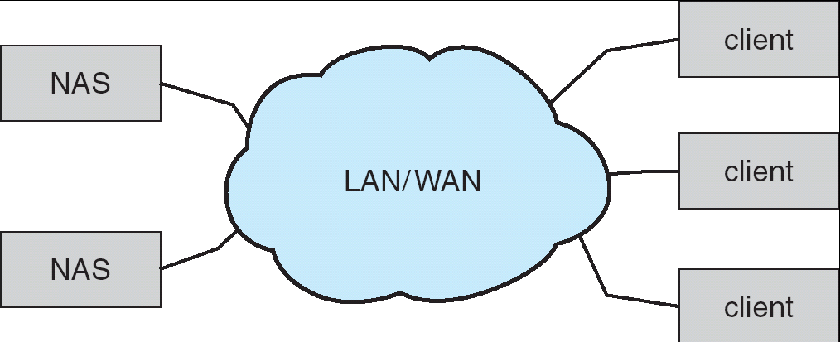
Network-Attached Storage
Network-attached storage (NAS) is storage made available over a network rather than over a local connection (such as a bus)
NFS and CIFS are common protocols
Implemented via remote procedure calls (RPCs) between host and storage
New iSCSI protocol uses IP network to carry the SCSI protocol
Page <number>

Slide 13
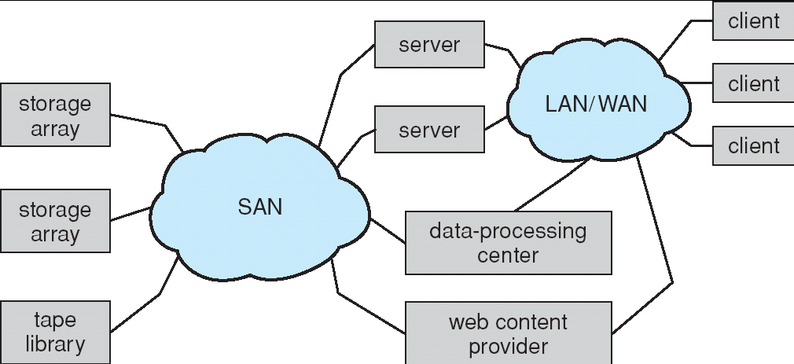
Storage Area Network
Common in large storage environments (and becoming more common)
Multiple hosts attached to multiple storage arrays - flexible
Page <number>

Slide 14
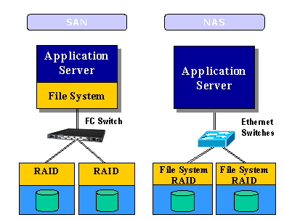
Disk Attachment
Page <number>

Slide 15
Chapter 12: Mass-Storage Systems
Overview of Mass Storage Structure
Disk Structure
Disk Attachment
Disk Scheduling
Disk Management
Swap-Space Management
RAID Structure
Disk Attachment
Stable-Storage Implementation
Tertiary Storage Devices
Operating System Issues
Performance Issues
Page <number>

Slide 16
Disk Scheduling
The operating system is responsible for using hardware efficiently — for the disk drives, this means having a fast access time and disk bandwidth.
Access time has two major components
  Seek time is the time for the disk are to move the heads to the cylinder containing the desired sector.
  Rotational latency is the additional time waiting for the disk to rotate the desired sector to the disk head.
Minimize seek time
Seek time ≈ seek distance
Disk bandwidth is the total number of bytes transferred, divided by the total time between the first request for service and the completion of the last transfer.
Page <number>

Slide 17
Disk Scheduling (Cont.)
Several algorithms exist to schedule the servicing of disk I/O requests.
We illustrate them with a disk queue for I/O to blocks on cylinders (0-199)
98, 183, 37, 122, 14, 124, 65, 67
Head pointer 53
Page <number>

Slide 18

FCFS
Illustration shows total head movement of 640 cylinders.
Page <number>

Slide 19
SSTF (Shortest Seek Time First)
Selects the request with the minimum seek time from the current head position.
SSTF scheduling is a form of SJF scheduling; may cause starvation of some requests.
Illustration shows total head movement of 236 cylinders.
Page <number>

Slide 20

SSTF (Cont.)
Page <number>

Slide 21
SCAN
The disk arm starts at one end of the disk, and moves toward the other end, servicing requests until it gets to the other end of the disk, where the head movement is reversed and servicing continues.
Sometimes called the elevator algorithm.
Illustration shows total head movement of 208 cylinders.
Page <number>

Slide 22

SCAN (Cont.)
Page <number>

Slide 23
C-SCAN （Circular -SCAN）
Provides a more uniform wait time than SCAN.
The head moves from one end of the disk to the other. servicing requests as it goes. When it reaches the other end, however, it immediately returns to the beginning of the disk, without servicing any requests on the return trip.
Treats the cylinders as a circular list that wraps around from the last cylinder to the first one.
Page <number>

Slide 24

C-SCAN (Cont.)
Page <number>

Slide 25
C-LOOK
Version of C-SCAN
Arm only goes as far as the last request in each direction, then reverses direction immediately, without first going all the way to the end of the disk.
Page <number>

Slide 26

C-LOOK (Cont.)
Page <number>

Slide 27
Selecting a Disk-Scheduling Algorithm
SSTF is common and has a natural appeal
SCAN and C-SCAN perform better for systems that place a heavy load on the disk.
Performance depends on the number and types of requests.
Requests for disk service can be influenced by the file-allocation method.
The location of directories and index blocks are also important
The disk-scheduling algorithm should be written as a separate module of the operating system, allowing it to be replaced with a different algorithm if necessary.
Either SSTF or LOOK is a reasonable choice for the default algorithm.
Page <number>

Slide 28
Chapter 12: Mass-Storage Systems
Overview of Mass Storage Structure
Disk Structure
Disk Attachment
Disk Scheduling
Disk Management
Swap-Space Management
RAID Structure
Disk Attachment
Stable-Storage Implementation
Tertiary Storage Devices
Operating System Issues
Performance Issues
Page <number>

Slide 29
Disk Management
Low-level formatting, or physical formatting — Dividing a disk into sectors that the disk controller can read and write.
  Header, data area, trailer
To use a disk to hold files, the operating system still needs to record its own data structures on the disk.
  Partition the disk into one or more groups of cylinders.
  Logical formatting or “making a file system”.
Boot block initializes system.
  The bootstrap is stored in ROM.
  Bootstrap loader program.
Methods such as sector sparing used to handle bad blocks.
Page <number>

Slide 30
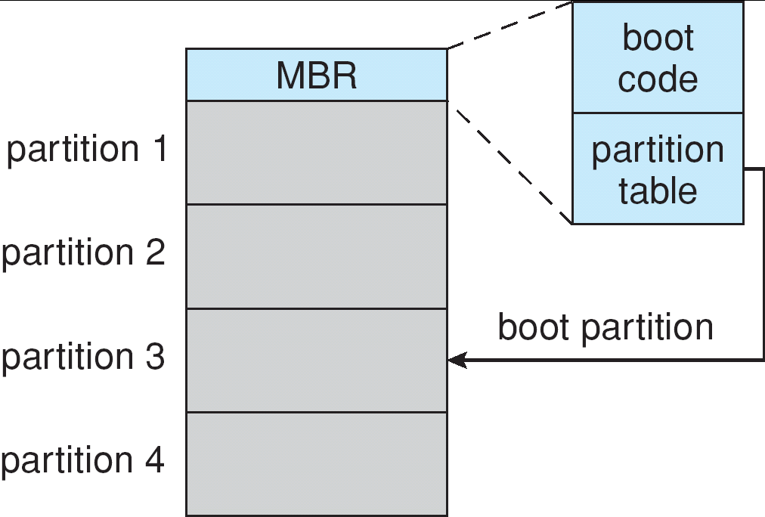
Booting from a Disk in Windows 2000
Page <number>

Slide 31
Chapter 12: Mass-Storage Systems
Overview of Mass Storage Structure
Disk Structure
Disk Attachment
Disk Scheduling
Disk Management
Swap-Space Management
RAID Structure
Stable-Storage Implementation
Tertiary Storage Devices
Operating System Issues
Performance Issues
Page <number>

Slide 32
Swap-Space Management
Swap-space — Virtual memory uses disk space as an extension of main memory.
Swap-space can be carved out of the normal file system
  Easy to implement, but inefficient
    Directory structure and disk-allocation data structures takes time and extra disk accesses
Swap space can be in a separate raw partition.
  Manager uses algorithms optimized for speed rather than for storage efficiency
    Swap space is accessed much more frequently
    The life of data in the swap space is much shorter than that of files
Page <number>

Slide 33
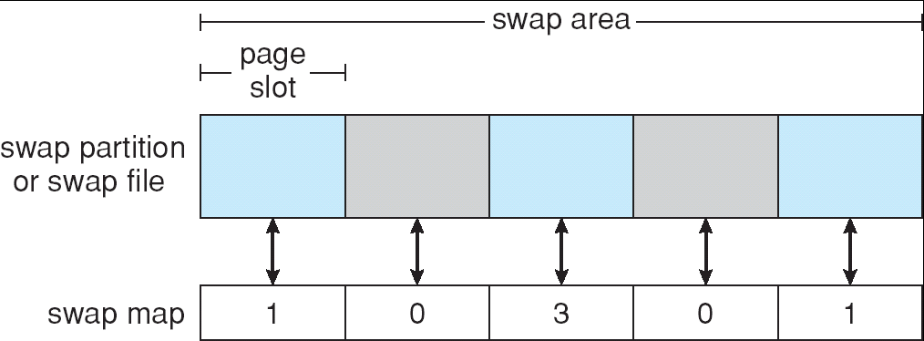
Data Structures for Swapping on Linux Systems
Page <number>

Slide 34
Chapter 12: Mass-Storage Systems
Overview of Mass Storage Structure
Disk Structure
Disk Attachment
Disk Scheduling
Disk Management
Swap-Space Management
RAID Structure
Stable-Storage Implementation
Tertiary Storage Devices
Operating System Issues
Performance Issues
Page <number>

Slide 35
RAID Structure
RAID – Redundant Arrays of Inexpensive Disks
  Improvement of reliability via redundancy
  Improvement in performance via parallelism
RAID is arranged into six different levels.
  RAID0~RAID6
Page <number>

Slide 36
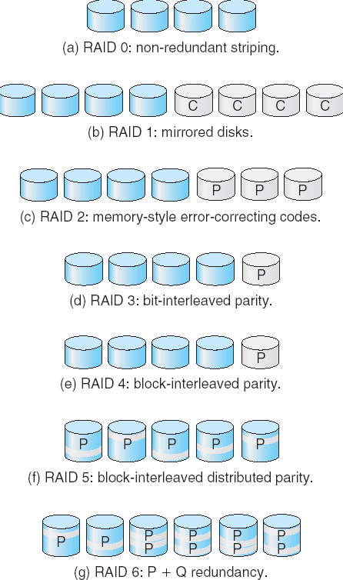
RAID Levels
Page <number>

Slide 37
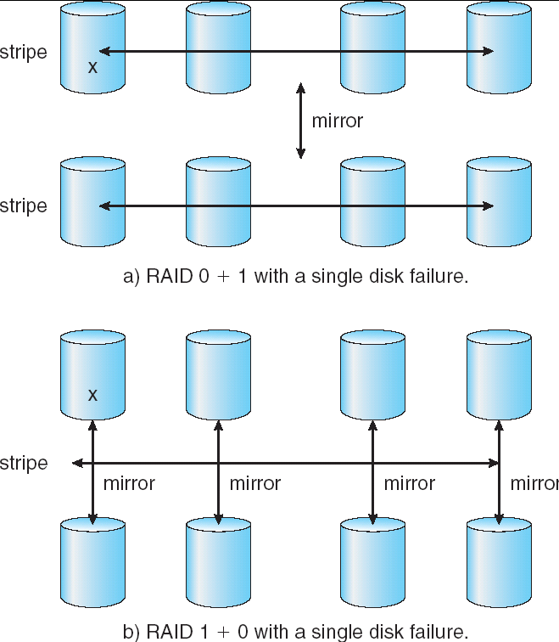
RAID (0 + 1) and (1 + 0)
Page <number>

Slide 38
Chapter 12: Mass-Storage Systems
Overview of Mass Storage Structure
Disk Structure
Disk Attachment
Disk Scheduling
Disk Management
Swap-Space Management
RAID Structure
Stable-Storage Implementation
Tertiary Storage Devices
Operating System Issues
Performance Issues
Page <number>

Slide 39
Stable-Storage Implementation
Write-ahead log scheme requires stable storage.
To implement stable storage:
  Replicate information on more than one nonvolatile storage media with independent failure modes.
  Update information in a controlled manner to ensure that we can recover the stable data after any failure during data transfer or recovery.
Page <number>

Slide 40
Tertiary Storage Devices
Low cost is the defining characteristic of tertiary storage.
Generally, tertiary storage is built using removable media
Common examples of removable media are floppy disks and CD-ROMs; other types are available.
Page <number>

Slide 41
Removable Disks
Floppy disk — thin flexible disk coated with magnetic material, enclosed in a protective plastic case.
  Most floppies hold about 1 MB; similar technology is used for removable disks that hold more than 1 GB.
  Removable magnetic disks can be nearly as fast as hard disks, but they are at a greater risk of damage from exposure.
Page <number>

Slide 42
Removable Disks (Cont.)
A magneto-optic disk records data on a rigid platter coated with magnetic material.
  Laser heat is used to amplify a large, weak magnetic field to record a bit.
  Laser light is also used to read data (Kerr effect).
  The magneto-optic head flies much farther from the disk surface than a magnetic disk head, and the magnetic material is covered with a protective layer of plastic or glass; resistant to head crashes.
Optical disks do not use magnetism; they employ special materials that are altered by laser light.
Page <number>

Slide 43
WORM Disks
The data on read-write disks can be modified over and over.
WORM (“Write Once, Read Many Times”) disks can be written only once.
Thin aluminum film sandwiched between two glass or plastic platters.
To write a bit, the drive uses a laser light to burn a small hole through the aluminum; information can be destroyed by not altered.
Very durable and reliable.
Read Only disks, such ad CD-ROM and DVD, come from the factory with the data pre-recorded.
Page <number>

Slide 44
Tapes
Compared to a disk, a tape is less expensive and holds more data, but random access is much slower.
Tape is an economical medium for purposes that do not require fast random access, e.g., backup copies of disk data, holding huge volumes of data.
Large tape installations typically use robotic tape changers that move tapes between tape drives and storage slots in a tape library.
  stacker – library that holds a few tapes
  silo – library that holds thousands of tapes
A disk-resident file can be archived to tape for low cost storage; the computer can stage it back into disk storage for active use.
Page <number>

Slide 45
Operating System Issues
Major OS jobs are to manage physical devices and to present a virtual machine abstraction to applications
For hard disks, the OS provides two abstraction:
  Raw device – an array of data blocks.
  File system – the OS queues and schedules the interleaved requests from several applications.
Page <number>

Slide 46
Application Interface
Most OSs handle removable disks almost exactly like fixed disks — a new cartridge is formatted and an empty file system is generated on the disk.
Tapes are presented as a raw storage medium, i.e., and application does not not open a file on the tape, it opens the whole tape drive as a raw device.
Usually the tape drive is reserved for the exclusive use of that application.
Since the OS does not provide file system services, the application must decide how to use the array of blocks.
Since every application makes up its own rules for how to organize a tape, a tape full of data can generally only be used by the program that created it.
Page <number>

Slide 47
Tape Drives
The basic operations for a tape drive differ from those of a disk drive.
locate positions the tape to a specific logical block, not an entire track (corresponds to seek).
The read position operation returns the logical block number where the tape head is.
The space operation enables relative motion.
Tape drives are “append-only” devices; updating a block in the middle of the tape also effectively erases everything beyond that block.
An EOT mark is placed after a block that is written.
Page <number>

Slide 48
File Naming
The issue of naming files on removable media is especially difficult when we want to write data on a removable cartridge on one computer, and then use the cartridge in another computer.
Contemporary OSs generally leave the name space problem unsolved for removable media, and depend on applications and users to figure out how to access and interpret the data.
Some kinds of removable media (e.g., CDs) are so well standardized that all computers use them the same way.
Page <number>

Slide 49
Hierarchical Storage Management (HSM)
A hierarchical storage system extends the storage hierarchy beyond primary memory and secondary storage to incorporate tertiary storage — usually implemented as a jukebox of tapes or removable disks.
Usually incorporate tertiary storage by extending the file system.
  Small and frequently used files remain on disk.
  Large, old, inactive files are archived to the jukebox.
HSM is usually found in supercomputing centers and other large installations that have enormous volumes of data.
Page <number>

Slide 50
Speed
Two aspects of speed in tertiary storage are bandwidth and latency.
Bandwidth is measured in bytes per second.
  Sustained bandwidth – average data rate during a large transfer; # of bytes/transfer time.
  Data rate when the data stream is actually flowing.
  Effective bandwidth – average over the entire I/O time, including seek or locate, and cartridge switching.
  Drive’s overall data rate.
Page <number>

Slide 51
Speed (Cont.)
Access latency – amount of time needed to locate data.
  Access time for a disk – move the arm to the selected cylinder and wait for the rotational latency; < 35 milliseconds.
  Access on tape requires winding the tape reels until the selected block reaches the tape head; tens or hundreds of seconds.
  Generally say that random access within a tape cartridge is about a thousand times slower than random access on disk.
The low cost of tertiary storage is a result of having many cheap cartridges share a few expensive drives.
A removable library is best devoted to the storage of infrequently used data, because the library can only satisfy a relatively small number of I/O requests per hour.
Page <number>

Slide 52
Reliability
A fixed disk drive is likely to be more reliable than a removable disk or tape drive.
An optical cartridge is likely to be more reliable than a magnetic disk or tape.
A head crash in a fixed hard disk generally destroys the data, whereas the failure of a tape drive or optical disk drive often leaves the data cartridge unharmed.
Page <number>

Slide 53
Cost
Main memory is much more expensive than disk storage
The cost per megabyte of hard disk storage is competitive with magnetic tape if only one tape is used per drive.
The cheapest tape drives and the cheapest disk drives have had about the same storage capacity over the years.
Tertiary storage gives a cost savings only when the number of cartridges is considerably larger than the number of drives.
Page <number>

Slide 54
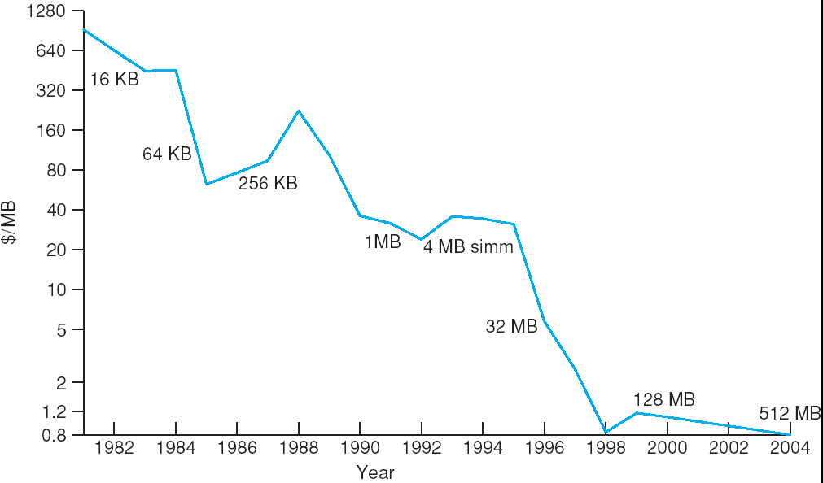
Price per Megabyte of DRAM, From 1981 to 2004
Page <number>

Slide 55
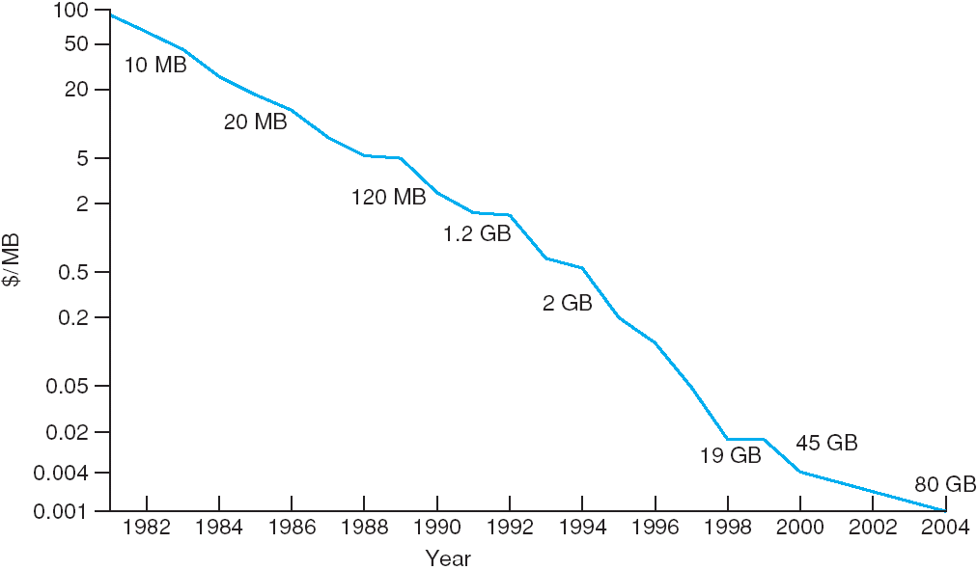
Price per Megabyte of Magnetic Hard Disk, From 1981 to 2004
Page <number>

Slide 56
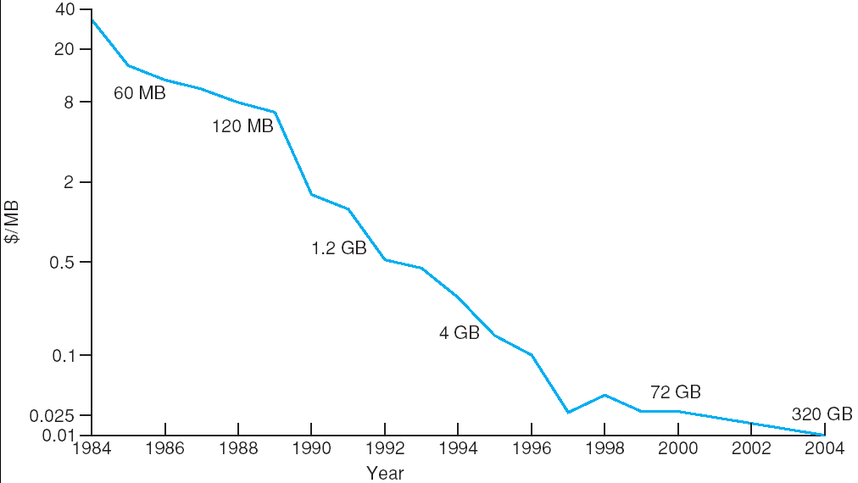
Price per Megabyte of a Tape Drive, From 1984-2000
Page <number>

Slide 57
End of Chapter 12

