Slide 1
Chapter 13: I/O Systems

Slide 2
Chapter 13: I/O Systems
I/O Hardware
Application I/O Interface
Kernel I/O Subsystem
Transforming I/O Requests to Hardware Operations
Streams
Performance
Page <number>

Slide 3
Objectives
Explore the structure of an operating system’s I/O subsystem
Discuss the principles of I/O hardware and its complexity
Provide details of the performance aspects of I/O hardware and software
Page <number>

Slide 4
Chapter 13: I/O Systems
I/O Hardware
Application I/O Interface
Kernel I/O Subsystem
Transforming I/O Requests to Hardware Operations
Streams
Performance
Page <number>

Slide 5
I/O Hardware
Incredible variety of I/O devices
Common concepts
  The device communicates with the machine via a connection port - Port
  Bus- a set of wires and a rigidly defined protocol that specifies a set of messages that can be sent on the wires
  Controller- a collection of electronics that can operate a port, a bus, or a device.
Page <number>

Slide 6

A Typical PC Bus Structure
Page <number>

Slide 7
I/O Hardware (Cont.)
How can the processor give commands and data to a controller to accomplish an I/O transfer?
  Controller has one or more registers for data and control signals
    Through the use of special I/O instructions that specify the transfer of a byte or word to an I/O port address
    Memory-mapped I/O - the device-control registers are mapped into the address space of the processor
Page <number>

Slide 8
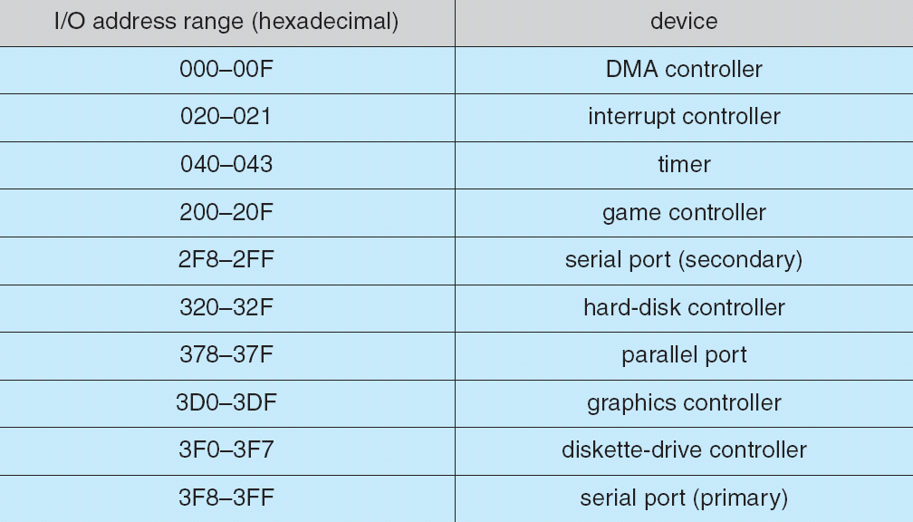
Device I/O Port Locations on PCs (partial)
Page <number>

Slide 9
I/O Hardware (Cont.)
An I/O port typically consists of four registers :
  The data-in register is ready by the host to get input
  The data-out register is written by the host to sent output
  The status register contain bits that can be read by the host
  The control register can be written by the host to start a command or to change the mode of a device
Page <number>

Slide 10
Polling
Host coordinating with controller by handshaking (write through a port)
  Host repeatedly reads the busy bit until that bit becomes clear
  Host sets the write bit in the command register and write a byte into the data-out register
  Host sets the command-ready bit
  When the controller notice that the command-ready bit is set, it sets the busy bit
  Controller reads the command register and see the write command. It reads the data-out register to get the byte and does the I/O to the device
  The controller clears the command-ready bit, clears the error bit in the status register to indicate that the device I/O succeeded, and clear the busy bit to indicate that it is finished
Page <number>

Slide 11
Polling
Busy-waiting (polling)
  host is in a loop, reading the status register over and over until the busy bit becomes clear
Polling becomes inefficient when it is attempted repeatedly yet rarely finds a device to be ready for service
In such instance, it may be more efficient to arrange for the hardware controller to notify the CPU when the device become ready for service
Page <number>

Slide 12
Interrupts
CPU hardware has a wire called the Interrupt-request line that CPU senses after executing every instruction.
  CPU detects that a controller has asserted a signal on the interrupt request line
  CPU performs a state save
  CPU jumps to the interrupt-handler routine at a fixed address in memory
  interrupt handler determines the cause of the interrupt and performs the necessary processing
  performs a state restore, and executes a return from interrupt instruction to return the CPU to the execution state prior to the interrupt.
Page <number>

Slide 13
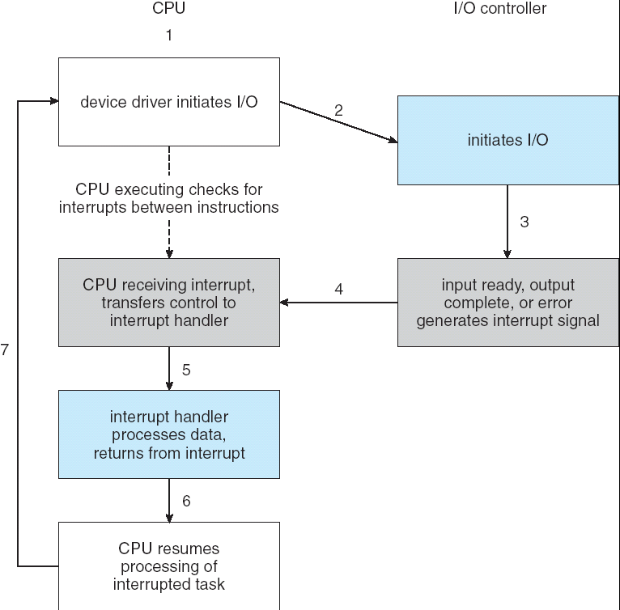
Interrupt-Driven I/O Cycle
Page <number>

Slide 14
Interrupts (Cont.)
Need more sophisticated interrupt-handling features
  the ability to defer interrupt handling during critical processing
  Dispatch to the proper interrupt handler for a device without first polling all the device
  Need multilevel interrupts, so that the operating system can response with the appropriate degree of urgency
Page <number>

Slide 15
Interrupts (Cont.)
Two interrupt request lines
  nonmaskable –reserved for events such as unrecoverable memory errors
  Maskable – can be turned off by the CPU, is used by device controller to request service
Interrupt mechanism accepts an address- an offset in a table called the Interrupt vector to dispatch interrupt to correct handler
  Interrupt chaining
  Based on priority
  Some nonmaskable
Interrupt mechanism also used for exceptions
Page <number>

Slide 16
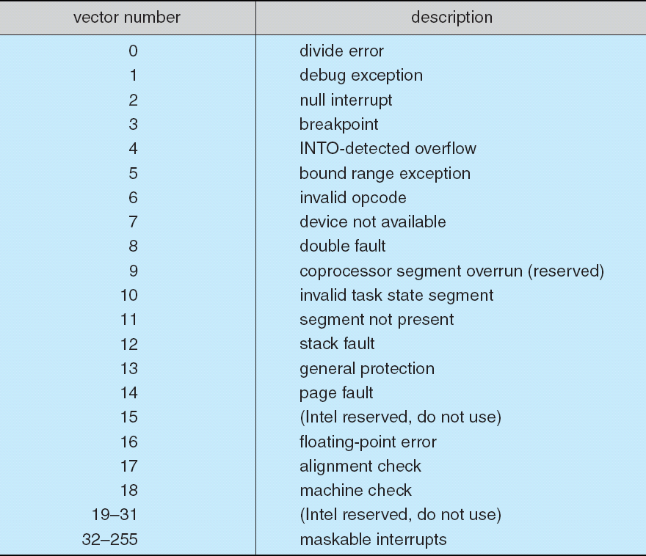
Intel Pentium Processor Event-Vector Table
Page <number>

Slide 17
Direct Memory Access
For a device that does large transfer, programmed I/O is expensive
  Use an expensive general-purpose processor to watch status bits and to feed data into a controller register one byte at a time
Offloading some of this work to a special-purpose processor called direct-memory-access (DMA) controller
Bypasses CPU to transfer data directly between I/O device and memory
Page <number>

Slide 18

Six Step Process to Perform DMA Transfer
Page <number>

Slide 19
Chapter 13: I/O Systems
I/O Hardware
Application I/O Interface
Kernel I/O Subsystem
Transforming I/O Requests to Hardware Operations
Streams
Performance
Page <number>

Slide 20
Application I/O Interface
Enable I/O devices to be treated in a standard, uniform way – abstraction, encapsulation, software layering
I/O system calls encapsulate device behaviors in generic classes that hide hardware differences from applications
Device-driver layer hides differences among I/O controllers from kernel
Unfortunately for device-hardware manufacturers, each type of operating system has its own standards for the device-driver interface
Page <number>

Slide 21
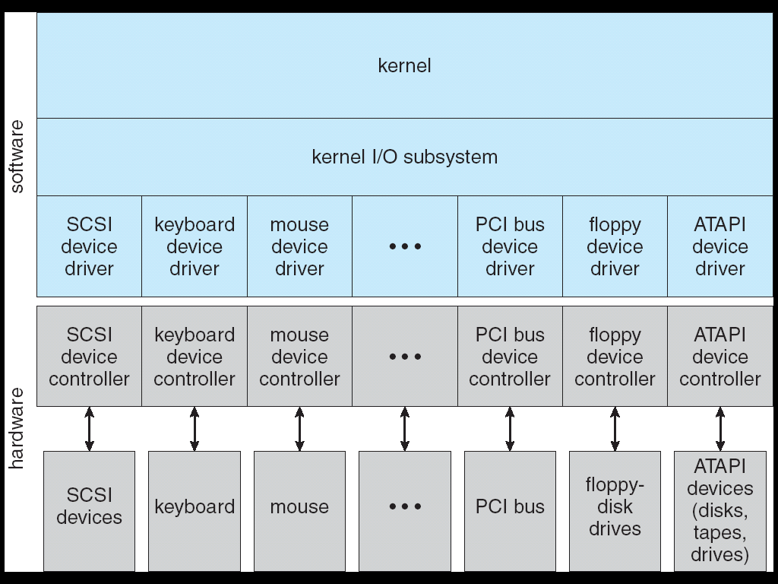
A Kernel I/O Structure
Page <number>

Slide 22
Application I/O Interface (Cont.)
Devices vary in many dimensions
  Character-stream or block
  Sequential or random-access
  Synchronous or asynchronous
  Sharable or dedicated
  Speed of operation
  read-write, read only, or write only
Page <number>

Slide 23
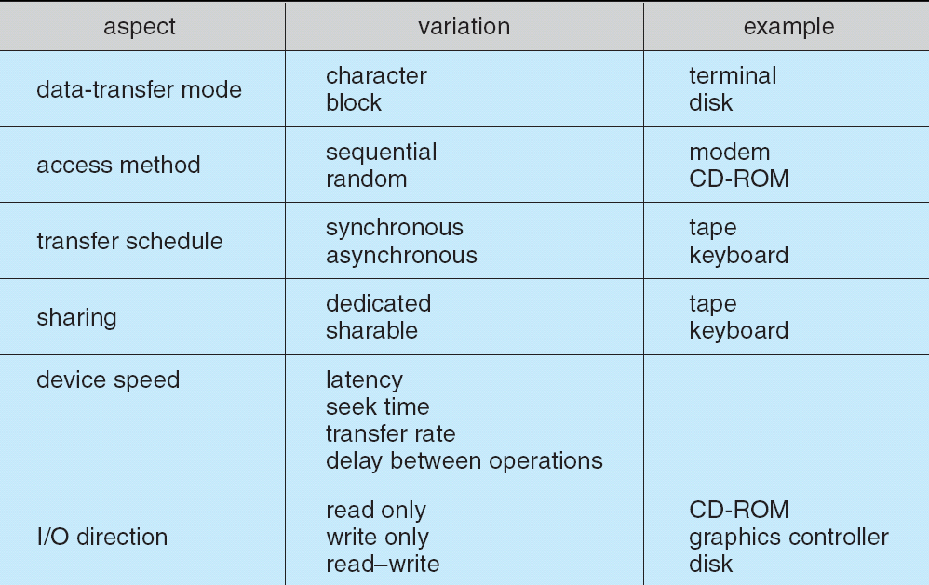
Characteristics of I/O Devices
Page <number>

Slide 24
Block and Character Devices
Block devices include disk drives
  Commands include read, write, seek
  Raw I/O or file-system access
  Memory-mapped file access possible
Character devices include keyboards, mice, serial ports
  Commands include get, put
  Libraries layered on top allow line editing
Page <number>

Slide 25
Network Devices
Varying enough from block and character to have own interface
Unix and Windows NT/9x/2000 include socket interface
  Separates network protocol from network operation
  Includes select functionality
Approaches vary widely (pipes, FIFOs, streams, queues, mailboxes)
Page <number>

Slide 26
Clocks and Timers
Provide current time, elapsed time, timer
Programmable interval timer used for timings, periodic interrupts
Page <number>

Slide 27
Blocking and Nonblocking I/O
Blocking - process suspended until I/O completed
  Easy to use and understand
  Insufficient for some needs
Nonblocking - I/O call returns as much as available
  Implemented via multi-threading
  Returns quickly with count of bytes read or written
Asynchronous - process runs while I/O executes
  Difficult to use
  I/O subsystem signals process when I/O completed
Page <number>

Slide 28
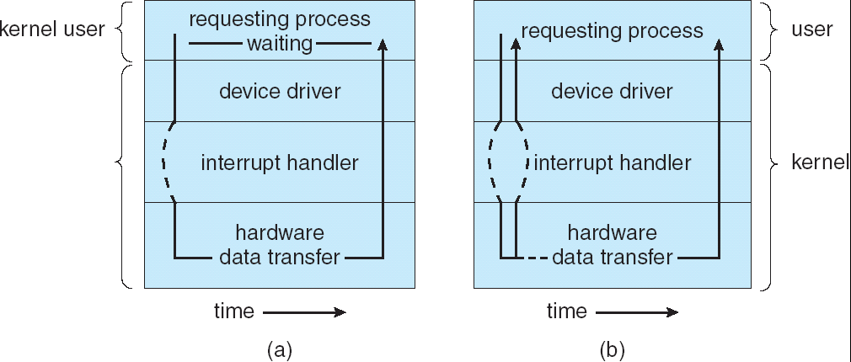
Two I/O Methods
Synchronous
Asynchronous
Page <number>

Slide 29
Chapter 13: I/O Systems
I/O Hardware
Application I/O Interface
Kernel I/O Subsystem
Transforming I/O Requests to Hardware Operations
Streams
Performance
Page <number>

Slide 30
Kernel I/O Subsystem
Scheduling
  Some I/O request ordering via per-device queue
  Some OSs try fairness
Buffering - store data in memory while transferring between devices
  To cope with device speed mismatch
  To cope with device transfer size mismatch
  To maintain “copy semantics”
Page <number>

Slide 31
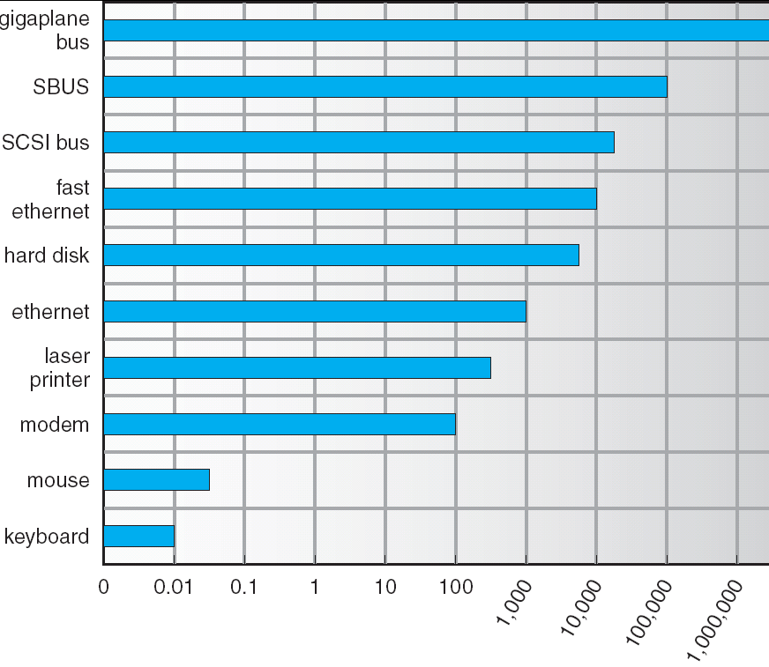
Sun Enterprise 6000 Device-Transfer Rates
Page <number>

Slide 32
Kernel I/O Subsystem
Caching - fast memory holding copy of data
  Always just a copy
  Key to performance
Spooling - hold output for a device
  If device can serve only one request at a time
  i.e., Printing
Page <number>

Slide 33
Error Handling
OS can recover from disk read, device unavailable, transient write failures
Most return an error number or code when I/O request fails
System error logs hold problem reports
Page <number>

Slide 34
I/O Protection
User process may accidentally or purposefully attempt to disrupt normal operation via illegal I/O instructions
  All I/O instructions defined to be privileged
  I/O must be performed via system calls
    Memory-mapped and I/O port memory locations must be protected too
Page <number>

Slide 35
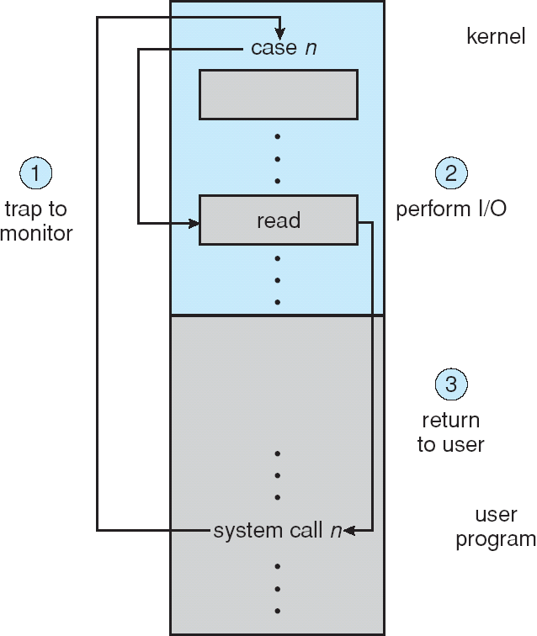
Use of a System Call to Perform I/O
Page <number>

Slide 36
Kernel Data Structures
Kernel keeps state info for I/O components, including open file tables, network connections, character device state
Many, many complex data structures to track buffers, memory allocation, “dirty” blocks
Page <number>

Slide 37
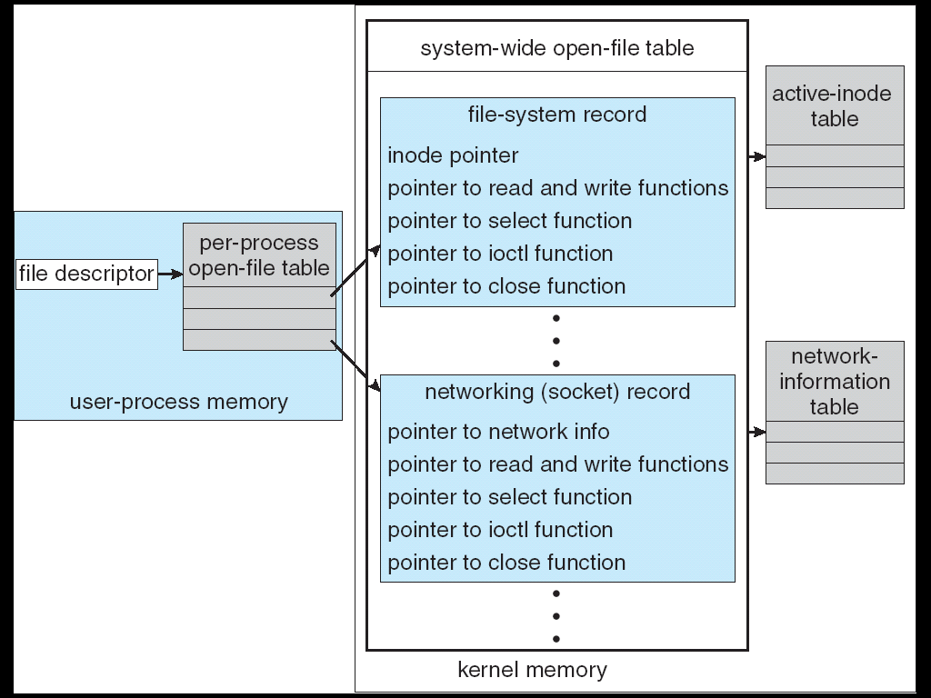
UNIX I/O Kernel Structure
Page <number>

Slide 38
Chapter 13: I/O Systems
I/O Hardware
Application I/O Interface
Kernel I/O Subsystem
Transforming I/O Requests to Hardware Operations
Streams
Performance
Page <number>

Slide 39
I/O Requests to Hardware Operations
Consider reading a file from disk for a process:
  Determine device holding file
  Translate name to device representation
  Physically read data from disk into buffer
  Make data available to requesting process
  Return control to process
Page <number>

Slide 40
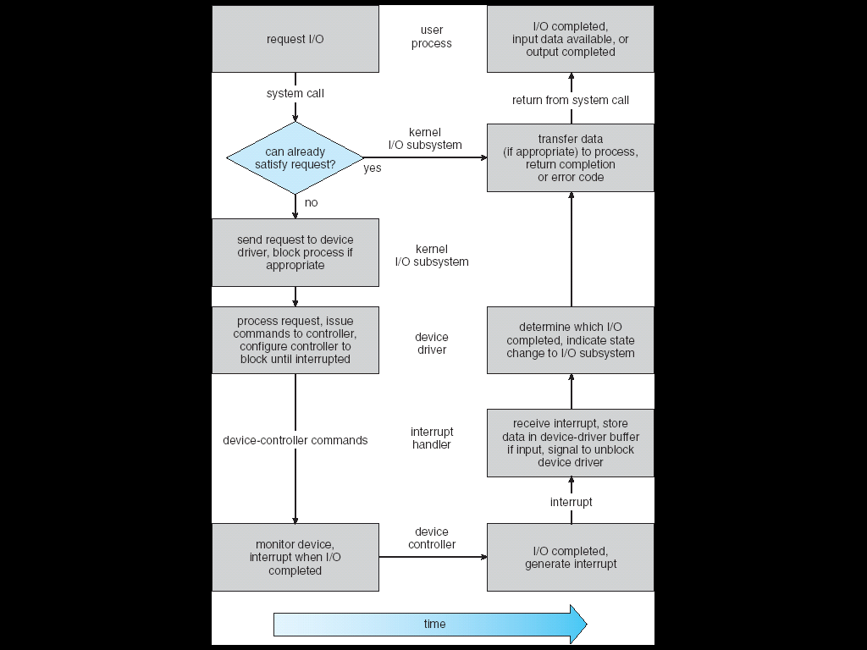
Life Cycle of An I/O Request
Page <number>

Slide 41
Chapter 13: I/O Systems
I/O Hardware
Application I/O Interface
Kernel I/O Subsystem
Transforming I/O Requests to Hardware Operations
Streams
Performance
Page <number>

Slide 42
STREAMS
STREAM – a full-duplex communication channel between a user-level process and a device in Unix System V and beyond
A STREAM consists of:
- STREAM head interfaces with the user process
- driver end interfaces with the device
- zero or more STREAM modules between them.
Each module contains a read queue and a write queue
Message passing is used to communicate between queues
Page <number>

Slide 43
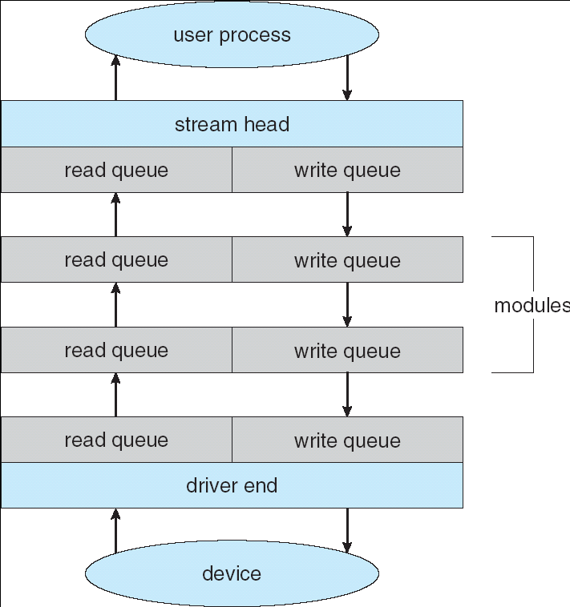
The STREAMS Structure
Page <number>

Slide 44
Chapter 13: I/O Systems
I/O Hardware
Application I/O Interface
Kernel I/O Subsystem
Transforming I/O Requests to Hardware Operations
Streams
Performance
Page <number>

Slide 45
Performance
I/O is a major factor in system performance:
  Demands CPU to execute device driver, kernel I/O code
  Context switches due to interrupts
  Data copying
  Network traffic especially stressful
Page <number>

Slide 46
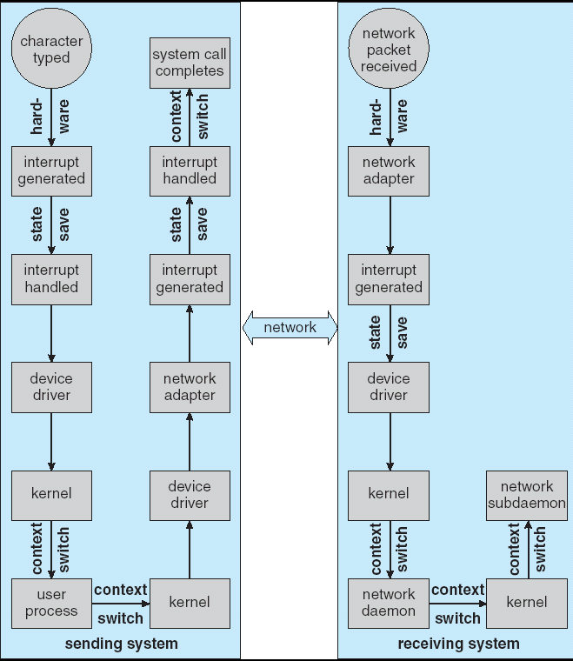
Intercomputer Communications
Page <number>

Slide 47
Improving Performance
Reduce number of context switches
Reduce data copying
Reduce interrupts by using large transfers, smart controllers, polling
Use DMA
Balance CPU, memory, bus, and I/O performance for highest throughput
Page <number>

Slide 48
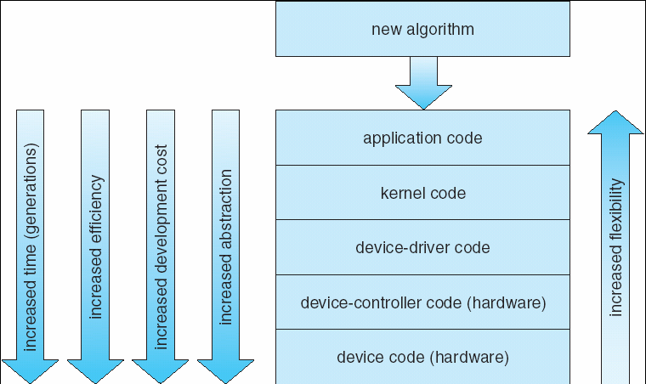
Device-Functionality Progression
Page <number>

Slide 49
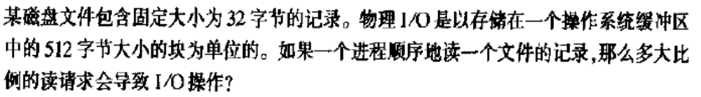
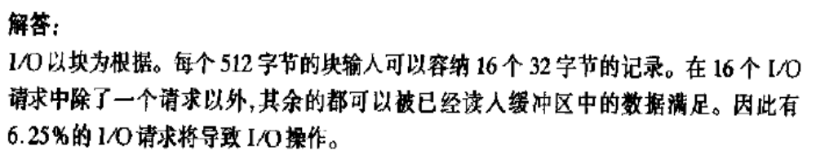
练习1
Page <number>

Slide 50
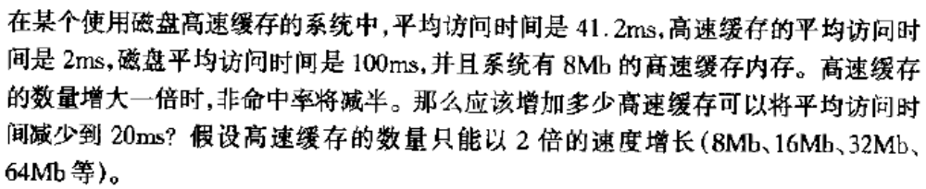
练习2
Page <number>

Slide 51
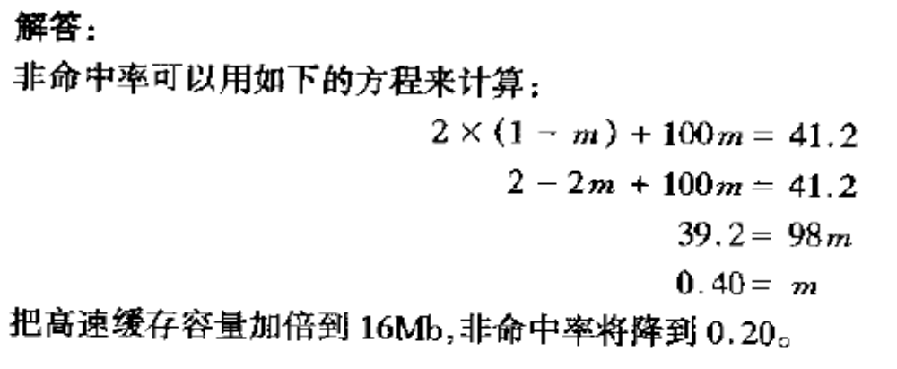
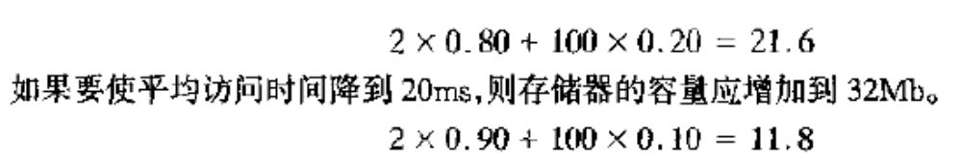
练习2 答案
Page <number>

Slide 52
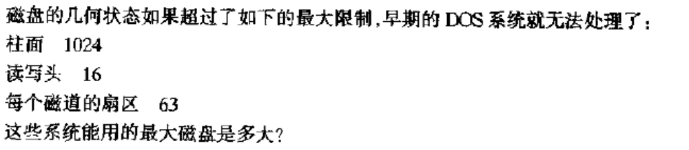
练习3
Page <number>

Slide 53
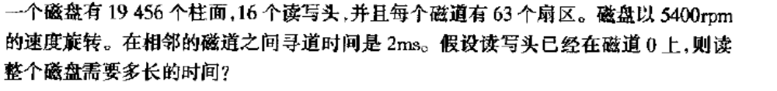
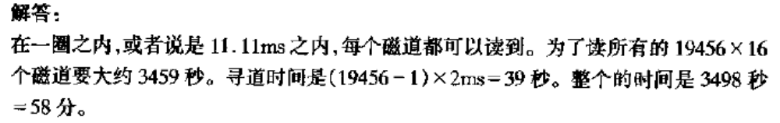
练习4
Page <number>

Slide 54
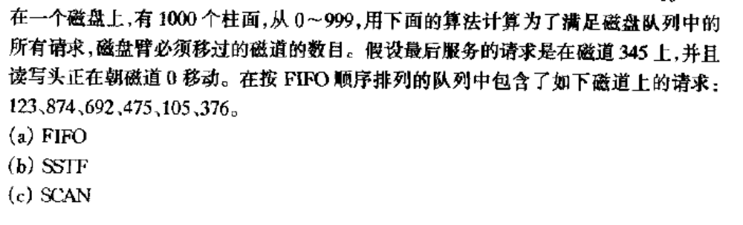

练习5
Page <number>

Slide 55
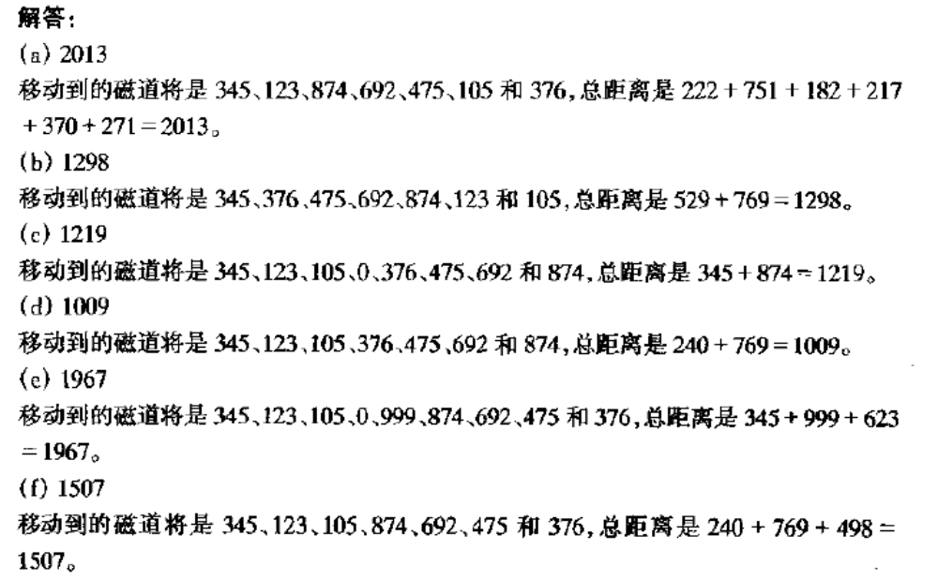
练习5 答案
Page <number>

Slide 56
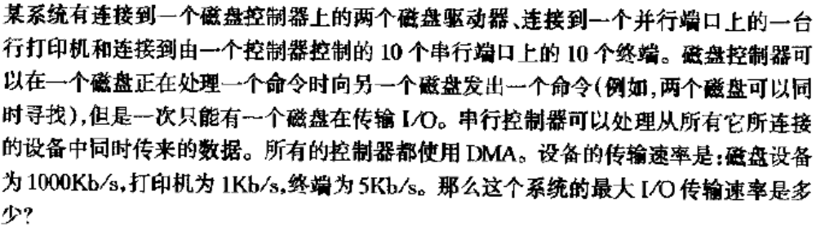

练习6
Page <number>

Slide 57
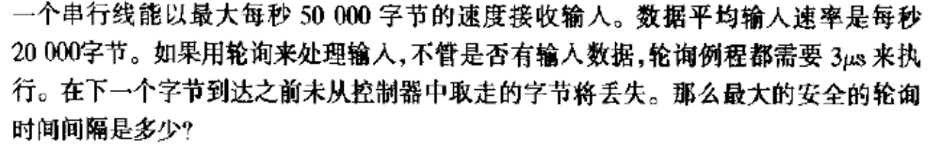
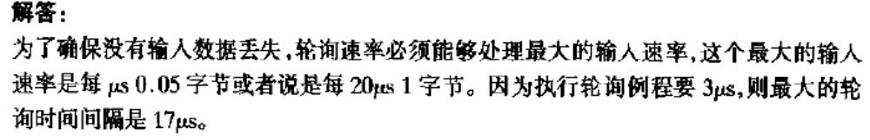
练习7
Page <number>

Slide 58
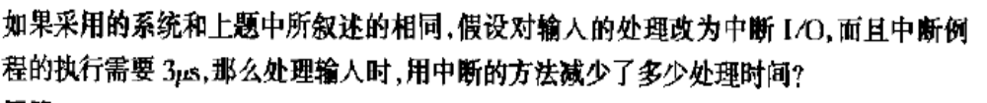
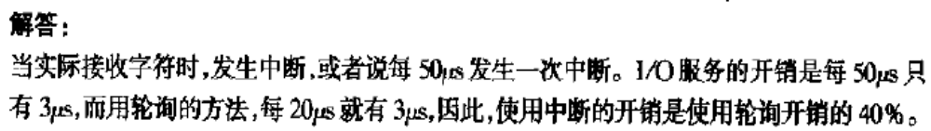
练习8
Page <number>

Slide 59

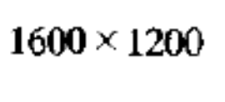
练习9
16MB
Page <number>

Slide 60
End of Chapter 13

