Slide 1
Chapter 14: Protection
May 24, 2010

Slide 2
Chapter 14: Protection
Goals of Protection
Principles of Protection
Domain of Protection
Access Matrix
Implementation of Access Matrix
Access Control
Revocation of Access Rights
Capability-Based Systems
Language-Based Protection
Page <number>

Slide 3
Objectives
Discuss the goals and principles of protection in a modern computer system
Explain how protection domains combined with an access matrix are used to specify the resources a process may access
Examine capability and language-based protection systems
Page <number>

Slide 4
Chapter 14: Protection
Goals of Protection
Principles of Protection
Domain of Protection
Access Matrix
Implementation of Access Matrix
Access Control
Revocation of Access Rights
Capability-Based Systems
Language-Based Protection
Page <number>

Slide 5
Goals of Protection
Operating system consists of a collection of objects, hardware or software
Each object has a unique name and can be accessed through a well-defined set of operations.
Protection problem - ensure that each object is accessed correctly and only by those processes that are allowed to do so.
Protection refers to a mechanism for controlling the access of programs, processes, or users to the resources
Page <number>

Slide 6
Chapter 14: Protection
Goals of Protection
Principles of Protection
Domain of Protection
Access Matrix
Implementation of Access Matrix
Access Control
Revocation of Access Rights
Capability-Based Systems
Language-Based Protection
Page <number>

Slide 7
Principles of Protection
Guiding principle
  principle of least privilege
    Programs, users and systems should be given just enough privileges to perform their tasks
Page <number>

Slide 8
Chapter 14: Protection
Goals of Protection
Principles of Protection
Domain of Protection
Access Matrix
Implementation of Access Matrix
Access Control
Revocation of Access Rights
Capability-Based Systems
Language-Based Protection
Page <number>

Slide 9
Domain of Protection
A computer system is a collection of processes and objects.
  Objects mean both hardware objects (CPU, memory, printers and disk) and software objects (files, programs and semaphores)
  A process should be allowed to access only those resource for which it has authorization.
  Furthermore, at any time, a process should be able to access only those resources that it currently requires to complete its task - need to know principle
Page <number>

Slide 10
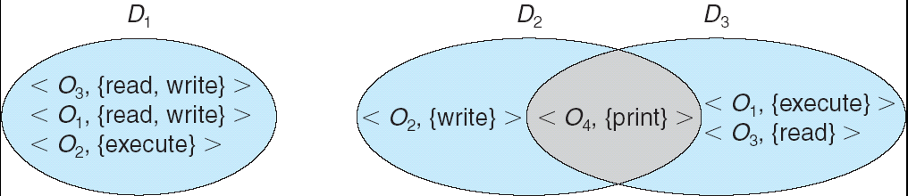
Domain Structure
Access-right = <object-name, rights-set>
where rights-set is a subset of all valid operations that can be performed on the object.
Domain = set of access-rights
Page <number>

Slide 11
Domain Implementation
System consists of 2 domains:
  User
  Supervisor
UNIX
  Domain = user-id
  Domain switch accomplished via file system.
    Each file has associated with it a domain bit (setuid bit).
    When file is executed and setuid = on, then user-id is set to owner of the file being executed. When execution completes user-id is reset.
Page <number>

Slide 12
Chapter 14: Protection
Goals of Protection
Principles of Protection
Domain of Protection
Access Matrix
Implementation of Access Matrix
Access Control
Revocation of Access Rights
Capability-Based Systems
Language-Based Protection
Page <number>

Slide 13
Access Matrix
Our model of protection can be viewed abstractly as a matrix (access matrix)
  Rows represent domains
  Columns represent objects
  Access(i, j) is the set of operations that a process executing in Domain_{i} can invoke on Object_{j}
Page <number>

Slide 14
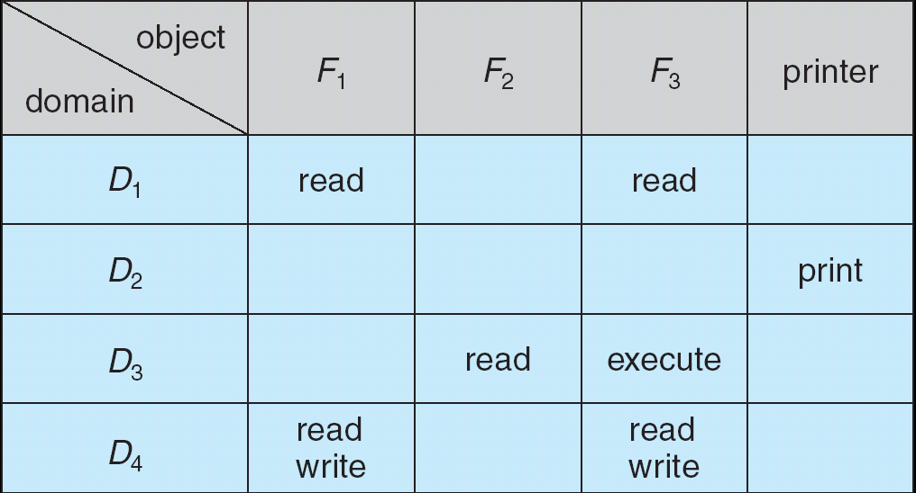
Access Matrix
Page <number>

Slide 15
Access Matrix
The access-matrix scheme provides us with the mechanism for specifying a variety of policies
  The policy decisions involve which rights should be included in the (i , j )th entry
    The users normally decide the contents of the access-matrix entries
  We must also decide the domain in which each process executes
    Usually decided by the operating system
Page <number>

Slide 16
Access Matrix With Domains as Objects
When we switch a process from one domain to another, we are executing an operation (switch) on an object (the domain)
We can control domain switching by including domains among the objects of the access matrix
Page <number>

Slide 17
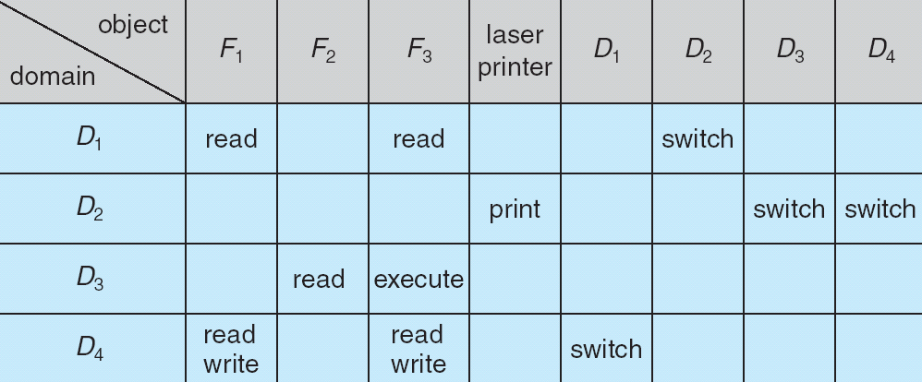
Access Matrix of Figure A With Domains as Objects
Figure B
Page <number>

Slide 18
Implementation of Access Matrix
Allowing controlled change in the contents of the access-matrix entries requires three additional operations:
  copy
  owner
  control
Page <number>

Slide 19
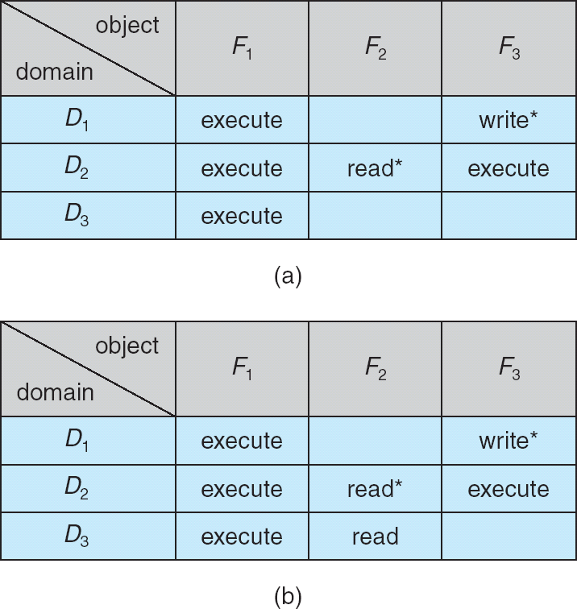
Access Matrix with Copy Rights
Page <number>

Slide 20
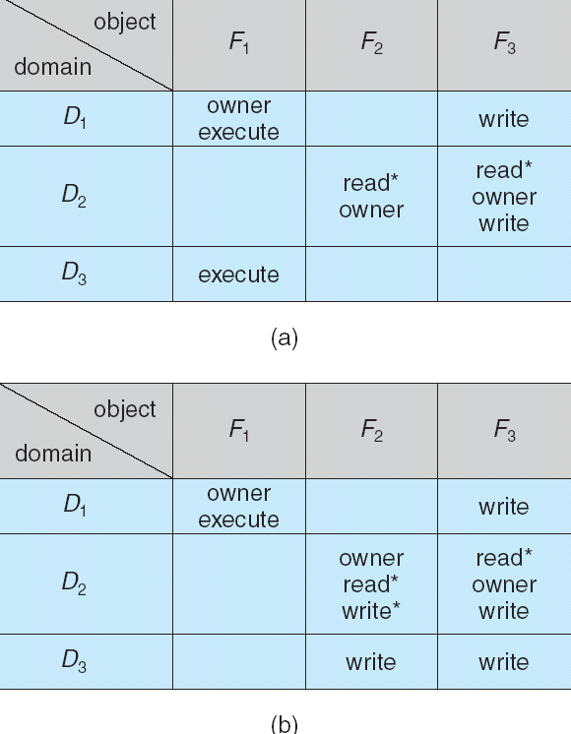
Access Matrix With Owner Rights
Page <number>

Slide 21
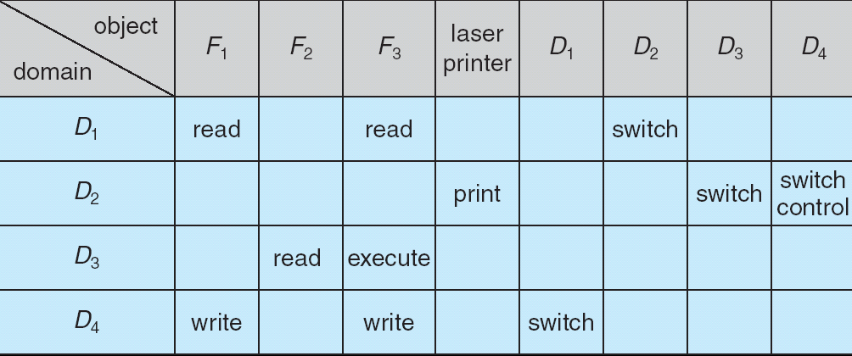
Modified Access Matrix of Figure B
Page <number>

Slide 22
Chapter 14: Protection
Goals of Protection
Principles of Protection
Domain of Protection
Access Matrix
Implementation of Access Matrix
Access Control
Revocation of Access Rights
Capability-Based Systems
Language-Based Protection
Page <number>

Slide 23
Implementation of Access Matrix
Each column = Access-control list for one object
Defines who can perform what operation.
Domain 1 = Read, Write
Domain 2 = Read
Domain 3 = Read

Each Row = Capability List (like a key)
For each domain, what operations allowed on what objects.
      Object 1 – Read
      Object 4 – Read, Write, Execute
      Object 5 – Read, Write, Delete, Copy
Page <number>

Slide 24
Chapter 14: Protection
Goals of Protection
Principles of Protection
Domain of Protection
Access Matrix
Implementation of Access Matrix
Access Control
Revocation of Access Rights
Capability-Based Systems
Language-Based Protection
Page <number>

Slide 25
Access Control
Protection can be applied to non-file resources
Solaris 10 provides role-based access control to implement least privilege
  Privilege is right to execute system call or use an option within a system call
  Can be assigned to processes
  Users assigned roles granting access to privileges and programs
Page <number>

Slide 26
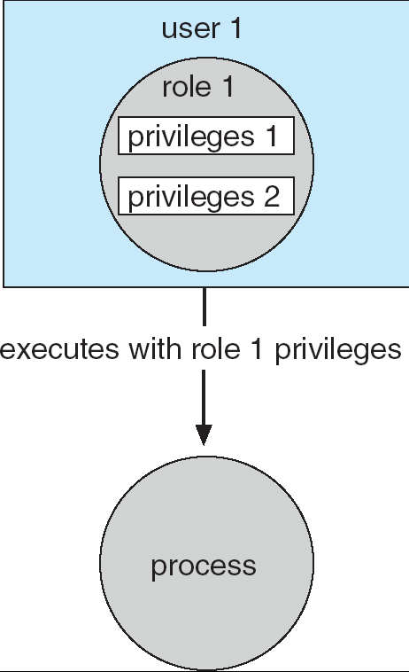
Role-based Access Control in Solaris 10
Page <number>

Slide 27
Revocation of Access Rights
Access List – Delete access rights from access list.
  Simple
  Immediate
Capability List – Scheme required to locate capability in the system before capability can be revoked.
  Reacquisition
  Back-pointers
  Indirection
  Keys
Page <number>

Slide 28
Capability-Based Systems
Hydra
  Fixed set of access rights known to and interpreted by the system.
  Interpretation of user-defined rights performed solely by user's program; system provides access protection for use of these rights.
Cambridge CAP System
  Data capability - provides standard read, write, execute of individual storage segments associated with object.
  Software capability -interpretation left to the subsystem, through its protected procedures.
Page <number>

Slide 29
Language-Based Protection
Specification of protection in a programming language allows the high-level description of policies for the allocation and use of resources.
Language implementation can provide software for protection enforcement when automatic hardware-supported checking is unavailable.
Interpret protection specifications to generate calls on whatever protection system is provided by the hardware and the operating system.
Page <number>

Slide 30
Protection in Java 2
Protection is handled by the Java Virtual Machine (JVM)
A class is assigned a protection domain when it is loaded by the JVM.
The protection domain indicates what operations the class can (and cannot) perform.
If a library method is invoked that performs a privileged operation, the stack is inspected to ensure the operation can be performed by the library.
Page <number>

Slide 31
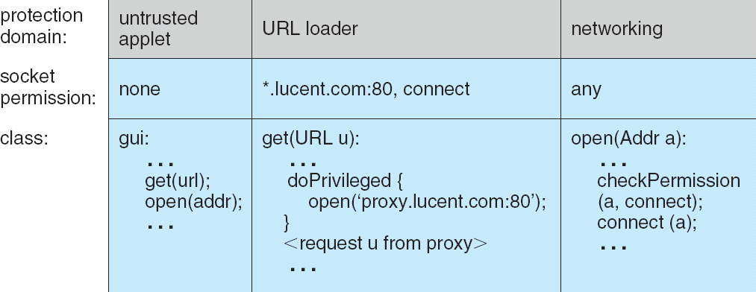
Stack Inspection
Page <number>

Slide 32
End of Chapter 14
May 24, 2010

