Slide 1
Chapter 1: Introduction

Slide 2
Chapter 1: Introduction
What Operating Systems Do
Computer-System Organization
Computer-System Architecture
Operating-System Structure
Operating-System Operations
Process Management
Memory Management
Storage Management
Protection and Security
Distributed Systems
Special-Purpose Systems
Computing Environments

Slide 3
Objectives
To provide a grand tour of the major operating systems components
To provide coverage of basic computer system organization

Slide 4
操作系统的名称
1.1 What Operating System Do
监控（督）程序（系统）（Monitor)
执行系统（程序）(Executive System(program))
控制系统（程序）(Control System program))
管理程序(Supervisor, Supervisory System)
核心程序(Kernel)
操作系统(Operating System)

Slide 5
Computer System Structure
Computer system can be divided into four components
  Hardware – provides basic computing resources
    CPU, memory, I/O devices
  Operating system
    Controls and coordinates use of hardware among various applications and users
  Application programs – define the ways in which the system resources are used to solve the computing problems of the users
    Word processors, compilers, web browsers, database systems, video games
  Users
    People, machines, other computers

Slide 6
What is an Operating System?
A program that acts as an intermediary between a user of a computer and the computer hardware.
Operating system goals:
  Execute user programs and make solving user problems easier.
  Make the computer system convenient to use.
Use the computer hardware in an efficient manner.

Slide 7
What is an Operating System?
Two Views
  User View
  System View

Slide 8

Four Components of a Computer System

Slide 9
What is an Operating System?
用户的角度 (User View)
用户接口：使用方便、资源利用率
系统的角度 (System View)
计算机资源管理者－管理与分配资源

Slide 10
Operating System Definition
OS is a resource allocator
  Manages all resources
  Decides between conflicting requests for efficient and fair resource use
OS is a control program
  Controls execution of programs to prevent errors and improper use of the computer

Slide 11
Operating System Definition (Cont.)
No universally accepted definition
“Everything a vendor ships when you order an operating system” is good approximation
  But varies wildly
“The one program running at all times on the computer” is the kernel. Everything else is either a system program (ships with the operating system) or an application program

Slide 12
Operating System Definition (Cont.)
操作系统是一组控制和管理计算机硬件和软件资源、合理地对各类作业进行调度，以及方便用户的程序集合。

Slide 13

1.2 Computer System Organization
1.2.1 Computer-system operation
  One or more CPUs, device controllers connect through common bus providing access to shared memory
  Concurrent execution of CPUs and devices competing for memory cycles (for example)

Slide 14

Structure of a large Pentium system

Slide 15
Computer Startup
bootstrap program is loaded at power-up or reboot
  Typically stored in ROM or EPROM, generally known as firmware
  Initializates all aspects of system
  Loads operating system kernel and starts execution

Slide 16
Computer Startup (Cont.)
计算机启动过程一般是指计算机从点亮到加载操作系统的一个过程。
以IBM 兼容机为例
  加电
  自检
  初始化设备
  测试设备
  更新SECD（Extended System Configuration Data，扩展系统配置数据）
  启动操作系统

Slide 17
Computer Startup--加电
电源开关打开,机器开始供电,主板的控制芯片组会向CPU发出并保持一个RESET （重置）信号，让CPU 恢复到初始状态
当芯片组检测到电源已经开始稳定供电时就会撤去RESET 信号（松开台式机的重启键是一样的效果）
CPU 就从0xffff0 处开始执行指令
该地址在系统BIOS （Basic Input/Output System，基本输入输出系统）的地址范围内，大部分系统BIOS 厂商放在这里的都只是一条跳转指令，跳到系统BIOS 真正的启动代码处

Slide 18
Computer Startup--自检
系统BIOS 的启动代码首先要做的事情就是进行POST（Power-On Self Test，加电后自检）
POST 的主要任务是检测系统中一些关键设备是否存在和能否正常工作，例如内存和显卡等
由于POST 是最早进行的检测过程，此时显卡还没有初始化，如果系统BIOS 在POST 的过程中发现了一些致命错误，不会将错误信息在屏幕上显示
例如没有找到内存或者内存有问题（此时只会检查640K 常规内存），那么系统BIOS 就会直接控制喇叭发声来报告错误，声音的长短和次数代表了错误的类型

Slide 19
Computer Startup--初始化设备
接下来系统BIOS 将查找显卡的BIOS，存放显卡BIOS 的ROM 芯片的起始地址通常设在0xC0000 处，系统BIOS 在这个地方找到显卡BIOS 之后就调用它的初始化代码，由显卡BIOS 来初始化显卡
此时多数显卡都会在屏幕上显示出一些初始化信息，介绍生产厂商、图形芯片类型等内容
系统BIOS 接着会查找其它设备的BIOS 程序，找到之后同样要调用这些BIOS内部的初始化代码来初始化相关的设备

Slide 20
Computer Startup--测试设备
查找完所有其它设备的BIOS 之后，系统BIOS 将显示出它自己的启动画面，其中包括有系统BIOS 的类型、序列号和版本号等内容
接着系统BIOS 将检测和显示CPU 的类型和工作频率，然后开始测试所有的RAM （Random Access Memory，随机访问存储器），并同时在屏幕上显示内存测试的进度
内存测试通过之后，系统BIOS 将开始检测系统中安装的一些标准硬件设备，包括硬盘、光驱、串口、并口、软驱等
另外绝大多数较新版本的系统BIOS 在这一过程中还要自动检测和设置内存的定时参数、硬盘参数和访问模式等
标准设备检测完毕后，系统BIOS 内部的支持即插即用的代码将开始检测和配置系统中安装的即插即用设备，每找到一个设备之后，系统BIOS 都会在屏幕上显示出设备的名称和型号等信息，同时为该设备分配中断（INT）、DMA （Direct Memory Access，直接存储器存取）通道和I/O （Input/Output，输入输出）端口等资源

Slide 21
Computer Startup--更新SECD
所有硬件都检测配置完毕后，多数系统BIOS 会重新清屏并在屏幕上方显示出一个表格，其中概略地列出了系统中安装的各种标准硬件设备，以及它们使用的资源和一些相关工作参数
接下来系统BIOS 将更新ESCD （Extended System Configuration Data，扩展系统配置数据）
ESCD 是系统BIOS 用来与操作系统交换硬件配置信息的一种手段，这些数据被存放在CMOS （Complementary Metal Oxide Semiconductor，互补金属氧化物半导体）之中

Slide 22
Computer Startup--启动操作系统
ESCD 更新完毕后，系统BIOS 的启动代码将进行它的最后一项工作，即根据用户指定的启动顺序从软盘、硬盘及光驱等启动操作系统
以Windows XP 为例
  系统BIOS将启动盘（一般是主硬盘）的第一个扇区（Boot Sector，引导扇区）读入到内存的0x7c00处，并检查0x7dfe 地址的内存，如果其内容是0xaa55，就跳转到0x7c00 处执行MBR （Master Boot Record，主引导记录）
  MBR 从分区表（Partition Table）中找到第一个活动分区（Active Partition，一般是C 盘分区），然后按照类似方式读取并执行这个活动分区的引导扇区（Partition Boot Sector），引导扇区负责读取并执行NTLDR （NT LoaDeR，Windows NT的加载程序），完成Windows的启动

Slide 23
Computer-System Operation
I/O devices and the CPU can execute concurrently.
Each device controller is in charge of a particular device type.
Each device controller has a local buffer.
CPU moves data from/to main memory to/from local buffers
I/O is from the device to local buffer of controller.
Device controller informs CPU that it has finished its operation by causing an interrupt.

Slide 24
Common Functions of Interrupts
Interrupt transfers control to the interrupt service routine generally, through the interrupt vector, which contains the addresses of all the service routines.
Interrupt architecture must save the address of the interrupted instruction.
Incoming interrupts are disabled while another interrupt is being processed to prevent a lost interrupt.
A trap is a software-generated interrupt caused either by an error or a user request （e.g. system call）.
An operating system is interrupt driven.(vs. event driven)

Slide 25
Common Functions of Interrupts(Cont.)
Interrupt driven (hardware and software)
  Hardware interrupt by one of the devices
  Software interrupt (exception or trap):
    Software error (e.g., division by zero)
    Request for operating system service
    Other process problems include infinite loop, processes modifying each other or the operating system

Slide 26
Interrupt vs. trap
Interrupt
  a hardware-generated change-of-flow within the system.
  an interrupt handler is summoned to deal with the cause of the interrupt; control is then returned to the interrupted context and instruction.
  an interrupt can be used to signal the completion of an I/O to obviate the need for device polling.
Trap
  a software-generated interrupt.
  a trap can be used to call operating system routines (system services) or to catch arithmetic errors.

Slide 27
Interrupt Handling
The operating system preserves the state of the CPU by storing registers and the program counter. (context)
Determines which type of interrupt has occurred:
  polling
  vectored interrupt system
Separate segments of code determine what action should be taken for each type of interrupt

Slide 28

Interrupt Timeline
Interrupt Timeline for a single process doing output

Slide 29
1.2.2 Storage Structure
Main memory – only large storage media that the CPU can access directly.
Secondary storage – extension of main memory that provides large nonvolatile storage capacity.
Magnetic disks – rigid metal or glass platters covered with magnetic recording material
  Disk surface is logically divided into tracks, which are subdivided into sectors.
  The disk controller determines the logical interaction between the device and the computer.

Slide 30
Storage Hierarchy
Storage systems organized in hierarchy.
  Speed
  Cost
  Volatility
Caching – copying information into faster storage system; main memory can be viewed as a last cache for secondary storage.
Disk cache

Slide 31

Storage-Device Hierarchy

Slide 32
1.2.3 I/O Structure
A general-purpose computer system consists of CPUs and multiple device controllers
These device controllers connected through a common bus
Operating systems have a device driver for each device controller
The device drivers understand the device controllers and present a uniform interface to the devices to the rest of the operating system.

Slide 33
Direct Memory Access (DMA) Structure
Used for high-speed I/O devices able to transmit information at close to memory speeds.
Device controller transfers blocks of data from buffer storage directly to main memory without CPU intervention.
Only one interrupt is generated per block, rather than the one interrupt per byte.

Slide 34
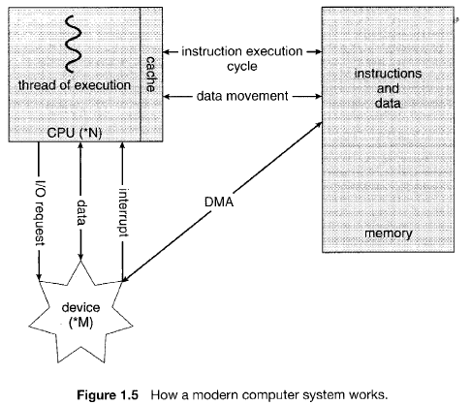
Interplay of all components of a computer systems

Slide 35
1.3 Computer-System Architecture
Single-Processor Systems
Multiprocessor Systems
Clustered systems

Slide 36
Multiprocessor Systems
Increased throughput
Economy of scale
Increased reliability

Slide 37
Multiprocessor Systems
Asymmetric multiprocessing
  Master-slave relationship
  Has one master CPU and the remainder CPUs are slaves.
  The master distributes tasks among the slaves, and I/O is usually done by the master only.
Symmetric multiprocessing
  Treats all processors as equals, and I/O can be processed on any CPU

Slide 38
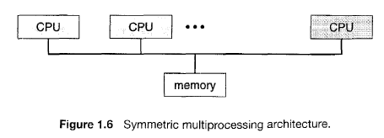
Symmetric Multiprocessing Architecture

Slide 39

Symmetric Multiprocessing Architecture

Slide 40

A Dual-Core Design
Multi-chip and multicore
Systems containing all chips
  Chassis containing multiple separate systems

Slide 41
Clustered Systems
Combining multiple computers into a single system
Composed of two or more individual systems coupled together
Clustered computers share storage and are closely linked via a LAN
Asymmetric clustering
Symmetric clustering

Slide 42

Clustered Systems

Slide 43
1.4 Operating System Structure
Multiprogramming needed for efficiency
  Single user cannot keep CPU and I/O devices busy at all times
  Multiprogramming organizes jobs (code and data) so CPU always has one to execute
  A subset of total jobs in system is kept in memory
  One job selected and run via job scheduling
  When it has to wait (for I/O for example), OS switches to another job

Slide 44

Memory Layout for Multiprogramming System

Slide 45
Three main categories
Batch systems （批处理系统）
Time-sharing systems （分时系统）
Real time systems（实时系统）

Slide 46

OS-人工操作方式
硬件昂贵
手工时期
采取预约方式，用户独占资源

Slide 47

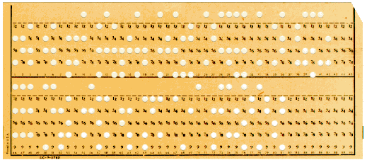
人工操作方式
工作流程：
    （1）由程序员事先穿孔（对应程序和数据）
    （2）将穿孔的纸带（卡片）装入纸带（卡片)输入机
    （3）再启动输入机将程序和数据输入计算机，
    （4）然后启动计算机运行。
    （5）运行完毕取走计算机结果。
    （6）下一位用户

Slide 48
人工操作方式带来的矛盾及解决方法
缺点：
    用户独占全机（资源浪费）
    CPU等待人工操作：装入时、取走时CPU及内存等资源是空闲。CPU既要负责计算，又要负责传输。（即属于单控制方式）
矛盾
    人机矛盾即人工操作方式与机器利用率的矛盾
    CPU与I/O设备之间速度不匹配的矛盾
解决方法
    通道技术、缓冲技术
    脱机输入输出方式
返回

Slide 49
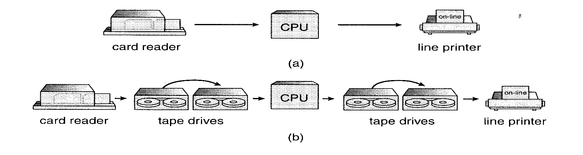
(a) online (b) off-line

Slide 50
脱机输入/输出方式(off-Line I/O）
OS--------Introduction
工作流程：（示意图)
优点：（1）减少了CPU的空闲时间。
（2）提高了I/O速度（与高速的磁盘打交道）
输入设备
外围机
外存
外存
高速
主机
高速
外存
外存
外围机
输出设备
返回

Slide 51
OS—批处理系统
批处理系统
工作方式：
用户将作业交给系统操作员，系统操作员将许多用户的作业组成一批作业(jobs)之后输入到计算机中，在系统中形成一个自动转接的连续的作业流，系统自动、依次执行每个作业。最后由操作员将作业结果交给用户
操作系统：自动将控制从一个任务转到下一个任务

Slide 52








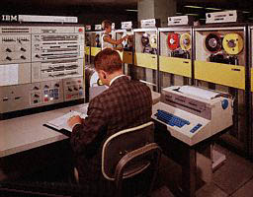
OS—批处理系统
早期批处理系统
卡片
磁带机
打印机
卡片阅读机
IBM1401
IBM7094
IBM1401
输入磁带
输出磁带

Slide 53
$END
Data for program
$RUN
$LOAD
Fortran program
$FORTRAN
典型的
FMS JOB 结构
$JOB, 10,429754
Cherry Chen

Slide 54
批处理系统
单道批处理系统
多道批处理系统

Slide 55
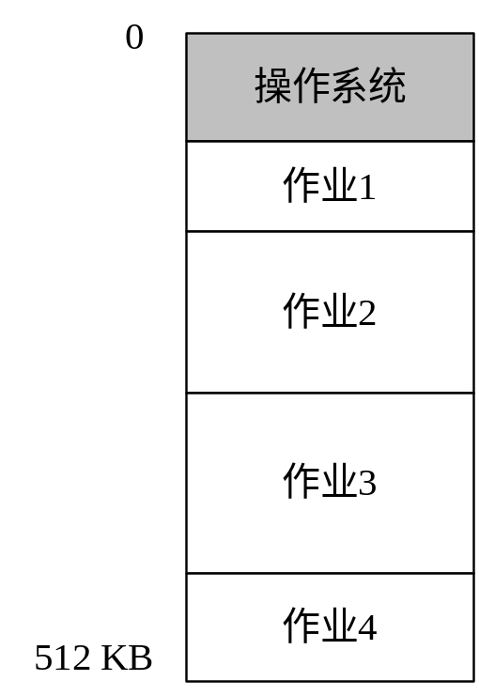
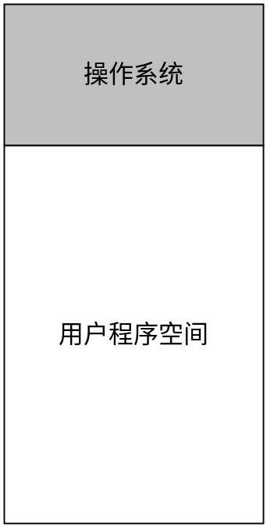
简单批处理&多道程序
单个用户独享内存空间
多用户共享内存空间

Slide 56
单道批处理系统
用户在一次解题或一个事务处理过程中要求计算机系统所做的全部工作。
1、工作流程：
（1）作业合成一批输入到外存上，同时在系统中配上监控程序。
（2）monitor将作业逐个送入内存并运行。
2、特征：（1）自动性 （2）顺序性 （3）单道性
3、优点：减少了人工操作的时间，提高机器的利用率和系统吞吐量。
4、缺点：对某些作业来说，当它发出输入/输出请求后，CPU必须等待I/O的完成，特别因为I/O设备的低速性，从而使机器的利用率很低。
返回

Slide 57
多道批处理系统
OS--------Introduction
特征：（1）调度性 （2）无序性 （3）多道性
优点：（1）资源的利用率高 （2）系统吞吐量大
缺点：（1）平均周转周期长 （2）无交互能力
需解决问题
处理机管理、内存管理、I/O设备管理、文件及作业管理问题
操作系统的形成
为解决上述问题，在多道程序系统中增设一组软件以有效加以解决，同时增设方便用户使用计算机的软件，这样便形成了操作系统。

Slide 58
批处理操作系统优缺点
优点：
    作业流程自动化;
    效率高
    吞吐量高
缺点：
    无交互手段
    调试程序困难
返回

Slide 59



Time-Sharing Systems–Interactive Computing
终端
主机

Slide 60
Time-Sharing Systems–Interactive Computing
Timesharing (multitasking) is logical extension in which CPU switches jobs so frequently that users can interact with each job while it is running, creating interactive computing
  Response time should be < 1 second
  Each user has at least one program executing in memory process
  If several jobs ready to run at the same time  CPU scheduling
  If processes don’t fit in memory, swapping moves them in and out to run
  Virtual memory allows execution of processes not completely in memory

Slide 61
Time-Sharing Systems–Interactive Computing
Interactive system
Time slice.
Time-Sharing Systems – Multics,UNIX,VMS,Windows.
Unix - A time-sharing system
Computer systems with Time-Sharing Systems (VAX).
  Mainfram
  Terminal
Virtual Machine
  Darkroom
  Alan Turing- Can Machine Think?

Slide 62
Discussion
multiprograming system
  Nonpreemptive (非抢占、非抢先、非剥夺)
    Multitask system with I/O
  Preemptive （抢占、抢先、剥夺）
    Time-sharing system
How to test if a operating system is a time-sharing system or not? (Nonpreemptive or Preemptive ？)

Slide 63
Time-Sharing Systems–Interactive Computing
The CPU is multiplexed among several jobs that are kept in memory and on disk (the CPU is allocated to a job only if the job is in memory).
A job swapped in and out of memory to the disk.
On-line communication between the user and the system is provided; when the operating system finishes the execution of one command, it seeks the next “control statement” from the user’s keyboard.
On-line system must be available for users to access data and code.

Slide 64
Real-Time Systems
Often used as a control device in a dedicated application such as controlling scientific experiments, medical imaging systems, industrial control systems, and some display systems.
Well-defined fixed-time constraints.
Real-Time systems may be either hard or soft real-time.

Slide 65
Real-Time Systems (Cont.)
Hard real-time:
  Secondary storage limited or absent, data stored in short term memory, or read-only memory (ROM)
  Conflicts with time-sharing systems, not supported by general-purpose operating systems.
  All delays in the system should be bounded.
  Guarantees that critical tasks be completed on time.

Slide 66
Real-Time Systems (Cont.)
Soft real-time
  A less restrictive type of real-time system.
  A task cannot be kept waiting indefinitely for the kernel to run it.
  Limited utility in industrial control of robotics
  Useful in applications (multimedia, virtual reality) requiring advanced operating-system features.

Slide 67
Real-time Systems
实时操作系统是保证在一定时间限制内完成特定功能的操作系统
实时操作系统
  硬实时系统
    硬实时要求在规定的时间内必须完成操作，这是在操作系统设计时保证的；
  软实时系统
    软实时则只要按照任务的优先级，尽可能快地完成操作即可

Slide 68
Real-time Systems （Cont.）
IEEE 的实时UNIX分委会认为实时操作系统应具备以下的几点:
  异步的事件响应
  切换时间和中断延迟时间确定
  优先级中断和调度
  抢占式调度

Slide 69
1.5 Operating-System Operations
Interrupt driven by hardware
Software error or request creates exception or trap
    Division by zero,
    request for operating system service (system call)
Other process problems include infinite loop, processes modifying each other or the operating system
  硬件检测，软件处理

Slide 70
Hardware Protection-Introduction
Normal operation of the system may be disrupted by issuing illegal instruction, by accessing memory locations within the operating system, or by refusing to relinquish the CPU.
Many errors usually are detected by hardware and handled by the OS.

Slide 71
Hardware Protection－measures
Dual-Mode Operation
I/O Protection
Memory Protection
CPU Protection
Dual-Mode Operation→ privileged instructions→将一些限定的操作设定为特权指令，不允许用户直接执行，而只能通过系统调用使用；或只能由系统操作；

Slide 72
Dual-Mode Operation
类比
  Windows 中的两种类型的账户
    系统管理员（Administrator）
    受限的账户
  facts
    Some resources can only be accessed by Administrators;
    Some operations can only be accessed by Administrators；(e.g create, delete files)
  goals
    保护计算机系统的安全

Slide 73

Transition from User to Kernel Mode
Dual-mode operation allows OS to protect itself and other system components
  User mode and kernel mode
  Mode bit provided by hardware (PSW)
    Provides ability to distinguish when system is running user code or kernel code
    Some instructions designated as privileged, only executable in kernel mode
    System call changes mode to kernel, return from call resets it to user

Slide 74
Dual-Mode Operation
Privileged instructions
  Privileged instructions can be issued only in monitor mode, otherwise an error occurs and the hardware will trap to the OS.
Provide hardware support to differentiate between at least two modes of operations.
  1. User mode – execution done on behalf of a user.
  Monitor mode (also kernel mode or system mode) – execution done on behalf of operating system.

Slide 75
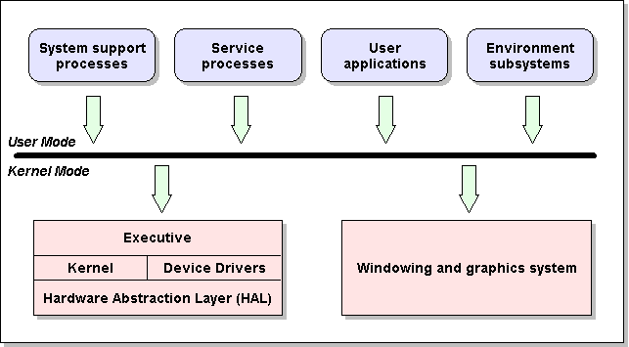
Windows NT

Slide 76
Dual-Mode Operation (Cont.)
Mode bit added to computer hardware to indicate the current mode: monitor (0) or user (1). （PSW-Program State Word）
When an interrupt or fault occurs hardware switches to monitor mode.
Interrupt/fault
monitor
user
set user mode

Slide 77

Use of A System Call to Perform I/O

Slide 78
Dual-Mode Operation (Cont.)
Must ensure that a user program could never gain control of the computer in monitor mode
  Sometimes users can load data and store it in the memory or vice versa directly.
  A user program that, as part of its execution, stores a new address in the interrupt vector, and then transfer control through the modified interrupt vector to the user program.

Slide 79
I/O Protection
All I/O instructions are privileged instructions.
  To prevent users from issuing I/O instruction directly.
    Almost all the I/O devices are shared by the users.
  To prevent users from performing illegal I/O.
    E.g. Read data from a printer

Slide 80
Memory Protection
Should protect the OS from access by user programs, and protect user programs from one another.
Must provide memory protection at least for the interrupt vector and the interrupt service routines of the OS.
In order to have memory protection, add two registers that determine the range of legal addresses a program may access:
  Base register – holds the smallest legal physical memory address.
  Limit register – contains the size of the range
Memory outside the defined range is protected.

Slide 81

Use of A Base and Limit Register

Slide 82

Hardware Address Protection

Slide 83
Memory Protection
When executing in monitor mode, the operating system has unrestricted access to both monitor and user’s memory.
The load instructions for the base and limit registers are privileged instructions.

Slide 84
CPU Protection
Must prevent a user program from getting stuck in an infinite loop or not calling system services, and never returning control to the OS.
Timer to prevent infinite loop / process hogging resources
  Set interrupt after specific period
  Operating system decrements counter
  When counter zero generate an interrupt
  Set up before scheduling process to regain control or terminate program that exceeds allotted time
Timer commonly used to implement time sharing.
Time also used to compute the current time.
Load-timer is a privileged instruction.

Slide 85
Process Management
A process is a program in execution. It is a unit of work within the system. Program is a passive entity, process is an active entity.
Process needs resources to accomplish its task
  CPU, memory, I/O, files
  Initialization data
Process termination requires reclaim of any reusable resources
Single-threaded process has one program counter specifying location of next instruction to execute
  Process executes instructions sequentially, one at a time, until completion
Multi-threaded process has one program counter per thread
Typically system has many processes, some user, some operating system running concurrently on one or more CPUs
  Concurrency by multiplexing the CPUs among the processes / threads

Slide 86
1.6 Process Management Activities
The operating system is responsible for the following activities in connection with process management:
Creating and deleting both user and system processes
Suspending and resuming processes
Providing mechanisms for process synchronization
Providing mechanisms for process communication
Providing mechanisms for deadlock handling

Slide 87
1.7 Memory Management
All data in memory before and after processing
All instructions in memory in order to execute
Memory management determines what is in memory when
  Optimizing CPU utilization and computer response to users
Memory management activities
  Keeping track of which parts of memory are currently being used and by whom
  Deciding which processes (or parts thereof) and data to move into and out of memory
  Allocating and deallocating memory space as needed

Slide 88
1.8 Storage Management
OS provides uniform, logical view of information storage
  Abstracts physical properties to logical storage unit - file
  Each medium is controlled by device (i.e., disk drive, tape drive)
    Varying properties include access speed, capacity, data-transfer rate, access method (sequential or random)
File-System management
  Files usually organized into directories
  Access control on most systems to determine who can access what (file protection)
  OS activities include
    Creating and deleting files and directories
    Primitives to manipulate files and dirs
    Mapping files onto secondary storage
    Backup files onto stable (non-volatile) storage media

Slide 89
Mass-Storage Management
Usually disks used to store data that does not fit in main memory or data that must be kept for a “long” period of time.
Proper management is of central importance
Entire speed of computer operation hinges on disk subsystem and its algorithms
OS activities
  Free-space management
  Storage allocation
  Disk scheduling
Some storage need not be fast
  Tertiary storage includes optical storage, magnetic tape
  Still must be managed
  Varies between WORM (write-once, read-many-times) and RW (read-write)

Slide 90
Caching
Important principle, performed at many levels in a computer (in hardware, operating system, software)
Information in use copied from slower to faster storage temporarily
Faster storage (cache) checked first to determine if information is there
  If it is, information used directly from the cache (fast)
  If not, data copied to cache and used there
Cache smaller than storage being cached
  Cache management important design problem
  Cache size and replacement policy
Caching vs. Buffering

Slide 91

Performance of Various Levels of Storage
Movement between levels of storage hierarchy can be explicit or implicit

Slide 92

Migration of Integer A from Disk to Register
Multitasking environments must be careful to use most recent value, no matter where it is stored in the storage hierarchy
Multiprocessor environment must provide cache coherency in hardware such that all CPUs have the most recent value in their cache
Distributed environment situation even more complex
  Several copies of a datum can exist
  Various solutions covered in Chapter 17

Slide 93
I/O Subsystem
One purpose of OS is to hide peculiarities of hardware devices from the user
I/O subsystem responsible for
  Memory management of I/O including buffering (storing data temporarily while it is being transferred), caching (storing parts of data in faster storage for performance), spooling (the overlapping of output of one job with input of other jobs)
  General device-driver interface
  Drivers for specific hardware devices

Slide 94
1.9 Protection and Security
Protection – any mechanism for controlling access of processes or users to resources defined by the OS
Security – defense of the system against internal and external attacks
  Huge range, including denial-of-service, worms, viruses, identity theft, theft of service
Systems generally first distinguish among users, to determine who can do what
  User identities (user IDs, security IDs) include name and associated number, one per user
  User ID then associated with all files, processes of that user to determine access control
  Group identifier (group ID) allows set of users to be defined and controls managed, then also associated with each process, file
  Privilege escalation allows user to change to effective ID with more rights

Slide 95
1.10 Distributed Systems
Distribute the computation among several physical processors.
Loosely coupled system – each processor has its own local memory; processors communicate with one another through various communications lines, such as high-speed buses or telephone lines.
Advantages of distributed systems.
  Resources Sharing
  Computation speed up – load sharing
  Reliability
  Communications

Slide 96
Distributed Systems (cont)
Requires networking infrastructure.
Local area networks (LAN) or Wide area networks (WAN) (MAN)
May be either client-server or peer-to-peer systems.
Client-server systems
  Computer-server systems
  File-server systems
P2P-Peer-to-Peer systems
RPC-Remote Process Call
  Stub
RMI-Remote Method Invocation

Slide 97
1.11 Special-Purpose Systems
Real-Time Embedded Systems
Multimedia Systems
Handheld Systems

Slide 98
Real-Time Systems
Often used as a control device in a dedicated application such as controlling scientific experiments, medical imaging systems, industrial control systems, and some display systems.
Well-defined fixed-time constraints.
Real-Time systems may be either hard or soft real-time.

Slide 99
Real-Time Systems (Cont.)
Hard real-time:
  Secondary storage limited or absent, data stored in short term memory, or read-only memory (ROM)
  Conflicts with time-sharing systems, not supported by general-purpose operating systems.
  All delays in the system should be bounded.
  Guarantees that critical tasks be completed on time.

Slide 100
Real-Time Systems (Cont.)
Soft real-time
  A less restrictive type of real-time system.
  A task cannot be kept waiting indefinitely for the kernel to run it.
  Limited utility in industrial control of robotics
  Useful in applications (multimedia, virtual reality) requiring advanced operating-system features.

Slide 101
Multimedia Systems
Multimedia data consist of audio and video files as well as conventional files
MP3,MP4, movies, video conference

Slide 102
Handheld Systems
Personal Digital Assistants (PDAs)
Cellular telephones
Issues:
  Limited memory
  Slow processors
  Small display screens.
Embedded systems
Laptop, palmtop
Research field: Mobile Computing

Slide 103
1.12 Computing Environments
Traditional computer
  Blurring over time
  Office environment
    PCs connected to a network
    Terminals attached to mainframe or minicomputers providing batch and timesharing
    Now portals allowing networked and remote systems access to same resources
  Home networks
    Used to be single system, then modems
    Now firewalled, networked

Slide 104

Client-Server Computing
Dumb terminals supplanted by smart PCs
Many systems now servers, responding to requests generated by clients
  Compute-server provides an interface to client to request services (i.e. database)
  File-server provides interface for clients to store and retrieve files

Slide 105
Peer-to-Peer Computing
Another model of distributed system
P2P does not distinguish clients and servers
  Instead all nodes are considered peers
  May each act as client, server or both
  Node must join P2P network
    Registers its service with central lookup service on network, or
    Broadcast request for service and respond to requests for service via discovery protocol
  Examples include Napster and Gnutella

Slide 106
Web-Based Computing
Web has become ubiquitous
PCs most prevalent devices
More devices becoming networked to allow web access
  Workstations, handheld PDAs, cell phones ,etc
New category of devices to manage web traffic among similar servers: load balancers
Use of operating systems like Windows 95, client-side, have evolved into Linux and Windows XP, which can be clients and servers

Slide 107
Homework
The definition of the Operating System
说明对cpu、I/O、memory的保护的目的及措施
一般情况下，操作系统尽量提高资源的利用率及提高运行效率，但有时也违反这一原则。请举例并加以说明。
Page 35
1，10，12，15，17

Slide 108
End of Chapter 1

Slide 109
附录
OS的发展简史

Slide 110
OS的发展过程-人工操作方式
硬件昂贵
手工时期
采取预约方式，用户独占资源

Slide 111
人工操作方式
工作流程：
    （1）由程序员事先穿孔（对应程序和数据）
    （2）将穿孔的纸带（卡片）装入纸带（卡片)输入机
    （3）再启动输入机将程序和数据输入计算机，
    （4）然后启动计算机运行。
    （5）运行完毕取走计算机结果。
    （6）下一位用户

Slide 112
人工操作方式带来的矛盾及解决方法
缺点：（1）用户独占全机（资源浪费）
（2）CPU等待人工操作：装入时、取走时CPU及内存等资源是空闲。CPU即负责计算，又要负责传输。（即属于单控制方式）
矛盾
    人机矛盾即人工操作方式与机器利用率的矛盾
    CPU与I/O设备之间速度不匹配的矛盾
解决方法
    通道技术、缓冲技术
    脱机输入输出方式
返回

Slide 113
脱机输入/输出方式(off-Line I/O）
OS--------Introduction
工作流程：（示意图)
优点：（1）减少了CPU的空闲时间。
（2）提高了I/O速度（与高速的磁盘打交道）
输入设备
外围机
外存
外存
高速
主机
高速
外存
外存
外围机
输出设备
返回

Slide 114
OS的发展过程—批处理系统
批处理系统
工作方式：
用户将作业交给系统操作员，系统操作员将许多用户的作业组成一批作业(job)之后输入到计算机中，在系统中形成一个自动转接的连续的作业流，系统自动、依次执行每个作业。最后由操作员将作业结果交给用户
操作系统：自动将控制从一个任务转到下一个任务

Slide 115
OS的发展过程—批处理系统
早期批处理系统
卡片
磁带机
打印机
卡片阅读机
IBM1401
IBM7094
IBM1401
输入磁带
输出磁带

Slide 116
$END
Data for program
$RUN
$LOAD
Fortran program
$FORTRAN
典型的
FMS JOB 结构
$JOB, 10,429754
Cherry Chen

Slide 117
批处理系统
单道批处理系统
多道批处理系统

Slide 118
OS的发展过程—多道程序系统
多道程序系统
多道程序 – 系统同时运行多个作业
在磁盘上多个作业等待运行
选择若干作业准备运行（调度）
并装入内存（存储管理）
运行一个作业，当它等待时切换至内存中的另一
个作业（如需安装磁带，等键按下）

Slide 119
简单批处理&多道程序
单个用户独享内存空间
多用户共享内存空间

Slide 120
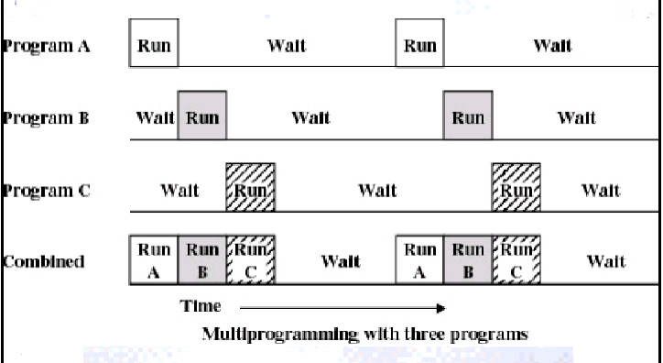
OS的发展过程—多道程序系统

Slide 121
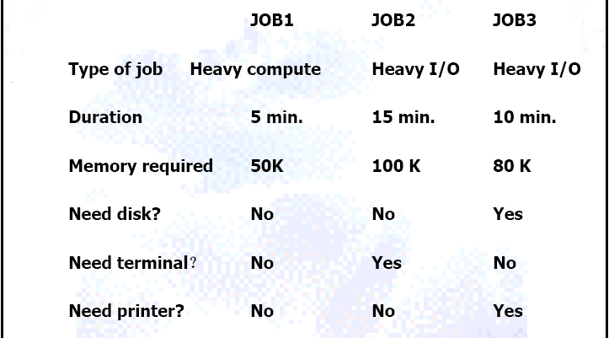
OS的发展过程—多道程序系统

Slide 122
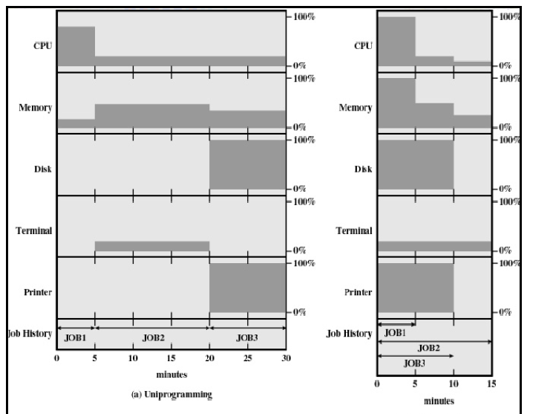
OS的发展过程—多道程序系统

Slide 123
OS的发展过程—多道程序系统
需解决问题
同步、互斥；内存保护、文件管理和设备管理
管理程序的功能
存储器管理、处理机管理、设备管理、文件管理
新的概念
作业调度、CPU调度
多道程序系统的特点
作业自动调度执行
资源利用率高，系统吞吐量大
平均周转时间长，对小型作业不利，无交互能力
缺点：没有交互能力

Slide 124
单道批处理系统
用户在一次解题或一个事务处理过程中要求计算机系统所做的全部工作。
1、工作流程：
（1）作业合成一批输入到外存上，同时在系统中配上监控程序。
（2）monitor将作业逐个送入内存并运行。
2、特征：（1）自动性 （2）顺序性 （3）单道性
3、优点：减少了人工操作的时间，提高机器的利用率和系统吞吐量。
4、缺点：对某些作业来说，当它发出输入/输出请求后，CPU必须等待I/O的完成，特别因为I/O设备的低速性，从而使机器的利用率很低。
返回

Slide 125
多道批处理系统
OS--------Introduction
特征：（1）调度性 （2）无序性 （3）多道性
优点：（1）资源的利用率高 （2）系统吞吐量大
缺点：（1）平均周转周期长 （2）无交互能力
需解决问题
处理机管理、内存管理、I/O设备管理、文件及作业管理问题
操作系统的形成
为解决上述问题，在多道程序系统中增设一组软件以有效加以解决，同时增设方便用户使用计算机的软件，这样便形成了操作系统。
操作系统：是一组控制和管理计算机硬件和软件资源，合理地组织计算工作流程，以及方便用户使用的程序集合。

Slide 126
批处理操作系统优缺点
优点：
    作业流程自动化;
    效率高
    吞吐量高
缺点：
    无交互手段
    调试程序困难
返回

Slide 127
OS的发展过程—分时系统
终端
主机

Slide 128
OS的发展过程—分时系统
Time Sharing OS
分时处理
终端请求
Hardware
终端
终端
…...
终端
界面1：交互式命令语言(eg. shell, command)
界面2：图形用户界面(GUI)

Slide 129
分时操作系统
时间片：
操作系统将CPU的时间划分成若干个片段,称为时间片
操作系统以时间片为单位,轮流为每个终端用户服务
每次服务一个时间片
(其特点是利用人的错觉，使人感觉不到)

Slide 130
OS的发展过程—分时系统
CPU通过在作业之间的切换来执行多个位于内存中或物理存储器上的作业（CPU只能分配给那些在内存中的作业）
作业在内存与物理存储器之间来回交换（swap）
允许用户与系统之间的联机通信（交互）
  当OS执行完一条命令后，它将接收用户通过键盘输入的下一条控制指令。
联机系统必须提供给用户访问数据和代码。

Slide 131
OS的发展过程—分时系统
多道分时系统的特点
多道性、同时性、独立性、及时性、交互性
响应时间：终端用户发出命令到处理机运行完毕并返回结果给终端的时间

Slide 132
OS的发展过程—分时系统
管理程序的功能
内存管理和保护、处理机管理、设备管理、文件管理、磁盘管理
内存覆盖、交换技术、虚拟内存
虚拟内存
允许作业的执行不完全在物理内存中，而是暂时放在磁盘上，根据需要调入调出
所以允许运行比物理内存大的程序

Slide 133
MULTICS的灾难
1965年在ARPA的支持下MIT、AT&T（贝尔实验室）和通用电气公司决定开发一种“公用计算服务系统”， 希望能够同时支持整个波士顿所有的分时用户。该系统称作MULTICS。
(MULTiplexed Information and Computing Service )
MULTICS设计目标是：便利的远程终端使用，大量终端通过电话线接入计算机主机；高可靠的大型文件系统；大容量的用户信息共享；存储和构造层次化信息结构的能力；……

Slide 134
MULTICS研制难度超出了所有人预料
长期研制工作达不到预期目标，1969年4月贝尔实验室退出，通用电气公司也退出了；
但最终，经过多年的努力，MULTICS成功地应用；
运行MULTICS的计算机系统在九十年代中陆续被关闭；
MULTICS引入了许多现代操作系统领域概念雏形，对随后操作系统特别是UNIX的成功有着巨大的影响

Slide 135
小型计算机，电子游戏和UNIX的成功
1969年，在贝尔退出MULTICS研制项目后，Ken Thompson和Dennis M. Ritchie 想申请经费买计算机从事操作系统研究，但多次申请得不到批准
项目无着落，他们在一台无人用的PDP-7上，重新摆弄原先在MULTICS项目上设计的“Space Travel”游戏
为了使游戏能够在PDP-7上顺利运行，他们陆续开发了浮点运算软件包、显示驱动软件，设计了文件系统、实用程序、shell 和汇编程序
到了1970年，在一切完成后，给新系统起了个同MULTICS发音相近的名字UNIX
随后，UNIX用C语言全部重写，自此，UNIX诞生了

Slide 136
UNIX
UNIX是现代操作系统的代表。Unix运行时的安全性、可靠性以及强大的计算能力赢得广大用户的信赖
促使UNIX系统成功的因素：
  首先，由于UNIX是用C语言编写，因此它是可移植的，UNIX 是世界上唯一能在笔记本计算机、PC机、工作站直至巨型机上运行的操作系统
  第二，系统源代码非常有效，系统容易适应特殊的需求
  最后，也是最重要的一点，它是一个良好的、通用的、多用户、多任务、分时操作系统

Slide 137
Bell Labs
第1版1969年
第5版1973
第6版1976
第7版1978
1 BSD 1977
System III 1982
第8版1982
2 BSD 1978
System v 1983
第9版1986
3 BSD 1978
SvR2 1984
4.0 BSD 1979
第10版1988
SVR3 1987
4.3 BSD 1986
SVR4 1989
4.4 BSD 1992
IBMAIX
Sun Solaris
UNIX版本发展历史
返回

Slide 138
OS的发展过程—桌面系统
随着硬件的价格越来越低
PC－为单个用户服务的计算机系统
I/O设备 － 键盘，鼠标，显示器，打印机等
非多用户、用户方便性和响应性
可以采用大型机操作系统上的技术
  通常人们都可以拥有一台计算机，从而CPU的利用率也不再是主要问题。所以，有些大型机OS的设计决策可能不再适用于小系统
网络出现－文件保护
可以运行多个不同类型的操作系统（Windows，MacOS，UNIX，Xenix，Linux，Solaris，OS/2）

Slide 139
桌面系统—CP/M 操作系统
随着大规模集成电路发展，个人计算机时代到来了各种类型的个人计算机和软件层出不穷
世界上第一台个人计算机Alto，1972年在施乐Palo Alto研究中心出现；
1973年Gary Kildall看到对个人计算机操作系统的需求,设计了CP/M操作系统
  Control Program/Microprocessor or Microcomputer
CP/M操作系统有较好的层次结构。它的BIOS把操作系统的其他模块与硬件配置分隔开，所以它的可移植性好, 具有较好的可适应性和易学易用性
到了1981年，CP/M操作系统成为世界上流行最广的8位操作系统之一

Slide 140
微软MS DOS
个人计算机的成功，逼得IBM采取紧急战略行动,决定要在1980年尽快生产出微型计算机，以应付挑战
但没有操作系统不行。要想快就是找现成系统配套，IBM公司洽谈 CP/M操作系统不顺利，机遇落到了微软公司
在关键时刻，开发新操作系统时间和人手上已经不可能，微软找到西雅图计算机产品公司，达成由微软经销西雅图计算机产品公司的QDOS操作系统的协议
当时西雅图公司并不知道QDOS将被转卖给IBM，否则历史将会怎样演变，谁也无法知晓

Slide 141
IBM在1981年推出个人计算机，宣布了PC-DOS操作系统
版权合同：没有限制MS-DOS
随着IBM PC和MS DOS普及，CP/M逐渐走向下坡路
MS DOS有优良的文件系统
但受到Intel x86体系结构的限制
缺乏以硬件为基础的存储保护机制
它属于单用户单任务操作系统
从1981的 1.0版到1998年在Windows 95/98之下的7.0版，MS DOS历经了16个年头
迄今仍有MS DOS爱好者继续开发各种DOS软件产品
兼容机市场，Compaq 与 Micro Channel

Slide 142
拯救苹果公司的Macintosh(MAC OS)
在推出IBM PC机后，市场卷起一股龙卷风
IBM自己也没有料到产品会有如此巨大的成功
IBM的成功说明必有其他公司失败。甚至连苹果公司也遇到了问题，销售数量落到了兰色巨人的后面
苹果公司推出Lisa机遭到失败，Apple III型也遭到失败
分析家们：微机市场上的战斗似乎兰色巨人要嬴了

Slide 143
施乐Palo Alto研究中心--70年代的计算机研究思想库
世界上第一台个人计算机Alto，1972年在这里出现
图形界面，手持鼠标，面向对象程序设计
微机网络，桌面出版和激光打印等等
很多先进概念和技术的原型都首次出现在这里

Slide 144
1979年苹果公司允许施乐公司购买一百万股的苹果公司股票
作为回报，施乐公司允许苹果公司的少数人员，包括乔布斯，在有限的时间内考察施乐公司Palo Alto研究中心内部，并同该思想库的研究人员交谈
苹果公司对Palo Alto研究中心内的技术大感吃惊
他们更吃惊的是，施乐公司在拥有这些宝贵技术的同时竟然什么也没有做！

Slide 145
对Palo Alto研究中心这些科学家们而言，苹果公司的人是他们第一次遇到真正理解他们技术的人
这些科学家们后来有的去了苹果公司，微软公司，有的最终创办了自己的公司
在访问的基础上，苹果决定立即开发采用这些新技术的个人计算机
苹果公司已看到
IBM PC机的技术有多么糟糕，但他们卖得又是特别的好

Slide 146
MAC OS、鼠标的新型个人计算机
1984年，人们看到一则广告：“What was that?”和对Macintosh的介绍, 这是配有图形界面操作系统 MAC OS和鼠标的新型个人计算机
MAC机一上市立即在市场上获得极大的成功
当年比尔.盖茨都说，这是一台他的妈妈也能使用的计算机
Macintosh把苹果公司从连续的失败中拯救出来
苹果公司又开始向前发展
正是Mac先进图形界面操作系统技术，超前PC机若干年，造就了一批苹果的忠实追随者

Slide 147
一波三折的微软Windows操作系统
1983年10月，PC机竞争厂家的图形界面相关产品上市
面对市场压力，比尔.盖茨在1983年11月10日宣布推出Windows操作系统
然而宣布容易，交货不简单，Windows交货期的灾难，成了当年计算机界的笑柄
直到1985年11月20日，Windows 1.0才正式上市

Slide 148
Windows的历史记录
Windows在当时微软历史上创了几个记录：延迟交货次数最多，投入开发人员最多，开发时间最长，更换主管人员最多
不过几年之后，Windows终于创造了销售成绩最佳的历史记录
1992年4月，推出Windows 3.1, 1993年5月，发表Windows NT
Windows 95，Windows CE，Windows 98，Windows 2000，Windows XP, Windows Vista
个人计算机采用Windows占90％以上，微软公司成了垄断PC行业的同义词

Slide 149
Internet时代与Linux
1990年秋天，Linus在芬兰首都赫尔辛基大学学习操作系统课程，因为上机需要排队等待，Linus买了台PC机，开发了第一个程序，程序包括两个进程，向屏幕上写字母，然后用定时器来切换进程
Linus需要终端仿真程序来存取Usenet新闻组的内容，于是他写了从调制解调器上接发信息的程序以及显示器、键盘和调制解调器的驱动程序
然后写了磁盘驱动程序，文件系统，一旦有了进程切换、文件系统和设备驱动程序，就拥有了一个操作系统原型，或者至少是它的一个内核
Linux就以这样极其古怪但也极其自然式问世

Slide 150
OS的发展过程—并行系统（parallel system）
这类系统有多个紧密通信的处理器
  亦称为多处理器系统或紧耦合系统
紧耦合系统（tightly coupled system）－ 处理器共享计算机总线、内存、时钟；通信常通过共享内存的方式来实现。
其主要优点：
  增加吞吐量（throughput）
  经济节约
  增加可靠性（在某些情况下）
    功能退化（graceful degradation）
    容错系统（fault tolerant)

Slide 151
OS的发展过程—并行系统（parallel system）
非对称处理（Asymmetric multiprocessing）
  每个处理器被赋予一个特定的任务，主处理器为从处理器调度和安排工作。(master-slaver)
  类似于超大型系统
对称处理（Symmetric multiprocessing, SMP）
  每个处理器都运行同一个操作系统的拷贝，这些拷贝需要互相通信
  许多处理器可能同时运行而性能上不会有多大损失
    例如N个处理器理念上可以同时运行N个进程
  许多现代操作系统支持SMP
    Windows NT、Solaris、Digital UNIX、OS/2、Linux等

Slide 152
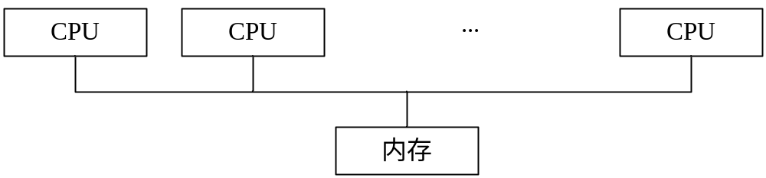
紧密耦合多处理体系结构

Slide 153
OS的发展过程—分布式系统(distributed system)
在若干个位于不同位置的处理器之间组成分布式计算
松耦合系统 （loosely coupled system） － 每个处理器都有自己的内存；处理器相互之间通过不同的通信线路进行通信，如高速总线或电话线
优点
  资源共享
  计算速度提高
  可靠性
  通信
需要网络基础结构
局域网（local-area network, LAN） 或 广域网（wide-area network, WAN）
  根据节点间的距离来划分
可以是C/S系统或端对端系统

Slide 154
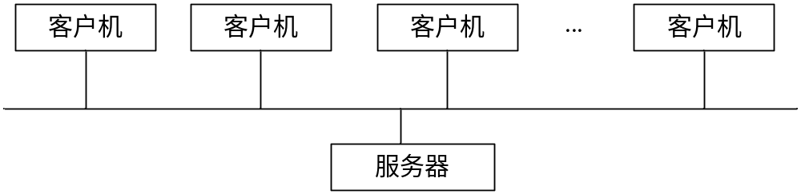
客户 － 服务器系统的通用结构

Slide 155
OS的发展过程—分布式系统(distributed system)
对等系统
P2P
(BT)

Slide 156
OS的发展过程—集群系统（clustered system）
服务器按照其体系架构可以分为RISC（精简指令集计算）架构服务器和基于CISC（复杂指令集计算）的IA架构服务器。
Cluster集群技术可定义如下：一组相互独立的服务器在网络中表现为单一的系统，并以单一系统的模式加以管理。此单一系统为客户工作站提供高可靠性的服务。

Slide 157
小帖士：IA(Intel Architecture)
通常将采用英特尔处理器的服务器称为IA(Intel Architecture)架构服务器
由于该架构服务器采用了开放式体系，并且实现了工业标准化技术和得到国内外大量软硬件供应商的支持，在大批量生产的基础上，以其极高的性能价格比而在全球范围内，尤其在我国得到广泛的应用
国内比较知名的IA架构服务器供应商有：
  惠普、IBM、浪潮

Slide 158
集群（cluster）就是一组计算机，它们作为一个整体向用户提供一组网络资源。
这些单个的计算机系统就是集群的节点（node）
集群系统将多个CPU集中起来完成计算任务。然而，集群系统与并行系统不同，它是由两个或多个独立的系统耦合起来的。

Slide 159
OS的发展过程—集群系统（clustered system）
大多数模式下，集群中所有的计算机拥有一个共同的名称，集群内任一系统上运行的服务可被所有的网络客户所使用。Cluster必须可以协调管理各分离的组件的错误和失败，并可透明地向Cluster中加入组件。
一个Cluster包含多台（至少二台）拥有共享数据存储空间的服务器。任何一台服务器运行一个应用时，应用数据被存储在共享的数据空间内。每台服务器的操作系统和应用程序文件存储在其各自的本地储存空间上。
Cluster内各节点服务器通过一内部局域网相互通讯。当一台节点服务器发生故障时，这台服务器上所运行的应用程序将在另一节点服务器上被自动接管。当一个应用服务发生故障时，应用服务将被重新启动或被另一台服务器接管。当以上任一故障发生时，客户将能很快连接到新的应用服务上。

Slide 160
OS的发展过程—集群系统（clustered system）
集群分类：高可用(High Availability)集群,简称HA集群。这类集群致力于提供高度可靠的服务。高性能计算(High Perfermance Computing)集群，简称HPC集群
非对称集群（asymmetric clustering）： 一台或多台机器处于热备份模式（hot standby mode），而另外机器运行应用程序。热备份主机（机器）不做什么，只监视现役服务器。如果服务器失效，热备份主机会成为现役服务器。
对称集群（symmetric clustering）：两个或多个主机都运行应用程序，它们互相监视。

Slide 161
OS的发展过程—集群系统（clustered system）
不管分布式计算机如何改善，绝大多数系统并不提供通用分布式文件系统。因此，绝大多数集群不允许对磁盘上的数据进行共享访问。因此，分布式文件系统必须提供对文件的访问控制和加锁，以确保不出现互为矛盾的操作。这种类型的服务通常称为分布式锁管理器（distributed lock manager, DLM）
全球集群

Slide 162
1.7 实时系统（real-time system）
当对处理器操作或数据流动有严格时间要求时，就需要使用实时系统。通常用于控制特定应用的设备。如控制科学实验，医疗成像系统，工业控制系统等等
实时系统有明确和固定的时间约束。
实时系统分为硬实时系统与软实时系统两类

Slide 163
实时系统
硬实时系统（hard real-time system）保证关键任务按时完成
  对系统内所有延迟都有限制，包括从获取存储数据到要求操作系统完成任何操作的请求。通常只有少量或根本没有使用任何类型的辅助存储器，数据通常存在短期存储器或ROM中。
  硬实时系统没有绝大多数高级操作系统的功能，这是因为这些功能常常将用户与硬件分开，导致难以估计操作所需时间。因此，硬实时系统与分时操作系统的操作相矛盾，两者不能混合使用。

Slide 164
实时系统
软实时系统（soft real-time system）
  关键实时任务的优先级要高于其他任务的优先级，且在完成之前能保持其高优先级。与硬实时系统一样，需要限制操作系统内核的延迟：实时任务不能无休止地等待内核来执行它。
  可以与分时系统集成在一起
  在那些需要快速响应时间的应用程序（如多媒体、虚拟现实）中是非常有用的。

Slide 165
手持系统（handheld system）
个人数字助理（Personal Digital Assistants, PDAs）
蜂窝电话（Cellular telephones）
存在的问题
  内存有限(32M – 64M)
  低速处理器（只有个人计算机处理器速度的几分之一）
  屏幕小（5英寸×3英寸）

Slide 166
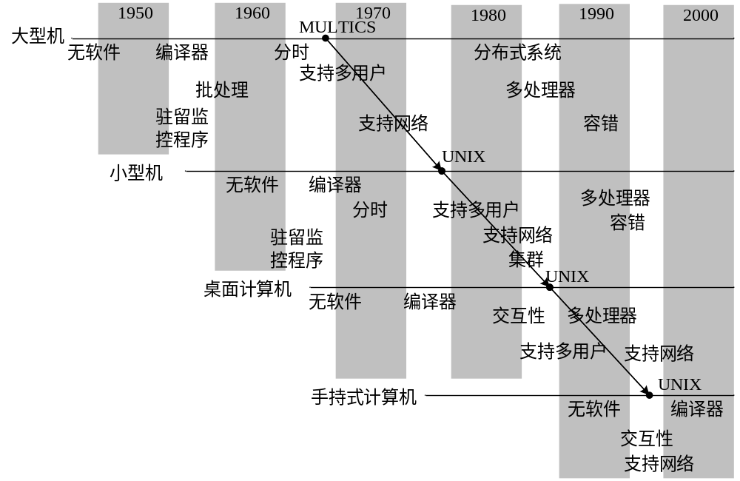
操作系统概念与功能的变迁

Slide 167
计算环境
传统计算
  PC， 服务器， 有限的远程访问
基于Web的计算
  C/S和Web服务，便捷的远程访问，不用关心服务器的位置
嵌入式计算
  嵌入式计算机是现在最为普遍的计算机，如汽车发动机、VCR、微波炉等等
  系统功能比较简单，没有高级功能（如虚拟内存和磁盘）
  只有少量或没有用户接口

Slide 168
研究中的新的操作系统
哈佛大学的VINO，使应用得以重用内核构件
犹他州大学的OSKit，提供构造操作系统所需的基础构件，也提供高层次构件。OSKit可用来构造新的OS
MIT Exokernel,该系统只有一个极小的核。系统抽象通过Library Operating System完成
NASA空间飞行中心(GSFC)研制Beowulf项目开始于1994年，用商业化的微型计算机，Linux和以太网等构造集群。已有世界各地的约六十个大学和研究机构在使用
加州大学伯克利分校NOW集群操作系统，100台Ultra SPARC-I处理机集群，排名于世界最快的200台超级计算机之内

Slide 169
加州大学伯克利分校Millennium项目
目的是在校园范围完成内一个“机群的机群(Cluster of Clusters)” 。在这个项目中，层次化的机群Millennium由五层构成，第一层，计算机工作站分布在十七个校园区内；第二层，多处理机服务器，提供各有关部门的计算服务；第三层， NOW组，每一个NOW都一个机群；第四层，一个非常大规模的NOW，供全校园共享；第五层，整体计算层，它在NOW组上构造，用于提供NOW组和校园NOW的共享。
在Millennium项目基础上，又提出了一个Vineyard项目：一个面向未来的研究项目。作为Millennium的后续项目，它的目标超越了一个伯克利分校校园范围内的机群，它要通过高速网络连接其他工作站机群，从而构成了一个协同工作站机群联合体。

Slide 170
国内操作系统的研制状况
60年代末至70年代初
杨芙清院士主持
我国第一台百万次集成电路计算机（150）操作系统
支持多道程序运行，在石油勘探领域成功应用
70年代中后期
杨芙清院士主持
我国第一个全部用高级语言书写的DJS240机操作系统DJS200/XT2
层次管程结构模型，PCM设计方法，活跃管程结构模式

Slide 171
国内操作系统的研制状况（续）
GX73多机实时操作系统（1978年）
国防科技大学，1980年装在“远望”-I 号航天测量船上，完成了向太平洋发射运载火箭、潜水艇水下发射的测控任务；完成了我国第一颗同步地球卫星的测控、定轨、控制任务
“银河”-1 YHOS巨型操作系统（1983年）国防科技大学，用于YH-1、YH-2超级计算机，用于我国的石油勘探、天气预报和核物理研究
COSIX v 1.X/2.0 国产UNIX类操作系统（国家八五、九五重点科技攻关成果，以中软为首，联合国内18个单位共同完成）
微内核结构，安全级别超过B1，中文界面
嵌入式操作系统Hopen（女娲计划）
Linux类操作系统

Slide 172
思考和回顾
个人计算机的兴起，结束了IBM的霸主地位
Internet普及，Linux的成功，极大地推动了当代操作系统的研究发展活动
据不完全统计，当前在Internet上，有超过100个操作系统的项目在14个国家中进行着
一批批的程序设计员们自愿通过互联网组织成为研究小组，从事着各类操作系统的研究开发工作

Slide 173
思考和回顾（续）
在一些影响全球的操作系统的诞生和发展过程中，大师们设计那些知名操作系统的初始动机真是各不相同的
一个操作系统成功的缘由，似乎也在于某种机遇，往往是有心裁花花不开，无心插柳柳成行
未来操作系统的发展是否还会是这个模式?
在Internet时代，新概念、新思想、新原理和新技术层出不穷
谁又能预测，未来会有什么样的新型操作系统在国际互联网上问世呢！

