Slide 1
Chapter 14: Protection

Slide 2
Chapter 14: Protection
Goals of Protection
Principles of Protection
Domain of Protection
Access Matrix
Implementation of Access Matrix
Access Control
Revocation of Access Rights
Capability-Based Systems
Language-Based Protection

Slide 3
Objectives
Discuss the goals and principles of protection in a modern computer system
Explain how protection domains combined with an access matrix are used to specify the resources a process may access
Examine capability and language-based protection systems

Slide 4
保护与安全
保护
  保护系统的资源不被合法用户滥用（误用）；
  保护系统的资源被合法的用户正确使用，不被用户有意或恶意地违反相应的约束；
  保证系统中活动的程序组件只能以规定的策略、一致的方式使用系统的资源；
  保护的主要手段
    授权；(如不同用户建立相应的登录帐户，并授予相应的权限)
安全
  防止非法用户侵入计算机系统而使信息泄密或造成系统的损坏
  安全的主要手段
    用户身份认证
    入侵检测（IDS）
    病毒检测；
    数据加密等；

Slide 5
对于主机的保护以及网络的保护，其含义大致相同；采取的措施也大同小异；

Slide 6
类比
  国家（社会） vs. 计算机系统
一个社会
  每个公民应遵纪守法，做好自己的本职工作，不做自己不应该做的事情；
计算机系统
  每个用户（进程）都需要遵纪守法；
  每个用户（进程）按规定使用和访问资源
  防止系统资源的非法使用；
  比较困难，但必须采取措施加以控制；

Slide 7
14.1 Goals of Protection
Operating system consists of a collection of objects, hardware or software
Each object has a unique name and can be accessed through a well-defined set of operations.
Protection problem –
  ensure that each object is accessed correctly，and
  only by those processes that are allowed to do so.
对于一个对象的保护问题 (如 files in Linux)
  哪些进程(用户)可以访问这个对象
  这些进程(用户)可以对其进行哪些操作

Slide 8
14.2 Principles of Protection
Guiding principle can be used throughout a project, such as the design of an operating system.
Guiding principle for protection– principle of least privilege
  Programs, users and systems should be given just enough privileges to perform their tasks

Slide 9
14.3 Domain of Protection
Need-to-know principle（须知原则）
  A process should be able to access only those resources that it currently requires to complete its task.
  It is useful in limitation the amount of damage a faulty process can cause in the system.
Domain of Protection （保护域）
  Specifies the resources that the process may access.
  Each domain defines a set of objects and the types of operations that may invoke on each objects.
  Access right
    the ability to execute an operation on an object;
    Access-right = <object-name, rights-set>
    where rights-set is a subset of all valid operations that can be performed on the object.
A domain is a collection of access rights, each of which is an ordered pair <object-name, rights-set>.
Object
  Hardware objects and software objects

Slide 10
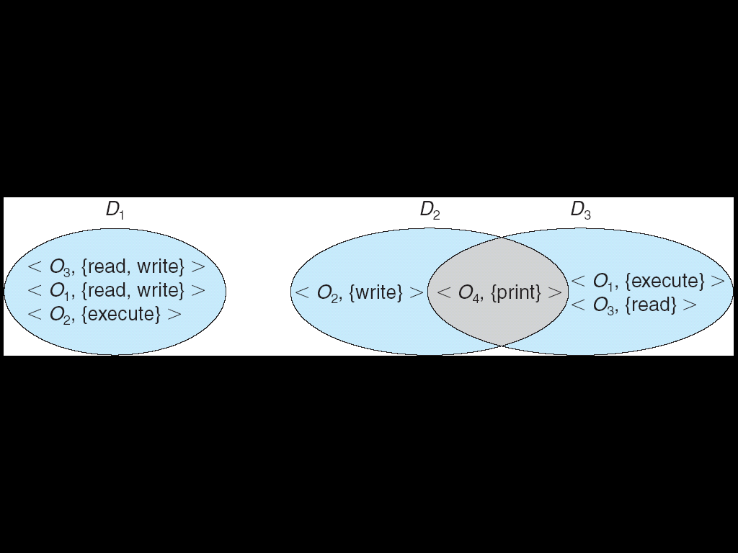
14.3.1 Domain of protection Structure
Access-right = <object-name, rights-set>
where rights-set is a subset of all valid operations that can be performed on the object.
Domain = set of access-rights
  Each domain defines a set of objects and the types of operations that may invoke on each objects.
Figure 14.1 System with three protection domains

Slide 11
A domain can be realized in a variety ways
Each user may be a domain
  The set of objects that can be accessed depends on the identity of the user.
  Domain switching occurs when the user is changed---generally when one user logs out and another user logs in.
Each process may be a domain
  The set of objects that can be accessed depends on the identity of the process.
  Domain switching occurs when one process sends a message to another process and then waits for a response.
Each procedure may be a domain
  A procedure can be rated as a method
  The set of objects that can be accessed corresponds to the local variables defined within the procedure.
  Domain switching occurs when a procedure call is made.

Slide 12
14.3.2 Domain Implementation (UNIX)
System consists of 2 domains:
  User
  Supervisor
UNIX
  Domain = user-id
  Domain switch accomplished via file system.
    Each file has associated with it a domain bit (setuid bit).
    When file is executed and setuid = on, then user-id is set to owner of the file being executed. When execution completes user-id is reset.
    当一个用户A运行另一个用户B的程序P，若程序P的 setuid = on，则用户A在执行程序P时就有了用户B的权限；
    Setuid应该由用户B修改；

Slide 13
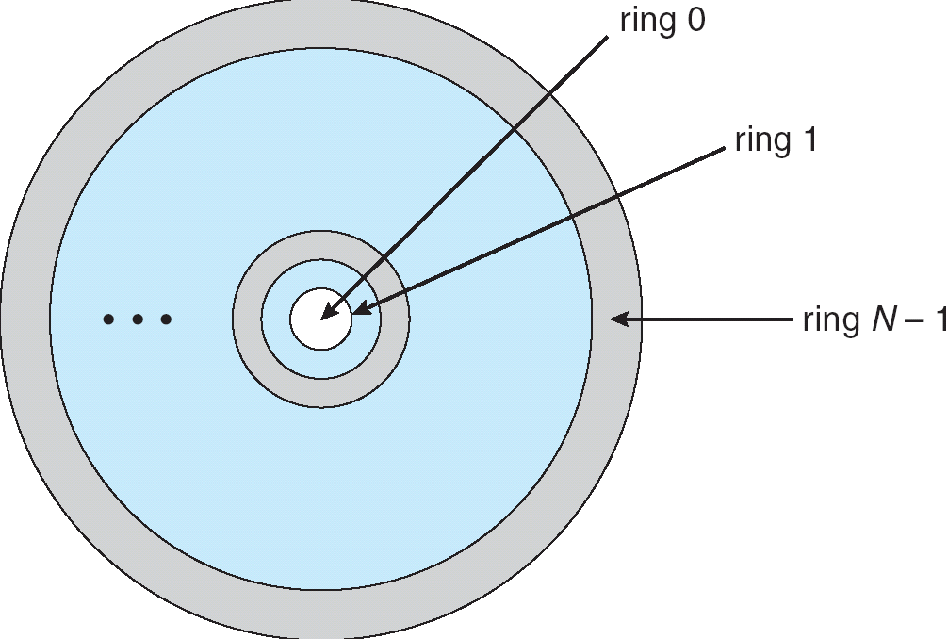
14.3.3 Domain Implementation (MULTICS)
Let D_{i} and D_{j} be any two domain rings.
If j < I ⇒ D_{i} ⊆ D_{j}
在保护域D₀中运行的进程拥有最高的权限；
Figure 14.2 MULTICS ring structure

Slide 14
14.4 Access Matrix
View protection as a matrix (access matrix)
Rows represent domains
Columns represent objects
Entry access(i, j) is the set of operations that a process executing in Domain D_{i} can invoke on Object O_{j}

Slide 15
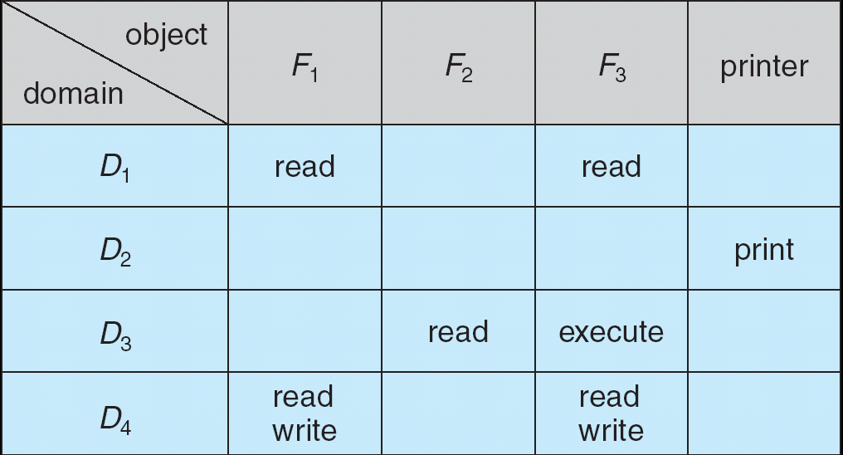
Access Matrix
Figure 14.3 Access matrix

Slide 16
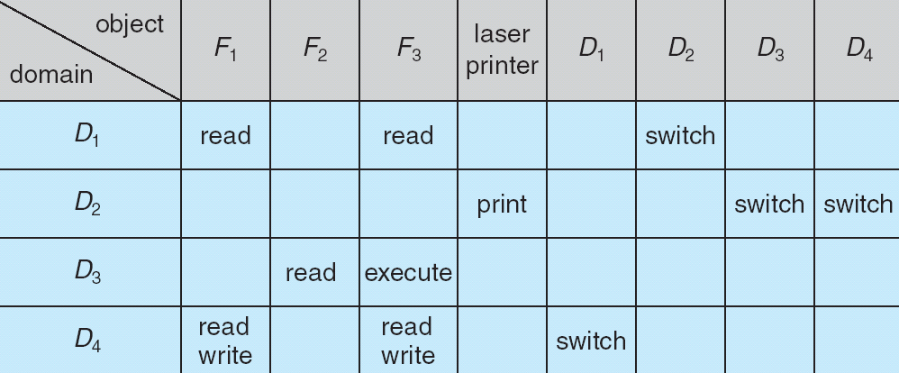
Access Matrix
Figure 14.4 Access matrix of Figure 14.3 with domains as objects

Slide 17
Use of Access Matrix
If a process in Domain D_{i} tries to do “op” on object O_{j}, then “op” must be in the access matrix.
Can be expanded to dynamic protection.
  Operations to add, delete access rights.
  Special access rights:
    copy op from D_{i} to D_{j} （将在域D_{i}中对O_{k} 的访问权限复制到域D_{j}中）
    owner of O_{i} （ O_{i}的属主可以授予其它域对O_{i}的访问权限，或收回所授的权限）
      （如UNIX中，文件主利用chmod可以修改文件的访问权限）
    control – D_{i} can modify D_{j} access rights
      (root用户可修改其他用户对文件的文件)
    switch – switch from domain D_{i} to D_{j}

Slide 18
Use of Access Matrix (Cont.)
Access matrix design separates mechanism from policy.
  Mechanism
    Operating system provides access-matrix + rules.
    If ensures that the matrix is only manipulated by authorized agents and that rules are strictly enforced.
  Policy
    User dictates policy.
    Who can access what object and in what mode.

Slide 19
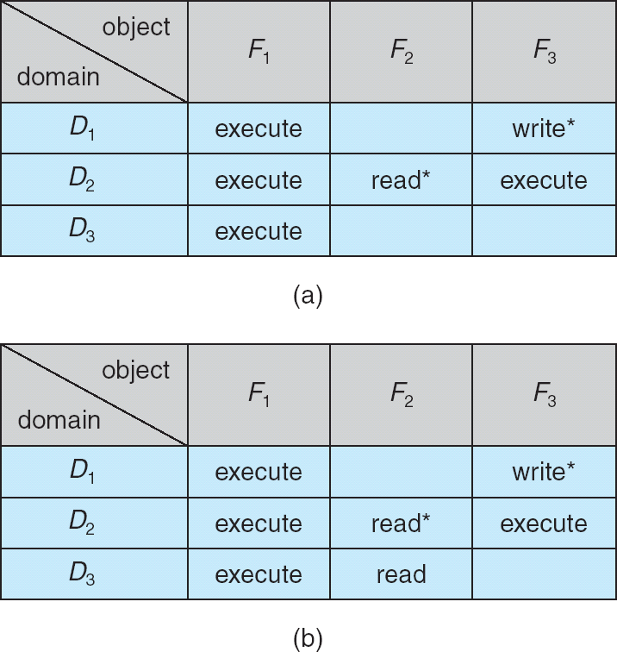
Access Matrix with Copy Rights
Copy：（*）
在保护域D2中运行的进程，可以复制对F2的read权限到其它域中(如(b)所示，D2中运行的进程复制对F2的read权限到D3中)；
在保护域D1中运行的进程，也可以复制对F3的write权限到其它域中；
其他变种：
权限的转移：当权限复制后，删除原来保护域中的相应的权限；
权限的传播限制：仅复制R，而不是R*，以防权限进一步扩散；
Figure 14.5 Access matrix with copy rights

Slide 20
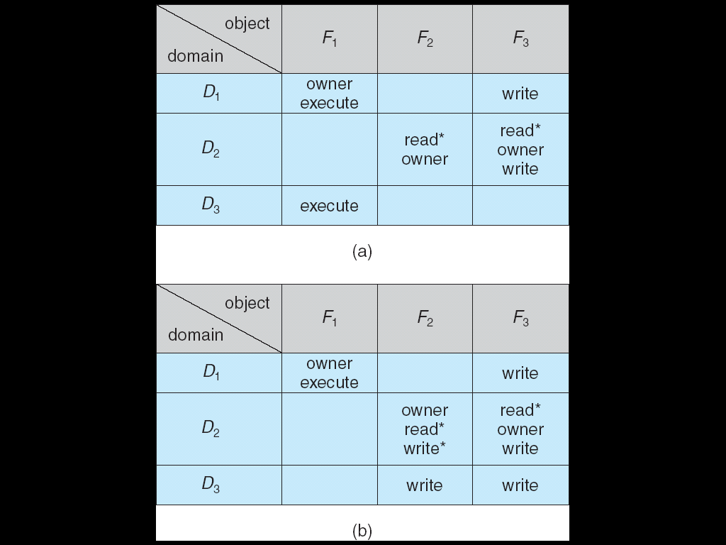
Access Matrix With Owner Rights
Owner：
在保护域D1中运行的进程，由于是对象F1的所有者（Owner），可以授予其它域对F1的访问权限，或收回其相应的权限(D3,收回)；
图示：对象F1的owner收回D3对它的访问权限。
Figure 14.6 Access matrix with owner rights

Slide 21
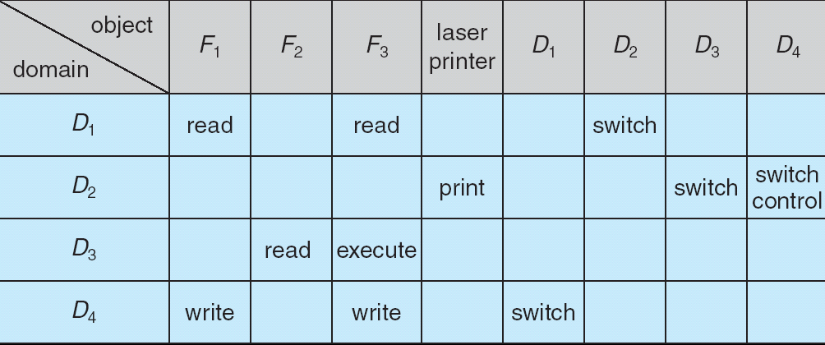
Modified Access Matrix of Figure 14.4
Access Matrix With control Rights
Control－在保护域D₂中运行的进程，可以修改D₄中对各对象的访问权限；
Figure 14.7 Modified access matrix of Figure 14.4

Slide 22
Modified Access Matrix of Figure 14.4
Access Matrix With control Rights
Switch:在保护域D2中运行的进程，可以切换到D3及D4域中；
Figure 14.4 Access matrix of Figure 14.3 with domains as objects

Slide 23
14.5 Implementation of Access Matrix
Global table
Each column = Access-control list for one object (ACL,AL)
Each Row = Capability List (like a key)

Slide 24

14.5.1 Global Table
Global table
  Consisting of a set of order triples <domain, object, right-set>;
  Whenever an operation M is executed on an object O_{j}, the global table is searched for a triple <D_{i},O_{j},R_{k}> with M R_{k}
    if this triple is found, the operation is allowed to continue;
    Otherwise, an exception condition is raised.
  Drawbacks
    The table is usually lager and thus cannot be kept in main memory, additional I/O is needed;
    It is difficult to take advantage of special groupings of objects or domains.
    (e.g. if everyone can read a particular objects, it must have a separate entry in every domain)

Slide 25
14.5.2 Access Lists for Objects
14.5.3 Capability List for Domains
Global table
Each column = Access-control list for one object (ACL,AL)
Defines who can perform what operation.
Domain 1 = Read, Write
Domain 2 = Read
Domain 3 = Read

Each Row = Capability List (like a key)
For each domain, what operations allowed on what objects.
      Object 1 – Read
      Object 4 – Read, Write, Execute
      Object 5 – Read, Write, Delete, Copy

Slide 26
ACL in Windows NT
Domain switch
  用户之间的切换（人工）
  运行态之间的切换（系统调用）

Slide 27

Windows XP Access-control List Management

Slide 28
14.6 Access Control
Protection can be applied to non-file resources
Solaris 10 provides role-based access control （RBAC）to implement least privilege
  Privilege is right to execute system call or use an option within a system call
  Can be assigned to processes
  Users assigned roles granting access to privileges and programs

Slide 29
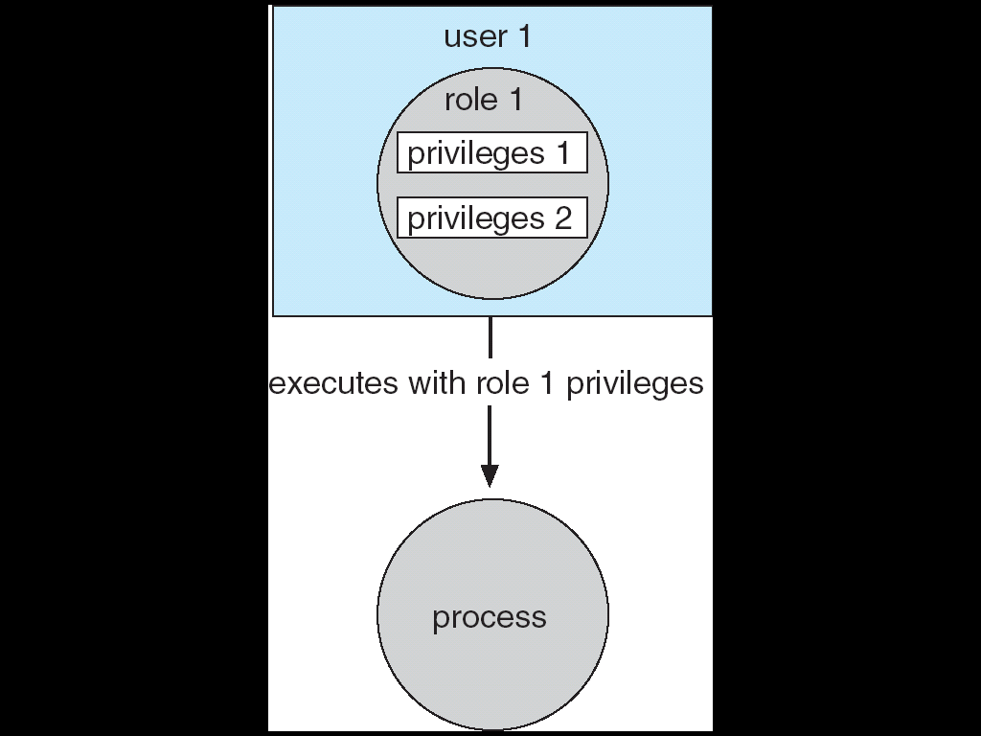
Role-based Access Control in Solaris 10

Slide 30
14.7 Revocation of Access Rights
Access List – Delete access rights from access list.
  Simple
  Immediate
Capability List – Scheme required to locate capability in the system before capability can be revoked.
  Reacquisition
  Back-pointers
  Indirection
  Keys

Slide 31
14.8 Capability-Based Systems
Hydra
  Fixed set of access rights known to and interpreted by the system.
  Interpretation of user-defined rights performed solely by user's program; system provides access protection for use of these rights.
Cambridge CAP System
  Data capability - provides standard read, write, execute of individual storage segments associated with object.
  Software capability -interpretation left to the subsystem, through its protected procedures.

Slide 32
14.9 Language-Based Protection
Specification of protection in a programming language allows the high-level description of policies for the allocation and use of resources.
Language implementation can provide software for protection enforcement when automatic hardware-supported checking is unavailable.
Interpret protection specifications to generate calls on whatever protection system is provided by the hardware and the operating system.

Slide 33
14.9.1 Compiler-Based Enforcement
Specifying the desired control of access to a shared resource in a system is making a declarative statement about the resource.
This kind of statement can be integrated into a language by an extension of its typing facility.
When protection is declared along with data typing, the designer of each subsystem can specify its requirements for protection, as well as its need for use of other resources in a system.
Such specification should be given directly as a program is composed, and in the language in which the program itself is stated.

Slide 34
14.9.2 Protection in Java 2
Protection is handled by the Java Virtual Machine (JVM)
A class is assigned a protection domain when it is loaded by the JVM.
The protection domain indicates what operations the class can (and cannot) perform.
If a library method is invoked that performs a privileged operation, the stack is inspected to ensure the operation can be performed by the library.

Slide 35
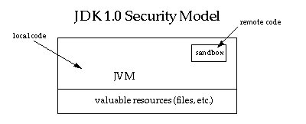
JDK1.0 安全保护模型
The original security model provided by the Java platform is known as the sandbox model, which existed in order to provide a very restricted environment in which to run untrusted code obtained from the open network.
The essence of the sandbox model is that
  local code is trusted to have full access to vital system resources (such as the file system)
  while downloaded remote code (an applet) is not trusted and can access only the limited resources provided inside the sandbox.
  This sandbox model is illustrated in the figure below.

Slide 36
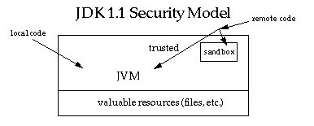
JDK1.1 安全保护模型
jdk1.0中如此严格的安全机制也给程序的功能扩展带来障碍
例如当用户希望远程代码访问本地系统的文件时候，就无法实现。
因此在后续的 Java1.1 版本中，针对安全机制做了改进，增加了安全策略，允许用户指定代码对本地资源的访问权限。

Slide 37
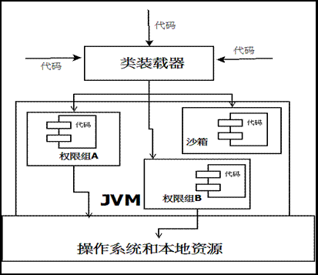
JDK1.2 安全保护模型
在 Java1.2 版本中，再次改进了安全机制，增加了代码签名。
不论本地代码或是远程代码，都会按照用户的安全策略设定，由类加载器加载到虚拟机中权限不同的运行空间，来实现差异化的代码执行权限控制。

Slide 38
New Protection Mechanisms in JAVA
A fundamental concept and important building block of system security is the protection domain
A domain can be scoped by the set of objects that are currently directly accessible by a principal, where a principal is an entity in the computer system to which permissions (and as a result, accountability) are granted.
The sandbox utilized in JDK 1.0 is one example of a protection domain with a fixed boundary.
Protection domains generally fall into two distinct categories:
  system domain
  application domain.
It is important that all protected external resources, such as the file system, the networking facility, and the screen and keyboard, be accessible only via system domains.

Slide 39
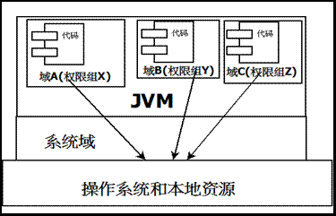
security model

Slide 40
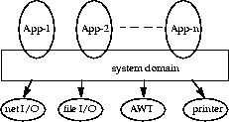
New Protection Mechanisms in JAVA (Cont.)
The domain composition of a Java application environment.

Slide 41
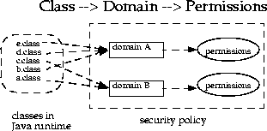
mapping from code to protection domains
A domain conceptually encloses a set of classes whose instances are granted the same set of permissions.
Protection domains are determined by the policy currently in effect.
The Java application environment maintains a mapping from code (classes and instances) to their protection domains and then to their permissions.

Slide 42
Traversing multiple protection domains
A thread of execution may occur completely within a single protection domain or may involve an application domain and also the system domain.
application domain --> system domain
  an application that prints a message out will have to interact with the system domain that is the only access point to an output stream.
  In this case, it is crucial that at any time the application domain does not gain additional permissions by calling the system domain. Otherwise, there can be serious security implications.
system domain --> application domain
  In the reverse situation where a system domain invokes a method from an application domain, such as when the AWT system domain calls an applet's paint method to display the applet
  It is again crucial that at any time the effective access rights are the same as current rights enabled in the application domain.

Slide 43
Traversing multiple protection domains (cont.)
In other words, a less "powerful" domain cannot gain additional permissions as a result of calling or being called by a more powerful domain.
Each domain (system or application) may also implement additional protection of its internal resources within its own domain boundary.

Slide 44
doPrivileged() method
The doPrivileged() method enables a piece of trusted code to temporarily enable access to more resources than are available directly to the application that called it.
This is necessary in some situations. For example,
  an application may not be allowed direct access to files that contain fonts, but the system utility to display a document must obtain those fonts, on behalf of the user.
  providing the doPrivileged() method for the system domain to deal with this situation, and the method is in fact available to all domains.

Slide 45
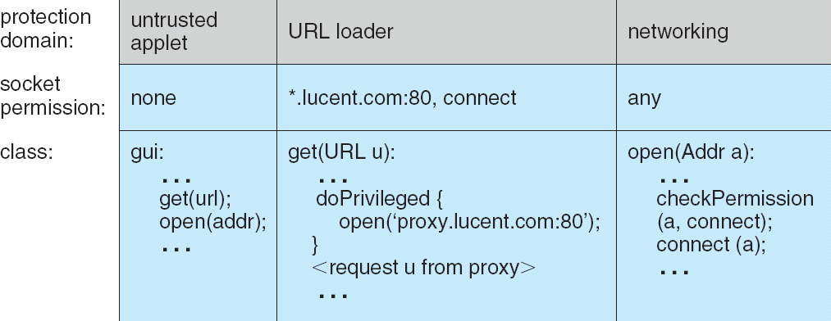
Stack Inspection

Slide 46
作业
P556：5，6，9，12，13，14
概念
  须知原则
  保护域
  RBAC
访问控制矩阵及其实现方法，每种方法的思想及特点。

Slide 47
End of Chapter 14

