Slide 1
Chapter 15: Security

Slide 2
Chapter 15: Security
The Security Problem
Program Threats
System and Network Threats
Cryptography as a Security Tool
User Authentication
Implementing Security Defenses
Firewalling to Protect Systems and Networks
Computer-Security Classifications
An Example: Windows XP

Slide 3
Objectives
To discuss security threats and attacks
To explain the fundamentals of encryption, authentication, and hashing
To examine the uses of cryptography in computing
To describe the various countermeasures to security attacks

Slide 4
保护与安全
保护
  保护系统的资源不被合法用户滥用（误用）；
  是保护系统的资源被合法的用户正确使用，不被用户有意或恶意地违反相应的约束；
  保证系统中活动的程序组件只能以规定的策略、一致的方式使用系统的资源；
  保护的主要手段：
    授权；
安全
  防止非法用户侵入计算机系统而使信息泄密或造成系统的损坏
  安全的主要手段：
    用户身份认证
    入侵检测（IDS）
    病毒检测；
    数据加密等；

Slide 5
计算机系统的安全
类比
  国家（社会） vs. 计算机系统
社会的安全
  对外来人口要严加管理，进行身份认证；
  防止阶级敌人、特务或基地组织搞破坏；
  偶然因素对系统的破坏；
计算机系统的安全
  身份认证；
  入侵及病毒检测；
  数据加密技术等；
  很难，但必须采取措施加以控制；

Slide 6
15.1 The Security Problem
Security must consider external environment of the system, and protect the system resources from:
  unauthorized access. (未经授权的访问)
  malicious modification or destruction
  accidental introduction of inconsistency.
Intruders (crackers) attempt to breach security
Threat is potential security violation
Attack is attempt to breach security
Attack can be accidental or malicious
Easier to protect against accidental than malicious misuse

Slide 7
Security Violations
Categories
  Breach of confidentiality
  Breach of integrity
  Breach of availability
  Theft of service
  Denial of service
Methods
  Masquerading (breach authentication)
  Replay attack
    Message modification
  Man-in-the-middle attack
  Session hijacking

Slide 8
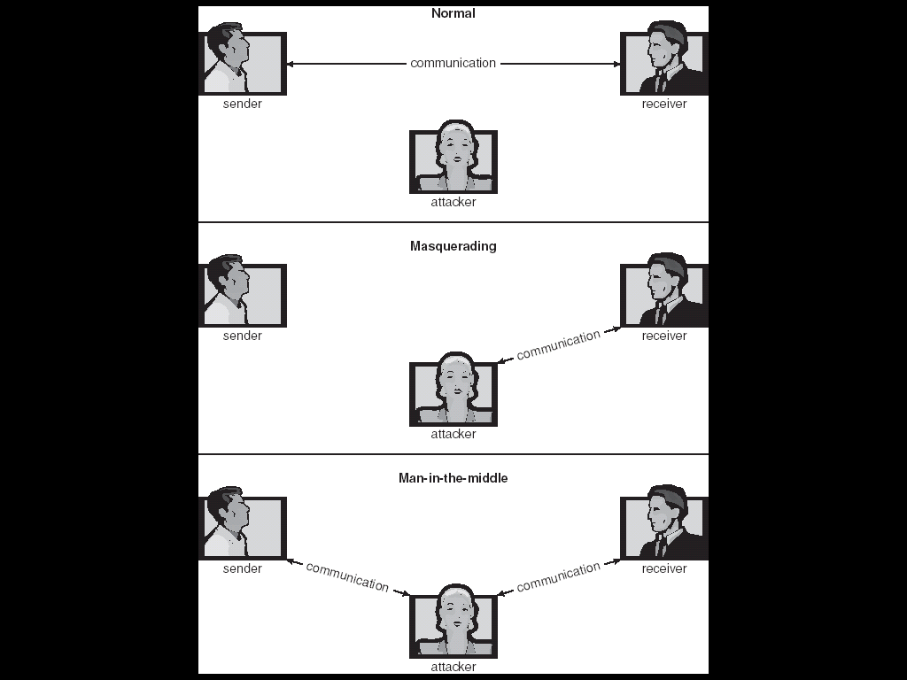
Standard Security Attacks

Slide 9
Security Measure Levels
Security must occur at four levels to be effective:
  Physical
  Human
    Avoid social engineering, phishing, dumpster diving
  Operating System
  Network
Security is as weak as the weakest chain

Slide 10
15.2 Program Threats
Trojan Horse
  Code segment that misuses its environment
  Exploits mechanisms for allowing programs written by users to be executed by other users
  Spyware, pop-up browser windows, covert channels
Trap Door
  Specific user identifier or password that circumvents normal security procedures
  Could be included in a compiler
Logic Bomb
  Program that initiates a security incident under certain circumstances
Stack and Buffer Overflow
  Exploits a bug in a program (overflow either the stack or memory buffers)

Slide 11
15.2.1 Trojan Horse
Facts
  一个用户可以运行其他用户编写的程序；
  有可能发生误用或其它一些不可预知的行为；
    有些病毒仅仅是程序员编写了一些程序，存在bug，后成为病毒
Trojan Horse
  Code segment that misuses its environment.
  Exploits mechanisms for allowing programs written by users to be executed by other users.
  Spyware, pop-up browser windows, covert channels
  UNIX中，为了方便安全域之间的切换，设置了一个set-uid位
    若该位是关闭的，则程序运行期间对资源的访问权限是运行该文件的用户所具有的权限；
    若该位是开启的，则程序运行期间对资源的访问权限是文件主所具有的权限；
    若一个普通用户运行一个set-uid位开启的、由root创建的文件，则可能导致系统资源的误用；
  窃取系统及用户信息，例如用户的密码；

Slide 12
15.2.2 Trap Door
Trap Door
  The designer of a program might leave a hole in the software that only she is capable of using.
  Specific user identifier or password that circumvents normal security procedures.
  Could be included in a compiler.
  有些超市工作人员在收费及转帐软件上开后门；
  有的软件开发者在系统中设置程序的运行次数；
  军事上需要自主开发网络设备；
  有一个时期政府禁用某一机型；
  政府也担心windwos开后门，意图推广Linux

Slide 13
15.2.3 Logic Bomb
Consider a program that initiates a security incident only under certain circumstances.
It would be hard to detect because under normal operations, there would be no security hole. However, when a predefined set of parameters were met, the security hole would be created.
This scenario is known as a logic bomb.
A programmer, for example, might write code to detect if she is still
employed; if that check failed, a daemon could be spawned to allow remote access, or code could be launched to cause damage to the site.

Slide 14
15.2.4 Stack and Buffer Overflow
Stack and Buffer Overflow
  Exploits a bug in a program (overflow either the stack or memory buffers.)
  利用系统的一个缺陷，程序返回时返回到攻击者的代码，从而对系统实施攻击；
Mobile code
  Mobile agent
    减少网络的通信量；
    Google声称使用了该技术；
    …
  一个agent若是一段恶意代码，攻击威力更强；
  当一个agent到某地运行时，本地需要对agent进行认证；

Slide 15
C Program with Buffer-overflow Condition
#include <stdio.h>
#define BUFFER SIZE 256
int main(int argc, char *argv[])
{
char buffer[BUFFER SIZE];
if (argc < 2)
return -1;
else {
strcpy(buffer,argv[1]);
return 0;
}
}

Slide 16
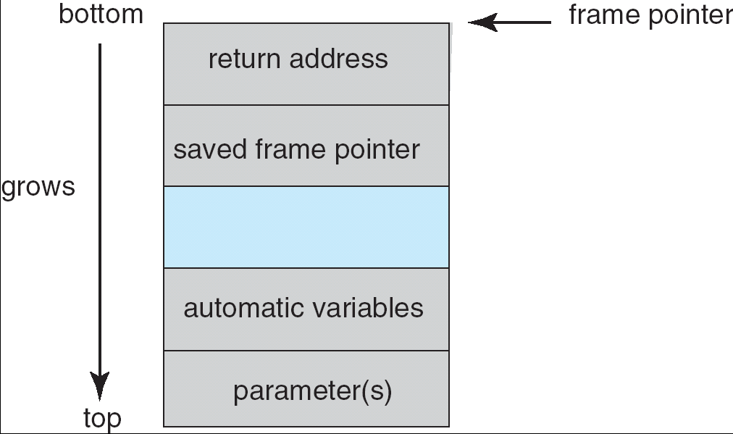
Layout of Typical Stack Frame

Slide 17
Modified Shell Code
#include <stdio.h>
int main(int argc, char *argv[])
{
execvp(‘‘\bin\sh’’,‘‘\bin \sh’’, NULL);
return 0;
}

Slide 18
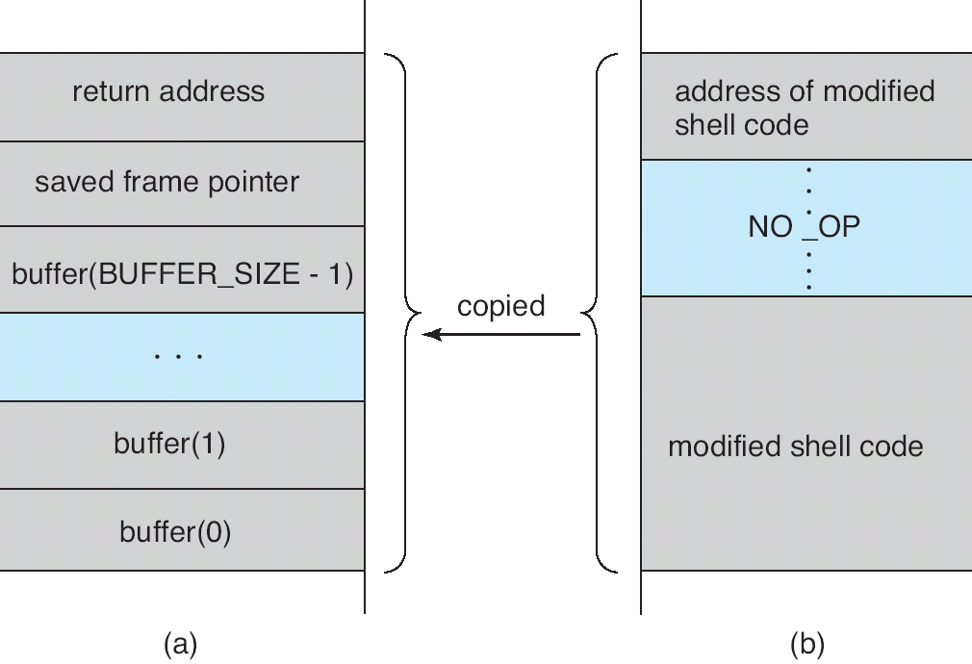
Hypothetical Stack Frame
Before attack
After attack

Slide 19
15.2.5 Viruses
Viruses
  Code fragment embedded in legitimate program
  Very specific to CPU architecture, operating system, applications
  Usually borne via email or as a macro
    Visual Basic Macro to reformat hard drive
      Sub AutoOpen()
      Dim oFS
      Set oFS = CreateObject(’’Scripting.FileSystemObject’’)
      vs = Shell(’’c:command.com /k format c:’’,vbHide)
      End Sub

Slide 20
Viruses (Cont.)
Virus dropper inserts virus onto the system
Many categories of viruses, literally many thousands of viruses
  File
  Boot
  Macro
  Source code
  Polymorphic
  Encrypted
  Stealth
  Tunneling
  Multipartite
  Armored

Slide 21
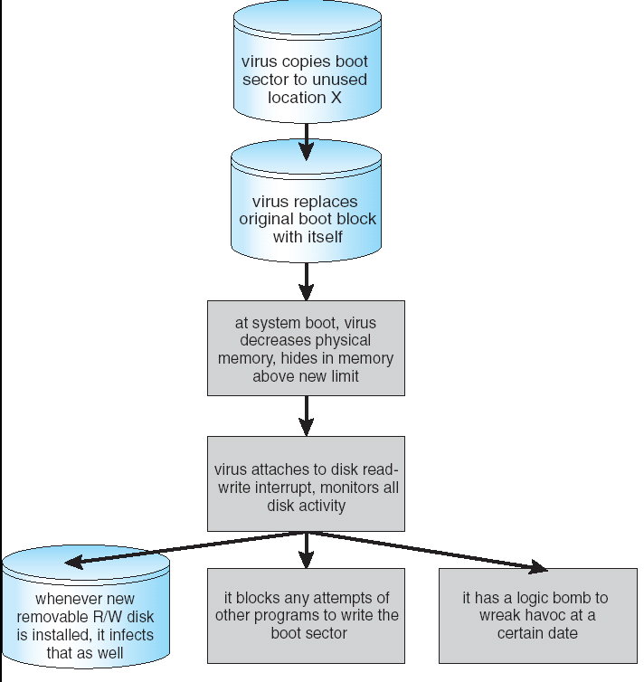
A Boot-sector Computer Virus

Slide 22
15.3 System and Network Threats
OS提供了创建子进程（线程）的机制，使进程并发执行，提高了系统的利用率；
Problems
  病毒可以利用该机制大量繁殖；

Slide 23
15.3.1, 15.3.2, 15.3.3
Worms – use spawn mechanism; standalone program
Worm大量产生自身的拷贝，耗尽系统资源，甚至可能让其它进程都停止使用系统；
Internet worm
  Exploited UNIX networking features (remote access) and bugs in finger and sendmail programs
  Grappling hook program uploaded main worm program
Port scanning
  Automated attempt to connect to a range of ports on one or a range of IP addresses
Denial of Service
  Overload the targeted computer preventing it from doing any useful work
  Distributed denial-of-service (DDOS) come from multiple sites at once

Slide 24
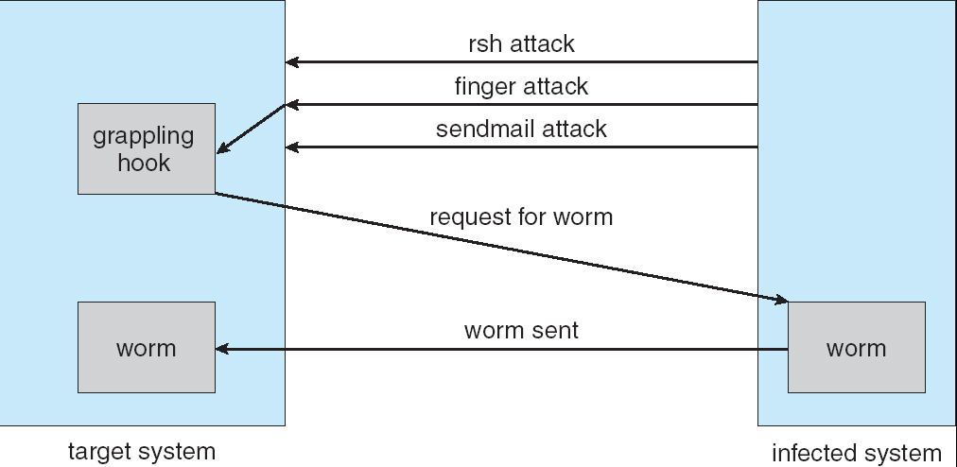
The Morris Internet Worm

Slide 25
15.4 Cryptography as a Security Tool
Broadest security tool available
  Source and destination of messages cannot be trusted without cryptography
  Means to constrain potential senders (sources) and / or receivers (destinations) of messages
Based on secrets (keys)

Slide 26
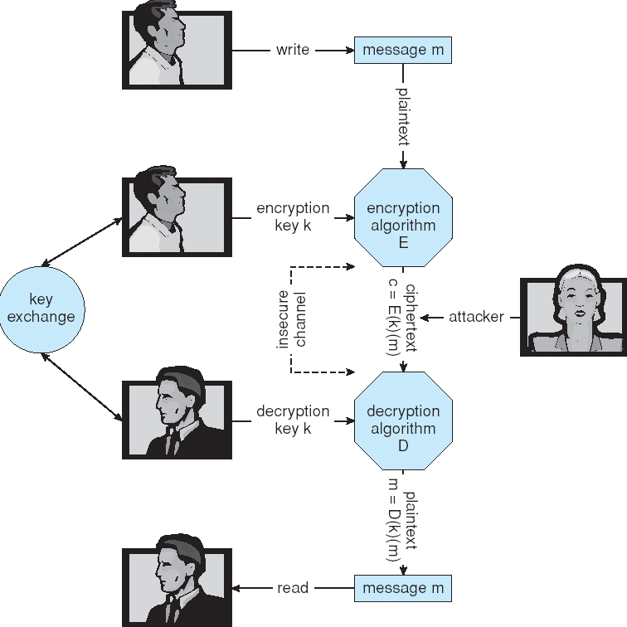
Secure Communication over Insecure Medium

Slide 27
15.4.1 Encryption
Encryption algorithm consists of
  Set of K keys
  Set of M Messages
  Set of C ciphertexts (encrypted messages)
  A function E : K → (M→C). That is, for each k ∈ K, E(k) is a function for generating ciphertexts from messages.
    Both E and E(k) for any k should be efficiently computable functions.
  A function D : K → (C → M). That is, for each k ∈ K, D(k) is a function for generating messages from ciphertexts.
    Both D and D(k) for any k should be efficiently computable functions.
An encryption algorithm must provide this essential property: Given a ciphertext c ∈ C, a computer can compute m such that E(k)(m) = c only if it possesses D(k).
  Thus, a computer holding D(k) can decrypt ciphertexts to the plaintexts used to produce them, but a computer not holding D(k) cannot decrypt ciphertexts.
  Since ciphertexts are generally exposed (for example, sent on the network), it is important that it be infeasible to derive D(k) from the ciphertexts

Slide 28
15.4.1.1 Symmetric Encryption
Same key used to encrypt and decrypt
  E(k) can be derived from D(k), and vice versa
DES is most commonly used symmetric block-encryption algorithm (created by US Govt)
  Encrypts a block of data at a time
Triple-DES considered more secure
Advanced Encryption Standard (AES), twofish up and coming
RC4 is most common symmetric stream cipher, but known to have vulnerabilities
  Encrypts/decrypts a stream of bytes (i.e wireless transmission)
  Key is a input to psuedo-random-bit generator
    Generates an infinite keystream

Slide 29
15.4.1.2 Asymmetric Encryption
Public-key encryption based on each user having two keys:
  public key – published key used to encrypt data
  private key – key known only to individual user used to decrypt data
Must be an encryption scheme that can be made public without making it easy to figure out the decryption scheme
  Most common is RSA block cipher
  Efficient algorithm for testing whether or not a number is prime
  No efficient algorithm is know for finding the prime factors of a number

Slide 30
Asymmetric Encryption (Cont.)
Formally, it is computationally infeasible to derive D(k_{d} , N) from E(k_{e} , N), and so E(k_{e} , N) need not be kept secret and can be widely disseminated
  E(k_{e} , N) (or just k_{e}) is the public key
  D(k_{d} , N) (or just k_{d}) is the private key
  N is the product of two large, randomly chosen prime numbers p and q (for example, p and q are 512 bits each)
  Encryption algorithm is E(k_{e} , N)(m) = m^{ke} mod N, where k_{e} satisfies k_{e}k_{d} mod (p−1)(q −1) = 1
  The decryption algorithm is then D(k_{d} , N)(c) = c^{kd} mod N

Slide 31
Asymmetric Encryption Example
For example. make p = 7and q = 13
We then calculate N = 7∗13 = 91 and (p−1)(q−1) = 72
We next select k_{e} relatively prime to 72 and< 72, yielding 5
Finally,we calculate k_{d} such that k_{e}k_{d} mod 72 = 1, yielding 29
We how have our keys
  Public key, k_{e,} N = 5, 91
  Private key, k_{d} , N = 29, 91
Encrypting the message 69 with the public key results in the cyphertext 62
Cyphertext can be decoded with the private key
  Public key can be distributed in cleartext to anyone who wants to communicate with holder of public key

Slide 32
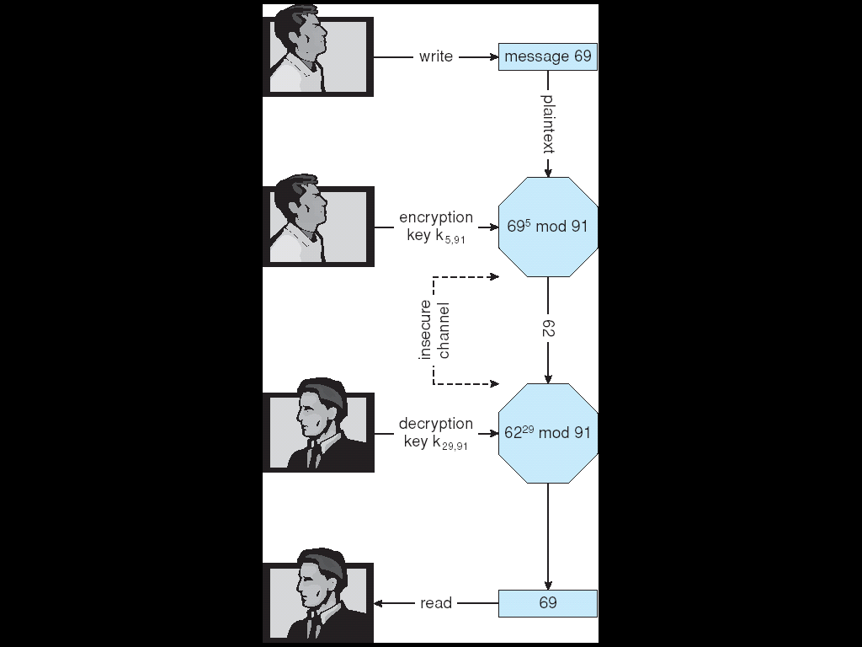
Encryption and Decryption using RSA Asymmetric Cryptography

Slide 33
Cryptography (Cont.)
Note symmetric cryptography based on transformations, asymmetric based on mathematical functions
  Asymmetric much more compute intensive
  Typically not used for bulk data encryption

Slide 34
15.4.1.3 Authentication
Constraining set of potential senders of a message
  Complementary and sometimes redundant to encryption
  Also can prove message unmodified
Algorithm components
  A set K of keys
  A set M of messages
  A set A of authenticators
  A function S : K → (M→ A)
    That is, for each k ∈ K, S(k) is a function for generating authenticators from messages
    Both S and S(k) for any k should be efficiently computable functions
  A function V : K → (M× A→ {true, false}). That is, for each k ∈ K, V(k) is a function for verifying authenticators on messages
    Both V and V(k) for any k should be efficiently computable functions

Slide 35
Authentication (Cont.)
For a message m, a computer can generate an authenticator a ∈ A such that V(k)(m, a) = true only if it possesses S(k)
Thus, computer holding S(k) can generate authenticators on messages so that any other computer possessing V(k) can verify them
Computer not holding S(k) cannot generate authenticators on messages that can be verified using V(k)
Since authenticators are generally exposed (for example, they are sent on the network with the messages themselves), it must not be feasible to derive S(k) from the authenticators

Slide 36
Authentication – Hash Functions
Basis of authentication
Creates small, fixed-size block of data (message digest, hash value) from m
Hash Function H must be collision resistant on m
  Must be infeasible to find an m’ ≠ m such that H(m) = H(m’)
If H(m) = H(m’), then m = m’
  The message has not been modified
Common message-digest functions include MD5, which produces a 128-bit hash, and SHA-1, which outputs a 160-bit hash

Slide 37
Authentication - MAC
Symmetric encryption used in message-authentication code (MAC) authentication algorithm
Simple example:
  MAC defines S(k)(m) = f (k, H(m))
    Where f is a function that is one-way on its first argument
      k cannot be derived from f (k, H(m))
    Because of the collision resistance in the hash function, reasonably assured no other message could create the same MAC
    A suitable verification algorithm is V(k)(m, a) ≡ ( f (k,m) = a)
    Note that k is needed to compute both S(k) and V(k), so anyone able to compute one can compute the other

Slide 38
Authentication – Digital Signature
Based on asymmetric keys and digital signature algorithm
Authenticators produced are digital signatures
In a digital-signature algorithm, computationally infeasible to derive S(k_{s} ) from V(k_{v})
  V is a one-way function
  Thus, k_{v} is the public key and k_{s} is the private key
Consider the RSA digital-signature algorithm
  Similar to the RSA encryption algorithm, but the key use is reversed
  Digital signature of message S(k_{s} )(m) = H(m)^{ks} mod N
  The key k_{s} again is a pair d, N, where N is the product of two large, randomly chosen prime numbers p and q
  Verification algorithm is V(k_{v})(m, a) ≡ (a^{kv} mod N = H(m))
    Where k_{v} satisfies k_{v}k_{s} mod (p − 1)(q − 1) = 1

Slide 39
Authentication (Cont.)
Why authentication if a subset of encryption?
  Fewer computations (except for RSA digital signatures)
  Authenticator usually shorter than message
  Sometimes want authentication but not confidentiality
    Signed patches et al
  Can be basis for non-repudiation

Slide 40
15.4.1.4 Key Distribution
Delivery of symmetric key is huge challenge
  Sometimes done out-of-band
Asymmetric keys can proliferate – stored on key ring
  Even asymmetric key distribution needs care – man-in-the-middle attack

Slide 41
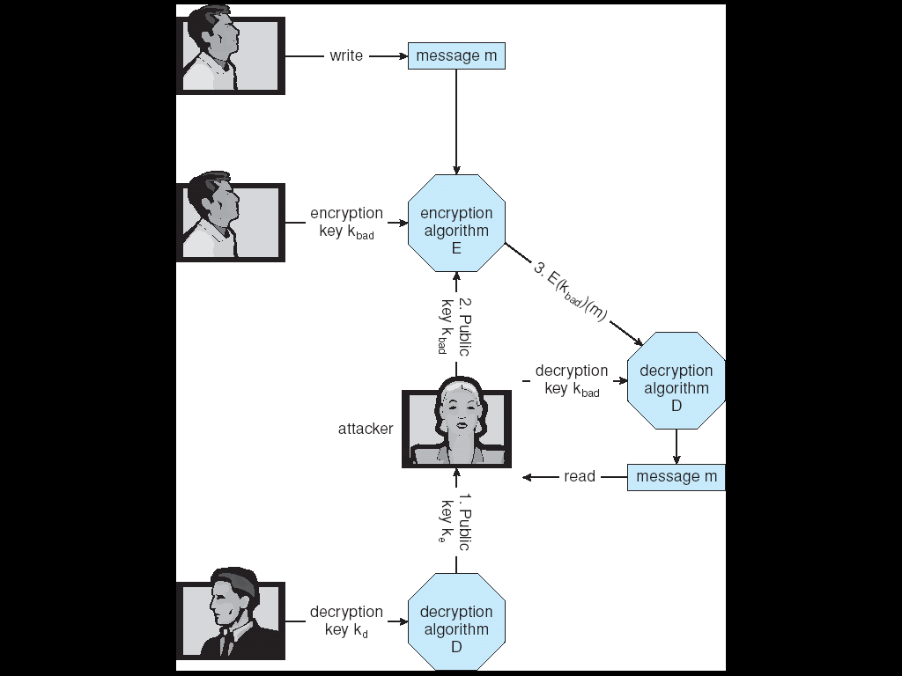
Man-in-the-middle Attack on Asymmetric Cryptography

Slide 42
Digital Certificates
Proof of who or what owns a public key
Public key digitally signed a trusted party
Trusted party receives proof of identification from entity and certifies that public key belongs to entity
Certificate authority are trusted party – their public keys included with web browser distributions
  They vouch for other authorities via digitally signing their keys, and so on

Slide 43
15.4.2 Implementation of Cryptography
ISO Reference Model
IPSec
  defines IP packet formats that allow the insertion of authenticators and the encryption of packet contents.
  It uses symmetric encryption and uses the IKE protocol for key exchange.
  Virtual private networks (VPN)

Slide 44
15.4.3 Encryption Example - SSL
Insertion of cryptography at one layer of the ISO network model (the transport layer)
SSL – Secure Socket Layer (also called TLS)
Cryptographic protocol that limits two computers to only exchange messages with each other
  Very complicated, with many variations
Used between web servers and browsers for secure communication (credit card numbers)
The server is verified with a certificate assuring client is talking to correct server
Asymmetric cryptography used to establish a secure session key (symmetric encryption) for bulk of communication during session
Communication between each computer theb uses symmetric key cryptography

Slide 45
15.5 User Authentication
Crucial to identify user correctly, as protection systems depend on user ID
User identity most often established through passwords, can be considered a special case of either keys or capabilities
  Also can include something user has and /or a user attribute
Passwords must be kept secret
  Frequent change of passwords
  Use of “non-guessable” passwords
  Log all invalid access attempts
Passwords may also either be encrypted or allowed to be used only once

Slide 46
15.6 Implementing Security Defenses
Defense in depth is most common security theory – multiple layers of security
Security policy describes what is being secured
Vulnerability assessment compares real state of system / network compared to security policy
Intrusion detection endeavors to detect attempted or successful intrusions
  Signature-based detection spots known bad patterns
  Anomaly detection spots differences from normal behavior
    Can detect zero-day attacks
  False-positives and false-negatives a problem
Virus protection
Auditing, accounting, and logging of all or specific system or network activities

Slide 47
15.7 Firewalling to Protect Systems and Networks
A network firewall is placed between trusted and untrusted hosts
  The firewall limits network access between these two security domains
Can be tunneled or spoofed
  Tunneling allows disallowed protocol to travel within allowed protocol (i.e. telnet inside of HTTP)
  Firewall rules typically based on host name or IP address which can be spoofed
Personal firewall is software layer on given host
  Can monitor / limit traffic to and from the host
Application proxy firewall understands application protocol and can control them (i.e. SMTP)
System-call firewall monitors all important system calls and apply rules to them (i.e. this program can execute that system call)

Slide 48
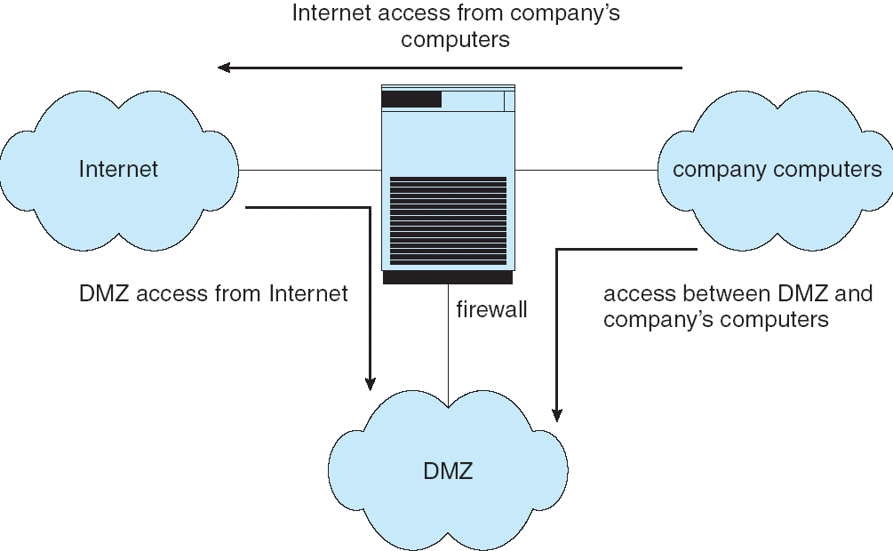
Network Security Through Domain Separation Via Firewall

Slide 49
15.8 Computer Security Classifications
U.S. Department of Defense outlines four divisions of computer security: A, B, C, and D.
D – Minimal security.
C – Provides discretionary protection through auditing. Divided into C1 and C2. C1 identifies cooperating users with the same level of protection. C2 allows user-level access control.
B – All the properties of C, however each object may have unique sensitivity labels. Divided into B1, B2, and B3.
A – Uses formal design and verification techniques to ensure security.

Slide 50
15.9 Example: Windows XP
Security is based on user accounts
  Each user has unique security ID
  Login to ID creates security access token
    Includes security ID for user, for user’s groups, and special privileges
    Every process gets copy of token
    System checks token to determine if access allowed or denied
Uses a subject model to ensure access security. A subject tracks and manages permissions for each program that a user runs
Each object in Windows XP has a security attribute defined by a security descriptor
  For example, a file has a security descriptor that indicates the access permissions for all users

Slide 51
作业
P605：2，7，11，12
什么是worm？

Slide 52
End of Chapter 15

