Slide 1
Chapter 4: Threads

Slide 2
Chapter 4: Threads
Overview
Multithreading Models
Threading Issues
Pthreads
Windows XP Threads
Linux Threads
Java Threads

Slide 3

Single and Multithreaded Processes
4.1 Overview

Slide 4
Benefits (Why thread?)
Responsiveness
  allowing a program to continue running even if parts of it is blocked or is performing a lengthy operation
Resource Sharing
  threads sharing the memory and the resources of the process to which they belong
Economy
  allocating memory and resources for process creating is constly, context switch is the same
Utilization of MP Architectures
  a single-threaded process can only run on one CPU, while threads belong to one process can run on diffrent CPUs.

Slide 5
Why threads?
OS中进程的引入
  使多个程序并发执行，改善资源利用率，提高系统的吞吐量；
OS中引入线程
  为了减少程序并发执行时所付出的时空开销，使OS具有更好的并发性；

Slide 6
Why threads
进程的两个基本特征
  可拥有资源的独立单位；
  可以独立调度和分派的基本单位；
进程的这两个基本属性，使进程成为一个能独立运行基本单位，从而构成了进程并发执行的基础；

Slide 7
Why threads
为使进程能并发执行，系统还必须提供一些相应的操作:
  创建进程
    OS需要为之分配必需的、除CPU以外的所有资源，如内存空间、I/O设备、PCB等；
  撤销进程
    回收资源，撤销PCB
  进程切换
    保留当前进程的运行环境，设置新选中的进程的运行环境；
    要花费很多额外开销；

Slide 8
Why threads
进程是一个资源的拥有者，因此在进程的创建、撤销以及切换中，系统必须为之付出很大的时空开销；
系统中所设置的进程数目不宜过多，进程切换的频率不宜过高；
限制了并发程度的进一步提高；

Slide 9
Why threads
如果将进程的两个基本属性分开
  作为调度和分派的基本单位，不同时作为独立分配资源的单位，使之轻装上阵；
  作为拥有资源的基本单位，不频繁对之进行切换；
这种观点导致了线程的产生；

Slide 10
threads
线程
  是进程的一个实体；
  是被系统独立调度和分派的基本单位；
  自己基本不拥有资源，只拥有一点在运行中必不可少的资源（e.g. 程序计数器、寄存器、栈）；
  可与同属于一个进程的其他线程共享进程所拥有的资源；
  可以创建和撤销另一个线程；
  同一进程中的多个线程可以并发执行；
  称为light-weight process
Process –heavy-weight process
  一个进程一般拥有若干线程，至少需要一个线程；
  进程不再是一个可执行的实体。

Slide 11
Thread vs. Process
调度
  传统的OS中，调度和分派的基本单位是进程，拥有资源的基本单位也是进程；
  引入线程的OS中，调度和分派的基本单位是线程，拥有资源的基本单位是进程；
  线程能轻装上阵，可显著地提高系统的并发度；
  同一进程中，线程的切换不会引起进程切换；
  不同进程中的线程之间的切换要引起进程的切换；
并发性
  引入线程的系统中，同一进程中的多个线之间可并发执行，使系统具有更好的并发性，进一步提高了资源的利用率及系统的吞吐量；
  例如web server，迅雷等

Slide 12
Thread vs. Process
拥有资源
  进程是拥有资源的独立单位；
  线程仅拥有比不可少的资源，可以访问其隶属进程的资源；例如进程的代码段、数据段及系统资源，如已打开的文件、I/O设备等，可供同一进程的线程共享；
系统开销
  系统创建及撤销进程时的开销远远大于创建及撤销线程时的开销；
  进程切换时的开销也远远大于线程切换时的开销；
  由于同一进程中的多个线程具有相同的地址空间，致使他们之间的同步和通信的实现，也变得比较容易；
  在有的OS中，线程的切换、同步和通信都无需OS内核的干预；

Slide 13
4.2 Multithreading Models
Mapping of user-level threads and kernel-level threads
Models
  Many-to-One
  One-to-One
  Many-to-Many
  Two-level

Slide 14
User Threads and Kernel Threads
类比：客户到银行接受服务
  众多客户到银行办理业务，银行职员提供相应的服务。
    客户到达银行，离开银行，可以自己协商服务顺序；
    客户之间可以进行通信交流；
    客户必须通过银行职员才能办理相应业务；
    （用户自己管理效率高，因此系统提供一些线程库来管理用户级线程）
  客户可以视为用户级线程，银行职员可以理解为核心线程；
    用户级线程的管理无需通过核心线程干预；
    用户级线程的运行需要映射到相应的核心线程才能完成；

Slide 15
User Threads and Kernel Threads
User Threads
用户级线程仅存在于用户空间中。对于这种线程的创建、 撤消、线程之间的同步与通信等功能，都无须利用系统调用来实现，而是通过用户级线程库来实现。
对于用户级线程的切换，通常是发生在一个应用进程的诸多线程之间，这时，也同样无需内核的支持，也是通过用户级线程库来管理的。
由于切换的规则远比进程调度和切换的规则简单，因而使线程的切换速度特别快。
这种线程的管理是与内核无关的。
只是当用户级线程执行时，要将线程映射到核心线程才能执行。

Slide 16
User Threads
Thread management done by user-level threads library
User-level threads are managed by a thread library, and the kernel is unaware of them.
To run on a CPU, user-level threads must ultimately be mapped to an associated kernel-level thread
  Even thouth a process could comproise of several user-level threads, the operating system sees only a single process and will not schedule the different threads of the process on separate processors.
Three primary thread libraries:
  POSIX Pthreads (for the user-level library-Pthread)
  Win32 threads (user-level library)
  Java threads (Windows,UNXI and Linux, for the user-level library)

Slide 17
Kernel Threads
系统支持线程，无论是用户进程中的线程，还是系统进程中的线程，它们的创建、撤消和切换等，都是依靠内核实现的。
在内核空间中为每一个内核支持线程设置了一个线程控制块(TCB)， 内核是根据该控制块而感知某线程的存在的，并对其加以控制。

Slide 18
Kernel Threads
Supported by the Kernel and managed by the Kernel
Examples
  Windows XP/2000
  Solaris
  Linux
  Tru64 UNIX
  Mac OS X

Slide 19

4.2.1 Many-to-One Model
e.g. In a bank,
a lot of custmers,
only one staff.

Slide 20
Many-to-One
Many user-level threads mapped to single kernel thread
  E.g. in a bank，only one clerk，and many customers
Thread management is done by the thread libray in user space.
  Efficient
  Developer can create as many user threads as necessary
  The entire process will block if a thread makes a blocking system call
  Only one thread can access the kernel at a time
    Multiple threads are unable to run in parallel on multiprocessors
Usually used on systems that do not support kernel threads.
Examples:
  Solaris Green Threads
  GNU Portable Threads

Slide 21

4.2.2 One-to-one Model
e.g. In a bank,
one staff for each custmer.

Slide 22
One-to-One
Each user-level thread maps to kernel thread
  .E.g. in a bank，each customer has her own clerk.
Provides more concurrency than many-to-one model
  Allow another thread to run when a thread makes a blocking system call
  Allow multiple threads to run in parallel on multiprocessors
Creating a user thread required creating the corresponding kernel thread
  Overhead of creating kernel threads can burden the performance of an application
  Restrict the number of threads supported by the system
Examples
  Windows 95/98/NT/2000/XP…
  Linux
  Solaris 9 and later

Slide 23

4.2.3 Many-to-Many Model
e.g. In a bank,
many custmers,
many staffs.

Slide 24
Many-to-Many Model
Multiplexes many user-level threads to a smaller or equal number of kernel threads
  Developer can create as many user threads as necessary
Allow multiple threads to run in parallel on multiprocessors
Solaris prior to version 9
Windows NT/2000 with the ThreadFiber package

Slide 25

Two-level Model
e.g. In a bank,
many custmers,
many staffs,
and a lot of staffs for VIPs.

Slide 26
Two-level Model
Similar to M:M, except that it allows a user thread to be bound to a kernel thread
Examples
  IRIX
  HP-UX
  Tru64 UNIX
  Solaris 8 and earlier

Slide 27
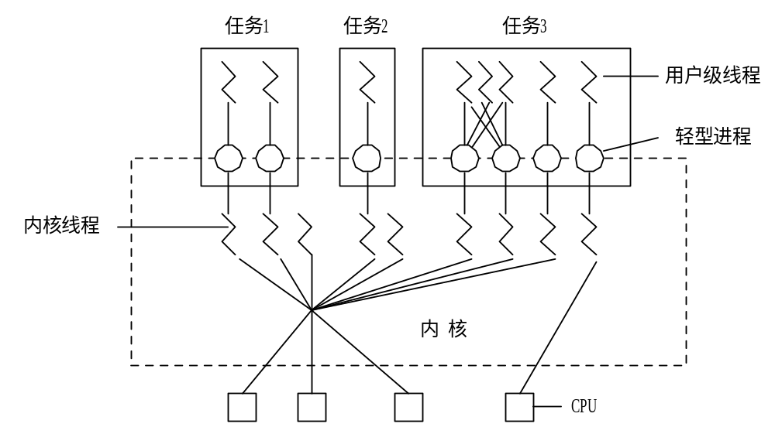
利用轻型进程作为中间系统

Slide 28
4.3 Thread libraries
A thread library provides the programmer an API for creating and managing threads.
Two ways of implementing a thread library
  Provides a library entirely in user space with no kernel support
    All code and data structures for the library exists in user space
    Invoking a function in the library results in a local call in user space and not a system call
  Provides a kernel-level library supported directly by the kernel
    All code and data structures for the library exists in kernel space
    Invoking a function in the API for the library typically results in a system call to the kernel

Slide 29
Three primary thread libraries
POSIX Pthreads (UNIX,LINUX)
  Provides either a user-level or kernel-level library
Win32 threads
  Provides kernel-level library on Windows systems
Java threads
  Allows threads creating and management directly in Java programs.
  Java thread API is typically implemented using a thread library available on the host system.
    Windows system – Win32 API
    UNIX and Linux system -- Pthreads

Slide 30
Pthreads
A POSIX standard (IEEE 1003.1c) API for thread creation and synchronization
API specifies behavior of the thread library, implementation is up to development of the library
Common in UNIX operating systems (Solaris, Linux, Mac OS X)
Page 133 figure 4.6 (next page)

Slide 31
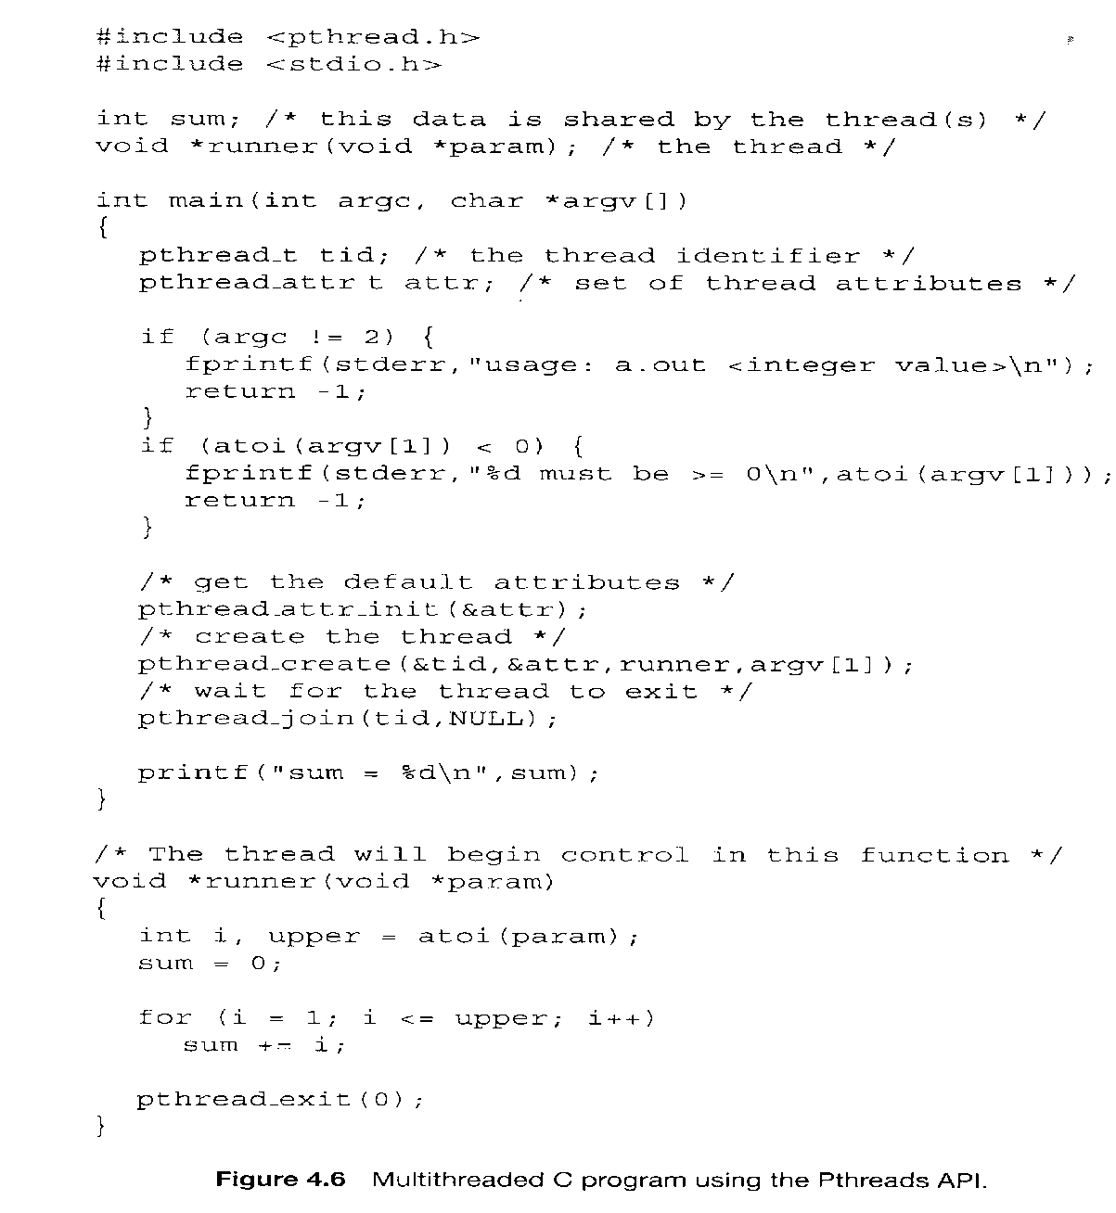
Eaxmple of pthread1
gcc -lpthread filename.c

Slide 32
Eaxmple of pthread2 (P148)
#include <pthread.h>
#include <stdio.h>
int value=0;
void *runner(void *param); /* the thread*/
int main(int argc, char *argv[])
{
int pid;
pthread_t tid;
pthread_attr_t attr;
pid=fork();
if (pid==0) { /* CHILD prcess */
pthread_attr_init(&attr);
pthread_create(&tid,&attr,runner,NULL);
pthread_join(tid,NULL); //挂起当前线程，
//切换到线程tid
printf("CHILD: value= %d \n",value);
}
else if (pid>0) { /* praent process */
wait(NULL);
printf("PARENT: value=%d\n",value);
}
}
void *runner(void *param) {
value=5;
pthread_exit(0);
}
Figure 4.11 C program for question 4. (P147 4.7)

Slide 33
Eaxmple of pthread2 (P148) (Cont.)
注意资源的继承与共享问题：
  子进程继承了父进程的变量value=0，然后分离；
  线程共享创建该线程的进程的资源，包括value；
So，the result is:
  PARENT value=0
  CHILD value=5

Slide 34
Eaxmple of pthread3
iint value=5;
void *runner1(void *param);
void *runner2(void *param);
int main(int argc, char *argv[])
{
int pid;
pthread_t tid1,tid2;
pthread_attr_t attr1,attr2;
pid=fork(); //子进程
if (pid==0) {
pthread_attr_init(&attr1);
pthread_create(&tid1,&attr1,runner1,NULL);
pthread_join(tid1,NULL);
printf("\nCHILD: Runner1: value=%d\n",value);
pthread_attr_init(&attr2);
pthread_create(&tid2,&attr2,runner2,NULL);
pthread_join(tid2,NULL);
printf("\nCHILD: Runner2: value=%d\n",value);
}
else if (pid>0) { //父进程
wait(NULL);
printf("PARENT: value=%d\n",value);
}
}
void *runner1(void *param) {
value=value+3;
pthread_exit(0);
}
void *runner2(void *param) {
value=value+11;
pthread_exit(0);
}

Slide 35
Eaxmple of pthread3 (Cont.)
facts
  子进程继承了父进程的value=5
  子进程的两个线程runner1与runner2共享子进程的变量value
因此，执行结果
  CHILD: runner1: value=8
  CHILD: runner2: value=19
  PARENT: value=5

Slide 36
Win32 Threads
CreateThread(…) API
  Page 135 figure 4.7

Slide 37
Java Threads
Java threads are managed by the JVM
Java threads may be created by:
  Extending Thread class
  Implementing the Runnable interface

Slide 38
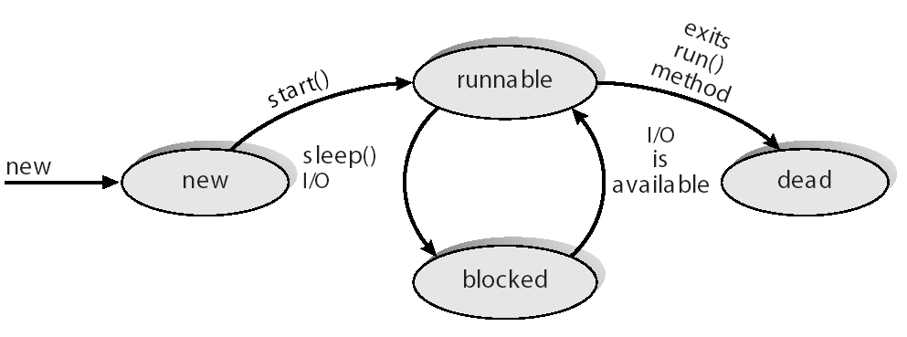
Java Thread States

Slide 39
Java Thread Management
suspend() – suspends execution of the currently running thread.
sleep() – puts the currently running thread to sleep for a specified amount of time.
resume() – resumes execution of a suspended thread.
stop() – stops execution of a thread.

Slide 40
Extending the Thread Class
class Worker1 extends Thread
{
public void run() {
System.out.println(“I am a Worker Thread”);
}
}

Slide 41
Creating the Thread
public class First
{
public static void main(String args[]) {
Worker runner = new Worker1();
runner.start();
System.out.println(“I am the main thread”);
}
}

Slide 42
The Runnable Interface
public interface Runnable
{
public abstract void run();
}

Slide 43
Implementing the Runnable Interface
class Worker2 implements Runnable
{
public void run() {
System.out.println(“I am a Worker Thread”);
}
}

Slide 44
Creating the Thread
public class Second
{
public static void main(String args[]) {
Runnable runner = new Worker2();
Thread thrd = new Thread(runner);
thrd.start();
System.out.println(“I am the main thread”);
}
}

Slide 45
Producer Consumer Problem
public class Server {
public Server() {
MessageQueue mailBox = new MessageQueue();
Producer producerThread = new Producer(mailBox);
Consumer consumerThread = new Consumer(mailBox);
producerThread.start();
consumerThread.start();
}
public static void main(String args[]) {
Server server = new Server();
}
}

Slide 46
Producer Thread
class Producer extends Thread {
public Producer(MessageQueue m) {
mbox = m;
}
public void run() {
while (true) {
// produce an item & enter it into the buffer
Date message = new Date();
mbox.send(message);
}
}
private MessageQueue mbox;
}

Slide 47
Consumer Thread
class Consumer extends Thread {
public Consumer(MessageQueue m) {
mbox = m;
}
public void run() {
while (true) {
Date message = (Date)mbox.receive();
if (message != null)
// consume the message
}
}
private MessageQueue mbox;
}

Slide 48
4.4 Threading Issues
Semantics of fork() and exec() system calls
Thread cancellation
Signal handling
Thread pools
Thread specific data
Scheduler activations

Slide 49
Semantics of fork() and exec()
Once a thread invoke the fork() system call
  duplicate all the threads in the process?
  duplicate only the thread that invoke the fork() system call? (Linux)
Once a thread invoke the exec() system call
  Replace the entire process, including all the threads in the process？
  Replace only the thread that invoke the exec() system call? (Linux)
Solution: two versions

Slide 50
Thread Cancellation
Terminating a thread before it has finished
Two general approaches:
  Asynchronous cancellation terminates the target thread immediately
  Deferred cancellation allows the target thread to periodically check if it should be cancelled

Slide 51
Signal Handling
Signals are used in UNIX systems to notify a process that a particular event has occurred
A signal handler is used to process signals
  Signal is generated by particular event
  Signal is delivered to a process
  Signal is handled
    Two possible handlers
      A default signal handler
      A user-defined signal handler
Options:
  Deliver the signal to the thread to which the signal applies
  Deliver the signal to every thread in the process
  Deliver the signal to certain threads in the process
  Assign a specific thread to receive all signals for the process

Slide 52
Thread pools
Especially used on the server, such as web server
  When a request comes, create a thread for it , and discarded once it has completed its work.
    problems
      waste time, inefficient
      unlimited threads could exhaust systems resources.
  Solution
    thread pools

Slide 53
Thread Pools
Create a number of threads in a pool where they await work
Advantages:
  Usually slightly faster to service a request with an existing thread than create a new thread
  Allows the number of threads in the application(s) to be bound to the size of the pool
抓壮丁

Slide 54
Thread Specific Data
Threads share the data of the process they belong to
Allows each thread to have its own copy of data
Useful when you do not have control over the thread creation process (i.e., when using a thread pool)

Slide 55
Scheduler Activations
Both M:M and Two-level models require communication to maintain the appropriate number of kernel threads allocated to the application
Scheduler activations provide upcalls - a communication mechanism from the kernel to the thread library
This communication allows an application to maintain the correct number kernel threads

Slide 56
Operating-System Examples
Windows XP Threads
Linux Threads

Slide 57
Windows XP Threads
Implements the one-to-one mapping
Each thread contains
  A thread id
  Register set
  Separate user and kernel stacks
  Private data storage area
The register set, stacks, and private storage area are known as the context of the threads
The primary data structures of a thread include:
  ETHREAD (executive thread block)
  KTHREAD (kernel thread block)
  TEB (thread environment block)

Slide 58
Linux Threads
Linux refers to them as tasks rather than threads
Thread creation is done through clone() system call
clone() allows a child task to share the address space of the parent task (process)

Slide 59
实验2--hints
设有二元函数 f(x,y) = f(x) + f(y)
其中：f(x) = f(x-1) * x, (x >1), 其中 f(x)=1, (x=1)
f(y) = f(y-1) + f(y-2) , (y> 2), 其中 f(y)=1 ,(y=1,2)
请编程建立 3 个并发协作进程或线程，它们分别完成 f(x,y)、f(x)、f(y)
提示：
函数f(x)与f(y)利用递归函数实现；
创建4个或5管道文件；
创建三个子进程或者三个线程，线程1向管道1写入x，然后从管道1读取x，并向管道2写入f(x)；
线程2向管道3写入y，然后从管道3读取y，并向管道4写入f(y),线程3分别从管道2、4中读出f(x)及f(y),并计算f(x,y)=f(x)+f(y)，并输出结果。
x
pipeline1
f(x)
pipeline2
f(x,y)
y
pipeline3
f(y)
pipeline4

Slide 60
实验2--hints（Cont.）
函数的递归实现：
函数：f(x) = f(x-1) * x, (x >1), 其中 f(x)=1, (x=1)
int fx(int x) {
if (x==1) return 1 else return fx(x-1)*x;
}
函数：f(y) = f(y-1) + f(y-2) , (y> 2), 其中 f(y)=1 ,(y=1,2)
int fy(int x) {
if (x==1 || x==2 ) return 1 else return fy(x-1)+fy(x-2);
}

Slide 61
实验2--hints（Cont.）
管道文件：
int pipe1[2]；
if(pipe(pipe1) < 0) { //创建一个管道文件
perror("pipe1 not create");
exit(EXIT_FAILURE);
}
//向管道文件写入一个整数x，占用一个int空间；
write(pipe1[1],&x,sizeof(int));
//从管道文件读取一个整数x，占用一个int空间；
read(pipe2[0],&x,sizeof(int));

Slide 62
homework
什么是线程？为什么要引入线程？
用户线程与核心线程之间有哪些映射模型？
P146 4,5,7,8
思考：P146
1,2,3

Slide 63
End of Chapter 4

