Slide 1
Chapter 7: Deadlocks

Slide 2
Chapter 7: Deadlocks
The Deadlock Problem
System Model
Deadlock Characterization
Methods for Handling Deadlocks
Deadlock Prevention
Deadlock Avoidance
Deadlock Detection
Recovery from Deadlock

Slide 3
Chapter Objectives
To develop a description of deadlocks, which prevent sets of concurrent processes from completing their tasks
To present a number of different methods for preventing or avoiding deadlocks in a computer system.

Slide 4
The Deadlock Problem
Deadlock: P245
A set of blocked processes each holding a resource and waiting to acquire a resource held by another process in the set.
Example
  Opusculum 开锁：黄宏、董卿、巩汉林、林永健 ；
Example
  System has 2 disk drives.
  P₁ and P₂ each hold one disk drive and each needs another one.
Example
  semaphores A and B, initialized to 1
        P₀ P₁
        wait (A); wait(B)
        wait (B); wait(A)

Slide 5
Bridge Crossing Example
Traffic only in one direction.
Each section of a bridge can be viewed as a resource.
If a deadlock occurs, it can be resolved if one car backs up (preempt resources and rollback).
Several cars may have to be backed up if a deadlock occurs.
Starvation is possible.

Slide 6
Deadlock and Starvation
Deadlock – two or more processes are waiting indefinitely for an event that can be caused by only one of the waiting processes.( signal() 可产生这些事件 )
Let S and Q be two semaphores initialized to 1
P₀ P₁
wait(S); wait(Q);
wait(Q); wait(S);
 
signal(S); signal(Q);
signal(Q) signal(S);
Starvation – indefinite blocking. A process may never be removed from the semaphore queue in which it is suspended.
(若信号量的等待队列按LIFO或优先级管理，则可能导致饥饿)
(或者就绪进程长时间得不到调度)
（或者是处于等待状态，但不是互相等待）

Slide 7
7.1 System Model
Resource types R₁, R₂, . . ., R_{m}
    CPU cycles, memory space, I/O devices
Each resource type R_{i} has W_{i} instances.
Each process utilizes a resource as follows:
  request
  use
  release

Slide 8
7.2 Deadlock Characterization
7.2.1 Necessary condition
Deadlock can arise if four conditions hold simultaneously
Mutual exclusion: only one process at a time can use a resource.
Hold and wait: a process holding at least one resource is waiting to acquire additional resources held by other processes.
No preemption: a resource can be released only voluntarily by the process holding it, after that process has completed its task.
Circular wait: there exists a set {P₀, P₁, …, P₀} of waiting processes such that P₀ is waiting for a resource that is held by P₁, P₁ is waiting for a resource that is held by
P₂, …, P_{n–1} is waiting for a resource that is held by
P_{n}, and P₀ is waiting for a resource that is held by P₀.

Slide 9
7.2.2 Resource-Allocation Graph (RAG)
A set of vertices V and a set of edges E.
V is partitioned into two types:
  P = {P₁, P₂, …, P_{n}}, the set consisting of all the processes in the system.
  R = {R₁, R₂, …, R_{m}}, the set consisting of all resource types in the system.
request edge – directed edge P₁ → R_{j}
assignment edge – directed edge R_{j} → P_{i}

Slide 10
Resource-Allocation Graph (Cont.)
Process
Resource Type with 4 instances
P_{i} requests instance of R_{j}
P_{i} is holding an instance of R_{j}
P_{i}
printf(“…”);申请打印机资源
设备的独立性 （虚拟设备）
R_{j}
P_{i}
R_{j}

Slide 11

Example of a Resource Allocation Graph

Slide 12

Resource Allocation Graph With A Deadlock

Slide 13

Graph With A Cycle But No Deadlock

Slide 14
Basic Facts
If graph contains no cycles ⇒ no deadlock.
If graph contains a cycle ⇒
  if only one instance per resource type, then deadlock.
  if several instances per resource type, possibility of deadlock.

Slide 15
例题
1、假定某计算机系统有R1设备3台，R2设备4台，它们被P1,P2,P3,P4四个进程所共享，且已知这4个进程均以下面所示的顺序使用现有设备。
￫申请R1￫申请R2￫申请R1￫释放R1￫释放R2￫释放R1￫
（1）说明系统运行过程中是否有产生死锁的可能？为什么？
（2）如果有可能的话，举出一例，并画出表示该死锁状态的进程－资源图。

Slide 16
提示
需要考察死锁的原因以及死锁的四个必要条件;
如果进程按上面所示的顺序使用现有设备，进程对资源的使用满足四个必要条件，因此有可能发生死锁。
画出RAG，给出一个死锁点
  注意：死锁的进程一定是处于阻塞状态。

Slide 17
7.3 Methods for Handling Deadlocks
Ensure that the system will never enter a deadlock state.
  Deadlock Prevention
    Restrain the ways request can be made
  Deadlock Avoidance
    Requires that the system has some additional a priori information
    available.
Allow the system to enter a deadlock state and then recover.
  Deadlock detection and recovery
Ignore the problem and pretend that deadlocks never occur in the system; used by most operating systems, including UNIX. (鸵鸟策略)

Slide 18
7.4 Deadlock Prevention
Restrain the ways request can be made.
以哲学家就餐为例。
Mutual Exclusion – not required for sharable resources; must hold for nonsharable resources.
Hold and Wait – must guarantee that whenever a process requests a resource, it does not hold any other resources.
  Require process to request and be allocated all its resources before it begins execution (资源静态分配策略）
    System calls requesting resources for a process precede all other system calls
  or allow process to request resources only when the process has none. （当进程不拥有资源时才可申请资源；当进程申请其它资源时，应该释放已经拥有的资源；进程使用完一种资源，才可以申请另一种资源）
  Problems：Low resource utilization; Starvation is possible.

Slide 19
Deadlock Prevention (Cont.)
No Preemption –
  If a process that is holding some resources requests another resource that cannot be immediately allocated to it, then all resources currently being held are released (preempted).
  （如果申请资源而未满足，则释放自己已经获得的资源）
  Preempted resources are added to the list of resources for which the process is waiting.
  Process will be restarted only when it can regain its old resources, as well as the new ones that it is requesting.
  Problems: 适用于状态可保存及恢复的资源，如CPU，Memory etc；
Circular Wait – impose a total ordering of all resource types, and require that each process requests resources in an increasing order of enumeration.
注：正向思维与逆向思维；

Slide 20
预防死锁总结
预防死锁可以采取哪些措施？说明原因。
给出一种资源分配策略，说明这种策略是否会导致死锁？为什么？可能存在什么问题？
原因说明：摒弃了死锁四个必要条件中的哪一个或哪几个。

Slide 21
例题
考虑下面的资源分配策略。进程在任何时刻都可以进行资源的请求和释放。
如果一个进程对资源进行请求时，若系统中目前没有可用的资源，系统则检查所有等待资源而被阻塞的进程。
如果这些阻塞的进程中有请求资源进程所需要的资源，则把资源从这些阻塞的进程中拿出以分配给请求资源的进程。
(1) 这种资源分配方案会出现死锁吗？为什么？
(2) 这种资源分配方案存在什么问题？

Slide 22
7.5 Deadlock Avoidance
Safe state
Imagination
Dream
邓小平关于改革开放的一句名言

Slide 23
Deadlock Avoidance
Requires that the system has some additional a priori information
available.
Simplest and most useful model requires that each process declare the maximum number of resources of each type that it may need.
The deadlock-avoidance algorithm dynamically examines the resource-allocation state to ensure that there can never be a circular-wait condition.
Resource-allocation state is defined by the number of available and allocated resources, and the maximum demands of the processes.

Slide 24
Safe State
Suppose the system is in the following state at one time, is the system in a safe sate?
Processes Maximum Allocation Need Available
p0 10 5 5 3
p1 4 2 2
p2 9 2 7
Safe sequence
  p1,p0,p2

Slide 25
Safe State
Suppose the system is in the following state at one time, is the system in a safe sate?
Processes Maximum allocation need available
p0 10 7 3 1
p1 4 2 2
p2 9 2 7
There is no any Safe sequence.
  Unsafe state

Slide 26
Safe State
When a process requests an available resource, system must decide if immediate allocation leaves the system in a safe state.
System is in safe state if there exists a sequence <P₁, P₂, …, P_{n}> of ALL the processes is the systems such that for each P_{i}, the resources that P_{i} can still request can be satisfied by currently available resources + resources held by all the P_{j}, with j < i.
That is:
  If P_{i} resource needs are not immediately available, then P_{i} can wait until all P_{j} have finished.
  When P_{j} is finished, P_{i} can obtain needed resources, execute, return allocated resources, and terminate.
  When P_{i} terminates, P_{i +1} can obtain its needed resources, and so on.

Slide 27
Basic Facts
If a system is in safe state ⇒ no deadlocks.
If a system is in unsafe state ⇒ possibility of deadlock.
Avoidance ⇒ ensure that a system will never enter an unsafe state.

Slide 28

Safe, Unsafe , Deadlock State

Slide 29
Avoidance algorithms
总体思想：当进程提出资源请求时，系统进行假分配，然后检测假分配之后的状态是否安全，如果不安全，则不满足系统的请求；否则，满足本次进程的资源请求。（摸着石头过河）
Single instance of a resource type. Use a resource-allocation graph（7.5.2）
Multiple instances of a resource type. Use the banker’s algorithm （7.5.3）

Slide 30
Resource-Allocation Graph Scheme
7.5.2 Resource-Allocation Graph Algorithm
Single instance
assignment edge R_{j} → P_{i} : resource R_{j} has assigned to process P_{i}
Claim edge P_{i} → R_{j} indicated that process P_{j} may request resource R_{j}; represented by a dashed line. (May need)
（ Claim edge-需求边）
Claim edge converts to request edge when a process requests a resource.
Request edge converted to an assignment edge when the resource is allocated to the process.
（ Request edge-请求边）
When a resource is released by a process, assignment edge reconverts to a claim edge.
Resources must be claimed a priori in the system.
  Before a process starts executing, all its claim edges must already appear in the resource-allocation graph.

Slide 31
Safe state and unsafe state in RAG Scheme
假定系统中的资源R1与R2各有一个单位的资源；
进程P1及P2均使用资源R1与R2的一个单位；

Slide 32

Resource-Allocation Graph
请求
分配
assignment edge
Request edge
将要请求
Claim edge
Claim edge
Safe state

Slide 33
Safe State In Resource-Allocation Graph
Proc. Max alloc. Need
-------------------------------
P1 2 1 1
P2 2 0 2
Available:1
Safe sequence: p1,p2
Facts:
graph contains no cycle ⇒safe state
graph contains a cycle ⇒unsafe state
Safe state

Slide 34

Unsafe State In Resource-Allocation Graph
graph contains a cycle ⇒unsafe state
Unsafe state

Slide 35
Resource-Allocation Graph Algorithm
Single instance
Suppose that process P_{i} requests a resource R_{j}
The request can be granted only if converting the request edge to an assignment edge does not result in the formation of a cycle in the resource allocation graph
假定满足请求（分配资源给请求的进程），如果出现环，则状态不安全，则不分配。否则满足请求，分配资源。
Algorithm
  Step 1: converts the relevant claim edge to the request edge.
  Step 2: if the requested resource is available, then converts the request edge to the assignment edge ,otherwise, p_{i} waits.
  Step 3: if a cycle is detected, the request should not be granted, otherwise, the request should be granted.

Slide 36

Resource-Allocation Graph Algorithm
Single instance
假定系统中的资源R1与R2各有一个单位的资源；
进程P1及P2均使用资源R1与R2的一个单位；
safe state

Slide 37
Resource-Allocation Graph For Deadlock Avoidance
Suppose that P2 requests R2 at this time, can this request be granted ?
????

Slide 38
NO.
Since it will create a cycle in the graph if P2’s request is granted , this indicates that the system is in an unsafe state.（假分配）
Discussion: when P2 requests R1, P2 will be in a blocked state, and then P2 will not still request R2.
Unsafe state

Slide 39
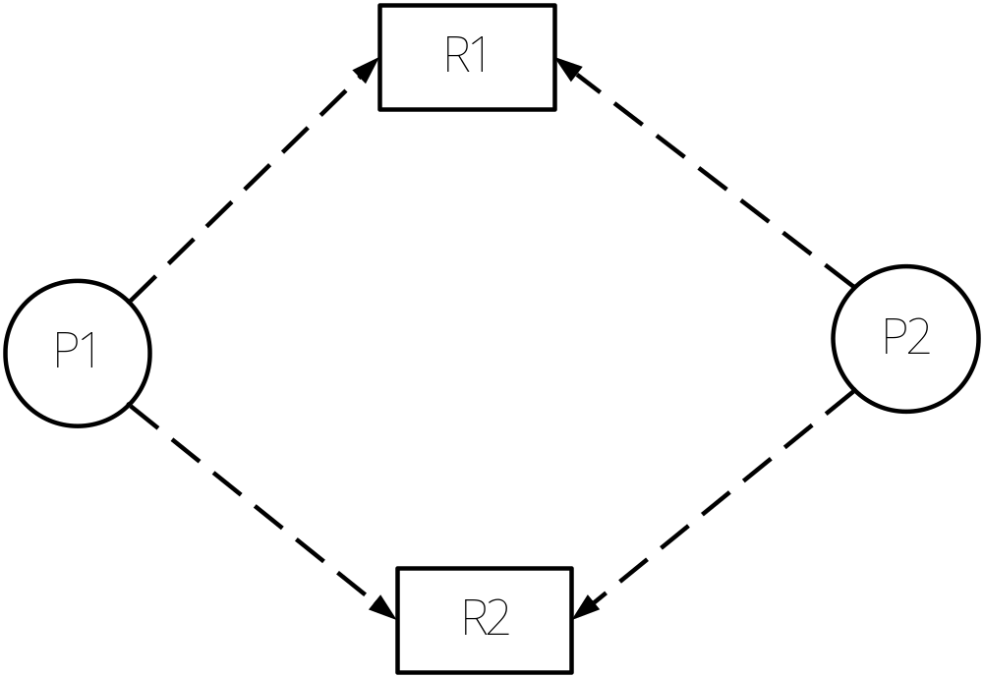
Resource-Allocation Graph For Deadlock Avoidance (Demo1)
Suppose that P1 requests R1 at this time, can this request be granted ?
可能使用，或将要请求

Slide 40
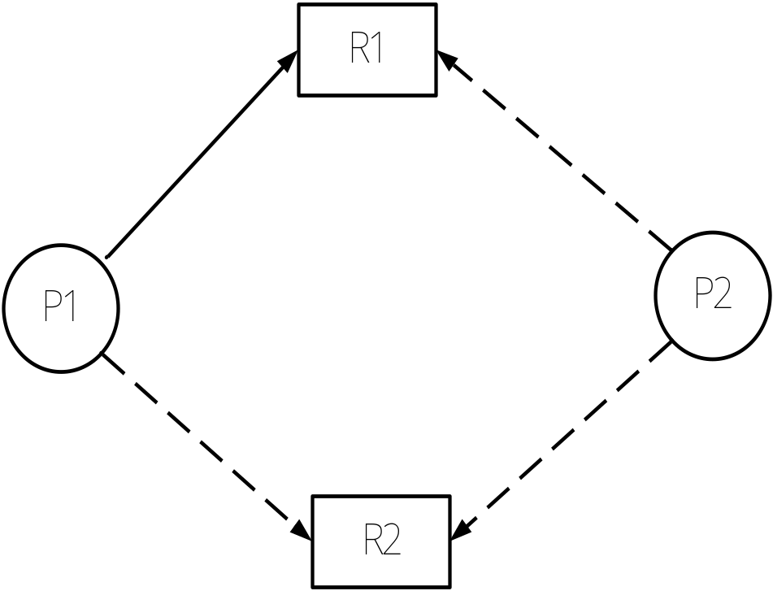
Step1
1. Converts the relevant claim edge to the request edge
系统检查是否能够满足进程的需求。
如果能够满足，进入下一步（假分配），否则进程等待。

Slide 41
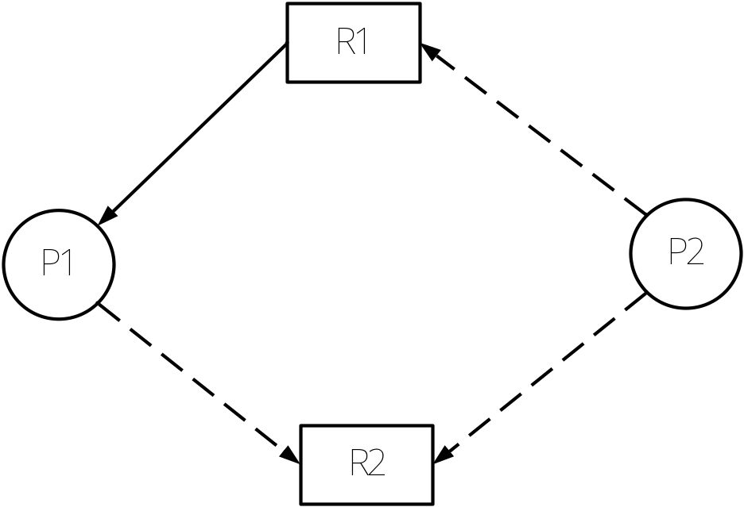
Step2
2. if the requested resource is available, then converts the request edge to the assignment edge
假分配

Slide 42
Step 3
3. If a cycle is detected, the request should not be granted, otherwise, the request should be granted.
真分配
Yes, request should be granted
(No cycle)
No cycle →safe state

Slide 43
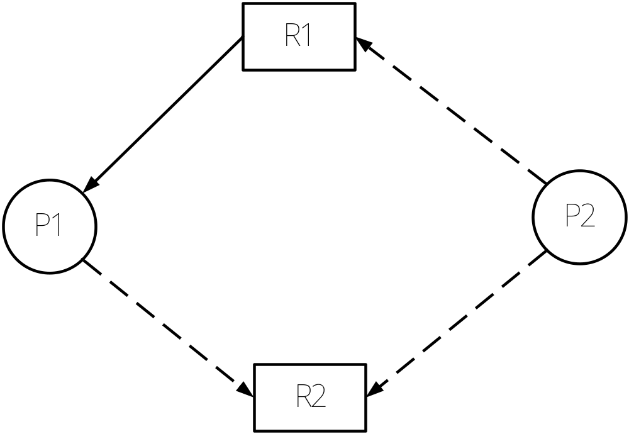
Resource-Allocation Graph For Deadlock Avoidance(Demo2)
Suppose that P2 requests R2 at this time, can this request be granted ?

Slide 44
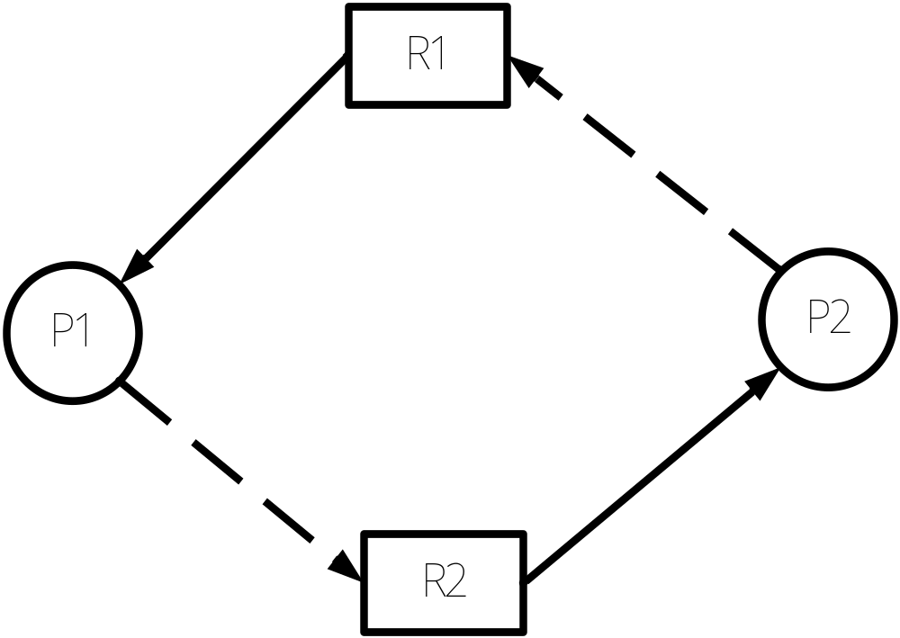
Unsafe State In Resource-Allocation Graph
No!!!
There exists a cycle =>Unsafe
假分配

Slide 45
7.5.3 Banker’s Algorithm
Multiple instances.
Each process must a priori claim maximum use.
When a process requests a resource it may have to wait.
When a process gets all its resources it must return them in a finite amount of time.

Slide 46
Data Structures for the Banker’s Algorithm
Let n = number of processes, and m = number of resources types.
Available: Vector of length m. If available [j] = k, there are k instances of resource type R_{j} available.
Max: n x m matrix. If Max [i,j] = k, then process P_{i} may request at most k instances of resource type R_{j}.
Allocation: n x m matrix. If Allocation[i,j] = k then P_{i} is currently allocated k instances of R_{j.}
Need: n x m matrix. If Need[i,j] = k, then P_{i} may need k more instances of R_{j} to complete its task.
    Need [i,j] = Max[i,j] – Allocation [i,j].

Slide 47
Safety Algorithm
1. Let Work and Finish be vectors of length m and n, respectively. Initialize:
      Work = Available
      Finish [i] = false for i = 0, 1, …, n- 1.
2. Find and i such that both:
  (a) Finish [i] = false
  (b) Need_{i} ≤ Work
  If no such i exists, go to step 4.
3. Work = Work + Allocation_{i}
Finish[i] = true
go to step 2.
4. If Finish [i] == true for all i, then the system is in a safe state.

Slide 48
Resource-Request Algorithm for Process Pi
Banker’s Algorithm
Request = request vector for process P_{i}. If Request_{i} [j] = k then process P_{i} wants k instances of resource type R_{j.}
  1. If Request_{i} ≤ Need_{i} go to step 2. Otherwise, raise error condition, since process has exceeded its maximum claim.
  2. If Request_{i} ≤ Available, go to step 3. Otherwise P_{i} must wait, since resources are not available.
  3. Pretend to allocate requested resources to P_{i} by modifying the state as follows:
      Available = Available – Request;
      Allocation_{i} = Allocation_{i} + Request_{i};
      Need_{i} = Need_{i} – Request_{i};
    If safe ⇒ the resources are allocated to Pi.
    If unsafe ⇒ Pi must wait, and the old resource-allocation state is restored

Slide 49
Example of Banker’s Algorithm
5 processes P₀ through P₄;
3 resource types:
A (10 instances), B (5instances), and C (7 instances).
Snapshot at time T₀:
Allocation Max Available
A B C A B C A B C
P₀ 0 1 0 7 5 3 3 3 2
P₁ 2 0 0 3 2 2
P₂ 3 0 2 9 0 2
P₃ 2 1 1 2 2 2
P₄ 0 0 2 4 3 3

Slide 50
Example (Cont.)
The content of the matrix Need is defined to be Max – Allocation.
Need Available
A B C A B C
P₀ 7 4 3 3 3 2
P₁ 1 2 2
P₂ 6 0 0
P₃ 0 1 1
P₄ 4 3 1
The system is in a safe state since the sequence < P₁, P₃, P₄, P₂, P₀> satisfies safety criteria.

Slide 51
或将上述状态表示成：
Allocation Need Available
A B C A B C A B C
P₀ 0 1 0 7 4 3 3 3 2
P₁ 2 0 0 1 2 2
P₂ 3 0 2 6 0 0
P₃ 2 1 1 0 1 1
P₄ 0 0 2 4 3 1
The system is in a safe state since the sequence < P₁, P₃, P₄, P₂, P₀> satisfies safety criteria.

Slide 52
Example: P₁ Request (1,0,2)
Check that Request ≤ Need₁ (that is, (1,0,2) ≤ (1,2,2 ) ⇒ true).
Check that Request ≤ Available (that is, (1,0,2) ≤ (3,3,2) ⇒ true).
Allocation Need Available
A B C A B C A B C
P₀ 0 1 0 7 4 3 2 3 0
P₁ 3 0 2 0 2 0
P₂ 3 0 2 6 0 0
P₃ 2 1 1 0 1 1
P₄ 0 0 2 4 3 1
Executing safety algorithm shows that sequence < P₁, P₃, P₄, P₀, P₂> satisfies safety requirement.
So, request for (1,0,2) by P₁ be granted.

Slide 53
例
When system at the original state,
  Can request for (3,3,0) by P₄ be granted?
  Can request for (0,2,0) by P₀ be granted?
  Can request for (0,2,0) by P₃ be granted?
  Can request for (4,0,0) by P₂ be granted?

Slide 54
Example: P₄ Request (3,3,0)
Check that Request ≤ Need₄ (that is, (3,3,0) ≤ (4,3,1 ) ⇒ true).
Check that Request ≤ Available (that is, (3,3,0) ≤ (3,3,2) ⇒ true).
Allocation Need Available
A B C A B C A B C
P₀ 0 1 0 7 4 3 0 0 2
P₁ 2 0 0 1 2 2
P₂ 3 0 2 6 0 2
P₃ 2 1 1 0 1 1
  P₄ 3 3 2 1 0 1
Executing safety algorithm shows that no any sequence will satisfy safety requirement.
So, request for (3,3,0) by P₄ not be granted.

Slide 55
Example: P₀ Request (0,2,0)
Check that Request ≤ Need₀ (that is, (0,2,0) ≤ (7 4 3 ) ⇒ true).
Check that Request ≤ Available (that is, (0,2,0) ≤ (3,3,2) ⇒ true).
Allocation Need Available
A B C A B C A B C
P₀ 0 3 0 7 2 3 3 1 2
P₁ 2 0 0 1 2 2
P₂ 3 0 2 6 0 0
P₃ 2 1 1 0 1 1
P₄ 0 0 2 4 3 1
Executing safety algorithm shows that sequence < P₃, P₁, P₀, P₂, P₄> satisfies safety requirement.
So, request for (0,2,0) by P₀ be granted.

Slide 56
Example: P₃ Request (0,2,0)
Check that Request not ≤ Need₃ (that is, (0,2,0) ≤ (0,1,1 ) ⇒ false.
Since process P₃ has exceeded its maximum claim, an error condition will be raised.
So, request for (0,2,0) by P₃ not be granted.

Slide 57
Example: P₂ Request (4,0,0)
Check that Request ≤ Need₂ (that is, (4,0,0) ≤ (6 0 0 ) ⇒ true).
Check that Request not ≤ Available (that is, (4,0,0) ≤ (3,3,2) ⇒ false).
Since resources are not available, P₂ must wait.
So, request for (4,0,0) by P₂ not be granted

Slide 58
避免死锁要点
对于每类资源只有一个实例的情况，可以采用具有claimed edge的RAG图。
  当一个进程提出资源请求，假如满足该请求，在RAG图中检测到环，则不安全，不予以满足；
  否则，满足；
对于每类资源有多个实例的情况，可以采用银行家算法。
  一、
    给定一个状态，问该状态是否安全？
    当某一进程提出请求，系统是否满足？
      严格按银行家算法规定的步骤进行；如果时间不允许，安全性检查算法可以简化；
  二、
    叙述银行家算法的基本思想。（严格按银行家算法规定的步骤）

Slide 59
7.6 Deadlock Detection
Allow system to enter deadlock state
Detection algorithm
Recovery scheme
Deadlock Detection algorithm
  Single Instance: Wait-for Graph
  Several Instances: Detection Algorithm

Slide 60
7.6.1 Single Instance of Each Resource Type
Maintain wait-for graph
  Nodes are processes.
  P_{i} → P_{j} if P_{i} is waiting for P_{j}.
Periodically invoke an algorithm that searches for a cycle in the graph. If there is a cycle, there exists a deadlock.
An algorithm to detect a cycle in a graph requires an order of n² operations, where n is the number of vertices in the graph.（O(n²)）

Slide 61

Resource-Allocation Graph and Wait-for Graph
(a) Resource-Allocation Graph
(b) Corresponding wait-for graph

Slide 62
7.6.2 Several Instances of a Resource Type
Available: A vector of length m indicates the number of available resources of each type.
Allocation: An n x m matrix defines the number of resources of each type currently allocated to each process.
Request: An n x m matrix indicates the current request of each process. If Request [i_{j}] = k, then process P_{i} is requesting k more instances of resource type. R_{j}.

Slide 63
Detection Algorithm
1. Let Work and Finish be vectors of length m and n, respectively Initialize:
  (a) Work = Available
  (b) For i = 1,2, …, n, if Allocation_{i} ≠ 0, then
  Finish[i] = false;otherwise, Finish[i] = true.
2. Find an index i such that both:
  (a) Finish[i] == false
  (b) Request_{i} ≤ Work
  If no such i exists, go to step 4.

Slide 64
Detection Algorithm (Cont.)
3. Work = Work + Allocation_{i}
Finish[i] = true
go to step 2.
4. If Finish[i] == false, for some i, 1 ≤ i ≤ n, then the system is in deadlock state. Moreover, if Finish[i] == false, then P_{i} is deadlocked.
Algorithm requires an order of O(m x n²⁾ operations to detect whether the system is in deadlocked state.

Slide 65
Example of Detection Algorithm
Five processes P₀ through P₄; three resource types
A (7 instances), B (2 instances), and C (6 instances).
Snapshot at time T₀:
Allocation Request Available
A B C A B C A B C
P₀ 0 1 0 0 0 0 0 0 0
P₁ 2 0 0 2 0 2
P₂ 3 0 3 0 0 0
P₃ 2 1 1 1 0 0
P₄ 0 0 2 0 0 2
Sequence <P₀, P₂, P₃, P₁, P₄> will result in Finish[i] = true for all i.
The system is not deadlocked.

Slide 66
Example (Cont.)
P₂ requests an additional instance of type C.
Allocation Request Available
A B C A B C A B C
P₀ 0 1 0 0 0 0 0 0 0
P₁ 2 0 0 2 0 1
P₂ 3 0 3 0 0 1
P₃ 2 1 1 1 0 0
P₄ 0 0 2 0 0 2
State of system?
  Can reclaim resources held by process P₀, but insufficient resources to fulfill other processes’ requests.
  No Sequence will result in Finish[i] = true for all i.
  Deadlock exists, consisting of processes P₁, P₂, P₃, and P₄.

Slide 67
Example of Detection Algorithm 2

Slide 68
Example of Detection Algorithm 2
Three processes P₁ through P₃; four resource types
R₁ (1 instances), R₂ (2 instances), R₃ (1 instances), and R₄ (3 instances).
Snapshot at time T₀:
Allocation Request Available
R₁ R₂ R₃ R₄ R₁ R₂ R₃ R₄ R₁ R₂ R₃ R₄
P₁ 0 1 0 0 1 0 0 0 0 0 0 3
P₂ 1 1 0 0 0 0 1 0
P₃ 0 0 1 0 0 0 0 0
Sequence < P₁, P₂, P₃> will result in Finish[i] = true for all i.
The system is not deadlocked.

Slide 69
Example of Detection Algorithm 2 (Cont.)

Slide 70
Example of Detection Algorithm 2 (Cont.)
P₃ requests an additional instance of type R₂.
Allocation Request Available
R₁ R₂ R₃ R₄ R₁ R₂ R₃ R₄ R₁ R₂ R₃ R₄
P₁ 0 1 0 0 1 0 0 0 0 0 0 3
P₂ 1 1 0 0 0 0 1 0
P₃ 0 0 1 0 0 0 1 0
  No Sequence will result in Finish[i] = true for all i.
  Deadlock exists, consisting of processes P₁, P₂, and P₃.

Slide 71
比较
利用死锁检测算法检测系统是否存在死锁
  检测目前系统是否进入死锁状态
  request，available
  当进程提出请求
    进程等待（当系统资源不能满足）
    分配（当系统资源不能满足）
利用银行家算法避免死锁
  利用先验知识(max矩阵)，当进程提出资源请求，系统进行检查以确定是否满足该请求。
  need，available
  当进程提出请求
    出错（当请求数量超过其声明的数量）
    进程等待（当请求数量未超过其声明的数量，但系统资源不能满足；或者若分配后系统状态不安全）
    分配（当请求数量未超过其声明的数量，且系统资源能满足，且分配后不会导致死锁）

Slide 72
7.6.3 Detection-Algorithm Usage
When, and how often, to invoke depends on:
  How often a deadlock is likely to occur?
  How many processes will need to be rolled back?
    one for each disjoint cycle
If detection algorithm is invoked arbitrarily, there may be many cycles in the resource graph and so we would not be able to tell which of the many deadlocked processes “caused” the deadlock.

Slide 73
Recovery from Deadlock: Process Termination
Abort all deadlocked processes.
Abort one process at a time until the deadlock cycle is eliminated.
In which order should we choose to abort?
  Priority of the process.
  How long process has computed, and how much longer to completion.
  Resources the process has used.
  Resources process needs to complete.
  How many processes will need to be terminated.
  Is process interactive or batch?

Slide 74
Recovery from Deadlock: Resource Preemption
Selecting a victim – minimize cost.
Rollback – return to some safe state, restart process for that state.
Starvation – same process may always be picked as victim, include number of rollback in cost factor.

Slide 75
例题
1、什么是死锁？死锁的四个必要条件是什么？
2、对于死锁问题，系统有哪些处理措施？说明他们的基本思想。
3、考虑下面的资源分配策略。进程在任何时刻都可以进行资源的请求和释放。如果一个进程对资源进行请求时，若系统中目前没有可用的资源，系统则检查所有等待资源而被阻塞的进程。如果这些阻塞的进程中有请求资源进程所需要的资源，则把资源从它们那里拿出以分配给请求资源的进程。
(1) 这种资源分配方案会出现死锁吗？为什么？
(2) 这种资源分配方案存在什么问题？

Slide 76
例题
1、简述利用银行家算法避免死锁的过程。
2、 银行家算法的例子；
(1) 给定一个状态，判断是否安全；
(2) 一进程提出请求，问系统是否满足该请求；

Slide 77

例题
3、系统中现有四个进程和两类资源，进程和资源的关系如下图所示。试分析目前系统中是否存在死锁进程，并说明理由。

Slide 78
第3题 参考
采用死锁检测算法：
  如果资源是单实例的，可以采用wait-for graph。
  如果资源是多实例的，可以采用多实例的检测算法；
    从图中可以得出如下信息：
      Allocation
      Request
      Available
死锁定理：系统处于死锁状态当且仅当系统的资源分配图是不可完全简化的；即RAG图化简后不会使所有的进程成为孤立点。

Slide 79
例题
1、假定某计算机系统有R1设备3台，R2设备4台，它们被P1,P2,P3,P4四个进程所共享，且已知这4个进程均以下面所示的顺序使用现有设备。
￫申请R1￫申请R2￫申请R1￫释放R1￫释放R2￫释放R1￫
（1）说明系统运行过程中是否有产生死锁的可能？为什么？
（2）如果有可能的话，举出一例，并画出表示该死锁状态的进程－资源图。

Slide 80
提示
需要考察死锁的四个必要条件;
如果进程按上面所示的顺序使用现有设备，进程对资源的使用满足四个必要条件，因此有可能发生死锁。
画出RAG，给出一个死锁点
  注意：死锁的进程一定是处于阻塞状态。

Slide 81
Homework
Page 268
2，3，4，5，6，8，11
思考题
  死锁的概念
  死锁的四个必要条件
  对于死锁问题，可以考虑哪些方法予以解决？
  以哲学家就餐为例，说明如何预防死锁
  避免死锁的方法
  死锁的检测与恢复
  课件中的例题

Slide 82
End of Chapter 7

