Slide 1


Emissions from the transport sector in Costa Rica: a reduction through electric vehicles
Lucía Rodríguez Delgado (lucia.rodriguezdelgado@ucr.ac.cr)
Susana Solórzano Jiménez (susana.solorzano@ucr.ac.cr)
Energy Modelling Platform Latin America and The Caribbean (EMP-LAC)
2022

Slide 2

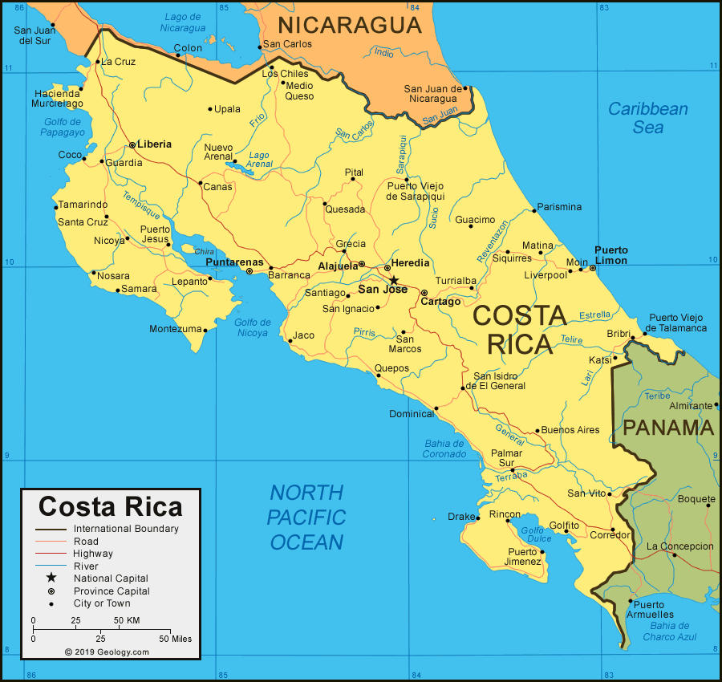
Outline
Context, challenges & Research Question
Costa Rica's Reference Energy System
Scenarios
Results
Conclusions, Policy insights, & Future Work
Notes:
(for reference – do not include in final presentation)

Slide 3
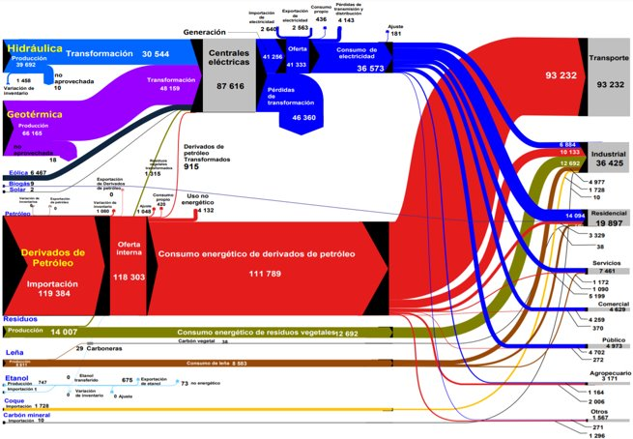
Context, Challenges, and Main Findings
Costa Rica’s electrical matrix is about a 100% renewable.
The transport sector is responsible for 78% of the fossil fuels used in Costa Rica, and over 40 % of the country's total greenhouse gas emissions.
Replacing fossil fuels, such as diesel and gasoline, in the transport sector with electricity and EV will reduce the total GHG emissions?

Slide 4
Scenarios
Using the OSEMOSYS the following scenarios were investigated:
Scenario Label
Scenario Description
Key Assumptions
Scenario Label | Scenario Description | Key Assumptions
BAU | On this scenario the use of fossil fuels (diesel and gasoline) will continue to be used as the primary fuel in the transport sector. | The electric fleet will not increase (around 3000 electric vehicles). The demand shall be met with fossil fuel technologies.
DECARB | Replace 8 % of the public and private transport sector fleet with EV by 2030. | The electric fleet will achieve 8% of the total transport sector by 2030. Projections in demand and vehicular fleet will follow the trend of growth from the past 10 years. Costa Rica’s electrical matrix will be modelled as 100% renewable.
Net_zero_2050 | Net zero by 2050 in the transport sector | Net zero by 2050 in the transport sector, according to the Costa Rican NDC. Projections in demand and vehicular fleet will follow the trend of growth from the past 10 years.

Slide 5
Results
Present graphs (or tables) that clearly show the differences between your scenarios (side by side, so audience can see the differences or on a combined graph). Be clear on the purpose of the figures you present and how they support your recommendations and conclusions.
For all figures and/or tables make sure the font is large enough for your audience to read...
Maximum 2 slides for different aspects/results/comparisons across your scenarios. Bear in mind you only have 5 minutes to present, so you may need to be selective about which results you show.
Think about the aim of your study and how the results you present address this question, and how the results you present support your conclusions and recommendations.
Include a cost-benefit analysis: One slide which presents a figure of the costs (or cost differences) associated with each scenario, and the system benefits this will provide. Example – the tradeoff between reducing CO2 and the cost of abatement.

Slide 6
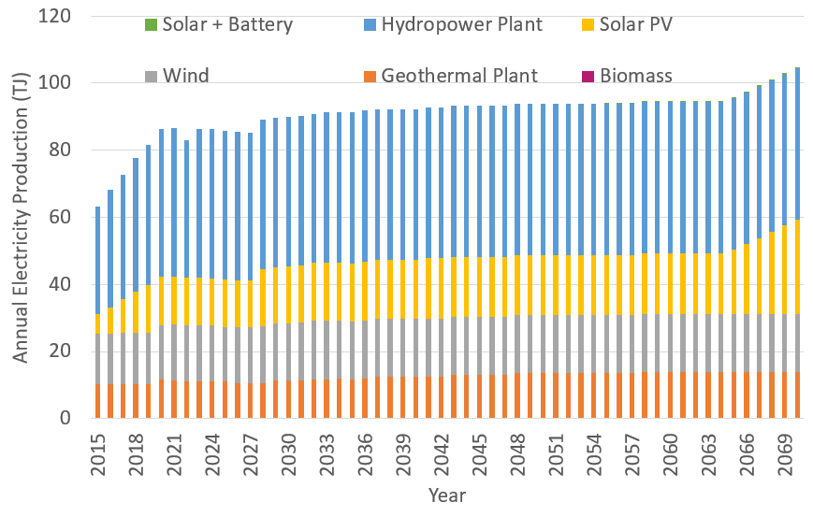
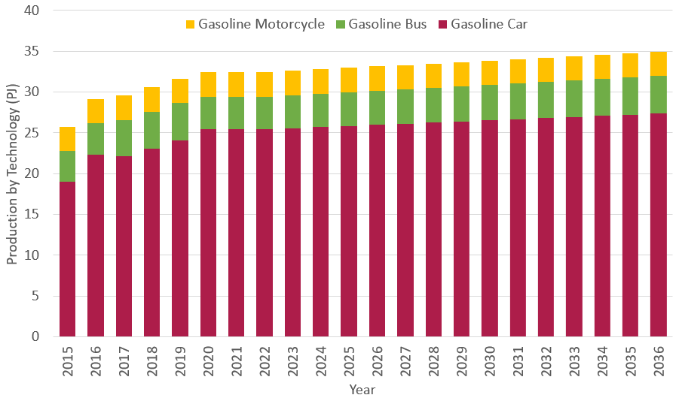
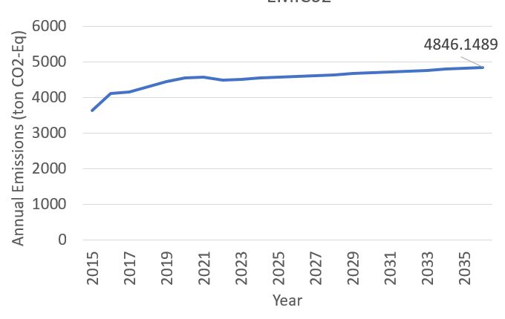
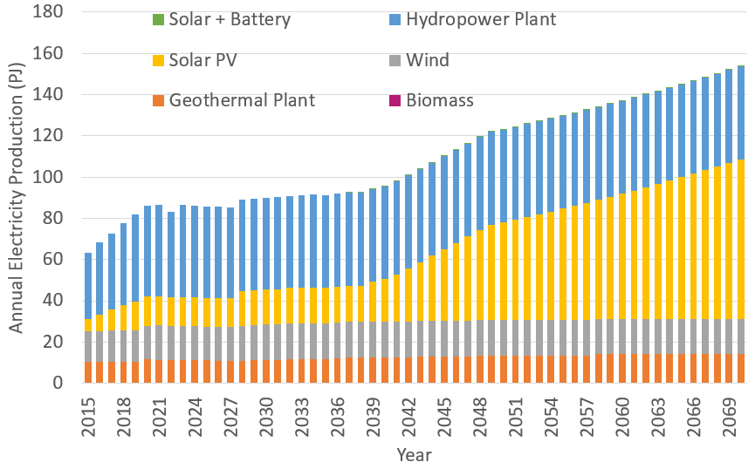
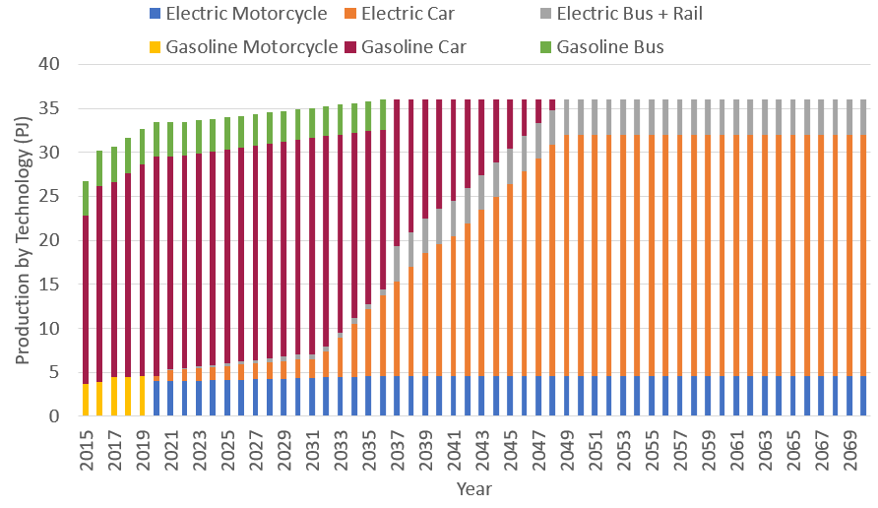
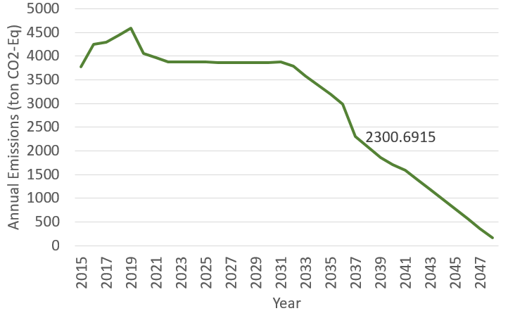
Results
BAU
Decarbonization | Net Zero

Slide 7
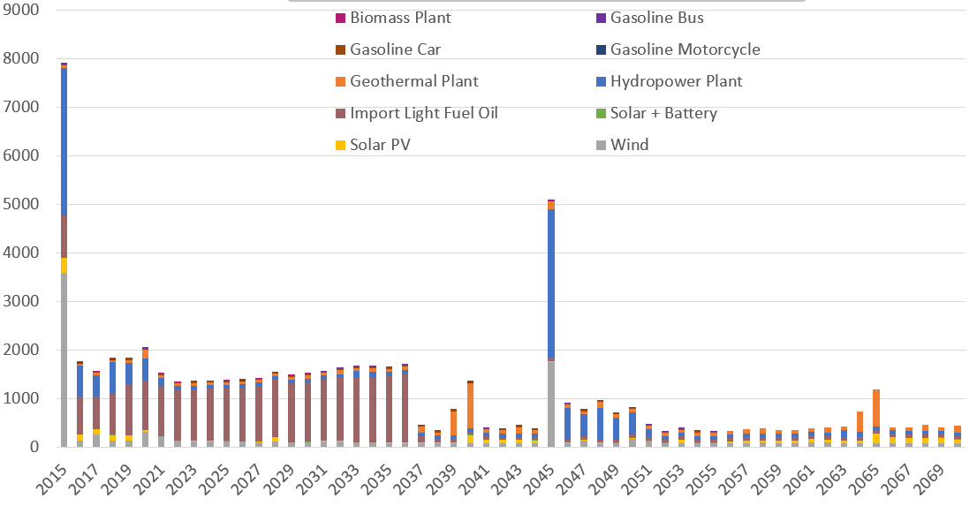
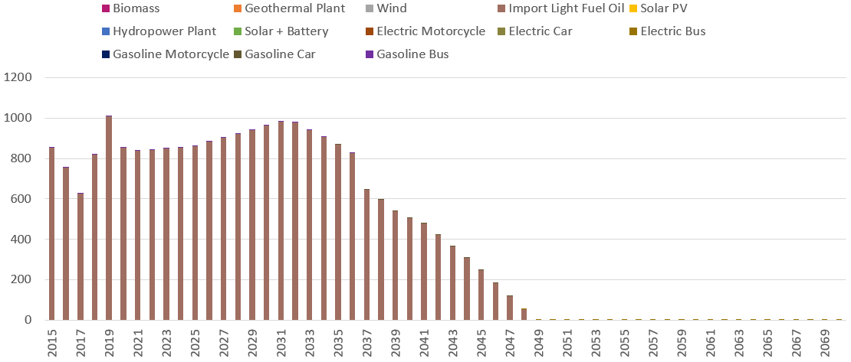
Results
BAU
Decarbonization | Net Zero
Variable Operational Costs (M$)
The total costs for the BAU scenario are $ 38 741 M for 2030. The total costs for the decarbonization scenario are $ 31 867 M for 2030.
To achive a net zero by 2050 the total costs will be $ 64 920 M.

Slide 8
Conclusion and Policy Insights
Conclusions: ​
By fulfilling the NDC for transport sector, Costa Rica can achieve ~50 % reduction in the emissions of this sector. ​
There is a 32 % increment in the electricity generation to achieve the net zero scenario and 5 % for the NDC scenario in comparison with the BAU.​
There is a ~50 % reduction in the total costs by fulfilling the NDC commitment in the transport sector. ​
Policy insights: ​
The recommended route to decarbonise the transport sector is a slow progression into EV up to 2030, then to promote a faster transition from 2030 onwards.
It is recommended to invest in solar technologies, since it is the most cost beneficial one.​
Future work: ​
It is recommended to study a decarbonization of the sector by using hydrogen impulsed vehicles. ​

