Slide 1
Chapter 18 Transitions after secondary design and technology
Part 4 Developing your design and technology teaching and career
Rebecca Topps
St George’s Academy
Rebecca.topps@st-georges-academy.org
Topps, R. (2021). Transitions after secondary design and technology. In A. Hardy (Ed.), Learning to teach design and technology in the secondary school: a companion to school experience (4th Edition). Abingdon, UK: Routledge. ISBN: 9780367336813
Notes:
Image taken from: https://www.routledge.com/Learning-to-Teach-Design-and-Technology-in-the-Secondary-School-A-Companion/Hardy/p/book/9780367336813

Slide 2
Objectives
• Know the two routes most pupils take post-16;
• Know about some of the different qualifications available post-16 that follow on from secondary design and technology;
• Understand different educational settings and the post-16 opportunities commonly available in each setting;
• Identify how secondary design and technology is useful for pupils’ post-16 routes.

Slide 3
Introduction
How did you get to this stage now?
The design and technology journey does not always finish at the age of 16 when compulsory education often ends.
The transition after secondary education opens a range of potential avenues for pupils to follow.
The range of skills pupils learn during their primary and secondary design and technology education are broad and these skills are useful in different routes post-16.

Slide 4
Big Question 1
’Is D&T education linear?’

Slide 5
Post-16 routes: Academic and Vocational
Academic Overview
Academic routes lead to higher education courses
typically involves two further years in full time education
used as a route into higher education
Vocational Overview
Vocational routes onto a career in a defined profession
can also lead to a higher education degree
can be studied full time or part time
easier access into employment
Notes:
There is overlap and convergence between the academic and vocation routes stages, but here they are used to simply explain the two main routes that occur immediately post-16.
Ask the students to reflect on the route they took on their own post-16 journey. How did they get here?

Slide 6
Which one should pupils choose?
Neither route determines a pupil’s future employment and education
Pupils who opt for a vocational route can go into specialist higher education degrees via foundation degrees
Pupils who take the academic route sometimes choose to take a vocational training route after completing a degree.
Your role as the teacher is to empower the pupils to let them make the right choice.
Notes:
Diuscss how they can help pupils think about the choices open to them and value the choices they make.

Slide 7
Level of study
Qualifications have a difficulty level.
There are nine different levels:
Entry Level and Level 1 through to 8.
Typically, pre-16 qualifications are Level 1 and Level 2
Post-16 are Level 3 but some post-16 courses have to start at Level 1 or 2 (such as hair and beauty, construction and motor vehicle courses)
In the UK general education qualifications include:
the Welsh Baccalaureate intermediate;
the Scottish Credit Standard Grade 2 and the Scottish Vocational Qualification 2;
the General Certificate of Education (GCSE) in England and Wales
in Northern Ireland, the Council for the Curriculum, Examinations & Assessment (CCEA) offer their own GCSEs and vocational Level 1 and 2 qualifications.

Slide 8
What qualifications are there? (England based)
Academic qualifications Post-16
can be defined into three different routes; Product Design, Fashion and Textiles and Design Engineering
Focus on technical principles and design and make principles
Complete a design, make and evaluate task
Technical Levels – a new Post-16 qualification
Level 2 Technical Certificate, Level 3 Technical Award or a Level 3 Applied General Qualification.
No Design and Technology but some cross over subjects
Some courses have specific teaching requirements
Can be studied at Level 2 or 3 full time, or alongside academic qualifications, or as part of a wider curriculum.
Post-18 qualifications
Higher National Certificate (HNC)
Higher National Diploma (HND)
Degree
Apprenticeship based
Combine practical learning with a theory element
‘on the job’ training
Experience the application of the theory

Slide 9
Big Question 2
How do you prepare for post- 16 D&T education?

Slide 10
Making the leap from pre-16 to post-16
During KS4:
Pupils will discover creative skills and imagination in applying the iterative process
They begin to explore how to solve real world problems, through considering the needs of others.
The next step:
Pupils become more independent and show, through the iterative design process, their confidence in making decisions and justifying their design development.

Slide 11
Summary
There is no one ‘correct’ route for a pupil to take and we need to acknowledge how transferable design and technology skills are
As a teacher, you may need to be prepared to teach across a range of subjects linked to design and technology post-16.
Being honest with pupils and explaining what different options are available will empower them to make the right decision.

Slide 12
References
Proudlove, R.K. (2009). The Science and Technology of Foods (Fifth Edition), Odiham, Hampshire: Forbes Publications.
Rutland, M. (2019). The academic study of food in the English curriculum for pupils aged 16-18 years: its demise and future prospects. In PATT 37 - Conference 2019: Developing a knowledge economy through technology and engineering education, pp 373- 380. University of Malta, June 3-6th 2019.

Slide 13
About the author
Rebecca Topps is currently second in department for a large design and technology faculty, with over 12 years experience of teaching a variety of different subjects, mainly specialising in Product Design. Through GCSE to A Level, Rebecca has taught a range of qualifications both academically and vocational. Rebecca has won both a Design and Technology Association Award and an Institute of Engineering Technology Award for her teaching and is currently shortlisted for the National Teaching Awards Secondary Teacher of the Year 2020. She continues to develop her research by currently completing her Masters in Education.
Email: Rebecca.topps@st-georges-academy.org
LinkedIn: Rebecca-topps-326293109
Twitter: @designteacher2

Slide 14
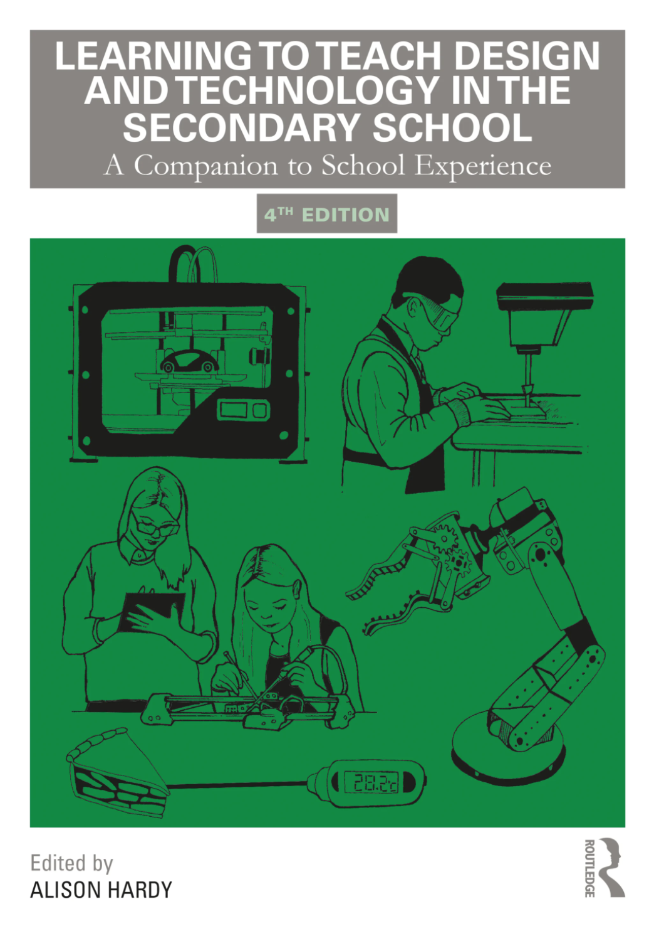
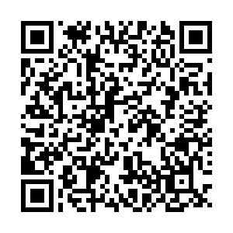
About the book
Editor: Dr Alison Hardy
Click here, or scan the QR code below, for the full contents or to order the book…
Notes:
Image taken from: https://www.routledge.com/Learning-to-Teach-Design-and-Technology-in-the-Secondary-School-A-Companion/Hardy/p/book/9780367336813

