Slide 1


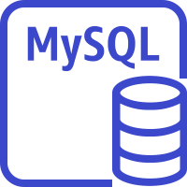




Overview
Chrome Extension
EC2 instance contents(Kubernetes)
YouTube API
Client
Gate Way Node.js
MySQL instance
User
Dictionary API
Mobile client
Web Container NginX
API Container Node.js
ElastiCache for Redis
Amazon DynamoDB
Speech to Text API
Data Visualiation Container
Django
Development Env
Web Continer NginX
Developer
Management Container
Spring Boot
Docker
Prometeus

