Slide 1



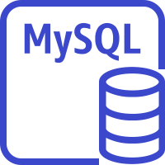




Overview
Chrome Extension
YouTube API
containers(Kubernetes)
Client
AWS API-GW
GraphQL Node.js
MySQL instance
User
Dictionary API
Mobile client
Web Container NginX
REST API Containers Node.js/Python
ElastiCache for Redis
Amazon DynamoDB
Speech to Text API
Data Visualiation Container
Django
Development Env
Web Continer NginX
Developer
Management Container
Spring Boot
Docker
Prometeus

