Slide 1
Pumped-storage upper reservoir project
Surface-flow regimes in a shallow
single-port reservoir model
Experiment results and discussion
Takahiro KOSHIBA
Yuna SHONAI
KYOTO UNIVERSITY
August 2026
1

Slide 2
Today in one slide
Three findings from the 24-run campaign; the middle one is new and is the headline.
Inflow
Jet deflects to one wall and drives a basin-scale circulation, at every depth.
Depth modulates intensity,
not the pattern.
NEW Flow rate picks the direction
Low: counterclockwise, 4/4 runs.
High: clockwise, 4/4. Medium: bistable, 3/1.
The sign splits within every day.
Outflow
A symmetric converging sink, ~1000x weaker at the surface; no rotation.
Weak mean, largest relative fluctuation.
One port: the flow rate decides which way the basin turns.
KYOTO UNIVERSITY
2
Notes:
30-second version of the talk. Everything else is evidence for these three boxes.

Slide 3
1
Setup recap and the measurement
KYOTO UNIVERSITY

Slide 4
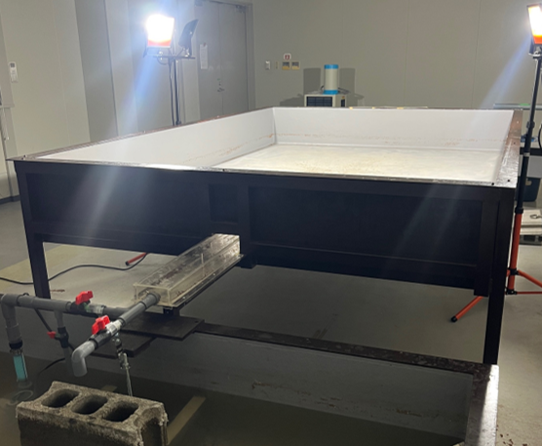
Facility and campaign
Same rig as before: shallow rectangular basin, one reversible port on the short wall.
Geometry (measured)
Basin 2.952 x 1.962 m, depth range 0.03-0.10 m
Port 0.11 m wide x 0.055 m high, at mid short wall
Port bottom flush with the floor; a = 0.055 m
PHOTO PLACEHOLDER
basin overview + port close-up
Campaign (24 runs, all from still water)
2 modes (inflow / outflow) x 3 flow levels x 4 reps
Nominal 0.25 / 0.50 / 0.75 L/s (valve-set)
Inflow reps blocked by day: each of 4 days ran
low + medium + high -> day vs flow separable
KYOTO UNIVERSITY
3
Notes:
Block design matters later: it is what lets us attribute the sign to flow rate.

Slide 5
Depth is swept within each run
Depth is an axis every run traverses; we analyze in four depth bands.
Band
Range and meaning
B1 30-50 mm
h/a = 0.55-0.91 shallow, port partly open to the surface
B2 50-60 mm
h/a = 0.91-1.09 transition around full submergence
B3 60-75 mm
h/a = 1.09-1.36 moderately submerged
B4 75-100 mm
h/a = 1.36-1.82 clearly submerged, quasi-steady
● Inflow fills 30 -> 100 mm, outflow drains 100 -> 30 mm; every PIV frame gets a depth tag from the level logger.
● The controlling ratio is h/a (depth over port height). B3+B4 is the quasi-steady window used for statistics.
Everything that follows is plotted against h/a;
the port ceiling h/a = 1 is the landmark.
KYOTO UNIVERSITY
4

Slide 6
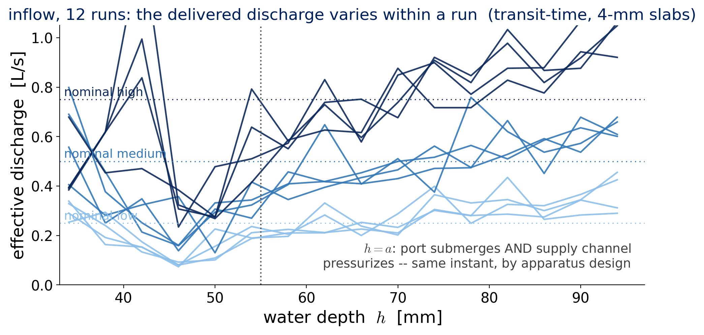
The delivered discharge varies within a run
The valve fixes the label, not the discharge -- so we quote measured, band-wise Q.
● Dip to roughly 25-30% of nominal just below h = a, then recovery; high runs overshoot nominal at depth.
● Note for later: at h = a the port submerges AND the supply channel pressurizes -- same instant, by design.
KYOTO UNIVERSITY
5
Notes:
This is why all quantitative claims use the transit-time discharge over stated bands, not the nominal value. The h=a coincidence returns on the unsteadiness slide.

Slide 7
From movies to numbers: three layers
One fixed pipeline; settings identical for all 24 runs except the pair interval.
1 Surface velocity field
u(x, y, t) from surface PIV
92 x 61 vectors, 31.5 mm grid
2 Frame scalars
E, phi_lv, I_asym,
I_circ, I_rot per frame
3 Band statistics
mean, std, SNR, I_unst
per run x band
Settings actually used (identical for all 24 runs except dt)
camera 29.97 Hz, rectified to 1501 x 1001 px (1.97 mm/px, full basin)
PIV multi-pass 128 > 64 > 32 px, 50% overlap, 6-sigma + median filters
dt inflow 0.200 / 0.100 / 0.067 s (displacement matched across levels)
outflow 0.334 s everywhere <- too short, revisited on the outflow slides
KYOTO UNIVERSITY
6
Notes:
Tool-agnostic after import: PIVLab output is normalized to a canonical struct, so the metric layer never sees the tool.

Slide 8
Five primary metrics
Chosen once during the pilot, then frozen; all are area means over the full vector grid.
Metric
What it measures
E
how much the surface moves -- mean of |u|^2 [m2/s2]
phi_lv
how much of it is dead -- area fraction below 0.2 Up
I_asym
left-right imbalance of energy (unsigned magnitude)
I_circ
net rotation, SIGNED -- which way the basin turns
I_rot
rotation activity, unsigned -- how much turning exists
I_unst
band-wise variability -- std/mean of E while in a band
KYOTO UNIVERSITY
7
Notes:
Up = Q/(a b) is the port mean velocity; it makes thresholds and vorticity flow-rate-free.

Slide 9
Two ways to be zero: I_circ vs I_rot
The signed and unsigned rotation metrics answer different questions -- we need both.
I_circ ~ 0, I_rot large
Strong counter-rotating cells that cancel in the signed mean.
This is inflow.
I_circ ~ 0, I_rot small
No rotation to begin with.
This is outflow.
Rule we enforce: the SIGN of I_circ is a per-run outcome. Never average signed I_circ across repetitions -- opposite-branch runs cancel to zero and erase the result.
Read the pair (I_circ, I_rot); the signed one carries the branch information.
KYOTO UNIVERSITY
8

Slide 10
Noise-floor discipline
Every scalar is reported against the measured noise floor of the PIV.
Measured floor
E_noise ~ 2e-7 m2/s2
= 0.06 px displacement per image pair
Band is 'resolved' only if SNR = E/E_noise >= 3
Where the data stand
Inflow: SNR > 400 in every band -- fully resolved
Outflow high: resolved at B1 (SNR ~ 37) and B4 (~6)
Outflow low/medium: below or near floor everywhere
● Time-mean vector fields survive below the floor (random error averages down by 1/sqrt(N) over ~1000 frames per band).
● So for weak outflow: trust the mean maps, treat the scalars as qualitative.
One honest rule, applied everywhere -- it will matter for outflow.
KYOTO UNIVERSITY
9

Slide 11
2
Inflow: one regime, modulated by depth
Deflected jet + basin-scale circulation, at every depth band
KYOTO UNIVERSITY

Slide 12
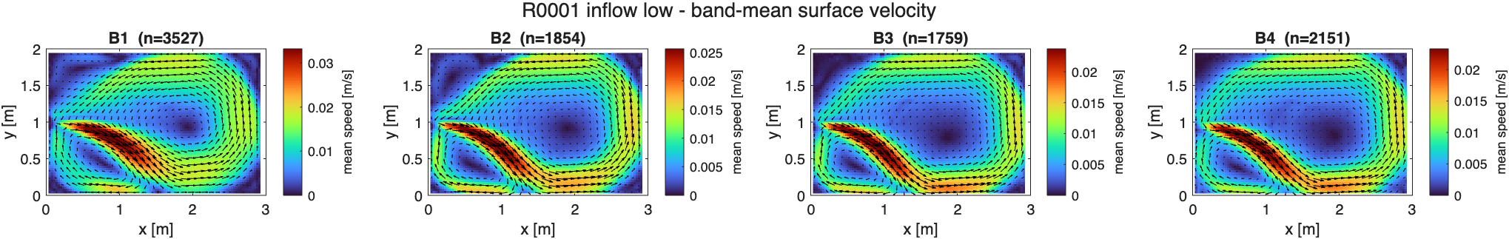
The same structure at every depth
Band-mean surface velocity, one representative low-flow run; port at the left wall center.
● The jet does not go straight: it attaches to one side wall, accelerates along it, and drives one basin-scale circulation.
● The opposite side holds a broad, slow recirculation.
● Topology is identical in B1-B4 -- submergence changes the intensity, not the pattern.
One regime across the whole depth range: deflected jet + asymmetric circulation.
KYOTO UNIVERSITY
10

Slide 13
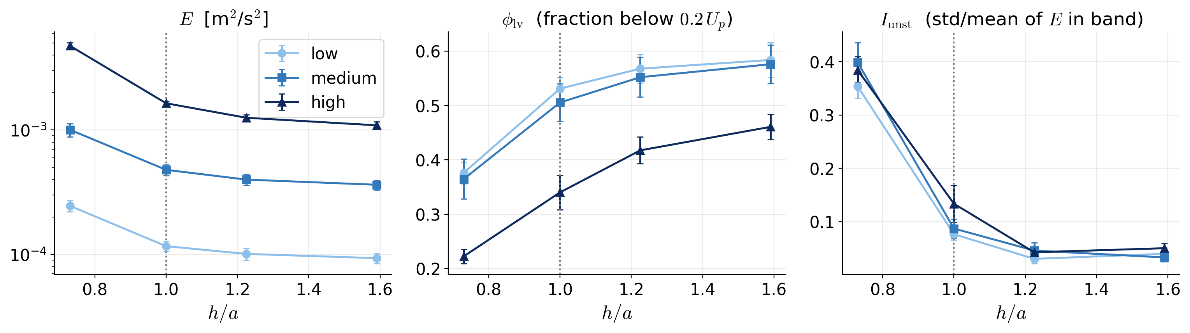
Depth modulates intensity, not topology
Band statistics over the 12 inflow runs (mean +/- sd over the 4 repetitions).
● E drops 2.6-4.4x from B1 to B4: the jet's momentum reaches the surface less and less.
● The dead-water fraction phi_lv grows to ~half of the basin; I_asym stays flat at ~0.26 throughout.
KYOTO UNIVERSITY
11

Slide 14
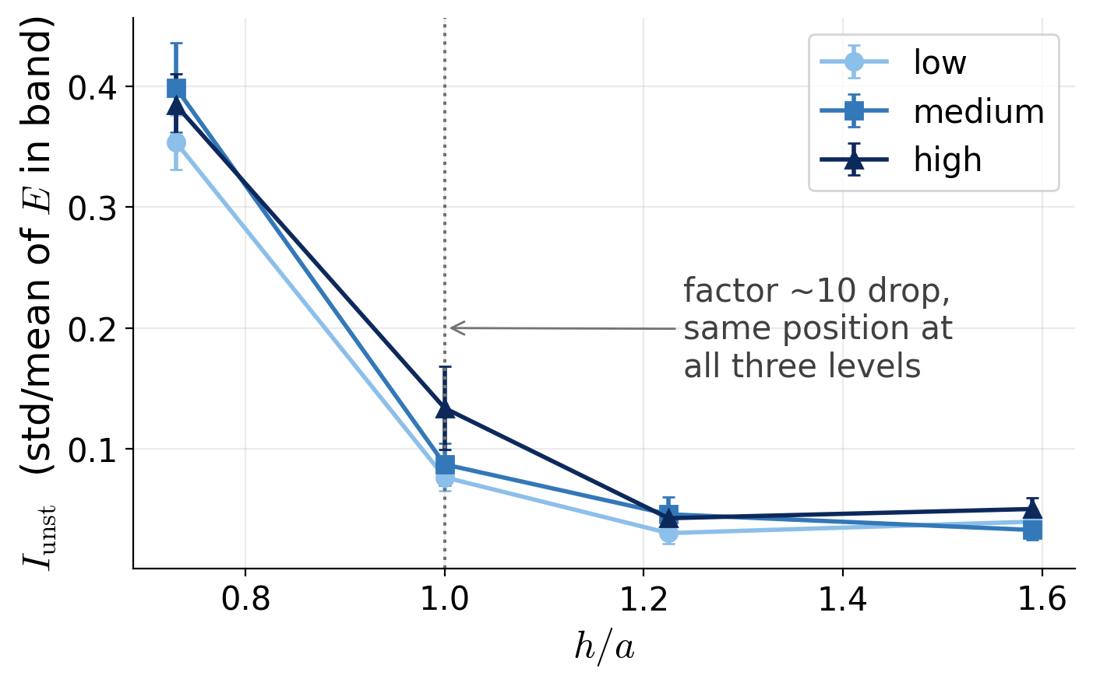
h/a ~ 1 is an unsteadiness switch
The clearest depth transition is not in the pattern but in the fluctuation level.
What switches
h < a: exposed jet wanders -- I_unst 0.35-0.40
h > a: submerged jet, calm surface -- 0.03-0.05
Same switch position at all three flow levels
One honest caveat
At h = a the port submerges and the supply
channel pressurizes at the same instant (channel
roof = a by design). This rig cannot separate the
two mechanisms -- stated as such in the paper.
Keep water above the port ceiling and the inflow surface is steady; near it, it is not.
KYOTO UNIVERSITY
12

Slide 15
3
The headline: flow rate selects the branch
KYOTO UNIVERSITY

Slide 16
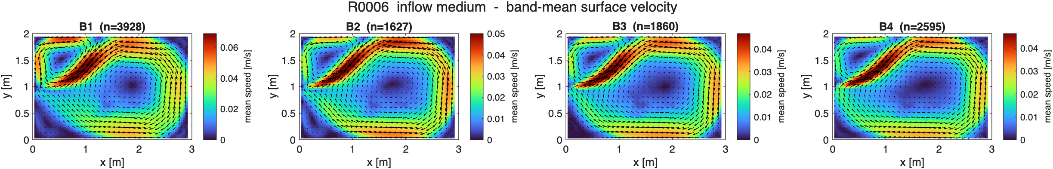
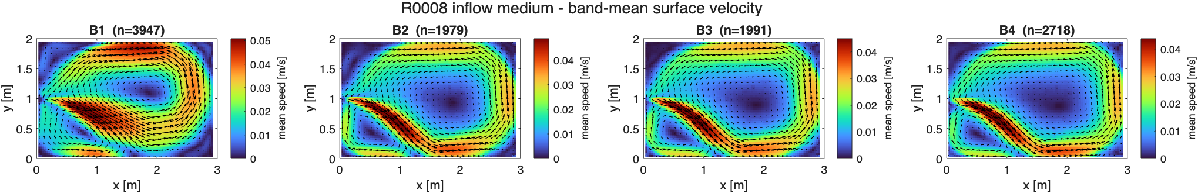
Same condition, opposite branch
Two medium repetitions, identical settings, four days apart -- mirror-image circulations.
CW
CCW
Two mirror states, both realized: a symmetry-breaking pair, not scatter.
KYOTO UNIVERSITY
13
Notes:
Top: R0006 (clockwise). Bottom: R0008 (counterclockwise). 'CW/CCW' refer to the plotted frame.

Slide 17
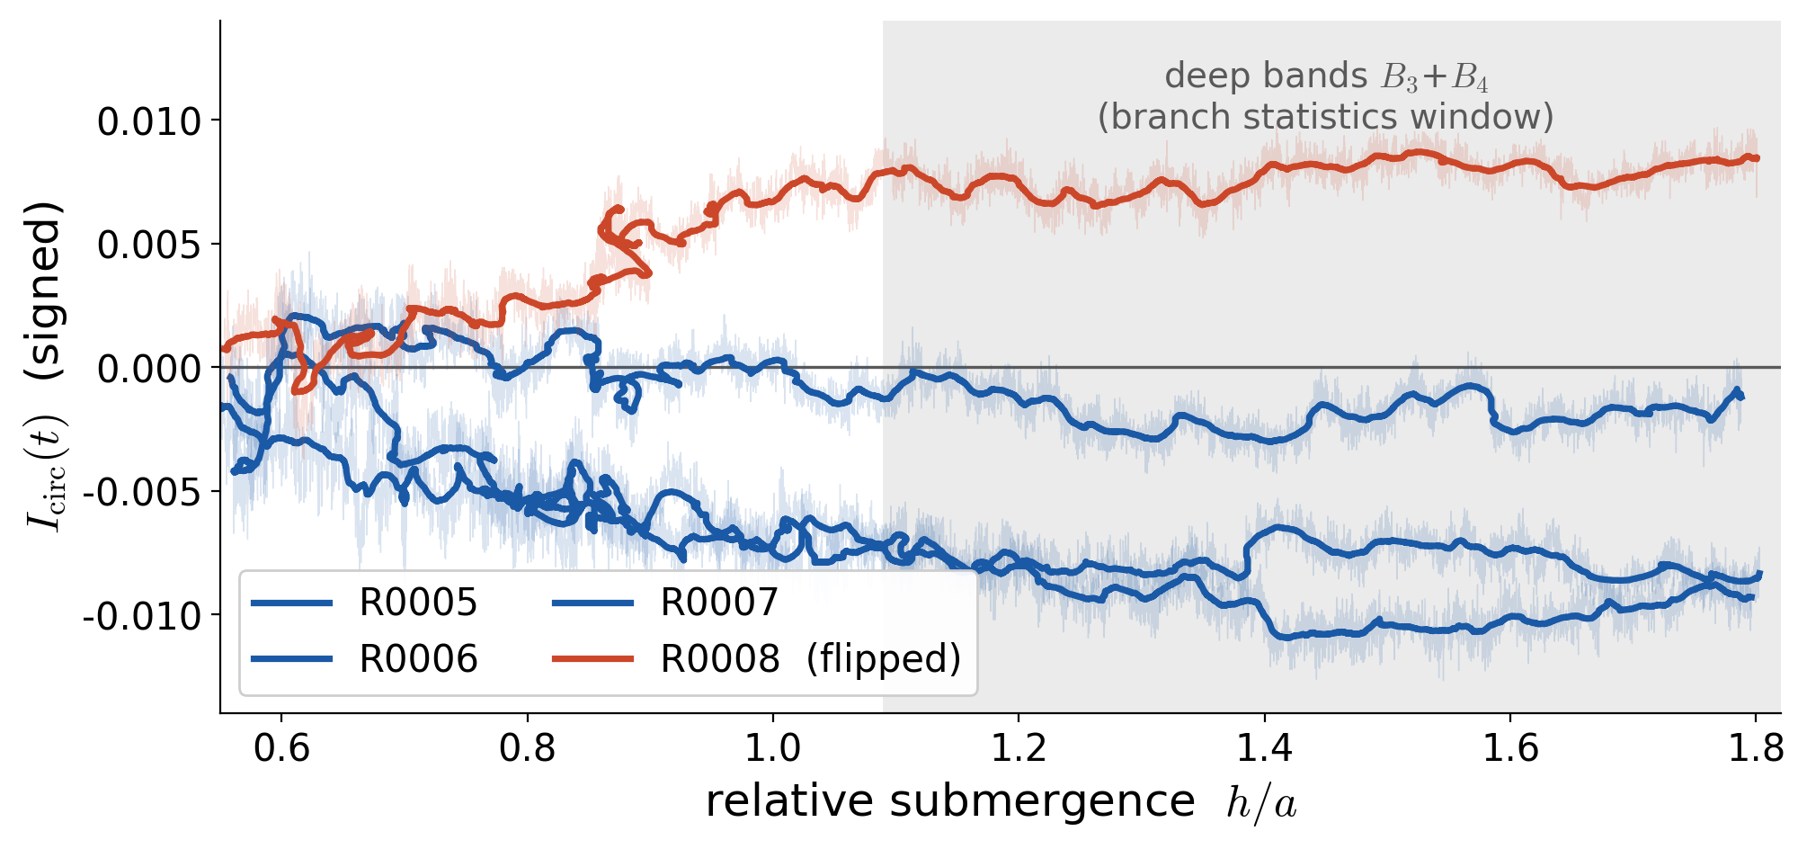
Locked traces -- one of them flipped
Signed I_circ through the fill, all four medium repetitions (thin: raw; bold: smoothed).
● Each run settles onto one sign as the jet submerges and never leaves it: in 10 of 12 inflow runs the deep-band sign persistence is 1.000.
KYOTO UNIVERSITY
14

Slide 18
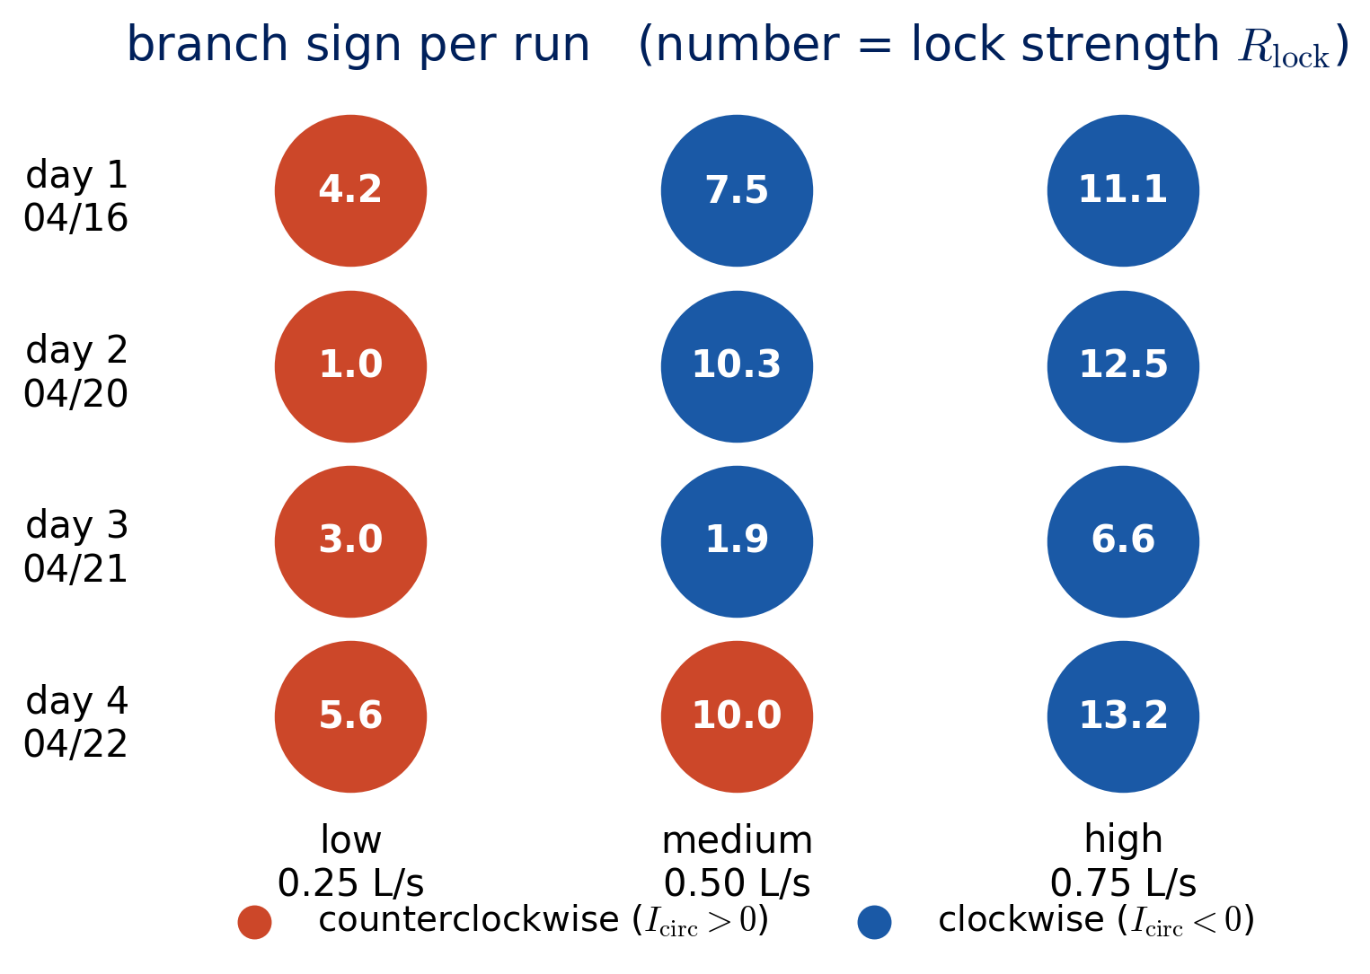
The sign, day by day
Every experiment day ran low, medium and high -- and the sign splits inside each day.
● low: counterclockwise in 4 of 4 runs
● high: clockwise in 4 of 4 runs
● medium: 3 CW / 1 CCW -- the fence-sitter
– same day, same rig, same water -- only the valve differs between columns
● so the selector is the flow rate, not the day, not the setup
Deterministic at low and high; the preferred direction REVERSES between them.
KYOTO UNIVERSITY
15

Slide 19
Medium sits on the fence -- genuine bistability
The flipped run is not a discharge outlier: both branches occur at the same Q.
The flipped run, R0008
Deep-band discharge (transit-time):
R0008 = 0.492 L/s vs R0007 = 0.485 L/s -> 1.4%
(B4 alone: 0.2%). Within the medium spread
0.485-0.519 L/s across the four repetitions.
The weak run, R0007
Same sign as the majority but barely locked:
R_lock = 1.9 (vs 7.5-10.3 for the others),
sign persistence 0.970 -- occasional excursions
toward zero. The fence is real on both sides.
● Same condition, two outcomes: that is a bistable transition band, not measurement scatter.
● Low (all CCW) and high (all CW) sit safely on either side of it.
Medium is where the two branches compete -- exactly where a transition band should sit.
KYOTO UNIVERSITY
16

Slide 20
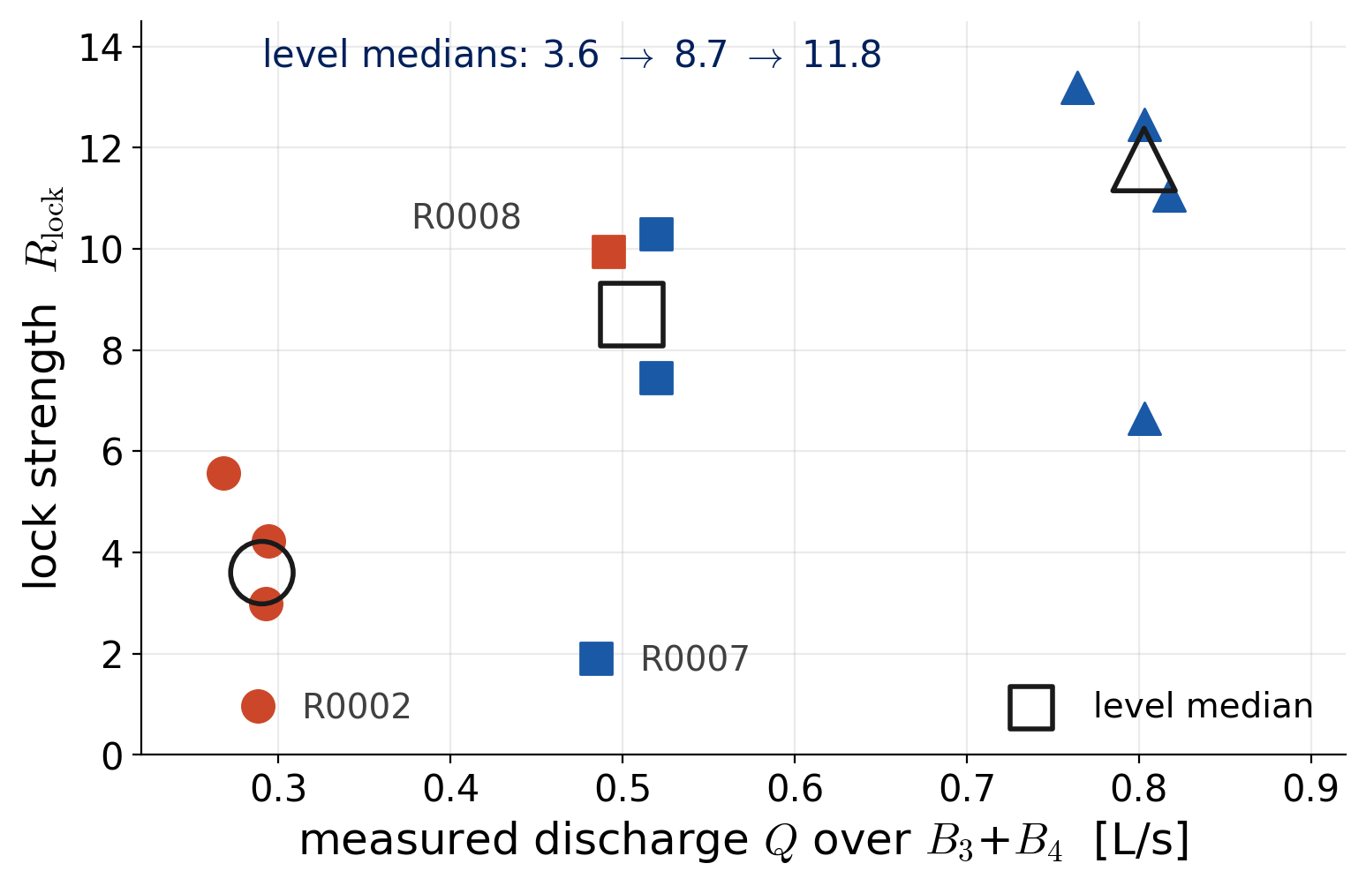

How firmly the branch is held grows with discharge
Lock strength: mean net circulation over its own fluctuation, per run (deep bands).
Reading
Level medians 3.6 -> 8.7 -> 11.8:
monotonic in discharge.
The two weak points are the fence
(R0007) and one marginal low run
(R0002, persistence 0.83).
Flow rate controls both WHICH branch is taken and HOW FIRMLY it is held.
KYOTO UNIVERSITY
17

Slide 21
Reading it as symmetry breaking
A deliberately careful reading: the data constrain the story, not close it.
Mirror pair = broken symmetry
The geometry is left-right symmetric, so the two circulations are twin solutions; shallow-basin work treats wall attachment as a symmetry-breaking bifurcation (Dewals 2008; Mullin 2003).
A fixed imperfection cannot explain a REVERSING preference
One geometric defect would always pick the same side. Ours reverses between low and high -- so at least two
competing biases with different flow-rate dependence must be present (e.g. supply-line bias vs jet-momentum bias).
Identifying them needs deliberate asymmetry experiments -- future work, stated as such.
Firmer lock at higher flow fits stability theory
More flow means bottom friction matters relatively less (higher effective Re, cf. Chen & Jirka 1997):
the system sits farther above the symmetry-breaking threshold, so the chosen branch is held harder.
KYOTO UNIVERSITY
Dewals et al. 2008; Chen & Jirka 1997; Mullin et al. 2003
18
Notes:
Keep this slide modest: selection mechanism is NOT identified; only its flow-rate dependence is established.

Slide 22
4
Outflow: the other half of the cycle
KYOTO UNIVERSITY

Slide 23
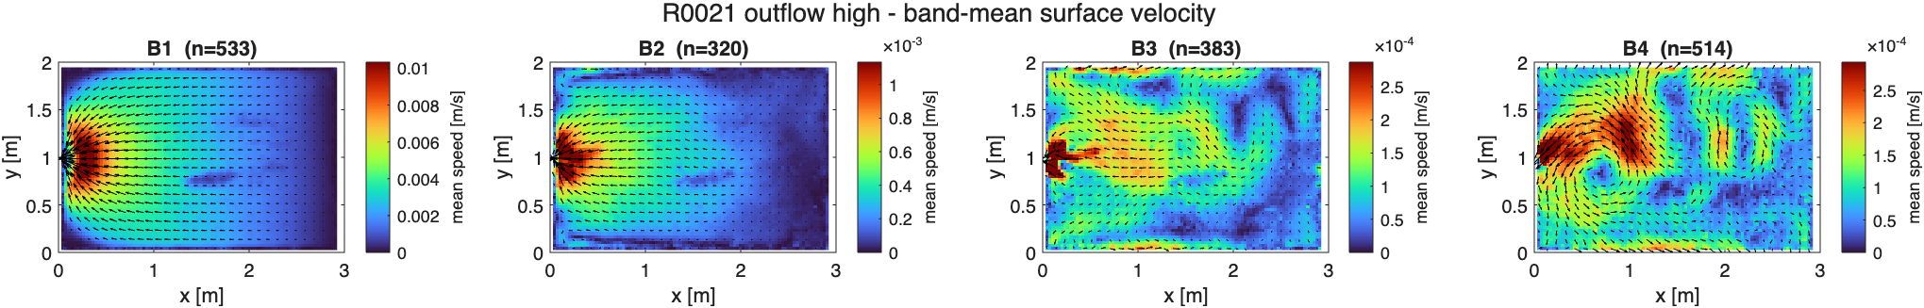
A converging sink, three orders weaker
Band-mean fields, high-flow outflow run; note the color scales vs the inflow slides.
● All vectors point at the port: a near-symmetric converging sink. No deflection, no attached wall jet, no rotation.
● I_rot = 0.002-0.007, about 1/20 of inflow; I_asym ~ 0.08 vs 0.26 -- and E is ~1/1000 of inflow at equal discharge.
● So the branch-selection question simply does not arise here: there is nothing rotating to choose a side.
Same port, opposite role: injection makes a jet; withdrawal makes a sink.
KYOTO UNIVERSITY
19

Slide 24
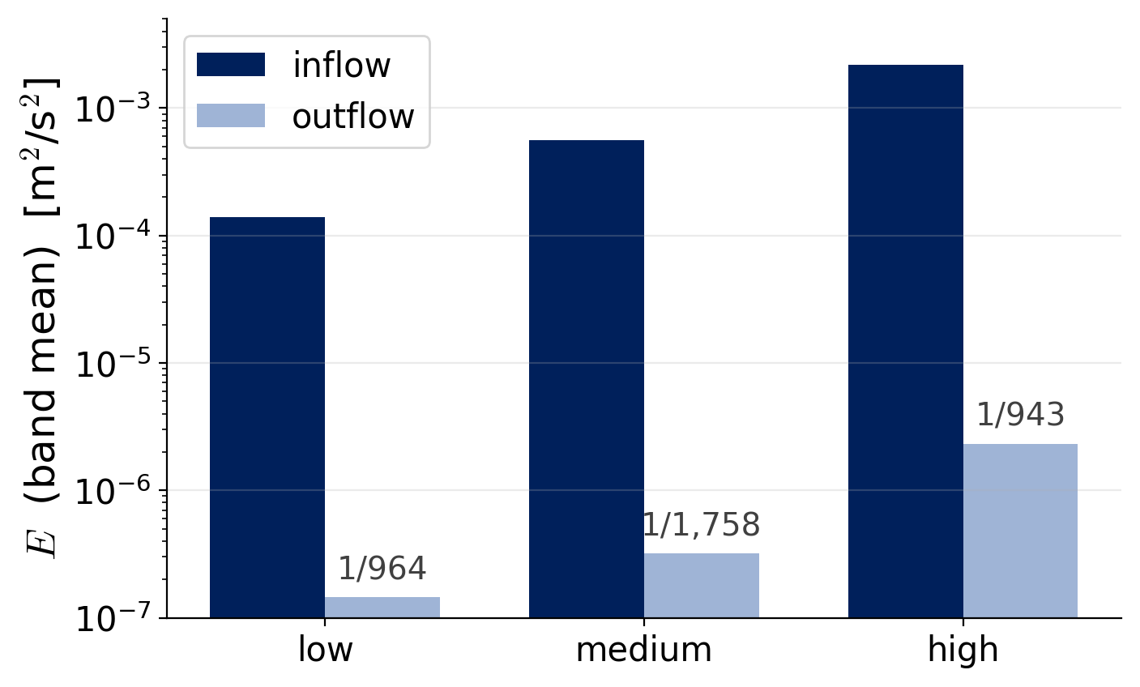
The surface barely feels the withdrawal
This is geometry, not an instrument limit: the free surface is ~1000 port areas wide.
Saturated dead water
phi_lv = 1.000 in every outflow band:
the whole surface is below 0.2 Up.
Band-mean speeds: 0.35-2.2% of Up.
Continuity does the arithmetic
A_plan / (a b) ~ 1e3, so a sink of Up at the
port dilutes to ~1e-3 Up at the surface --
matching what we measure.
In a shallow basin, outflow is geometrically guaranteed to leave the surface almost still.
KYOTO UNIVERSITY
20

Slide 25
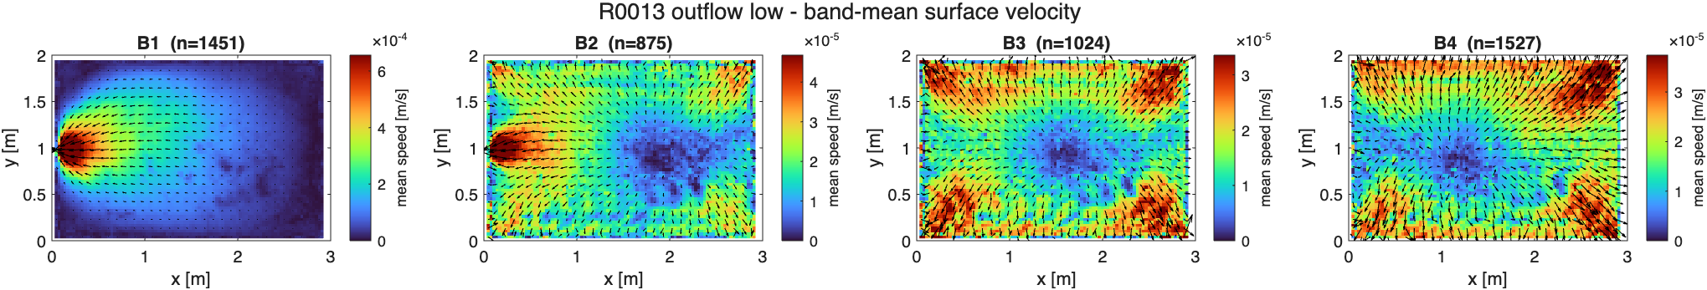
Weak but restless -- and partly below our floor
Where we can resolve it, outflow fluctuates twice as hard (relatively) as inflow ever does.
● Low-flow outflow (above): B2-B4 show no coherent mean structure -- these bands sit at the noise floor.
● The one well-resolved band (high flow, B1): I_unst = 0.76, twice the inflow maximum -- weak mean, large relative fluctuation (consistent with Zhu et al. 2023 near intakes).
● Root cause of the floor problem is our dt = 0.33 s: particle displacements 0.05-0.16 px. Fix already planned: re-export the SAME videos at dt ~ 2-7 s and re-run PIV -- no new experiments needed.
Outflow unsteadiness is real but under-resolved -- the re-analysis will recover it before submission.
KYOTO UNIVERSITY
21

Slide 26
History matters (to be tested properly)
The old continuous-operation observation and this batch disagree -- informatively.
What we saw before
In inflow -> outflow continuous operation, the
outflow surface kept a basin-wide circulation.
PLACEHOLDER (optional)
continuous-run sketch or photo
What the still-start batch says
From rest, outflow is a rotation-free sink -- so the
old circulation was inherited from the preceding
inflow (cf. Muller 2012: cells persist ~0.2-0.8 t_P).
Still-start = the clean baseline; history runs are next.
In alternating operation the outflow surface is set by the previous inflow -- a paper-2-era experiment.
KYOTO UNIVERSITY
22

Slide 27
What Paper 1 will claim
1
Inflow and outflow through one reversible port are decisively asymmetric: deflected jet + circulation vs a ~1000x weaker symmetric sink.
2
h/a ~ 1 is a transition of unsteadiness and surface reach, not of topology (with the stated apparatus caveat at h = a).
3
Flow rate selects the circulation branch -- deterministically at low and high (opposite signs), bistably at medium -- and firms the lock as Q grows.
4
Method lesson: signed + unsigned rotation metrics together, per-run branch statistics, and an explicit noise floor.
KYOTO UNIVERSITY
23

Slide 28
Where this sits in the three-paper plan
Paper 1 is written to stand on the experiment alone.
Paper 1 -- this talk
Experiment only, no CFD
inside. Target: submit after
the outflow re-analysis and
final figure pass.
Paper 2 -- 3D CFD
OpenFOAM VOF campaign
running in parallel;
quantifies what 3D CFD can
and cannot reproduce of
these regimes.
Paper 3 -- 2D x 3D
Joint comparison with your
HEC-RAS 2D results --
model hierarchy on one
bifurcation axis. Builds on
papers 1 + 2.
● Open items before submitting Paper 1: outflow re-PIV (longer dt), tracer specs for Methods, two intro references.
● Nothing in today's results depends on the CFD -- by design.
Comments most welcome on the branch-selection story -- it is the paper's centerpiece.
KYOTO UNIVERSITY
24

Slide 29
Discussion
Especially: does the reversing branch preference survive your scrutiny?
Data, scripts and the manuscript draft live in the shared repository.
KYOTO UNIVERSITY
25

