Slide 1
Diffie-Hellman

Slide 2
The question of key exchange was one of the first problems addressed by a cryptographic protocol. This was prior to the invention of public key cryptography.
The Diffie-Hellman key agreement protocol (1976) was the first practical method for establishing a shared secret over an unsecured communication channel.
The point is to agree on a key that two parties can use for a symmetric encryption, in such a way that an eavesdropper cannot obtain the key.

Slide 3
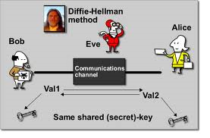

Slide 4
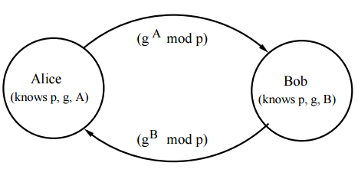
Cryptographic explanation
non-secret values in blue, and secret values in red.
Alice and Bob agree to use a modulus p = 23 and base g = 5
Alice chooses a secret integer a = 6, then sends Bob A = gª mod p
A = 5⁶ mod 23 = 8
Bob chooses a secret integer b = 15, then sends Alice B = g^{b} mod p
B = 5¹⁵ mod 23 = 19
Alice computes s = Bª mod p
s = 19⁶ mod 23 = 2
Bob computes s = A^{b} mod p
s = 8¹⁵ mod 23 = 2
Alice and Bob now share a secret (the number 2).

Slide 5
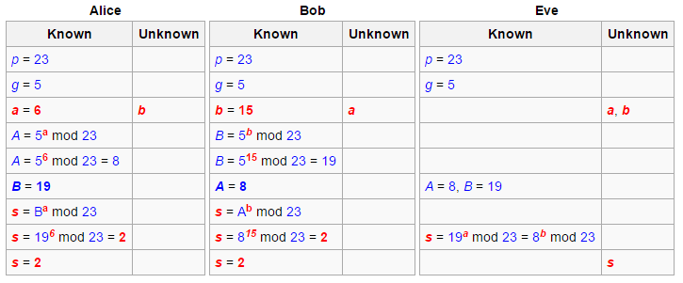
Secrecy chart
The chart below depicts who knows what, again with non-secret values in blue, and secret values in red. Here Eve is an eavesdropper—she watches what is sent between Alice and Bob, but she does not alter the contents of their communications.
g = public (prime) base, known to Alice, Bob, and Eve. g = 5
p = public (prime) modulus, known to Alice, Bob, and Eve. p = 23
a = Alice's private key, known only to Alice. a = 6
b = Bob's private key known only to Bob. b = 15
A = Alice's public key, known to Alice, Bob, and Eve. A = gª mod p = 8
B = Bob's public key, known to Alice, Bob, and Eve. B = g^{b} mod p = 19
Now s is the shared secret key and it is known to both Alice and Bob, but not to Eve

Slide 6
Demo Program

Slide 7
Elliptic Curve Cryptography

