Slide 1
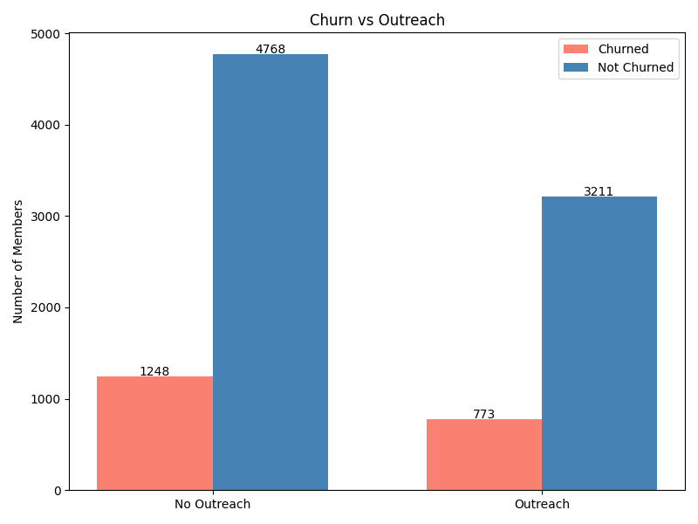


WellCo
Member Churn
Prediction & Retention
Identifying at-risk members to maximize retention at minimal cost
10,000
~20%
Members Analyzed
Churn Rate
WellCo

Slide 2
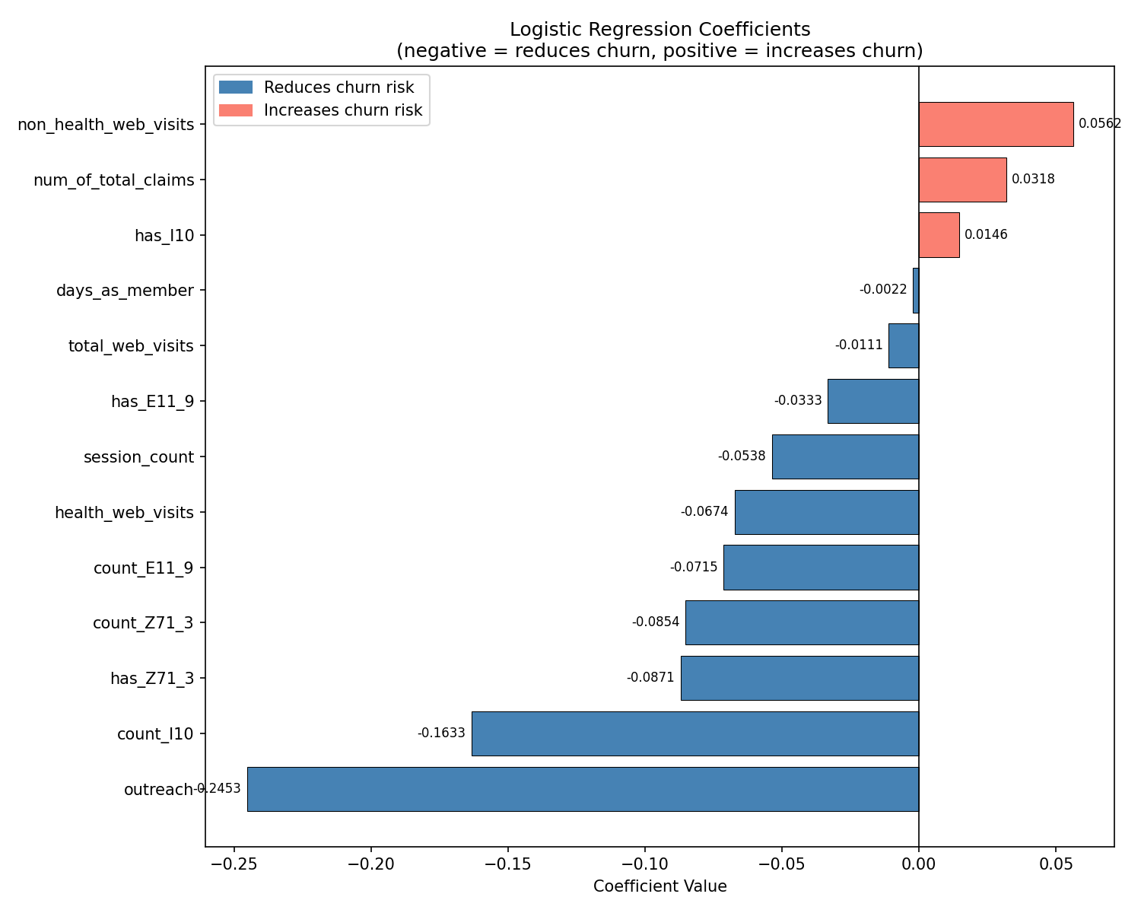
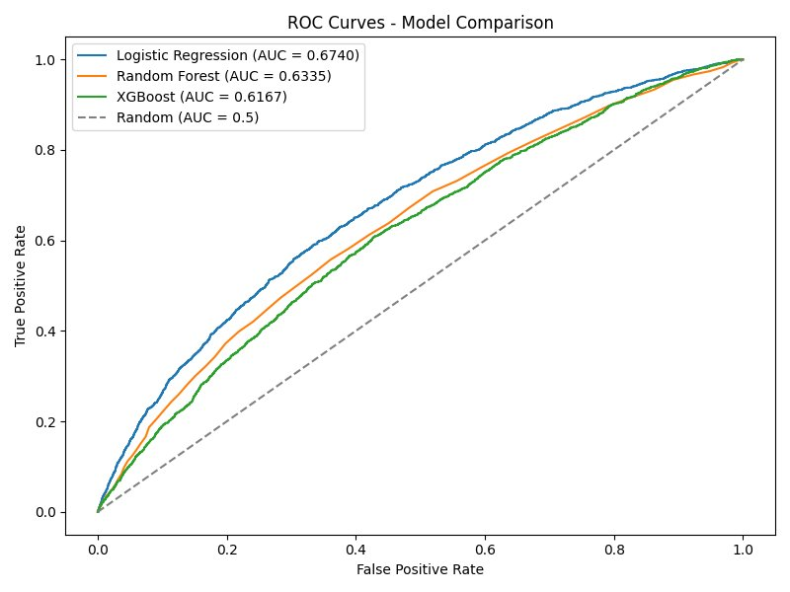
02
DATA & MODEL SELECTION
Model
Logistic Regression
✓ SELECTED
AUC-ROC: 0.674
ROC Curves
2-week observation window • 10,000 members • 4 data sources
WellCo Member Retention Analysis

Slide 3




03
WHAT DRIVES CHURN?
Outreach = Strongest Retention Tool
Health Engagement = Loyalty
Being contacted directly and significantly reduces the likelihood of churn — proactive outreach works.
App sessions, health content visits & clinical encounters are all associated with lower churn probability.
Non-Health Browsing = Warning Sign
Newer Members Churn More
Members drifting toward non-health content show elevated churn risk — a key early signal to act on.
Early engagement is critical. New members haven't yet built the habits that drive long-term loyalty.
WellCo Member Retention Analysis

Slide 4
04
WHO TO REACH OUT TO & OPTIMAL n
Prioritization Score Formula
Target Population
Prioritization Score
= Model Score + ICD Boost
Model Score
= Churn Probability × Outreach Benefit
ICD Boost
+0.05 per priority diagnosis
1,996
members recommended for outreach (20% of test population)
Threshold: churn probability > 30%
Grounded in the observed ~20% base churn rate
WellCo Member Retention Analysis

Slide 5
05
RECOMMENDATIONS
1
Contact the top 1,996 members in the provided ranked list
2
Focus messaging on health content re-engagement for members drifting to non-health browsing
3
Act early on newer members — they churn at higher rates before building habits
4
Priority diagnosis members (E11.9, I10, Z71.3) should receive condition-specific messaging tied to their care pathway
5
Future improvement: targeted outreach (vs random) would significantly improve model accuracy
WellCo | Member Retention Analysis

