Slide 1
Hierarchical View-Frustum Culling for Z-buffer Rendering
17. 3. 2019
Aleš Koblížek

Slide 2
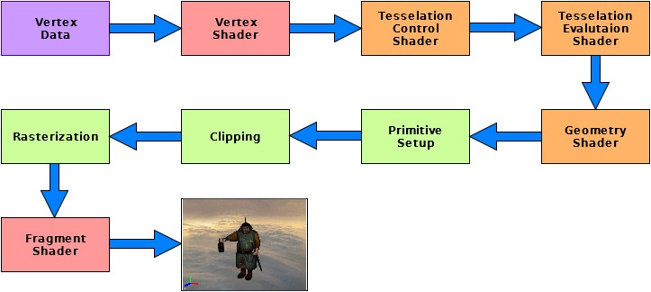
Why?
Rendering pipeline. From [3]

Slide 3
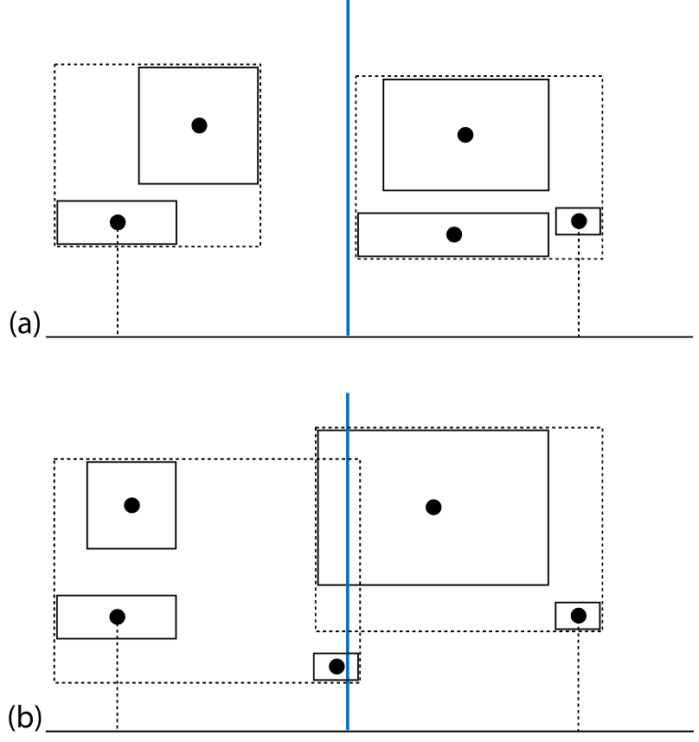
BVH construction
Top down
Midpoint subdivision
Midpoint subdivision. From [4]

Slide 4
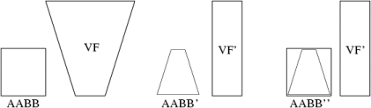
View-frustum & box intersection
Projection space
Transformation
6 comparisons
World space
6x box & plane
AABB and view-frustum transformation. From [1]

Slide 5
Plane-coherency test
If the node was outside the plane last frame, ….

Slide 6
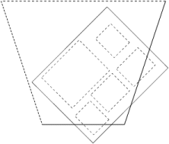
Plane masking
If the parent is inside the plane, the children are too. From [1]

Slide 7
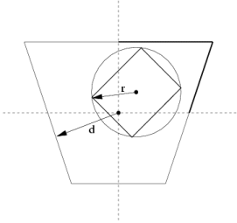
Octant test
It must hold that r <= d. From [1]

Slide 8
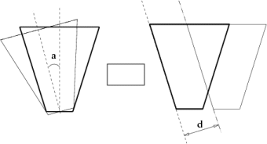
Rotation and translation coherency
Can be used only when BB did not change. From [1]

Slide 9
Performance tests outline
Frame time with and without culling
Culling speedup (camera flythrough)
  each optimisation individually
  all optimisations at once
  scenes of various sizes
Number of triangles sent for rendering
  (should not change with optimizations)

Slide 10
Sources
[1] http://old.cescg.org/CESCG-2002/DSykoraJJelinek/index.html
[2] http://www.cse.chalmers.se/~uffe/vfc_bbox.pdf
[3] https://shot511.github.io/img/beginner_opengl/GL-Pipeline.jpg
[4] http://www.pbr-book.org/3ed-2018/Primitives_and_Intersection_Acceleration/Bounding_Volume_Hierarchies.html

Slide 11
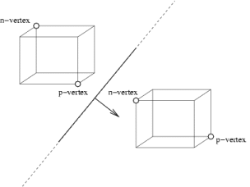
Box & plane intersection
Choice of N and P vertices to be tested against the plane. From [1]

Slide 12
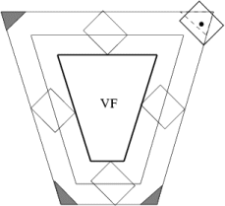
Box & plane intersection
False-positive intersections. From [1]

