Slide 1

Hierarchical View-Frustum Culling for Z-buffer Rendering
20. 5. 2019
FEL CTU in Prague
Aleš Koblížek

Slide 2
Overview
Choose algorithm parameters
  max triangles per leaf
  traversal optimizations
Evaluate the algorithm
using prerecorded routes
6 scenes

Slide 3
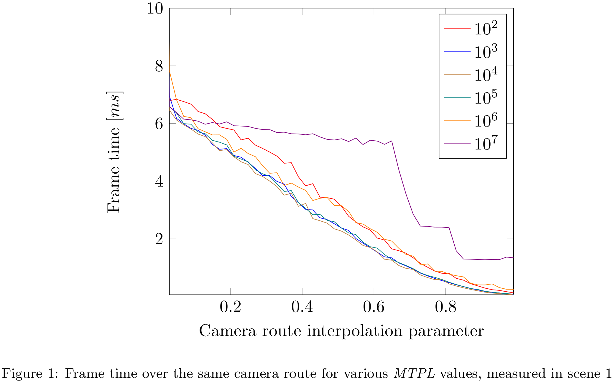

Slide 4
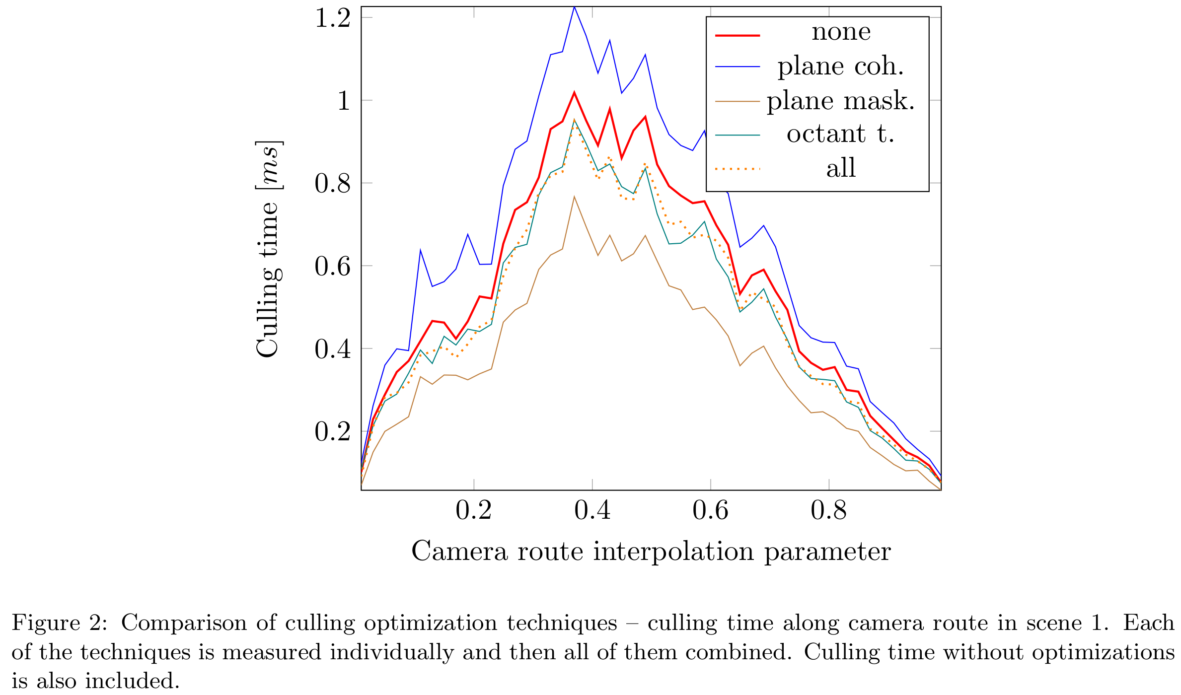

Slide 5
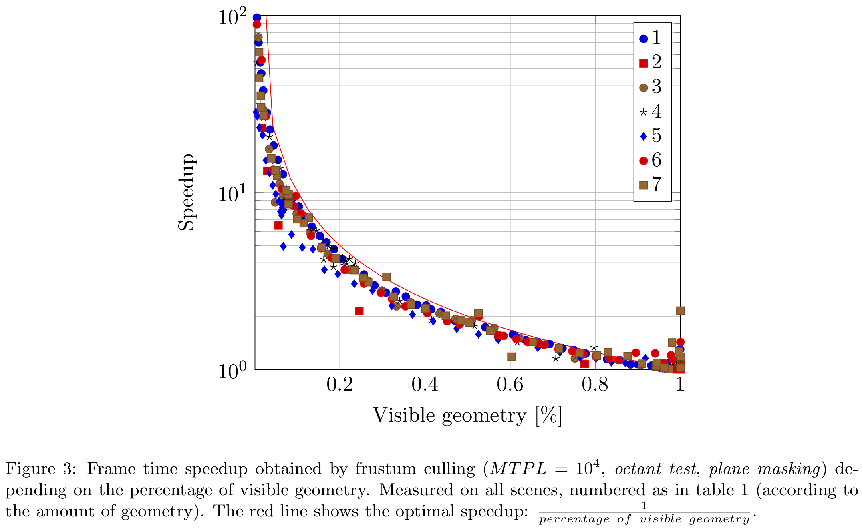

Slide 6
