Slide 1
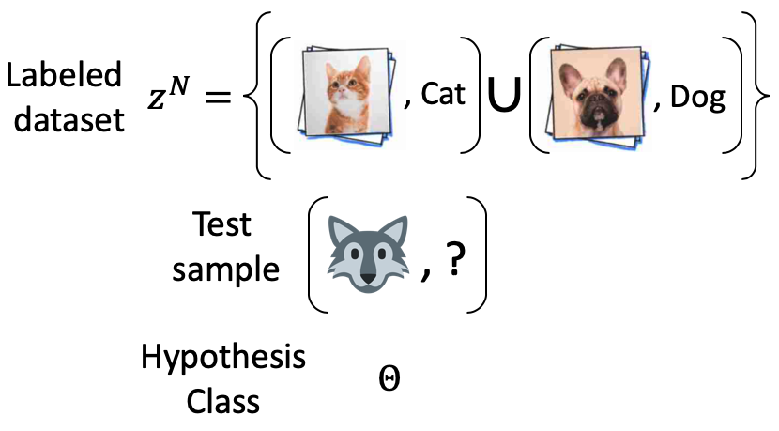


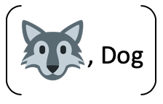

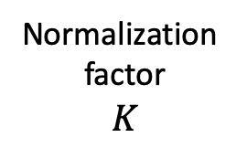

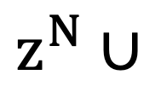
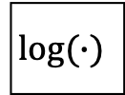





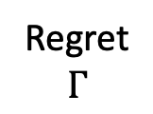

$\underset{θ∈Θ}{argmin}{L(∙)}$
$$z^{N}∪$$
$$z^{\left\{N+1\right\}}$$
$$θ_{1}$$
Normalization
factor
$$K$$
$$\log{(∙)}$$
Regret
$$Γ$$
+
$\underset{θ∈Θ}{argmin}{L(∙)}$
$$z^{N}∪$$
$$z^{\left\{N+1\right\}}$$
$$θ_{2}$$

Slide 2
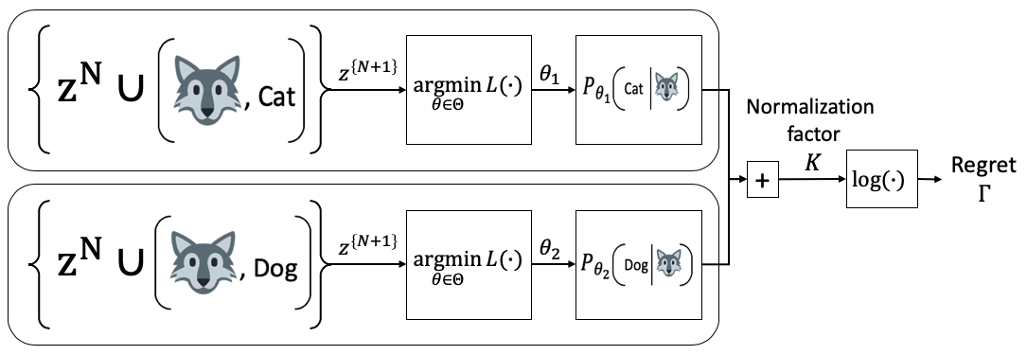
Input
Algorithm

Slide 3
Input
Algorithm

Slide 4
https://mc.ai/cats-and-dogs-classifier-convolutional-neural-network-with-python-and-tensorflow-9-steps-of/

Slide 5
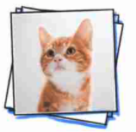
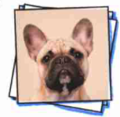

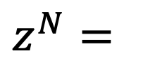



Labeled
dataset
$$∪$$
$$z^{N}=$$
, Cat
, Dog
Test
sample
, ?
Hypothesis
Class
$$Θ$$
$$P_{θ_{1}}$$
Cat
$$P_{θ_{2}}$$
Dog
, Cat
, Dog

Slide 6


Input: $x$
Feature extraction
$$φ(x)$$
Classification

