Slide 1
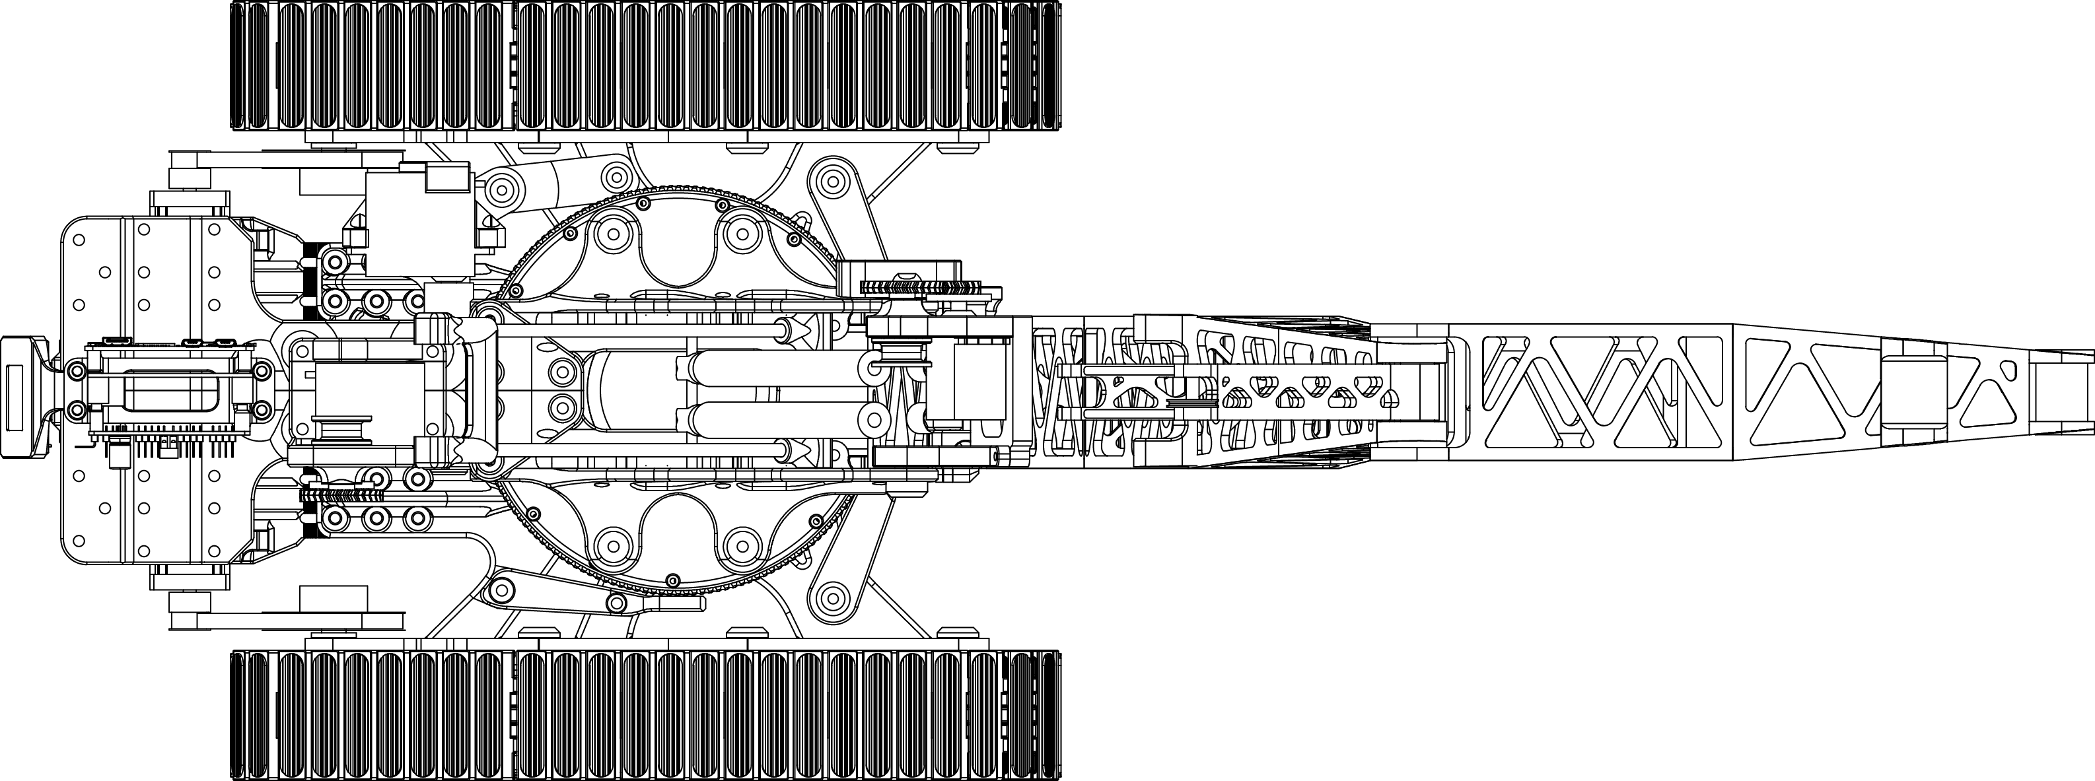

Slide 2
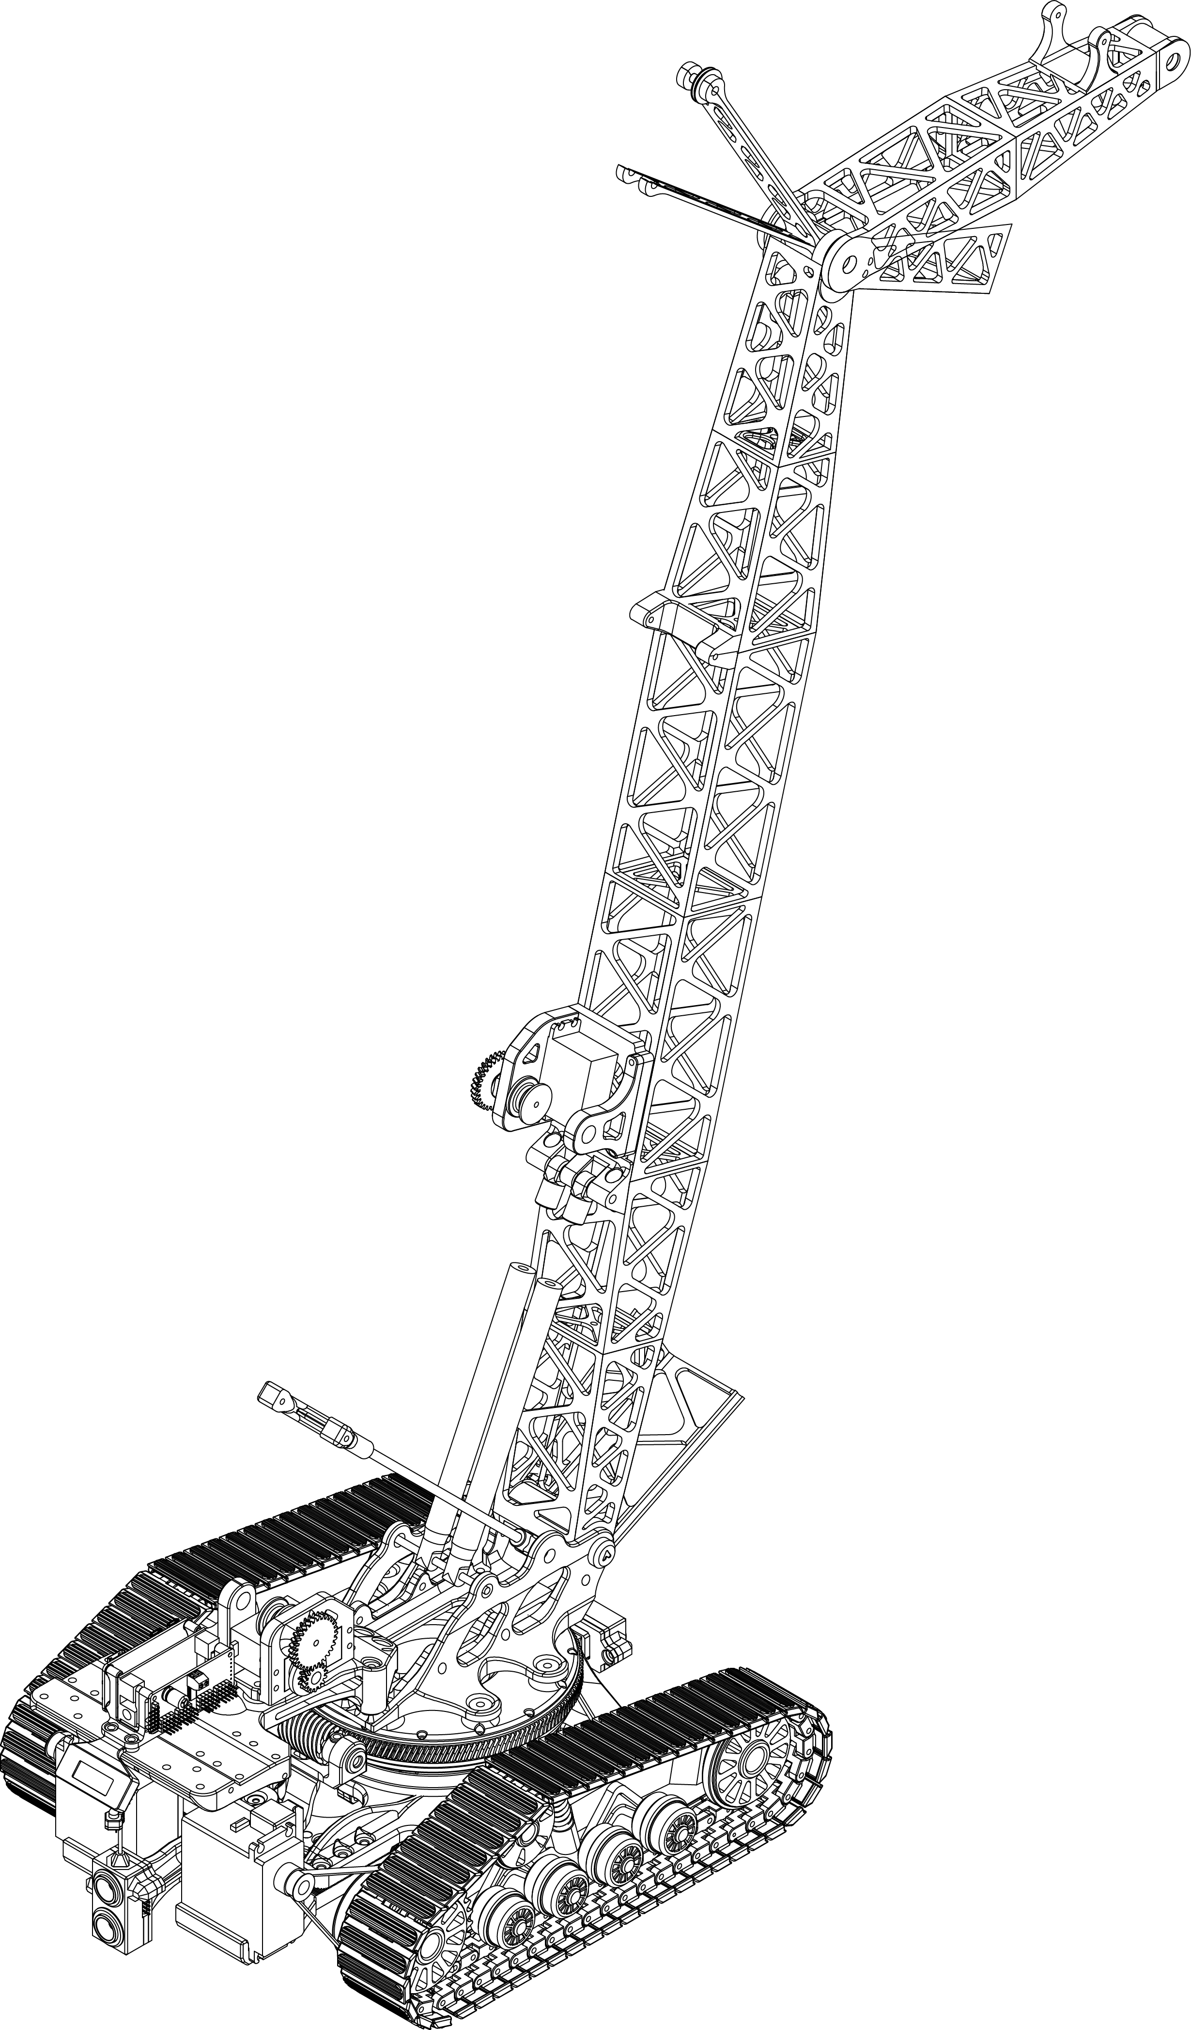

Slide 3
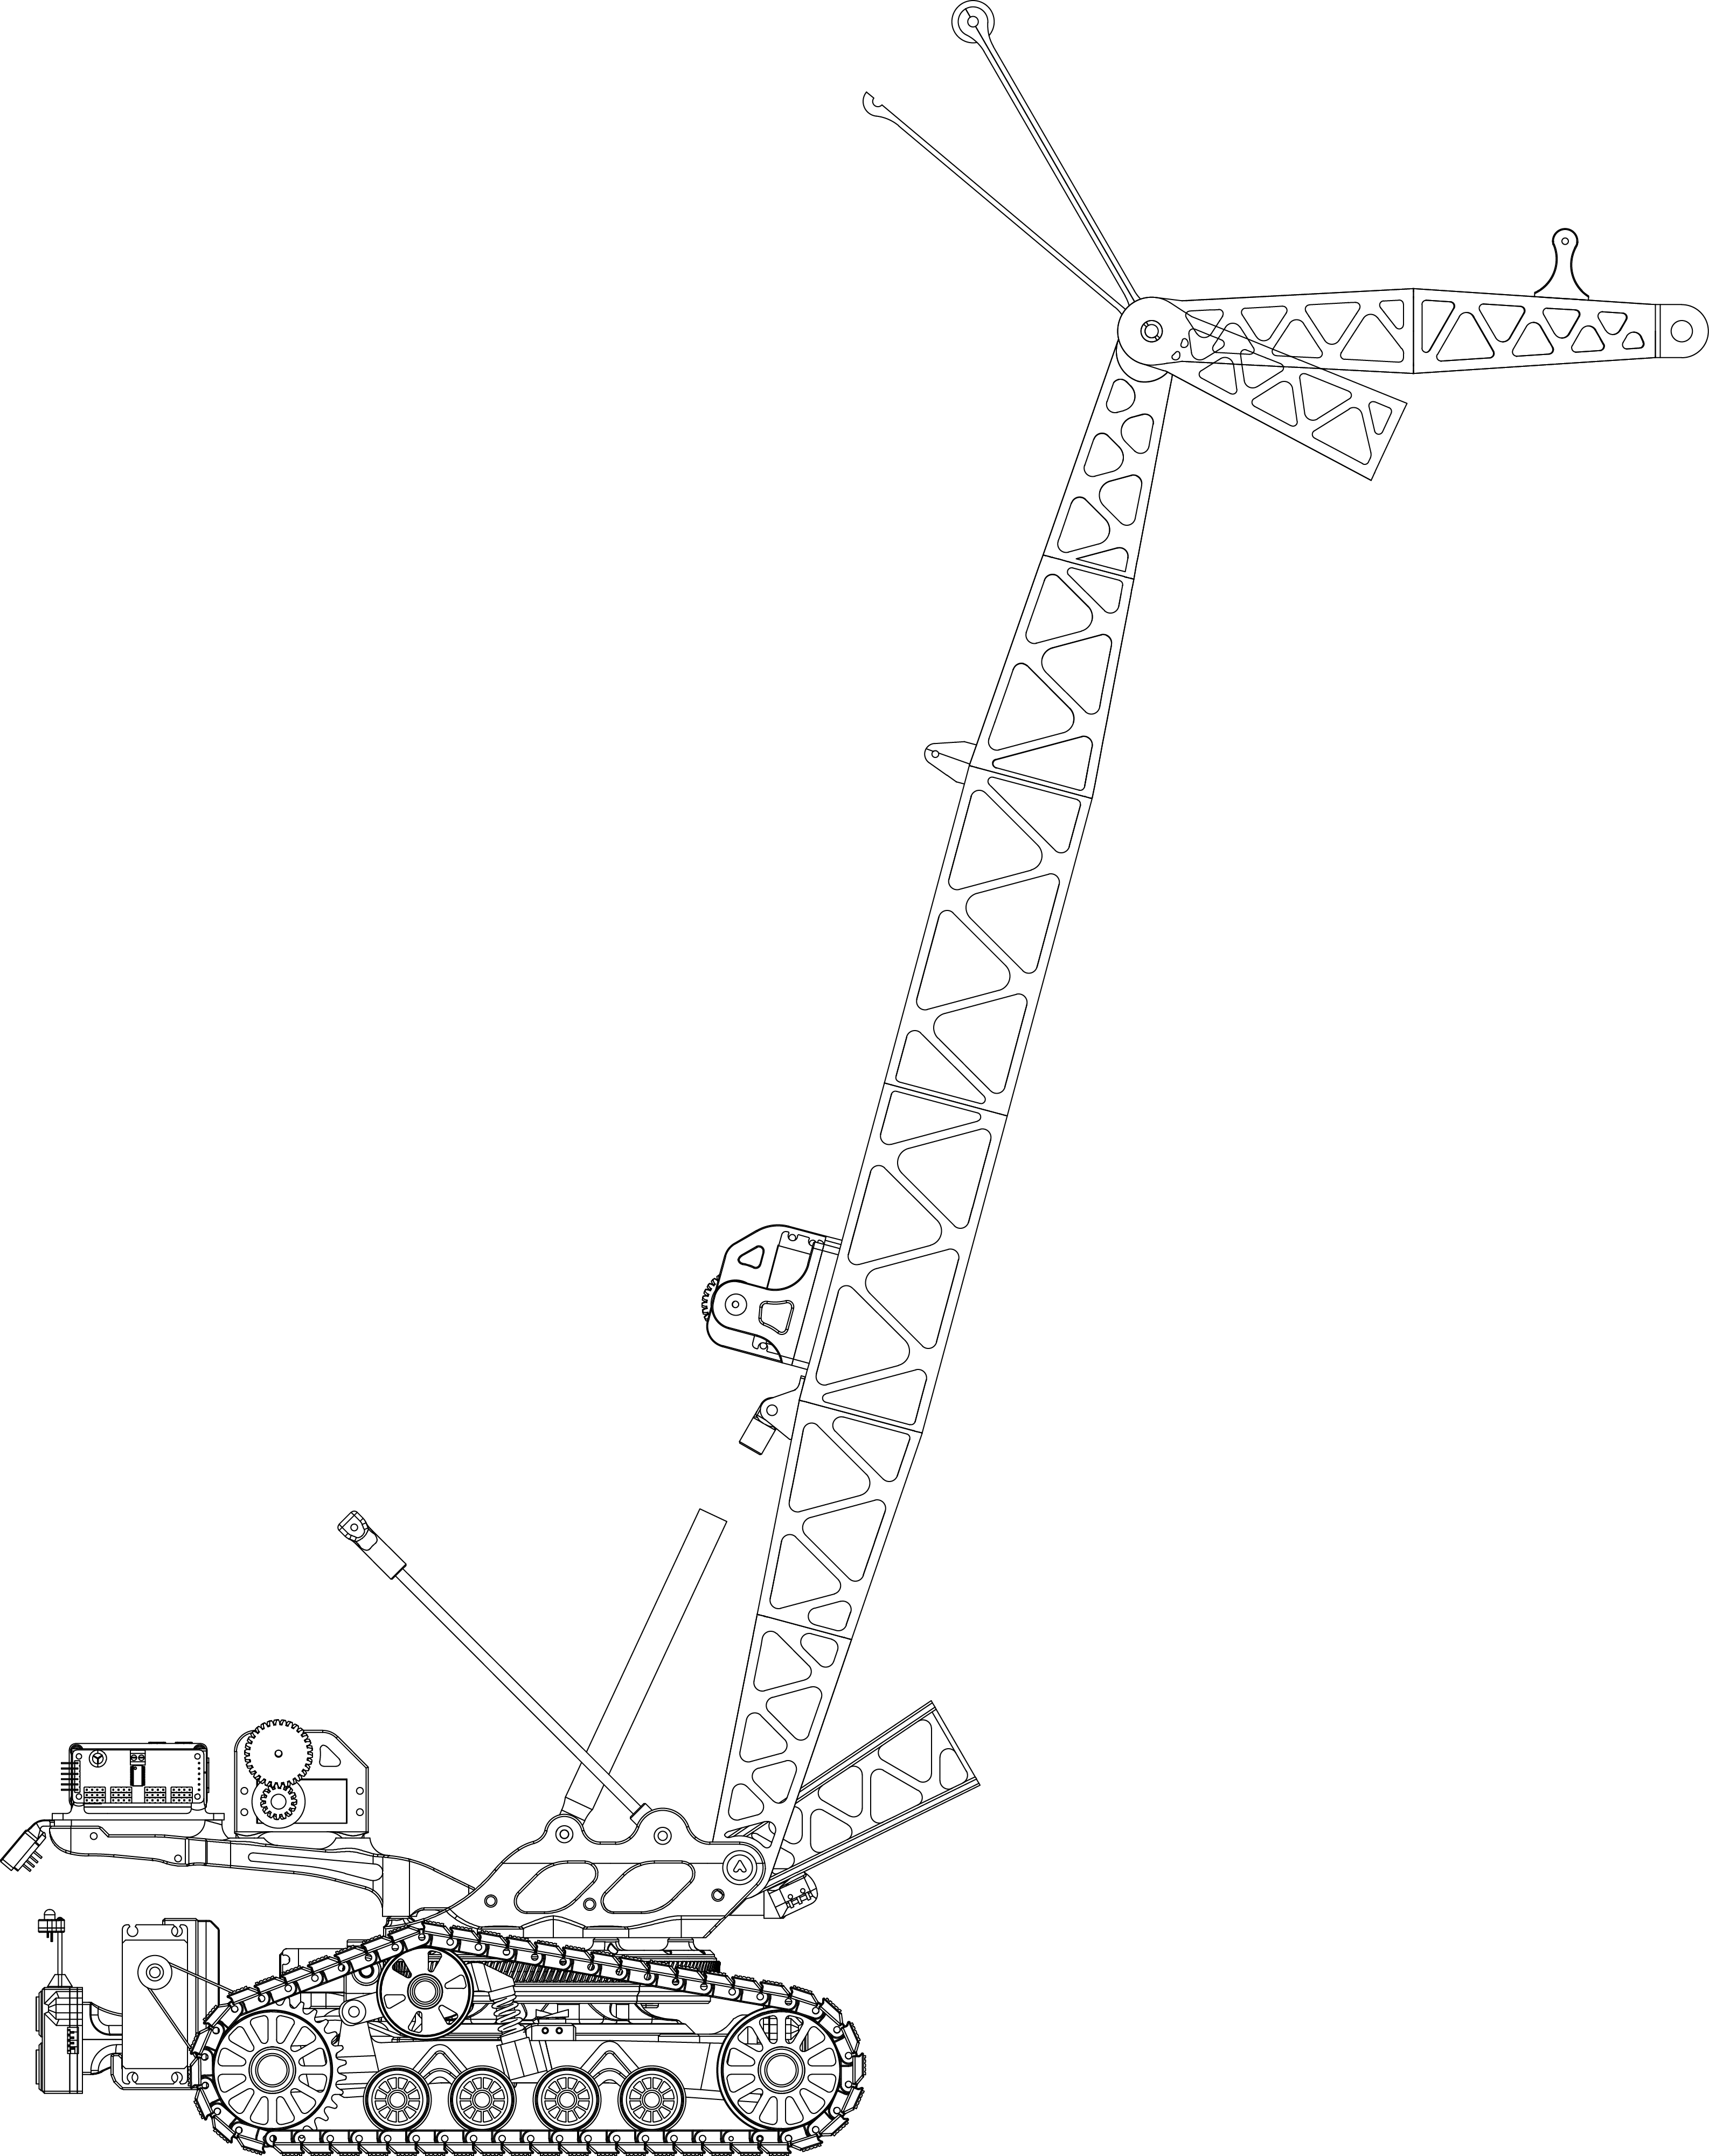

Slide 4
SWB
SWTCCW (outer ring) SWTCW (inner ring)

