Slide 1
Travel Diary
Mini Project
06.03.2011
Jonathan Wey
Michael Rüegg
Sergii Bilousov

Slide 2
Motivation
You want to share your geo location with a personal note to your friends on the Internet
You want a basic functionality for a shared service that you want to implement
We want to get acquainted to Android app programming

Slide 3
Goal
The goal is to design and implement an app
where a user can store geo locations, each
linked with a describing text to a server.

Slide 4
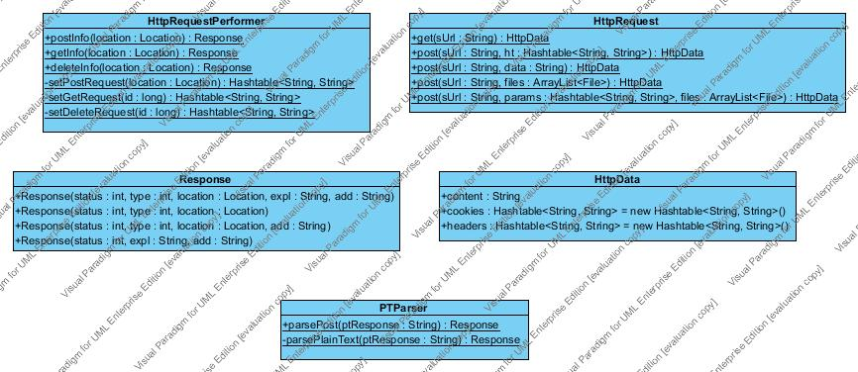
UML Diagrams

Slide 5
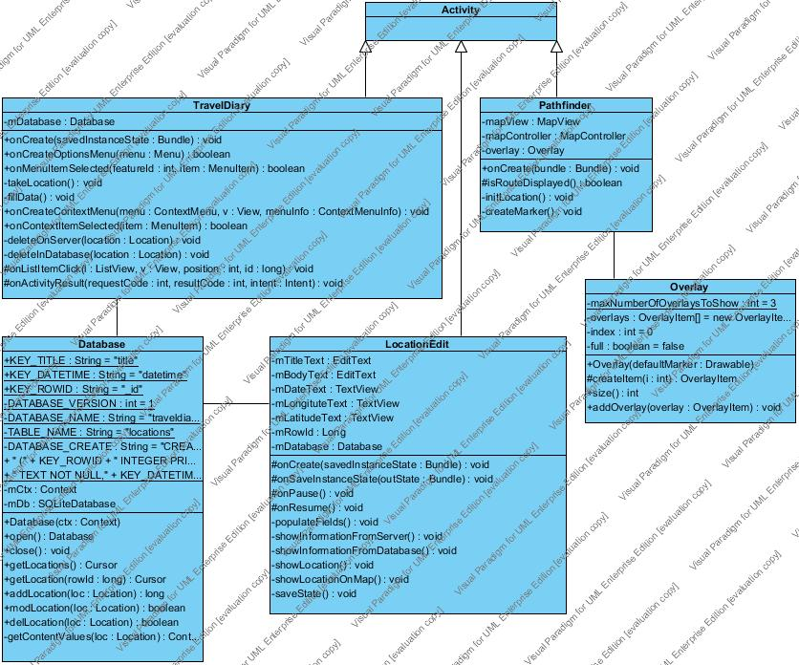
UML Diagrams

Slide 6
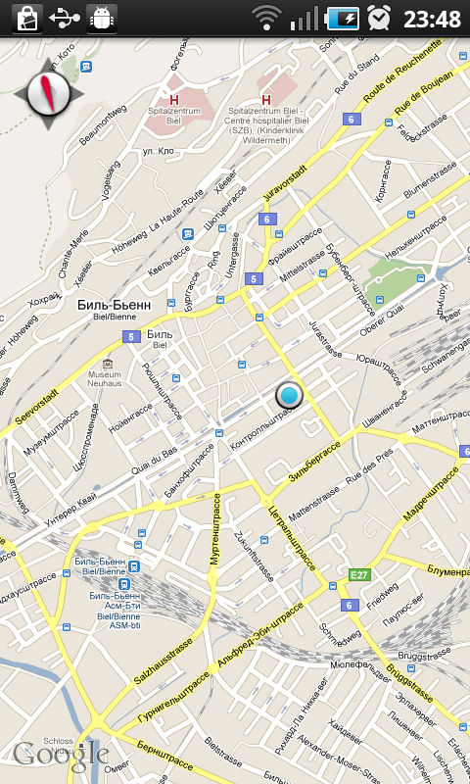
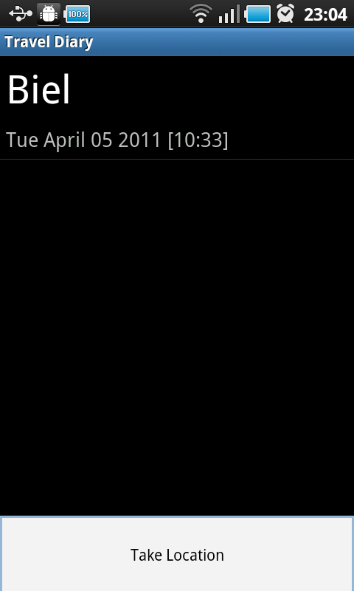
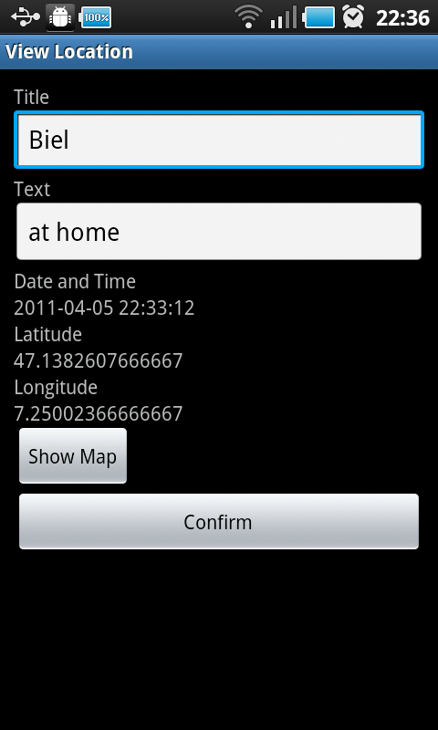
Screenshots

Slide 7
Leasons Learned
How to use Layouts
How to use ContentProviders
How to use SQLLite
Etc.

