Slide 1
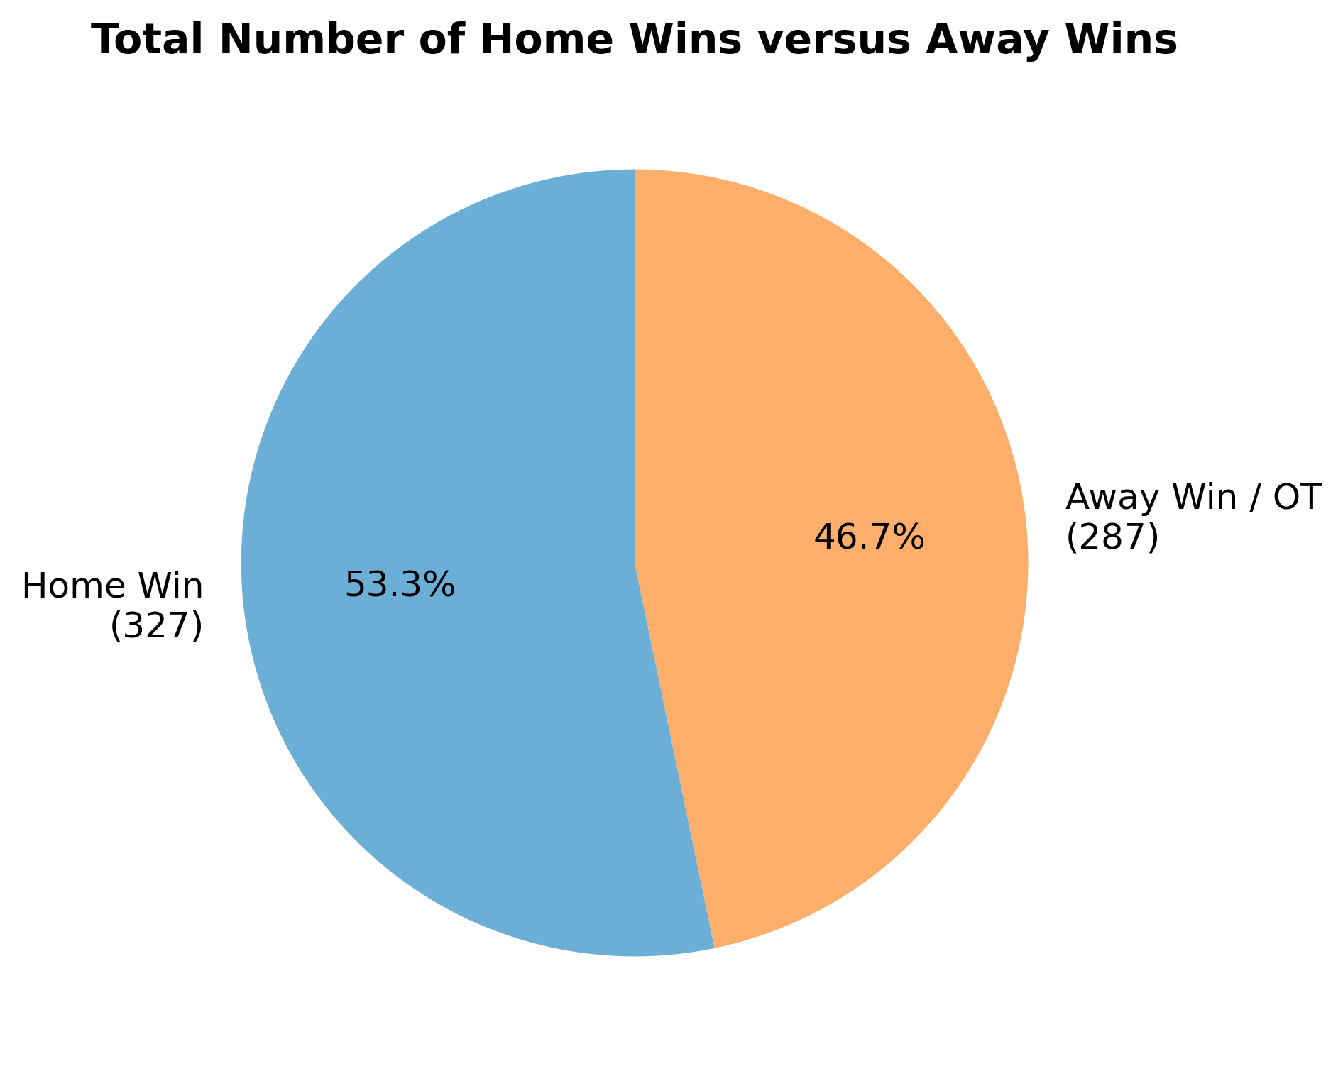
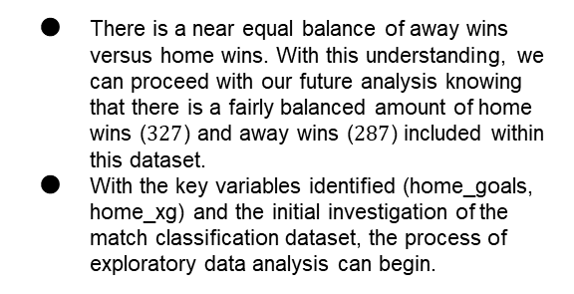

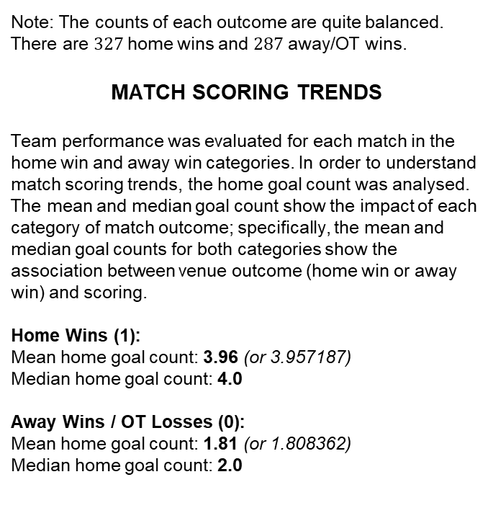
Executive Summary
Milestone 1 of the Finnish Liiga Game Outcome Classification Project
UNDERSTANDING THE DATA
Missing Values: 32 records (~5.2%) are missing Expected Goals (home_xg / away_xg) data.
OT/Shootout Complexity: Regulation ties going into OT/SO are currently forced into a binary classification.
Attendance Outliers: Certain matches display 0 spectators, requiring data cleaning before feature engineering.
After reviewing the provided dataset, the variable home_win seemed particularly useful, given the proposed match outcome prediction project. The following metrics show important points of analysis required to understand the home_win variable:
Home Wins (1): $327$games ($53.26\%$)
Away Wins / OT Losses (0): $287$games ($46.74\%$)
Note: The counts of each outcome are quite balanced. There are $327$home wins and $287$ away/OT wins.
MATCH SCORING TRENDS
Team performance was evaluated for each match in the home win and away win categories. In order to understand match scoring trends, the home goal count was analysed. The mean and median goal count show the impact of each category of match outcome; specifically, the mean and median goal counts for both categories show the association between venue outcome (home win or away win) and scoring.
Home Wins (1):
Mean home goal count: 3.96 (or 3.957187)
Median home goal count: 4.0
Away Wins / OT Losses (0):
Mean home goal count: 1.81 (or 1.808362)
Median home goal count: 2.0
A preliminary investigation of the Finnish Liiga match classification dataset was conducted to identify key relationships between variables. To classify game outcomes, the distribution of home and away wins was analyzed to understand the frequency of each match result.
The impact of this preliminary analysis will be evident in the next steps. In order to understand the impact of match dynamics, the data team identified two important variables to consider. The variables home_goals and home_xg (expected goals) are both important factors to consider for future prediction models.
Pie chart visualizes the comparison of the count of home wins and away wins
There is a near equal balance of away wins versus home wins. With this understanding, we can proceed with our future analysis knowing that there is a fairly balanced amount of home wins ($327$) and away wins ($287$) included within this dataset.
With the key variables identified (home_goals, home_xg) and the initial investigation of the match classification dataset, the process of exploratory data analysis can begin.

