Slide 1
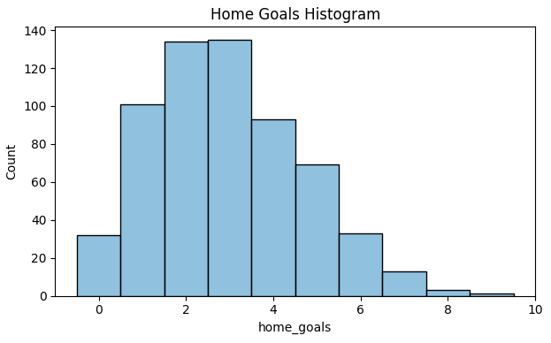
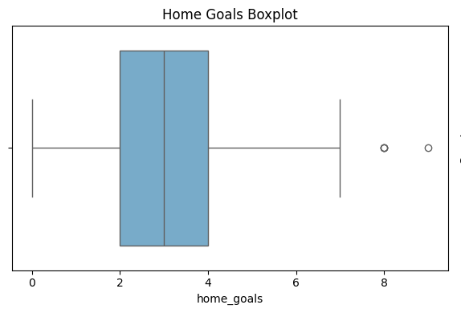
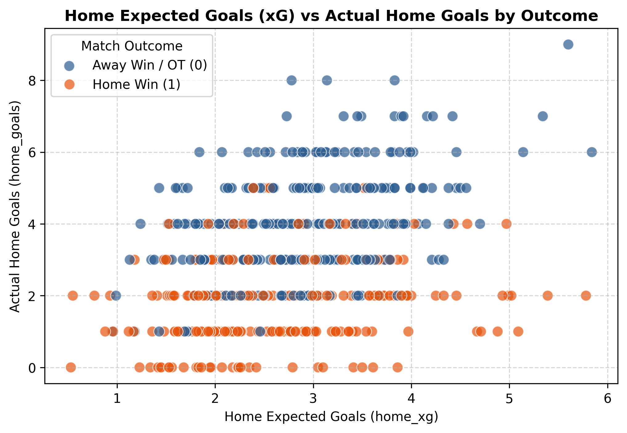
Finnish Liiga Match Classification Project
Exploratory Data Analysis (EDA) - Executive Summary
The objective of this project is to develop a machine learning model to predict match outcomes (home wins versus away wins / OT losses) for the Finnish Liiga. In this phase of the project, the raw match dataset needs to be thoroughly explored, cleaned, and structured to identify key statistical distributions, missing values, and potential outliers prior to any predictive model building.
A key component of this project’s exploratory data analysis involves visualizing the data. As illustrated in the following charts, it is clear how scoring metrics, outlier distributions, and expected goal (xG) relationships behave across the 614 games in the Finnish Liiga dataset.
Exploratory data analysis (EDA) was conducted at this stage to understand the impact of match dynamics on team performance and game outcomes. To do so, the data team analyzed variables that showcase attacking performance: home goals and expected goals (xG).
According to the findings from the exploratory data analysis, the future match outcome classification model will need to account for null values (missing xG data) and skewed scoring distributions by incorporating proper data imputation and feature engineering into the model parameters.
The home goals variable has a right-skewed distribution, with the vast majority of matches clustered between 2 and 4 goals. Games with 6 or more goals occur rarely in regular play.
Similar to goal counts, the boxplot illustrates a median of 3.0 goals and highlights 17 blowout games (>6 goals) as legitimate statistical outliers exceeding the upper 1.5 * IQR threshold.
Data is Balanced: Home teams win 53% of games and lose 47%. This almost 50/50 split means our model can learn easily without any complex data adjustments.
High-Scoring Games are Real: Matches with 6+ goals are real blowout wins, not typos or errors. Our model needs to accept these high scores as normal hockey games.
Ready for Modeling: Once we clean up the 32 missing xG values, the dataset is 100% ready for building our prediction models.
Again, looking at match outcomes, the scatter plot demonstrates a strong positive signal where home wins cluster at higher actual goals (≥3) and higher expected goals (xG ≥ 2.5).
The exploratory data analysis conducted from the Liiga data team revealed many considerations for the classification model, including missing values, "home wins" to "away wins / OT" balance, and overall distribution of data variables. The two key insights from this analysis were:
Null values
32 null values were found in expected goals metrics (home_xg and away_xg). As a result, future modeling should consider these null values to avoid making insights that would assume complete data. Imputation (e.g., median filling) or row exclusion is necessary to prevent missing values from impacting future statistical analysis or model building.
Skewed data distribution
Match scoring and attendance counts are concentrated at lower ranges (2–4 goals per game for most teams, with a median of 3.0). Therefore, the data distribution is right-skewed with notable high-scoring outliers (>6 goals), which will inform the models and model types that will be built (e.g., favoring tree-based algorithms like Random Forest).

