Slide 1
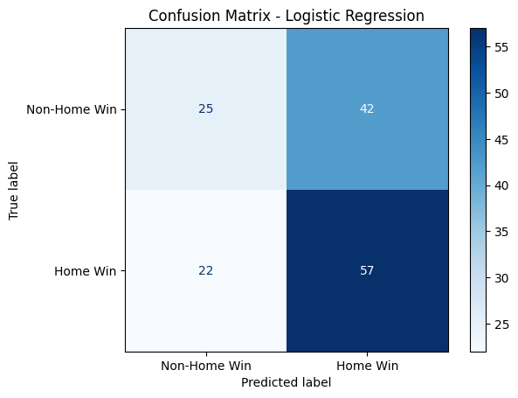
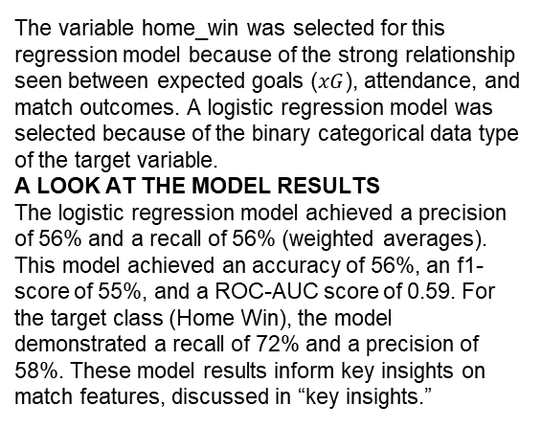
Executive Summary: Regression Analysis
Finnish Liiga Match Outcome Classification Project
The goal is to develop a machine learning model to classify match outcomes in the Finnish Liiga. Earlier analysis showed that higher expected goals (home_xg) are significantly associated with winning matches. Because the end goal is to predict game results, it is important to build a model that quantifies how key match metrics influence home team performance. In this phase of the project, a logistic regression model was built to predict home_win status.
The variable home_win was selected for this regression model because of the strong relationship seen between expected goals ($xG$), attendance, and match outcomes. A logistic regression model was selected because of the binary categorical data type of the target variable.
A LOOK AT THE MODEL RESULTS
The logistic regression model achieved a precision of 56% and a recall of 56% (weighted averages). This model achieved an accuracy of 56%, an f1-score of 55%, and a ROC-AUC score of 0.59. For the target class (Home Win), the model demonstrated a recall of 72% and a precision of 58%. These model results inform key insights on match features, discussed in “key insights.”
Based on the estimated model coefficients from the logistic regression, higher home expected goals (home_xg) and lower away expected goals (away_xg) tend to be associated with higher odds of a home win.
Other match features, such as attendance (spectators), have very small estimated coefficients in the model, so their association with home win status seems to be small. As a result, other match features besides expected goals do not seem to be strongly associated with home win status.
Confusion matrix for logistic regression model
The next step is to construct a classification model that will predict the outcome of matches in the Finnish Liiga. That is the final project and original expectation for the match outcome analysis. Now, there is enough information to analyze the results of that model with helpful context around team performance and expected goals metrics.
Upper-left: the number of matches resulting in non-home wins. Upper-right: the number of matches resulting in non-home wins. Lower-left: the number of matches resulting in home wins. Lower-right: the number of matches resulting in home wins.

