Slide 1
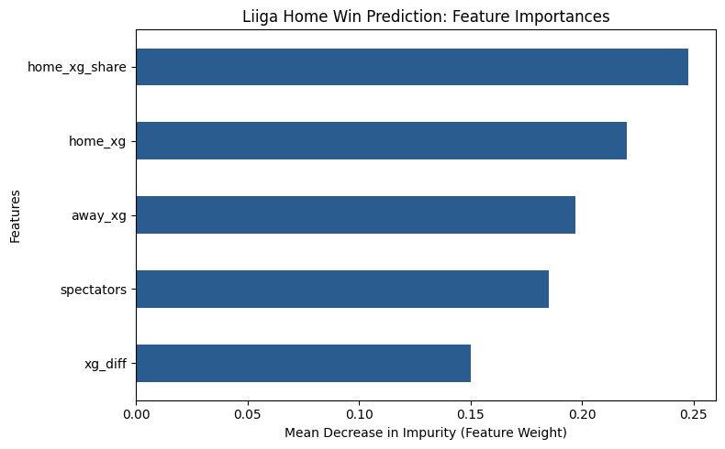
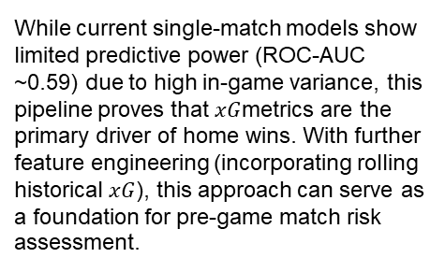
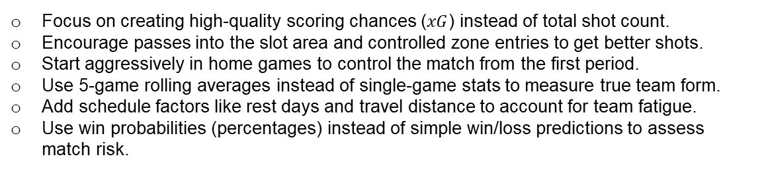
Finnish Liiga
Match Outcome Prediction Project
This project seeks to analyze match data from the Finnish Liiga and answer the following question:
What underlying performance metrics are most predictive of a home team victory?
Since the target variable (home_win) is categorical, either a logistic regression or tree-based machine learning model can be utilized.
The random forest model outperformed the XGBoost model, achieving higher cross-validation ROC-AUC scores and superior sensitivity on holdout test data.
In the random forest model above, 'xg_diff', 'home_xg_share', 'home_xg', 'away_xg', and 'spectators' have the highest importance. These variables are most helpful in predicting the outcome variable, 'home_win'
While current single-match models show limited predictive power (ROC-AUC ~0.59) due to high in-game variance, this pipeline proves that $xG$metrics are the primary driver of home wins. With further feature engineering (incorporating rolling historical $xG$), this approach can serve as a foundation for pre-game match risk assessment.
Focus on creating high-quality scoring chances ($xG$) instead of total shot count.
Encourage passes into the slot area and controlled zone entries to get better shots.
Start aggressively in home games to control the match from the first period.
Use 5-game rolling averages instead of single-game stats to measure true team form.
Add schedule factors like rest days and travel distance to account for team fatigue.
Use win probabilities (percentages) instead of simple win/loss predictions to assess match risk.

