Slide 1
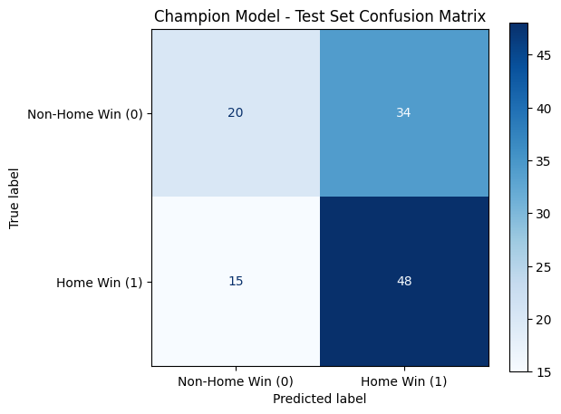
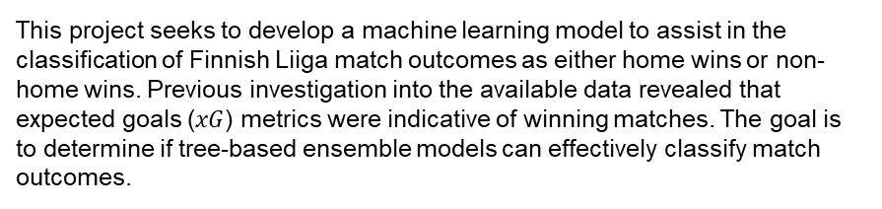
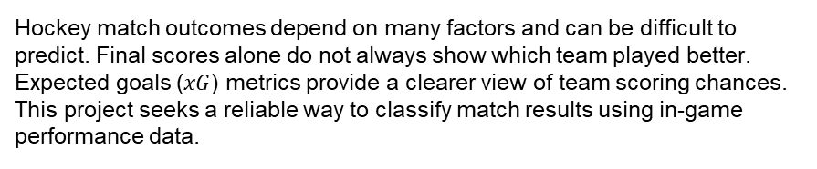
Machine Learning Model Outcomes
Executive summary report for the Finnish Liiga home win classification model
This project seeks to develop a machine learning model to assist in the classification of Finnish Liiga match outcomes as either home wins or non-home wins. Previous investigation into the available data revealed that expected goals ($xG$) metrics were indicative of winning matches. The goal is to determine if tree-based ensemble models can effectively classify match outcomes.
Hockey match outcomes depend on many factors and can be difficult to predict. Final scores alone do not always show which team played better. Expected goals ($xG$) metrics provide a clearer view of team scoring chances. This project seeks a reliable way to classify match results using in-game performance data.
Two tree-based classification models—Random Forest and XGBoost—were developed. Both models were tuned using cross-validation and evaluated on a held-out validation dataset, with the champion model selected based on the best ROC-AUC score. The final champion model was then evaluated on a holdout test dataset to estimate future performance.
Confusion matrix for the champion model on test holdout data shows 48 correctly predicted home wins and 49 misclassified samples out of 117 total matches.
Both model architectures—random forest (RF) and XGBoost—performed exceptionally well. The RF model had a better recall score (0.995) and was selected as champion.
Performance on the test holdout data yielded an overall accuracy of 58%, with 49 misclassified samples out of 117.
Subsequent analysis indicated that, as expected, the primary predictors were expected goals metrics, with xg_diff and home_xg_share accounting for nearly all predictive signal in the data. With these results, we can conclude that matches with higher expected goal differentials were much more likely to result in home wins. In fact, the model correctly identified 48 out of 63 actual home victories.
As noted, the model demonstrated strong sensitivity in detecting home wins on the test holdout data. Before deploying the model into production, further evaluation using additional historical seasons is recommended. Furthermore, monitoring the distributions of expected goals metrics and incorporating rolling team performance features will ensure that the model remains robust to in-season form fluctuations.

