Slide 1
Books & Antiques Store Website
Final Presentation
Briana Courtois
Maria Kochetygova
Xuran Wang

Slide 2
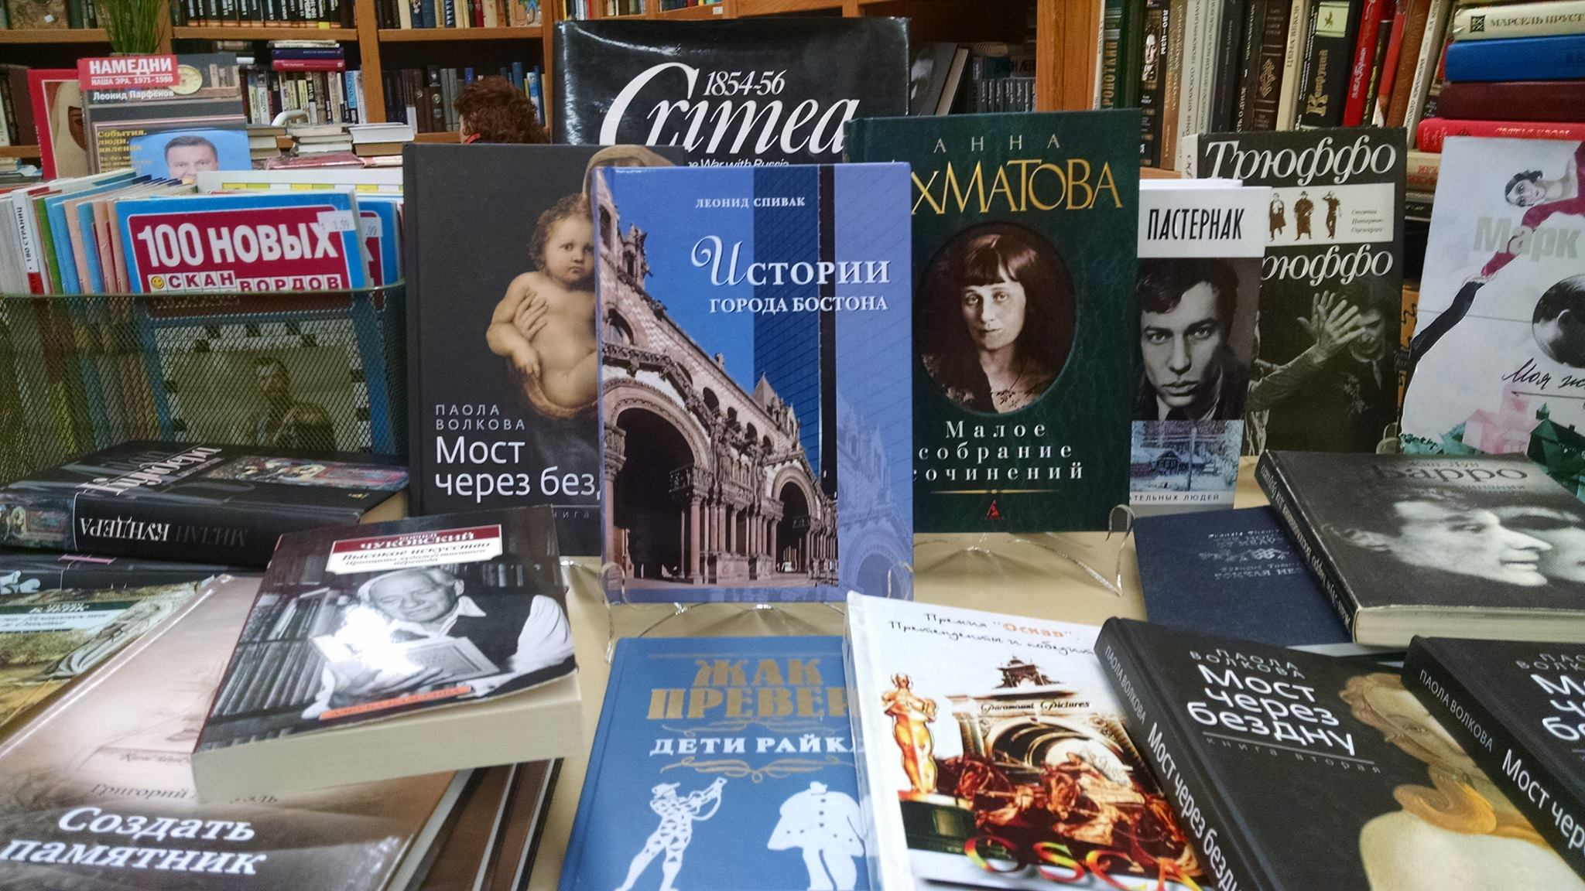
About
Local store
Selling: Books & Antiques
Hosting :Cultural events
1428 Beacon Street & 77 Harvard St,
Brookline, MA 02445
Address

Slide 3

Introduction
1
User Research Methods Briana Courtois
2
Storyboarding
Xuran Wang
3
Usability Testing
Maria Kochetygova
4
Wireframe Modifications
Briana Courtois
5
Prototyping Demonstration
Xuran Wang
6
Quality Assurance Testing
Maria Kochetygova

Slide 4
1
User Research Methods

Slide 5
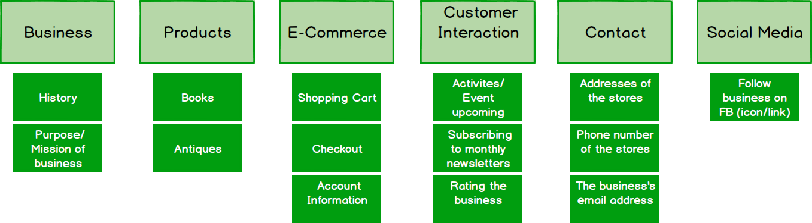
RESEARCH METHODS
CARD SORTING
Opened approach to build a better structured site

Slide 6
RESEARCH METHODS
FIRST-CLICK
ANALAYSIS
CUSTOMER FEEDBACK
DESIRABILITY STUDIES
Provided different visual-design color themes
Analyzed the pages and elements users click on
Surveyed individuals for their overall opinions

Slide 7
2
Storyboarding

Slide 8
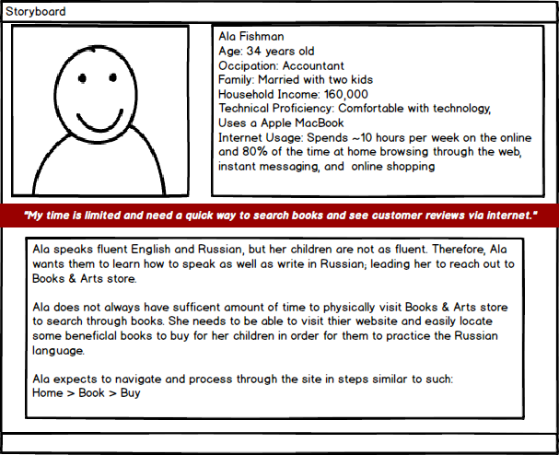
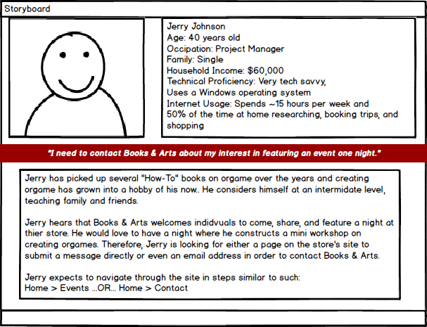
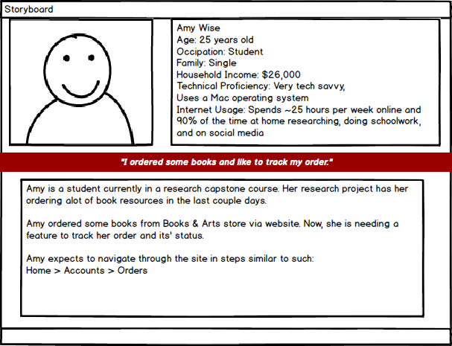
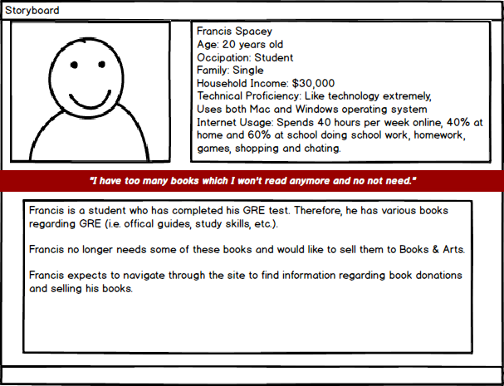
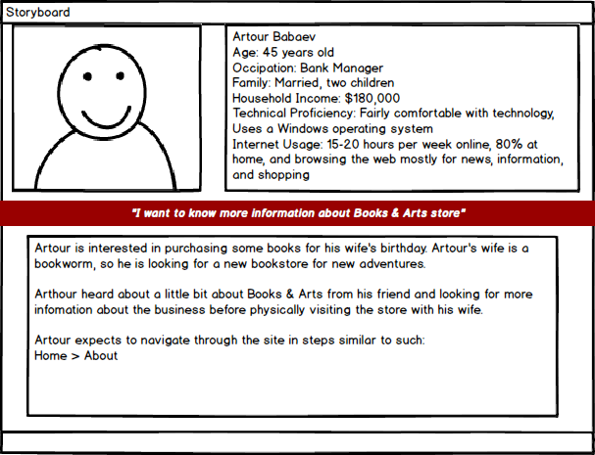
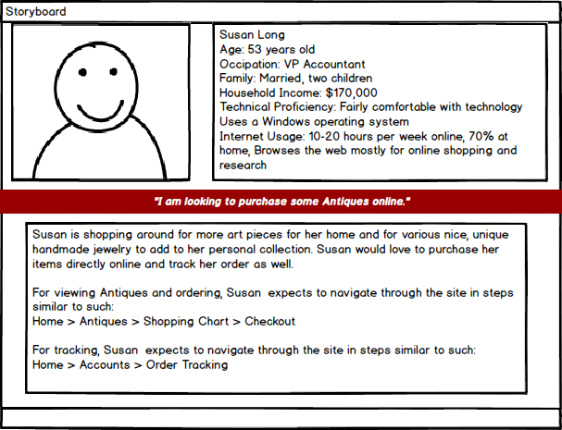
PERSONAS

Slide 9
PERSONAS
Donating user requirement

Slide 10
PERSONAS
Business’ history/story user requirement

Slide 11
3
Usability Testing

Slide 12
First-Click Testing

Slide 15
First-Click Testing
USER SUGGESTIONS
Remove Subscribe to US
Move Sell books to us on header because people don't really pay attention to footer
Make Login, shopping car and Location Logos Bigger
Create a sections for antiques

Slide 16
Survey
How would you describe the website in one or more words?
Answers:
Nice and simple, kind, welcoming, user-friendly
Clean
Very helpful, gives great ideas for future business development
Foreign

Slide 17
If you were to review what score would you give it out of 10?

Slide 18
If you could change one thing about the website what would it be and why?
The language- I can't understand it
Put "sell books to us" to the top menu
Nothing, I don't think.
I would shorten the word content
lf I could change, I would expand the range and download pictures

Slide 19
What do you like best about the website?
The design
I like its simplicity and its usefulness. It's easy to navigate, has a warm and inviting presentation, isn't confusing. The ease of its use is huge though, to me. The desired information is easy to access and the content seems simple and straightforward.
The navigation menu is easy to follow

Slide 20
How can we improve the website. Send us your ideas and suggestions?
Offer different languages
I don't think I have anything-- it looks good!
Continue to get feedback from customers
Color, better graphics, less paragraph make into bullets or shorter sentences.

Slide 21
Usability Testing : Tasks and Scenarios Execute when the website is complete
Task: Find a book "Arch Of Triumph" by Erich Maria Remarque
Scenario: You are taking a German literature class at local collage, and the book that you will discuses in the class is Arch of Triumph by Erich Maria Remarque, so you need to find and purchase the book.
Task: Find and antique Vase
Scenario: Mother's day is coming and you need to buy a present for you mom. You know that your mom loves antique vases. So you decided to get one for her.
Task: Create an account
Scenario: You purchase books from Books & Arts often . You need to create an account , so you can track you next purchase.
Task: Buy GRE Books
Scenario: You decided to apply for master program and you need to buy GRE Books

Slide 22
4
Wireframe Modifications

Slide 23
WIREFRAME MODIFICATIONS
INFO PLACEMENT
COLOR
THEME
Rearranged information to better enhance our navigation design
Changed color theme to brighter and friendlier mood as suggested by testers
https://app.moqups.com/courtois.b@husky.neu.edu/pfRq0WgK/view

Slide 24
WIREFRAME MODIFICATIONS
FOOTER
BOOKS
JOIN
Removed some unnecessary information
Added a scrolling informational line on page to bring attention to users
Removed the previous unnecessary tab
https://app.moqups.com/courtois.b@husky.neu.edu/pfRq0WgK/view

Slide 25
5
Prototyping Demonstration
http://www1.coe.neu.edu/~mockinaeon/UX_Final/index

Slide 26
6
Quality Assurance Testing

Slide 27
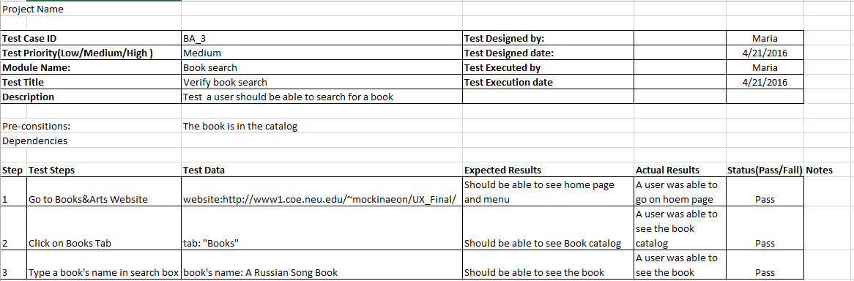
Quality Assurance Testing Cases

Slide 28
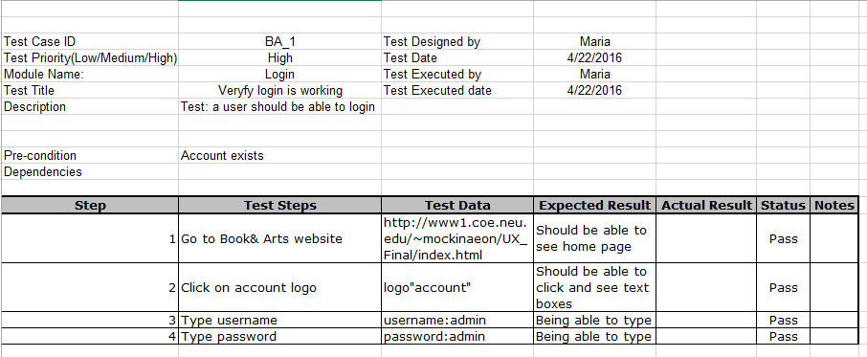
Test Login Function

Slide 29
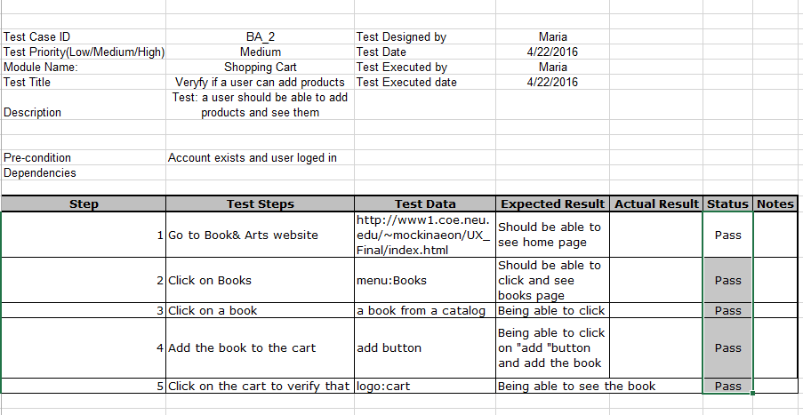
Test Shopping Cart

Slide 30
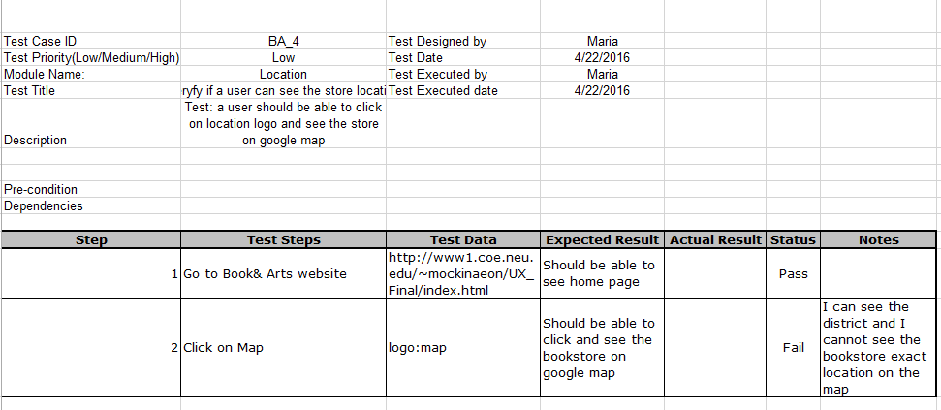
Test Location logo

Slide 31
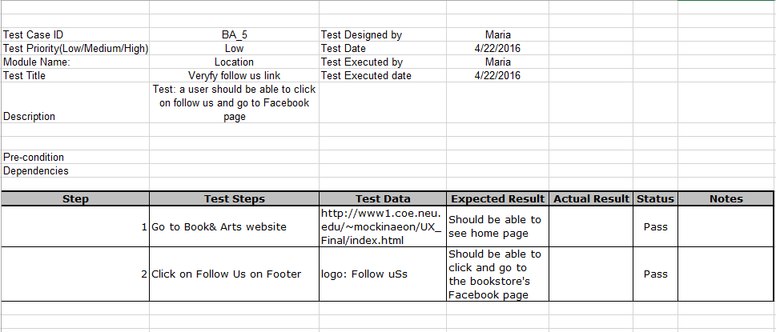
Test Follow us

Slide 32
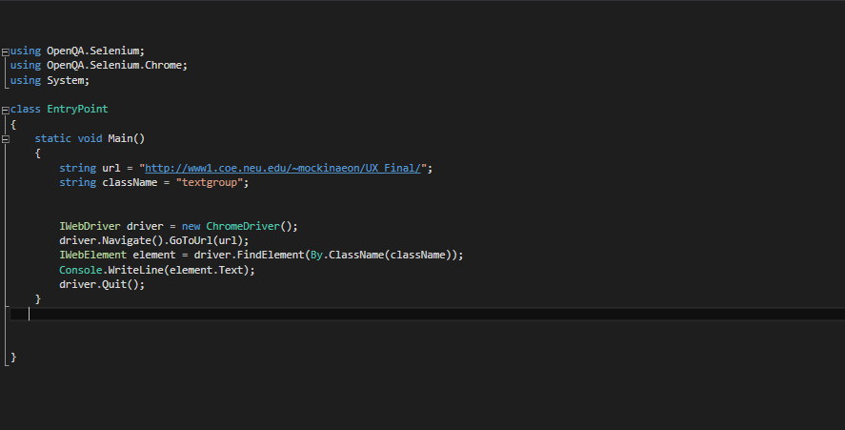
Small Senelium.WebDrive Test Cases Using C#
Test if the class of a specific element exists on the webpage.

Slide 33
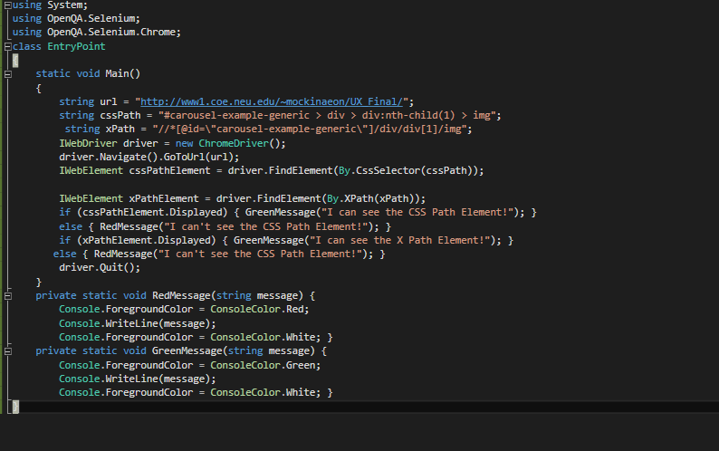
Test using CSS path or X path

Slide 34
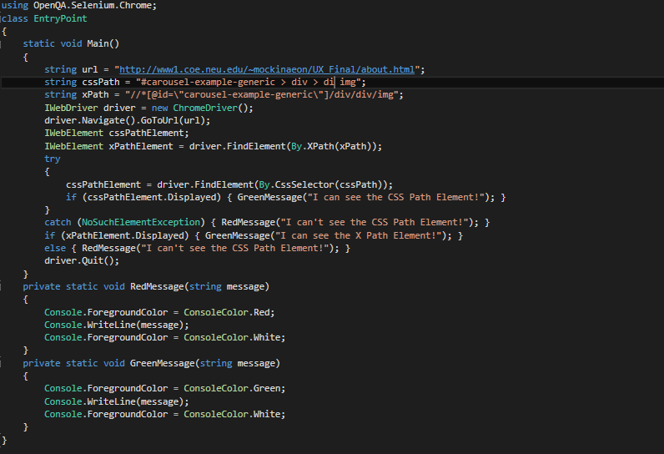
No Such Element

Slide 35
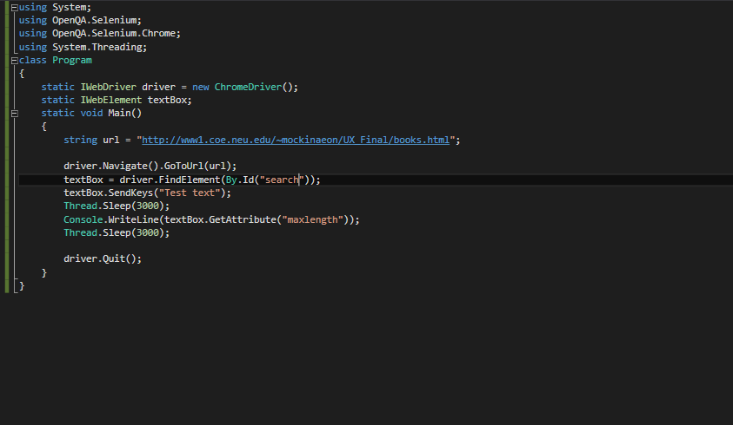
Test Text Box

Slide 36
Thank You
Any Questions?

