Slide 1
Books & Antiques Store Website
Briana Courtois
Maria Kochetygova
Mengqi Zhao
Xuran Wang

Slide 2
About
Local store
Selling: Books & Antiques
Hosting :Cultural events
1428 Beacon Street & 77 Harvard St,
Brookline, MA 02445
Address

Slide 3

Introduction
1
Strategy Plane -Maria Kochetygova
2
Scope Plane- Maria Kochetygova
3
Information Architecture
Xuran Wang
4
Wireframes Briana Courtois & Mengqi Zhao
5
Moqups Demonstration

Slide 4
1
Project Strategy

Slide 5
STRATEGY
Aspirations
1.Objectives
Create a website that will help to reach new customers.
2.Desire UX:
Make it immediately understandable, make it delightful, integrate information about the product that were easy to maintain
3 Focus: User ( segment and needs)
Geography,Product,Area of UX,
Aspect of Usability
Challenge
Losing customers and experience challenge to reach customers
1
2
Measurements:
Qualitative: User Research (tests, interviews.), Inspection (checklist, review.)
Quantitative: Metrics (analytics -Revenue growth)
Blue
Print
6
Activities:
User Research, Card sorting, Storyboards, Design exploration, Wireframing, Prototyping
5
4
Guiding Principle/Approach
Persuasive and user-friendly design
Constantly asking and checking if this is what the a user wants

Slide 6
2
Project Scope

Slide 7


Scope
What we are creating
We are creating a website that will help users to purchase products online and get information about new arrivals and events. The nature of the website is to help business to promote itself and attract more customers.
What we are not creating
We are considering adding features to the website that will help customer communicate, watch videos or read books, but it does not ﬁt as possibilities for future releases.

Slide 8
Define functional requirements
The user will go to the website browser the catalog of books, antiques, or event and buy products
The user will be able to get information about the website
The content requirements
In Book section, each book will have the name of the book, author’s name, price, and ratings accompanied by photographs
In Antique section, each item will have a short description accompanied by photographs, author's’ name, and price
In Event section, there will be a calendar with events’ name and possible photographs ( not a requirement)

Slide 9
3
Information Architecture
A further look on the site’s Information Architecture according to User Requirements

Slide 10
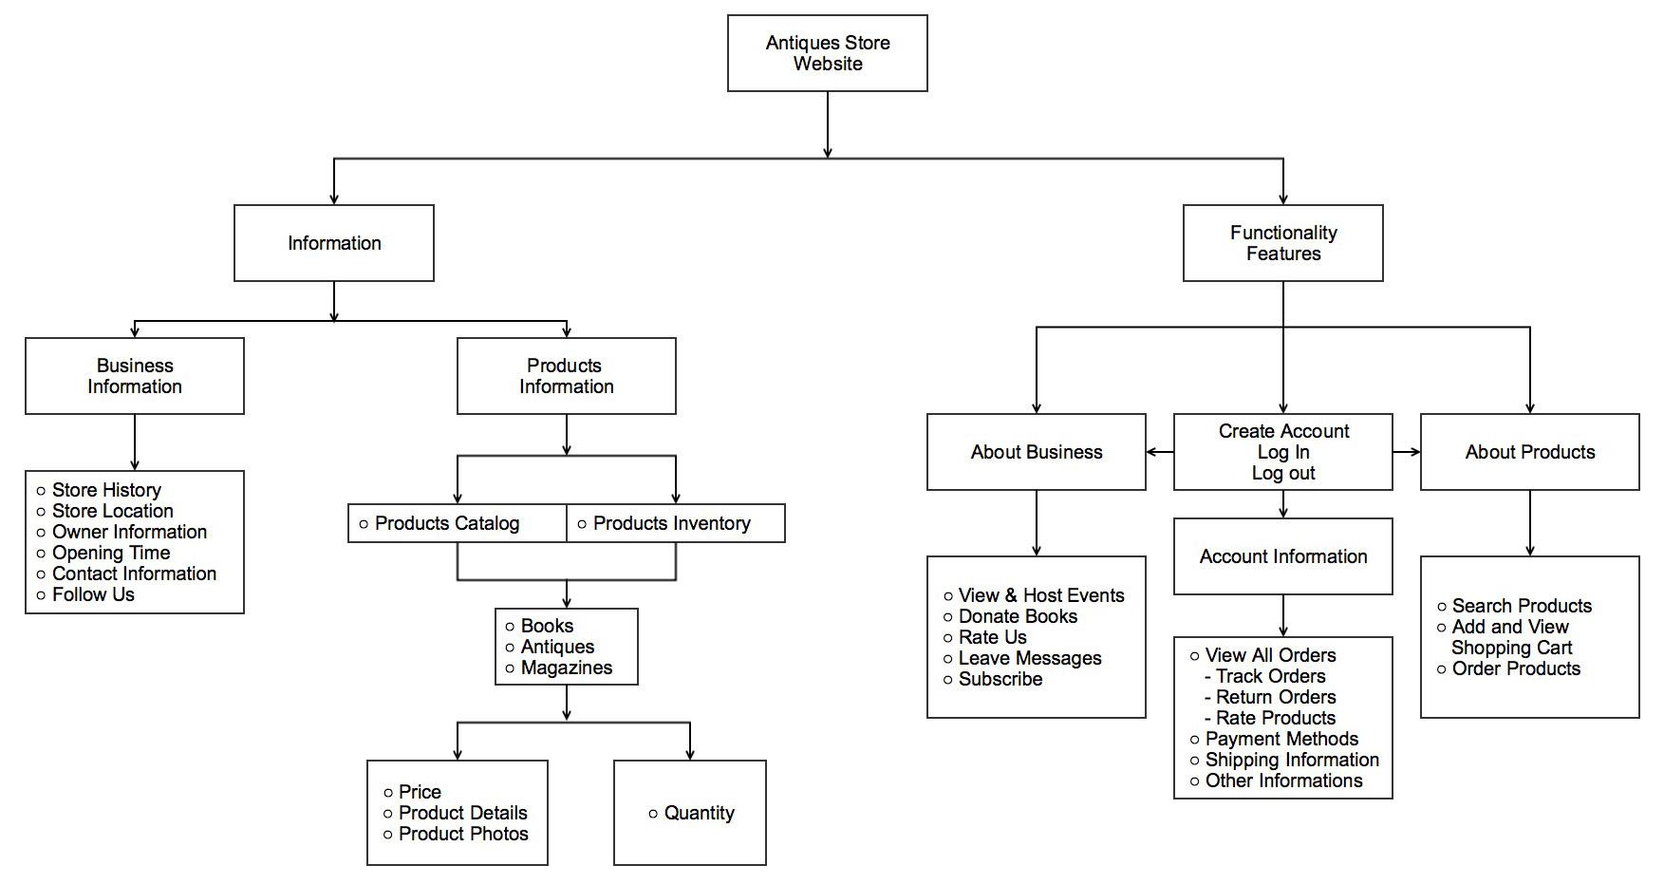
Information Architecture

Slide 11
4
Wireframes
See how our mockups align with good user experience mentioned in course textbook “Elements of User Experience”

Slide 12
MAIN UX TIPS
CONSISTENCY
SIMPLICITY
PLACEMENT
Jakob’s Law of User Experience keeping consistency with design conventions
Keeping it simple for end user providing a user-friendly experience
Used proper placement of information throughout the site

Slide 13
MAIN UX TIPS
USER REQUIREMENTS
NAVIGATION DESIGN
SEARCH
ENGINE
Align our site with user needed and requirements
Site’s navigation shows clear relation between pages/tabs
Page titles have high search visibility

Slide 14
5
Moqups Demonstration
First Set Mockups Ex. - Bre
https://app.moqups.com/courtois.b@husky.neu.edu/pfRq0WgK/view
Second Set Mockups Ex. - Mengqi
https://moqups.com/#!/edit/zhaomengqi8000/LWNF4wq4

Slide 15
Thank You
Any Questions?

