Slide 1
1
Project for CSYE 7210
Spring 2016 | Midterm Presentaton Books & Arts Store Website
Maria Kochetygova
Briana Courtois
Mengqi Zhao
Xuran Wang

Slide 2
2
Project Strategy & Scope
A synopsis of our Project Summary website and User Requirements gathered

Slide 3
About
Local store
Selling: Books & Antiques
Hosting :Cultural events
1428 Beacon Street & 77 Harvard St,
Brookline, MA 02445
Address

Slide 4
STRATEGY
Aspirations
1.Objectives
Create a website that will help to reach new customers.
2.Desire UX:
Make it immediately understandable, make it delightful, integrate information about the product that were easy to maintain
3 Focus: User ( segment and needs)
Geography,Product,Area of UX,
Aspect of Usability
Challenge
Losing customers and experience challenge to reach customers
1
2
Measurements:
Qualitative: User Research (tests, interviews.), Inspection (checklist, review.)
Quantitative: Metrics (analytics -Revenue growth)
Blue
Print
6
Activities:
User Research, Card sorting, Storyboards, Design exploration, Wireframing, Prototyping
5
4
Guiding Principle/Approach
Losing customers and experience challenge to reach customers

Slide 5


Scope
What we are creating
We are creating a website that will help users to purchase products online and get information about new arrivals and events. The nature of the website is to help business to promote itself and attract more customers.
What we are not creating
We are considering adding features to the website that will help customer communicate, watch videos or read books, but it does not ﬁt as possibilities for future releases.

Slide 6
3
Information Architecture
A further look on the site’s Information Architectue accordign to User Requirements

Slide 7
4
Wireframes
See how our mockups align with good user experience mentioned in course textbook “Elements of User Experience”

Slide 8
MAIN UX TIPS
CONSISTENCY
SIMPLICITY
PLACEMENT
Jakob’s Law of User Experience keeing consistency with design conventions
Keeoing it simple for end user providing a user-friendly experience
Used proper placement of information througout the site

Slide 9
MAIN UX TIPS
USER REQUIREMENTS
NAVIGATION DESIGN
SEARCH
ENGINE
Align our site with user needed and requirements
Site’s navigation shows clear relation between pages/tabs
Page titles have high search visibility

Slide 10
5
Moqups Demonstration
First Set Mockups Ex. - Bre
https://app.moqups.com/courtois.b@husky.neu.edu/pfRq0WgK/view
Second Set Mockups Ex. - Mengqi
https://moqups.com/#!/edit/zhaomengqi8000/LWNF4wq4

Slide 11
Thank You
Any Questions?

Slide 12
Extra Slide Templates
Xuran, Remove what’s left once you complete with your Section 3.

Slide 13
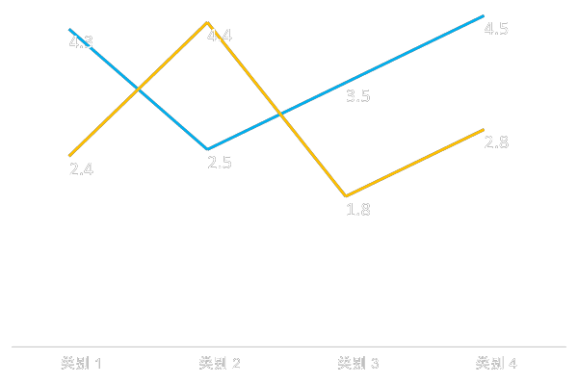
ENTER TEXT
Enter text
Albert Einstein: Logic will get you from A to B. Imagination will take you everywhere.
Enter text
Albert Einstein: Logic will get you from A to B. Imagination will take you everywhere.

Slide 14
ENTER TEXT
Albert Einstein: Logic will get you from A to B. Imagination will take you everywhere.
Albert Einstein: Logic will get you from A to B. Imagination will take you everywhere.
ENTER TEXT
ENTER TEXT
ENTER TEXT
ENTER TEXT
Albert Einstein: Logic will get you from A to B. Imagination will take you everywhere.
Albert Einstein: Logic will get you from A to B. Imagination will take you everywhere.

Slide 15

ENTER TEXT
Albert Einstein: Logic will get you from A to B. Imagination will take you everywhere.
Albert Einstein: Logic will get you from A to B. Imagination will take you everywhere.
2
4
1
3
Albert Einstein: Logic will get you from A to B. Imagination will take you everywhere.
Albert Einstein: Logic will get you from A to B. Imagination will take you everywhere.

Slide 16
ENTER TEXT
1
1
Albert Einstein: Logic will get you from A to B. Imagination will take you everywhere.
2
2
Albert Einstein: Logic will get you from A to B. Imagination will take you everywhere.
3
3
Albert Einstein: Logic will get you from A to B. Imagination will take you everywhere.

Slide 17
ENTER TEXT
Albert Einstein: Logic will get you from A to B. Imagination will take you everywhere.
ENTER TEXT
ENTER TEXT
Albert Einstein: Logic will get you from A to B. Imagination will take you everywhere.
ENTER TEXT
Albert Einstein: Logic will get you from A to B. Imagination will take you everywhere.
ENTER TEXT
Albert Einstein: Logic will get you from A to B. Imagination will take you everywhere.

Slide 18
ENTER TEXT
2
3
1
Albert Einstein: Logic will get you from A to B. Imagination will take you everywhere.
Albert Einstein: Logic will get you from A to B. Imagination will take you everywhere.
Albert Einstein: Logic will get you from A to B. Imagination will take you everywhere.

Slide 19
ENTER TEXT
ENTER TEXT
ENTER TEXT
Albert Einstein: Logic will get you from A to B. Imagination will take you everywhere.
ENTER TEXT
Albert Einstein: Logic will get you from A to B. Imagination will take you everywhere.
Albert Einstein: Logic will get you from A to B. Imagination will take you everywhere.

