Slide 1
Card Sorting
Maria Kochetygova

Slide 2
Preparation
Based on website for Riverside Art Center
http://www.riversideartcenter.org/html/children_s_art.html
The website does not really have an Information Architecture
The same stuff can be in different categories. So, I decided to organized and make it clear
For organizing information, I used a card sorting

Slide 3

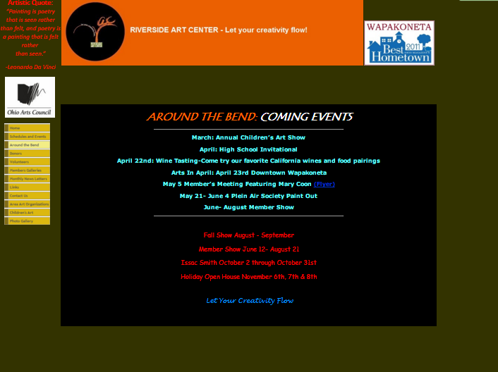
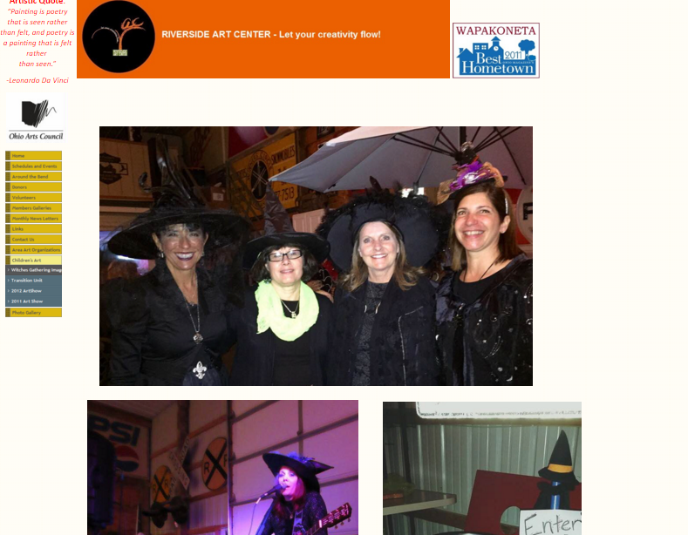
Some Screenshots of the Website

Slide 4
Card Sorting
Calendar of events
Class schedule
Special events
Pictures from events
Art
Donate
Donors list
Donate form
Amazon smile
Kroger Rewards Card
Help local business

Slide 5
Card Sorting
Volunteer
Skills survey.
Members
Becoming a member
Blog
Partners
Board members info
Address
Phone
Email
History
Quote

Slide 6
Organized by Category
About Us | Art Gallery | Calendar | Help Us | Blog | Partners
History | Art | Month calendar | Donations | Pictures from Events | Local Galleries
Contact Info | Members | Special events | Affiliated Products | New | Local Business
Board members info |  | Class schedule | Volunteer

Slide 7
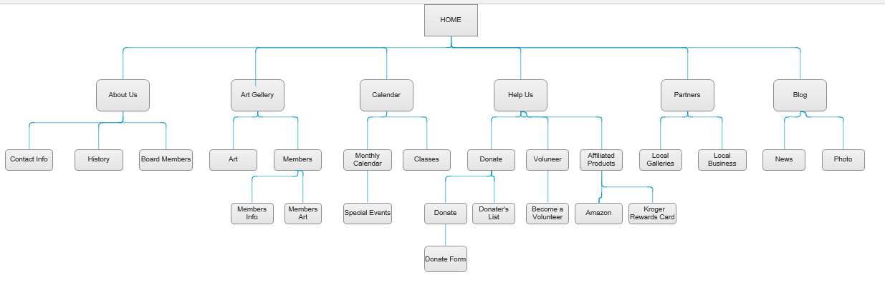
Information Architecture

