Slide 1
Example :TranskriptWunder

Slide 2
Why will people come to your site?
They have audio files and want them to be transcribed in text, for instance interviews, meeting notes, videos
Determine the immediate and long-range goals of the site: are they different?
Immediate goal:
Company goal: is to get clients
Clients’ goal: is to get cheap services with high quality
Long term goal:
Company goal: create a data base of regular / loyal customers and high skilled permanent transcribers
Pinpoint the intended audiences and conduct a requirements analysis for each group.
Students, who do interviews in their work - entrepreneurs, journalist, researchers, who don't want to waste time typing, and marketers have videos to be transcribed

Slide 3
The website used the hierarchical structure approach for organizing its information. I decided to keep the same structure because it is easy to navigate and understand for the users. I used bottom-up technique to reorganize the information, add more tabs with info that the users might find interesting, and reproduce the hierarchical structure. “Bottom up design is the result of thoroughly understanding the users and their needs and designing starting from there”.
It is important to have an information about the company such as team’s pics and their bio, mission of the website, and history. Human contact is an important part of the website. It adds a personal touch and can lend trust to visitors. Also I think it is important to separate Testimonials and Contacts for Clients and Transcribers, it makes it more organize and easy to find information for both categories.

Slide 4
Work Together
User Needs
Two types of users: Client and Transcriber
Client needs:
Get a quote
Sign up for service
Contact with the support
Read Reviews
Get Info about Team and company
Transcriber needs:
Get info how to become a transcribe
Sign up for account
Contact with Support
Read Reviews
Get Info about Team and company

Slide 5
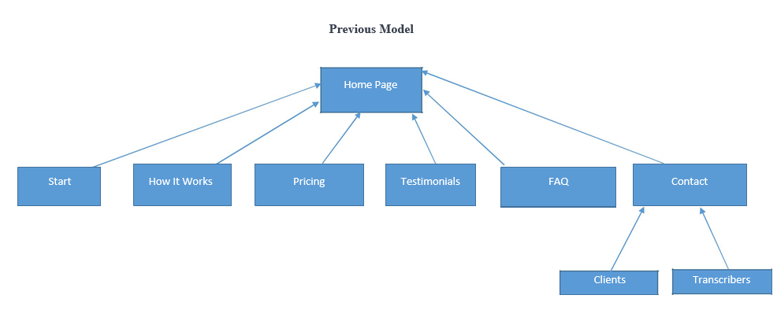
Notes:
In Slide Show mode, click the arrow to enter the PowerPoint Getting Started Center.

Slide 6
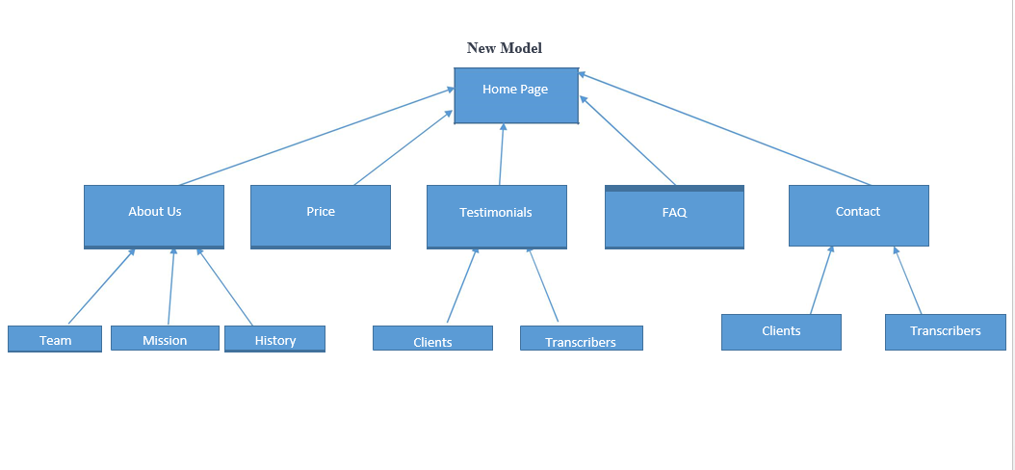

Slide 7
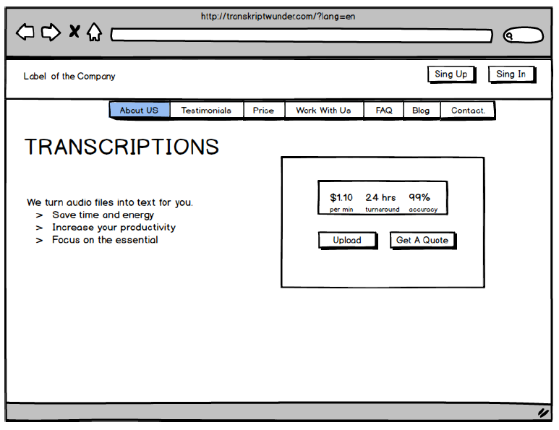

Slide 8
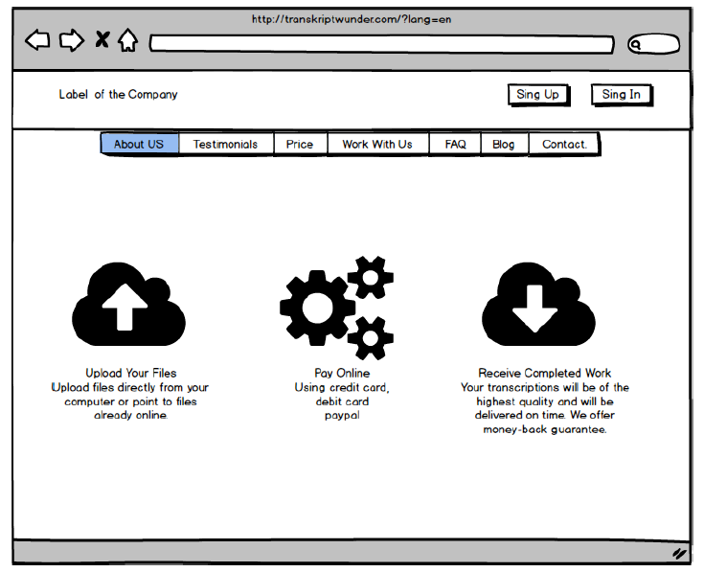

Slide 9
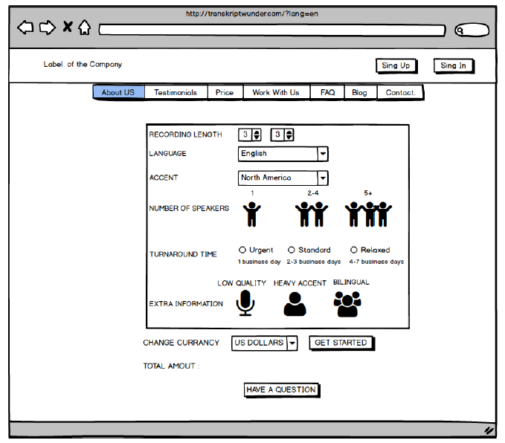

Slide 10
