Slide 1

How can we leverage data science techniques to identify and understand the target audience best suited for NutriFit

Slide 2
content
Introduction to the Business(NutriFit)
Data Used
Analysis
What questions need to be asked
Analytical Application
Big Data Sources
Predictions

Slide 3
Introduction to the business
NutriFit is a cloud kitchen that is planning to provide tailored, nutritious meal plans based on individual dietary needs and health goals. NutriFit is planning to target the youth who prioritize health and convenience. For understanding the market better, they conducted a survey and gathered few insights. Below is a summary of the present market fit and landscape.
Key Statistics:
  70% of those responded to our survey showed interest in meal services that would align with certain health goals.
  65% selected plant-based and low-carb food alternatives.
  45% would be willing to pay more for a personalized meal plan.

Slide 4
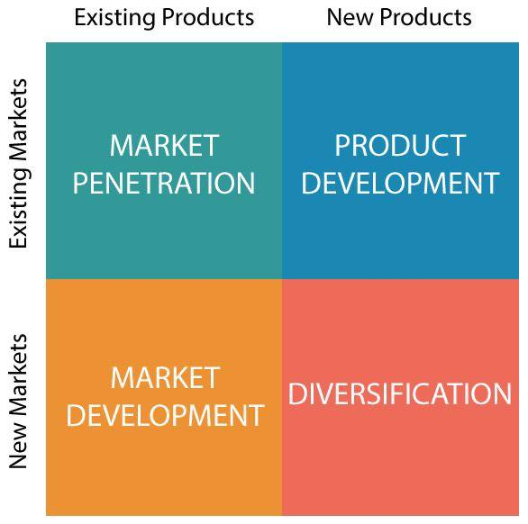
CURRENT BUSINESS PROCESS
Increase Revenue – Product Development
Goal: Drive revenue with top product offerings and enhancements in customer experience.
In its product development, NutriFit strives to drive revenue growth by:
1. Data-Driven Meal Customization: By leveraging insights from surveys and demographic data, NutriFit creates meals that speak to highly popular dieting trends for example, keto or vegan. This personalization sparks customer engagement and repeat purchases.
2. Targeted Promotions:
NutriFit crafts promotional offers informed by insights into customer preference and budget, in a bid to drive trials and subscriptions that turn one-time customers into regulars.

Slide 5
Data used in the business process
Prospective customer data - personal details of our prospective customers.
Data collected from the survey - Target group analysis.
Dietary Trends - Analysing the market and seeing what kind of diet is trending more in the prevailing market.
Competitors - Checking for the prices and offers our competitors are providing to their customers, analysis like this can help us in fixing competitive pricing thus making us relevant in the market.
Data containing diet preferences of our prospective customers.
Availability of ingredients across different regions - Checking for data that shows the availability of ingredients across regions to optimize our purchase thus leading to proper inventory management.

Slide 6
What analysis do we need to make?
User demographics: By analysing user demographics we can examine, for instance; what age group people are more inclined to opt for our service.
Anthropometric analysis: We can examine, people falling under what BMI range are more interested in our service.
Financial statistics: We can analyse correlation between prospective customer’s monthly income and the amount they’re willing to spend per week on our service.
Fitness metrics: People with what sort of body goals are more interested in subscribing to our service.
Consumption habits: Based on our prospective customers Consumption habits we can analyse the availability of resources needed to fulfil our customer’s requirements.

Slide 7
Big data sources
Data Sources | Attributes | Scoring
Prospective Customer Data | Age, gender, region, personal details | We could further use clustering algorithms to group the prospects into different clusters based on their demographic profiles. This would enable targeting of marketing and tailored service recommendations at a finer level of granularity.
Data Collected from the Survey | Target group, budget, meal preference, occupation | The predictive analytics can be applied to survey data in order to find out the customer segments most likely to adopt our service, hence enabling one to target the campaigns and offerings.
Dietary Trends | Popular diet types, trend analysis over time | Web scrapping is used to systematically search the Internet for emerging trends in dieting, utilizing sentiment analysis on social media platforms and health forums. This allows us to keep our product offerings in line with customer interests, maintaining our competitive edge.

Slide 8
Data Sources | Attributes | Scoring
Competitors | Pricing, promotions, customer offers | Competitor's data is gathered through web scraping technologies and public sources, which allows for sentiment analysis and optimal pricing strategy identification to meet market needs.
Diet Preferences of Prospective Customers | Preferred diet type, allergy information, health goals | We can use machine learning models to analyze customer diet preferences and tailor the meal plans—_personalized at scale—for better customer satisfaction and increased retention.
Availability of Ingredients | Regional ingredient availability, seasonality | Integration of real-time external data sources on ingredient availability allows predictive analytics to maintain inventory effectively and reduce costs without causing any disturbances in the supply chain.

Slide 9
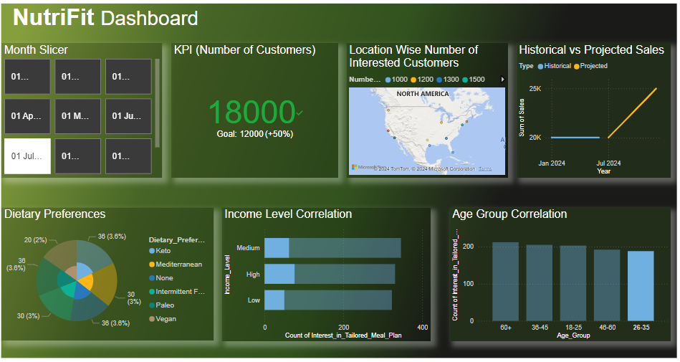
Analytical Application

Slide 10

Live ANALYTICAL APPLICATION

Slide 11
EXPLANATION OF A RELATIONSHIP BETWEEN ONE VARIABLE AND AN OUTCOME THAT INFLUENCES VALUE IN THE BUSINESS
KPIs to track NutriFit’s growth and operational success
Customer Acquisition Rate: Measures how quickly NutriFit gains new customers.
Customer Retention Rate: Tracks the percentage of returning customers, crucial for assessing customer satisfaction.
Average Order Value (AOV): Evaluates revenue generated per order, key for identifying the impact of upselling and personalization.
Cost per Acquisition (CPA): Calculates the cost of acquiring each new customer, allowing NutriFit to optimize marketing budgets.

Slide 12
Balanced Scorecard
Balanced Scorecard: This approach aligns NutriFit’s operations with strategic goals by focusing on four key perspectives:
Financial:
Revenue Growth Rate: Assess the augmentation in both monthly and annual revenue.
Average Order Value (AOV): Track the amount a customer spends per order.
Customer:
Customer Retention Rate: Measures loyalty and repeat business.
Customer Satisfaction: Obtain reviews of after-sales experience.
Internal Processes:
Order Fulfilment Time: The average time cycle between an order being placed and delivered.
Supply Chain Efficiency: Monitor inventory turn over, sources of ingredients.
Learning and Growth:
Innovation Rate: Measuring the volume of newly introduced products or items.
Employee Training: Measuring overall hours devoted to employee education regarding customer service and nutritional knowledge.

Slide 13

Expanding Target Audience through Data Insights
Objective: To show how data analysis identifies new market segments that boost the value proposition of NutriFit.
Initial Hypothesis
NutriFit initially targeted youth (ages 18-30) based on anticipated demand for health-conscious, convenient meal options.
Chief Insight from Data Analysis
Analysis and dashboard data indicate that individuals aged 60+ show significant interest in NutriFit’s personalized meal services.
  People above the age of 60 years form a sizeable secondary market, showing keen interest in customized dieting, health maintenance, and convenience.

Slide 14

Value Derived
Expanded Market Potential: By targeting the 60+ group, NutriFit can increase its customer base and raise revenue.
Customized Marketing Strategies: NutriFit can craft messages that will catch the interests of older adults by emphasizing the conveniences of preparing meals, healthful nutrition, and special diets.
Product Development Opportunities: By understanding the preferences of this demographic, one can develop appropriate meal plans that meet their dietary needs associated with aging, such as low-sodium and high-fiber meals.
Conclusion
Data analysis has not only confirmed the appeal of NutriFit among young adults but also identified an additional, high-interest demographic. This strategic shift now will let NutriFit maximize its engagement and revenues by better addressing the needs of both the young adult and the older customer.

Slide 15
What questions need to be asked
How large is the market for diet-conscious younger individuals?
What trends or behaviours indicate a strong potential for engagement?
What are the spending patterns of the target group?
What types of meals and services are they most interested in?
To what degree can revenue be expected from this newly identified target audience?
What are the potential risks of focusing on this demographic?
How can these risks be mitigated through data-driven strategies?
What are the best sources of internal and external data to increase our knowledge and understanding of the target audience?
How can big data enhance our predictive capabilities for customer trends?

Slide 16

Predictions
We’ll try to predict -
Increase in revenue we’ll be able to achieve in coming months.
Number of customers who’ll be interested in our service.
Amongst the prevailing competition what market space would we be able to capture.
Using customer profiles, we can predict meal plans tailored for specific groups thus enhancing customer satisfaction.
As a part of our long-term business plan, using customer order history we can strategically predict and select high demand areas for our first physical stores.

Slide 17
Predictions
Based on NutriFit’s data-driven strategies, we predict:
Wider Customer Base: It is believed that targeted marketing and tailor-made meal plans will let customer acquisition increase by 20% in the next quarter.
Higher Average Order Value: The AOV can increase by 15% within six months with the introduction of premium add-ons and subscriptions.
Reduced Operational Costs: Improved inventory management and strategic ingredient sourcing are expected to cut supply costs by 10%, thus increasing profit margins
Improved Customer Retention: It is anticipated as personalized meal choices and loyalty incentives are expected to boost repeat patronage by 25%.

