Slide 1
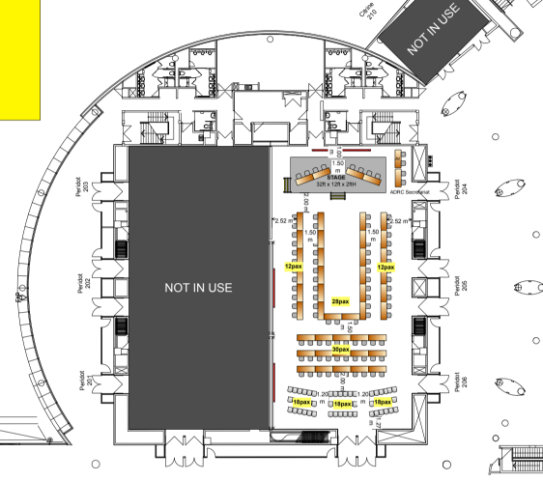
ACDR2026 配席表 最終案 10/1（Peridot 204-206）
AV
ADRC Sec. 8 席（AV 脇 2＋壁沿い追加 2＋右側面列上端 4、Expo に提案中）
ADRC Sec.
ADRC Sec.
Singapore
member
Singapore
member
member
ADRC (Miura)
ADRC Sec.
Singapore
Singapore
ADRC (Kitamoto)
NZ
member
NZ
advisor
member
Armenia
ADRC Sec.
NZ
AUS
Viet Nam
Azerbaijan
member
Azerbaijan
member
member
Uzbekistan
member
ADRC (Miyaki)
Brunei
Bangladesh
Turkiye
Viet Nam
Fiji?
member
Bhutan
member
member
Thailand
member
Viet Nam
India
Brunei
Sri Lanka
Uzbekistan
India
member
Cambodia
member
member
ROK
member
Turkiye
Fiji
PNG
Turkiye
member
India
member
member
Pakistan
member
ROK
member
member
member
ROK
Lao PDR
Maldives
Myanmar
member
Japan
Malaysia
Mongolia
member
resource
partner
partner
Japan
Sendai VM*
Google *
ADB
AHA Centre
ADPC
ADPC
Japan
Sendai
BRIN
member
member
general
general
general
Japan
Sendai
JICA
JAXA
Nepal
Japan
Sendai
Tohoku U
JAXA
ROK
ADRC Sec.
member
member
general
ADRC Sec.
PNG
Pakistan
配席 最終案 10/1（荒木田案に児玉案 10/1 を統合）: U 字 28 席＝左脚上端 Singapore×2 → NZ・AUS（アドバイザー）→ Azerbaijan からアルファベット順に左脚・底・右脚を回り、Japan が底の左端、Armenia と ADRC（三浦・北本）が右脚上端（AV 卓・事務局側）。
側面列: 左 12 席＝左脚各国の随員（3 席予備）。右 12 席＝上端 2 卓 4 席を ADRC 事務局に転用（AV 脇 2＋壁沿い追加 2 と合わせ 8 席、Expo に提案中）、残り 8 席に宮木所長と右脚各国の随員。
教室型 30 席: 左 2 列を日本側（内閣府 4・仙台市 4・JICA・東北大・JAXA 2、赤字）、右を資源者・パートナー（Google・BRIN・ADB・AHA・ADPC・Nepal・ROK・PNG・Pakistan）。後列両端 ADRC 事務局（予備）。* 卓上マイク（RT 発言: Google・仙台副市長）。シアター 54 席は SEPDM・オブザーバー、名札なし。
要確認: Fiji 2 人目、Nepal の参加区分（メンバー国の政府代表なら U 字へ）、Expo の U 字 28 席の卓割（11＋6＋11 で作図）。

