Slide 1
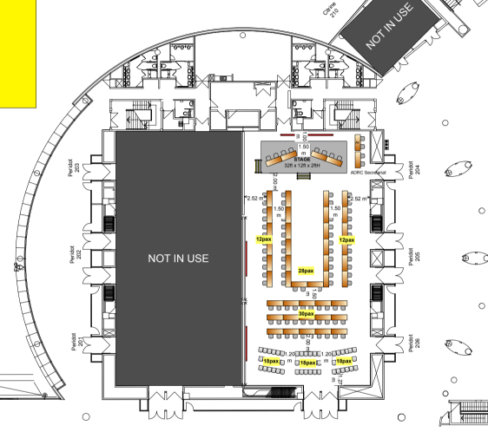
ACDR2026 配席表 最終案 10/1（Peridot 204-206）
AV
ADRC Sec.
ADRC Sec.
Singapore
member
Singapore
member
member
ADRC (Miura)
ADRC Sec.
Singapore
Singapore
ADRC (Kitamoto)
NZ
member
NZ
advisor
member
Armenia
member
ADRC (Miyaki)
NZ
AUS
Viet Nam
Viet Nam
Azerbaijan
member
Azerbaijan
member
member
Uzbekistan
member
Viet Nam
Brunei
Bangladesh
Turkiye
Uzbekistan
Fiji?
member
Bhutan
member
member
Thailand
member
Turkiye
India
Brunei
Sri Lanka
ROK
India
member
Cambodia
member
member
ROK
member
PNG
ADPC
Fiji
PNG
Pakistan
ADPC
partner
India
member
member
Pakistan
ADRC Sec.
AHA Centre
member
member
member
Lao PDR
Maldives
Myanmar
member
Japan
Malaysia
Mongolia
member
resource
resource
partner
Japan
Sendai VM*
JAXA
Google *
ADB
Turkiye
Japan
Sendai
BRIN
Nepal
member
member
general
general
member
Japan
Japan
Sendai
Sendai
Sendai
JAXA
Tohoku U
ROK
ROK
ADRC Sec.
general
general
JICA
general
general

