Slide 1

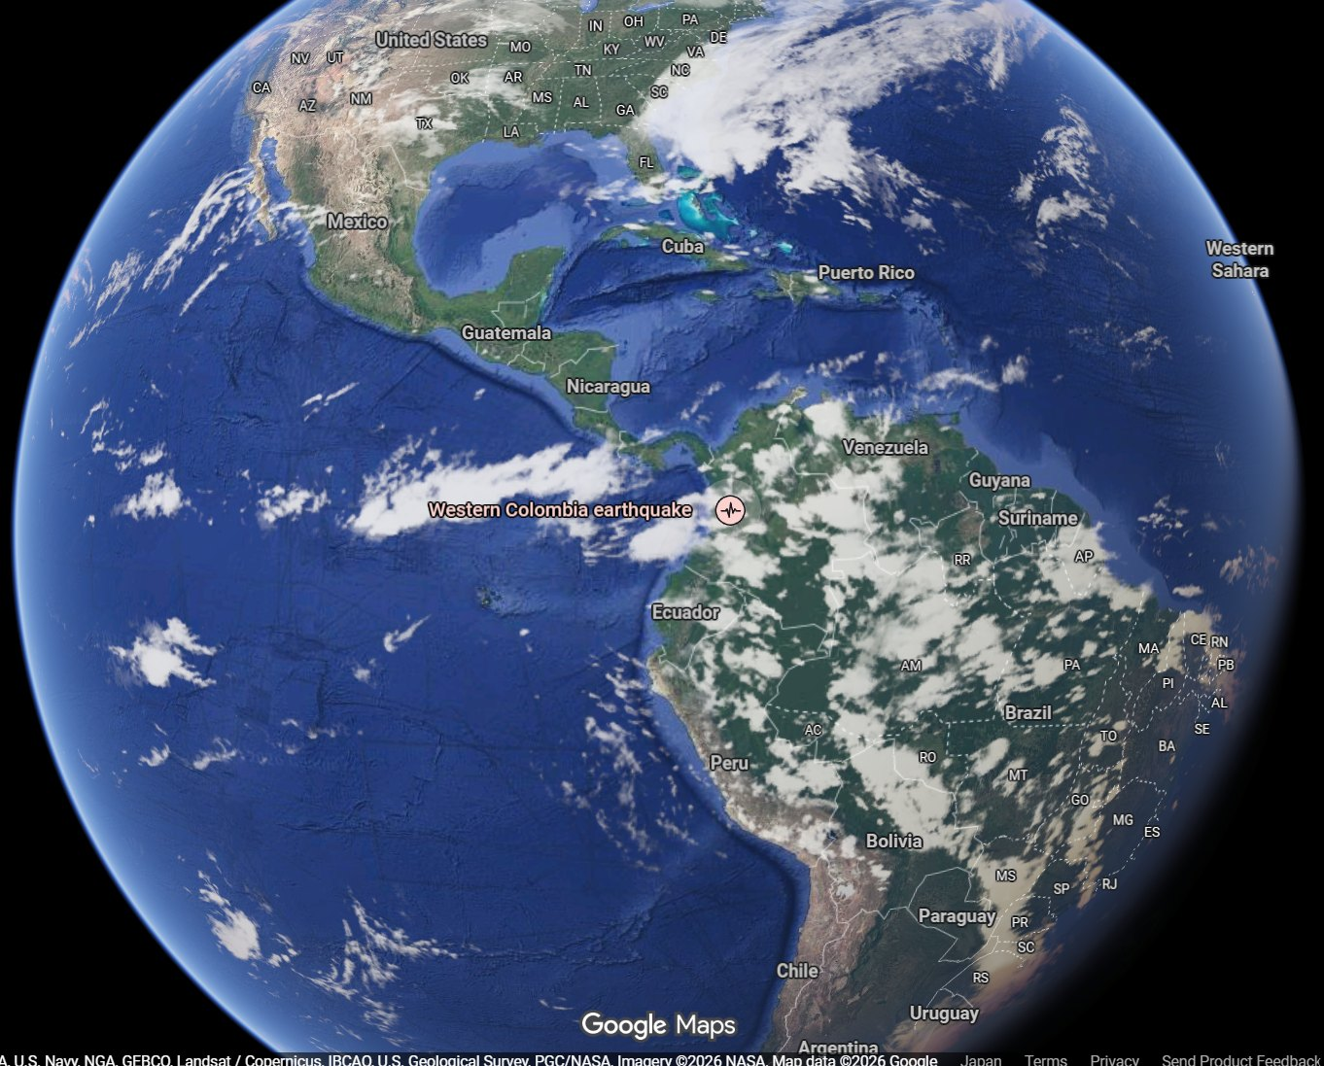
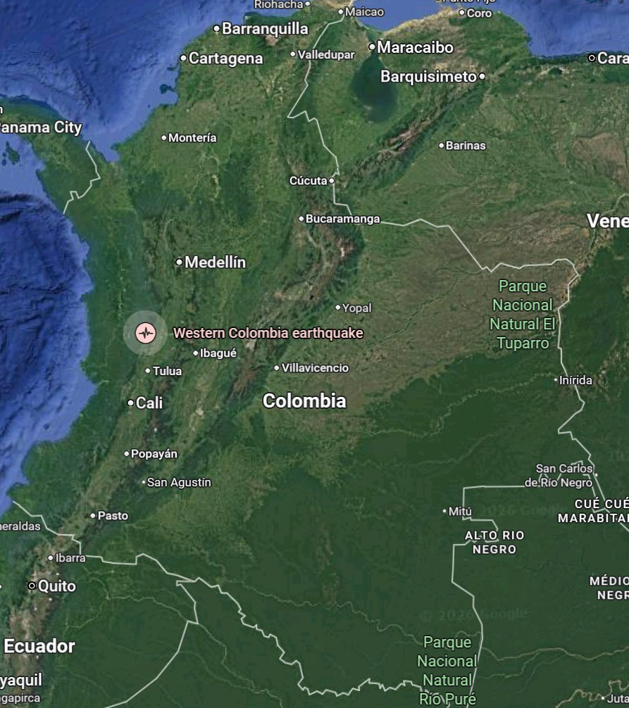
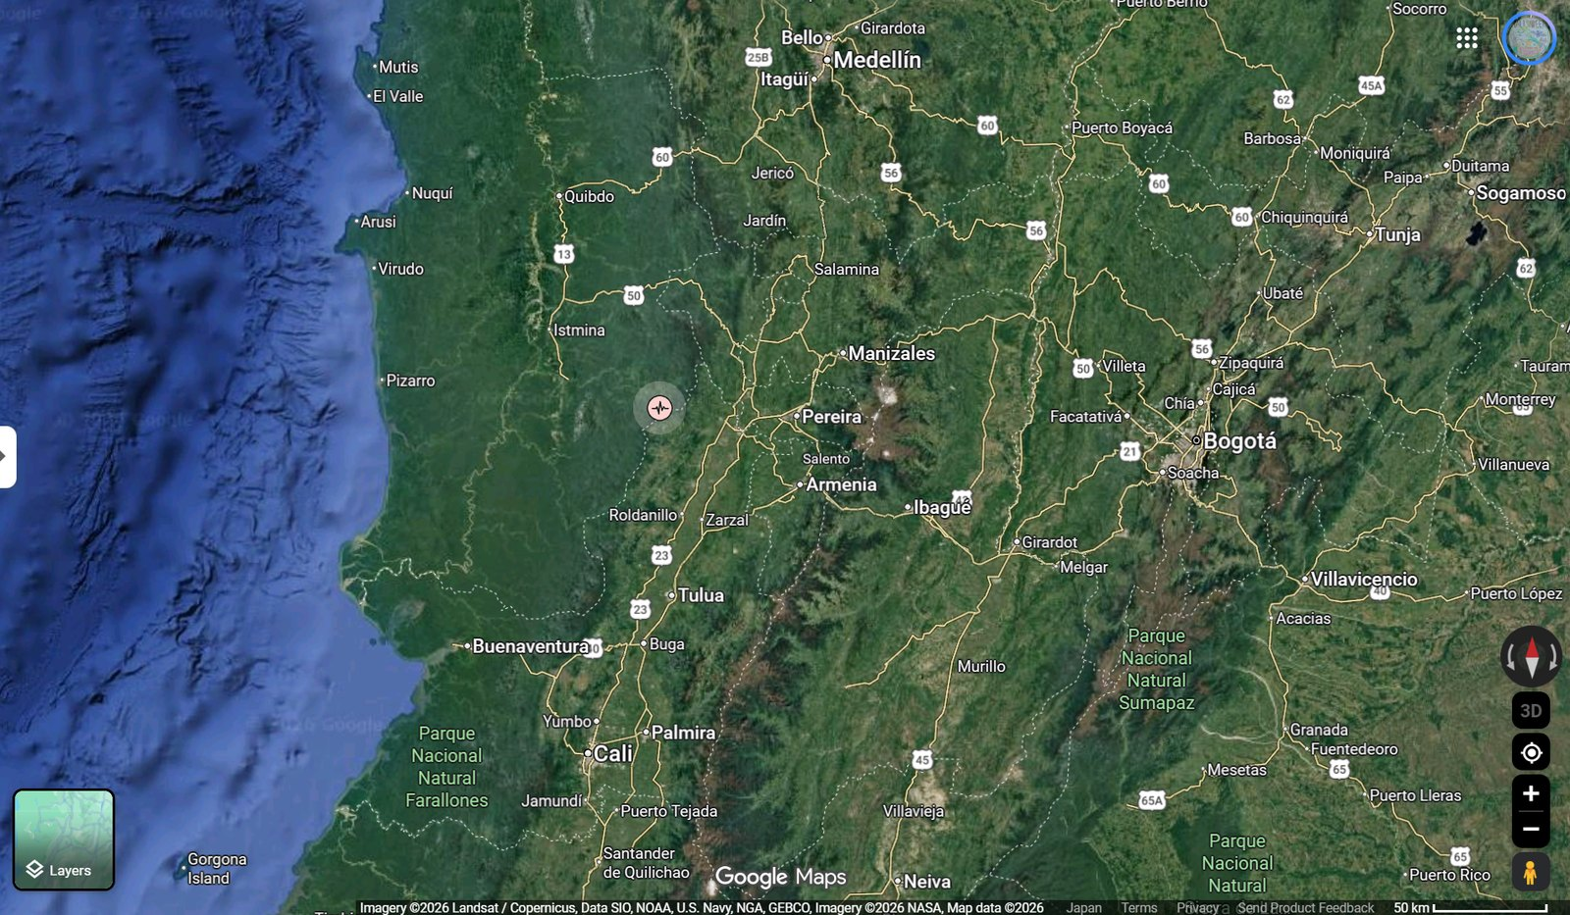
Disaster Report
2026 Chocó Earthquake (Colombia)
M7.4, San José del Palmar, Chocó Department - 10 August 2026
Mww 7.4 · depth 110 km · MMI VII (Very strong) — USGS ShakeMap; the SGC macroseismic intensity map agrees · GLIDE EQ-2026-000146-COL
(1) World / Colombia
(2) NW South America
(3) Epicentre & affected cities
Locator maps © Google (Google Maps). Distances shown on later pages are computed from the published USGS coordinates.
Overview At 07:34 local time (12:34 UTC) on 10 August 2026, an Mww 7.4 earthquake struck western Colombia with its epicentre 5 km east of San José del Palmar in Chocó Department, at a depth of about 110 km (USGS). The event was an intermediate-depth, strike-slip rupture inside the subducting Nazca slab; because of its depth, strong shaking (MMI VI-VII) was spread over a wide area of the Andean Coffee Region rather than concentrated near the epicentre, and about 10.5 million people were exposed to it. The SGC describes it as the largest-magnitude earthquake recorded in Colombia in the past decade. The toll rose steeply through the first two days: 111 deaths in the Government's 13:00 COT balance on 10 August, 132 by that evening, and 182 deaths with 2,542 injured and 189 missing in UNGRD's situation report on 11 August, against 240 deaths when the departmental and city announcements are added up — more than 1,600 buildings damaged (1,575 homes damaged, 37 destroyed, 61 buildings collapsed), together with damage to 18 health facilities, 52 educational facilities, 18 major roads and six regional airports. The passenger terminal of Matecaña International Airport in Pereira partially collapsed, a tower of the neo-Gothic cathedral in Manizales fell onto the nave, and about 30% of the University Hospital in Cali collapsed. The President declared a national disaster, set up a Unified Command Post in Chocó and deployed four USAR teams and the armed forces. There was no tsunami. All figures are preliminary and are expected to change as assessment proceeds.
Sources: USGS - M 7.4 San José del Palmar, Colombia (event page) · SGC — event bulletin SGC2026pqqmro (this earthquake) · UNGRD - National Unit for Disaster Risk Management · Google Maps
1
ADRC 20/08/2026

Slide 2
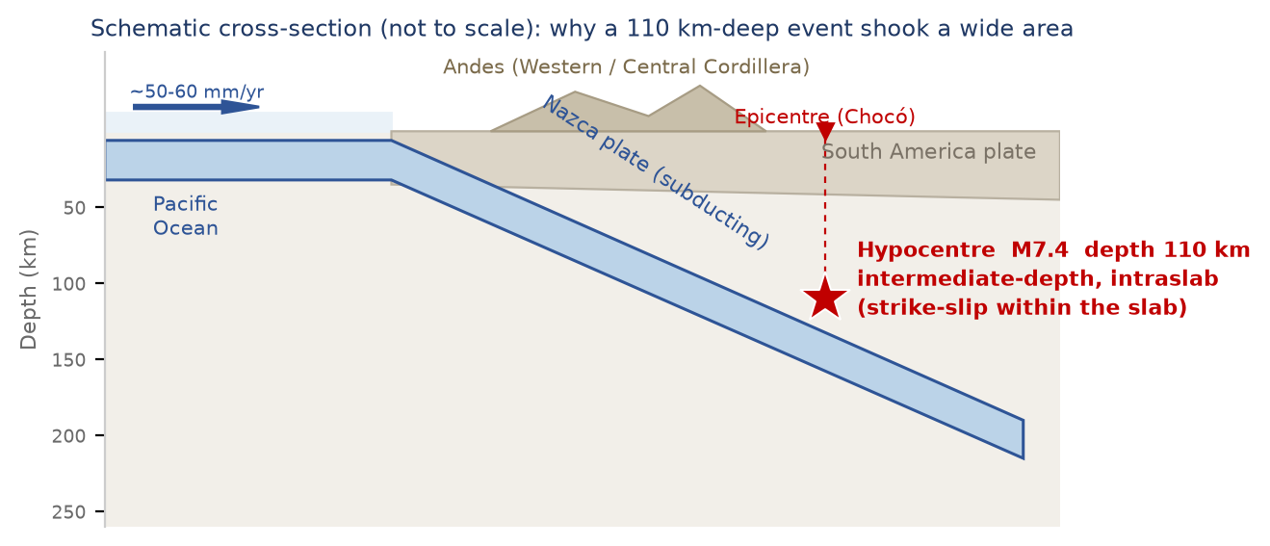

Seismotectonic Setting: an intraslab earthquake
[Official] Depth about 110 km (USGS, revised): an intraslab event, not a plate-interface megathrust.
[Official] Strike-slip mechanism within the descending Nazca slab (USGS tectonic summary).
[Official] Maximum shaking MMI VII (Very strong); about 10.5 million people exposed to MMI VI-VII.
[Official] USGS PAGER (v5) Orange alert: the most likely fatality band is 1,000-10,000 and the most likely loss band USD 100-1,000 million — model estimates, not observations, and far above the figures reported so far.
[Official] The SGC assesses this as the largest-magnitude earthquake recorded in Colombia in the past decade.
[Media] Shaking was reported as unusually long in duration in cities far from the epicentre - a characteristic of deep events recorded on soft valley sediments.
[Official] The Coffee Region has a history of both deep and shallow damaging events: M7.0 at 150 km depth in 1938, M6.5 at 64 km in 1962 and M6.1 at 15 km in 1999 (SGC/GEM national hazard model).
Schematic cross-section (ADRC)
Colombia lies at the junction of the Nazca, Caribbean and South America plates. Off the Pacific coast the Nazca plate subducts eastward beneath South America at roughly 50-60 mm/yr, and the descending slab reaches intermediate depths (70-300 km) beneath the Western and Central Cordilleras. This event ruptured inside that slab at about 110 km depth, which is why the shaking was felt over hundreds of kilometres - as far as Bogotá, Quito and Panamá City - while surface faulting and tsunami generation were absent. Intermediate-depth events radiate high-frequency energy efficiently and attenuate slowly, so damage tends to be distributed across many cities rather than concentrated in a narrow epicentral zone.
Focal mechanism (beachball) Both agencies report a strike-slip mechanism.
Sources: USGS - M 7.4 San José del Palmar, Colombia (event page) · SGC — event bulletin SGC2026pqqmro (this earthquake) · GDACS - Orange earthquake alert, Colombia, 10 Aug 2026
2
ADRC 20/08/2026

Slide 3
Overview of the Earthquake & Response Measures
10 Aug 2026, 07:34 COT (12:34 UTC / 21:34 JST) | Mww 7.4 | depth 110 km | MMI VII (Very strong) — USGS ShakeMap; the SGC macroseismic intensity map agrees
Figures as of the UNGRD balance with a 06:30 COT cut-off on 19 Aug 2026: 312 deaths, 4,611 injured, 290 missing, 358 rescued alive, 143,533 families (294,503 people) affected in 470 municipalities across 15 departments, 29,548 homes destroyed and 134,124 damaged, 267 buildings collapsed. The President has put preliminary direct physical losses at about COP 30 trillion (USD 9.6 billion) across five departments. The SGC had located 325 aftershocks by 17 August. All figures are preliminary; quote the cut-off with the number.
[Official] The Government declared a national disaster (desastre nacional), enabling extraordinary mobilisation and coordination of the response.
[Official] President Abelardo de la Espriella - in office for three days - ordered a Unified Command Post (PMU) in Chocó to coordinate the emergency, and travelled to Pereira, one of the worst-hit cities.
[Official] The National Unit for Disaster Risk Management (UNGRD) activated the national system, verified damage with departmental and municipal authorities, and channelled offers of assistance together with the Ministry of Foreign Affairs.
[Official] Four USAR (urban search and rescue) groups were deployed from Bogotá, Envigado, Yopal and Medellín to reinforce search and rescue.
[Official] Soldiers were deployed to the affected departments for search, rescue and route clearance.
[Official] Civil aviation suspended flights at Pereira, Manizales, Quibdó, Armenia, Cartago and Buenaventura while runways and terminals were inspected.
[Media] Damaged buildings, power outages and communications disruption are slowing assessment in parts of Chocó closest to the epicentre.
[Official] GLIDE number assigned for this event: EQ-2026-000146-COL.
Sources: UNGRD - National Unit for Disaster Risk Management · Colombia One - Government declares national disaster · France 24 - Colombia declares national emergency as quake toll hits 111
3
ADRC 20/08/2026

Slide 4
Chronology of the Response (10-19 August) (1/4)
Times are Colombia time (COT, UTC-5). The earthquake occurred at 07:34 COT = 21:34 JST on 10 August.
Time | Action | Source
07:34 | Mww 7.4 earthquake, epicentre 5 km S of San José del Palmar (Chocó), depth approx. 110 km. Felt in Bogotá, Cali, Medellín, and in Ecuador, Panama and Venezuela. | USGS / SGC
07:40s | The SGC issues a first bulletin (initially M6.6, 79 km depth), later revised to M7.4 at 96 km, located with 69 stations (event SGC2026pqqmro); damage-assessment protocols activated. | SGC
Morning | UNGRD reports first damage indications in 9 municipalities of Chocó, 8 of Caldas, 2 of Valle del Cauca and 2 of Risaralda, plus localities in Quindío. | UNGRD
Morning | Cali reports collapsed structures at 12 critical points with people trapped; part of the University Hospital collapses. | Mayor of Cali
Morning | Manizales reports 17 buildings collapsed and 19 partially collapsed; a tower of the neo-Gothic cathedral falls onto the nave. Residents asked to stay outdoors because of aftershocks. | Mayor of Manizales
Morning | Passenger terminal of Matecaña International Airport (Pereira) partially collapses; flights suspended at six regional airports. | Aerocivil / media
Daytime | National disaster declared; Unified Command Post established in Chocó; armed forces deployed. | Government
Daytime | Four USAR teams deployed from Bogotá, Envigado, Yopal and Medellín. | UNGRD
Daytime | More than 20 aftershocks recorded; the largest widely felt aftershock is M4.8. | SGC
Daytime | President travels to Pereira to lead the response on the ground. | Presidency
12:13 | Copernicus EMS Rapid Mapping activated as EMSR916 (17:13 UTC), requested by EC Services / DG ECHO, for earthquake damage assessment mapping. | Copernicus EMS
Sources: USGS - M 7.4 San José del Palmar, Colombia (event page) · UNGRD - National Unit for Disaster Risk Management · CNN — live updates: death toll rises to 132 · Colombia One - First official assessment: widespread structural damage
4
ADRC 20/08/2026

Slide 5
Chronology of the Response (10-19 August) (2/4)
Times are Colombia time (COT, UTC-5). The earthquake occurred at 07:34 COT = 21:34 JST on 10 August.
Time | Action | Source
Afternoon | First national damage report: 111 deaths, 87 injured; 1,575 homes damaged, 37 destroyed, 61 buildings collapsed; 18 health facilities, 52 educational facilities, 17 community facilities, 18 major roads and 6 regional airports damaged. | Presidency / UNGRD
Afternoon | Ecuador mobilises a 47-person USAR team with canine units; Mexico and other governments offer assistance, to be channelled through the Foreign Ministry and UNGRD. | International media
Evening | The reported national death toll rises to 132. Four people have been rescued alive from the rubble; more than 20 municipalities are reported affected, and power and telecommunications faults continue in Chocó. | International media
11 Aug | Search continues overnight. The President reports 700 injured nationally and about 5,000 homes damaged or destroyed, declares the missing the State's priority, and orders troops to Cali to maintain order. The mayor of Cali reports 85 deaths, 885 injured and 188 missing; Pereira's fire service reports 66 deaths; about 100 people are missing in Manizales. Five capital cities - Cali, Pereira, Quibdó, Manizales and Armenia - remain on red alert. | Presidency / local authorities
11 Aug PM | UNGRD's situation report gives 182 deaths, 2,542 injured and 189 missing, with 13,067 homes damaged and 2,501 destroyed, 93 health facilities, 884 educational institutions, 427 community facilities and 77 roads affected. The President puts the toll at 181, of which 97.6% in capital cities. Ecuador, El Salvador and Russia are thanked for assistance. | UNGRD / Presidency
11 Aug PM | The SGC's published aftershock total reaches 103 at 15:00 COT - 97 at M3.0 or below, 5 between M3.0 and M4.0, one above M4.0 - and an M3.9 during the day prompts building evacuations in several affected cities. Its catalogue for the same period holds 147 located events, the wider figure including background seismicity. | SGC
11 Aug 14:20 UTC | The SGC revises its solution for the mainshock to M7.4 at 103 km depth, 4.99 N 76.29 W, located with 119 stations and 208 phases. Its first bulletin had given M6.6 at 79 km and its second 7.4 at 96 km with 69 stations. | SGC
11 Aug 07:31 | Japan's Prime Minister posts condolences (21:31 JST) and Foreign Minister Motegi issues a message offering condolences and stating that the Government of Japan also stands ready to provide the necessary assistance and that Japan stands in strong solidarity with the people of Colombia. | Japan (MOFA)
12 Aug | Cali city officials report 107 buildings collapsed, 643 with structural damage and 18 under evacuation order; 230 people trapped, 88 rescued, 69 dead and 1,008 injured in the city. | Mayor of Cali
11 Aug | OCHA states the humanitarian system is ready to support Colombia and names drinking water, hygiene and household items, health, food and shelter as the priority needs; no formal request for assistance has been received from the Colombian authorities. | UN / OCHA
12 Aug | The provisional national balance passes 224 deaths and more than 2,500 injured, with 279 taken to hospital and 243 people rescued alive; 195 are reported missing to the authorities. The citizen platform “Colombia te busca” holds 4,084 registrations, 3,653 of them still unresolved. Search continues in Pereira with about 300 rescuers, and much of Chocó remains reachable only by boat or aircraft. | Government
Sources: USGS - M 7.4 San José del Palmar, Colombia (event page) · UNGRD - National Unit for Disaster Risk Management · CNN — live updates: death toll rises to 132 · Colombia One - First official assessment: widespread structural damage
5
ADRC 20/08/2026

Slide 6
Chronology of the Response (10-19 August) (3/4)
Times are Colombia time (COT, UTC-5). The earthquake occurred at 07:34 COT = 21:34 JST on 10 August.
Time | Action | Source
12 Aug | The President tours Pereira, Dosquebradas, Manizales and Armenia after Quibdó and Cali, announcing three months of relief on utility bills for affected households, rent subsidies for those who lost their homes and a shock plan for education and housing; an economic emergency decree is being prepared. | Presidency
12 Aug | UNGRD's consolidated report covers 14 departments and 403 municipalities: 239 deaths, 3,755 injured, 287 missing, 140 buildings collapsed, 24,324 families (49,214 people) affected, 9,215 homes destroyed and 45,457 seriously damaged. Colombia accepts INSARAG-classified USAR teams from Israel, Ecuador, El Salvador and the United States; El Salvador sends 100 tonnes of relief supplies. A woman is rescued in Pereira after 36 hours under the rubble. | UNGRD
12 Aug | Adding up the departmental and city announcements gives 254 deaths - Pereira 101, Cali 95 - ahead of the national consolidation, which media attribute to the central government being slower to update. | International media
12 Aug PM | From the Palacio de San Carlos the President announces UNGRD's updated balance: 265 deaths, 3,494 injured, 496 missing, 25,872 families (53,816 people) affected, 11,347 homes destroyed and 53,526 damaged, 1,819 educational centres and 631 community facilities affected. He also announces the declaration of an economic emergency. | Presidency
13 Aug 09:42 | An M4.2 aftershock strikes San José del Palmar at 95 km depth, about 20 km from the mainshock epicentre. Felt in Pereira, Manizales, Medellín and Bogotá; search-and-rescue work is halted temporarily. It is the second aftershock above M4.0. | SGC
13 Aug AM | UNGRD's director gives a new balance: 273 dead, 3,824 injured, 377 missing, 40,753 families (97,515 people) affected, 12,584 homes destroyed and 74,873 damaged, 172 buildings collapsed, 2,198 educational and 825 community facilities, 216 health facilities, 71 aqueducts, 29 banking offices and five airports. Medicina Legal has received 250 bodies, 227 recognised. Red alert continues in Cali, Pereira, Quibdó, Manizales and Armenia. | UNGRD
14 Aug 09:00 | UNGRD's 09:00 cut: 287 dead, 3,975 injured, 378 missing, 354 rescued alive; 56,448 families (135,179 people) affected in 15 departments and 437 municipalities; 13,077 homes destroyed and 79,108 damaged; 121 buildings collapsed. Confined-space search continues with the certified international teams. | UNGRD
14 Aug | India sends 20 tonnes of humanitarian supplies; Norway allocates NOK 10 million and Sweden SEK 5 million through UNHCR; Spain, Italy, Chile, Mexico, Turkey, Brazil and the World Bank also send or announce support. The Interior Minister says the hospital network in Buenaventura is overwhelmed. | Cancillería / donors
14-15 Aug | Running balance: 288 dead, 4,018 injured, 202 missing, 354 rescued alive; 45,523 families (102,263 people) affected in 15 departments and 426 municipalities; 12,828 homes destroyed and 73,455 damaged; 121 buildings collapsed; 240 health, 2,205 educational and 1,208 community facilities; 210 roads, 73 aqueducts, 44 road bridges, 13 footbridges and five airports. The falls against the 09:00 cut are duplicate assessment records being consolidated. | UNGRD
14 Aug 07:00 | SGC reports 184 aftershocks located since the mainshock, 15 of them above M3.0 and 2 above M4.0. | SGC
15 Aug | Search continues for the missing while more than 100,000 people affected await assistance; in El Cairo (Valle del Cauca) 80% of the houses are reported damaged. | International media
Sources: USGS - M 7.4 San José del Palmar, Colombia (event page) · UNGRD - National Unit for Disaster Risk Management · CNN — live updates: death toll rises to 132 · Colombia One - First official assessment: widespread structural damage
6
ADRC 20/08/2026

Slide 7
Chronology of the Response (10-19 August) (4/4)
Times are Colombia time (COT, UTC-5). The earthquake occurred at 07:34 COT = 21:34 JST on 10 August.
Time | Action | Source
15 Aug 06:30 | UNGRD balance with a 06:30 cut-off: 294 dead, 3,935 injured, 320 missing, 353 people and 188 animals rescued alive; 54,008 families (115,461 people) affected; 448 municipalities reporting damage; 14,493 homes destroyed and 81,506 damaged; 66 buildings collapsed. Chocó, Risaralda and Valle del Cauca are the worst affected. | UNGRD
12 Aug | Decree 1172 declares three days of national mourning from 12 August, flags at half-mast at home and in Colombian missions abroad. The same night the governor of Chocó ends the department's search-and-rescue phase after the last family sought in Quibdó, four people, is found alive. | Presidency / Gobernación del Chocó
16 Aug 07:30 | UNGRD balance with a 07:30 cut-off: 289 dead, 4,187 injured, 143 missing, 354 people and 510 animals rescued alive; 120,238 families (185,016 people) affected across 450 municipalities in 15 departments; 26,945 homes destroyed and 127,557 damaged; 66 buildings collapsed. UNGRD states that the variations come from verifying and consolidating figures reported by the territories, some of which had been sent unverified. | UNGRD
16 Aug 18:30 | UNGRD balance with an 18:30 cut-off: 287 dead, 4,147 injured, 194 missing, 355 people and 496 animals rescued alive; 120,671 families (185,996 people) affected across 472 municipalities in 15 departments; 26,392 homes destroyed and 127,608 damaged; 197 buildings collapsed; 304 health, 3,207 educational and 4,059 community facilities; 410 roads, 95 aqueducts, 48 road bridges, 13 footbridges and five airports. | UNGRD
17 Aug | UNGRD explains the reductions in its registers: five names left the list of the dead and 177 the consolidated missing list because the same person could appear in several territorial reports and be counted more than once during verification; the change does not necessarily correspond to new findings. The Foreign Ministry reports 222.5 tonnes of humanitarian aid and 144 members of international teams received, and says no country has been excluded; China announces 80 tonnes. | UNGRD / Cancillería
17 Aug | One week on, the SGC reports 325 aftershocks located: San José del Palmar 111, El Litoral del San Juan 67, Sipí 61, at an average depth of about 100 km. The largest remains the M4.8 of 10 August. | SGC
18 Aug 06:30 | UNGRD balance with a 06:30 cut-off: 304 dead, 4,548 injured, 426 missing, 356 rescued alive; 123,789 families (292,043 people) affected in 472 municipalities across 15 departments; 29,554 homes destroyed and 134,342 damaged; 267 buildings collapsed and 5,808 damaged; 303 health, 3,443 educational and 3,905 community facilities. Deaths and missing both rise after several days of falling. | UNGRD
18 Aug 19:00 | UNGRD balance with a 19:00 cut-off: 312 dead, 4,611 injured, 290 missing, 356 rescued alive; 29,548 homes destroyed and 134,124 damaged. In his first address on the disaster the President puts preliminary direct physical losses at about COP 30 trillion (USD 9.6 billion) across five departments - COP 24.5 trillion in buildings, COP 5.5 trillion in infrastructure - calling it an initial evaluation that will be adjusted. | UNGRD / Presidency
19 Aug 06:30 | UNGRD balance with a 06:30 cut-off: 312 dead, 4,611 injured, 290 missing, 358 rescued alive; 143,533 families (294,503 people) affected in 470 municipalities across 15 departments. Deaths and missing hold at the previous evening's figures. | UNGRD
Sources: USGS - M 7.4 San José del Palmar, Colombia (event page) · UNGRD - National Unit for Disaster Risk Management · CNN — live updates: death toll rises to 132 · Colombia One - First official assessment: widespread structural damage
7
ADRC 20/08/2026

Slide 8
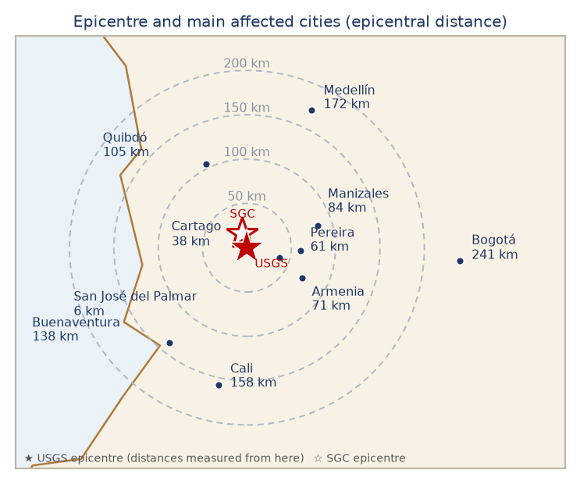
Affected Departments & Cities
Department | Main cities | Dist. | MMI | Situation
Chocó | San José del Palmar / Quibdó | 6 / 105 km | VII / VI | Epicentral department; 9 municipalities with reported damage; access, power and communications constrained.
Risaralda | Pereira, Dosquebradas | 61 km | VII | Highest reported death toll (at least 40; the governor cites at least 42). Airport terminal partially collapsed.
Valle del Cauca | Cali, Cartago, Buenaventura | 158 / 38 / 138 km | VI-VII | 27 deaths reported; 25-30 collapsed structures at 12 critical points in Cali; University Hospital heavily damaged.
Caldas | Manizales | 84 km | VI-VII | 8 municipalities affected; 17 buildings collapsed and 19 partially collapsed in Manizales; cathedral tower fell onto the nave.
Quindío | Armenia and other localities | 71 km | VII | Several localities reported affected; the same Coffee Region devastated by the 1999 Armenia earthquake.
Antioquia | Medellín and surroundings | 172 km | V-VI | One death reported (a 73-year-old); structural damage under inspection.
Cundinamarca / Bogotá | Bogotá, Nilo | 241 km | IV-V | Widely felt; buildings evacuated; structural damage to a school in Nilo reported.
Epicentral distances (ADRC)
Why damage is dispersed A 110 km-deep source puts every city in the region at a broadly similar hypocentral distance (110-205 km), so no single city sits in a narrow zone of extreme shaking.
Sources: UNGRD - National Unit for Disaster Risk Management · Colombia One - First official assessment: widespread structural damage · CBS News - Strong earthquake strikes western Colombia
8
ADRC 20/08/2026

Slide 9
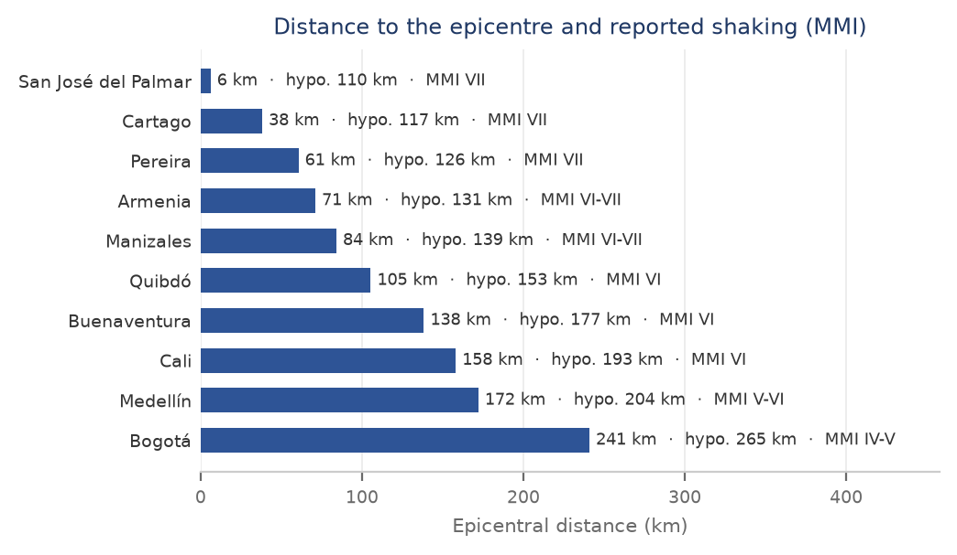
Event Parameters & Observed Shaking
Item | Value
Origin time (local) | 10 Aug 2026, 07:34:28 COT (UTC-5)
Origin time (UTC / JST) | 10 Aug 2026, 12:34:28 UTC / 10 Aug 2026, 21:34 JST
Epicentre | USGS: 5 km S of San José del Palmar, Chocó Department (approx. 280 km W of Bogotá) — SGC: 12 km from San José del Palmar
Coordinates | USGS 4.8436 N, 76.2422 W · SGC 4.99 N, 76.29 W
Magnitude | Mww 7.4 (USGS) · 7.4 (SGC)
Depth | 110.3 km (USGS, PAGER v5) / 103 km (SGC, revised 11 Aug)
Mechanism | Strike-slip faulting at intermediate depth, within the subducting Nazca slab (not on the shallow plate interface)
Max. shaking | MMI VII (Very strong) — USGS ShakeMap; the SGC macroseismic intensity map agrees
Felt area | Felt across western and central Colombia including Bogotá, Cali and Medellín, and in Ecuador, Panama and Venezuela
Tsunami | No tsunami. The event was inland and at intermediate depth; no tsunami warning was issued for the Pacific coast.
Alert level | USGS PAGER: Orange (version 5). Most likely fatality band 1,000-10,000 (35% probability); economic losses most likely USD 100-1,000 million (34%), less than 1% of Colombia's GDP. GDACS: Orange.
GLIDE | EQ-2026-000146-COL
Distance vs. reported MMI (ADRC)
USGS PAGER (version 5) exposure estimates. About 10.5 million people were exposed to Strong or Very Strong shaking (MMI VI-VII) and about 34 million to MMI IV or above across four countries. These are model estimates.
USGS and SGC agree on size. The SGC revised its solution at 14:20 UTC on 11 August to 103 km with 119 stations and 208 phases; the revised location is 17 km from the USGS one and their depths differ by 7 km, so the two have converged as more stations were read. Epicentral distances in this report are measured from the USGS location. SGC bulletins remain subject to change.
Sources: USGS - M 7.4 San José del Palmar, Colombia (event page) · SGC — event bulletin SGC2026pqqmro (this earthquake) · GDACS - Orange earthquake alert, Colombia, 10 Aug 2026
9
ADRC 20/08/2026

Slide 10
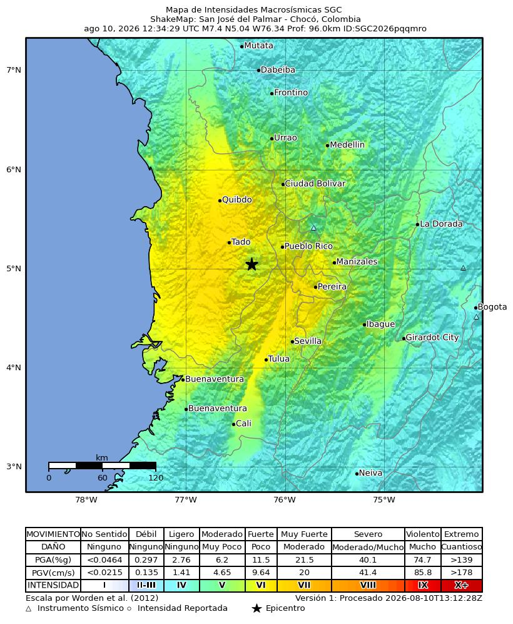
Macroseismic Intensity (SGC)
ShakeMap: San José del Palmar - Chocó, Colombia · 10 Aug 2026 12:34:29 UTC · M7.4 · N5.04 W76.34 · depth 96.0 km · ID SGC2026pqqmro · Version 1, processed 2026-08-10T13:12:28Z · scale after Worden et al. (2012)
The SGC map shows the strongest band (MMI VII, 'Muy Fuerte') over the epicentral area of Chocó and along the inter-Andean corridor through Risaralda, Caldas, Quindío and northern Valle del Cauca — the belt in which the collapses in Pereira, Manizales, Armenia and Cartago occurred. Intensity falls away eastward: Medellín and Cali sit in the moderate-to-strong bands and Bogotá, 241 km from the epicentre, in a low one. The elongated pattern along the valleys, rather than a compact circle around the epicentre, is the signature of a 96-110 km-deep source combined with soft valley sediments.
MMI | Perceived shaking | Potential damage | PGA (%g) | PGV (cm/s)
I | Not felt | None | <0.0464 | <0.0215
II-III | Weak | None | 0.297 | 0.135
IV | Light | None | 2.76 | 1.41
V | Moderate | Very light | 6.2 | 4.65
VI | Strong | Light | 11.5 | 9.64
VII | Very strong | Moderate | 21.5 | 20
VIII | Severe | Moderate/heavy | 40.1 | 41.4
IX | Violent | Heavy | 74.7 | 85.8
X+ | Extreme | Very heavy | >139 | >178
Official SGC intensity map (© SGC) — https://www.sgc.gov.co/detallesismo/SGC2026pqqmro/mmi
Modified Mercalli scale (Worden et al., 2012), as printed on the SGC map
Sources: SGC — macroseismic intensity map (ShakeMap) for this earthquake · SGC — event bulletin SGC2026pqqmro (this earthquake) · USGS - M 7.4 San José del Palmar, Colombia (event page)
10
ADRC 20/08/2026

Slide 11
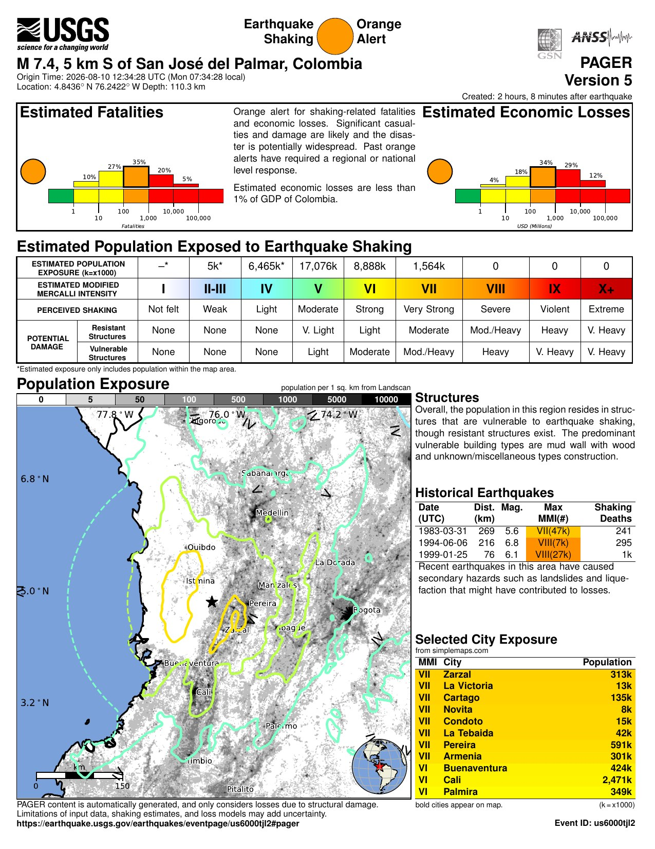
USGS PAGER Assessment
PAGER is the USGS rapid impact estimate, issued within minutes and revised as the event is refined; version 5 was created 2 hours 8 minutes after the earthquake. It is a probability distribution, not a forecast of a single number: the orange alert means significant casualties and damage are likely and that past orange alerts have required a regional or national response. Its most likely fatality band, 1,000-10,000, sat far above the 111 deaths reported nine hours after the event; 33 hours in the reported toll had risen to 182-240, into PAGER's 100-1,000 band, which the model gave a lower but substantial probability. The gap is normal at this stage and narrows as ground truth replaces modelled losses.
MMI | Perceived shaking | Exposed
VIII+ | Severe | -
VII | Very strong | 1,564k
VI | Strong | 8,888k
V | Moderate | 17,076k
IV | Light | 6,465k
USGS PAGER (version 5) exposure estimates. About 10.5 million people were exposed to Strong or Very Strong shaking (MMI VI-VII) and about 34 million to MMI IV or above across four countries. These are model estimates.
onePAGER, version 5 (public domain, USGS) — https://earthquake.usgs.gov/earthquakes/eventpage/us6000tjl2/pager
Sources: USGS - M 7.4 San José del Palmar, Colombia (event page) · GDACS - Orange earthquake alert, Colombia, 10 Aug 2026
11
ADRC 20/08/2026

Slide 12
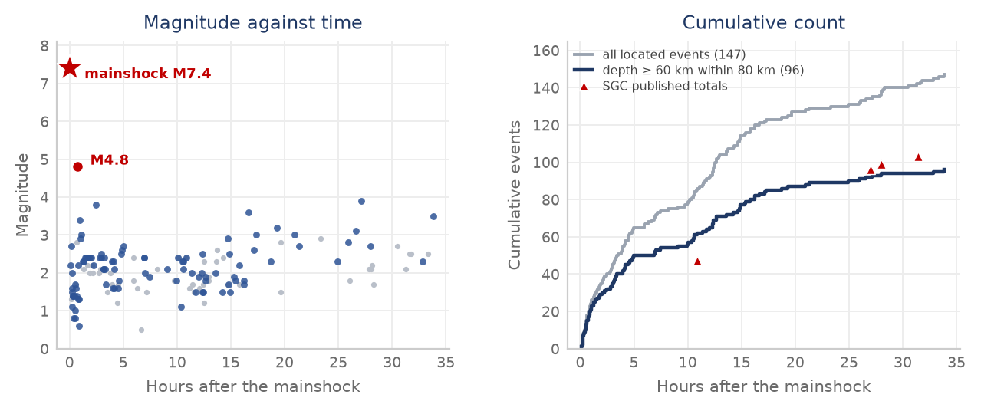
Seismicity: Aftershocks
Time | Magnitude | Note | Tier
10 Aug 08:18 COT (13:18 UTC) | M4.8 | The largest aftershock, 44 minutes after the mainshock: San José del Palmar, depth 94 km, 19 km from the epicentre (SGC2026pqryij). USGS catalogues the same event as mb 5.0 at 98.5 km. Widely felt. | Official
10 Aug 10:01 COT (15:01 UTC) | M3.8 | San José del Palmar, depth 88 km. This is the event two regional agencies published as M4.7 in the multi-agency bulletin; the SGC solution is 0.9 units smaller. | Official
11 Aug 00:12 / 10:43 COT | M3.6 / M3.9 | San José del Palmar, depths 96 km and 92 km. The 10:43 event was felt strongly enough for buildings to be evacuated in several of the affected cities. | Official
13 Aug 09:42 COT (14:42 UTC) | M4.2 | San José del Palmar, depth 95 km, about 20 km from the epicentre - the same source volume as the mainshock. Felt as far as Bogotá and strong enough to halt search-and-rescue work temporarily. | Official
to 17 Aug COT | 325 located | SGC running total one week on: 325 aftershocks, against 184 by 07:00 on 14 August and 103 at 15:00 on 11 August. By municipality: San José del Palmar 111, El Litoral del San Juan (Docordó) 67, Sipí 61. Average depth about 100 km, and the largest remains the M4.8 of 10 August. | Official
The SGC located 147 events in the 34 hours after the mainshock. Within that window only one exceeded M4.0 - the M4.8 that followed 44 minutes later - and 92% were below M3.0; the M4.2 of 13 August is the second. No aftershock has come close to the mainshock in size. Ninety-six of the 147 lie at 60 km depth or more within 80 km of the epicentre: that subset is the intraslab sequence itself, and its cumulative curve tracks the SGC's published totals. A modest, quickly-decaying sequence is what an intermediate-depth rupture is expected to produce - but the 13 August event shows that shaking able to stop rescue work continues. The SGC's published total reached 184 by 07:00 on 14 August, of which 15 above M3.0 and 2 above M4.0, and 325 by the 17 August cut-off - a rate consistent with the catalogue extract and with normal decay. They cluster around the epicentre at an average depth of about 100 km - the slab, not the crust.
147 SGC-located events after the mainshock (ADRC, from the SGC catalogue)
How much the agencies differ More than 30 agencies published a solution for the mainshock within minutes. Their magnitudes span Mw 7.0-7.7 and their depths 74-121 km; several automatic solutions defaulted to 10 km before revision. This report uses the USGS/NEIC solution (Mw 7.4, 110 km), which matches PAGER v5, and shows the SGC solution beside it. The spread is normal for a deep event recorded at teleseismic distances, and it is the reason early media figures for depth and magnitude disagreed.
Data: SGC catalogue extract for the region, 10 Aug 07:34 to 11 Aug 17:24 COT, 148 rows including the mainshock, each with an SGC event id and reviewed (“manual”) status; supplied by the author and held in this repository as images/sgc_aftershocks.csv. Both panels are generated from that file, so the figure can be reproduced and each event checked against sgc.gov.co by its id. The extract's mainshock row (103 km at 4.99 N 76.29 W) matches the SGC event page as revised on 11 August, which is a check on the extract as a whole.
Sources: Servicio Geológico Colombiano (SGC) · Semana — SGC total: 103 aftershocks to 15:00 on 11 Aug · El Tiempo — 99 aftershocks and their magnitudes (SGC) · USGS - M 7.4 San José del Palmar, Colombia (event page)
12
ADRC 20/08/2026

Slide 13
Human Damage
Deaths
Injured
Missing
312
4,611
290
UNGRD balance with a 06:30 COT cut-off on 19 August. 143,533 families (294,503 people) affected in 470 municipalities across 15 departments; 29,548 homes destroyed and 134,124 damaged; 267 buildings collapsed; 358 rescued alive. Deaths and missing are unchanged from the 19:00 cut the previous evening. Quote the cut-off with the number: on 18 August the same day carried 304 dead and 426 missing in the morning against 312 and 290 in the evening.
Department | Deaths | Note
Valle del Cauca (Cali) | 97 | President, 11 Aug. The department government's count is higher: 95 in Cali plus 35 in other municipalities
Risaralda (Pereira) | 66 | President, 11 Aug. The department reports around 90
Chocó (Quibdó) | 9 | Chocó closed its search phase on 12 Aug; the department reports 14 dead and 138 injured.
Caldas (Manizales) | 5 | Reported as 2, then 4, then 5
Antioquia | 1 | 73-year-old
Reading the numbers The national figure is 312 at the 19:00 cut on 18 August, after 304 at the 06:30 cut that morning and 287 on the evening of 16 August. The series ran 273 (13 Aug), 281, 285, 287, 288, 294, 289, 287, 304 and now 312, and UNGRD attributes the movement in either direction to verification and consolidation of figures reported from the territories. Medicina Legal had received 250 bodies with 227 recognised at the 13 August reading. Cite 312 with its cut-off as the official national figure. The chart is the President's 11 August breakdown (181) and shows the shape of the distribution - deaths concentrated in Risaralda (Pereira) and Valle del Cauca (Cali) - not a current tally. Cali is reported three ways as well: 97 in the President's breakdown, 85 by the mayor on 11 August and 69 in the city's own municipal report, which carries no cut-off time.
Sources: Noticias Caracol — UNGRD balance: 182 deaths, 2,542 injured, 189 missing · RPP — the President's 181 is 59 fewer than the regional data · El Tiempo — live updates, 11 August (Cali toll rises to 85) · Asocapitales balance — 132 deaths, 570+ injured, by city
13
ADRC 20/08/2026

Slide 14
Missing Persons: two counts
Reported to the authorities
Unresolved on the citizen platform
Located through the platform
290
3,653
429
Two different “missing” numbers 290 and 3,653 are not the same measure and neither is wrong. 290 is the official count reported by UNGRD with a 06:30 cut-off on 19 August, unchanged from the 19:00 cut the previous evening, drawn from the Fiscalía's register; twelve hours before that cut it stood at 426. The series has run 496, 377, 378, 202, 320, 143, 194, 426 and now 290, moving in both directions because reports are filed, resolved and de-duplicated at the same time; UNGRD attributes the movement to verification and consolidation of figures sent from the territories. Neither a rise nor a fall is evidence about how many people are still under rubble: the count that measures people found is rescued alive, 358, and Chocó closed its search phase on 12 August. 3,653 is the number of people on the citizen platform “Colombia te busca” whom families have registered and not yet found - a community initiative, not a state register, which does not replace a report to the police or the prosecutor's office and will contain duplicates and people simply out of contact where power and telephone service are down. Cite 290 with its cut-off as the missing count; cite 3,653 as the volume of family enquiries, which is the better measure of how many households do not yet know.
The registrations cluster in Valle del Cauca, Risaralda, Caldas and Chocó - the same four departments that hold the deaths. Asocapitales, the association of capital cities, has launched a second platform, so the enquiry volume is now split across two registers and the totals should not be added together.
Sources: “Colombia te busca” — citizen missing-persons platform · Asocapitales — earthquake missing-persons tool · El Tiempo — live updates, 11 August (Cali toll rises to 85)
14
ADRC 20/08/2026

Slide 15
Cali: municipal damage report
Officials of the Alcaldía de Santiago de Cali. City figures; they are not a subset of any national cut-off.
Deaths
Injured
People trapped
People rescued
69
1,008
230
88
Item | Reported
Buildings collapsed | 107
Buildings with structural damage | 643
Buildings under evacuation order | 18
People trapped | 230
People rescued | 88
Deaths | 69
Injured | 1,008
Reading these against the other Cali figures The city's own count of 69 deaths sits below the 85 the mayor gave on 11 August and the 97 in the President's breakdown the same day, and its 1,008 injured sits above the mayor's 885. The municipal report carries no cut-off time, so it cannot be placed in that sequence: it may be an earlier snapshot, or a narrower count of deaths confirmed by the city itself. Until the city states its cut-off, cite the national figures for the national picture and use these for what only the municipality reports - collapsed and structurally damaged buildings, evacuation orders, and the trapped-versus-rescued balance.
230 people trapped against 88 rescued is the number that drives the next 48 hours in Cali: it is the search-and-rescue caseload, and it is larger than the city's death toll.
Officials of the Alcaldía de Santiago de Cali, received 12 August 2026
Sources: Alcaldía de Santiago de Cali — disaster risk management · El Tiempo — live updates, 11 August (Cali toll rises to 85) · UNGRD - National Unit for Disaster Risk Management
15
ADRC 20/08/2026

Slide 16
Damage: Buildings, Services & Lifelines (1/3)
All figures preliminary. Official (government) figures are primary; media-sourced items are labelled.
Item | Reported | Source | Tier
Deaths | 312 (UNGRD, 06:30 cut on 19 Aug), unchanged from the 19:00 cut the previous evening, after 304 at 06:30 on 18 Aug and 287 on 16 Aug. The series ran 273, 281, 285, 287, 288, 294, 289, 287, 304 and now 312. Chocó, Risaralda and Valle del Cauca remain the worst affected. | UNGRD, 19 Aug | Official
Injured | 4,611 (UNGRD, 06:30 cut on 19 Aug), unchanged from the previous evening | UNGRD, 19 Aug | Official
Missing (reported to the authorities) | 290 (UNGRD, 06:30 cut on 19 Aug), unchanged from the 19:00 cut the previous evening, which had fallen from 426 that morning. The series has run 496, 377, 378, 202, 320, 143, 194, 426 and now 290: reports are filed, resolved and de-duplicated at the same time, and UNGRD attributes the movement to verification of territorial reports. It is not a measure of how many people are still under rubble; 358 have been rescued alive and Chocó closed its search phase on 12 August. | UNGRD / Fiscalía General de la Nación, 19 Aug | Official
Unresolved reports on citizen platforms | 4,084 people registered on “Colombia te busca”, of whom 3,653 are still to be located and 429 have been found - concentrated in Valle del Cauca, Risaralda, Caldas and Chocó. Asocapitales has launched a second platform. | “Colombia te busca” (citizen initiative); Asocapitales | Media
Rescued alive | 358 (UNGRD, 06:30 cut on 19 Aug), up from 356 the day before. They include a woman recovered in Cali almost 30 hours after the earthquake, a woman freed in Pereira after 36 hours, a baby pulled from an apartment block and the family of four found alive in Quibdó. | UNGRD, 19 Aug | Official
Municipalities affected | 470 municipalities in 15 departments (UNGRD, 06:30 cut on 19 Aug), against 472 at the 06:30 cut on 18 Aug and 403 on 12 Aug. Red alert continues in Cali, Pereira, Quibdó, Manizales and Armenia. | UNGRD, 19 Aug | Official
People affected | 143,533 families - 294,503 people - affected (UNGRD, 06:30 cut on 19 Aug), against 143,470 families (294,278 people) at the 19:00 cut the previous evening. Families jumped by about 20,000 between the two cut-offs on 18 August while people barely moved, so the two are not maintained on the same basis and should not be divided into one another. | UNGRD, 19 Aug | Official
Sources: UNGRD - National Unit for Disaster Risk Management · Colombia One - First official assessment: widespread structural damage · CNN — live updates: death toll rises to 132
16
ADRC 20/08/2026

Slide 17
Damage: Buildings, Services & Lifelines (2/3)
All figures preliminary. Official (government) figures are primary; media-sourced items are labelled.
Item | Reported | Source | Tier
Homes damaged or destroyed | 163,672: 29,548 destroyed and 134,124 damaged (UNGRD, 19:00 cut on 18 Aug), essentially unchanged from that morning. The rise from 154,000 on 16 Aug was the assessment reaching further, not new damage. In El Cairo, a coffee town in the mountains of Valle del Cauca, 80% of the houses were damaged. | UNGRD, 18 Aug 19:00 | Official
of which seriously damaged | 134,124 | UNGRD, 18 Aug 19:00 | Official
of which destroyed | 29,548 | UNGRD, 18 Aug 19:00 | Official
Buildings collapsed | 267 collapsed and 5,808 damaged (UNGRD, 06:30 cut on 18 Aug), against 197 collapsed on 16 Aug; the collapsed count has moved 172, 121, 66, 197 and now 267 as structures are inspected and reclassified. Asocapitales counts 243 collapsed in the capital cities; Cali city officials report 107 collapsed and 643 structurally damaged. | UNGRD, 18 Aug; Asocapitales; Alcaldía de Cali | Official
Health facilities | 303 damaged (UNGRD, 06:30 cut on 18 Aug), against 304 on 16 Aug and 18 on 10 Aug; 7 health institutions closed; about 30% of the University Hospital in Cali collapsed, including three floors (paediatrics, internal medicine, part of the neonatal unit). The Interior Minister said on 14 Aug that the hospital network in Buenaventura is overwhelmed. | UNGRD, 18 Aug; Ministry of the Interior; Valle del Cauca government | Official
Educational facilities | 3,443 affected (UNGRD, 06:30 cut on 18 Aug), against 3,207 on 16 Aug and 52 on 10 Aug | UNGRD, 18 Aug | Official
Community facilities | 3,905 damaged (UNGRD, 06:30 cut on 18 Aug), against 4,059 on 16 Aug | UNGRD, 18 Aug | Official
Sources: UNGRD - National Unit for Disaster Risk Management · Colombia One - First official assessment: widespread structural damage · CNN — live updates: death toll rises to 132
17
ADRC 20/08/2026

Slide 18
Damage: Buildings, Services & Lifelines (3/3)
All figures preliminary. Official (government) figures are primary; media-sourced items are labelled.
Item | Reported | Source | Tier
Roads | 410 roads damaged (UNGRD, 18:30 cut on 16 Aug), up from 210 that morning and 18 on 10 Aug; 48 road bridges and 13 footbridges also damaged | UNGRD, 16 Aug 18:30 | Official
Airports | 5 airports with damage in the UNGRD balance of 13 Aug; operations had been suspended at seven. Matecaña International (Pereira) passenger terminal partially collapsed; flights suspended at Pereira, Manizales, Quibdó, Armenia, Cartago and Buenaventura | UNGRD, 13 Aug; civil aviation authority | Official
Cultural heritage | A tower of the neo-Gothic Cathedral of Manizales collapsed onto the nave | Mayor of Manizales | Media
Lifelines | 95 aqueducts damaged (UNGRD, 18:30 cut on 16 Aug), up from 73 that morning, and 29 banking offices out of service; power outages and communications disruption reported in areas near the epicentre | UNGRD, 16 Aug 18:30 | Media
Displacement | Thousands reported to have left their homes; shelter figures not yet published | Media / humanitarian agencies | Media
Economic loss (preliminary) | About COP 30 trillion (USD 9.6 billion) in direct physical losses across Chocó, Valle del Cauca, Risaralda, Quindío and Caldas, announced by the President in his first address on the disaster: COP 24.5 trillion in buildings and COP 5.5 trillion in infrastructure, calculated by a private firm. The President called it an initial evaluation that will be adjusted as more detailed information arrives from the affected areas. BBVA independently puts direct material damage at COP 20-30 trillion (USD 6.4-9.6 billion). | Presidency, 18 Aug; BBVA Research | Official
Sources: UNGRD - National Unit for Disaster Risk Management · Colombia One - First official assessment: widespread structural damage · CNN — live updates: death toll rises to 132
18
ADRC 20/08/2026

Slide 19
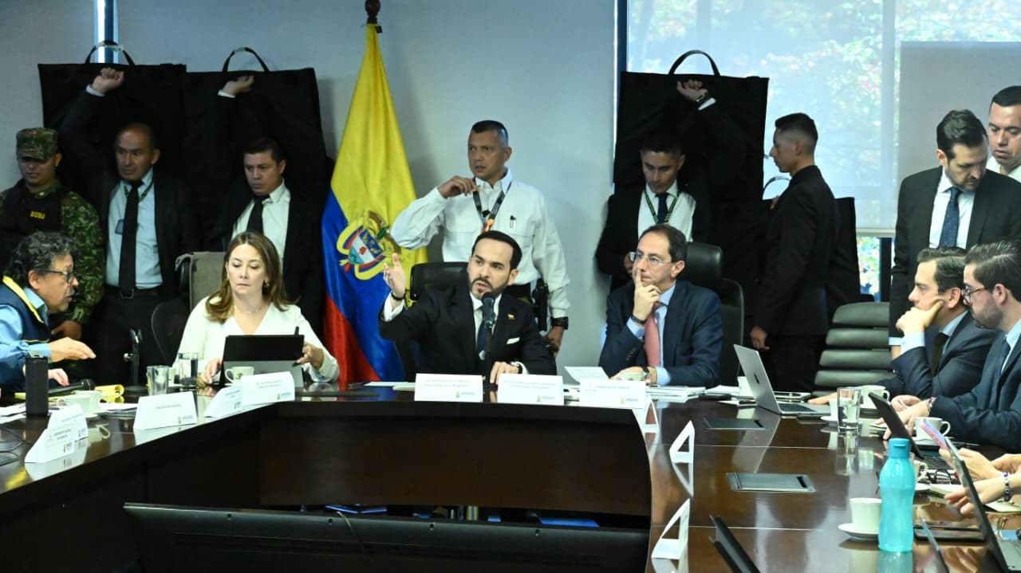
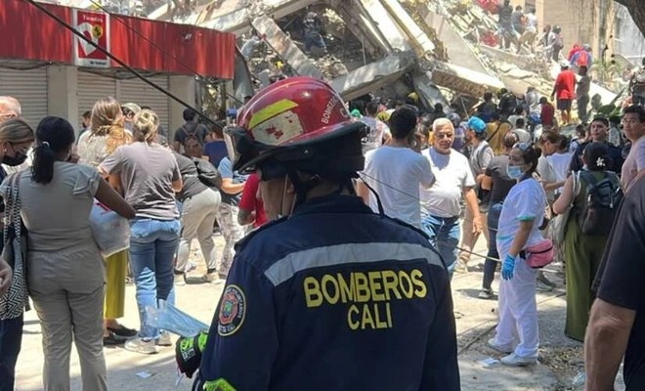
National Response
[Official] National disaster declaration activating the National Disaster Risk Management System (SNGRD) under Law 1523 of 2012.
[Official] Three days of national mourning declared by Decree 1172 from 12 August, with the flag at half-mast on all public buildings and at Colombian embassies and consulates abroad.
[Official] Unified Command Post (PMU) established in Chocó; UNGRD coordinating with departmental and municipal risk-management councils.
[Official] Four USAR teams (Bogotá, Envigado, Yopal, Medellín) deployed for search and rescue in collapsed structures.
[Official] Chocó ended its search-and-rescue phase on the night of 12 August, the governor stating that nobody remained reported under the rubble after the last family sought in Quibdó was found alive; the department moved to care for the affected and recovery. It reports 14 dead, 138 injured and 2,791 damaged properties.
[Official] Armed forces deployed for search, rescue, route clearance and security in the affected departments.
[Official] Rapid structural inspection of hospitals, schools and airports; seven health institutions closed and six airports suspended pending assessment.
[Media] Patients transferred from the damaged University Hospital in Cali to other facilities; the city reported casualties concentrated at 12 critical collapse sites.
[Official] The President toured the affected regions on 11-12 August - Quibdó, then Cali, then Pereira, Dosquebradas, Manizales and Armenia - and said he would direct the response from the field rather than Bogotá.
[Official] Relief measures announced during the tour: three months of relief on public-utility bills for households registered as affected, a rent subsidy for those who lost their homes, a census and characterisation of damaged housing ahead of repairs, and a shock plan for education and housing. On the evening of 12 August the President announced the declaration of an economic emergency, a constitutional mechanism intended to speed up the response.
[Official] Bogotá's collection drive had moved 1,174 tonnes of food, hygiene items and habitat kits to five departments by 16 August, with 900 units of blood, 45 engineers, 18 water-utility staff and 10 debris vehicles. Domestic solidarity, counted separately from international aid.
President Abelardo de la Espriella chairs the national response meeting © UNGRD — https://portal.gestiondelriesgo.gov.co/
Cali fire service at a collapsed building in the city © Alcaldía de Santiago de Cali — https://www.cali.gov.co/gestiondelriesgo/
Legal basis The national disaster declaration activates the SNGRD established by Law 1523 of 2012, allowing UNGRD to direct resources and the national disaster fund (FNGRD) to be used without the ordinary procurement timelines.
Sources: UNGRD - National Unit for Disaster Risk Management · Colombia One - Government declares national disaster · PreventionWeb - Colombia PNGRD 2015-2030
19
ADRC 20/08/2026

Slide 20
International Support (1/2)
[Official] Colombia is taking INSARAG-classified USAR teams from four countries only - the United States, Israel, Ecuador and El Salvador - on the stated grounds that they are internationally certified, work to INSARAG standards under UN coordination, and are fully self-sufficient, so they place no additional burden on municipal administrations. Their role is to support the Colombian USAR teams already deployed. The Government denied reports that other offers were declined for ideological reasons; the selection has nonetheless been questioned in the Colombian press.
[Official] By 17 August the Foreign Ministry reported 222.5 tonnes of humanitarian aid and 144 members of international teams received, stating that assistance arrived promptly and without restrictions in Chocó, Valle del Cauca and the Coffee Triangle. Delivered so far: El Salvador 100 t, Mexico 58.5 t, Chile 50 t, Peru 14 t. In preparation: Paraguay about 52 t, India 20 t, Guatemala 1,600 food kits and 3,000 hygiene kits (about 30 t), Luxembourg 75 family tents and four multipurpose tents, Germany 2,500 water filters and 3,000 kitchen kits, Sweden 150 family tents and 360 blankets. China announced 80 tonnes on 17 August. The Foreign Minister said no country had been excluded.
[Official] Assistance broadened on 14 August beyond the four countries sending rescuers. India dispatched 20 tonnes of humanitarian supplies (medicines and medical equipment, temporary shelter and hygiene items). Norway allocated NOK 10 million (about USD 1 million) for emergency health care, water supply, disease prevention and temporary housing, and Sweden SEK 5 million (about USD 522,000) channelled through UNHCR. Spain, Italy, Chile, Mexico, Turkey, Brazil and the World Bank have also sent or announced support; the Colombian government says it has received offers worth about USD 1.3 billion in total, and lists Japan among the countries that have announced assistance.
[Official] On 12 August Colombia accepted international search-and-rescue assistance, from countries whose teams meet the INSARAG classification: Israel, Ecuador, El Salvador and the United States. At Colombia's request the US State Department mobilised the Fairfax County (Virginia) and Los Angeles County (California) USAR task forces. El Salvador sent 100 tonnes of relief supplies and a Mexican aid flight has arrived.
[Official] United States: USD 15.5 million in emergency assistance announced on 10 August, for emergency shelter, food, protection and damage assessment.
[Official] European Union: the EU Civil Protection Mechanism was activated and an initial EUR 100,000 in humanitarian funding released, channelled through the German Red Cross, whose teams were already in the country. Copernicus was placed at the disposal of the Colombian authorities and the EU consular crisis mechanism was activated for EU citizens in the affected area. The Commission President and the High Representative stated the EU is ready to provide more if needed.
[Official] Japan: on 11 August at 21:31 JST (07:31 COT) the Prime Minister, Takaichi Sanae, posted condolences - “Japan stands with Colombia in this difficult time”. Foreign Minister Motegi issued a message: “In the wake of the earthquake that struck the Republic of Colombia on August 10, I express my deepest condolences to those who lost their lives and extend my heartfelt sympathies to all those affected. The Government of Japan also stands ready to provide the necessary assistance. Japan stands in strong solidarity with the people of Colombia.” No dispatch of the Japan Disaster Relief team and no emergency grant aid had been announced at the time of writing.
Sources: El Tiempo — SAR teams arriving from Israel, Ecuador, El Salvador and the US · El Tiempo — list of countries that have offered assistance · UN in Colombia — earthquake information and updates · Copernicus EMS — EMSR916 'Earthquake in Colombia' (activation)
20
ADRC 20/08/2026

Slide 21
International Support (2/2)
[Media] Japan: the Colombian government lists Japan among the countries that have announced assistance, but as of this cut-off neither MOFA nor JICA has published a Japan Disaster Relief dispatch, an emergency relief goods provision or emergency grant aid. On the Japanese side what is confirmed is non-governmental: the Japanese Red Cross Society is supporting the Colombian Red Cross response, and the Nippon Foundation opened a Colombia earthquake appeal running from 12 August to 30 September.
[Official] Ecuador mobilised a specialised USAR team of 47 personnel with canine units and self-sufficient equipment.
[Media] Offers of assistance were also reported from Chile, Peru, Panama, Argentina, Brazil, Venezuela, Bolivia, Guatemala, Cuba, El Salvador, Spain, Italy, France, Germany, Switzerland, Israel and Ukraine - USAR teams, medical and paramedic personnel, relief items and satellite observation. The CAF development bank announced a USD 500,000 donation.
[Official] Copernicus EMS Rapid Mapping activated as EMSR916 'Earthquake in Colombia' at 17:13 UTC on 10 August (12:13 COT), requested by EC Services / DG ECHO, to provide earthquake damage assessment emergency mapping. Status ongoing, with 3 areas of interest and 3 products at the time of writing. The activation reason names Quibdó, Pereira, Manizales and Cali as cities with significant damage and collapsed buildings.
[Official] United Nations: OCHA stated the humanitarian system is ready to support Colombia, and its preliminary needs analysis names drinking water, hygiene kits and household items, health care, food assistance and shelter. As of 11 August no formal request had been made; on 12 August the Government accepted international search-and-rescue assistance.
[TBC] The International Charter 'Space and Major Disasters' is also reported to have been activated for this earthquake; the activation number had not been confirmed at the time of writing.
[Media] International NGOs mobilising: Direct Relief and Americares (medical supplies), Save the Children (child protection and education), International Rescue Committee (assessment near the epicentre in Chocó), Convoy of Hope (relief goods).
Rescue was filtered; relief was not The two channels can now be quantified separately, and that is the finding. Search and rescue was opened to four countries only - the United States, Israel, Ecuador and El Salvador - on stated criteria of INSARAG classification, self-sufficiency and speed, even though offers came from at least seventeen and several of the others hold the same classification. Relief was not filtered: by 17 August the Foreign Ministry counted 222.5 tonnes delivered and 144 international team members received, from El Salvador, Mexico, Chile and Peru, with Paraguay, India, Guatemala, Luxembourg, Germany, Sweden and China in the pipeline and about USD 1.3 billion in offers on the table. The Foreign Minister says no country has been excluded. Both statements hold at once because they describe different things, and the distinction is what to carry away: rescue teams work inside a national command structure and must be certified and self-sufficient to be useful, while relief goods do not. Under Ley 1523 the response is Colombia's to direct - and a country that narrows the operational field this far should still expect to explain the basis in writing.
Sources: El Tiempo — SAR teams arriving from Israel, Ecuador, El Salvador and the US · El Tiempo — list of countries that have offered assistance · UN in Colombia — earthquake information and updates · Copernicus EMS — EMSR916 'Earthquake in Colombia' (activation)
21
ADRC 20/08/2026

Slide 22
Satellite & Analytical Support
Organisation | Contribution | Status | Tier
International Charter | Activation for the Colombia earthquake reported; wide-area optical/SAR imagery for damage assessment | Reported / number pending | TBC
Copernicus EMS | EMSR916 'Earthquake in Colombia' — Rapid Mapping for damage assessment; requested by EC Services / DG ECHO; 3 AOIs, 3 products | Ongoing (EMSR916) | Official
USGS | ShakeMap, PAGER (Orange), finite-fault and aftershock catalogue | Published | Official
GDACS | Overall Orange alert; population exposure and impact estimates | Published | Official
SGC | National seismic network: hypocentre, magnitude revision, aftershock bulletins, accelerographic records | Published | Official
Sentinel Asia | Not applicable - the mechanism covers the Asia-Pacific region; Colombia is served by the International Charter and Copernicus EMS | n/a | Official
Note on Sentinel Asia Sentinel Asia, for which ADRC serves as a joint project team member, covers the Asia-Pacific region. For a disaster in Colombia the equivalent international mechanisms are the International Charter 'Space and Major Disasters' and the Copernicus Emergency Management Service; UNOSAT/UNITAR rapid mapping is also commonly used in Latin America.
Sources: International Charter 'Space and Major Disasters' - activations · Copernicus EMS — EMSR916 'Earthquake in Colombia' (activation) · GDACS - Orange earthquake alert, Colombia, 10 Aug 2026
22
ADRC 20/08/2026

Slide 23
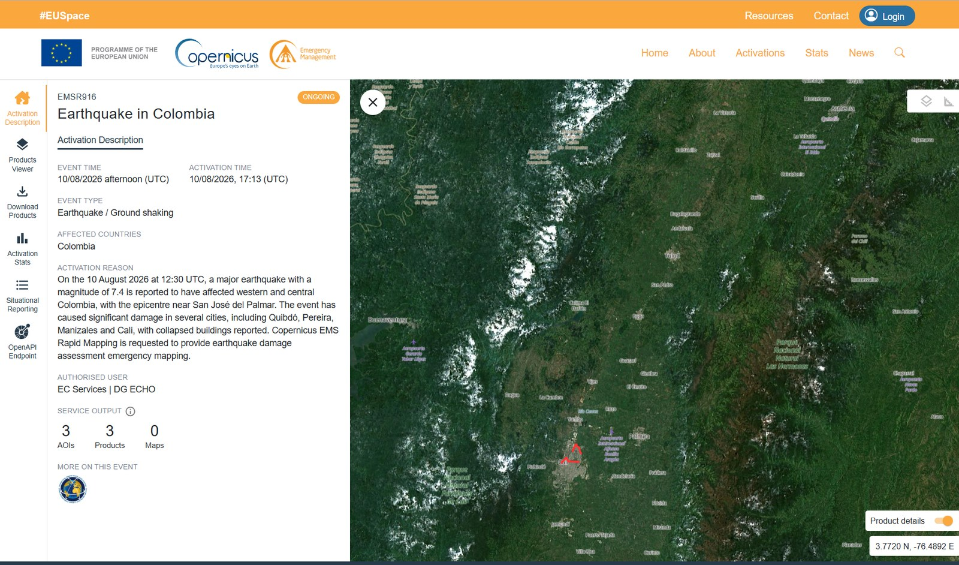
Copernicus EMS Rapid Mapping: EMSR916
Item | Value
Activation | EMSR916 — Earthquake in Colombia
Event time | 10/08/2026 afternoon (UTC)
Activation time | 10/08/2026, 17:13 (UTC) = 12:13 COT
Event type | Earthquake / Ground shaking
Affected country | Colombia
Authorised user | EC Services | DG ECHO
Service output | 3 AOIs · 3 products · 0 maps
Status | ONGOING
Activation reason (verbatim) “On the 10 August 2026 at 12:30 UTC, a major earthquake with a magnitude of 7.4 is reported to have affected western and central Colombia, with the epicentre near San José del Palmar. The event has caused significant damage in several cities, including Quibdó, Pereira, Manizales and Cali, with collapsed buildings reported. Copernicus EMS Rapid Mapping is requested to provide earthquake damage assessment emergency mapping.”
Activation page (© Copernicus EMS) — https://mapping.emergency.copernicus.eu/activations/EMSR916/
What Rapid Mapping delivers Rapid Mapping delivers reference and grading products over selected areas of interest, not nationwide coverage. Products are published on the activation page as they are produced and are free to use.
Sources: Copernicus EMS — EMSR916 'Earthquake in Colombia' (activation) · European Commission — EU support for Colombia, Copernicus activated
23
ADRC 20/08/2026

Slide 24
Colombia's Disaster Risk Management System
Colombia rebuilt its disaster risk management framework after the 1985 Armero volcanic disaster and again after the 1999 Armenia earthquake. Law 1523 of 2012 created the National Disaster Risk Management System (SNGRD), led by the National Unit for Disaster Risk Management (UNGRD), which reports to the Presidency.
Law 1523 of 2012 - national policy on disaster risk management; defines the SNGRD and makes risk management a mandatory duty of every public authority and, in part, of private actors.
UNGRD - national coordinating agency under the Presidency; runs the national response, the disaster fund (FNGRD) and the national information system.
Departmental and municipal risk management councils (CDGRD / CMGRD) carry out first response; UNGRD reinforces when local capacity is exceeded.
PNGRD 2015-2030 — the national disaster risk management plan, adopted by Decree 308 of 2016 and updated by Decree 1478 of 3 August 2022; aligned with the Sendai Framework and monitored annually by UNGRD.
NSR-10 - the national seismic building code (in force since 2010, technical annexes updated since). Buildings predating modern code enforcement, and non-engineered masonry and earthen construction, remain the dominant source of risk.
Seismic microzonation studies exist for major cities including Bogotá, Medellín, Cali, Pereira, Manizales and Armenia — a direct legacy of the 1999 earthquake. In Cali the microzonation is binding on structural design through Decree 411.0.20.0158 of 2014.
The SGC operates the National Seismological Network and the national accelerograph network, and issues public bulletins within minutes.
Cities run their own instruments alongside the national system: Cali's SATIC community-and-sensor early warning system (from 2018, formalised by Municipal Decree 0858 of 2022), Medellín's DAGRD and its municipal plan, and municipal risk-management funds created under Law 1523.
Sources: UN-SPIDER - UNGRD of Colombia · UNGRD — Plan Nacional de Gestión del Riesgo de Desastres (PNGRD) · Decreto 1478 de 2022 — update of the PNGRD · SATIC — Cali's intelligent and community early warning system
24
ADRC 20/08/2026

Slide 25
The 1999 Armenia (Quindío) Earthquake & Recovery
The 1999 Armenia (Quindío) Earthquake - the same Coffee Region On 25 January 1999 an M6.1-6.2 earthquake at about 30 km depth struck the Quindío coffee-growing region. It killed about 1,185 people, injured over 5,000 and damaged or destroyed some 50,000 structures; roughly 60% of the buildings in the city of Armenia collapsed or were severely damaged, and more than 200,000 people were displaced. Although far smaller in magnitude than the 2026 event, it was much shallower and much closer to the cities, which is why its local destructiveness was far greater.
What followed / lessons
Reconstruction was managed through a dedicated temporary body for the Coffee Region, an early example in Latin America of a purpose-built reconstruction agency.
The disaster drove enforcement of the national seismic code and the seismic microzonation studies that now cover Pereira, Manizales and Armenia.
Recovery of the coffee economy took roughly a decade - the economic tail of the disaster far outlasted the emergency phase.
The 2026 earthquake shook the same cities, but as a deep, distant source rather than a shallow local one: a different loading of the same building stock.
1999 impact | Figure
Deaths | approx. 1,185
Injured | over 5,000
Structures damaged or destroyed | approx. 50,000
Displaced | over 200,000
Coffee sector | approx. 8,000 farms and 1,200 processing facilities damaged
Why this matters now The cities hit hardest in 2026 - Pereira, Manizales, Armenia - are the same cities that rebuilt after 1999. How that rebuilt stock performed under long-period, long-duration shaking from a 110 km-deep source is the key question for post-event assessment.
Sources: GEM - Seismic regulations for Colombia (NSR-10) · PreventionWeb - Colombia PNGRD 2015-2030
25
ADRC 20/08/2026

Slide 26
Pre-event Risk Assessment: Santiago de Cali
Cali did not lack a risk assessment. Between 2020 and 2022 the city built a full urban earthquake risk model with the GEM Foundation under the USAID-supported TREQ project, one of three pilot cities alongside Quito and Santiago de los Caballeros. The modelled scenario is a shallow local one — magnitude 6.5 at 10 km depth on the Dagua-Calima fault — and its estimates dwarf what the city actually experienced on 10 August 2026.
What the city had already prioritised
Seismic vulnerability studies of indispensable buildings — hospitals, schools, fire stations — to the NSR-10 code (budgeted at about USD 1.7 million, short term).
Structural retrofitting of indispensable buildings and of basic-service infrastructure, to keep essential services running after an earthquake.
Seismic vulnerability assessment of the EMCALI water, sewerage and power networks and of the city gas network.
Updating the local soil-response model and the seismic microzonation, in force since INGEOMINAS/DAGMA (2005) and adopted by Decree 411.0.20.0158 of 2014 for structural design.
Maintaining and extending the Cali accelerograph network (RAC) and its interoperability with the SGC national network.
Insuring public infrastructure against seismic risk, and retrofitting low-income housing through subsidies and safe self-build programmes.
Financing model for the priority measures: local government 30-50%, national disaster fund (FNGRD/UNGRD) 30-50%, international partners including JICA, the GEM Foundation and the IDB about 20%.
Modelled scenario (GEM-TREQ, 2022) | Value
Modelled scenario | M6.5, 10 km depth, Dagua-Calima fault, urban area
Population exposed | approx. 2,300,000
Estimated deaths | approx. 1,200
Seriously injured | approx. 36,300
Displaced | approx. 181,000
Buildings collapsed | approx. 1,800 of 348,000 (0.5%)
Residual risk | assessed at about 40% after existing measures
Figures from the GEM-TREQ urban risk assessment for Santiago de Cali and from the city's local disaster risk management plan, as compiled by the Municipality of Santiago de Cali (Secretaría de Gestión del Riesgo de Emergencias y Desastres) for a JICA training course.
The 2026 earthquake was not this scenario The 10 August event was larger in magnitude (M7.4) but 110 km deep and 158 km from Cali, giving the city MMI VI rather than the near-field shaking of the modelled M6.5. Cali recorded 27 deaths and 25-30 collapsed structures — two orders of magnitude below the scenario. What it did test is exactly the weakness the local plan had flagged: about 30% of the University Hospital collapsed and seven health institutions closed. The city's own worst case remains ahead of it, and the case for retrofitting indispensable buildings is now evidential rather than theoretical.
Sources: GEM Foundation — TREQ project (urban earthquake risk, Quito / Cali / Santiago de los Caballeros) · GEM-TREQ — Evaluación de riesgo sísmico para Santiago de Cali (technical report D2.6.2) · Alcaldía de Santiago de Cali — disaster risk management
26
ADRC 20/08/2026

Slide 27
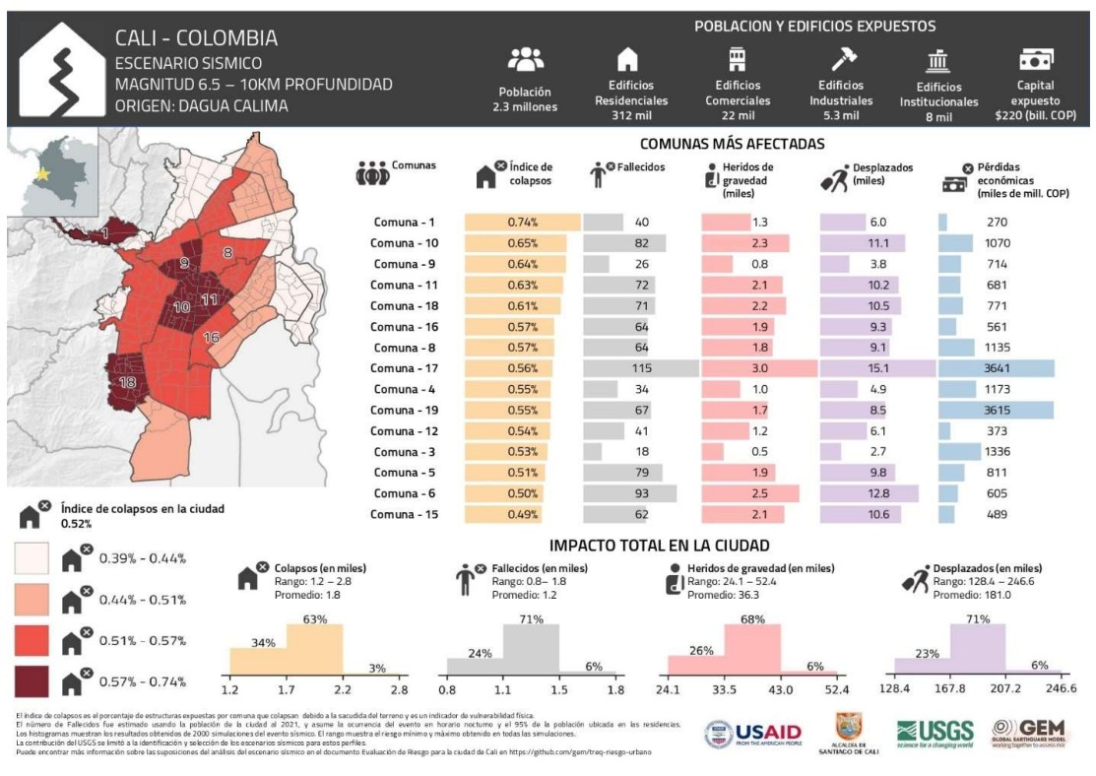
GEM-TREQ City Profile: Cali
© GEM Foundation / USAID / Alcaldía de Santiago de Cali / USGS — https://github.com/gem/treq-riesgo-urbano
GEM-TREQ city profile for Cali: the M6.5 / 10 km Dagua-Calima scenario. 2.3 million people and 312,000 residential, 22,000 commercial, 5,300 industrial and 8,000 institutional buildings are exposed, with COP 220 trillion of exposed capital. The bars give, per comuna, the collapse index, fatalities, serious injuries, displaced people and economic losses; the histograms give the city totals with their modelled ranges.
Sources: GEM-TREQ — Evaluación de riesgo sísmico para Santiago de Cali (technical report D2.6.2) · GEM Foundation — TREQ project (urban earthquake risk, Quito / Cali / Santiago de los Caballeros)
27
ADRC 20/08/2026

Slide 28
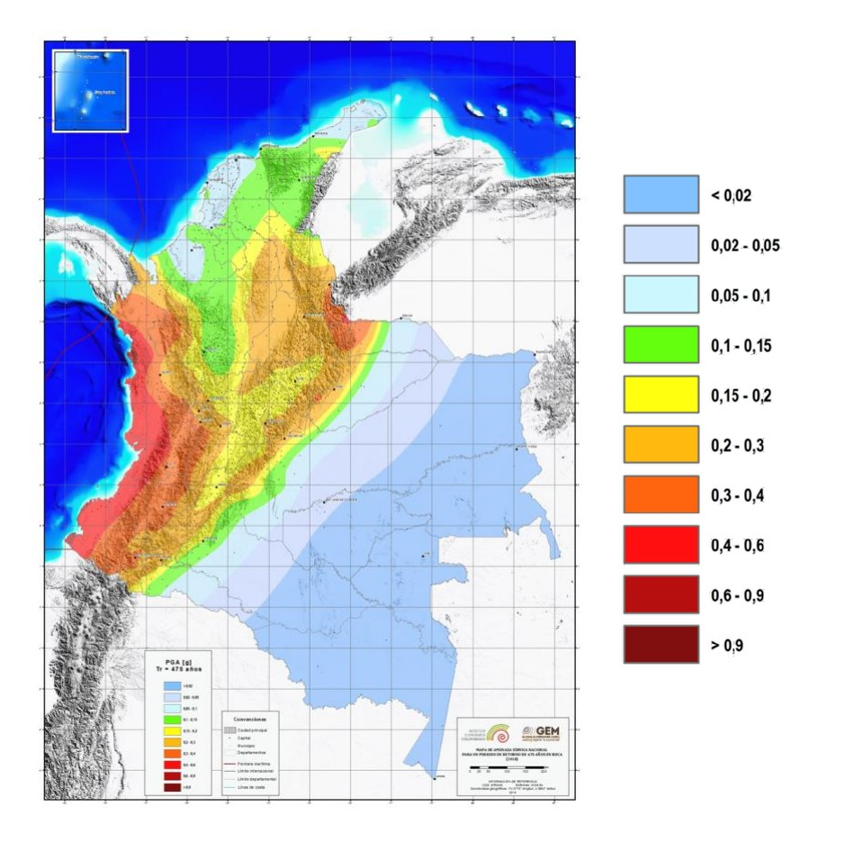
Historical Earthquakes in Colombia
Year | Event | Mag. | Impact
1906 | Ecuador-Colombia earthquake (Pacific coast) | M8.8 | One of the largest earthquakes ever recorded; destructive tsunami on the Pacific coast
1925 | Cali earthquake (Valle del Cauca) | M7.0 | The reference historical event for Cali; the city was also shaken in 1995 and 2004, the latter damaging clinics and residential buildings
1938 | Coffee Region earthquake (deep, 150 km) | M7.0 | An intermediate-depth event beneath the same coffee-growing departments — the closest historical analogue to the 2026 earthquake
1979 | Tumaco earthquake (Nariño) | M8.1 | Subduction-interface event with tsunami; several hundred deaths
1983 | Popayán earthquake (Cauca) | M5.5 | About 250-300 deaths; historic city centre heavily damaged - a small but shallow, urban event
1994 | Páez (Cauca) earthquake | M6.8 | About 1,100 deaths, most caused by earthquake-triggered landslides and debris flows
1995 | Chocó earthquake | M6.6 | Intermediate-depth event in the same department as the 2026 earthquake
1999 | Armenia (Quindío) earthquake | M6.1-6.2 | About 1,185 deaths; Colombia's costliest earthquake disaster; drove the modern DRM reforms
2026 | Chocó earthquake (this event) | M7.4 | Largest magnitude recorded in Colombia in the past decade (SGC); intermediate depth, wide-area damage
PGA (g), SGC / GEM national seismic hazard model (2020) — https://amenazasismica.sgc.gov.co/
National seismic hazard, 475-year return period
Pattern Colombia's deadliest earthquakes have not been its largest. Popayán 1983 (M5.5), Páez 1994 (M6.8) and Armenia 1999 (M6.1-6.2) were all shallow and close to towns; the largest events, offshore in 1906 and 1979, killed fewer people. Depth and proximity, not magnitude alone, drive the toll.
Sources: USGS - M 7.4 San José del Palmar, Colombia (event page) · Servicio Geológico Colombiano (SGC) · GEM Foundation — TREQ project (urban earthquake risk, Quito / Cali / Santiago de los Caballeros)
28
ADRC 20/08/2026

Slide 29
Observations & Points to Watch
[Official] A deep source with shallow-disaster consequences. At 110 km depth the earthquake produced no surface rupture and no tsunami, yet it damaged buildings in at least six departments. Damage is dispersed rather than concentrated, which complicates needs assessment, logistics and the targeting of search and rescue.
[Official] Critical facilities failed. The collapse of about 30% of Cali's University Hospital, the closure of seven health institutions, damage to 52 schools and the partial collapse of an international airport terminal all reduce response capacity exactly where it is needed. Seismic performance of hospitals, schools and transport terminals is the clearest lesson emerging so far.
[Official] The toll multiplied as the assessment reached the damage. In 56 hours deaths went from 111 to 239, injured from 87 to 3,755, missing from none counted to 287, damaged homes from 1,612 to about 54,000, and the affected area from “more than 20 municipalities” to 403 across 14 departments. Nothing new happened to cause those jumps; the assessment reached places it had not reached, and much of Chocó is still accessible only by boat or aircraft. Two lessons for reading early figures: the first-day numbers describe the reach of the assessment, not the size of the disaster; and where two counts of the same thing exist, check what each is counting before comparing them.
[Media] The affected area is the Coffee Region rebuilt after 1999. Comparing how post-1999 construction performed against older stock, under a very different type of shaking, will be valuable for the region and for other countries with intermediate-depth seismic sources.
[Official] The assessments existed before the event. Cali's GEM-TREQ risk model and its local plan had already named hospitals and other indispensable buildings as the priority to retrofit, and the 2026 earthquake — a far weaker test than the city's own modelled scenario — still took out roughly 30% of its main public hospital. The gap here is not knowledge but implementation and financing.
[Official] Aftershock risk to damaged buildings. The SGC located 147 events in 34 hours, 92% of them below M3.0 and only one above M4.0 - as modest as an intermediate-depth intraslab rupture predicts. That statistic is not the operational point: the M4.8 of 10 August was felt widely, and the M3.9 of 11 August emptied buildings again in several cities. Structures the mainshock left standing but damaged have lost capacity, so rapid habitability assessment before re-occupancy matters more than the aftershock numbers.
[TBC] Points to watch: the reconciled national casualty figures; shelter and displacement numbers, which have not yet been published; water and power restoration in Chocó; the results of satellite-based damage mapping; and whether the Government requests international assistance beyond the offers already made.
Sources: UNGRD - National Unit for Disaster Risk Management · USGS - M 7.4 San José del Palmar, Colombia (event page) · ReliefWeb - Colombia
29
ADRC 20/08/2026

Slide 30
Useful Links & Sources (1/7)
Source policy: Source hierarchy: official > media > TBC. Government and scientific-agency figures are used as primary; media reports are used only where official figures are not yet published and are labelled as such. Items still being verified are marked TBC. Preliminary figures are never replaced by larger unverified numbers.
Source | Tier | URL
USGS - M 7.4 San José del Palmar, Colombia (event page) | Official | https://earthquake.usgs.gov/earthquakes/eventpage/us6000tjl2/executive
Servicio Geológico Colombiano (SGC) | Official | https://www.sgc.gov.co/
SGC — event bulletin SGC2026pqqmro (this earthquake) | Official | https://www.sgc.gov.co/detallesismo/SGC2026pqqmro/
SGC — macroseismic intensity map (ShakeMap) for this earthquake | Official | https://www.sgc.gov.co/detallesismo/SGC2026pqqmro/mmi
UNGRD - National Unit for Disaster Risk Management | Official | https://portal.gestiondelriesgo.gov.co/
GDACS - Orange earthquake alert, Colombia, 10 Aug 2026 | Official | https://gdacs.org/report.aspx?eventid=1557236&eventtype=EQ
International Charter 'Space and Major Disasters' - activations | Official | https://disasterscharter.org/activations
Copernicus EMS — EMSR916 'Earthquake in Colombia' (activation) | Official | https://mapping.emergency.copernicus.eu/activations/EMSR916/
ReliefWeb - Colombia | Official | https://reliefweb.int/country/col
PAHO/WHO - Colombia | Official | https://www.paho.org/en/colombia
PreventionWeb - Colombia PNGRD 2015-2030 | Official | https://www.preventionweb.net/publication/colombia-plan-nacional-de-gestion-del-riesgo-de-desastres-pngrd-2015-2030
GEM - Seismic regulations for Colombia (NSR-10) | Official | https://www.globalquakemodel.org/seismic-regulations/colombia
CNN — live updates: death toll rises to 132 | Media | https://www.cnn.com/2026/08/10/world/live-news/colombia-earthquake-san-jose-del-palmar
El Colombiano — 84 injured and 12 dead in Chocó (department government) | Media | https://www.elcolombiano.com/colombia/terremoto-temblor-hoy-colombia-choco-heridos-FL39761141
30
ADRC 20/08/2026

Slide 31
Useful Links & Sources (2/7)
Source | Tier | URL
UN-SPIDER - UNGRD of Colombia | Official | https://un-spider.org/national-unit-disaster-risk-management-ungrd-colombia
OECD - Risk governance scan of Colombia | Official | https://www.oecd.org/en/publications/risk-governance-scan-of-colombia_eeb81954-en.html
CNN - Live updates: at least 111 dead | Media | https://www.cnn.com/2026/08/10/world/live-news/colombia-earthquake-san-jose-del-palmar
France 24 - Colombia declares national emergency as quake toll hits 111 | Media | https://www.france24.com/en/americas/20260810-powerful-quake-rocks-colombia-causing-major-damage
Al Jazeera - M7.4 earthquake hits Colombia | Media | https://www.aljazeera.com/news/2026/8/10/7-4-magnitude-earthquake-hits-colombia-killing-at-least-20
CBS News - Strong earthquake strikes western Colombia | Media | https://www.cbsnews.com/news/colombia-earthquake-western-region-evacuations/
NBC News - Deaths, injuries and collapsed buildings | Media | https://www.nbcnews.com/world/latin-america/strong-earthquake-colombia-ecuador-people-evacuating-homes-buildings-rcna591709
Colombia One - First official assessment: widespread structural damage | Media | https://colombiaone.com/2026/08/10/earthquake-colombia-official-details/
Colombia One - Government declares national disaster | Media | https://colombiaone.com/2026/08/10/colombia-national-disaster/
Infobae - SGC explains why the shaking lasted so long | Media | https://www.infobae.com/colombia/2026/08/10/por-que-el-temblor-en-colombia-de-este-lunes-10-de-agosto-duro-una-eternidad-el-servicio-geologico-explico-que-paso/
NHK - President reports 111 dead, 87 injured (Japanese) | Media | https://www3.nhk.or.jp/news/
Nikkei - M7.4 earthquake in western Colombia (Japanese) | Media | https://www.nikkei.com/article/DGXZQOGN108V30Q6A810C2000000/
Jiji Press - M7.4 earthquake in Colombia (Japanese) | Media | https://www.jiji.com/jc/article?k=2026081000878&g=int
Save the Children - Children at risk after the earthquake | Media | https://www.savethechildren.org/us/about-us/media-and-news/2026-press-releases/children-at-risk-after-earthquake-strikes-colombia
31
ADRC 20/08/2026

Slide 32
Useful Links & Sources (3/7)
Source | Tier | URL
Direct Relief - Mobilising medical aid | Media | https://www.directrelief.org/2026/08/colombia-earthquake-7-4-magnitude-direct-relief-response/
Americares - Colombia earthquake, August 2026 | Media | https://www.americares.org/crisis-alerts/colombia-earthquake-august-2026/
GLIDEnumber — EQ-2026-000146-COL (event identifier) | Official | https://glidenumber.net/
ADRC - Asian Disaster Reduction Center | Official | https://www.adrc.asia/
European Commission — EU support for Colombia, Copernicus activated | Media | https://www.democrata.es/en/international/von-der-leyen-expresses-the-eu-s-support-for-colombia-and-activates-copernicus-after-the-earthquake/
GEM Foundation — TREQ project (urban earthquake risk, Quito / Cali / Santiago de los Caballeros) | Official | https://www.globalquakemodel.org/proj/treq
GEM-TREQ — Evaluación de riesgo sísmico para Santiago de Cali (technical report D2.6.2) | Official | https://cloud-storage.globalquakemodel.org/public/wix-new-website/pdf-collections-wix/publications/TREQ%20deliverables/reports/TREQ_D262_Riesgo_Sismico_Cali_v1.00.pdf
Understanding seismic risk in Santiago de Cali for its application in risk management (peer-reviewed, 2025) | Official | https://www.sciencedirect.com/science/article/abs/pii/S2212420925003097
SATIC — Cali's intelligent and community early warning system | Official | https://satic.cali.gov.co/satic
Alcaldía de Santiago de Cali — disaster risk management | Official | https://www.cali.gov.co/gestiondelriesgo/
UNGRD — Plan Nacional de Gestión del Riesgo de Desastres (PNGRD) | Official | https://portal.gestiondelriesgo.gov.co/Paginas/Plan-Nacional-de-Gestion-del-Riesgo.aspx
Decreto 1478 de 2022 — update of the PNGRD | Official | https://www.funcionpublica.gov.co/eva/gestornormativo/norma.php?i=191411
EMSC-CSEM SeismicPortal — bulletin and FDSN event service | Official | https://www.emsc-csem.org/
SGC — seismic catalogue viewer (reviewed catalogue ends Feb 2018) | Official | https://catalogosismico.sgc.gov.co/visor/index.html
32
ADRC 20/08/2026

Slide 33
Useful Links & Sources (4/7)
Source | Tier | URL
El Tiempo — live updates, 11 August (Cali toll rises to 85) | Media | https://www.eltiempo.com/colombia/otras-ciudades/terremoto-en-colombia-de-7-4-en-vivo-el-comandante-del-ejercito-nacional-se-encuentra-en-choco-coordinando-las-labores-de-atencion-de-la-emergencia-3577491
Asocapitales balance — 132 deaths, 570+ injured, by city | Media | https://www.elespectador.com/colombia/mas-regiones/temblor-en-colombia-hoy-10-de-agosto-en-vivo-epicentro-y-reporte-de-afectaciones/
Noticias Caracol — UNGRD balance: 182 deaths, 2,542 injured, 189 missing | Media | https://www.noticiascaracol.com/colombia/en-vivo-colombia-hoy-tras-terremoto-de-magnitud-7-4-continuan-las-labores-de-rescate-so35
RPP — the President's 181 is 59 fewer than the regional data | Media | https://rpp.pe/mundo/colombia/abelardo-de-la-espriella-cifra-en-181-los-muertos-por-el-terremoto-59-menos-que-datos-regionales-noticia-1701022
El Tiempo — 99 aftershocks and their magnitudes (SGC) | Media | https://www.eltiempo.com/colombia/otras-ciudades/cuantas-replicas-se-han-registrado-tras-el-terremoto-de-7-4-en-colombia-estas-son-todas-las-magnitudes-3577711
Semana — SGC total: 103 aftershocks to 15:00 on 11 Aug | Media | https://www.semana.com/tecnologia/articulo/servicio-geologico-revela-el-numero-total-de-replicas-que-ha-habido-en-colombia-tras-fuerte-terremoto-que-estremecio-al-pais/202641/
MOFA Japan — Foreign Minister Motegi's message on the earthquake in Colombia | Official | https://www.mofa.go.jp/mofaj/la_c/sa/co/pageit_000001_00001.html
MOFA Japan on X — post of 11 August | Official | https://x.com/MofaJapan_jp/status/2087155064855261537
El Tiempo — list of countries that have offered assistance | Media | https://www.eltiempo.com/mundo/mas-regiones/la-comunidad-internacional-se-vuelca-en-ayudas-para-colombia-lista-de-paises-que-han-ofrecido-apoyo-tras-el-terremoto-de-magnitud-7-3577512
UN in Colombia — earthquake information and updates | Official | https://colombia.un.org/es/320793-informaci%C3%B3n-y-actualizaciones-sobre-el-terremoto-en-colombia
UN News — the UN offers support to Colombia | Official | https://news.un.org/es/story/2026/08/1541792
“Colombia te busca” — citizen missing-persons platform | Media | https://www.colombiatebusca.com/
Asocapitales — earthquake missing-persons tool | Official | https://www.asocapitales.co/terremoto-colombia.html
Infobae — relief and subsidies announced on the Coffee Region tour | Media | https://www.infobae.com/colombia/2026/08/12/de-la-espriella-anuncio-alivios-y-subsidios-tras-emergencia-en-el-eje-cafetero-por-el-terremoto-detallo-plan-de-choque-para-educacion-y-vivienda/
33
ADRC 20/08/2026

Slide 34
Useful Links & Sources (5/7)
Source | Tier | URL
Pulzo — UNGRD damage and casualty report across 14 departments | Media | https://www.pulzo.com/nacion/terremoto-en-colombia-ungrd-reporta-danos-y-victimas-en-valle-del-cauca-y-risaralda-PP5272829A
El Tiempo — SAR teams arriving from Israel, Ecuador, El Salvador and the US | Media | https://www.eltiempo.com/colombia/otras-ciudades/terremoto-en-colombia-hoy-12-de-agosto-ultimas-noticias-presidente-de-la-espriella-celebro-rescate-de-daniela-largo-tras-36-horas-bajo-los-escombros-3577781
Asocapitales — 188 deaths and 1,677 injured in capital cities | Official | https://www.asocapitales.co/actualidad/noticias/ciudades-seguras/terremoto-deja-188-fallecidos-y-1677-heridos-en-ciudades
infolibre — at least 254 dead as the search continues | Media | https://www.infolibre.es/internacional/terremoto-colombia-deja-254-muertos-continua-busqueda-escombros_1_2235003.html
El Colombiano — 265 dead, 3,494 injured, 496 missing | Media | https://www.elcolombiano.com/colombia/cifra-muertos-heridos-desaparecidos-por-terremoto-colombia-MK39884181
El Tiempo — UNGRD balance of 13 August: 273 dead, 3,824 injured, 377 missing | Media | https://www.eltiempo.com/colombia/otras-ciudades/balance-oficial-de-la-ungrd-tras-terremoto-de-magnitud-7-4-en-colombia-273-fallecidos-3-824-heridos-y-377-desaparecidos-3578196
El Tiempo — 40,753 families affected: UNGRD's new balance | Media | https://www.eltiempo.com/vida/40-753-familias-afectadas-y-273-muertos-ungrd-entrega-nuevo-balance-del-terremoto-en-colombia-3578185
El Tiempo — M4.2 aftershock at San José del Palmar, 13 August | Media | https://www.eltiempo.com/colombia/otras-ciudades/nuevo-temblor-de-magnitud-4-2-se-registro-en-san-jose-del-palmar-choco-en-la-manana-de-este-jueves-13-de-agosto-3578131
Infobae — Colombia to receive rescue teams from the US, Israel, Ecuador and El Salvador | Media | https://www.infobae.com/colombia/2026/08/13/colombia-recibira-equipos-de-rescate-de-ee-uu-israel-ecuador-y-el-salvador-por-terremoto/
El Tiempo — UNGRD balance of 14 August: 287 dead, 3,975 injured, 378 missing | Media | https://www.eltiempo.com/colombia/otras-ciudades/balance-oficial-de-la-ungrd-tras-terremoto-de-magnitud-7-4-en-colombia-287-fallecidos-3-975-heridos-y-378-desaparecidos-3578445
Infobae — live: the toll rises to 288, more than 4,000 injured and 202 missing | Media | https://www.infobae.com/colombia/2026/08/14/temblor-de-74-en-colombia-el-10-de-agosto-se-actualizo-el-numero-de-fallecidos-en-todo-el-pais/
Infobae — international assistance grows: India, Norway, Sweden and Spain | Media | https://www.infobae.com/colombia/2026/08/14/aumenta-la-ayuda-internacional-a-colombia-tras-el-terremoto-de-74-india-envia-20-toneladas-y-noruega-suecia-y-espana-anuncian-nuevos-recursos/
El Heraldo — Italy, India, Spain, Chile and the World Bank among those sending aid | Media | https://www.elheraldo.co/colombia/2026/08/14/italia-india-espana-chile-y-banco-mundial-entre-los-paises-y-organismos-que-han-enviado-ayudas-a-colombia-por-el-terremoto/
Japanese Red Cross Society — Colombian Red Cross response to the M7.4 earthquake | Official | https://www.jrc.or.jp/international/news/2026/0812_054987.html
34
ADRC 20/08/2026

Slide 35
Useful Links & Sources (6/7)
Source | Tier | URL
El Tiempo — why Colombia did not need foreign rescuers: 23 national USAR teams | Media | https://www.eltiempo.com/vida/medio-ambiente/por-que-colombia-no-necesito-rescatistas-extranjeros-tras-el-terremoto-el-pais-cuenta-con-23-equipos-con-personal-que-hace-parte-de-la-elite-global-3577677
El Tiempo — SGC: 184 aftershocks since 10 August (14 Aug) | Media | https://www.eltiempo.com/amp/vida/medio-ambiente/terremoto-en-colombia-desde-el-sismo-del-10-de-agosto-se-han-registrado-184-replicas-reporta-este-viernes-14-el-servicio-geologico-colombiano-3578360
CNN en Español — live coverage of rescue and recovery | Media | https://cnnespanol.cnn.com/2026/08/12/colombia/live-news/terremoto-en-vivo-muertos-videos-rescates-orix
El Tiempo — UNGRD balance of 15 August: 294 dead, 3,935 injured, 320 missing, 353 rescued | Media | https://www.eltiempo.com/colombia/otras-ciudades/balance-oficial-de-la-ungrd-este-15-de-agosto-tras-terremoto-de-7-4-en-colombia-294-fallecidos-3-935-heridos-320-desaparecidos-y-353-rescatados-3578602
Semana — 294 dead and 81,506 homes damaged, official figures | Media | https://www.semana.com/nacion/articulo/ascienden-a-294-los-fallecidos-del-terremoto-del-10-de-agosto-y-van-81506-viviendas-averiadas-segun-cifras-oficiales/202627/
El Heraldo — Decree 1172: three days of national mourning | Media | https://www.elheraldo.co/colombia/2026/08/12/presidente-de-la-espriella-decreta-tres-dias-de-duelo-nacional-por-victimas-del-terremoto/
El Tiempo — the governor of Chocó ends the department's search-and-rescue phase | Media | https://www.eltiempo.com/colombia/otras-ciudades/gobernadora-del-choco-dio-por-finalizada-la-fase-de-busqueda-y-rescate-en-el-departamento-tras-terremoto-de-7-4-en-colombia-ya-no-buscamos-a-nadie-3578022
El Tiempo — UNGRD balance of 16 August: 289 dead, 4,187 injured, 143 missing | Media | https://www.eltiempo.com/colombia/otras-ciudades/balance-oficial-de-la-ungrd-este-16-de-agosto-tras-terremoto-de-7-4-en-colombia-289-fallecidos-4-187-heridos-y-143-desaparecidos-3578742
RTVC Noticias — 289 dead, 143 missing and more than 185,000 affected | Media | https://www.rtvcnoticias.com/actualidad/terremoto-deja-289-fallecidos-143-desaparecidos-y-mas-de-185000-afectados-en-colombia
Radio Santa Fe — UNGRD reduces the death and missing figures | Media | https://www.radiosantafe.com/2026/08/16/ungrd-reduce-a-289-cifra-de-fallecidos-y-a-143-la-de-personas-desaparecidas-por-el-terremoto/
Semana — UNGRD balance of 16 August evening: 287 dead, 4,147 injured | Media | https://www.semana.com/nacion/articulo/terremoto-en-colombia-reportan-287-muertos-y-4147-heridos-en-nuevo-balance-de-la-ungrd/202615/
La Tercera — Colombia lowers the death toll and raises the injured count | Media | https://www.latercera.com/mundo/noticia/colombia-rebaja-a-casi-287-los-muertos-y-eleva-a-cerca-de-4150-los-heridos-por-el-terremoto/
Infobae — UNGRD explains the reduction in the registers of dead and missing | Media | https://www.infobae.com/colombia/2026/08/17/terremoto-en-colombia-ungrd-explica-la-reduccion-en-el-registro-de-fallecidos-y-desaparecidos/
El Tiempo — Foreign Ministry: 220+ tonnes of aid and 144 international team members | Media | https://www.eltiempo.com/politica/gobierno/colombia-ha-recibido-mas-de-220-toneladas-de-ayuda-humanitaria-y-144-integrantes-de-equipos-internacionales-tras-el-terremoto-informo-la-cancilleria-3578924
35
ADRC 20/08/2026

Slide 36
Useful Links & Sources (7/7)
Source | Tier | URL
Infobae — China sends 80 tonnes of aid to Colombia | Media | https://www.infobae.com/colombia/2026/08/17/china-envia-80-toneladas-de-ayuda-a-colombia-tras-el-terremoto-asi-es-el-cargamento-que-llegara-a-bogota/
Semana — SGC one week on: everything about the aftershocks | Media | https://www.semana.com/nacion/articulo/se-cumple-una-semana-del-fuerte-terremoto-que-estremecio-a-colombia-sgc-aclaro-todo-sobre-las-replicas/202600/
Alcaldía de Bogotá — 1,174 tonnes of aid collected for the affected municipalities | Official | https://bogota.gov.co/mi-ciudad/gobierno/ya-van-1174-toneladas-de-ayudas-y-donaciones-de-bogota-por-terremoto
La Opinión — UNGRD balance of 18 August: 304 dead, 4,548 injured, 426 missing | Media | https://laopinion.co/colombia/terremoto-en-colombia-deja-304-muertos-4548-heridos-y-426-desaparecidos
El Universal — the missing count rises sharply in the latest balance | Media | https://www.eluniversal.com.co/colombia/2026/08/18/terremoto-en-colombia-desaparecidos-aumentan-drasticamente-segun-ultimo-balance/
Infobae — new balance: 312 dead, 4,611 injured and 290 missing | Media | https://www.infobae.com/colombia/2026/08/18/terremoto-en-colombia-perdidas-por-danos-llegarian-a-30-billones-segun-estimacion-preliminar/
El Tiempo — five departments concentrate losses estimated at COP 30 trillion | Media | https://www.eltiempo.com/politica/gobierno/cinco-departamentos-concentran-perdidas-estimadas-en-30-billones-por-terremoto-segun-estimacion-revelada-por-el-presidente-abelardo-de-la-espriella-3578962
El Colombiano — how the COP 30 trillion loss estimate was calculated | Media | https://www.elcolombiano.com/inicio/calculo-perdidas-terremoto-colombia-plan-milagro-JA40049330
La FM — UNGRD balance of 19 August: 312 dead, 290 missing, 358 rescued | Media | https://www.lafm.com.co/actualidad/terremoto-colombia-van-312-muertos-290-desaparecidos-emergencia-rescate-408294
36
ADRC 20/08/2026

Slide 37
Asian Disaster Reduction Center (ADRC)
Bilingual (EN/JA) report for domestic and international dissemination. Public-agency sources take priority; gaps are filled with clearly-labelled media reports.
Figures as of the UNGRD balance with a 06:30 COT cut-off on 19 Aug 2026: 312 deaths, 4,611 injured, 290 missing, 358 rescued alive, 143,533 families (294,503 people) affected in 470 municipalities across 15 departments, 29,548 homes destroyed and 134,124 damaged, 267 buildings collapsed. The President has put preliminary direct physical losses at about COP 30 trillion (USD 9.6 billion) across five departments. The SGC had located 325 aftershocks by 17 August. All figures are preliminary; quote the cut-off with the number.
https://www.adrc.asia/
37
ADRC 20/08/2026

