Slide 1
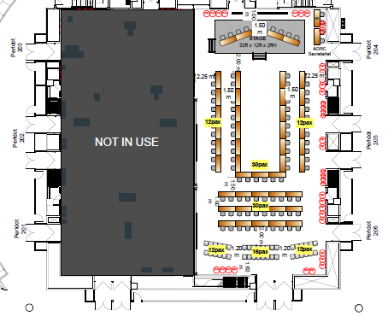
ACDR2026 配席表 最終案 10/8（Peridot 204-206）
AV
ADRC Sec.
ADRC (Arakida)
ADRC (Session/ PC)
Singapore
member
Singapore
member
member
ADRC (Miura)
ADRC Sec.
ADRC (WebCamera)
Singapore
Singapore
Armenia
ADRC (Miyaki)
NZ
member
NZ
advisor
member
Viet Nam
member
ADRC (Kitamoto)
NZ
AUS
Uzbekistan
Viet Nam
Azerbaijan
member
Azerbaijan
member
member
Turkiye
member
Viet Nam
Brunei
Bangladesh
Thailand
Uzbekistan
Fiji?
member
Bhutan
member
member
Sri Lanka
member
Turkiye
India
Brunei
ROK
ROK
India
member
Cambodia
member
member
PNG
member
PNG
ADPC
India
Pakistan
Pakistan
ADPC
partner
member
member
Myanmar
ADRC Sec.
ADRC (Note)
AHA Centre
member
member
member
ADRC (Photo/Mic)
Indonesia
Japan
Lao PDR
Malaysia
Maldives
Mongolia
member
member
resource
resource
partner
Japan
Sendai VM*
JAXA
Google *
ADB
Turkiye
Japan
Sendai
BRIN
Nepal
member
member
general
general
member
Japan
Japan
Sendai
Sendai
Sendai
JAXA
Tohoku U
ROK
ROK
ADRC Sec.
general
general
JICA
general
general
ADRC (Photo/Mic)
ADRC (Note)

