Slide 1

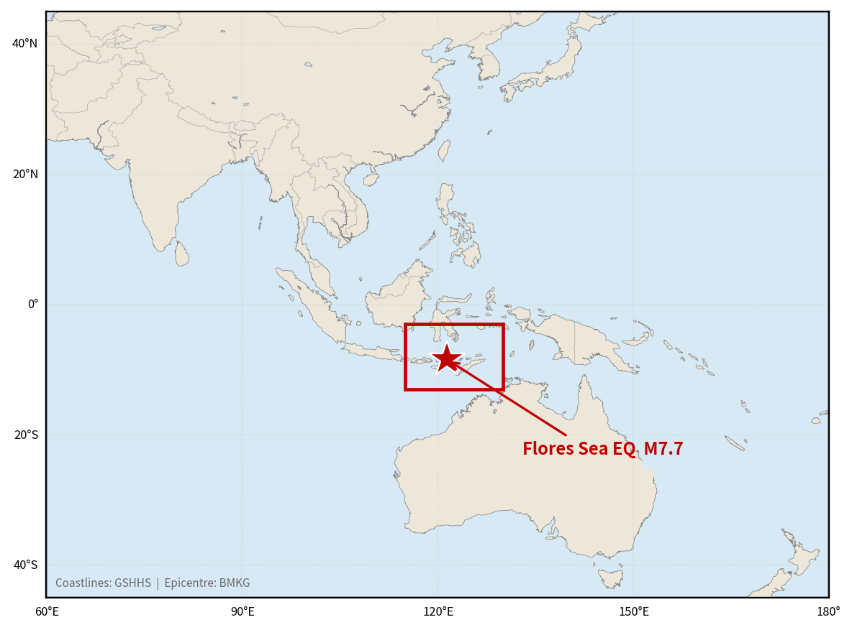
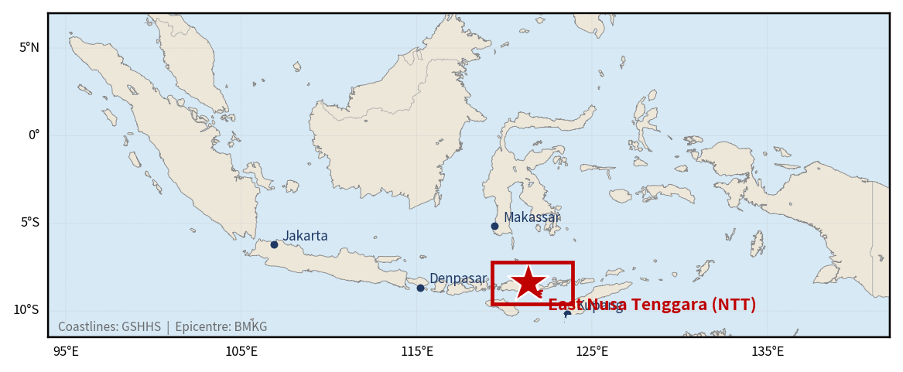
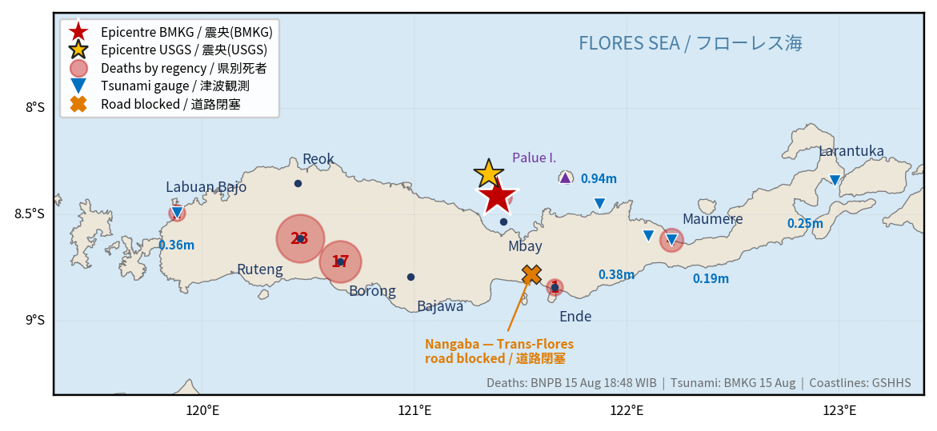
2026 East Nusa Tenggara Earthquake (Indonesia)
(GLIDE No. EQ-2026-000150-IDN)
M7.7 · Offshore Nagekeo Regency, about 30 km northeast of Mbay, Flores Island, East Nusa Tenggara
① World
② Indonesia
③ Flores, NTT
© BMKG / GSHHS
© BMKG / GSHHS
© BNPB / BMKG
Overview A magnitude 7.7 earthquake struck offshore Nagekeo Regency, East Nusa Tenggara, at 04:58 WIB on 15 August 2026, about 30 km northeast of Mbay, Flores. BMKG issued a tsunami warning for several coastal areas and lifted it at 07:31 WIB. Seven regencies were affected, from West Manggarai east to Sikka. The toll rose as access improved, reaching 120 deaths and about 188,673 displaced as of 31 August (BNPB, via the AHA Centre). On 15 September BNPB announced a revised toll of 142 deaths - 48 direct and 94 indirect deaths at evacuation sites - after a joint verification with the Ministry of Health, and revised the injured figure to 1,603. BNPB attributed the indirect deaths mainly to elderly evacuees with chronic conditions, and rejected readings that they had died for want of treatment. DPR's Commission IX and Amnesty International Indonesia have called for an audit and independent investigation, respectively. ADRC requested Sentinel Asia and the International Charter on the day of the earthquake on behalf of BRIN. The response has shifted into recovery: roads and bridges are restored, 1,931 schools have resumed classes, and Rp200 billion in contingency funds has gone to NTT. Tent displacement is 22,383 (30 Sep) and 103,427 damaged houses are being re-verified. BMKG recorded 17,073 aftershocks by 21 Sep; a felt M5.1 that day in Manggarai Timur, linked to the Flores Back-arc Thrust, collapsed a partly built shelter.
Sources: BMKG · BNPB (via ReliefWeb) · USGS
ADRC 04/10/2026

Slide 2
Chronology of Response (15 August - 4 October 2026 (Western Indonesian Time, UTC+7)) (1/6)
Government and agency actions from the earthquake - all official sources. Times follow BNPB's own reporting in WIB (UTC+7) unless stated
Time | Action | Source
15 Aug | Sentinel Asia emergency observation is activated for the Flores region earthquake at the request of the National Research and Innovation Agency (BRIN); the record notes escalation to the International Charter and carries GLIDE EQ-2026-000150-IDN. | Sentinel Asia
15 Aug 04:58 | A magnitude 7.7 earthquake strikes offshore Nagekeo Regency, East Nusa Tenggara, about 30 km northeast of Mbay on Flores Island. USGS gives Mww 7.7 at 10 km depth (14 Aug 21:58 UTC); BMKG reports 15 km. | BMKG / USGS
15 Aug 05:28 | An M6.1 aftershock is located in the same area, 30 minutes after the main shock. | USGS
15 Aug 07:31 | BMKG lifts the tsunami warning at 07:31 WIB. Seven BMKG tide gauges recorded maximum wave heights of 0.14-0.94 m (Maurole, Ende the highest at 0.94 m), with arrival times of 10 to 60 minutes. | BMKG
15 Aug 08:00 | BNPB first report: 2 deaths at Laurentius Say Port, Maumere. | BNPB
15 Aug 13:54 | The International Charter Space and Major Disasters is activated as #1050 (13:54 UTC+09:00), with ADRC recorded as the requestor on behalf of BRIN. Project management is assigned to BRIN. | International Charter
15 Aug 18:48 | BNPB reports 47 deaths. Landslides sever the Trans-Flores highway and Nagekeo Regency is isolated. | BNPB
16 Aug 00:00 | BNPB reports 47 deaths and 101 injuries, with more than 5,000 people displaced and 1,357 houses damaged (914 severely). | BNPB
17 Aug | BMKG has recorded 341 aftershocks of M2.5-6.2. The displaced figure is revised to 9,290. | BMKG / BNPB
17 Aug 08:46 | An Mw 5.5 aftershock kills two people in Ngada Regency, one of them in a landslide (times in WITA, WIB+1h). | BMKG / BNPB
18 Aug | The toll reaches 69 deaths and 1,199 injured, with 46,252 displaced and 11,213 houses damaged. 283 educational, 211 health and 97 government facilities are affected. | BNPB / IFRC-PMI
20 Aug 06:45 | An Mw 5.8 aftershock; one death at Ruteng hospital is reported in association with it (WITA). | BMKG / BNPB
Sources: BNPB (via ReliefWeb) · USGS · International Charter
2 / 40
ADRC 04/10/2026

Slide 3
Chronology of Response (15 August - 4 October 2026 (Western Indonesian Time, UTC+7)) (2/6)
Government and agency actions from the earthquake - all official sources. Times follow BNPB's own reporting in WIB (UTC+7) unless stated
Time | Action | Source
22 Aug | Sentinel-1 SLC coherence analyses (VH and VV polarisation) are delivered under the Charter activation. | Int'l Charter / BRIN
23 Aug 05:00 | BMKG has recorded 5,688 aftershocks. | BMKG
24 Aug 09:00 | BNPB reports 100 deaths, 1,603 injured or ill and 180,327 displaced, with 73,818 houses damaged, 1,378 educational facilities, 118 health facilities, 504 government offices and 396 places of worship affected. | BNPB
25 Aug | A line-of-sight displacement analysis of the Flores earthquake is delivered. | Int'l Charter
26 Aug | A SAR-based earthquake damage proxy map is delivered. | Int'l Charter
27 Aug | BNPB announces housing repair-grant rates: Rp15 million per lightly damaged house and Rp30 million per moderately damaged house; severely damaged houses to be handled through new construction or replacement. Distribution mechanisms and common damage-grading guidance are still being finalised. | BNPB (Berton SP Panjaitan), via ANTARA
27 Aug | BNPB deploys assessment teams to all seven affected regencies to accelerate rehabilitation and reconstruction, without waiting for the emergency period to end. | BNPB Pusdatinkom
29 Aug - 12 Sep | NTT Province extends the emergency response period. | Governor of NTT
27-28 Aug | The Indonesian Humanitarian Coordination Platform's multi-stakeholder meeting on 25 Aug and its Situation Report No. 7 (published 28 Aug, citing the BNPB dashboard as of 27 Aug 09:00 WIB) flag continuing gaps in IDP data collection, especially among self-settled displaced people in West Manggarai, and record damage to 118 health facilities, 499 places of worship, 530 office units, 39 other public facilities, 19 irrigation facilities, 128 road points and 71 bridges. | IHCP (MPBI), citing BNPB dashboard
31 Aug 09:00 | The AHA Centre's ASEAN Weekly Disaster Update Week 35 reports that BNPB's emergency response period for the earthquake has been extended to 12 September, and records 120 deaths, 1,658 injured and approximately 188,673 displaced as of 09:00 WIB on 31 August. | AHA Centre (ASEAN), citing BNPB
Sources: BNPB (via ReliefWeb) · USGS · International Charter
3 / 40
ADRC 04/10/2026

Slide 4
Chronology of Response (15 August - 4 October 2026 (Western Indonesian Time, UTC+7)) (3/6)
Government and agency actions from the earthquake - all official sources. Times follow BNPB's own reporting in WIB (UTC+7) unless stated
Time | Action | Source
30 Aug 07:00 | At a Jakarta press conference, BNPB reports 111 deaths, 1,631 injured (223 severe, 1,408 minor), 188,161 displaced (down 4,142 from the prior count) and 95,567 houses damaged (46,161 light, 21,992 moderate, 27,414 severe). Manggarai and Nagekeo hold the largest evacuee caseloads. Cumulative aftershocks reach 9,765 (155 felt), M1.0-6.2. | BNPB (Berton SP Panjaitan), via ANTARA
30 Aug (data) / 4 Sep (reported) | The Ministry of Public Works confirms all 17 affected road sections and 14 bridges (plus 3 culverts) are restored and operational, and separately records 651 damaged public buildings (112 religious education facilities, 300 places of worship, 238 health facilities) plus damage to 81 drinking-water systems, 2 sludge plants, 1 landfill and several water-resource facilities, based on data as of 30 August. | Ministry of Public Works (Dody Hanggodo), via ANTARA
5 Sep | The ministry reports 1,931 education facilities serving 171,476 students have resumed classes (1,504 in makeshift classrooms, 392 via distance learning, 35 fully normal), with 3,763 emergency classroom units targeted in total. | Ministry of Primary and Secondary Education (Abdul Mu'ti), via ANTARA
7 Sep | A second batch of 160 Reserve Health Workers (TCK), focused on psychosocial and mental-health support, departs for Ngada, Manggarai, Manggarai Barat and Manggarai Timur, adding to 206 TCK personnel already deployed for primary care. Two field hospitals remain operational in Ruteng and Ngada. | Ministry of Health (Sumarjaya), via ANTARA
7-8 Sep | At a disaster-mitigation meeting chaired by President Prabowo on 7 September, the Home Affairs Minister urges NTT regions to accelerate use of Rp200 billion in central-government contingency funds (Rp40 billion to the province, Rp20 billion each to eight districts), noting the pace of realisation has been slow. The ministry has reissued 11,000 civil registration documents for affected residents. | Home Affairs Ministry (Tito Karnavian), via ANTARA
9 Sep | The NTT Governor reports aftershocks declining but still fluctuating (about 13,000 cumulative, 177 felt, as of 5 September; BMKG expects activity may continue 3-4 more weeks). In Sikka District, 925 families remain registered as evacuees, a continuing decline; province-wide house-damage re-verification continues (3,042 houses confirmed damaged, 1,252 being entered, about 2,808 still in data collection). | NTT Governor (Melki Laka Lena), citing BMKG, via ANTARA
Sources: BNPB (via ReliefWeb) · USGS · International Charter
4 / 40
ADRC 04/10/2026

Slide 5
Chronology of Response (15 August - 4 October 2026 (Western Indonesian Time, UTC+7)) (4/6)
Government and agency actions from the earthquake - all official sources. Times follow BNPB's own reporting in WIB (UTC+7) unless stated
Time | Action | Source
14 Sep | The Indonesian Humanitarian Coordination Platform's Situation Report No. 9 summarises a Joint Needs Assessment (JNA) conducted 19 August-4 September (primary data collection 24-26 August at 143 survey locations across 35 sub-districts in seven affected districts), led by Humanitarian Forum Indonesia and coordinated by World Vision Indonesia with 20 national and local organisations. Key findings: most locations reported shelter-in-place using tents/tarpaulins near damaged homes rather than displacement to central sites; 86.01% of locations had no private space in shelters and nearly half reported basic facilities hard to access for at-risk groups; acute respiratory infections were reported at 62.24% of locations, skin diseases at 47.55% and gastrointestinal infections at 41.26%; 42 locations had not yet received food assistance; and markets remain functional but constrained by pressure on staple-food and fuel prices and household purchasing power, particularly in Sikka and Manggarai districts for water access. | Indonesian Humanitarian Coordination Platform (IHCP), Situation Report No. 9
15 Sep | At an online press conference, BNPB's Acting Head for Disaster Data, Information and Communication, Berton SP Panjaitan, reported that the number of displaced persons has declined sharply, "from over 150,000 people to 46,461", which he attributed to the emergency response and post-disaster recovery efforts. Joint field teams, working with Dukcapil (population registration) and BPS (statistics), are re-verifying data on 103,427 damaged housing units (severe, moderate and minor combined) to prevent duplicate claims in housing repair assistance. Separately, BMKG reported 15,722 aftershocks (M0.9-6.2) over the 30 days since the 15 August M7.7 mainshock, in a declining weekly pattern (5,011 / 4,267 / 3,158 / 2,421 / 864). | BNPB (press conference, via ANTARA)
10 Sep | BNPB press conference: cumulative deaths 136, of which 88 indirect; 102,384 houses affected, field verification of damage about 70 per cent complete. | BNPB (ANTARA)
15 Sep | BNPB press conference: 48 direct deaths and 94 indirect deaths at evacuation sites (142 total); displacement down to 46,461 from over 150,000; 103,427 damaged houses being re-verified. | BNPB (ANTARA)
17 Sep | BNPB issues a video statement restating that the 94 indirect deaths were not caused by direct physical trauma or building collapse, and apologising if its earlier statement caused public concern. A deputy chair of the DPR's Commission IX calls for an audit of health services at evacuation sites; Amnesty International Indonesia demands an independent investigation. | BNPB / DPR / Amnesty (Kompas)
Sources: BNPB (via ReliefWeb) · USGS · International Charter
5 / 40
ADRC 04/10/2026

Slide 6
Chronology of Response (15 August - 4 October 2026 (Western Indonesian Time, UTC+7)) (5/6)
Government and agency actions from the earthquake - all official sources. Times follow BNPB's own reporting in WIB (UTC+7) unless stated
Time | Action | Source
18 Sep | Minister of Home Affairs Tito Karnavian said President Prabowo Subianto's contingency allocation to NTT had been increased by a further Rp20 billion, and separately criticised slow disbursement of an earlier Rp20 billion tranche to Sikka Regency. | Minister of Home Affairs Tito Karnavian (Kompas)
21 Sep | Responding to the Home Affairs Minister's criticism, Sikka Regency's acting secretary said not all of its Rp20 billion presidential aid needed to be spent during the emergency-response phase; part is earmarked for the recovery-transition phase (house repairs), with about Rp17 billion remaining unspent as of 21 Sep. | Sikka Regency acting secretary (Kompas)
21 Sep | BNPB confirmed that seven temporary-housing (huntara) units it built in Desa Gurung Liwut, Lamba Leda, Manggarai Timur, withstood the day's felt M5.1 aftershock (initially reported M5.3; see Aftershocks) without damage; the units had been formally handed over to beneficiaries the same day. BNPB separately addressed a video circulating on social media showing a lightweight steel frame collapsing, clarifying it depicted a different site still under construction (frame not yet fully fixed, foundation not yet cast), not a completed, occupied unit. | BNPB (via ANTARA, 23 Sep)
21 Sep | The Minister of Primary and Secondary Education told the House of Representatives' Commission X that the ministry is committed to revitalising 1,487 education units in NTT damaged by the earthquake, backed by a separately-announced Rp 1.2 trillion budget allocation for the province; reconstruction can begin once the second-tranche supplementary budget (ABT) is disbursed. The ministry states it has already disbursed Rp 860 million for initial handling of dozens of quake-affected schools. | Ministry of Primary and Secondary Education (Mendikdasmen), via ANTARA
25 Sep | Manggarai Barat Regency BPBD reported 6,657 houses verified damaged by the earthquake within the regency (488 severely, 1,589 moderately, 4,580 lightly damaged), a regency-level verification tally distinct from BNPB's national figures. Owners of severely damaged houses are offered a choice of temporary-housing (huntara) construction or a housing-wait allowance (DTH) of Rp 600,000/month; 248 families have opted for the DTH, citing lack of land for huntara construction. | BPBD Manggarai Barat (Kompas)
28 Sep | BNPB's 28 Sep update on temporary housing (huntara): Manggarai 4 units complete, 50 above 50% progress and 60 below 50%, of 1,494 verified heavily-damaged houses; East Manggarai 6 complete and 561 under construction (first-phase target 1,305); Ngada 11 complete and 272 in progress; Nagekeo 9 complete and 173 in progress of 314 verified; Sikka 2 complete and 25 in progress; Ende 7 complete and 7 in progress. | BNPB, via ANTARA (5762701)
Sources: BNPB (via ReliefWeb) · USGS · International Charter
6 / 40
ADRC 04/10/2026

Slide 7
Chronology of Response (15 August - 4 October 2026 (Western Indonesian Time, UTC+7)) (6/6)
Government and agency actions from the earthquake - all official sources. Times follow BNPB's own reporting in WIB (UTC+7) unless stated
Time | Action | Source
30 Sep | ANTARA reports 108 indirect deaths among evacuees as of end-September (Manggarai 44, East Manggarai 33, Nagekeo 20), mostly older people and children with pneumonia and diarrhoea. The Minister of Home Affairs said he would confirm the causes with the NTT provincial government and noted an additional Rp 20 billion contingency fund for each of the seven affected regencies/cities and Rp 40 billion for NTT Province. | BNPB / Ministry of Home Affairs, via ANTARA (5764619)
1 Oct | BNPB states that all temporary-housing (huntara) construction for survivors of the M7.7 earthquake is free of charge, responding to reports of Manggarai residents paying extra costs. It says accelerated huntara construction in the seven affected regencies has cut people in emergency tents by 87%, from 179,037 to 22,383 as of 30 September. | BNPB, via ANTARA (5767224)
4 Oct | A separate M6.1 earthquake struck offshore Sumba Barat Daya Regency at 06:55 WITA (UTC+8) on 4 Oct, 14 km southwest of Kodi, depth 10 km (9.70S 118.92E), no tsunami potential per BNPB. It was felt strongly for about one minute in Sumba Barat Daya, Sumba Barat and Manggarai Barat. The Kodi Utara police report one death, a 73-year-old who collapsed from shock, and many houses and one school severely damaged; BPBD is still compiling data. BMKG links the quake to Indo-Australian plate activity. This is not counted in the 15 August Flores earthquake figures; a relation to the Flores sequence has not been stated by any authority. | BNPB / Kodi Utara police (ANTARA 5770664)
Sources: BNPB (via ReliefWeb) · USGS · International Charter
7 / 40
ADRC 04/10/2026

Slide 8
Damage Situation (1/15)
Figures reported by BNPB and relayed by IFRC/PMI and humanitarian partners; source and cut-off shown per row. All provisional.
Item | Figure | Source | Tier
Deaths (direct / indirect) | 142 (BNPB, 15 Sep 2026 press conference): 48 direct deaths and 94 indirect deaths at evacuation sites. BNPB and the Ministry of Health (Kemenkes) carried out a joint verification and validation across the seven affected regencies and concluded that the 94 were not caused by physical trauma or building collapse. Medical-team data show most were older people (lansia) who died of complications of pre-existing chronic conditions such as stroke and diabetes. In a video statement on 17 September BNPB restated that the 94 did not die of direct physical trauma or building collapse, said medical teams had provided maximum care through health facilities and integrated health posts, and noted that logistics support posts at Labuan Bajo and Maumere had been active from the first day. It apologised if its earlier statement had caused public concern and speculation - this was not an apology for a delay in disclosure. The same day, Charles Honoris, a deputy chair of the DPR's Commission IX, called for an audit of conditions and health services at evacuation sites, noting that more people died at the sites than died directly in the earthquake, and asked that the Ministry of Health, Ministry of Home Affairs, BNPB and local governments take part. Also on 17 September, Amnesty International Indonesia (media manager Haeril Halim) demanded an immediate, independent, impartial and thorough investigation, arguing that deaths from chronic illness should have been avoidable with adequate health care and that an independent inquiry is needed to establish whether there was state negligence. | BNPB (press conference, 15 Sep 2026, Plt. Kapusdatinkom Berton SP Panjaitan; via Indonesian-language domestic media - ANTARA / Kompas / Tirto / Republika / NU Online) | Official
8 / 40
ADRC 04/10/2026

Slide 9
Damage Situation (2/15)
Figures reported by BNPB and relayed by IFRC/PMI and humanitarian partners; source and cut-off shown per row. All provisional.
Item | Figure | Source | Tier
Deaths (direct / indirect) (cont.) | The provincial BPBD NTT "Inatana" figure for the same date is 120; no authority has published an explanation of the divergence. Earlier BNPB figures: 136 (10 Sep), 127 (2 Sep), 120 (31 Aug, via AHA Centre), 111 (29 Aug). At the 10 September press conference BNPB gave 136 of which 88 were indirect, so the direct count has stood at 48 throughout and it is the indirect count that has risen: 57 (26 Aug), 72 (31 Aug), 88 (10 Sep), 94 (15 Sep). ANTARA still reported 94 indirect deaths as the current BNPB figure on 17 September. Update (1 Oct): ANTARA (30 Sep) reports that 108 evacuees have died of indirect causes at evacuation sites and posts as of end-September (up from 94 on 15 Sep): Manggarai 44, East Manggarai 33, Nagekeo 20. Most were older people and children with respiratory disease (pneumonia) and diarrhoea, per local governments. No later direct-death figure has been published; the 48 direct deaths of 15 Sep are retained. The total of 156 (48 + 108) is an ADRC sum, not a BNPB-published figure. The Minister of Home Affairs said on 30 Sep he would cross-check these deaths with the NTT provincial government. |  | Official
9 / 40
ADRC 04/10/2026

Slide 10
Damage Situation (3/15)
Figures reported by BNPB and relayed by IFRC/PMI and humanitarian partners; source and cut-off shown per row. All provisional.
Item | Figure | Source | Tier
Injured / ill | 1,603 (BNPB, 15 Sep 2026). Revised down from 1,658 (31 Aug, via AHA Centre) and 1,678 (29 Aug). This appears to be a retroactive correction from verification, but no official explanation has been published - it should be read as "revised", not "decreased". A separate line (Kompas.tv, 13 Sep) reports 1,776. The provincial Inatana figure for 15 Sep is 1,191. | BNPB (press conference, 15 Sep 2026, Plt. Kapusdatinkom Berton SP Panjaitan; via Indonesian-language domestic media - Tirto / Republika / NU Online) | Official
10 / 40
ADRC 04/10/2026

Slide 11
Damage Situation (4/15)
Figures reported by BNPB and relayed by IFRC/PMI and humanitarian partners; source and cut-off shown per row. All provisional.
Item | Figure | Source | Tier
Displaced | Approximately 188,673 (BNPB, via AHA Centre, as of 09:00 WIB 31 Aug), up from 179,037 at the 26 Aug report. The figure moved about 2,000 (15 Aug) to 9,290 (16 Aug) to 46,252 (18 Aug) to 59,647 (19 Aug) to 180,327 (24 Aug) to 179,037 (26 Aug) to 188,161 (30 Aug 07:00 WIB, BNPB press conference via ANTARA - down 4,142 from the prior count as aftershocks began to ease; Manggarai and Nagekeo the largest caseloads at 50,556 and 50,574) to approximately 188,673 (31 Aug). BNPB attributes the very large caseload substantially to fear of continuing aftershocks and to circulating hoaxes predicting a larger earthquake and tsunami, not to housing loss alone. No BNPB or media figure found after 31 Aug supersedes this; a 9 Sep ANTARA report on Sikka District alone (925 families still registered, and falling) is consistent with a continuing gradual decline but is not a province-wide count. On 15 Sep, at an online press conference, BNPB's Acting Head for Disaster Data, Information and Communication, Berton SP Panjaitan, reported a sharp decline "from over 150,000 people to 46,461". No BNPB or media figure was found for the period between 31 Aug (approximately 188,673) and this 15 Sep report describing the intermediate peak of "over 150,000"; the two ends of the decline are shown as reported, without an intermediate series. | BNPB press conference (Berton SP Panjaitan), 15 Sep, via ANTARA | Official
11 / 40
ADRC 04/10/2026

Slide 12
Damage Situation (5/15)
Figures reported by BNPB and relayed by IFRC/PMI and humanitarian partners; source and cut-off shown per row. All provisional.
Item | Figure | Source | Tier
Displaced (cont.) | Update (1 Oct): BNPB (Acting Head of Disaster Data, Information and Communication Berton SP Panjaitan, via ANTARA, 1 Oct) says accelerated construction of temporary housing (huntara) in the seven affected regencies has cut the number of people in emergency tents by 87%, from 179,037 to 22,383 as of 30 September 2026. BNPB also stressed that huntara construction is fully government-funded after reports of residents in Manggarai paying extra costs; residents of severely damaged houses who do not take a physical huntara can receive the housing-wait allowance (DTH). |  | Official
Houses affected | 81,436 houses affected (BNPB, 26 Aug). This is a broader measure than the 24 August data lock of 77,912 damaged houses, which carries the by-regency breakdown. The two must not be used interchangeably; confirm the definitional boundary before external use. | BNPB, 26 Aug | Official
Houses damaged (data lock) | 77,912 (BNPB data lock, 24 Aug): 24,597 destroyed, 18,537 moderately damaged, 34,778 lightly damaged. This is the figure that carries the by-regency breakdown. | BNPB data lock, 24 Aug, via ANTARA | Official
12 / 40
ADRC 04/10/2026

Slide 13
Damage Situation (6/15)
Figures reported by BNPB and relayed by IFRC/PMI and humanitarian partners; source and cut-off shown per row. All provisional.
Item | Figure | Source | Tier
Houses damaged (30 Aug BNPB press conference) | 95,567 houses damaged as of 07:00 WIB 30 Aug (BNPB, via ANTARA): 46,161 lightly damaged, 21,992 moderately damaged, 27,414 severely damaged. This is a third, larger house-damage total alongside the 77,912 (24 Aug data lock) and 81,436 (26 Aug, 'affected') figures above; BNPB has not published a reconciliation across the three. The rise is consistent with the by-name-by-address survey still running (see observations), not necessarily new damage. BNPB flagged an urgent need for temporary housing or relocation for the 27,414 severely damaged houses. | BNPB press conference (Berton SP Panjaitan), 30 Aug 07:00 WIB, via ANTARA | Official
Houses damaged (15 Sep re-verification, BNPB) | 103,427 damaged housing units (severe, moderate and minor combined) currently being re-verified in the field, per Berton SP Panjaitan (BNPB) at the 15 Sep press conference. This is a fourth house-damage total alongside the 77,912 (24 Aug data lock), 81,436 (26 Aug, 'affected') and 95,567 (30 Aug press conference) figures above; BNPB describes this round explicitly as a re-verification exercise (joint field teams, with Dukcapil and BPS, to prevent duplicate entitlement claims), not a closed data lock, and has not published a reconciliation across the four figures. | BNPB press conference (Berton SP Panjaitan), 15 Sep, via ANTARA | Official
Public facilities (26 Aug) | Education 658 units, health 172 units (19 puskesmas not yet operational; 122 tents deployed), places of worship 172, government offices 187, other public facilities 89 (BNPB, 26 Aug). These differ from the 24 August figures below; BNPB has not published a reconciliation, so both are shown with their dates. | BNPB / Ministry of Health, 26 Aug | Official
13 / 40
ADRC 04/10/2026

Slide 14
Damage Situation (7/15)
Figures reported by BNPB and relayed by IFRC/PMI and humanitarian partners; source and cut-off shown per row. All provisional.
Item | Figure | Source | Tier
Public facilities (27 Aug, BNPB dashboard via IHCP) | Health 118 units, places of worship 499, office units 530, other public facilities 39, irrigation facilities 19, road points 128 and bridges 71 damaged, as of 27 Aug 09:00 WIB (BNPB dashboard, cited by the Indonesian Humanitarian Coordination Platform / MPBI). The health-facility count matches the 24 Aug figure below; the places-of-worship and office counts are far higher than either the 24 Aug or 26 Aug figures above. BNPB has not published a reconciliation across these three counts, so all are shown with their dates rather than replacing one another. | BNPB dashboard, via Indonesian Humanitarian Coordination Platform (MPBI) Situation Report No. 7, 27 Aug | Official
Infrastructure | Power and telecommunications restored to 100% (Telkomsel had reached 85% by 17 Aug). All road sections closed by landslides, including the Trans-Flores highway at Nangaba, are functionally passable again. No bridge severely damaged; some approaches affected by landslides. Five airports and two seaports were affected on 15 Aug and the Maumere port passenger terminal collapsed; logistics now move by air and sea. | BNPB / ANTARA / Beritasatu, 26 Aug | Official
14 / 40
ADRC 04/10/2026

Slide 15
Damage Situation (8/15)
Figures reported by BNPB and relayed by IFRC/PMI and humanitarian partners; source and cut-off shown per row. All provisional.
Item | Figure | Source | Tier
Infrastructure recovery (Ministry of Public Works, 30 Aug data / reported 4 Sep) | Minister Dody Hanggodo confirmed all 17 affected road sections (88 landslide points, 3 fault breaks) and all 14 affected bridges plus 3 culverts have been restored and are operational; work is continuing on smaller provincial and regency roads. Separately, the ministry is verifying damage to 81 drinking-water supply systems (SPAM, 1 already repaired), 2 sludge treatment plants and 1 landfill, and is assessing 2 weirs, 1 dam, 15 irrigation areas, 14 raw-water wells, 3 reservoirs, 4 coastal protection structures and 2 rivers. | Ministry of Public Works (Dody Hanggodo), via ANTARA, 4 Sep 2026 (response data as of 30 Aug) | Official
Public facilities (Ministry of Public Works, 30 Aug data / reported 4 Sep) | 651 affected public buildings recorded: 112 religious education facilities, 300 places of worship and 238 health facilities, of which 152 have undergone phased verification. A further 17 government buildings and 1 military building are affected and under assessment. This is a fourth distinct public-facility count alongside the 24 Aug, 26 Aug and 27 Aug (IHCP dashboard) figures above, using yet another methodology; BNPB/the ministries have not reconciled any of these counts against one another. | Ministry of Public Works (Dody Hanggodo), via ANTARA, 4 Sep 2026 (response data as of 30 Aug) | Official
15 / 40
ADRC 04/10/2026

Slide 16
Damage Situation (9/15)
Figures reported by BNPB and relayed by IFRC/PMI and humanitarian partners; source and cut-off shown per row. All provisional.
Item | Figure | Source | Tier
Housing repair funding rates | BNPB announced repair-grant rates of Rp15 million per unit for lightly damaged houses and Rp30 million for moderately damaged houses; severely damaged houses are to be handled separately through new construction or replacement housing. Distribution and accounting mechanisms were still being prepared as of 27 Aug, and assessors were given common technical guidance to standardise damage grading (light/moderate/severe) across agencies. | BNPB (Berton SP Panjaitan), via ANTARA, 27 Aug 2026 | Official
Central government contingency funds | President Prabowo Subianto approved Rp200 billion (about US$11.3 million) in contingency funds for NTT's disaster response: Rp40 billion to the NTT provincial government and Rp20 billion each to eight district administrations. Discussed at a disaster-mitigation meeting chaired by Prabowo on 7 Sep, Home Affairs Minister Tito Karnavian noted the relatively slow pace of fund realisation and said his ministry had deployed a team to help NTT administrations use the funds, including via direct procurement. The ministry separately reported reissuing 11,000 civil registration documents for affected residents. | Home Affairs Ministry (Tito Karnavian), via ANTARA, 8 Sep 2026 | Official
16 / 40
ADRC 04/10/2026

Slide 17
Damage Situation (10/15)
Figures reported by BNPB and relayed by IFRC/PMI and humanitarian partners; source and cut-off shown per row. All provisional.
Item | Figure | Source | Tier
Health workforce deployment | Ministry of Health has deployed 206 Reserve Health Workers (TCK) for primary medical care plus a second batch of 160 TCK personnel dispatched on 7 Sep focused on psychosocial and mental-health support, to Ngada, Manggarai, Manggarai Barat and Manggarai Timur districts. Two field hospitals are operational, in Ruteng and Ngada. TCK rotations follow WHO-standard 14-day shifts, aligned with the emergency response period through 12 Sep. | Ministry of Health (Sumarjaya), via ANTARA, 8 Sep 2026 | Official
Education recovery | Ministry of Primary and Secondary Education reported 1,931 education facilities serving 171,476 students had resumed classes as of 5 Sep: 1,504 schools in makeshift classrooms, 392 via distance learning and 35 back to normal in-person classes. The ministry has distributed 100 large tents for makeshift classrooms, 9,500 reading books, 5,500 school-kit packages and 1,500 family kits, disbursed Rp1.1 billion for debris clearance at severely damaged schools, and is targeting 3,763 emergency classroom units in total. | Ministry of Primary and Secondary Education (Abdul Mu'ti), via ANTARA, 5 Sep 2026 | Official
Emergency response period | NTT Province extended the emergency response period to 12 September 2026. It was reported as a 14-day extension, but 29 August to 12 September inclusive is 15 days, so the stated end date and duration do not fully agree. | Governor Melki Laka Lena, 27 Aug | Official
17 / 40
ADRC 04/10/2026

Slide 18
Damage Situation (11/15)
Figures reported by BNPB and relayed by IFRC/PMI and humanitarian partners; source and cut-off shown per row. All provisional.
Item | Figure | Source | Tier
Public facilities (24 Aug) | 1,378 educational facilities, 118 health facilities, 504 government offices and 396 places of worship damaged (BNPB, 24 Aug). On 18 August the figures were 283 educational, 211 health, 97 government, 96 places of worship and 106 business premises. | BNPB, 24 Aug | Official
Affected regencies | Seven regencies in East Nusa Tenggara: West Manggarai, Manggarai, East Manggarai, Ngada, Nagekeo, Ende and Sikka. Displacement was also reported in Bima Regency, West Nusa Tenggara (71 people on 18 Aug) and in the Selayar Islands. | BNPB / IFRC-PMI | Official
Tsunami | Warning issued with the 05:09:54 WIB bulletin and lifted at 07:30 WIB. Seven BMKG tide gauges recorded 0.14-0.94 m: Maurole (Ende) 0.94, Kuwapante Port 0.38, Labuan Bajo 0.36, East Flores 0.25, Sikka 0.19, Dompu 0.17, Bakalan (Alor) 0.14. BNPB's aerial assessment characterised the tsunami impact as minor and no tsunami deaths have been reported. Some secondary compilations cite a maximum run-up of 1.61 m, which exceeds every BMKG gauge value and is not used here as a primary figure. | BMKG, 15 Aug (7 tide gauges); BNPB aerial assessment | Official
18 / 40
ADRC 04/10/2026

Slide 19
Damage Situation (12/15)
Figures reported by BNPB and relayed by IFRC/PMI and humanitarian partners; source and cut-off shown per row. All provisional.
Item | Figure | Source | Tier
Aftershocks | BMKG recorded 341 aftershocks of magnitude 2.5 to 6.2 by 17 August, including M6.1 and M5.9 events. USGS separately located an M6.1 at 22:28 UTC on 14 August, 30 minutes after the main shock. Thousands of aftershocks have continued, discouraging families from returning to damaged homes. The cumulative count later reached 9,765 (M1.0-6.2, 155 felt) as of 30 Aug and around 13,000 (177 felt) as of 5 Sep, per BNPB/BMKG cited by ANTARA. On 9 Sep the NTT Governor, citing BMKG, described the trend as declining but still fluctuating, with aftershocks possibly continuing another 3-4 weeks from the mainshock. BMKG's fuller breakdown, reported 15 Sep, records 15,722 aftershocks (M0.9-6.2) over the 30 days following the 15 August M7.7 mainshock, in a declining, decaying pattern: 5,011 in week 1, 4,267 in week 2, 3,158 in week 3, 2,421 in week 4, and 864 from week 5 through 15 Sep. | BMKG, 17 Aug / USGS; BNPB via ANTARA, 30 Aug and 9 Sep; BNPB/BMKG via ANTARA, 15 Sep | Official
PAGER / USGS PAGER | Yellow alert for both estimated fatalities and estimated economic losses. Maximum estimated shaking MMI VIII; 51 felt reports. | USGS PAGER, last updated 17 Aug 21:56 UTC | Official
Access | The Larantuka-Maumere road is passable; the Ende-Nagekeo road was cut. Damaged roads, power outages and communication disruptions have hampered assessment and relief. Access along major routes has since improved, but remote villages and island communities remain logistically constrained. Existing dry-season and El Nino water shortages compound the situation. | IFRC & PMI, 16-24 Aug | Official
19 / 40
ADRC 04/10/2026

Slide 20
Damage Situation (13/15)
Figures reported by BNPB and relayed by IFRC/PMI and humanitarian partners; source and cut-off shown per row. All provisional.
Item | Figure | Source | Tier
For comparison - 1992 | The 12 December 1992 Flores earthquake was also M7.7, at 28 km depth, and caused more than 2,500 fatalities according to BNPB. The 2026 event has a comparable magnitude at shallower depth. | BNPB, cited in DG ECHO / ERCC daily map, 18 Aug | Official
GDACS | GDACS issued a red alert for this earthquake. | GDACS, via DG ECHO / ERCC daily map | Official
Health facilities damaged (hospitals / community health centres) | 9 hospitals and 68 community health centres (puskesmas) damaged, as of 30 Aug (Gender Alert #1, jointly issued by Indonesia's Ministry of Women's Empowerment and Child Protection, the Indonesia Humanitarian Coordination Platform, UNFPA and UN Women, published 2 Sep). This is a hospital/puskesmas breakdown not previously published; it sits alongside, and has not been reconciled with, the BNPB 26 Aug figure of 172 health units damaged (including 19 puskesmas not yet operational). | UN Women / UNFPA, Gender Alert #1, 2 Sep 2026 (data as of 30 Aug) | Official
Protection needs of women and girls | Gender Alert #1 identifies heightened protection risks for women and girls in displacement settings - gender-based violence, limited access to maternal and reproductive health services, and gaps in safe and inclusive evacuation facilities - and calls for gender-responsive assistance, disaggregated data collection, GBV coordination and survivor-centred services, and gender- and disability-inclusive WASH, shelter and evacuation facilities. | UN Women / UNFPA, Gender Alert #1, 2 Sep 2026 | Media
20 / 40
ADRC 04/10/2026

Slide 21
Damage Situation (14/15)
Figures reported by BNPB and relayed by IFRC/PMI and humanitarian partners; source and cut-off shown per row. All provisional.
Item | Figure | Source | Tier
Divergence between national (BNPB) and provincial (BPBD NTT "Inatana") tallies | For the same date of 15 September the two official tallies differ widely: deaths 142 vs 120, injured 1,603 vs 1,191, displaced 46,461 vs 136,642, houses damaged 103,427 vs 86,018+, health facilities 157 vs 573, education facilities 712 vs 2,240. No authority has published an explanation. Bapperida NTT states only that reports from the regencies keep being updated and that the Inatana data still require verification. The Governor has instructed that data validity must be identical from regency to province to centre, and a uji publik (public verification) is under way. **ADRC uses the BNPB figures and shows the provincial tally alongside; the two must not be mixed.** | BNPB / BPBD NTT (Inatana), both as of 15 Sep 2026 | Official
Emergency response period and SAR closure | The NTT provincial extension ran 29 Aug to 12 Sep and has ended. Basarnas formally closed SAR operations at 18:00 WITA on 12 September, citing declining aftershock activity and the move to a recovery transition; operations can resume if needed. **End dates differ by regency** - Ende to 12 Sep (ended, in transition), West Manggarai to 11 Sep (ended), Ngada in transition with a public verification of housing data, Nagekeo extended 14 days to 27 Sep, Manggarai re-extended 15-28 Sep (the last two from secondary sources only). The length of the transition period is not settled: both a 30-day and a 60-day (13 Sep - 13 Nov) reading circulate and neither is confirmed from a primary document. A separate ANTARA item of 17 Sep refers to an extension to 26 September without naming the scope, the deciding body or the date of decision. | NTT Province / Basarnas / regency governments, Sep 2026 | Official
21 / 40
ADRC 04/10/2026

Slide 22
Damage Situation (15/15)
Figures reported by BNPB and relayed by IFRC/PMI and humanitarian partners; source and cut-off shown per row. All provisional.
Item | Figure | Source | Tier
Recovery planning (Jitupasna / R3P) | R3P (Rencana Rehabilitasi dan Rekonstruksi Pascabencana) is a three-year recovery framework for the seven affected regencies (West Manggarai, Manggarai, East Manggarai, Ngada, Nagekeo, Ende, Sikka), built on Jitupasna (post-disaster needs assessment). Target completion is mid-November 2026, set against the 90 days from the emergency declaration. A damage-data verification workshop was held in Kupang on 17 September using geospatial techniques, drone imagery and phone geotags to detect anomalies such as wrong coordinates for public facilities; standardised data are returned to the regencies and technical agencies for verification, then put through a uji publik involving TNI, Polri, the prosecution service, BNPB and BPBD. The government is to discuss the required budget with the DPR from 20 September. The guiding principle is build back better. The estimated rehabilitation and reconstruction need is about IDR 2.59 trillion, but the primary source (the BPBD NTT site) is unreachable and this figure is not confirmed. | NTT Province / BNPB, Sep 2026 | Official
Public facilities damaged (BNPB, 15 Sep) | 712 education facilities, 558 places of worship, 157 health facilities, 685 offices, 175 road points and 50 irrigation facilities. These are BNPB's national figures as read out at the 15 September press conference; the provincial BPBD NTT "Inatana" tally for the same date gives markedly different counts (712 vs 2,240 education, 157 vs 573 health) and the two must not be mixed. | BNPB press conference, 15 Sep 2026 (via Kompas) | Official
22 / 40
ADRC 04/10/2026

Slide 23
Response & Support - Domestic
[Official] The Indonesian Red Cross (PMI) is responding alongside IFRC under DREF operation MDRID029. Priority needs are emergency shelter, safe water and sanitation, healthcare, essential household items, protection and psychosocial support.
23 / 40
ADRC 04/10/2026

Slide 24
Response & Support - International
[Official] ADRC requested both Sentinel Asia and the International Charter Space and Major Disasters on the day of the earthquake, on behalf of Indonesia's National Research and Innovation Agency (BRIN). The Charter records the requestor as "ADRC on behalf of BRIN" - Activation #1050, 15 August, 13:54 UTC+09:00.
[Official] Value adding was contributed by Masahiko Nagai (Yamaguchi University) and Yenni Vetrita (BRIN). Four products were delivered: Sentinel-1 SLC coherence analyses in VH and VV polarisation (22 August), a line-of-sight displacement analysis (25 August) and a SAR-based earthquake damage proxy map (26 August).
[Official] IFRC opened a DREF operation (MDRID029) for the Flores earthquake response. Caritas Indonesia and CARE Indonesia are also responding; CARE reported distributing 15,000 litres of clean water.
Sources: Sentinel Asia — https://sentinel-asia.org/EO/2026/article20260815ID.html
24 / 40
ADRC 04/10/2026

Slide 25
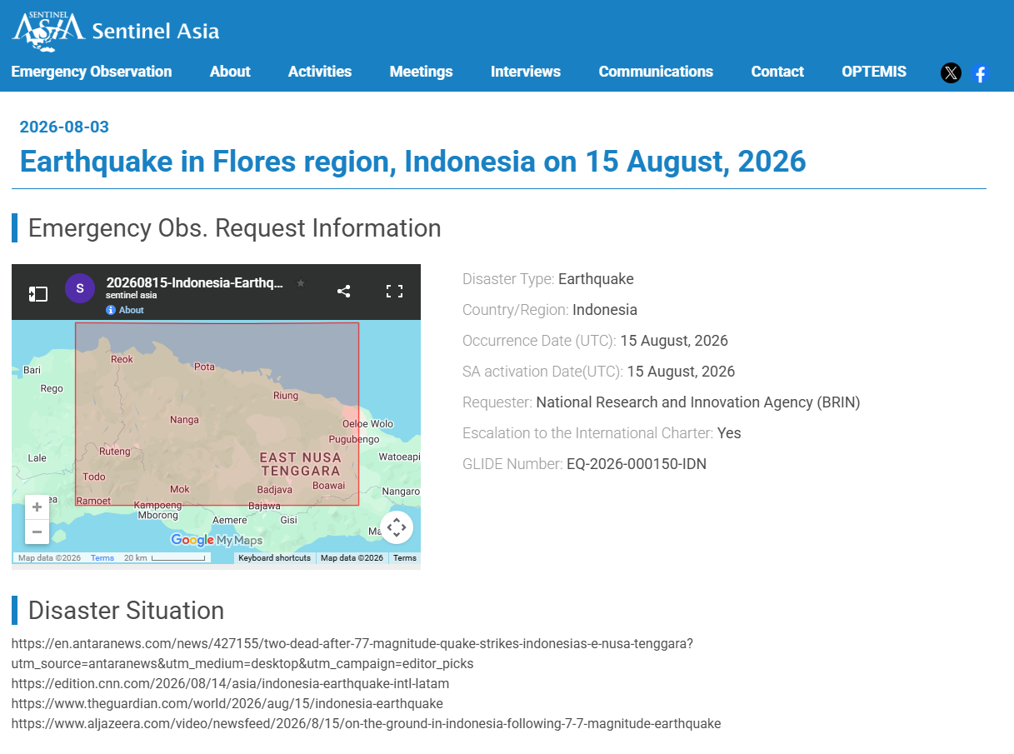
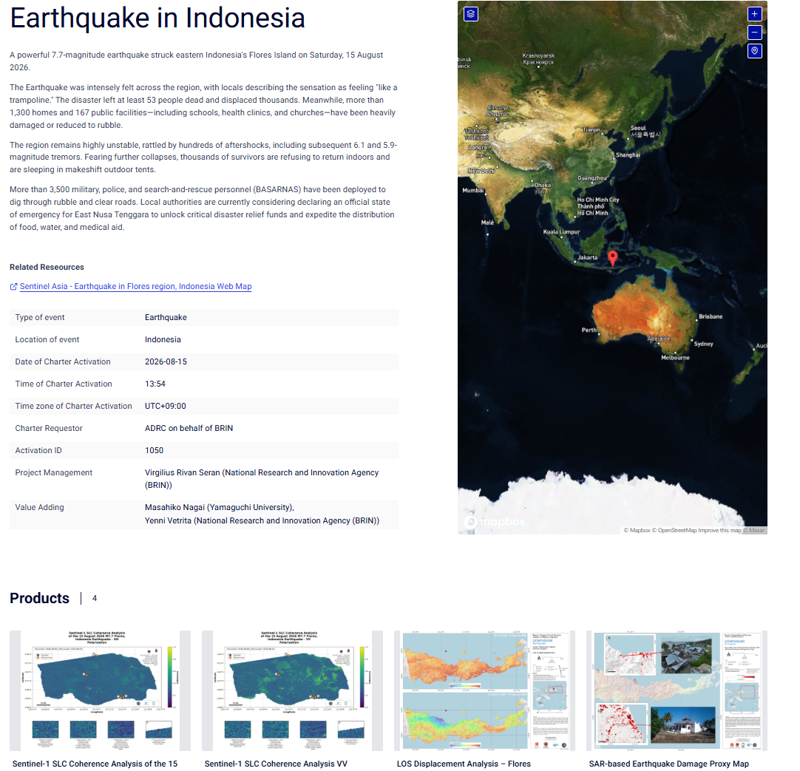
International Activation Pages (requested by ADRC on behalf of BRIN)
Sentinel Asia - Earthquake in Flores region, Indonesia (requested by BRIN)
https://sentinel-asia.org/EO/2026/article20260815ID.html
International Charter - Earthquake in Indonesia, Activation #1050
https://disasterscharter.org/activations/earthquake-in-indonesia-activation-1050-
Sources: Sentinel Asia — https://sentinel-asia.org/EO/2026/article20260815ID.html
25 / 40
ADRC 04/10/2026

Slide 26
Observation Bodies & Products
All bodies contributing observations or value-added products; source tier shown per row
Body | Contribution | Status | Tier
Sentinel Asia | Emergency observation request for the Flores region earthquake, requested by BRIN and activated on the day of the event. The record notes escalation to the International Charter and carries GLIDE EQ-2026-000150-IDN. ADRC (M. Sugiura) formally ended the EOR (SA-00656) on 31 Aug 2026, 23:45 JST. | Activated 15 Aug, ended by ADRC 31 Aug | Official
International Charter | Requestor recorded as "ADRC on behalf of BRIN". Project management: Virgilius Rivan Seran (BRIN). Value adding: Masahiko Nagai (Yamaguchi University) and Yenni Vetrita (BRIN). Four products delivered between 22 and 26 August. | Activated #1050 (15 Aug, 13:54 UTC+09:00) | Official
JAXA (via RESTEC) | ALOS-2/4 archive and observation images. Archive observations of 30 May 2020 (L1.1, f3780/f3790, SB6) and 6 March 2021 (L1.1, f3780/f3790, SB7). | Uploaded 24 Aug | Official
GIC-AIT | A value-added product produced using Sentinel-1 data observed on 20, 21 and 23 August 2026. | Uploaded 26 Aug | Official
KGS (Kazakhstan) | Two KazEOSAT-1 observation images, both observed on 23 August 2026 at 02:01 and 02:02 UTC. | Uploaded 27 Aug | Official
Sources: Sentinel Asia · International Charter
26 / 40
ADRC 04/10/2026

Slide 27
Observations & Points to Watch
[Official] The sequence has been unusually productive: 7,259 events to 25 August, against 265 in the first ten hours. The largest aftershock was M6.2 and no event exceeded the mainshock.
[Official] Aftershocks are distributed along the north coast of Flores - Aesesa, Riung, Kota Ambai, Manggarai and Ruteng - consistent with an E-W striking rupture on the Flores Back-Arc Thrust.
[Official] The first-day totals understated the final picture by one to two orders of magnitude: deaths 2 to 105, evacuees about 2,000 to 179,037, injuries 13 to 1,678. This is characteristic of a shallow event that severs road and telecom access to the worst-hit districts.
[Official] BNPB attributes the very large displacement caseload substantially to fear of continuing aftershocks and to hoaxes predicting a larger earthquake, not to housing loss alone. Government and partners are running counter-messaging.
[TBC] Rupture length, slip distribution and a finite-fault model had not been published in accessible sources at the time of writing. Figures remain provisional; BNPB collects data in stages from hamlet level upward and the by-name-by-address survey is still running.
[Official] IHCP Situation Report No. 9 (14 Sep, posted 15 Sep) reports the Joint Needs Assessment (JNA, conducted 19 Aug-4 Sep, primary data collection 24-26 Aug at 143 locations across 35 sub-districts, led by Humanitarian Forum Indonesia/WVI with 20 organisations) found that "a secondary health emergency may emerge from living conditions rather than the earthquake itself": acute respiratory infections were reported at 62.24% of surveyed locations, skin diseases at 47.55%, and gastrointestinal infections at 41.26%, with outreach services and access to medicines still limited. 86.01% of locations had no private space in displacement settings. This is consistent with Indonesian media reporting in mid-September of a rising share of deaths recorded in evacuation/displacement settings rather than directly from the earthquake, which this report has not been able to verify against a primary source: the specific domains carrying that reporting (e.g. okezone.com, suara.com, kompas.com, idntimes.com, detik.com, antaranews.com and its regional subdomains) return a network-policy block (CONNECT tunnel failed, HTTP 403) rather than site content, while en.antaranews.com (reachable) and bnpb.go.id (reachable but blocked by the site's own Cloudflare challenge) do not carry an equivalent report as of this update. The BNPB-sourced headline toll (120 deaths, as of 31 Aug) has accordingly not been revised.
27 / 40
ADRC 04/10/2026

Slide 28
Housing Damage by Regency
BNPB data lock, 24 August 2026. Manggarai Timur and Manggarai together account for 46% of all damaged houses and 54% of houses destroyed.
Regency | Destroyed | Moderate | Light | Total
Manggarai Timur | 6,833 | 4,996 | 6,973 | 18,802
Manggarai | 6,360 | 5,196 | 5,552 | 17,108
Manggarai Barat | 3,732 | 2,014 | 5,067 | 10,813
Nagekeo | 3,218 | 1,598 | 4,828 | 9,644
Ngada | 2,256 | 2,116 | 5,190 | 9,562
Ende | 1,208 | 1,725 | 4,547 | 7,480
Sikka | 990 | 892 | 2,621 | 4,503
Total | 24,597 | 18,537 | 34,778 | 77,912
Nagekeo - nearest the epicentre and cut off in the first days - ranks fourth by total damage and third by overall impact in BNPB's assessment, which is consistent with its early absence from national tallies having been a reporting lag rather than an absence of damage. That reading is an ADRC inference, not an official finding.
Sources: BNPB data lock 24 Aug 2026 (via ANTARA) — https://www.antaranews.com/berita/5713387/bnpb-percepat-rehab-rekon-rumah-rusak-karena-gempa-di-flores-ntt
28 / 40
ADRC 04/10/2026

Slide 29
Response - Central Government
Actor | Action
President | Prabowo Subianto visited Nagekeo and the Maumere evacuation posts on 26 August, chairing a response meeting on site. Earlier he ordered 50,000 relief packages (275 t).
National command | Posko Pengendalian Nasional activated from day one. Tiered task forces (Satgas): regency level led by each bupati, provincial level by the governor, and a central government mentoring task force.
Forward posts | Two forward posts split the seven regencies: Labuan Bajo covers Manggarai Barat, Manggarai, Manggarai Timur and Nagekeo; Maumere covers Sikka, Ende and Ngada.
Line ministries | Ministry of Health field hospital designed to remain safe during aftershocks; Ministry of Energy generators; Ministry of Higher Education waived tuition for 5,000 affected students; Ministry of Religious Affairs strengthened its response.
Logistics | Citilink carried 91.5 t of relief cargo; Baznas and other bodies are operating public kitchens.
Sources: ANTARA — https://www.antaranews.com/video/5712568/presiden-tinjau-penanganan-dampak-gempa-bumi-di-nagekeo-ntt
29 / 40
ADRC 04/10/2026

Slide 30
Recovery and Reconstruction
The response has entered rehabilitation and reconstruction while the emergency period still runs to 12 September 2026.
Workstream | Content
Assessment teams | BNPB deployed teams to all seven affected regencies to accelerate rehabilitation and reconstruction of damaged housing.
Not waiting for the emergency phase to end | Assessment preparation and damage-grading standardisation proceed in parallel with the emergency response period.
By name by address | Technical guidance delivered to local government agencies (OPD) and hundreds of volunteer enumerators, beginning in Manggarai Barat and Manggarai, to produce name-and-address level data.
Build back better | Reconstruction is to follow build back better principles so that rebuilt housing is more resilient, based on objective and auditable data.
Housing repair funding | BNPB announced per-unit repair rates on 27 August: Rp15 million for lightly damaged houses and Rp30 million for moderately damaged houses; severely damaged houses are handled separately via new construction or replacement. Distribution/accounting mechanisms and the aggregate budget total were still being finalised as of that date.
Central government contingency funds | President Prabowo approved Rp200 billion in contingency funds (Rp40 billion to NTT province, Rp20 billion each to eight districts). As of the 7 Sep disaster-mitigation meeting, the Home Affairs Ministry described realisation as slow and deployed a support team to the regions.
Sources: BNPB, 27 Aug; Home Affairs Ministry, 8 Sep 2026 (via ANTARA) — https://www.antaranews.com/berita/5713387/bnpb-percepat-rehab-rekon-rumah-rusak-karena-gempa-di-flores-ntt
30 / 40
ADRC 04/10/2026

Slide 31
Items to Confirm in the Next Cycle
Item | Detail | Priority
Reconciling the house-damage figures | Now three unreconciled totals: 77,912 'damaged' (24 Aug data lock), 81,436 'affected' (26 Aug), and 95,567 'damaged' (30 Aug BNPB press conference). Each is larger than the last; confirm whether this reflects the ongoing by-name-by-address survey (ADRC's working assumption) or a genuine methodology change before external use. | High
Public-facility counts | Now four unreconciled BNPB/ministry counts (24 Aug, 26 Aug, 27 Aug IHCP dashboard, 30 Aug/4 Sep Ministry of Public Works), each using a different category breakdown. Identify which measure each uses before citing a single number externally. | High
Final death toll composition | The 48 direct / 57 subsequent split will likely be revised as health-facility and SAR records are reconciled. | Med
Maximum tsunami run-up | Secondary compilations cite 1.61 m against a maximum BMKG gauge value of 0.94 m. Identify the basis before citing. | Med
USGS PAGER revision | Confirm whether the alert level was revised upward after the toll reached 105. | Med
Emergency period after 12 September | Confirm whether the period is extended again or transitions formally to recovery. | Med
Displacement drivers | BNPB attributes much of the 179,037 caseload to fear and hoaxes rather than housing loss; the shelter caseload may fall quickly once aftershocks subside. | Med
Lewotobi Laki-laki eruption | Flores Timur is outside the earthquake-affected area but under volcanic response; watch for compounding demands on NTT provincial capacity. | Low
Sources: ADRC compilation — https://reliefweb.int/disaster/eq-2026-000150-idn
31 / 40
ADRC 04/10/2026

Slide 32
Useful Links & Sources (1/9)
Source policy:
Source | Tier | URL
ReliefWeb - Indonesia: Earthquake, Aug 2026 (GLIDE EQ-2026-000150-IDN) | Official | https://reliefweb.int/disaster/eq-2026-000150-idn
USGS - M 7.7, 68 km NNW of Ende, Indonesia | Official | https://earthquake.usgs.gov/earthquakes/eventpage/us6000tkt2
International Charter - Earthquake in Indonesia, Activation #1050 | Official | https://disasterscharter.org/activations/earthquake-in-indonesia-activation-1050-
ERCC / DG ECHO daily map - Indonesia 7.7 M earthquake and tsunami (18 Aug 2026) | Official | https://reliefweb.int/map/indonesia/indonesia-77-m-earthquake-and-tsunami-14-august-dg-echo-daily-map-18082026
Sentinel Asia - Earthquake in Flores region, Indonesia | Official | https://sentinel-asia.org/EO/2026/article20260815ID.html
Field Report Update 3: M7.7 East Nusa Tenggara Earthquake (24 Aug 2026) | Official | https://reliefweb.int/report/indonesia/idn-earthquake-08-2026-field-report-update-3-m77-east-nusa-tenggara-earthquake-4-2026-08-24
BMKG - Meteorology, Climatology and Geophysical Agency | Official | https://www.bmkg.go.id/
AHA Centre - Flash Update No.1 (15 Aug 2026) | Official | https://ahacentre.org/flash-update/flash-update-no-1-m7-7-earthquake-in-east-nusa-tenggara-indonesia-15-august-2026/
AHA Centre - Weekly Disaster Update 17-23 Aug 2026 | Official | https://ahacentre.org/weekly-disaster-update/weekly-disaster-update-17-23-august-2026/
ReliefWeb - Situation Report No. 6 (25 Aug 2026) | Official | https://reliefweb.int/report/indonesia/indonesian-humanitarian-coordination-platform-situation-report-no-6-earthquake-and-tsunami-flores-and-surrounding-areas-25-august-2026
32 / 40
ADRC 04/10/2026

Slide 33
Useful Links & Sources (2/9)
Source | Tier | URL
BNPB - news index | Official | https://www.bnpb.go.id/berita
ANTARA - BNPB accelerates rehabilitation; house damage by regency (27 Aug) | Official | https://www.antaranews.com/berita/5713387/bnpb-percepat-rehab-rekon-rumah-rusak-karena-gempa-di-flores-ntt
ANTARA - power and telecommunications 100% restored | Official | https://www.antaranews.com/berita/5709283/bnpb-listrik-dan-sinyal-di-flores-pulih-100-persen-pascagempa
Harian Jogja - BNPB: 105 deaths, 179,037 evacuees, 81,436 houses (27 Aug) | Media | https://news.harianjogja.com/r-1268934/update-gempa-flores-105-orang-meninggal-dan-81436-rumah-terdampak
Harian Jogja - 19 puskesmas not yet recovered, 122 tents | Media | https://news.harianjogja.com/r-1268964/gempa-flores-19-puskesmas-belum-pulih-dan-122-tenda-disiapkan
Haluan NTT - emergency period extended to 12 September 2026 | Official | https://haluanntt.com/2026/08/27/pemprov-ntt-perpanjang-tanggap-darurat-gempa-flores-hingga-12-september-2026/
BMKG - press release on recovery cooperation | Official | https://www.bmkg.go.id/siaran-pers/bmkg-pemerintah-pusat-dan-pemerintah-daerah-kolaborasi-percepat-pemulihan-bencana-gempa-flores
AHA Centre - Flash Update No.1 (17 Aug 2026, day-1 data, superseded) | Official | https://reliefweb.int/report/indonesia/flash-update-no-1-m77-earthquake-east-nusa-tenggara-indonesia-15-august-2026
OCHA Asia-Pacific El Nino / Middle East snapshot, 28 Aug 2026 (regional, not earthquake-specific) | Official | https://reliefweb.int/report/indonesia/asia-and-pacific-snapshot-el-nino-middle-east-crisis-28-august-2026
Caritas Indonesia - community support update | Media | https://reliefweb.int/report/indonesia/caritas-indonesia-stands-communities-affected-earthquake
CARE Indonesia - 15,000 litres clean water distribution | Media | https://reliefweb.int/report/indonesia/care-indonesia-distributes-15000-litres-clean-water-earthquake-survivors
33 / 40
ADRC 04/10/2026

Slide 34
Useful Links & Sources (3/9)
Source | Tier | URL
AHA Centre - ASEAN Weekly Disaster Update, week 33 (10-16 Aug 2026) | Official | https://reliefweb.int/report/indonesia/asean-weekly-disaster-update-week-33-10-16-august-2026
IOM - Rohingya refugee response flash appeal (unrelated crisis) | Official | https://reliefweb.int/report/indonesia/iom-flash-appeal-rohingya-refugee-response-january-december-2026
IHCP (MPBI) - Situation Report No. 7 (28 Aug 2026, BNPB dashboard as of 27 Aug) | Official | https://reliefweb.int/report/indonesia/indonesian-humanitarian-coordination-platform-situation-report-no-7-earthquake-and-tsunami-flores-and-surrounding-areas-28-august-2026
AHA Centre - ASEAN Weekly Disaster Update, week 35 (24-30 Aug 2026) | Official | https://reliefweb.int/report/indonesia/asean-weekly-disaster-update-week-35-24-30-august-2026
Gender Alert #1 - Protection needs of women and girls, Flores earthquake (2 Sep 2026) | Official | https://reliefweb.int/report/indonesia/gender-alert-1-critical-protection-needs-women-and-girls-following-flores-earthquake-indonesia
Gender Alert #1 - Anticipating the impact of El Niño 2026 (Indonesia, national) | Media | https://reliefweb.int/report/indonesia/gender-alert-1-anticipating-impact-el-nino-2026-women-girls-and-vulnerable-groups-indonesia
Indonesia | Anak Krakatau volcanic eruption - DG ECHO Daily Map (07/09/2026) | Media | https://reliefweb.int/map/indonesia/indonesia-anak-krakatau-volcanic-eruption-dg-echo-daily-map-07092026
Indonesia: Wildfire haze threatens children across SE Asia and closes schools (Save the Children) | Media | https://reliefweb.int/report/indonesia/indonesia-wildfire-haze-threatens-children-across-se-asia-and-closes-schools
Indonesia: Wildfire haze threatens children across SE Asia and closes schools (duplicate ReliefWeb listing) | Media | https://reliefweb.int/report/indonesia/indonesia-wildfire-haze-threatens-children-across-se-asia-and-closes-schools-save-children
AHA Centre - ASEAN Weekly Disaster Update Week 36 (31 Aug - 6 Sep 2026) | Official | https://reliefweb.int/report/philippines/asean-weekly-disaster-update-week-36-31-august-6-september-2026
34 / 40
ADRC 04/10/2026

Slide 35
Useful Links & Sources (4/9)
Source | Tier | URL
AHA Centre - ASEAN Weekly Disaster Update Week 37 (7-13 Sep 2026, posted 14 Sep) | Official | https://reliefweb.int/report/philippines/asean-weekly-disaster-update-week-37-7-13-september-2026
ANTARA (EN) - Indonesia prepares housing aid for NTT quake victims (27 Aug 2026) | Official | https://en.antaranews.com/news/428627/indonesia-prepares-housing-aid-for-ntt-quake-victims
ANTARA (EN) - BNPB reports NTT quake evacuees decline as aftershocks begin to ease (30 Aug 2026) | Official | https://en.antaranews.com/news/429081/bnpb-reports-ntt-quake-evacuees-decline-as-aftershocks-begin-to-ease
ANTARA (EN) - NTT earthquake: 17 road sections, 14 bridges restored (4 Sep 2026) | Official | https://en.antaranews.com/news/429936/ntt-earthquake-17-road-sections-14-bridges-restored
ANTARA (EN) - 1,931 education facilities resume classes after NTT quake (5 Sep 2026) | Official | https://en.antaranews.com/news/430027/1931-education-facilities-resume-classes-after-ntt-quake
ANTARA (EN) - Minister urges NTT regions to optimize Rp200 billion quake funds (8 Sep 2026) | Official | https://en.antaranews.com/news/430328/minister-urges-ntt-regions-to-optimize-rp200-billion-quake-funds
ANTARA (EN) - Ministry sends 160 health workers to NTT for earthquake trauma care (8 Sep 2026) | Official | https://en.antaranews.com/news/430347/ministry-sends-160-health-workers-to-ntt-for-earthquake-trauma-care
ANTARA (EN) - Flores aftershocks decline, residents urged to remain vigilant (9 Sep 2026) | Official | https://en.antaranews.com/news/430597/flores-aftershocks-decline-residents-urged-to-remain-vigilant
UNHCR Indonesia: 2026 Funding Update (as of 31 Aug 2026) - reviewed, not relevant (Myanmar refugee situation funding, unrelated to the NTT earthquake) | TBC | https://reliefweb.int/report/indonesia/unhcr-indonesia-2026-funding-update-31-august-2026
35 / 40
ADRC 04/10/2026

Slide 36
Useful Links & Sources (5/9)
Source | Tier | URL
IHCP Situation Report No. 9 - Earthquake and Tsunami in Flores and Surrounding Areas (14 Sep 2026) | Official | https://reliefweb.int/report/indonesia/indonesian-humanitarian-coordination-platform-situation-report-no-9-earthquake-and-tsunami-flores-and-surrounding-areas-14-september-2026
 | TBC | https://tirto.id/sebulan-usai-gempa-ntt-94-orang-tewas-di-pengungsian-hCXo
 | TBC | https://news.republika.co.id/berita/tlicbu409/bnpb-klarifikasi-data-94-korban-gempa-flores-ntt-meninggal-di-pengungsian
 | TBC | https://nasional.kompas.com/read/2026/09/17/14301031/94-orang-meninggal-di-pengungsian-gempa-ntt-anggota-dpr-dorong-audit
 | TBC | https://www.antaranews.com/berita/5742093/jumlah-pengungsi-gempa-ntt-menurun-signifikan-kini-46461-jiwa
 | TBC | https://www.antaranews.com/berita/5735263/bnpb-korban-gempa-ntt-capai-136-jiwa-70-persen-rumah-terverifikasi
 | TBC | https://www.antaranews.com/berita/5745161/pascagempa-ntt-pemerintah-kolaborasi-benahi-sanitasi-cegah-stunting
 | TBC | https://nasional.kompas.com/read/2026/09/17/17144961/bnpb-luruskan-data-94-warga-meninggal-di-pengungsian-gempa-ntt-disebabkan
 | TBC | https://nasional.kompas.com/read/2026/09/17/21491021/amnesty-international-soroti-kematian-94-warga-di-pengungsian-gempa-ntt
 | TBC | https://nasional.kompas.com/read/2026/09/15/16512731/bnpb-ungkap-94-korban-gempa-ntt-meninggal-di-pengungsian
ANTARA - NTT provincial govt consolidates single dataset for Flores quake recovery (17 Sep 2026) | Media | https://www.antaranews.com/berita/5746076/pemprov-ntt-konsolidasikan-satu-data-percepat-pemulihan-gempa-flores
36 / 40
ADRC 04/10/2026

Slide 37
Useful Links & Sources (6/9)
Source | Tier | URL
 | TBC | https://regional.kompas.com/read/2026/09/21/140540378/gempa-susulan-flores-m77-capai-17073-kali-198-kali-dirasakan-warga
 | TBC | https://regional.kompas.com/read/2026/09/21/120040378/gempa-m-51-guncang-manggarai-timur-terasa-di-sejumlah-daerah
 | TBC | https://regional.kompas.com/read/2026/09/21/090000378/gempa-m-53-guncang-manggarai-bmkg-tidak-berpotensi-tsunami
 | TBC | https://regional.kompas.com/read/2026/09/21/174624178/baru-3-hari-dibangun-huntara-korban-gempa-di-manggarai-timur-roboh
 | TBC | https://regional.kompas.com/read/2026/09/21/151815278/disorot-mendagri-soal-dana-gempa-rp-20-miliar-pemda-sikka-tersisa-rp-17
 | TBC | https://regional.kompas.com/read/2026/09/21/164050278/227-anak-terdampak-gempa-flores-ikuti-trauma-healing-di-manggarai
 | TBC | https://regional.kompas.com/read/2026/09/18/06192401/tito-presiden-prabowo-tambah-alokasi-belanja-tidak-terduga-di-ntt-rp-20
 | TBC | https://reliefweb.int/report/indonesia/asean-weekly-disaster-update-week-32-3-9-august-2026
 | TBC | https://reliefweb.int/report/indonesia/care-responding-indonesia-earthquake
 | TBC | https://reliefweb.int/report/indonesia/flores-earthquake-512-schools-affected-plan-indonesia-urges-education-recovery-be-prioritized
 | TBC | https://reliefweb.int/report/indonesia/flores-earthquake-children-face-serious-health-and-safety-risks-amid-prolonged-displacement
 | TBC | https://reliefweb.int/report/indonesia/idn-earthquake-08-2026-field-report-update-2-m77-east-nusa-tenggara-earthquake-3-2026-08-18
37 / 40
ADRC 04/10/2026

Slide 38
Useful Links & Sources (7/9)
Source | Tier | URL
 | TBC | https://reliefweb.int/report/indonesia/indonesia-77-earthquake-strikes-flores-plan-indonesia-warns-grave-risks-children-and-girls
 | TBC | https://reliefweb.int/report/indonesia/indonesia-earthquake-situation-overview-18-august-2026
 | TBC | https://reliefweb.int/report/indonesia/indonesia-over-8000-children-face-disruptions-education-following-deadly-earthquake-save-children
 | TBC | https://reliefweb.int/report/indonesia/indonesian-humanitarian-coordination-platform-situation-report-no-3-earthquake-and-tsunami-flores-and-surrounding-areas-19-august-2026
 | TBC | https://reliefweb.int/report/indonesia/world-vision-launches-emergency-response-death-toll-rises-following-powerful-indonesia-earthquake
 | TBC | https://reliefweb.int/report/indonesia/indonesia-flores-earthquake-response-dref-operation-mdrid029
 | TBC | https://reliefweb.int/report/indonesia/indonesian-humanitarian-coordination-platform-situation-report-no-8-earthquake-and-tsunami-flores-and-surrounding-areas-september-1-2026
ANTARA: BNPB confirms temporary housing in Manggarai Timur is sturdy and earthquake-resistant (23 Sep 2026) | Official | https://www.antaranews.com/berita/5754315/bnpb-tegaskan-huntara-di-manggarai-timur-kokoh-dan-tahan-gempa
ANTARA: House of Representatives Commission X urges accelerated recovery of schools affected by the NTT earthquake (19 Sep 2026) | Official | https://www.antaranews.com/berita/5749213/komisi-x-dpr-desak-percepatan-pemulihan-sekolah-terdampak-gempa-ntt
Kompas: Manggarai Barat earthquake victims to receive Rp 600,000/month housing-wait allowance (25 Sep 2026) | Official | https://regional.kompas.com/read/2026/09/25/165607778/korban-gempa-flores-di-manggarai-barat-dapat-dana-tunggu-hunian-rp-600000
38 / 40
ADRC 04/10/2026

Slide 39
Useful Links & Sources (8/9)
Source | Tier | URL
ReliefWeb: Caritas Indonesia hands over housing to flood-affected residents in Central Tapanuli | Media | https://reliefweb.int/report/indonesia/caritas-indonesia-hands-over-housing-flood-affected-residents-central-tapanuli
ReliefWeb: Psychosocial impacts on Afghan refugee youth in Indonesia (APRRN) | Media | https://reliefweb.int/report/indonesia/psychosocial-impacts-prolonged-uncertainty-mental-well-being-resilience-and-community-engagement-afghan-refugee-youth-indonesia
ReliefWeb: DKI Jakarta earthquake shake map, 11 Sep 2026 (WFP) | Official | https://reliefweb.int/map/indonesia/dki-jakarta-indonesia-earthquake-shake-map-11-september-2026
ReliefWeb: ADAM earthquake, DKI Jakarta, 11 Sep 2026 21:48:37 GMT (WFP) | Official | https://reliefweb.int/map/indonesia/adam-earthquake-dki-jakarta-indonesia-11-september-2026-214837-gmt
ANTARA: Mendikdasmen commits to revitalising 1,487 education units in NTT (21 Sep 2026) | Official | https://www.antaranews.com/berita/5751641/mendikdasmen-berkomitmen-revitalisasi-1487-sekolah-untuk-pulihkan-ntt
ReliefWeb: ASEAN Weekly Disaster Update Week 39, 21-27 Sep 2026 | Official | https://reliefweb.int/report/indonesia/asean-weekly-disaster-update-week-39-21-27-september-2026
ReliefWeb: Caritas Indonesia housing, Tapanuli Tengah floods | Media | https://reliefweb.int/report/indonesia/caritas-indonesia-entrega-viviendas-los-residentes-afectados-por-las-inundaciones-en-tapanuli-central
ReliefWeb: JDR SDF unit conclusion (Kalimantan wildfire), 29 Sep 2026 | Media | https://reliefweb.int/report/indonesia/conclusion-activities-japan-disaster-relief-self-defense-forces-unit-response-damage-caused-forest-and-land-fires-republic-indonesia
ReliefWeb: Indonesia Drought DREF MDRID030 | Media | https://reliefweb.int/report/indonesia/indonesia-drought-2026-dref-operation-mdrid030
ANTARA: Mendagri follow-up on evacuee deaths (30 Sep 2026) | Media | https://www.antaranews.com/berita/5764619/mendagri-tindaklajuti-korban-gempa-ntt-meninggal-di-pengungsian
ANTARA: BNPB temporary housing built in stages (28 Sep data) | Media | https://www.antaranews.com/berita/5762701/bnpb-hunian-sementara-penyintas-gempa-ntt-dibangun-bertahap
39 / 40
ADRC 04/10/2026

Slide 40
Useful Links & Sources (9/9)
Source | Tier | URL
ANTARA: BNPB says huntara construction is free; tent evacuees down to 22,383 (1 Oct 2026) | Media | https://www.antaranews.com/berita/5767224/bnpb-tegaskan-pembangunan-huntara-ntt-gratis
40 / 40
ADRC 04/10/2026

