Slide 1
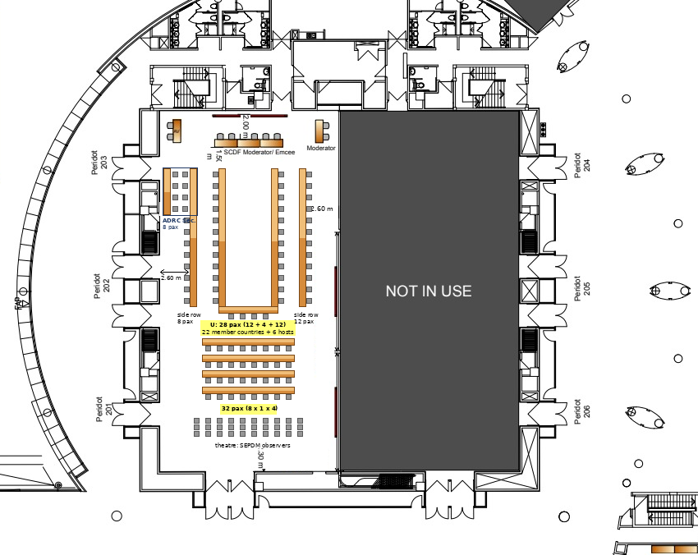
ACDR2026 配席表
ADRC Sec.
ADRC Sec.
ADRC
member
member
Singapore
member
Singapore
8 pax
ADRC
Singapore
Singapore
ADRC Sec.
NZ
Japan
Japan
member
member
Armenia
member
Japan
AUS
NZ
Viet Nam
Azerbaijan
Japan
member
member
member
member
NZ
Uzbekistan
Bangladesh
Azerbaijan
Viet Nam
member
Turkiye
member
member
Bhutan
member
Viet Nam
Thailand
Brunei
Brunei
Uzbekistan
member
Sri Lanka
member
member
Cambodia
member
Turkiye
ROK
Fiji
Turkiye
member
PNG
member
member
India
member
India
ROK
Pakistan
member
member
member
Lao PDR
India
Myanmar
Mongolia
Maldives
Malaysia
member
partner
partner
member
member
PNG
Pakistan
AHA Centre
ADPC
Japan
Japan
ROK
ROK
resource
resource
resource
resource
配席案 9/28 荒木田修正（9/25 名簿・9/25 所内決定を反映）
・U字28席: 上端を主催3者に。左上 ADRC×2（三浦会長・北本理事長）、右上 Singapore×2（Comr・Alan Chow）＋Japan（内閣府）。以下は時計回りに国名アルファベット順（Armenia の位置を修正）。
・2列目右: Japan×3（仙台市: 副市長ほか）を Japan の後ろへ。Singapore×2, Azerbaijan, Brunei, India×2 は各国の後ろ。
・2列目左: 左上4卓（8席）は ADRC 事務局ブロック（9/25 決定）。残り8席に NZ×2, Viet Nam×2, Uzbekistan, Turkiye×2, ROK。ROK 3・4人目は教室型へ。ADRC の2列目2席は事務局ブロックに吸収。
・要確認: AUS 未登録（登録なければ空席か Japan 2席目）／Thailand・Uzbekistan は登録待ち／仙台副市長の RT 発言（2列目はマイクなし）／Comr の RT 在席。

