Slide 1

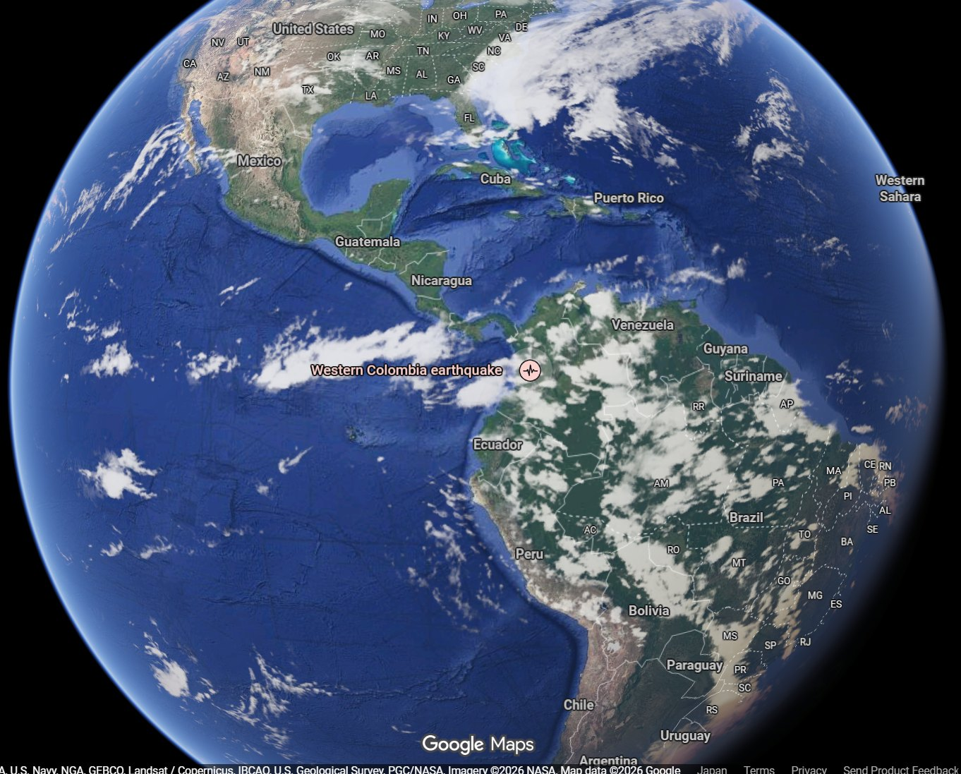
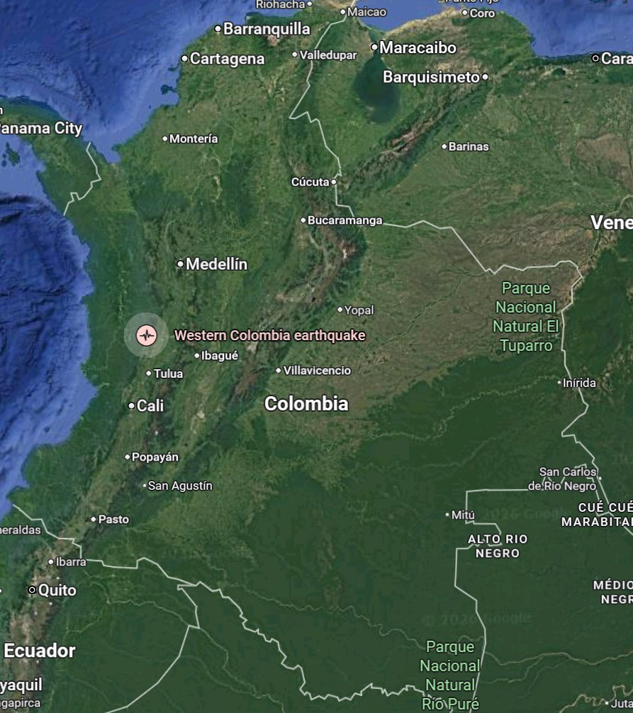
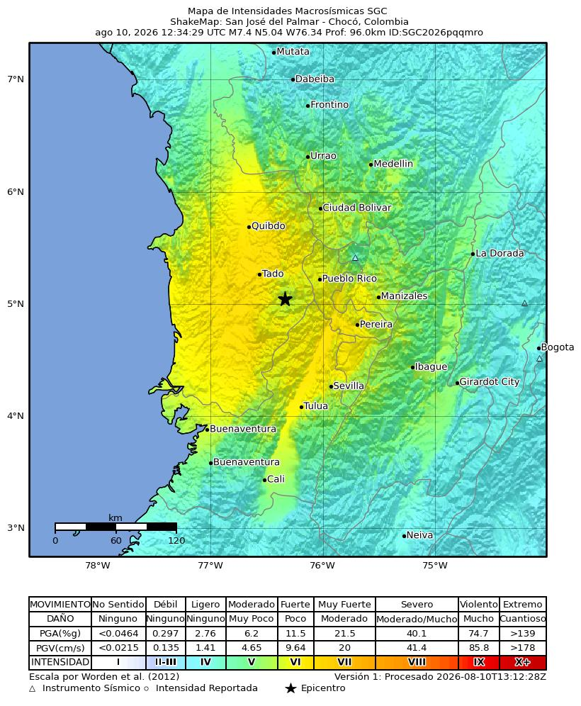
2026 Chocó Earthquake (Colombia)
(GLIDE No. EQ-2026-000146-COL)
Mww 7.4 · Max. seismic intensity MMI VII (USGS ShakeMap) · USGS: 5 km S of San José del Palmar, Chocó Department (approx. 280 km W of Bogotá) — SGC: 12 km from San José del Palmar
① World → Colombia
② Colombia → Chocó
③ SGC macroseismic intensity
© Google
© Google
© SGC
Overview At 07:34 local time (12:34 UTC) on 10 August 2026, an Mww 7.4 earthquake struck western Colombia with its epicentre 5 km east of San José del Palmar in Chocó Department, at a depth of about 110 km (USGS). The event was an intermediate-depth, strike-slip rupture inside the subducting Nazca slab; because of its depth, strong shaking (MMI VI-VII) was spread over a wide area of the Andean Coffee Region rather than concentrated near the epicentre, and about 10.5 million people were exposed to it. The SGC describes it as the largest-magnitude earthquake recorded in Colombia in the past decade. The toll rose steeply through the first two days: 111 deaths in the Government's 13:00 COT balance on 10 August, 132 by that evening, and 182 deaths with 2,542 injured and 189 missing in UNGRD's situation report on 11 August, against 240 deaths when the departmental and city announcements are added up — more than 1,600 buildings damaged (1,575 homes damaged, 37 destroyed, 61 buildings collapsed), together with damage to 18 health facilities, 52 educational facilities, 18 major roads and six regional airports. The passenger terminal of Matecaña International Airport in Pereira partially collapsed, a tower of the cathedral in Manizales fell onto the nave, and about 30% of Cali's University Hospital collapsed. The President declared a national disaster, set up a Unified Command Post in Chocó and deployed four USAR teams. There was no tsunami.
Sources: SGC · Google Maps © Google
ADRC 08/09/2026

Slide 2
The 1999 Armenia Earthquake & Recovery
The 1999 Armenia (Quindío) Earthquake - the same Coffee Region / On 25 January 1999 an M6.1-6.2 earthquake at about 30 km depth struck the Quindío coffee-growing region. It killed about 1,185 people, injured over 5,000 and damaged or destroyed some 50,000 structures; roughly 60% of the buildings in the city of Armenia collapsed or were severely damaged, and more than 200,000 people were displaced. Although far smaller in magnitude than the 2026 event, it was much shallower and much closer to the cities, which is why its local destructiveness was far greater.
Recovery and what it changed Reconstruction was managed through a dedicated temporary body for the Coffee Region, an early example in Latin America of a purpose-built reconstruction agency.
The disaster drove enforcement of the national seismic code and the seismic microzonation studies that now cover Pereira, Manizales and Armenia.
Recovery of the coffee economy took roughly a decade - the economic tail of the disaster far outlasted the emergency phase.
The 2026 earthquake shook the same cities, but as a deep, distant source rather than a shallow local one: a different loading of the same building stock.
1999 damage | Figure
Deaths | approx. 1,185
Injured | over 5,000
Structures damaged or destroyed | approx. 50,000
Displaced | over 200,000
Coffee sector | approx. 8,000 farms and 1,200 processing facilities damaged
The cities hit hardest in 2026 - Pereira, Manizales, Armenia - are the same cities that rebuilt after 1999. How that rebuilt stock performed under long-period, long-duration shaking from a 110 km-deep source is the key question for post-event assessment.
2 / 52
ADRC 08/09/2026

Slide 3
Chronology of Response (from onset) (1/8)
Government / agency actions from onset — all official sources. Times are local (COT, UTC-5); entries whose exact time is not published are placed at the end of that day
Time | Action | Source
07:34 | Mww 7.4 earthquake, epicentre 5 km S of San José del Palmar (Chocó), depth approx. 110 km. Felt in Bogotá, Cali, Medellín, and in Ecuador, Panama and Venezuela. | USGS / SGC
07:40s | The SGC issues a first bulletin (initially M6.6, 79 km depth), later revised to M7.4 at 96 km, located with 69 stations (event SGC2026pqqmro); damage-assessment protocols activated. | SGC
12:13 | Copernicus EMS Rapid Mapping activated as EMSR916 (17:13 UTC), requested by EC Services / DG ECHO, for earthquake damage assessment mapping. | Copernicus EMS
Morning | UNGRD reports first damage indications in 9 municipalities of Chocó, 8 of Caldas, 2 of Valle del Cauca and 2 of Risaralda, plus localities in Quindío. | UNGRD
Morning | Cali reports collapsed structures at 12 critical points with people trapped; part of the University Hospital collapses. | Mayor of Cali
Morning | Manizales reports 17 buildings collapsed and 19 partially collapsed; a tower of the neo-Gothic cathedral falls onto the nave. Residents asked to stay outdoors because of aftershocks. | Mayor of Manizales
Morning | Passenger terminal of Matecaña International Airport (Pereira) partially collapses; flights suspended at six regional airports. | Aerocivil / media
Daytime | National disaster declared; Unified Command Post established in Chocó; armed forces deployed. | Government
Daytime | Four USAR teams deployed from Bogotá, Envigado, Yopal and Medellín. | UNGRD
Daytime | More than 20 aftershocks recorded; the largest widely felt aftershock is M4.8. | SGC
Daytime | President travels to Pereira to lead the response on the ground. | Presidency
Afternoon | First national damage report: 111 deaths, 87 injured; 1,575 homes damaged, 37 destroyed, 61 buildings collapsed; 18 health facilities, 52 educational facilities, 17 community facilities, 18 major roads and 6 regional airports damaged. | Presidency / UNGRD
Sources: Kantei (PM Office) · MOD
3 / 52
ADRC 08/09/2026

Slide 4
Chronology of Response (from onset) (2/8)
Government / agency actions from onset — all official sources. Times are local (COT, UTC-5); entries whose exact time is not published are placed at the end of that day
Time | Action | Source
Afternoon | Ecuador mobilises a 47-person USAR team with canine units; Mexico and other governments offer assistance, to be channelled through the Foreign Ministry and UNGRD. | International media
Evening | The reported national death toll rises to 132. Four people have been rescued alive from the rubble; more than 20 municipalities are reported affected, and power and telecommunications faults continue in Chocó. | International media
11 Aug 07:31 | Japan's Prime Minister posts condolences (21:31 JST) and Foreign Minister Motegi issues a message offering condolences and stating that the Government of Japan also stands ready to provide the necessary assistance and that Japan stands in strong solidarity with the people of Colombia. | Japan (MOFA)
11 Aug 09:20 | The SGC revises its solution for the mainshock to M7.4 at 103 km depth, 4.99 N 76.29 W, located with 119 stations and 208 phases. Its first bulletin had given M6.6 at 79 km and its second 7.4 at 96 km with 69 stations. (14:20 UTC) | SGC
11 Aug | Search continues overnight. The President reports 700 injured nationally and about 5,000 homes damaged or destroyed, declares the missing the State's priority, and orders troops to Cali to maintain order. The mayor of Cali reports 85 deaths, 885 injured and 188 missing; Pereira's fire service reports 66 deaths; about 100 people are missing in Manizales. Five capital cities - Cali, Pereira, Quibdó, Manizales and Armenia - remain on red alert. | Presidency / local authorities
11 Aug PM | UNGRD's situation report gives 182 deaths, 2,542 injured and 189 missing, with 13,067 homes damaged and 2,501 destroyed, 93 health facilities, 884 educational institutions, 427 community facilities and 77 roads affected. The President puts the toll at 181, of which 97.6% in capital cities. Ecuador, El Salvador and Russia are thanked for assistance. | UNGRD / Presidency
11 Aug PM | The SGC's published aftershock total reaches 103 at 15:00 COT - 97 at M3.0 or below, 5 between M3.0 and M4.0, one above M4.0 - and an M3.9 during the day prompts building evacuations in several affected cities. Its catalogue for the same period holds 147 located events, the wider figure including background seismicity. | SGC
11 Aug | OCHA states the humanitarian system is ready to support Colombia and names drinking water, hygiene and household items, health, food and shelter as the priority needs; no formal request for assistance has been received from the Colombian authorities. | UN / OCHA
Sources: Kantei (PM Office) · MOD
4 / 52
ADRC 08/09/2026

Slide 5
Chronology of Response (from onset) (3/8)
Government / agency actions from onset — all official sources. Times are local (COT, UTC-5); entries whose exact time is not published are placed at the end of that day
Time | Action | Source
12 Aug | Cali city officials report 107 buildings collapsed, 643 with structural damage and 18 under evacuation order; 230 people trapped, 88 rescued, 69 dead and 1,008 injured in the city. | Mayor of Cali
12 Aug | The provisional national balance passes 224 deaths and more than 2,500 injured, with 279 taken to hospital and 243 people rescued alive; 195 are reported missing to the authorities. The citizen platform “Colombia te busca” holds 4,084 registrations, 3,653 of them still unresolved. Search continues in Pereira with about 300 rescuers, and much of Chocó remains reachable only by boat or aircraft. | Government
12 Aug | The President tours Pereira, Dosquebradas, Manizales and Armenia after Quibdó and Cali, announcing three months of relief on utility bills for affected households, rent subsidies for those who lost their homes and a shock plan for education and housing; an economic emergency decree is being prepared. | Presidency
12 Aug | UNGRD's consolidated report covers 14 departments and 403 municipalities: 239 deaths, 3,755 injured, 287 missing, 140 buildings collapsed, 24,324 families (49,214 people) affected, 9,215 homes destroyed and 45,457 seriously damaged. Colombia accepts INSARAG-classified USAR teams from Israel, Ecuador, El Salvador and the United States; El Salvador sends 100 tonnes of relief supplies. A woman is rescued in Pereira after 36 hours under the rubble. | UNGRD
12 Aug | Adding up the departmental and city announcements gives 254 deaths - Pereira 101, Cali 95 - ahead of the national consolidation, which media attribute to the central government being slower to update. | International media
12 Aug PM | From the Palacio de San Carlos the President announces UNGRD's updated balance: 265 deaths, 3,494 injured, 496 missing, 25,872 families (53,816 people) affected, 11,347 homes destroyed and 53,526 damaged, 1,819 educational centres and 631 community facilities affected. He also announces the declaration of an economic emergency. | Presidency
12 Aug | Decree 1172 declares three days of national mourning from 12 August, flags at half-mast at home and in Colombian missions abroad. The same night the governor of Chocó ends the department's search-and-rescue phase after the last family sought in Quibdó, four people, is found alive. | Presidency / Gobernación del Chocó
13 Aug 09:42 | An M4.2 aftershock strikes San José del Palmar at 95 km depth, about 20 km from the mainshock epicentre. Felt in Pereira, Manizales, Medellín and Bogotá; search-and-rescue work is halted temporarily. It is the second aftershock above M4.0. | SGC
Sources: Kantei (PM Office) · MOD
5 / 52
ADRC 08/09/2026

Slide 6
Chronology of Response (from onset) (4/8)
Government / agency actions from onset — all official sources. Times are local (COT, UTC-5); entries whose exact time is not published are placed at the end of that day
Time | Action | Source
13 Aug AM | UNGRD's director gives a new balance: 273 dead, 3,824 injured, 377 missing, 40,753 families (97,515 people) affected, 12,584 homes destroyed and 74,873 damaged, 172 buildings collapsed, 2,198 educational and 825 community facilities, 216 health facilities, 71 aqueducts, 29 banking offices and five airports. Medicina Legal has received 250 bodies, 227 recognised. Red alert continues in Cali, Pereira, Quibdó, Manizales and Armenia. | UNGRD
14 Aug 07:00 | SGC reports 184 aftershocks located since the mainshock, 15 of them above M3.0 and 2 above M4.0. | SGC
14 Aug 09:00 | UNGRD's 09:00 cut: 287 dead, 3,975 injured, 378 missing, 354 rescued alive; 56,448 families (135,179 people) affected in 15 departments and 437 municipalities; 13,077 homes destroyed and 79,108 damaged; 121 buildings collapsed. Confined-space search continues with the certified international teams. | UNGRD
14 Aug | India sends 20 tonnes of humanitarian supplies; Norway allocates NOK 10 million and Sweden SEK 5 million through UNHCR; Spain, Italy, Chile, Mexico, Turkey, Brazil and the World Bank also send or announce support. The Interior Minister says the hospital network in Buenaventura is overwhelmed. | Cancillería / donors
14-15 Aug | Running balance: 288 dead, 4,018 injured, 202 missing, 354 rescued alive; 45,523 families (102,263 people) affected in 15 departments and 426 municipalities; 12,828 homes destroyed and 73,455 damaged; 121 buildings collapsed; 240 health, 2,205 educational and 1,208 community facilities; 210 roads, 73 aqueducts, 44 road bridges, 13 footbridges and five airports. The falls against the 09:00 cut are duplicate assessment records being consolidated. | UNGRD
15 Aug 06:30 | UNGRD balance with a 06:30 cut-off: 294 dead, 3,935 injured, 320 missing, 353 people and 188 animals rescued alive; 54,008 families (115,461 people) affected; 448 municipalities reporting damage; 14,493 homes destroyed and 81,506 damaged; 66 buildings collapsed. Chocó, Risaralda and Valle del Cauca are the worst affected. | UNGRD
15 Aug | Search continues for the missing while more than 100,000 people affected await assistance; in El Cairo (Valle del Cauca) 80% of the houses are reported damaged. | International media
Sources: Kantei (PM Office) · MOD
6 / 52
ADRC 08/09/2026

Slide 7
Chronology of Response (from onset) (5/8)
Government / agency actions from onset — all official sources. Times are local (COT, UTC-5); entries whose exact time is not published are placed at the end of that day
Time | Action | Source
16 Aug 07:30 | UNGRD balance with a 07:30 cut-off: 289 dead, 4,187 injured, 143 missing, 354 people and 510 animals rescued alive; 120,238 families (185,016 people) affected across 450 municipalities in 15 departments; 26,945 homes destroyed and 127,557 damaged; 66 buildings collapsed. UNGRD states that the variations come from verifying and consolidating figures reported by the territories, some of which had been sent unverified. | UNGRD
16 Aug 18:30 | UNGRD balance with an 18:30 cut-off: 287 dead, 4,147 injured, 194 missing, 355 people and 496 animals rescued alive; 120,671 families (185,996 people) affected across 472 municipalities in 15 departments; 26,392 homes destroyed and 127,608 damaged; 197 buildings collapsed; 304 health, 3,207 educational and 4,059 community facilities; 410 roads, 95 aqueducts, 48 road bridges, 13 footbridges and five airports. | UNGRD
27 Aug 12:44 | UNGRD balance with a 12:44 cut-off, published from the National Crisis Room: 329 dead, 4,592 injured and 151 missing across 494 municipalities in 16 departments. UNGRD reports it is tracking the Registro Unico de Damnificados (RUD), the register that determines which affected families can access support and subsidies, and is monitoring emergency humanitarian assistance, temporary shelter and the availability of heavy machinery. The balance does not restate housing damage. | UNGRD
27 Aug 20:00 | OCHA Flash Update 010: more than 406,000 people (193,011 families) affected, concentrated in Risaralda, Valle del Cauca, Choco, Quindio and Caldas. At least 25 humanitarian organizations have assisted nearly 72,000 people in 36 municipalities; donors have mobilized more than US$40 million and CERF has allocated US$5 million. | OCHA
31 Aug 06:30 | UNGRD balance with a 06:30 cut-off: 331 dead, 4,505 injured, 136 missing and 364 rescued; 225,024 families (449,442 people) affected across 497 municipalities in 16 departments. Housing is restated for the first time since 16 Aug: 198,720 homes damaged and 37,255 destroyed, plus 5,849 buildings damaged and 646 collapsed. Infrastructure: 406 health, 4,268 educational and 5,524 community facilities; 462 roads, 5 airports, 122 aqueducts, 91 road bridges and 13 footbridges affected. 2,874 animals affected and 2,976 rescued. UNGRD describes the figures as preliminary and still being consolidated by territorial entities and operational agencies. | UNGRD
1 Sep 06:30 | UNGRD balance with a 06:30 cut-off: 331 dead (unchanged), 4,519 injured, 136 missing (unchanged) and 364 rescued (unchanged); 290,252 families (466,606 people) affected across 497 municipalities in 16 departments. Housing: 200,929 homes damaged and 37,542 destroyed, plus 5,871 buildings damaged and 651 collapsed. Infrastructure: 400 health, 4,290 educational and 5,698 community facilities; 468 roads, 5 airports, 140 aqueducts, 91 road bridges and 13 footbridges affected. 3,018 animals affected and 2,976 rescued (unchanged). UNGRD again describes the figures as preliminary and still being consolidated by territorial entities and operational agencies. | UNGRD
Sources: Kantei (PM Office) · MOD
7 / 52
ADRC 08/09/2026

Slide 8
Chronology of Response (from onset) (6/8)
Government / agency actions from onset — all official sources. Times are local (COT, UTC-5); entries whose exact time is not published are placed at the end of that day
Time | Action | Source
2 Sep 06:30 | UNGRD balance with a 06:30 cut-off: 331 dead, 4,519 injured, 136 missing and 364 rescued (all four unchanged from 1 Sep); 293,743 families (466,606 people, unchanged) affected across 497 municipalities in 16 departments (unchanged). Housing: 201,005 homes damaged and 36,336 destroyed - down from 37,542 destroyed at the 1 Sep cut, with no explanation given - plus 5,889 buildings damaged and 709 collapsed (up from 5,871 and 651). Infrastructure: 400 health, 4,287 educational and 5,600 community facilities; 468 roads, 5 airports, 140 aqueducts, 91 road bridges and 13 footbridges affected. 3,023 animals affected and 2,976 rescued (unchanged). UNGRD again describes the figures as preliminary and still being consolidated by territorial entities and operational agencies. | UNGRD
2 Sep 17:00 | OCHA Flash Update 011: more than 466,600 people affected, including 331 deaths, thousands injured and missing, and more than 36,000 homes destroyed - consistent with UNGRD's same-day balance. At least 29 humanitarian organisations have assisted nearly 123,000 people in 49 municipalities; international cooperation has mobilised more than USD 40 million; the Humanitarian Response Plan Addendum continues to seek funding for needs through the end of the year. The update also flags 'double affectation' - communities facing both earthquake damage and risks tied to the armed conflict - as a persistent concern. | OCHA
3 Sep 06:30 | UNGRD balance with a 06:30 cut-off: 331 dead, 4,519 injured and 364 rescued (all unchanged from 2 Sep); missing fell to 122 from 136 at the 2 Sep cut, with no explanation given; 293,743 families (466,606 people, unchanged) affected across 498 municipalities in 16 departments (up from 497). Housing: 201,010 homes damaged (up from 201,005) and 36,336 destroyed (unchanged), plus 5,889 buildings damaged and 709 collapsed (both unchanged). Infrastructure: 400 health, 4,292 educational (up from 4,287) and 5,600 community facilities; 468 roads, 5 airports, 140 aqueducts, 91 road bridges and 13 footbridges affected (all unchanged). 3,023 animals affected and 2,976 rescued (unchanged). UNGRD again describes the figures as preliminary and still being consolidated by territorial entities and operational agencies. | UNGRD
2 Sep 19:02 | UNGRD announced a temporary economic subsidy of COP 787,907-1,050,543 per month for three months for RUD-registered families whose homes were destroyed or declared uninhabitable. | UNGRD (official X)
4 Sep | As of this update, UNGRD's most recent published balance remained the 3 Sep 06:30 cut-off (no new balance had posted as of mid-afternoon on 4 Sep); UNGRD's director met WFP Colombia's country director to coordinate food-assistance actions for affected families. | UNGRD / WFP (official X)
Sources: Kantei (PM Office) · MOD
8 / 52
ADRC 08/09/2026

Slide 9
Chronology of Response (from onset) (7/8)
Government / agency actions from onset — all official sources. Times are local (COT, UTC-5); entries whose exact time is not published are placed at the end of that day
Time | Action | Source
5 Sep 13:21 | UNGRD director David Santiago Tamayo accompanied President Abelardo de la Espriella and the Housing Minister to Buga and Cali to assess 10 August earthquake damage. In Buga, the delegation inspected structural damage at the Basílica del Señor de los Milagros, the ITA educational institute and the Pueblo Nuevo corregimiento; in Cali, the visit covered the Cuarto de Legua neighbourhood, meeting affected residents. The national government is coordinating with local mayors' offices to speed up the census and direct delivery of financial aid. | UNGRD (official X)
5 Sep 17:02 | UNGRD director David Santiago Tamayo and WFP Colombia country director Neils Greede formalised a strategic alliance to secure food assistance for families affected by the earthquake, building on their 4 Sep meeting; the two agencies also strengthened cooperation for future responses, citing El Niño and forest fires as examples. | UNGRD (official X)
6 Sep 11:48 | Figures as of the UNGRD balance with a 06:30 COT cut-off on 6 Sep 2026 (posted 11:48 COT), the first new balance since the 3 Sep 06:30 cut - no balance was posted on 4 or 5 Sep. 331 deaths (unchanged), 4,505 injured (down from 4,519), 111 missing (down from 122) and 364 rescued alive (unchanged), across 498 municipalities in 16 departments (unchanged); 296,725 families (466,644 people) affected, up from 293,743 families (466,606 people). Housing: 201,989 homes damaged (up from 201,010) and 36,326 destroyed (down from 36,336), plus 6,005 buildings damaged and 743 collapsed (both up from 5,889 and 709). UNGRD gives no explanation for the small decreases in injured, missing and destroyed housing; as with earlier revisions this report treats them as reconciliation of reports filed, resolved and de-duplicated during ongoing consolidation rather than new information about casualties or a corrected report. UNGRD again describes the figures as preliminary and still being consolidated by territorial entities and operational agencies. All figures are preliminary; quote the cut-off with the number. | UNGRD
Sources: Kantei (PM Office) · MOD
9 / 52
ADRC 08/09/2026

Slide 10
Chronology of Response (from onset) (8/8)
Government / agency actions from onset — all official sources. Times are local (COT, UTC-5); entries whose exact time is not published are placed at the end of that day
Time | Action | Source
7 Sep 06:30 | Figures as of the UNGRD balance with a 06:30 COT cut-off on 7 Sep 2026 (posted 07:43 COT). 331 deaths (unchanged), 4,505 injured (unchanged), 111 missing (unchanged) and 364 rescued alive (unchanged), across 498 municipalities in 16 departments (unchanged); 296,738 families (466,709 people) affected, up slightly from 296,725 families (466,644 people) at the 6 Sep 06:30 cut. Housing: 202,002 homes damaged (up from 201,989) and 36,326 destroyed (unchanged), plus 6,005 buildings damaged and 743 collapsed (both unchanged). Infrastructure newly itemised in this balance: 400 health facilities, 4,313 educational facilities (up from 4,288), 6,033 community facilities (down from 6,035), 521 roads (up from 491), 5 airports, 141 aqueducts (unchanged), 102 road bridges (up from 91) and 13 footbridges (unchanged) affected. UNGRD again describes the figures as preliminary and still being consolidated. All figures are preliminary; quote the cut-off with the number. | UNGRD
7 Sep | UNGRD received a 14.9-tonne field hospital donated by the State of Qatar, including 6 ICU beds, 44 standard patient beds, 50 blankets/sheets/pillows sets, 26 air-conditioning units and a diesel storage tank. The hospital can be relocated to whichever territory needs it to support the response to the earthquake and other emergencies. Coordinated via the Embassy of Qatar in Bogotá. | Government of Qatar / UNGRD
11-12 Sep | UNGRD began disbursing temporary housing economic support payments to earthquake-affected households: in Chocó from 11 September (more than COP 3,324 million for the first month, for households whose homes were destroyed or are uninhabitable), and in Cali from 12 September, both via SuperGiros payment points against original national ID, over a 15-calendar-day claim window. UNGRD states payments will subsequently extend to Valle del Cauca, Caldas, Quindio and Risaralda. No new casualty or damage balance was posted between 7 and 12 September. | UNGRD (official X)
Sources: Kantei (PM Office) · MOD
10 / 52
ADRC 08/09/2026

Slide 11
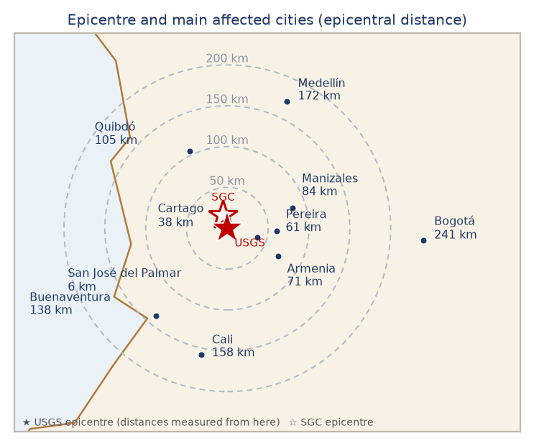
Affected Departments & Areas
Department | City | Dist. | Int. | Note
Chocó | San José del Palmar / Quibdó | 6 / 105 km | VII / VI | Epicentral department; 9 municipalities with reported damage; access, power and communications constrained.
Risaralda | Pereira, Dosquebradas | 61 km | VII | Highest reported death toll (at least 40; the governor cites at least 42). Airport terminal partially collapsed.
Valle del Cauca | Cali, Cartago, Buenaventura | 158 / 38 / 138 km | VI-VII | 27 deaths reported; 25-30 collapsed structures at 12 critical points in Cali; University Hospital heavily damaged.
+4 more
★ epicentre
Sources: Google Maps — https://www.google.com/maps/@5.69,-76.66,9z
11 / 52
ADRC 08/09/2026

Slide 12
Epicentre & Seismic Intensity
Item | Value
Origin time | 10 Aug 2026, 07:34:28 COT (UTC-5) · 10 Aug 2026, 12:34:28 UTC · 10 Aug 2026, 21:34 JST
Epicentre | USGS: 5 km S of San José del Palmar, Chocó Department (approx. 280 km W of Bogotá) — SGC: 12 km from San José del Palmar (4.8436N, -76.2422E)
Magnitude | Mww 7.4 (USGS) · 7.4 (SGC)
Depth | 110.3 km (USGS, PAGER v5) / 103 km (SGC, revised 11 Aug)
Max. intensity | MMI VII (Very strong) — USGS ShakeMap; the SGC macroseismic intensity map agrees
Mechanism | Strike-slip faulting at intermediate depth, within the subducting Nazca slab (not on the shallow plate interface)
Felt | Felt across western and central Colombia including Bogotá, Cali and Medellín, and in Ecuador, Panama and Venezuela
GLIDE | EQ-2026-000146-COL
Source | UNGRD / SGC / USGS
SGC macroseismic intensity map (ShakeMap)
https://www.sgc.gov.co/detallesismo/SGC2026pqqmro/mmi
Sources: SGC · USGS
12 / 52
ADRC 08/09/2026

Slide 13
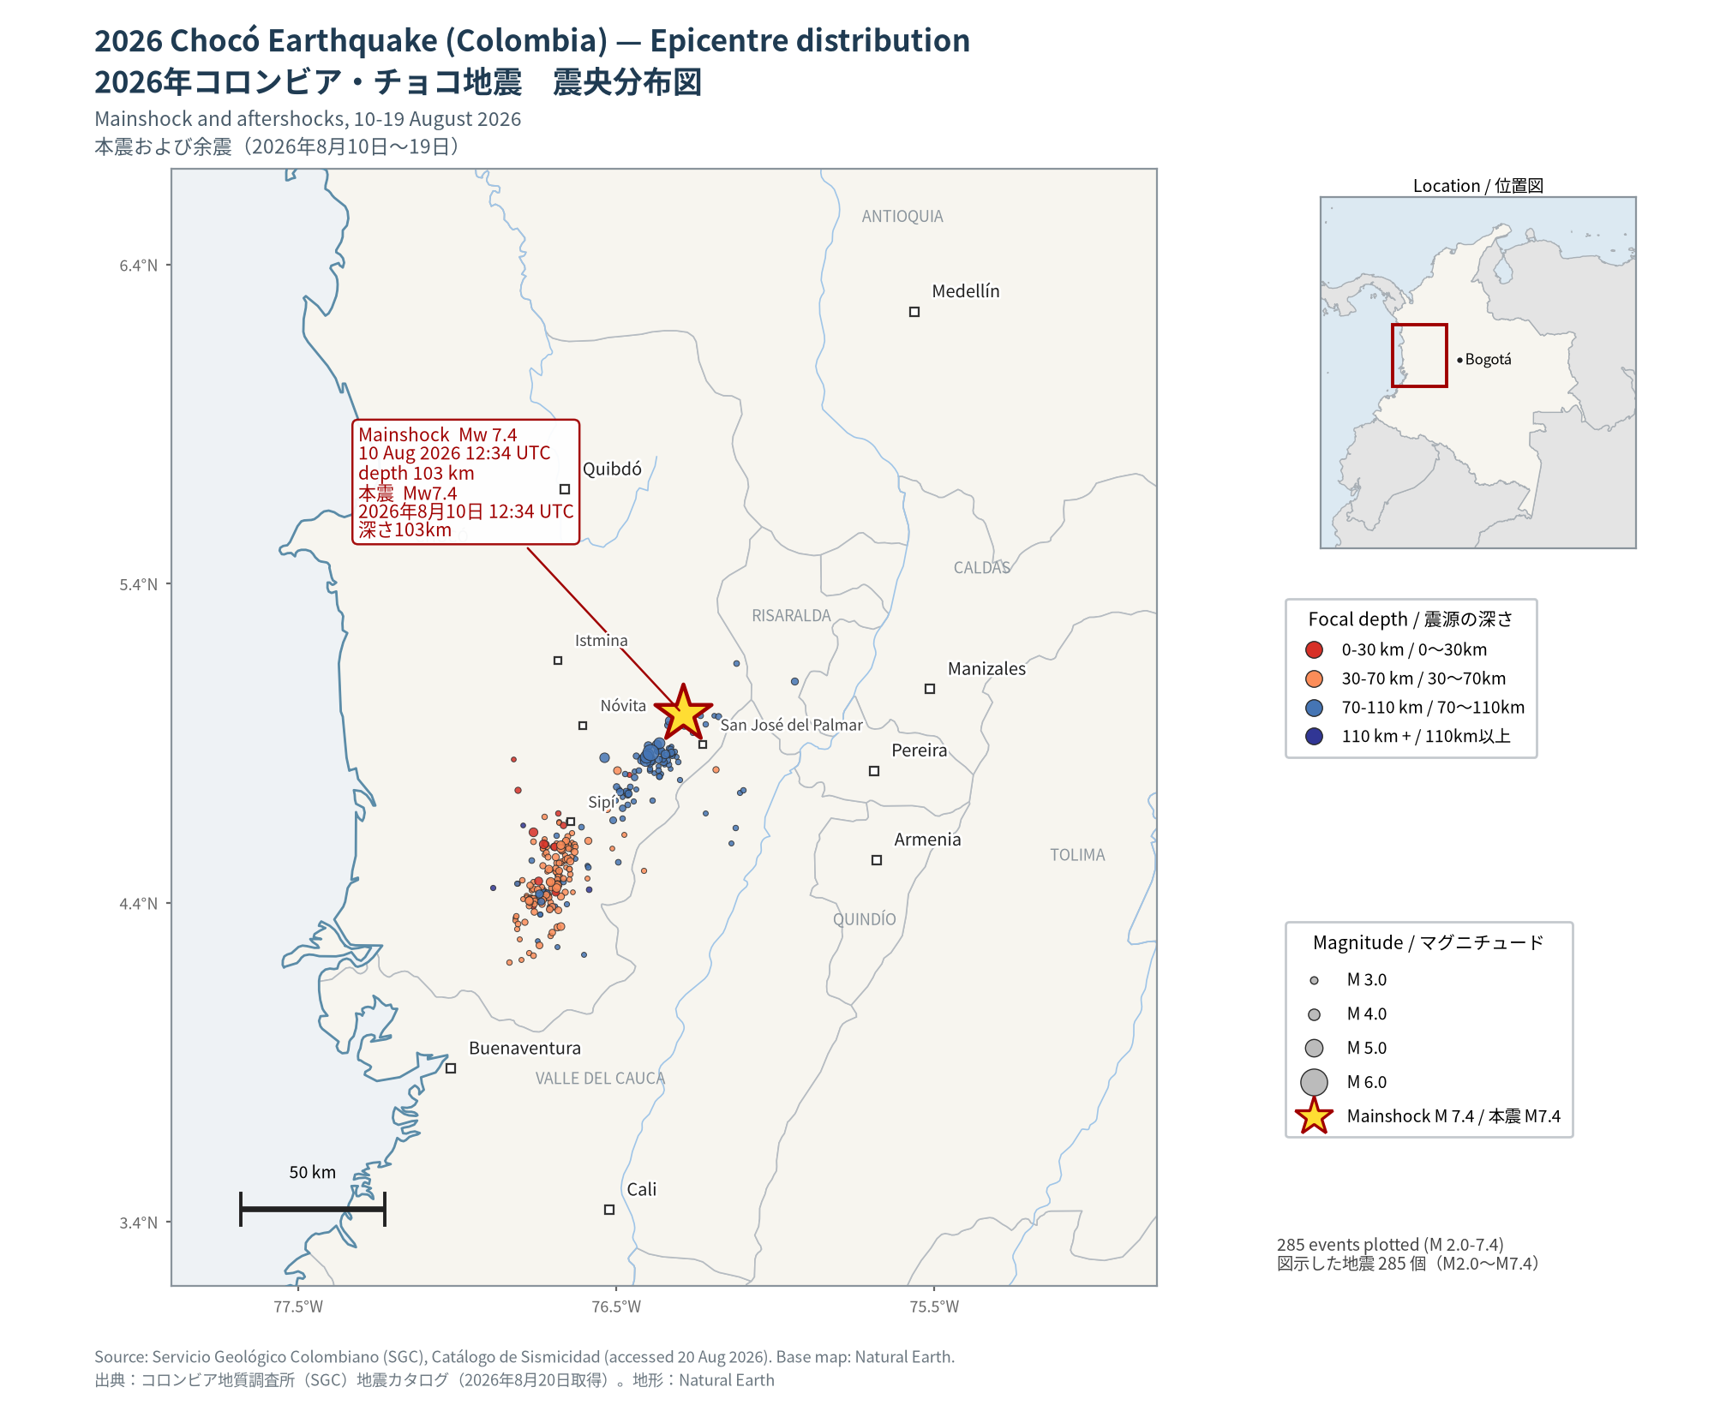
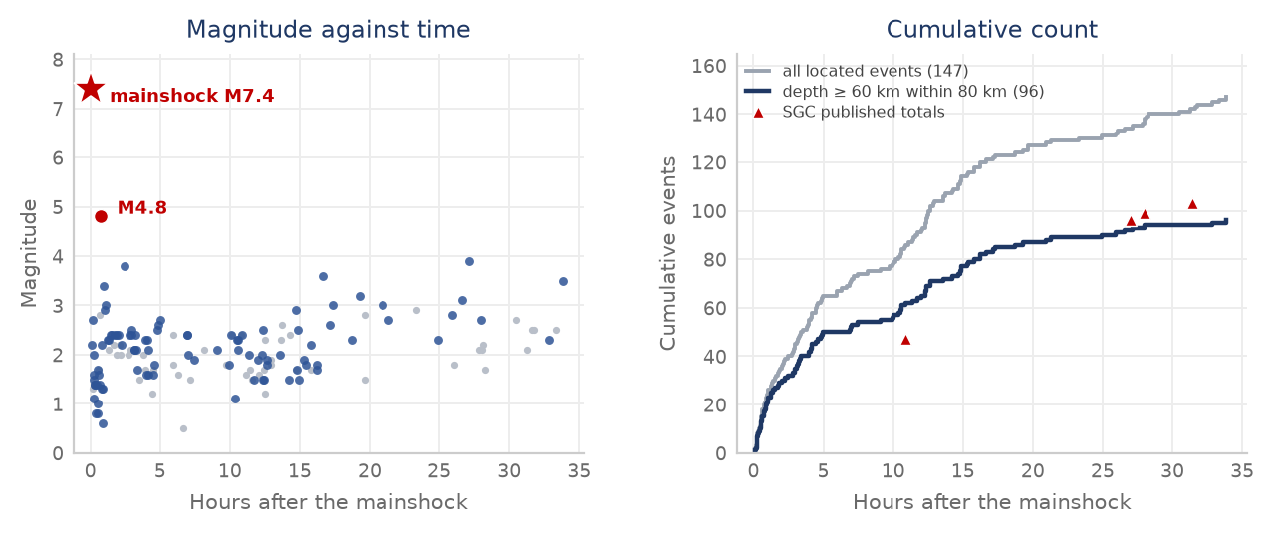
Seismicity - Epicentre Distribution & Aftershocks
Epicentre distribution: mainshock and 284 aftershocks, 10-19 Aug 2026 (SGC Catalogo de Sismicidad; base map Natural Earth)
https://bdrsnc.sgc.gov.co/paginas1/catalogo/index.php
Aftershock time-series
Sources: USGS — https://earthquake.usgs.gov/earthquakes/eventpage/us6000tjl2/executive
13 / 52
ADRC 08/09/2026

Slide 14
Seismotectonic Setting
Colombia lies at the junction of the Nazca, Caribbean and South America plates. Off the Pacific coast the Nazca plate subducts eastward beneath South America at roughly 50-60 mm/yr, and the descending slab reaches intermediate depths (70-300 km) beneath the Western and Central Cordilleras. This event ruptured inside that slab at about 110 km depth, which is why the shaking was felt over hundreds of kilometres - as far as Bogotá, Quito and Panamá City - while surface faulting and tsunami generation were absent. Intermediate-depth events radiate high-frequency energy efficiently and attenuate slowly, so damage tends to be distributed across many cities rather than concentrated in a narrow epicentral zone.
[Official] Depth about 110 km (USGS, revised): an intraslab event, not a plate-interface megathrust.
[Official] Strike-slip mechanism within the descending Nazca slab (USGS tectonic summary).
[Official] Maximum shaking MMI VII (Very strong); about 10.5 million people exposed to MMI VI-VII.
[Official] USGS PAGER (v5) Orange alert: the most likely fatality band is 1,000-10,000 and the most likely loss band USD 100-1,000 million — model estimates, not observations, and far above the figures reported so far.
[Official] The SGC assesses this as the largest-magnitude earthquake recorded in Colombia in the past decade.
[Media] Shaking was reported as unusually long in duration in cities far from the epicentre - a characteristic of deep events recorded on soft valley sediments.
[Official] The Coffee Region has a history of both deep and shallow damaging events: M7.0 at 150 km depth in 1938, M6.5 at 64 km in 1962 and M6.1 at 15 km in 1999 (SGC/GEM national hazard model).
Sources: USGS — https://earthquake.usgs.gov/earthquakes/eventpage/us6000tjl2/executive
14 / 52
ADRC 08/09/2026

Slide 15

Source Mechanism & Waveform Analysis
[Official] Magnitude M7.4 (USGS Mww) / M7.4 (SGC); depth about 110 km (USGS) / 103 km (SGC).
[Official] Intraslab event within the subducting Nazca plate, not a plate-interface megathrust.
[Official] No surface faulting and no tsunami; shaking felt as far as Bogota, Quito and Panama City.
Waveform-based analysis resources • USGS — moment tensor & finite-fault model (event page) • SGC — Colombian national seismological network (RSNC) • GEOFON / GFZ — regional broadband moment tensor
Focal mechanism / moment tensor (beachball)
https://www.fnet.bosai.go.jp/
Sources: USGS event page · SGC (RSNC)
15 / 52
ADRC 08/09/2026

Slide 16
Notable Aftershocks
The SGC located 147 events in the 34 hours after the mainshock. Within that window only one exceeded M4.0 - the M4.8 that followed 44 minutes later - and 92% were below M3.0; the M4.2 of 13 August is the second. No aftershock has come close to the mainshock in size. Ninety-six of the 147 lie at 60 km depth or more within 80 km of the epicentre: that subset is the intraslab sequence itself, and its cumulative curve tracks the SGC's published totals. The remainder is background seismicity the same catalogue records, which is why a raw count runs ahead of the official figure. A modest, quickly-decaying sequence is what an intermediate-depth rupture is expected to produce - but the 13 August event shows that shaking able to stop rescue work continues. By 07:00 on 14 August the SGC's published total had reached 184, of which 15 above M3.0 and 2 above M4.0 - a rate consistent with the catalogue extract and with normal decay.
Time | Mag. | Note | Tier
10 Aug 08:18 COT (13:18 UTC) | M4.8 | The largest aftershock, 44 minutes after the mainshock: San José del Palmar, depth 94 km, 19 km from the epicentre (SGC2026pqryij). USGS catalogues the same event as mb 5.0 at 98.5 km. Widely felt. | Official
10 Aug 10:01 COT (15:01 UTC) | M3.8 | San José del Palmar, depth 88 km. This is the event two regional agencies published as M4.7 in the multi-agency bulletin; the SGC solution is 0.9 units smaller. | Official
11 Aug 00:12 / 10:43 COT | M3.6 / M3.9 | San José del Palmar, depths 96 km and 92 km. The 10:43 event was felt strongly enough for buildings to be evacuated in several of the affected cities. | Official
13 Aug 09:42 COT (14:42 UTC) | M4.2 | San José del Palmar, depth 95 km, about 20 km from the epicentre - the same source volume as the mainshock. Felt as far as Bogotá and strong enough to halt search-and-rescue work temporarily. | Official
to 14 Aug 07:00 COT | 184 located | SGC running total four days on: 184 aftershocks, 15 above M3.0 and 2 above M4.0. The published total was 103 at 15:00 on 11 August; the catalogue extract used for the figure holds 147 events to 17:24 on 11 August. | Official
More than 30 agencies published a solution for the mainshock within minutes. Their magnitudes span Mw 7.0-7.7 and their depths 74-121 km; several automatic solutions defaulted to 10 km before revision. This report uses the USGS/NEIC solution (Mw 7.4, 110 km), which matches PAGER v5, and shows the SGC solution beside it. The spread is normal for a deep event recorded at teleseismic distances, and it is the reason early media figures for depth and magnitude disagreed.
16 / 52
ADRC 08/09/2026

Slide 17
Damage Situation (1/7)
Figures from UNGRD; source tier shown per row.
Item | Figure | Source | Tier
Deaths | 331 (UNGRD, 06:30 cut on 7 Sep, posted 07:43), unchanged from the 6 Sep 06:30 cut. The series has run 273, 281, 285, 287, 288, 294, 289, 287, 329, 331, 331, 331, 331, 331 and now 331 again; UNGRD attributes earlier movement to verification and consolidation of figures reported from the territories. | UNGRD, 7 Sep 07:43 | Official
Injured | 4,505 (UNGRD, 06:30 cut on 7 Sep), unchanged from the 6 Sep 06:30 cut. | UNGRD, 7 Sep 07:43 | Official
Missing (reported to the authorities) | 111 (UNGRD, 06:30 cut on 7 Sep), unchanged from the 6 Sep 06:30 cut. The series has run 496, 377, 378, 202, 320, 143, 194, 151, 136, 136, 136, 122, 111 and now 111 again: reports are filed, resolved and de-duplicated at the same time, so this count moves in both directions. | UNGRD, 7 Sep 07:43 | Official
Rescued alive (national balance) | 364 (UNGRD, 06:30 cut on 7 Sep), unchanged from 6 Sep, plus 3,003 animals rescued and 3,277 affected (both unchanged from 6 Sep). This is the national balance figure carried alongside the casualty count; see the separate 16 Aug entry below for named rescue cases. | UNGRD, 7 Sep 07:43 | Official
Unresolved reports on citizen platforms | 4,084 people registered on “Colombia te busca”, of whom 3,653 are still to be located and 429 have been found - concentrated in Valle del Cauca, Risaralda, Caldas and Chocó. Asocapitales has launched a second platform. | “Colombia te busca” (citizen initiative); Asocapitales | Media
17 / 52
ADRC 08/09/2026

Slide 18
Damage Situation (2/7)
Figures from UNGRD; source tier shown per row.
Item | Figure | Source | Tier
Rescued alive | 355 (UNGRD, 18:30 cut on 16 Aug), plus 496 animals rescued and 768 affected. They include a woman recovered in Cali almost 30 hours after the earthquake, a woman freed in Pereira after 36 hours, a baby pulled from an apartment block and the family of four found alive in Quibdó. | UNGRD, 16 Aug 18:30 | Official
Municipalities affected | 498 municipalities in 16 departments (UNGRD, 06:30 cut on 7 Sep), unchanged from the 6 Sep 06:30 cut. | UNGRD, 7 Sep 07:43 | Official
18 / 52
ADRC 08/09/2026

Slide 19
Damage Situation (3/7)
Figures from UNGRD; source tier shown per row.
Item | Figure | Source | Tier
People affected | 296,738 families (466,709 people) affected (UNGRD, 06:30 cut on 7 Sep), up from 296,725 families (466,644 people) at the 6 Sep 06:30 cut. OCHA's Flash Update 011 corroborates the people-affected figure as of 2 Sep 17:00 ("more than 466,600"). OCHA's earlier Flash Update 010 separately reported more than 406,000 people (193,011 families) as of 27 Aug 20:00, concentrated in Risaralda, Valle del Cauca, Choco, Quindio and Caldas; the two organisations' bases are not confirmed to be identical, so both are shown with their dates. Separately, WFP's Colombia Earthquake Emergency Situation Report (7 September) states "authorities reported 759,311 people affected, 331 fatalities, 4,519 injured people and 136 missing people" as of that date - a substantially larger affected-population figure than UNGRD's own 7 Sep balance (296,738 families/466,709 people), while the casualty figures WFP cites (4,519 injured, 136 missing) match UNGRD's earlier 1-2 Sep cuts rather than the 7 Sep cut (4,505 injured, 111 missing). The report does not explain what the 759,311 figure counts or which UNGRD cut it draws on; it is shown here with its date rather than merged with UNGRD's own count. | UNGRD, 7 Sep 06:30; OCHA Flash Update 011, 2 Sep 17:00 | Official
19 / 52
ADRC 08/09/2026

Slide 20
Damage Situation (4/7)
Figures from UNGRD; source tier shown per row.
Item | Figure | Source | Tier
Homes damaged or destroyed | 238,328: 36,326 destroyed and 202,002 damaged (UNGRD, 06:30 cut on 7 Sep), against 238,315 (36,326 destroyed and 201,989 damaged) at the 6 Sep 06:30 cut. The destroyed count is unchanged and the damaged count rose slightly. OCHA's Flash Update 011 (2 Sep 17:00) separately cites more than 36,000 homes destroyed, consistent with the UNGRD figure. In El Cairo, a coffee town in the mountains of Valle del Cauca, 80% of the houses were damaged (as of 16 Aug). | UNGRD, 7 Sep 06:30; OCHA Flash Update 011, 2 Sep 17:00 | Official
of which seriously damaged | 202,002 (UNGRD, 06:30 cut on 7 Sep), up from 201,989 at the 6 Sep 06:30 cut. | UNGRD, 7 Sep 06:30 | Official
of which destroyed | 36,326 (UNGRD, 06:30 cut on 7 Sep), unchanged from the 6 Sep 06:30 cut. | UNGRD, 7 Sep 06:30 | Official
Buildings collapsed | 743 nationally, plus 6,005 buildings damaged (UNGRD, 06:30 cut on 7 Sep), unchanged from the 6 Sep 06:30 cut (against 197 collapsed at the 18:30 cut on 16 Aug, 66 that morning and 121 on 14 Aug). Asocapitales separately counted 243 collapsed structures in the capital cities as of 16 Aug; Cali city officials reported 107 collapsed and 643 structurally damaged as of 16 Aug. | UNGRD, 7 Sep 06:30; Asocapitales (16 Aug); Alcaldía de Cali (16 Aug) | Official
20 / 52
ADRC 08/09/2026

Slide 21
Damage Situation (5/7)
Figures from UNGRD; source tier shown per row.
Item | Figure | Source | Tier
Health facilities | 400 damaged (UNGRD, 06:30 cut on 6 Sep), unchanged from the 3 Sep 06:30 cut (406 at the 31 Aug 06:30 cut, 304 at the 18:30 cut on 16 Aug, 240 that morning and 18 on 10 Aug); 7 health institutions closed as of 16 Aug. About 30% of the University Hospital in Cali collapsed, including three floors (paediatrics, internal medicine, part of the neonatal unit). The Interior Minister said on 14 Aug that the hospital network in Buenaventura is overwhelmed. | UNGRD, 6 Sep 06:30; Ministry of the Interior (14 Aug); Valle del Cauca government | Official
Educational facilities | 4,313 affected (UNGRD, 06:30 cut on 7 Sep), up from 4,288 at the 6 Sep 06:30 cut; UNGRD gives no explanation, treated as reconciliation rather than a correction (4,292 at 3 Sep, 4,287 at 2 Sep, 4,290 at 1 Sep, 4,268 at 31 Aug, 3,207 at the 18:30 cut on 16 Aug, 2,205 that morning and 52 on 10 Aug). | UNGRD, 7 Sep 06:30 | Official
Community facilities | 6,033 damaged (UNGRD, 06:30 cut on 7 Sep), down from 6,035 at the 6 Sep 06:30 cut; UNGRD gives no explanation, treated as reconciliation rather than a correction (5,600 at 3 Sep, 5,698 at 1 Sep, 5,524 at 31 Aug, 4,059 at the 18:30 cut on 16 Aug, 1,208 that morning). | UNGRD, 7 Sep 06:30 | Official
Roads | 521 roads damaged (UNGRD, 06:30 cut on 7 Sep), up from 491 at the 6 Sep 06:30 cut (468 at 3 Sep, 462 at 31 Aug, 410 at the 18:30 cut on 16 Aug, 210 that morning and 18 on 10 Aug); 102 road bridges and 13 footbridges also damaged (up from 91 road bridges on 6 Sep; against 48 road bridges and 13 footbridges on 16 Aug). | UNGRD, 7 Sep 06:30 | Official
21 / 52
ADRC 08/09/2026

Slide 22
Damage Situation (6/7)
Figures from UNGRD; source tier shown per row.
Item | Figure | Source | Tier
Airports | 5 airports with damage in the UNGRD balance of 13 Aug; operations had been suspended at seven. Matecaña International (Pereira) passenger terminal partially collapsed; flights suspended at Pereira, Manizales, Quibdó, Armenia, Cartago and Buenaventura | UNGRD, 13 Aug; civil aviation authority | Official
Cultural heritage | A tower of the neo-Gothic Cathedral of Manizales collapsed onto the nave | Mayor of Manizales | Media
Lifelines | 141 aqueducts damaged (UNGRD, 06:30 cut on 7 Sep), unchanged from the 6 Sep 06:30 cut (140 at 3 Sep, 122 at 31 Aug, 95 at the 18:30 cut on 16 Aug, 73 that morning); 29 banking offices out of service as of 16 Aug. Power outages and communications disruption reported in areas near the epicentre as of 16 Aug. | UNGRD, 7 Sep 06:30 | Official
Animals affected | 3,277 animals affected and 3,003 rescued nationally (UNGRD, 06:30 cut on 7 Sep), unchanged from the 6 Sep 06:30 cut, against 768 affected and 496 rescued at the 16 Aug 18:30 cut. | UNGRD, 7 Sep 06:30 | Official
Displacement | Thousands reported to have left their homes; shelter figures not yet published | Media / humanitarian agencies | Media
22 / 52
ADRC 08/09/2026

Slide 23
Damage Situation (7/7)
Figures from UNGRD; source tier shown per row.
Item | Figure | Source | Tier
Humanitarian response and funding | At least 29 humanitarian organizations have assisted nearly 123,000 people across 49 affected municipalities, up from 25 organizations / 72,000 people / 36 municipalities in Flash Update 010 (27 Aug). Donors have mobilized more than US$40 million. The Humanitarian Response Plan Addendum continues to seek additional funding to cover needs through the end of the year. OCHA also flags persistent urgent needs and 'double affectation' - communities facing both earthquake damage and risks tied to the armed conflict. | OCHA Flash Update 011, 2 Sep | Official
Secondary hazard - Baudó River flooding (Medio Baudó, Chocó) | Indigenous (Emberá) communities in Medio Baudó faced sudden flooding from the Baudó River about two days after the earthquake, compounding earthquake damage in an area with pre-existing barriers to healthcare and a presence of armed groups. | MSF, 2 Sep 2026 | Media
23 / 52
ADRC 08/09/2026

Slide 24
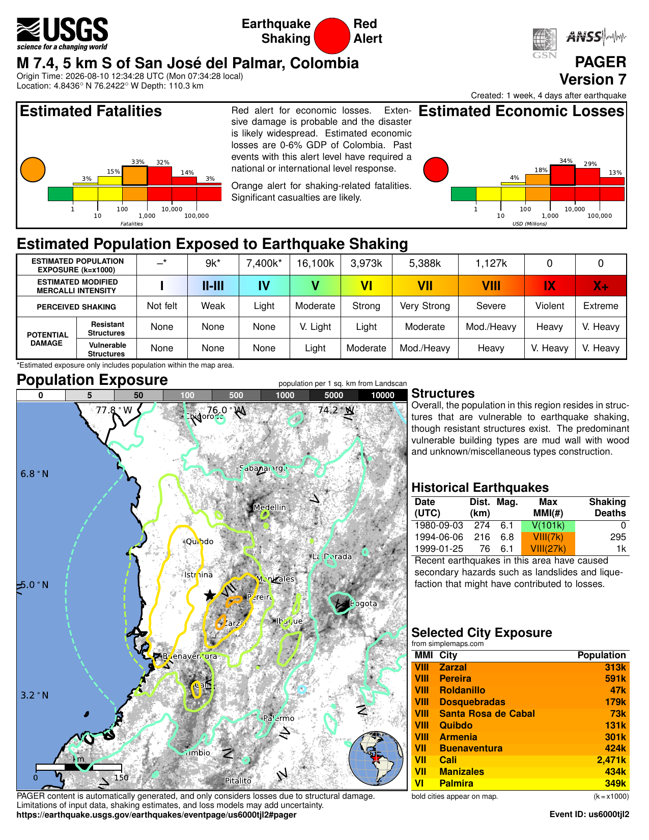
USGS PAGER assessment (version 7)
PAGER is the USGS rapid impact estimate, issued within minutes and revised as the event is refined. Version 7 was created eleven days after the earthquake and carries a RED alert, raised from the orange alert of the early versions. The alert has two components and the headline level is the higher of them: the fatality alert is orange (significant casualties likely), while the economic alert is red — estimated losses of 0-6% of Colombia's GDP, a level that past events have required a national or international response to meet. The fatality estimate is a probability distribution, not a single number: 33% for 100-1,000 deaths and 32% for 1,000-10,000. The reported toll of 329 (UNGRD, 27 Aug) sits in the 100-1,000 band. Estimated population exposed to MMI VIII is 1.13 million and to MMI VII 5.39 million; the cities carrying MMI VIII exposure include Pereira (591k), Armenia (301k), Zarzal (313k) and Quibdo (131k).
USGS PAGER one-pager (version 7) — alert levels, population exposure and selected city exposure
https://earthquake.usgs.gov/earthquakes/eventpage/us6000tjl2/pager
Sources: USGS PAGER — https://earthquake.usgs.gov/earthquakes/eventpage/us6000tjl2/pager
24 / 52
ADRC 08/09/2026

Slide 25
Deaths by Area
Area | Deaths | Note
Valle del Cauca (Cali) | 97 | President, 11 Aug. The department government's count is higher: 95 in Cali plus 35 in other municipalities
Risaralda (Pereira) | 66 | President, 11 Aug. The department reports around 90
Chocó (Quibdó) | 9 | Chocó closed its search phase on 12 Aug; the department reports 14 dead and 138 injured.
Caldas (Manizales) | 5 | Reported as 2, then 4, then 5
Antioquia | 1 | 73-year-old
The national figure is 287 at the 18:30 cut on 16 August, after 289 at the 07:30 cut the same morning and 294 on 15 August. The series ran 273 (13 Aug), 281, 285, 287, 288, 294, 289 and now 287. UNGRD attributes the movement to verification and consolidation of figures reported from the territories, some sent before being checked. Medicina Legal had received 250 bodies with 227 recognised at the 13 August reading. Cite 287 with its cut-off as the official national figure. The chart is the President's 11 August breakdown (181) and shows the shape of the distribution - deaths concentrated in Risaralda (Pereira) and Valle del Cauca (Cali) - not a current tally. Cali is reported three ways as well: 97 in the President's breakdown, 85 by the mayor on 11 August and 69 in the city's own municipal report, which carries no cut-off time.
25 / 52
ADRC 08/09/2026

Slide 26
Population Exposure by Shaking Intensity
MMI | Level | Exposed | Note
VIII+ | Severe | 0 | No population estimated at MMI VIII or above
VII | Very strong | 1,564,000 | Includes Pereira (591k), Armenia (301k) and Cartago (135k)
VI | Strong | 8,888,000 | Includes Cali (2,471k), Buenaventura (424k) and Palmira (349k)
V | Moderate | 17,076,000 | The largest exposed group
IV | Light | 6,465,000 | Reaches Bogotá and Medellín
USGS PAGER (version 5) exposure estimates. About 10.5 million people were exposed to Strong or Very Strong shaking (MMI VI-VII) and about 34 million to MMI IV or above across four countries. These are model estimates.
26 / 52
ADRC 08/09/2026

Slide 27
Response & Support - Domestic (1/2)
[Official] National disaster declaration activating the National Disaster Risk Management System (SNGRD) under Law 1523 of 2012.
[Official] Three days of national mourning declared by Decree 1172 from 12 August, with the flag at half-mast on all public buildings and at Colombian embassies and consulates abroad.
[Official] Unified Command Post (PMU) established in Chocó; UNGRD coordinating with departmental and municipal risk-management councils.
[Official] Four USAR teams (Bogotá, Envigado, Yopal, Medellín) deployed for search and rescue in collapsed structures.
[Official] Chocó ended its search-and-rescue phase on the night of 12 August, the governor stating that nobody remained reported under the rubble after the last family sought in Quibdó was found alive; the department moved to care for the affected and recovery. It reports 14 dead, 138 injured and 2,791 damaged properties.
[Official] Armed forces deployed for search, rescue, route clearance and security in the affected departments.
[Official] Rapid structural inspection of hospitals, schools and airports; seven health institutions closed and six airports suspended pending assessment.
[Media] Patients transferred from the damaged University Hospital in Cali to other facilities; the city reported casualties concentrated at 12 critical collapse sites.
[Official] The President toured the affected regions on 11-12 August - Quibdó, then Cali, then Pereira, Dosquebradas, Manizales and Armenia - and said he would direct the response from the field rather than Bogotá.
[Official] Relief measures announced during the tour: three months of relief on public-utility bills for households registered as affected, a rent subsidy for those who lost their homes, a census and characterisation of damaged housing ahead of repairs, and a shock plan for education and housing. On the evening of 12 August the President announced the declaration of an economic emergency, a constitutional mechanism intended to speed up the response.
27 / 52
ADRC 08/09/2026

Slide 28
Response & Support - Domestic (2/2)
[Official] UNGRD activated a temporary economic subsidy, announced 2 September, for families registered in the Single Registry of Victims (RUD) whose homes were destroyed or declared uninhabitable by the 10 August earthquake: a monthly payment of between COP 787,907 and COP 1,050,543 (depending on the municipality's category) for three months. UNGRD stresses that only municipal and departmental authorities may register households in the RUD; affected people cannot register directly, and any correction must go through the relevant territorial entity.
28 / 52
ADRC 08/09/2026

Slide 29
Response & Support - International (1/3)
[Official] Colombia is taking INSARAG-classified USAR teams from four countries only - the United States, Israel, Ecuador and El Salvador - on the stated grounds that they are internationally certified, work to INSARAG standards under UN coordination, and are fully self-sufficient, so they place no additional burden on municipal administrations. Their role is to support the Colombian USAR teams already deployed. The Government denied reports that other offers were declined for ideological reasons; the selection has nonetheless been questioned in the Colombian press.
[Official] Assistance broadened on 14 August beyond the four countries sending rescuers. India dispatched 20 tonnes of humanitarian supplies (medicines and medical equipment, temporary shelter and hygiene items). Norway allocated NOK 10 million (about USD 1 million) for emergency health care, water supply, disease prevention and temporary housing, and Sweden SEK 5 million (about USD 522,000) channelled through UNHCR. Spain, Italy, Chile, Mexico, Turkey, Brazil and the World Bank have also sent or announced support; the Colombian government says it has received offers worth about USD 1.3 billion in total, and lists Japan among the countries that have announced assistance.
[Official] On 12 August Colombia accepted international search-and-rescue assistance, from countries whose teams meet the INSARAG classification: Israel, Ecuador, El Salvador and the United States. At Colombia's request the US State Department mobilised the Fairfax County (Virginia) and Los Angeles County (California) USAR task forces. El Salvador sent 100 tonnes of relief supplies and a Mexican aid flight has arrived.
[Official] United States: USD 15.5 million in emergency assistance announced on 10 August, for emergency shelter, food, protection and damage assessment.
[Official] European Union: the EU Civil Protection Mechanism was activated and an initial EUR 100,000 in humanitarian funding released, channelled through the German Red Cross, whose teams were already in the country. Copernicus was placed at the disposal of the Colombian authorities and the EU consular crisis mechanism was activated for EU citizens in the affected area. The Commission President and the High Representative stated the EU is ready to provide more if needed.
Sources: ADRC — https://www.adrc.asia/
29 / 52
ADRC 08/09/2026

Slide 30
Response & Support - International (2/3)
[Official] Japan: on 11 August at 21:31 JST (07:31 COT) the Prime Minister, Takaichi Sanae, posted condolences - “Japan stands with Colombia in this difficult time”. Foreign Minister Motegi issued a message: “In the wake of the earthquake that struck the Republic of Colombia on August 10, I express my deepest condolences to those who lost their lives and extend my heartfelt sympathies to all those affected. The Government of Japan also stands ready to provide the necessary assistance. Japan stands in strong solidarity with the people of Colombia.” No dispatch of the Japan Disaster Relief team and no emergency grant aid had been announced at the time of writing.
[Media] Japan: the Colombian government lists Japan among the countries that have announced assistance, but as of this cut-off neither MOFA nor JICA has published a Japan Disaster Relief dispatch, an emergency relief goods provision or emergency grant aid. On the Japanese side what is confirmed is non-governmental: the Japanese Red Cross Society is supporting the Colombian Red Cross response, and the Nippon Foundation opened a Colombia earthquake appeal running from 12 August to 30 September; the NGO AMDA also dispatched a nurse (30 Aug) and, with AMDA Colombia and Fundación Salamandra, supported relief in Cali and Chocó until concluding its emergency-phase response on 4 September.
[Official] Ecuador mobilised a specialised USAR team of 47 personnel with canine units and self-sufficient equipment.
[Media] Offers of assistance were also reported from Chile, Peru, Panama, Argentina, Brazil, Venezuela, Bolivia, Guatemala, Cuba, El Salvador, Spain, Italy, France, Germany, Switzerland, Israel and Ukraine - USAR teams, medical and paramedic personnel, relief items and satellite observation. The CAF development bank announced a USD 500,000 donation.
[Official] Copernicus EMS Rapid Mapping activated as EMSR916 'Earthquake in Colombia' at 17:13 UTC on 10 August (12:13 COT), requested by EC Services / DG ECHO, to provide earthquake damage assessment emergency mapping. Status ongoing, with 3 areas of interest and 3 products at the time of writing. The activation reason names Quibdó, Pereira, Manizales and Cali as cities with significant damage and collapsed buildings.
[Official] United Nations: OCHA stated the humanitarian system is ready to support Colombia, and its preliminary needs analysis names drinking water, hygiene kits and household items, health care, food assistance and shelter. As of 11 August no formal request had been made; on 12 August the Government accepted international search-and-rescue assistance.
Sources: ADRC — https://www.adrc.asia/
30 / 52
ADRC 08/09/2026

Slide 31
Response & Support - International (3/3)
[TBC] The International Charter 'Space and Major Disasters' is also reported to have been activated for this earthquake; the activation number had not been confirmed at the time of writing.
[Media] International NGOs mobilising: Direct Relief and Americares (medical supplies), Save the Children (child protection and education), International Rescue Committee (assessment near the epicentre in Chocó), Convoy of Hope (relief goods).
[Official] UNGRD director David Santiago Tamayo Roldan and deputy director for disaster management Hernan Dario Diaz Diaz met with Nils Grede, WFP Colombia's representative and country director, to coordinate food-assistance actions for families affected by the 10 August earthquake.
Sources: ADRC — https://www.adrc.asia/
31 / 52
ADRC 08/09/2026

Slide 32
Observation Bodies & Products
All bodies contributing observations or value-added products; source tier shown per row
Body | Contribution | Status | Tier
International Charter | Activation for the Colombia earthquake reported; wide-area optical/SAR imagery for damage assessment | Reported / number pending | TBC
Copernicus EMS | EMSR916 'Earthquake in Colombia' — Rapid Mapping for damage assessment; requested by EC Services / DG ECHO; 3 AOIs, 3 products | Ongoing (EMSR916) | Official
USGS | ShakeMap, PAGER (Orange), finite-fault and aftershock catalogue | Published | Official
GDACS | Overall Orange alert; population exposure and impact estimates | Published | Official
SGC | National seismic network: hypocentre, magnitude revision, aftershock bulletins, accelerographic records | Published | Official
Sentinel Asia | Not applicable - the mechanism covers the Asia-Pacific region; Colombia is served by the International Charter and Copernicus EMS | n/a | Official
Sources: International Charter 'Space and Major Disasters' — https://disasterscharter.org/activations
32 / 52
ADRC 08/09/2026

Slide 33
Copernicus EMS Rapid Mapping — EMSR916
Activation | EMSR916 — Earthquake in Colombia
Event time | 10/08/2026 afternoon (UTC)
Activation time | 10/08/2026, 17:13 (UTC) = 12:13 COT
Event type | Earthquake / Ground shaking
Affected country | Colombia
Authorised user | EC Services | DG ECHO
Service output | 3 AOIs · 3 products · 0 maps
Status | ONGOING
Activation reason “On the 10 August 2026 at 12:30 UTC, a major earthquake with a magnitude of 7.4 is reported to have affected western and central Colombia, with the epicentre near San José del Palmar. The event has caused significant damage in several cities, including Quibdó, Pereira, Manizales and Cali, with collapsed buildings reported. Copernicus EMS Rapid Mapping is requested to provide earthquake damage assessment emergency mapping.” Rapid Mapping delivers reference and grading products over selected areas of interest, not nationwide coverage. Products are published on the activation page as they are produced and are free to use.
Sources: Copernicus EMS — https://mapping.emergency.copernicus.eu/activations/EMSR916/
33 / 52
ADRC 08/09/2026

Slide 34
National Disaster Risk Management System
Colombia rebuilt its disaster risk management framework after the 1985 Armero volcanic disaster and again after the 1999 Armenia earthquake. Law 1523 of 2012 created the National Disaster Risk Management System (SNGRD), led by the National Unit for Disaster Risk Management (UNGRD), which reports to the Presidency.
Law 1523 of 2012 - national policy on disaster risk management; defines the SNGRD and makes risk management a mandatory duty of every public authority and, in part, of private actors.
UNGRD - national coordinating agency under the Presidency; runs the national response, the disaster fund (FNGRD) and the national information system.
Departmental and municipal risk management councils (CDGRD / CMGRD) carry out first response; UNGRD reinforces when local capacity is exceeded.
PNGRD 2015-2030 — the national disaster risk management plan, adopted by Decree 308 of 2016 and updated by Decree 1478 of 3 August 2022; aligned with the Sendai Framework and monitored annually by UNGRD.
NSR-10 - the national seismic building code (in force since 2010, technical annexes updated since). Buildings predating modern code enforcement, and non-engineered masonry and earthen construction, remain the dominant source of risk.
Seismic microzonation studies exist for major cities including Bogotá, Medellín, Cali, Pereira, Manizales and Armenia — a direct legacy of the 1999 earthquake. In Cali the microzonation is binding on structural design through Decree 411.0.20.0158 of 2014.
The SGC operates the National Seismological Network and the national accelerograph network, and issues public bulletins within minutes.
Cities run their own instruments alongside the national system: Cali's SATIC community-and-sensor early warning system (from 2018, formalised by Municipal Decree 0858 of 2022), Medellín's DAGRD and its municipal plan, and municipal risk-management funds created under Law 1523.
34 / 52
ADRC 08/09/2026

Slide 35
Historical Damaging Earthquakes
Year | Event | Mag. | Impact
1906 | Ecuador-Colombia earthquake (Pacific coast) | M8.8 | One of the largest earthquakes ever recorded; destructive tsunami on the Pacific coast
1925 | Cali earthquake (Valle del Cauca) | M7.0 | The reference historical event for Cali; the city was also shaken in 1995 and 2004, the latter damaging clinics and residential buildings
1938 | Coffee Region earthquake (deep, 150 km) | M7.0 | An intermediate-depth event beneath the same coffee-growing departments — the closest historical analogue to the 2026 earthquake
1979 | Tumaco earthquake (Nariño) | M8.1 | Subduction-interface event with tsunami; several hundred deaths
1983 | Popayán earthquake (Cauca) | M5.5 | About 250-300 deaths; historic city centre heavily damaged - a small but shallow, urban event
1994 | Páez (Cauca) earthquake | M6.8 | About 1,100 deaths, most caused by earthquake-triggered landslides and debris flows
1995 | Chocó earthquake | M6.6 | Intermediate-depth event in the same department as the 2026 earthquake
1999 | Armenia (Quindío) earthquake | M6.1-6.2 | About 1,185 deaths; Colombia's costliest earthquake disaster; drove the modern DRM reforms
2026 | Chocó earthquake (this event) | M7.4 | Largest magnitude recorded in Colombia in the past decade (SGC); intermediate depth, wide-area damage
35 / 52
ADRC 08/09/2026

Slide 36
Observations & Points to Watch
[Official] A deep source with shallow-disaster consequences. At 110 km depth the earthquake produced no surface rupture and no tsunami, yet it damaged buildings in at least six departments. Damage is dispersed rather than concentrated, which complicates needs assessment, logistics and the targeting of search and rescue.
[Official] Critical facilities failed. The collapse of about 30% of Cali's University Hospital, the closure of seven health institutions, damage to 52 schools and the partial collapse of an international airport terminal all reduce response capacity exactly where it is needed. Seismic performance of hospitals, schools and transport terminals is the clearest lesson emerging so far.
[Official] The toll multiplied as the assessment reached the damage. In 56 hours deaths went from 111 to 239, injured from 87 to 3,755, missing from none counted to 287, damaged homes from 1,612 to about 54,000, and the affected area from “more than 20 municipalities” to 403 across 14 departments. Nothing new happened to cause those jumps; the assessment reached places it had not reached, and much of Chocó is still accessible only by boat or aircraft. Two lessons for reading early figures: the first-day numbers describe the reach of the assessment, not the size of the disaster; and where two counts of the same thing exist, check what each is counting before comparing them.
[Media] The affected area is the Coffee Region rebuilt after 1999. Comparing how post-1999 construction performed against older stock, under a very different type of shaking, will be valuable for the region and for other countries with intermediate-depth seismic sources.
[Official] The assessments existed before the event. Cali's GEM-TREQ risk model and its local plan had already named hospitals and other indispensable buildings as the priority to retrofit, and the 2026 earthquake — a far weaker test than the city's own modelled scenario — still took out roughly 30% of its main public hospital. The gap here is not knowledge but implementation and financing.
[Official] Aftershock risk to damaged buildings. The SGC located 147 events in 34 hours, 92% of them below M3.0 and only one above M4.0 - as modest as an intermediate-depth intraslab rupture predicts. That statistic is not the operational point: the M4.8 of 10 August was felt widely, and the M3.9 of 11 August emptied buildings again in several cities. Structures the mainshock left standing but damaged have lost capacity, so rapid habitability assessment before re-occupancy matters more than the aftershock numbers.
[TBC] Points to watch: the reconciled national casualty figures; shelter and displacement numbers, which have not yet been published; water and power restoration in Chocó; the results of satellite-based damage mapping; and whether the Government requests international assistance beyond the offers already made.
36 / 52
ADRC 08/09/2026

Slide 37
Cali: municipal damage report
Reading these against the other Cali figures — The city's own count of 69 deaths sits below the 85 the mayor gave on 11 August and the 97 in the President's breakdown the same day, and its 1,008 injured sits above the mayor's 885. The municipal report carries no cut-off time, so it cannot be placed in that sequence: it may be an earlier snapshot, or a narrower count of deaths confirmed by the city itself. Until the city states its cut-off, cite the national figures for the national picture and use these for what only the municipality reports - collapsed and structurally damaged buildings, evacuation orders, and the trapped-versus-rescued balance.
Item | Figure
Deaths | 69
Injured | 1,008
People trapped | 230
People rescued | 88
Buildings collapsed | 107
Buildings with structural damage | 643
Buildings under evacuation order | 18
People trapped | 230
People rescued | 88
Deaths | 69
Injured | 1,008
230 people trapped against 88 rescued is the number that drives the next 48 hours in Cali: it is the search-and-rescue caseload, and it is larger than the city's death toll. (Officials of the Alcaldía de Santiago de Cali, received 12 August 2026)
37 / 52
ADRC 08/09/2026

Slide 38
Pre-event Risk Assessment: Santiago de Cali
Cali did not lack a risk assessment. Between 2020 and 2022 the city built a full urban earthquake risk model with the GEM Foundation under the USAID-supported TREQ project, one of three pilot cities alongside Quito and Santiago de los Caballeros. The modelled scenario is a shallow local one — magnitude 6.5 at 10 km depth on the Dagua-Calima fault — and its estimates dwarf what the city actually experienced on 10 August 2026.
Item | Value
Modelled scenario | M6.5, 10 km depth, Dagua-Calima fault, urban area
Population exposed | approx. 2,300,000
Estimated deaths | approx. 1,200
Seriously injured | approx. 36,300
Displaced | approx. 181,000
Buildings collapsed | approx. 1,800 of 348,000 (0.5%)
Residual risk | assessed at about 40% after existing measures
Figures from the GEM-TREQ urban risk assessment for Santiago de Cali and from the city's local disaster risk management plan, as compiled by the Municipality of Santiago de Cali (Secretaría de Gestión del Riesgo de Emergencias y Desastres) for a JICA training course.
38 / 52
ADRC 08/09/2026

Slide 39
What the city had already prioritised
The 2026 earthquake was not this scenario — The 10 August event was larger in magnitude (M7.4) but 110 km deep and 158 km from Cali, giving the city MMI VI rather than the near-field shaking of the modelled M6.5. Cali recorded 27 deaths and 25-30 collapsed structures — two orders of magnitude below the scenario. What it did test is exactly the weakness the local plan had flagged: about 30% of the University Hospital collapsed and seven health institutions closed. The city's own worst case remains ahead of it, and the case for retrofitting indispensable buildings is now evidential rather than theoretical.
Priority already identified
Seismic vulnerability studies of indispensable buildings — hospitals, schools, fire stations — to the NSR-10 code (budgeted at about USD 1.7 million, short term).
Structural retrofitting of indispensable buildings and of basic-service infrastructure, to keep essential services running after an earthquake.
Seismic vulnerability assessment of the EMCALI water, sewerage and power networks and of the city gas network.
Updating the local soil-response model and the seismic microzonation, in force since INGEOMINAS/DAGMA (2005) and adopted by Decree 411.0.20.0158 of 2014 for structural design.
Maintaining and extending the Cali accelerograph network (RAC) and its interoperability with the SGC national network.
Insuring public infrastructure against seismic risk, and retrofitting low-income housing through subsidies and safe self-build programmes.
Financing model for the priority measures: local government 30-50%, national disaster fund (FNGRD/UNGRD) 30-50%, international partners including JICA, the GEM Foundation and the IDB about 20%.
Figures from the GEM-TREQ urban risk assessment for Santiago de Cali and from the city's local disaster risk management plan, as compiled by the Municipality of Santiago de Cali (Secretaría de Gestión del Riesgo de Emergencias y Desastres) for a JICA training course.
39 / 52
ADRC 08/09/2026

Slide 40
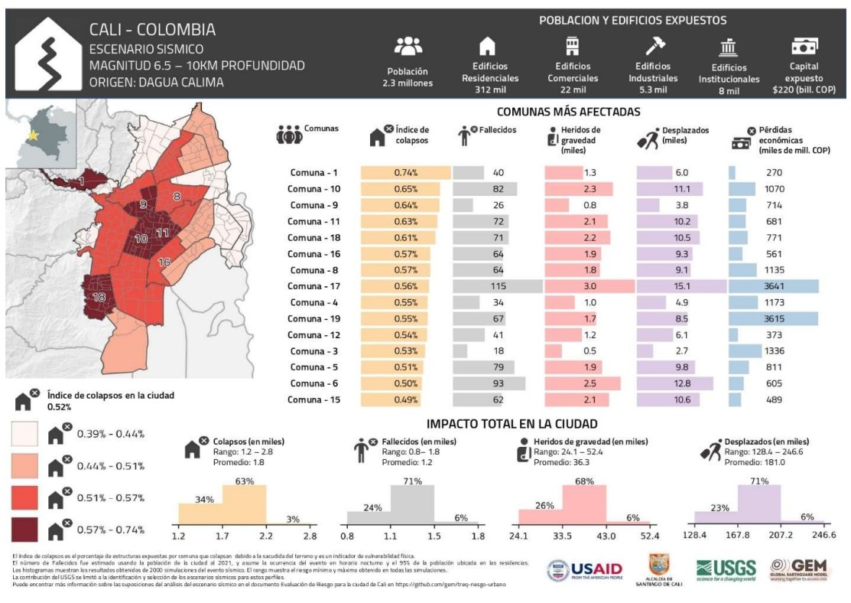
GEM-TREQ City Profile: Cali
GEM-TREQ city profile for Cali: the M6.5 / 10 km Dagua-Calima scenario. 2.3 million people and 312,000 residential, 22,000 commercial, 5,300 industrial and 8,000 institutional buildings are exposed, with COP 220 trillion of exposed capital. The bars give, per comuna, the collapse index, fatalities, serious injuries, displaced people and economic losses; the histograms give the city totals with their modelled ranges.
GEM-TREQ city profile for Cali
40 / 52
ADRC 08/09/2026

Slide 41
Useful Links & Sources (1/12)
Source policy: Source hierarchy: official > media > TBC. Government and scientific-agency figures are used as primary; media reports are used only where official figures are not yet published and are labelled as such. Items still being verified are marked TBC. Preliminary figures are never replaced by larger unverified numbers.
Source | Tier | URL
USGS - M 7.4 San José del Palmar, Colombia (event page) | Official | https://earthquake.usgs.gov/earthquakes/eventpage/us6000tjl2/executive
Servicio Geológico Colombiano (SGC) | Official | https://www.sgc.gov.co/
SGC — event bulletin SGC2026pqqmro (this earthquake) | Official | https://www.sgc.gov.co/detallesismo/SGC2026pqqmro/
SGC — macroseismic intensity map (ShakeMap) for this earthquake | Official | https://www.sgc.gov.co/detallesismo/SGC2026pqqmro/mmi
UNGRD - National Unit for Disaster Risk Management | Official | https://portal.gestiondelriesgo.gov.co/
GDACS - Orange earthquake alert, Colombia, 10 Aug 2026 | Official | https://gdacs.org/report.aspx?eventid=1557236&eventtype=EQ
International Charter 'Space and Major Disasters' - activations | Official | https://disasterscharter.org/activations
Copernicus EMS — EMSR916 'Earthquake in Colombia' (activation) | Official | https://mapping.emergency.copernicus.eu/activations/EMSR916/
ReliefWeb - Colombia | Official | https://reliefweb.int/country/col
PAHO/WHO - Colombia | Official | https://www.paho.org/en/colombia
PreventionWeb - Colombia PNGRD 2015-2030 | Official | https://www.preventionweb.net/publication/colombia-plan-nacional-de-gestion-del-riesgo-de-desastres-pngrd-2015-2030
GEM - Seismic regulations for Colombia (NSR-10) | Official | https://www.globalquakemodel.org/seismic-regulations/colombia
41 / 52
ADRC 08/09/2026

Slide 42
Useful Links & Sources (2/12)
Source | Tier | URL
CNN — live updates: death toll rises to 132 | Media | https://www.cnn.com/2026/08/10/world/live-news/colombia-earthquake-san-jose-del-palmar
El Colombiano — 84 injured and 12 dead in Chocó (department government) | Media | https://www.elcolombiano.com/colombia/terremoto-temblor-hoy-colombia-choco-heridos-FL39761141
UN-SPIDER - UNGRD of Colombia | Official | https://un-spider.org/national-unit-disaster-risk-management-ungrd-colombia
OECD - Risk governance scan of Colombia | Official | https://www.oecd.org/en/publications/risk-governance-scan-of-colombia_eeb81954-en.html
CNN - Live updates: at least 111 dead | Media | https://www.cnn.com/2026/08/10/world/live-news/colombia-earthquake-san-jose-del-palmar
France 24 - Colombia declares national emergency as quake toll hits 111 | Media | https://www.france24.com/en/americas/20260810-powerful-quake-rocks-colombia-causing-major-damage
Al Jazeera - M7.4 earthquake hits Colombia | Media | https://www.aljazeera.com/news/2026/8/10/7-4-magnitude-earthquake-hits-colombia-killing-at-least-20
CBS News - Strong earthquake strikes western Colombia | Media | https://www.cbsnews.com/news/colombia-earthquake-western-region-evacuations/
NBC News - Deaths, injuries and collapsed buildings | Media | https://www.nbcnews.com/world/latin-america/strong-earthquake-colombia-ecuador-people-evacuating-homes-buildings-rcna591709
Colombia One - First official assessment: widespread structural damage | Media | https://colombiaone.com/2026/08/10/earthquake-colombia-official-details/
Colombia One - Government declares national disaster | Media | https://colombiaone.com/2026/08/10/colombia-national-disaster/
42 / 52
ADRC 08/09/2026

Slide 43
Useful Links & Sources (3/12)
Source | Tier | URL
Infobae - SGC explains why the shaking lasted so long | Media | https://www.infobae.com/colombia/2026/08/10/por-que-el-temblor-en-colombia-de-este-lunes-10-de-agosto-duro-una-eternidad-el-servicio-geologico-explico-que-paso/
NHK - President reports 111 dead, 87 injured (Japanese) | Media | https://www3.nhk.or.jp/news/
Nikkei - M7.4 earthquake in western Colombia (Japanese) | Media | https://www.nikkei.com/article/DGXZQOGN108V30Q6A810C2000000/
Jiji Press - M7.4 earthquake in Colombia (Japanese) | Media | https://www.jiji.com/jc/article?k=2026081000878&g=int
Save the Children - Children at risk after the earthquake | Media | https://www.savethechildren.org/us/about-us/media-and-news/2026-press-releases/children-at-risk-after-earthquake-strikes-colombia
Direct Relief - Mobilising medical aid | Media | https://www.directrelief.org/2026/08/colombia-earthquake-7-4-magnitude-direct-relief-response/
Americares - Colombia earthquake, August 2026 | Media | https://www.americares.org/crisis-alerts/colombia-earthquake-august-2026/
GLIDEnumber — EQ-2026-000146-COL (event identifier) | Official | https://glidenumber.net/
ADRC - Asian Disaster Reduction Center | Official | https://www.adrc.asia/
European Commission — EU support for Colombia, Copernicus activated | Media | https://www.democrata.es/en/international/von-der-leyen-expresses-the-eu-s-support-for-colombia-and-activates-copernicus-after-the-earthquake/
GEM Foundation — TREQ project (urban earthquake risk, Quito / Cali / Santiago de los Caballeros) | Official | https://www.globalquakemodel.org/proj/treq
43 / 52
ADRC 08/09/2026

Slide 44
Useful Links & Sources (4/12)
Source | Tier | URL
GEM-TREQ — Evaluación de riesgo sísmico para Santiago de Cali (technical report D2.6.2) | Official | https://cloud-storage.globalquakemodel.org/public/wix-new-website/pdf-collections-wix/publications/TREQ%20deliverables/reports/TREQ_D262_Riesgo_Sismico_Cali_v1.00.pdf
Understanding seismic risk in Santiago de Cali for its application in risk management (peer-reviewed, 2025) | Official | https://www.sciencedirect.com/science/article/abs/pii/S2212420925003097
SATIC — Cali's intelligent and community early warning system | Official | https://satic.cali.gov.co/satic
Alcaldía de Santiago de Cali — disaster risk management | Official | https://www.cali.gov.co/gestiondelriesgo/
UNGRD — Plan Nacional de Gestión del Riesgo de Desastres (PNGRD) | Official | https://portal.gestiondelriesgo.gov.co/Paginas/Plan-Nacional-de-Gestion-del-Riesgo.aspx
Decreto 1478 de 2022 — update of the PNGRD | Official | https://www.funcionpublica.gov.co/eva/gestornormativo/norma.php?i=191411
EMSC-CSEM SeismicPortal — bulletin and FDSN event service | Official | https://www.emsc-csem.org/
SGC — seismic catalogue viewer (reviewed catalogue ends Feb 2018) | Official | https://catalogosismico.sgc.gov.co/visor/index.html
El Tiempo — live updates, 11 August (Cali toll rises to 85) | Media | https://www.eltiempo.com/colombia/otras-ciudades/terremoto-en-colombia-de-7-4-en-vivo-el-comandante-del-ejercito-nacional-se-encuentra-en-choco-coordinando-las-labores-de-atencion-de-la-emergencia-3577491
Asocapitales balance — 132 deaths, 570+ injured, by city | Media | https://www.elespectador.com/colombia/mas-regiones/temblor-en-colombia-hoy-10-de-agosto-en-vivo-epicentro-y-reporte-de-afectaciones/
Noticias Caracol — UNGRD balance: 182 deaths, 2,542 injured, 189 missing | Media | https://www.noticiascaracol.com/colombia/en-vivo-colombia-hoy-tras-terremoto-de-magnitud-7-4-continuan-las-labores-de-rescate-so35
44 / 52
ADRC 08/09/2026

Slide 45
Useful Links & Sources (5/12)
Source | Tier | URL
RPP — the President's 181 is 59 fewer than the regional data | Media | https://rpp.pe/mundo/colombia/abelardo-de-la-espriella-cifra-en-181-los-muertos-por-el-terremoto-59-menos-que-datos-regionales-noticia-1701022
El Tiempo — 99 aftershocks and their magnitudes (SGC) | Media | https://www.eltiempo.com/colombia/otras-ciudades/cuantas-replicas-se-han-registrado-tras-el-terremoto-de-7-4-en-colombia-estas-son-todas-las-magnitudes-3577711
Semana — SGC total: 103 aftershocks to 15:00 on 11 Aug | Media | https://www.semana.com/tecnologia/articulo/servicio-geologico-revela-el-numero-total-de-replicas-que-ha-habido-en-colombia-tras-fuerte-terremoto-que-estremecio-al-pais/202641/
MOFA Japan — Foreign Minister Motegi's message on the earthquake in Colombia | Official | https://www.mofa.go.jp/mofaj/la_c/sa/co/pageit_000001_00001.html
MOFA Japan on X — post of 11 August | Official | https://x.com/MofaJapan_jp/status/2087155064855261537
El Tiempo — list of countries that have offered assistance | Media | https://www.eltiempo.com/mundo/mas-regiones/la-comunidad-internacional-se-vuelca-en-ayudas-para-colombia-lista-de-paises-que-han-ofrecido-apoyo-tras-el-terremoto-de-magnitud-7-3577512
UN in Colombia — earthquake information and updates | Official | https://colombia.un.org/es/320793-informaci%C3%B3n-y-actualizaciones-sobre-el-terremoto-en-colombia
UN News — the UN offers support to Colombia | Official | https://news.un.org/es/story/2026/08/1541792
“Colombia te busca” — citizen missing-persons platform | Media | https://www.colombiatebusca.com/
Asocapitales — earthquake missing-persons tool | Official | https://www.asocapitales.co/terremoto-colombia.html
Infobae — relief and subsidies announced on the Coffee Region tour | Media | https://www.infobae.com/colombia/2026/08/12/de-la-espriella-anuncio-alivios-y-subsidios-tras-emergencia-en-el-eje-cafetero-por-el-terremoto-detallo-plan-de-choque-para-educacion-y-vivienda/
45 / 52
ADRC 08/09/2026

Slide 46
Useful Links & Sources (6/12)
Source | Tier | URL
Pulzo — UNGRD damage and casualty report across 14 departments | Media | https://www.pulzo.com/nacion/terremoto-en-colombia-ungrd-reporta-danos-y-victimas-en-valle-del-cauca-y-risaralda-PP5272829A
El Tiempo — SAR teams arriving from Israel, Ecuador, El Salvador and the US | Media | https://www.eltiempo.com/colombia/otras-ciudades/terremoto-en-colombia-hoy-12-de-agosto-ultimas-noticias-presidente-de-la-espriella-celebro-rescate-de-daniela-largo-tras-36-horas-bajo-los-escombros-3577781
Asocapitales — 188 deaths and 1,677 injured in capital cities | Official | https://www.asocapitales.co/actualidad/noticias/ciudades-seguras/terremoto-deja-188-fallecidos-y-1677-heridos-en-ciudades
infolibre — at least 254 dead as the search continues | Media | https://www.infolibre.es/internacional/terremoto-colombia-deja-254-muertos-continua-busqueda-escombros_1_2235003.html
El Colombiano — 265 dead, 3,494 injured, 496 missing | Media | https://www.elcolombiano.com/colombia/cifra-muertos-heridos-desaparecidos-por-terremoto-colombia-MK39884181
El Tiempo — UNGRD balance of 13 August: 273 dead, 3,824 injured, 377 missing | Media | https://www.eltiempo.com/colombia/otras-ciudades/balance-oficial-de-la-ungrd-tras-terremoto-de-magnitud-7-4-en-colombia-273-fallecidos-3-824-heridos-y-377-desaparecidos-3578196
El Tiempo — 40,753 families affected: UNGRD's new balance | Media | https://www.eltiempo.com/vida/40-753-familias-afectadas-y-273-muertos-ungrd-entrega-nuevo-balance-del-terremoto-en-colombia-3578185
El Tiempo — M4.2 aftershock at San José del Palmar, 13 August | Media | https://www.eltiempo.com/colombia/otras-ciudades/nuevo-temblor-de-magnitud-4-2-se-registro-en-san-jose-del-palmar-choco-en-la-manana-de-este-jueves-13-de-agosto-3578131
Infobae — Colombia to receive rescue teams from the US, Israel, Ecuador and El Salvador | Media | https://www.infobae.com/colombia/2026/08/13/colombia-recibira-equipos-de-rescate-de-ee-uu-israel-ecuador-y-el-salvador-por-terremoto/
El Tiempo — UNGRD balance of 14 August: 287 dead, 3,975 injured, 378 missing | Media | https://www.eltiempo.com/colombia/otras-ciudades/balance-oficial-de-la-ungrd-tras-terremoto-de-magnitud-7-4-en-colombia-287-fallecidos-3-975-heridos-y-378-desaparecidos-3578445
46 / 52
ADRC 08/09/2026

Slide 47
Useful Links & Sources (7/12)
Source | Tier | URL
Infobae — live: the toll rises to 288, more than 4,000 injured and 202 missing | Media | https://www.infobae.com/colombia/2026/08/14/temblor-de-74-en-colombia-el-10-de-agosto-se-actualizo-el-numero-de-fallecidos-en-todo-el-pais/
Infobae — international assistance grows: India, Norway, Sweden and Spain | Media | https://www.infobae.com/colombia/2026/08/14/aumenta-la-ayuda-internacional-a-colombia-tras-el-terremoto-de-74-india-envia-20-toneladas-y-noruega-suecia-y-espana-anuncian-nuevos-recursos/
El Heraldo — Italy, India, Spain, Chile and the World Bank among those sending aid | Media | https://www.elheraldo.co/colombia/2026/08/14/italia-india-espana-chile-y-banco-mundial-entre-los-paises-y-organismos-que-han-enviado-ayudas-a-colombia-por-el-terremoto/
Japanese Red Cross Society — Colombian Red Cross response to the M7.4 earthquake | Official | https://www.jrc.or.jp/international/news/2026/0812_054987.html
El Tiempo — why Colombia did not need foreign rescuers: 23 national USAR teams | Media | https://www.eltiempo.com/vida/medio-ambiente/por-que-colombia-no-necesito-rescatistas-extranjeros-tras-el-terremoto-el-pais-cuenta-con-23-equipos-con-personal-que-hace-parte-de-la-elite-global-3577677
El Tiempo — SGC: 184 aftershocks since 10 August (14 Aug) | Media | https://www.eltiempo.com/amp/vida/medio-ambiente/terremoto-en-colombia-desde-el-sismo-del-10-de-agosto-se-han-registrado-184-replicas-reporta-este-viernes-14-el-servicio-geologico-colombiano-3578360
CNN en Español — live coverage of rescue and recovery | Media | https://cnnespanol.cnn.com/2026/08/12/colombia/live-news/terremoto-en-vivo-muertos-videos-rescates-orix
El Tiempo — UNGRD balance of 15 August: 294 dead, 3,935 injured, 320 missing, 353 rescued | Media | https://www.eltiempo.com/colombia/otras-ciudades/balance-oficial-de-la-ungrd-este-15-de-agosto-tras-terremoto-de-7-4-en-colombia-294-fallecidos-3-935-heridos-320-desaparecidos-y-353-rescatados-3578602
Semana — 294 dead and 81,506 homes damaged, official figures | Media | https://www.semana.com/nacion/articulo/ascienden-a-294-los-fallecidos-del-terremoto-del-10-de-agosto-y-van-81506-viviendas-averiadas-segun-cifras-oficiales/202627/
El Heraldo — Decree 1172: three days of national mourning | Media | https://www.elheraldo.co/colombia/2026/08/12/presidente-de-la-espriella-decreta-tres-dias-de-duelo-nacional-por-victimas-del-terremoto/
47 / 52
ADRC 08/09/2026

Slide 48
Useful Links & Sources (8/12)
Source | Tier | URL
El Tiempo — the governor of Chocó ends the department's search-and-rescue phase | Media | https://www.eltiempo.com/colombia/otras-ciudades/gobernadora-del-choco-dio-por-finalizada-la-fase-de-busqueda-y-rescate-en-el-departamento-tras-terremoto-de-7-4-en-colombia-ya-no-buscamos-a-nadie-3578022
El Tiempo — UNGRD balance of 16 August: 289 dead, 4,187 injured, 143 missing | Media | https://www.eltiempo.com/colombia/otras-ciudades/balance-oficial-de-la-ungrd-este-16-de-agosto-tras-terremoto-de-7-4-en-colombia-289-fallecidos-4-187-heridos-y-143-desaparecidos-3578742
RTVC Noticias — 289 dead, 143 missing and more than 185,000 affected | Media | https://www.rtvcnoticias.com/actualidad/terremoto-deja-289-fallecidos-143-desaparecidos-y-mas-de-185000-afectados-en-colombia
Radio Santa Fe — UNGRD reduces the death and missing figures | Media | https://www.radiosantafe.com/2026/08/16/ungrd-reduce-a-289-cifra-de-fallecidos-y-a-143-la-de-personas-desaparecidas-por-el-terremoto/
Semana — UNGRD balance of 16 August evening: 287 dead, 4,147 injured | Media | https://www.semana.com/nacion/articulo/terremoto-en-colombia-reportan-287-muertos-y-4147-heridos-en-nuevo-balance-de-la-ungrd/202615/
La Tercera — Colombia lowers the death toll and raises the injured count | Media | https://www.latercera.com/mundo/noticia/colombia-rebaja-a-casi-287-los-muertos-y-eleva-a-cerca-de-4150-los-heridos-por-el-terremoto/
OCHA - Colombia Flash Update 010 (27 Aug 2026) | Official | https://reliefweb.int/report/colombia/colombia-flash-update-010-update-impact-earthquake-colombia-august-27-2026
OCHA - Colombia Flash Update 010, ES (27 Aug 2026) | Official | https://reliefweb.int/report/colombia/colombia-flash-update-010-actualizacion-afectaciones-por-terremoto-en-colombia-27-de-agosto-de-2026
OCHA - Colombia Flash Update 009 (24 Aug 2026) | Official | https://reliefweb.int/report/colombia/colombia-flash-update-009-update-impact-earthquake-colombia-august-24-2026
OCHA - Colombia Flash Update 009, ES (24 Aug 2026) | Official | https://reliefweb.int/report/colombia/colombia-flash-update-009-actualizacion-afectaciones-por-terremoto-en-colombia-24-de-agosto-de-2026
48 / 52
ADRC 08/09/2026

Slide 49
Useful Links & Sources (9/12)
Source | Tier | URL
IOM Colombia Earthquake Response - Situation Report #6 (28 Aug 2026) | Official | https://reliefweb.int/report/colombia/iom-colombia-earthquake-response-situation-report-6-28-august-2026
IOM Colombia Earthquake Response - Situation Report #6, ES (28 Aug 2026) | Official | https://reliefweb.int/report/colombia/oim-respuesta-al-terremoto-en-colombia-reporte-de-situacion-6-28-agosto-2026
UNGRD national balance, 06:30 cut, 31 Aug 2026 (official X) | Official | https://x.com/UNGRD/status/2094414373506736128
UNGRD national balance, 06:30 cut, 1 Sep 2026 (official X) | Official | https://x.com/UNGRD/status/2094764781831872512
Colombia - Earthquake: LTC Telecoms Situation Report #02 (25-31 Aug 2026) | Media | https://reliefweb.int/report/colombia/colombia-earthquake-ltc-telecoms-situation-report-02-reporting-period-25-31-august-2026
AMDA Emergency Relief 1 - Earthquake Colombia (1 Sep 2026) | Media | https://reliefweb.int/report/colombia/amda-emergency-relief-1-earthquake-colombia-1-september-2026
Colombia: ICRC assesses needs of communities affected by armed conflict following the earthquake | Media | https://reliefweb.int/report/colombia/colombia-icrc-assesses-needs-communities-affected-armed-conflict-following-earthquake
Colombia 7.4M Earthquake and EU response - DG ECHO Daily Map (26 Aug 2026) | Official | https://reliefweb.int/map/colombia/colombia-74-m-earthquake-10-august-and-eu-response-dg-echo-daily-map-26082026
Pereira, Colombia: temporary shelters, earthquake of 10 Aug 2026 (19 Aug 2026 map) | Official | https://reliefweb.int/map/colombia/pereira-colombia-alojamientos-temporales-terremoto-10-de-agosto-2026-19082026
Manizales, Colombia: affected neighbourhoods, earthquake of 10 Aug 2026 (20 Aug 2026 map) | Official | https://reliefweb.int/map/colombia/manizales-colombia-barrios-afectados-terremoto-10-de-agosto-2026-20082026
49 / 52
ADRC 08/09/2026

Slide 50
Useful Links & Sources (10/12)
Source | Tier | URL
Colombia: Addendum to the Humanitarian Response Plan - Earthquake (Aug 2026) | Official | https://reliefweb.int/report/colombia/colombia-addendum-humanitarian-response-plan-earthquake-august-2026
Colombia: Addendum to the Humanitarian Response Plan - Earthquake, ES | Official | https://reliefweb.int/report/colombia/colombia-adenda-al-plan-de-respuesta-humanitaria-terremoto-agosto-2026
Colombia Humanitarian Needs and Response Plan, Feb 2026 | Media | https://reliefweb.int/report/colombia/colombia-plan-de-respuesta-necesidades-humanitarias-febrero-2026-enes
Humanitarian Action for Children 2026 - Colombia | Media | https://reliefweb.int/report/colombia/humanitarian-action-children-2026-colombia
Colombia: Flash Update 011 (2 Sep 2026, Spanish) | Official | https://reliefweb.int/report/colombia/colombia-flash-update-011-actualizacion-afectaciones-por-terremoto-en-colombia-02-de-septiembre-de-2026
Colombia: Flash Update 011 (2 Sep 2026, English) | Official | https://reliefweb.int/report/colombia/colombia-flash-update-011-update-impact-earthquake-colombia-september-2-2026
Colombia: urgent needs persist three weeks after the earthquake (MSF) | Media | https://reliefweb.int/report/colombia/urgent-needs-persist-three-weeks-after-earthquake-colombia
DRC quarterly protection monitoring, Colombia (Apr-Jun 2026) | Media | https://reliefweb.int/report/colombia/informe-de-monitoreo-de-proteccion-trimestral-de-drc-colombia-abril-junio-2026
IOM Colombia Earthquake Situation Report #7 (31 Aug 2026) | Official | https://reliefweb.int/report/colombia/colombia-earthquake-situation-report-7-31-aug-2026
IOM Colombia Earthquake Situation Report #7 (Spanish, 31 Aug 2026) | Official | https://reliefweb.int/report/colombia/respuesta-al-terremoto-en-colombia-reporte-de-situacion-7-31-agosto-2026
AMDA Emergency Relief #2: Earthquake in Colombia (3 Sep 2026) | Media | https://reliefweb.int/report/colombia/amda-emergency-relief-2-earthquake-colombia-3-september-2026
50 / 52
ADRC 08/09/2026

Slide 51
Useful Links & Sources (11/12)
Source | Tier | URL
3iS - Manizales, Colombia: Barrios afectados (affected neighbourhoods) map, 10 August 2026 earthquake (03/09/2026) | Media | https://reliefweb.int/map/colombia/manizales-colombia-barrios-afectados-terremoto-10-de-agosto-2026-03092026
AMDA Emergency Relief #3: Earthquake in Colombia (7 Sep 2026, Istmina hospital/church needs assessment) | Media | https://reliefweb.int/report/colombia/amda-emergency-relief-3-earthquake-colombia-7-september-2026
Fundación ABBACOL - psychosocial intervention update, Cali (04 Sep 2026) | Media | https://reliefweb.int/report/colombia/resumen-actualizado-de-la-intervencion-psicosocial-de-abbacol-fecha-de-resumen-y-actualizacion-04-septiembre-2026
FEWS NET - Colombia Food Security Outlook Update (Aug 2026 - Jan 2027): earthquake impacts reduce food access as El Niño strengthens | Official | https://reliefweb.int/report/colombia/colombia-food-security-outlook-update-august-2026-january-2027-earthquake-impacts-reduce-food-access-affected-areas-el-nino-strengthens
Quibdó - Colombia: Barrios afectados map, 10 August 2026 earthquake (03/09/2026) | Media | https://reliefweb.int/map/colombia/quibdo-colombia-barrios-afectados-terremoto-10-de-agosto-2026-03092026
IOM Colombia Earthquake Situation Report #8 (3 Sep 2026) | Official | https://reliefweb.int/report/colombia/iom-colombia-earthquake-situation-report-8-03-september-2026
IOM Colombia Earthquake Situation Report #8 (Spanish) | Official | https://reliefweb.int/report/colombia/oim-respuesta-al-terremoto-en-colombia-reporte-de-situacion-8-3-septiembre-2026
WFP Colombia Earthquake Emergency Situation Report (7 Sep 2026) | Official | https://reliefweb.int/report/colombia/wfp-colombia-earthquake-response-7-september-2026
AMDA Emergency Relief #4: Earthquake in Colombia (8 Sep 2026) | Media | https://reliefweb.int/report/colombia/amda-emergency-relief-4-earthquake-colombia-8-september-2026
OCHA/EHP Colombia - HNRP 2026 5W System Response Report (Jan-Jul 2026) | Official | https://reliefweb.int/report/colombia/colombia-reporte-plan-de-respuesta-necesidades-humanitarias-hnrp-2026-en-el-sistema-5w-entre-enero-y-julio-de-2026
51 / 52
ADRC 08/09/2026

Slide 52
Useful Links & Sources (12/12)
Source | Tier | URL
Action Against Hunger - Situation and Response Analysis, Earthquake (4 Sep 2026) | Media | https://reliefweb.int/report/colombia/analisis-de-situacion-y-respuesta-al-terremoto-4-de-septiembre-2026
Action Against Hunger - Situation and Response Analysis, Earthquake (16 Aug 2026) | Media | https://reliefweb.int/report/colombia/analisis-de-situacion-y-respuesta-al-terremoto-16-agosto-2026
Cali, Colombia: Affected Neighbourhoods Map (3iS, 8 Sep 2026) | Official | https://reliefweb.int/map/colombia/cali-colombia-barrios-afectados-terremoto-10-de-agosto-2026-08092026
OCHA/EHP Colombia - Flash Update 012, Update on the Impact of the Earthquake (10 Sep 2026) | Official | https://reliefweb.int/report/colombia/colombia-flash-update-012-update-impact-earthquake-colombia-september-10-2026
Caritas - Earthquake in Colombia: Caritas moves from emergency response to recovery (FR, 10 Sep 2026) | Media | https://reliefweb.int/report/colombia/seisme-en-colombie-caritas-passe-de-laide-durgence-au-relevement
Caritas - Earthquake in Colombia: Caritas moves from emergency response to recovery (ES, 10 Sep 2026) | Media | https://reliefweb.int/report/colombia/terremoto-en-colombia-caritas-pasa-de-la-respuesta-de-emergencia-la-recuperacion
3iS - Buenaventura, Colombia: Affected Neighbourhoods Map (11 Sep 2026) | Official | https://reliefweb.int/map/colombia/buenaventura-colombia-barrios-afectados-terremoto-10-de-agosto-2026-11092026
iMMAP/OCHA/UNICEF - Colombia WASH Situation One Month After the Earthquake: Response, Gaps and Priorities (11 Sep 2026) | Official | https://reliefweb.int/report/colombia/colombia-situacion-agua-saneamiento-e-higiene-wash-un-mes-del-sismo-de-agosto-de-2026-respuesta-brechas-y-prioridades
DRC - Colombia Protection Monitoring (January-March 2026) | Media | https://reliefweb.int/report/colombia/drc-colombia-monitoreo-de-proteccion-enero-marzo-2026
UNGRD (X/Twitter) - temporary housing economic support payments, Choco and Cali (11-12 Sep 2026) | Official | https://x.com/UNGRD/status/2098758429951078754
52 / 52
ADRC 08/09/2026

Slide 53
Asian Disaster Reduction Center (ADRC)
Bilingual (EN/JA) report for domestic and international dissemination. Public-agency sources take priority; gaps are filled with clearly-labelled media reports.
2026-09-08 23:15 JST

