Slide 1

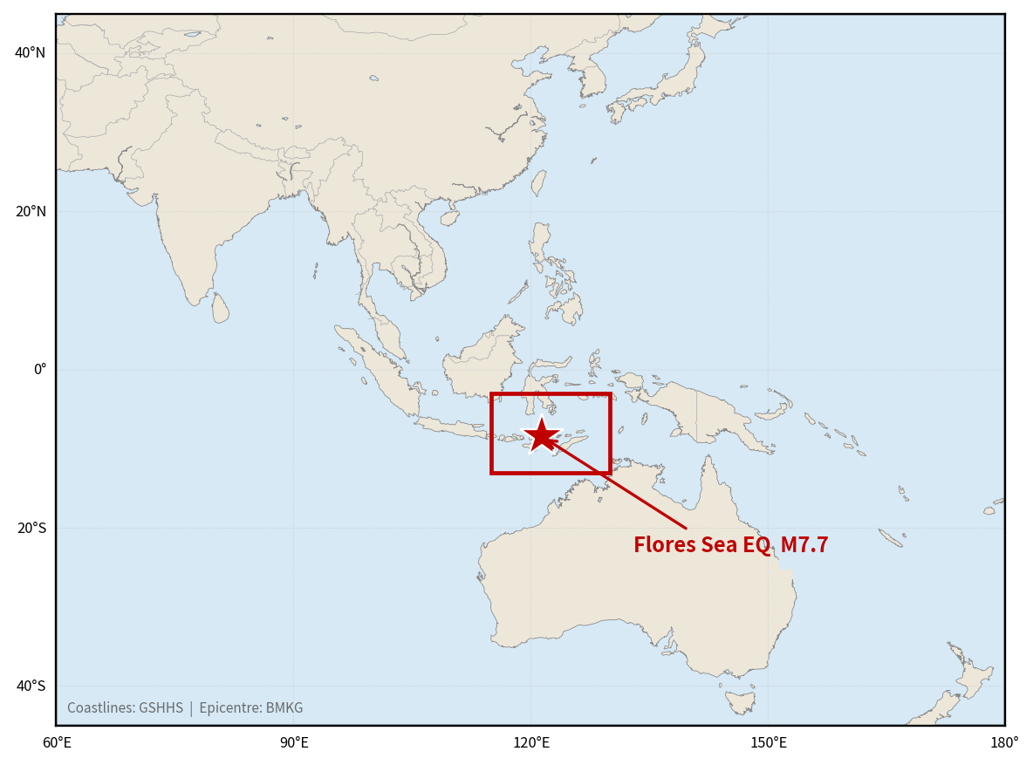
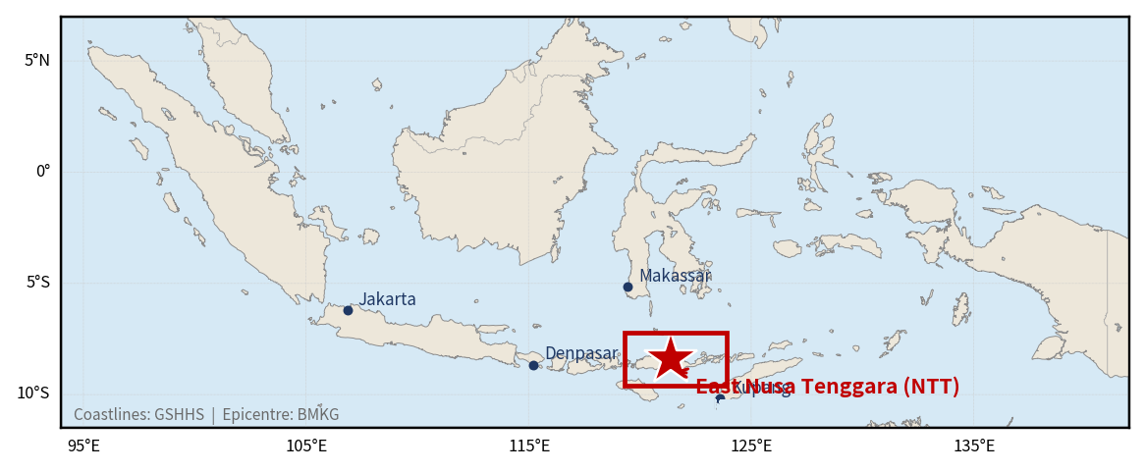
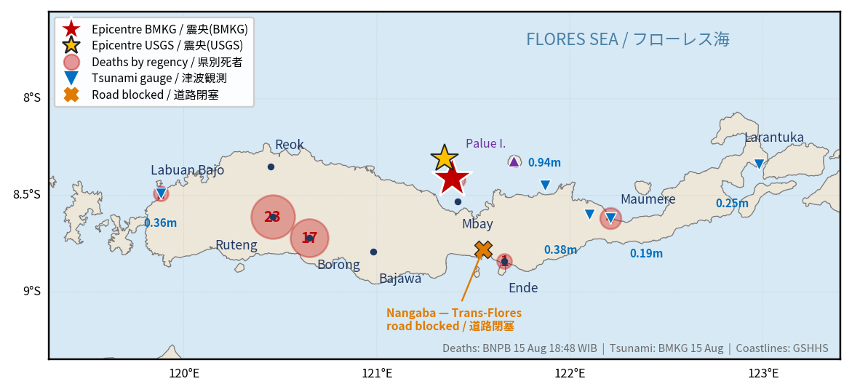
2026 East Nusa Tenggara Earthquake (Indonesia)
(GLIDE No. EQ-2026-000150-IDN)
M7.7 · Offshore Nagekeo Regency, about 30 km northeast of Mbay, Flores Island, East Nusa Tenggara
① World
② Indonesia
③ Flores, NTT
© BMKG / GSHHS
© BMKG / GSHHS
© BNPB / BMKG
Overview A magnitude 7.7 earthquake struck offshore Nagekeo Regency, East Nusa Tenggara, at 04:58 WIB on 15 August 2026, about 30 km northeast of Mbay on Flores Island. BMKG issued a tsunami warning for several coastal areas and lifted it at 07:31 WIB. Seven regencies were affected: West Manggarai, Manggarai, East Manggarai, Ngada, Nagekeo, Ende and Sikka. BNPB reported 105 deaths, 1,678 injured or ill, 179,037 displaced and 81,436 houses affected as of 26 August; the AHA Centre's ASEAN Weekly Disaster Update subsequently cited BNPB figures of 120 deaths, 1,658 injured and about 188,673 displaced as of 09:00 WIB on 31 August. The toll rose steadily as access improved: 47 deaths on 16 August, 69 on 18 August, 100 on 24 August, 105 on 26 August and 120 on 31 August. ADRC requested both Sentinel Asia and the International Charter on the day of the earthquake on behalf of BRIN.
Sources: BMKG · BNPB (via ReliefWeb) · USGS
ADRC 04/09/2026

Slide 2
Chronology of Response (15-31 August 2026 (Western Indonesian Time, UTC+7)) (1/2)
Government and agency actions from the earthquake - all official sources. Times follow BNPB's own reporting in WIB (UTC+7) unless stated
Time | Action | Source
15 Aug | Sentinel Asia emergency observation is activated for the Flores region earthquake at the request of the National Research and Innovation Agency (BRIN); the record notes escalation to the International Charter and carries GLIDE EQ-2026-000150-IDN. | Sentinel Asia
15 Aug 04:58 | A magnitude 7.7 earthquake strikes offshore Nagekeo Regency, East Nusa Tenggara, about 30 km northeast of Mbay on Flores Island. USGS gives Mww 7.7 at 10 km depth (14 Aug 21:58 UTC); BMKG reports 15 km. | BMKG / USGS
15 Aug 05:28 | An M6.1 aftershock is located in the same area, 30 minutes after the main shock. | USGS
15 Aug 07:31 | BMKG lifts the tsunami warning at 07:31 WIB. Tide gauges around the Flores Sea recorded maximum wave heights between 0.30 m and 1.61 m, with arrival times of 10 to 60 minutes. | BMKG
15 Aug 08:00 | BNPB first report: 2 deaths at Laurentius Say Port, Maumere. | BNPB
15 Aug 13:54 | The International Charter Space and Major Disasters is activated as #1050 (13:54 UTC+09:00), with ADRC recorded as the requestor on behalf of BRIN. Project management is assigned to BRIN. | International Charter
15 Aug 18:48 | BNPB reports 47 deaths. Landslides sever the Trans-Flores highway and Nagekeo Regency is isolated. | BNPB
16 Aug 00:00 | BNPB reports 47 deaths and 101 injuries, with more than 5,000 people displaced and 1,357 houses damaged (914 severely). | BNPB
17 Aug | BMKG has recorded 341 aftershocks of M2.5-6.2. The displaced figure is revised to 9,290. | BMKG / BNPB
17 Aug 08:46 | An Mw 5.5 aftershock kills two people in Ngada Regency, one of them in a landslide (times in WITA, WIB+1h). | BMKG / BNPB
18 Aug | The toll reaches 69 deaths and 1,199 injured, with 46,252 displaced and 11,213 houses damaged. 283 educational, 211 health and 97 government facilities are affected. | BNPB / IFRC-PMI
20 Aug 06:45 | An Mw 5.8 aftershock; one death at Ruteng hospital is reported in association with it (WITA). | BMKG / BNPB
22 Aug | Sentinel-1 SLC coherence analyses (VH and VV polarisation) are delivered under the Charter activation. | Int'l Charter / BRIN
Sources: BNPB (via ReliefWeb) · USGS · International Charter
2 / 21
ADRC 04/09/2026

Slide 3
Chronology of Response (15-31 August 2026 (Western Indonesian Time, UTC+7)) (2/2)
Government and agency actions from the earthquake - all official sources. Times follow BNPB's own reporting in WIB (UTC+7) unless stated
Time | Action | Source
23 Aug 05:00 | BMKG has recorded 5,688 aftershocks. | BMKG
24 Aug 09:00 | BNPB reports 100 deaths, 1,603 injured or ill and 180,327 displaced, with 73,818 houses damaged, 1,378 educational facilities, 118 health facilities, 504 government offices and 396 places of worship affected. | BNPB
25 Aug | A line-of-sight displacement analysis of the Flores earthquake is delivered. | Int'l Charter
26 Aug | A SAR-based earthquake damage proxy map is delivered. | Int'l Charter
27 Aug | BNPB deploys assessment teams to all seven affected regencies to accelerate rehabilitation and reconstruction, without waiting for the emergency period to end. | BNPB Pusdatinkom
29 Aug - 12 Sep | NTT Province extends the emergency response period. | Governor of NTT
27-28 Aug | The Indonesian Humanitarian Coordination Platform's multi-stakeholder meeting on 25 Aug and its Situation Report No. 7 (published 28 Aug, citing the BNPB dashboard as of 27 Aug 09:00 WIB) flag continuing gaps in IDP data collection, especially among self-settled displaced people in West Manggarai, and record damage to 118 health facilities, 499 places of worship, 530 office units, 39 other public facilities, 19 irrigation facilities, 128 road points and 71 bridges. | IHCP (MPBI), citing BNPB dashboard
31 Aug 09:00 | The AHA Centre's ASEAN Weekly Disaster Update Week 35 reports that BNPB's emergency response period for the earthquake has been extended to 12 September, and records 120 deaths, 1,658 injured and approximately 188,673 displaced as of 09:00 WIB on 31 August. | AHA Centre (ASEAN), citing BNPB
Sources: BNPB (via ReliefWeb) · USGS · International Charter
3 / 21
ADRC 04/09/2026

Slide 4
Damage Situation (1/6)
Figures reported by BNPB and relayed by IFRC/PMI and humanitarian partners; source and cut-off shown per row. All provisional.
Item | Figure | Source | Tier
Deaths | 120 (BNPB, via AHA Centre, as of 09:00 WIB 31 Aug), up from 105 at the 26 Aug report. BNPB distinguishes 48 deaths caused directly by the earthquake from 57 recorded afterwards through Basarnas SAR operations and health-facility reports, including patients who died in treatment and vulnerable people affected by trauma (26 Aug breakdown). The count rose as access improved: 2 and then 47 on 15 Aug, 68 on 17 Aug, 71 on 19 Aug, 100 on 24 Aug, 105 on 26 Aug, 120 on 31 Aug. The AHA Centre's ASEAN Weekly Disaster Update is the source for the 31 Aug figure; BNPB has not published its own bulletin with this cut-off. | BNPB, via AHA Centre ASEAN Weekly Disaster Update Week 35, 31 Aug 09:00 WIB | Official
Injured / ill | 1,658 (BNPB, via AHA Centre, as of 09:00 WIB 31 Aug), down slightly from 1,678 at the 26 Aug report. Neither BNPB nor the AHA Centre explains the decrease; it may reflect reclassification between the 26 Aug BNPB bulletin and the AHA Centre's own citation rather than a correction to an earlier over-count, but this has not been confirmed. The figure moved 13 (15 Aug) to 213 (17 Aug) to 1,199 (18 Aug, of which 115 serious and 1,084 minor) to 1,603 (24 Aug) to 1,678 (26 Aug) to 1,658 (31 Aug). | BNPB, via AHA Centre ASEAN Weekly Disaster Update Week 35, 31 Aug 09:00 WIB | Official
4 / 21
ADRC 04/09/2026

Slide 5
Damage Situation (2/6)
Figures reported by BNPB and relayed by IFRC/PMI and humanitarian partners; source and cut-off shown per row. All provisional.
Item | Figure | Source | Tier
Displaced | Approximately 188,673 (BNPB, via AHA Centre, as of 09:00 WIB 31 Aug), up from 179,037 at the 26 Aug report. The figure moved about 2,000 (15 Aug) to 9,290 (16 Aug) to 46,252 (18 Aug) to 59,647 (19 Aug) to 180,327 (24 Aug) to 179,037 (26 Aug) to approximately 188,673 (31 Aug). BNPB attributes the very large caseload substantially to fear of continuing aftershocks and to circulating hoaxes predicting a larger earthquake and tsunami, not to housing loss alone. | BNPB, via AHA Centre ASEAN Weekly Disaster Update Week 35, 31 Aug 09:00 WIB | Official
Houses affected | 81,436 houses affected (BNPB, 26 Aug). This is a broader measure than the 24 August data lock of 77,912 damaged houses, which carries the by-regency breakdown. The two must not be used interchangeably; confirm the definitional boundary before external use. | BNPB, 26 Aug | Official
Houses damaged (data lock) | 77,912 (BNPB data lock, 24 Aug): 24,597 destroyed, 18,537 moderately damaged, 34,778 lightly damaged. This is the figure that carries the by-regency breakdown. | BNPB data lock, 24 Aug, via ANTARA | Official
Public facilities (26 Aug) | Education 658 units, health 172 units (19 puskesmas not yet operational; 122 tents deployed), places of worship 172, government offices 187, other public facilities 89 (BNPB, 26 Aug). These differ from the 24 August figures below; BNPB has not published a reconciliation, so both are shown with their dates. | BNPB / Ministry of Health, 26 Aug | Official
5 / 21
ADRC 04/09/2026

Slide 6
Damage Situation (3/6)
Figures reported by BNPB and relayed by IFRC/PMI and humanitarian partners; source and cut-off shown per row. All provisional.
Item | Figure | Source | Tier
Public facilities (27 Aug, BNPB dashboard via IHCP) | Health 118 units, places of worship 499, office units 530, other public facilities 39, irrigation facilities 19, road points 128 and bridges 71 damaged, as of 27 Aug 09:00 WIB (BNPB dashboard, cited by the Indonesian Humanitarian Coordination Platform / MPBI). The health-facility count matches the 24 Aug figure below; the places-of-worship and office counts are far higher than either the 24 Aug or 26 Aug figures above. BNPB has not published a reconciliation across these three counts, so all are shown with their dates rather than replacing one another. | BNPB dashboard, via Indonesian Humanitarian Coordination Platform (MPBI) Situation Report No. 7, 27 Aug | Official
Infrastructure | Power and telecommunications restored to 100% (Telkomsel had reached 85% by 17 Aug). All road sections closed by landslides, including the Trans-Flores highway at Nangaba, are functionally passable again. No bridge severely damaged; some approaches affected by landslides. Five airports and two seaports were affected on 15 Aug and the Maumere port passenger terminal collapsed; logistics now move by air and sea. | BNPB / ANTARA / Beritasatu, 26 Aug | Official
Emergency response period | NTT Province extended the emergency response period to 12 September 2026. It was reported as a 14-day extension, but 29 August to 12 September inclusive is 15 days, so the stated end date and duration do not fully agree. | Governor Melki Laka Lena, 27 Aug | Official
Public facilities (24 Aug) | 1,378 educational facilities, 118 health facilities, 504 government offices and 396 places of worship damaged (BNPB, 24 Aug). On 18 August the figures were 283 educational, 211 health, 97 government, 96 places of worship and 106 business premises. | BNPB, 24 Aug | Official
6 / 21
ADRC 04/09/2026

Slide 7
Damage Situation (4/6)
Figures reported by BNPB and relayed by IFRC/PMI and humanitarian partners; source and cut-off shown per row. All provisional.
Item | Figure | Source | Tier
Affected regencies | Seven regencies in East Nusa Tenggara: West Manggarai, Manggarai, East Manggarai, Ngada, Nagekeo, Ende and Sikka. Displacement was also reported in Bima Regency, West Nusa Tenggara (71 people on 18 Aug) and in the Selayar Islands. | BNPB / IFRC-PMI | Official
Tsunami | Warning issued with the 05:09:54 WIB bulletin and lifted at 07:30 WIB. Seven BMKG tide gauges recorded 0.14-0.94 m: Maurole (Ende) 0.94, Kuwapante Port 0.38, Labuan Bajo 0.36, East Flores 0.25, Sikka 0.19, Dompu 0.17, Bakalan (Alor) 0.14. BNPB's aerial assessment characterised the tsunami impact as minor and no tsunami deaths have been reported. Some secondary compilations cite a maximum run-up of 1.61 m, which exceeds every BMKG gauge value and is not used here as a primary figure. | BMKG, 15 Aug (7 tide gauges); BNPB aerial assessment | Official
Aftershocks | BMKG recorded 341 aftershocks of magnitude 2.5 to 6.2 by 17 August, including M6.1 and M5.9 events. USGS separately located an M6.1 at 22:28 UTC on 14 August, 30 minutes after the main shock. Thousands of aftershocks have continued, discouraging families from returning to damaged homes. | BMKG, 17 Aug / USGS | Official
PAGER / USGS PAGER | Yellow alert for both estimated fatalities and estimated economic losses. Maximum estimated shaking MMI VIII; 51 felt reports. | USGS PAGER, last updated 17 Aug 21:56 UTC | Official
7 / 21
ADRC 04/09/2026

Slide 8
Damage Situation (5/6)
Figures reported by BNPB and relayed by IFRC/PMI and humanitarian partners; source and cut-off shown per row. All provisional.
Item | Figure | Source | Tier
Access | The Larantuka-Maumere road is passable; the Ende-Nagekeo road was cut. Damaged roads, power outages and communication disruptions have hampered assessment and relief. Access along major routes has since improved, but remote villages and island communities remain logistically constrained. Existing dry-season and El Nino water shortages compound the situation. | IFRC & PMI, 16-24 Aug | Official
For comparison - 1992 | The 12 December 1992 Flores earthquake was also M7.7, at 28 km depth, and caused more than 2,500 fatalities according to BNPB. The 2026 event has a comparable magnitude at shallower depth. | BNPB, cited in DG ECHO / ERCC daily map, 18 Aug | Official
GDACS | GDACS issued a red alert for this earthquake. | GDACS, via DG ECHO / ERCC daily map | Official
8 / 21
ADRC 04/09/2026

Slide 9
Damage Situation (6/6)
Figures reported by BNPB and relayed by IFRC/PMI and humanitarian partners; source and cut-off shown per row. All provisional.
Item | Figure | Source | Tier
Health facilities damaged (hospitals / community health centres) | 9 hospitals and 68 community health centres (puskesmas) damaged, as of 30 Aug (Gender Alert #1, jointly issued by Indonesia's Ministry of Women's Empowerment and Child Protection, the Indonesia Humanitarian Coordination Platform, UNFPA and UN Women, published 2 Sep). This is a hospital/puskesmas breakdown not previously published; it sits alongside, and has not been reconciled with, the BNPB 26 Aug figure of 172 health units damaged (including 19 puskesmas not yet operational). | UN Women / UNFPA, Gender Alert #1, 2 Sep 2026 (data as of 30 Aug) | Official
Protection needs of women and girls | Gender Alert #1 identifies heightened protection risks for women and girls in displacement settings - gender-based violence, limited access to maternal and reproductive health services, and gaps in safe and inclusive evacuation facilities - and calls for gender-responsive assistance, disaggregated data collection, GBV coordination and survivor-centred services, and gender- and disability-inclusive WASH, shelter and evacuation facilities. | UN Women / UNFPA, Gender Alert #1, 2 Sep 2026 | Media
9 / 21
ADRC 04/09/2026

Slide 10
Response & Support - Domestic
[Official] The Indonesian Red Cross (PMI) is responding alongside IFRC under DREF operation MDRID029. Priority needs are emergency shelter, safe water and sanitation, healthcare, essential household items, protection and psychosocial support.
10 / 21
ADRC 04/09/2026

Slide 11
Response & Support - International
[Official] ADRC requested both Sentinel Asia and the International Charter Space and Major Disasters on the day of the earthquake, on behalf of Indonesia's National Research and Innovation Agency (BRIN). The Charter records the requestor as "ADRC on behalf of BRIN" - Activation #1050, 15 August, 13:54 UTC+09:00.
[Official] Value adding was contributed by Masahiko Nagai (Yamaguchi University) and Yenni Vetrita (BRIN). Four products were delivered: Sentinel-1 SLC coherence analyses in VH and VV polarisation (22 August), a line-of-sight displacement analysis (25 August) and a SAR-based earthquake damage proxy map (26 August).
[Official] IFRC opened a DREF operation (MDRID029) for the Flores earthquake response. Caritas Indonesia and CARE Indonesia are also responding; CARE reported distributing 15,000 litres of clean water.
Sources: Sentinel Asia — https://sentinel-asia.org/EO/2026/article20260815ID.html
11 / 21
ADRC 04/09/2026

Slide 12
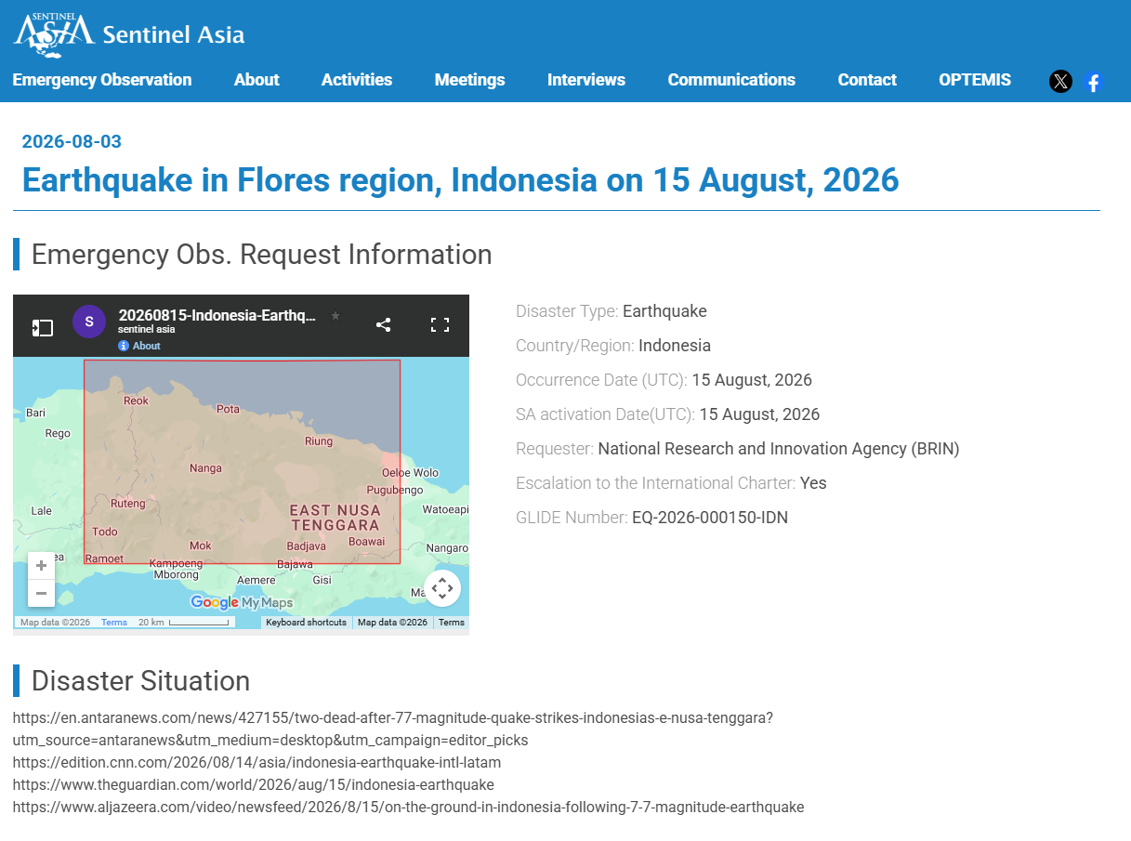
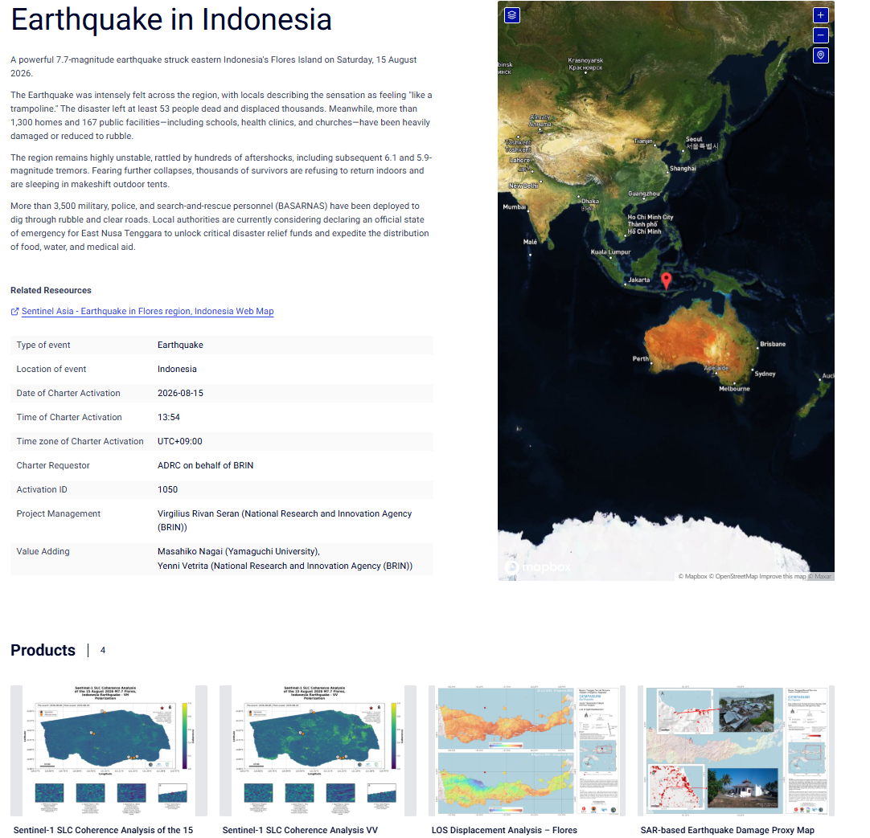
International Activation Pages (requested by ADRC on behalf of BRIN)
Sentinel Asia - Earthquake in Flores region, Indonesia (requested by BRIN)
https://sentinel-asia.org/EO/2026/article20260815ID.html
International Charter - Earthquake in Indonesia, Activation #1050
https://disasterscharter.org/activations/earthquake-in-indonesia-activation-1050-
Sources: Sentinel Asia — https://sentinel-asia.org/EO/2026/article20260815ID.html
12 / 21
ADRC 04/09/2026

Slide 13
Observation Bodies & Products
All bodies contributing observations or value-added products; source tier shown per row
Body | Contribution | Status | Tier
Sentinel Asia | Emergency observation request for the Flores region earthquake, requested by BRIN and activated on the day of the event. The record notes escalation to the International Charter and carries GLIDE EQ-2026-000150-IDN. ADRC (M. Sugiura) formally ended the EOR (SA-00656) on 31 Aug 2026, 23:45 JST. | Activated 15 Aug, ended by ADRC 31 Aug | Official
International Charter | Requestor recorded as "ADRC on behalf of BRIN". Project management: Virgilius Rivan Seran (BRIN). Value adding: Masahiko Nagai (Yamaguchi University) and Yenni Vetrita (BRIN). Four products delivered between 22 and 26 August. | Activated #1050 (15 Aug, 13:54 UTC+09:00) | Official
JAXA (via RESTEC) | ALOS-2/4 archive and observation images. Archive observations of 30 May 2020 (L1.1, f3780/f3790, SB6) and 6 March 2021 (L1.1, f3780/f3790, SB7). | Uploaded 24 Aug | Official
GIC-AIT | A value-added product produced using Sentinel-1 data observed on 20, 21 and 23 August 2026. | Uploaded 26 Aug | Official
KGS (Kazakhstan) | Two KazEOSAT-1 observation images, both observed on 23 August 2026 at 02:01 and 02:02 UTC. | Uploaded 27 Aug | Official
Sources: Sentinel Asia · International Charter
13 / 21
ADRC 04/09/2026

Slide 14
Observations & Points to Watch
[Official] The sequence has been unusually productive: 7,259 events to 25 August, against 265 in the first ten hours. The largest aftershock was M6.2 and no event exceeded the mainshock.
[Official] Aftershocks are distributed along the north coast of Flores - Aesesa, Riung, Kota Ambai, Manggarai and Ruteng - consistent with an E-W striking rupture on the Flores Back-Arc Thrust.
[Official] The first-day totals understated the final picture by one to two orders of magnitude: deaths 2 to 105, evacuees about 2,000 to 179,037, injuries 13 to 1,678. This is characteristic of a shallow event that severs road and telecom access to the worst-hit districts.
[Official] BNPB attributes the very large displacement caseload substantially to fear of continuing aftershocks and to hoaxes predicting a larger earthquake, not to housing loss alone. Government and partners are running counter-messaging.
[TBC] Rupture length, slip distribution and a finite-fault model had not been published in accessible sources at the time of writing. Figures remain provisional; BNPB collects data in stages from hamlet level upward and the by-name-by-address survey is still running.
14 / 21
ADRC 04/09/2026

Slide 15
Housing Damage by Regency
BNPB data lock, 24 August 2026. Manggarai Timur and Manggarai together account for 46% of all damaged houses and 54% of houses destroyed.
Regency | Destroyed | Moderate | Light | Total
Manggarai Timur | 6,833 | 4,996 | 6,973 | 18,802
Manggarai | 6,360 | 5,196 | 5,552 | 17,108
Manggarai Barat | 3,732 | 2,014 | 5,067 | 10,813
Nagekeo | 3,218 | 1,598 | 4,828 | 9,644
Ngada | 2,256 | 2,116 | 5,190 | 9,562
Ende | 1,208 | 1,725 | 4,547 | 7,480
Sikka | 990 | 892 | 2,621 | 4,503
Total | 24,597 | 18,537 | 34,778 | 77,912
Nagekeo - nearest the epicentre and cut off in the first days - ranks fourth by total damage and third by overall impact in BNPB's assessment, which is consistent with its early absence from national tallies having been a reporting lag rather than an absence of damage. That reading is an ADRC inference, not an official finding.
Sources: BNPB data lock 24 Aug 2026 (via ANTARA) — https://www.antaranews.com/berita/5713387/bnpb-percepat-rehab-rekon-rumah-rusak-karena-gempa-di-flores-ntt
15 / 21
ADRC 04/09/2026

Slide 16
Response - Central Government
Actor | Action
President | Prabowo Subianto visited Nagekeo and the Maumere evacuation posts on 26 August, chairing a response meeting on site. Earlier he ordered 50,000 relief packages (275 t).
National command | Posko Pengendalian Nasional activated from day one. Tiered task forces (Satgas): regency level led by each bupati, provincial level by the governor, and a central government mentoring task force.
Forward posts | Two forward posts split the seven regencies: Labuan Bajo covers Manggarai Barat, Manggarai, Manggarai Timur and Nagekeo; Maumere covers Sikka, Ende and Ngada.
Line ministries | Ministry of Health field hospital designed to remain safe during aftershocks; Ministry of Energy generators; Ministry of Higher Education waived tuition for 5,000 affected students; Ministry of Religious Affairs strengthened its response.
Logistics | Citilink carried 91.5 t of relief cargo; Baznas and other bodies are operating public kitchens.
Sources: ANTARA — https://www.antaranews.com/video/5712568/presiden-tinjau-penanganan-dampak-gempa-bumi-di-nagekeo-ntt
16 / 21
ADRC 04/09/2026

Slide 17
Recovery and Reconstruction
The response has entered rehabilitation and reconstruction while the emergency period still runs to 12 September 2026.
Workstream | Content
Assessment teams | BNPB deployed teams to all seven affected regencies to accelerate rehabilitation and reconstruction of damaged housing.
Not waiting for the emergency phase to end | Assessment preparation and damage-grading standardisation proceed in parallel with the emergency response period.
By name by address | Technical guidance delivered to local government agencies (OPD) and hundreds of volunteer enumerators, beginning in Manggarai Barat and Manggarai, to produce name-and-address level data.
Build back better | Reconstruction is to follow build back better principles so that rebuilt housing is more resilient, based on objective and auditable data.
Housing repair funding | The government is preparing repair funding for affected households. Per-household rates and the total budget had not been published.
Sources: BNPB (Pusdatinkom, 27 Aug 2026) via ANTARA — https://www.antaranews.com/berita/5713387/bnpb-percepat-rehab-rekon-rumah-rusak-karena-gempa-di-flores-ntt
17 / 21
ADRC 04/09/2026

Slide 18
Items to Confirm in the Next Cycle
Item | Detail | Priority
Reconciling the two house figures | 81,436 'affected' (26 Aug) versus 77,912 'damaged' (24 Aug data lock). Confirm the definitional boundary before external use. | High
Public-facility counts | The 24 August and 26 August BNPB figures differ substantially (education 1,378 vs 658). Identify which measure each uses. | High
Final death toll composition | The 48 direct / 57 subsequent split will likely be revised as health-facility and SAR records are reconciled. | Med
Maximum tsunami run-up | Secondary compilations cite 1.61 m against a maximum BMKG gauge value of 0.94 m. Identify the basis before citing. | Med
USGS PAGER revision | Confirm whether the alert level was revised upward after the toll reached 105. | Med
Emergency period after 12 September | Confirm whether the period is extended again or transitions formally to recovery. | Med
Displacement drivers | BNPB attributes much of the 179,037 caseload to fear and hoaxes rather than housing loss; the shelter caseload may fall quickly once aftershocks subside. | Med
Lewotobi Laki-laki eruption | Flores Timur is outside the earthquake-affected area but under volcanic response; watch for compounding demands on NTT provincial capacity. | Low
Sources: ADRC compilation — https://reliefweb.int/disaster/eq-2026-000150-idn
18 / 21
ADRC 04/09/2026

Slide 19
Useful Links & Sources (1/3)
Source policy:
Source | Tier | URL
ReliefWeb - Indonesia: Earthquake, Aug 2026 (GLIDE EQ-2026-000150-IDN) | Official | https://reliefweb.int/disaster/eq-2026-000150-idn
USGS - M 7.7, 68 km NNW of Ende, Indonesia | Official | https://earthquake.usgs.gov/earthquakes/eventpage/us6000tkt2
International Charter - Earthquake in Indonesia, Activation #1050 | Official | https://disasterscharter.org/activations/earthquake-in-indonesia-activation-1050-
ERCC / DG ECHO daily map - Indonesia 7.7 M earthquake and tsunami (18 Aug 2026) | Official | https://reliefweb.int/map/indonesia/indonesia-77-m-earthquake-and-tsunami-14-august-dg-echo-daily-map-18082026
Sentinel Asia - Earthquake in Flores region, Indonesia | Official | https://sentinel-asia.org/EO/2026/article20260815ID.html
Field Report Update 3: M7.7 East Nusa Tenggara Earthquake (24 Aug 2026) | Official | https://reliefweb.int/report/indonesia/idn-earthquake-08-2026-field-report-update-3-m77-east-nusa-tenggara-earthquake-4-2026-08-24
BMKG - Meteorology, Climatology and Geophysical Agency | Official | https://www.bmkg.go.id/
AHA Centre - Flash Update No.1 (15 Aug 2026) | Official | https://ahacentre.org/flash-update/flash-update-no-1-m7-7-earthquake-in-east-nusa-tenggara-indonesia-15-august-2026/
AHA Centre - Weekly Disaster Update 17-23 Aug 2026 | Official | https://ahacentre.org/weekly-disaster-update/weekly-disaster-update-17-23-august-2026/
ReliefWeb - Situation Report No. 6 (25 Aug 2026) | Official | https://reliefweb.int/report/indonesia/indonesian-humanitarian-coordination-platform-situation-report-no-6-earthquake-and-tsunami-flores-and-surrounding-areas-25-august-2026
19 / 21
ADRC 04/09/2026

Slide 20
Useful Links & Sources (2/3)
Source | Tier | URL
BNPB - news index | Official | https://www.bnpb.go.id/berita
ANTARA - BNPB accelerates rehabilitation; house damage by regency (27 Aug) | Official | https://www.antaranews.com/berita/5713387/bnpb-percepat-rehab-rekon-rumah-rusak-karena-gempa-di-flores-ntt
ANTARA - power and telecommunications 100% restored | Official | https://www.antaranews.com/berita/5709283/bnpb-listrik-dan-sinyal-di-flores-pulih-100-persen-pascagempa
Harian Jogja - BNPB: 105 deaths, 179,037 evacuees, 81,436 houses (27 Aug) | Media | https://news.harianjogja.com/r-1268934/update-gempa-flores-105-orang-meninggal-dan-81436-rumah-terdampak
Harian Jogja - 19 puskesmas not yet recovered, 122 tents | Media | https://news.harianjogja.com/r-1268964/gempa-flores-19-puskesmas-belum-pulih-dan-122-tenda-disiapkan
Haluan NTT - emergency period extended to 12 September 2026 | Official | https://haluanntt.com/2026/08/27/pemprov-ntt-perpanjang-tanggap-darurat-gempa-flores-hingga-12-september-2026/
BMKG - press release on recovery cooperation | Official | https://www.bmkg.go.id/siaran-pers/bmkg-pemerintah-pusat-dan-pemerintah-daerah-kolaborasi-percepat-pemulihan-bencana-gempa-flores
AHA Centre - Flash Update No.1 (17 Aug 2026, day-1 data, superseded) | Official | https://reliefweb.int/report/indonesia/flash-update-no-1-m77-earthquake-east-nusa-tenggara-indonesia-15-august-2026
OCHA Asia-Pacific El Nino / Middle East snapshot, 28 Aug 2026 (regional, not earthquake-specific) | Official | https://reliefweb.int/report/indonesia/asia-and-pacific-snapshot-el-nino-middle-east-crisis-28-august-2026
Caritas Indonesia - community support update | Media | https://reliefweb.int/report/indonesia/caritas-indonesia-stands-communities-affected-earthquake
CARE Indonesia - 15,000 litres clean water distribution | Media | https://reliefweb.int/report/indonesia/care-indonesia-distributes-15000-litres-clean-water-earthquake-survivors
20 / 21
ADRC 04/09/2026

Slide 21
Useful Links & Sources (3/3)
Source | Tier | URL
AHA Centre - ASEAN Weekly Disaster Update, week 33 (10-16 Aug 2026) | Official | https://reliefweb.int/report/indonesia/asean-weekly-disaster-update-week-33-10-16-august-2026
IOM - Rohingya refugee response flash appeal (unrelated crisis) | Official | https://reliefweb.int/report/indonesia/iom-flash-appeal-rohingya-refugee-response-january-december-2026
IHCP (MPBI) - Situation Report No. 7 (28 Aug 2026, BNPB dashboard as of 27 Aug) | Official | https://reliefweb.int/report/indonesia/indonesian-humanitarian-coordination-platform-situation-report-no-7-earthquake-and-tsunami-flores-and-surrounding-areas-28-august-2026
AHA Centre - ASEAN Weekly Disaster Update, week 35 (24-30 Aug 2026) | Official | https://reliefweb.int/report/indonesia/asean-weekly-disaster-update-week-35-24-30-august-2026
Gender Alert #1 - Protection needs of women and girls, Flores earthquake (2 Sep 2026) | Official | https://reliefweb.int/report/indonesia/gender-alert-1-critical-protection-needs-women-and-girls-following-flores-earthquake-indonesia
Gender Alert #1 - Anticipating the impact of El Niño 2026 (Indonesia, national) | Media | https://reliefweb.int/report/indonesia/gender-alert-1-anticipating-impact-el-nino-2026-women-girls-and-vulnerable-groups-indonesia
Indonesia | Anak Krakatau volcanic eruption - DG ECHO Daily Map (07/09/2026) | Media | https://reliefweb.int/map/indonesia/indonesia-anak-krakatau-volcanic-eruption-dg-echo-daily-map-07092026
Indonesia: Wildfire haze threatens children across SE Asia and closes schools (Save the Children) | Media | https://reliefweb.int/report/indonesia/indonesia-wildfire-haze-threatens-children-across-se-asia-and-closes-schools
Indonesia: Wildfire haze threatens children across SE Asia and closes schools (duplicate ReliefWeb listing) | Media | https://reliefweb.int/report/indonesia/indonesia-wildfire-haze-threatens-children-across-se-asia-and-closes-schools-save-children
AHA Centre - ASEAN Weekly Disaster Update Week 36 (31 Aug - 6 Sep 2026) | Official | https://reliefweb.int/report/philippines/asean-weekly-disaster-update-week-36-31-august-6-september-2026
21 / 21
ADRC 04/09/2026

