Slide 1

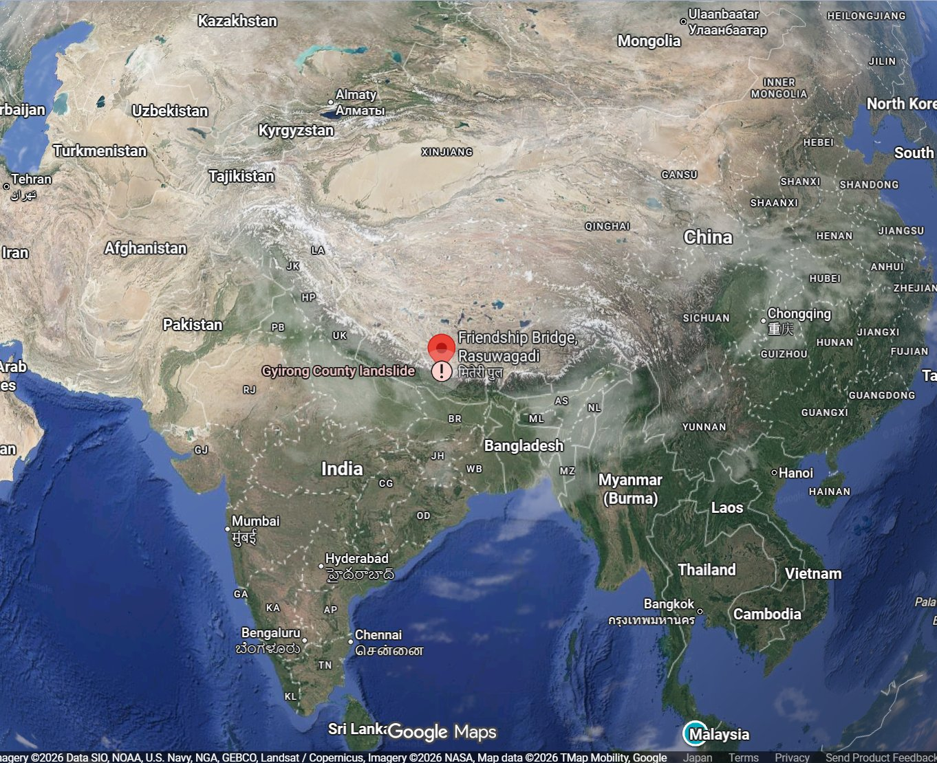
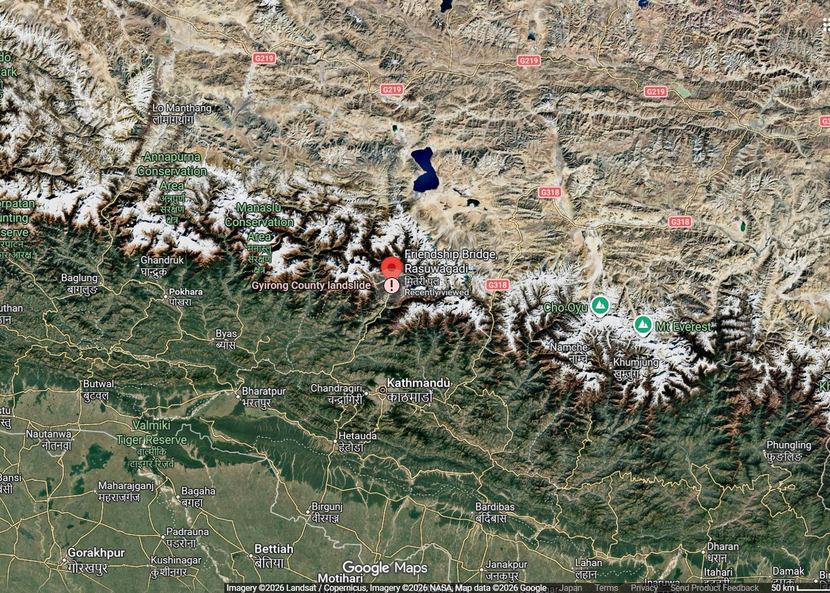
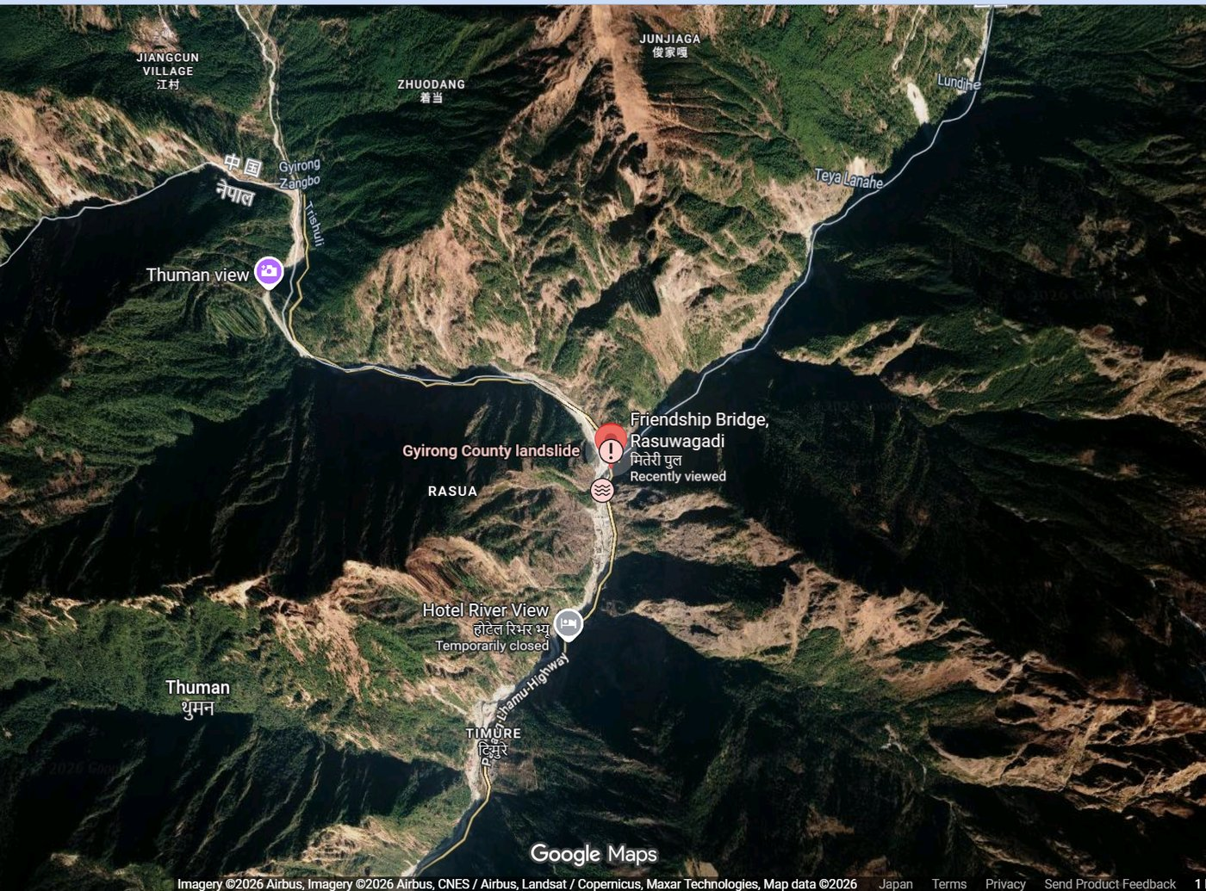
2026 Bhote Koshi Debris Flow and Flash Flood (Nepal)
(GLIDE No. FF-2026-000162-NPL)
· Source area around Deding in the Langtang region; the flood ran down the Bhote Koshi-Trishuli corridor
① World → Nepal
② Nepal → Rasuwa District
③ Bhote Koshi valley (Timure)
© Google
© Google
© Google
Overview At about 08:30-08:37 NPT on 26 August 2026 a temporary natural dam on the Bhote Koshi, formed the previous afternoon by an ice, rock and soil mass failure around Deding in the Langtang region, breached and released a debris-laden flood down the Bhote Koshi-Trishuli corridor. The flood reached Rasuwagadhi at about 09:00, Timure at about 09:15 and Betrawati at about 09:20. The steep, narrow valley kept the flow concentrated and fast, and the heavy load of ice, rock and sediment made it far more destructive than its water volume alone. Rasuwa, Nuwakot, Dhading and Chitwan Districts were affected. More than 32 bridges were washed away along the 42 km Betrawati-Rasuwagadhi corridor, the Timure and Rasuwagadhi customs facilities and Nepal-China border trade were severely damaged, and about 748 MW of hydropower capacity was affected. ADRC activated Sentinel Asia and the International Charter on the day of the event at the request of the Department of Hydrology and Meteorology.
Sources: Google Maps © Google · UNOSAT · BIPAD Portal, Ministry of Home Affairs, Nepal
ADRC 12/09/2026

Slide 2
Chronology of Response (25 August - 12 September 2026 (Nepal Standard Time, UTC+5:45)) (1/11)
Government and agency actions from the onset of the flood - all official sources. All times are Nepal Standard Time (NPT, UTC+5:45) unless stated
Time | Action | Source
25 Aug 13:00-14:00 | An ice, rock and soil mass detaches at about 5,000 m around Deding in the Langtang region and descends to the river at about 3,000 m, fracturing and mixing with soil and debris on the way. | IRDR (28 Aug)
25 Aug afternoon | The mass blocks the Bhote Koshi and forms a temporary natural dam. Water accumulates behind it for about 18-19 hours. Inflow from the Mala River and other tributaries keeps the downstream channel flowing, masking the blockage. | IRDR (28 Aug)
26 Aug 08:30-08:37 | The temporary dam breaches, releasing water, ice, rock, soil and sediment. An M4.4 seismic signal is recorded at about 08:37 and residents report a massive roar. | IRDR (28 Aug)
26 Aug 09:15 | The flood reaches Timure at about 09:15 and Betrawati at about 09:20. The short travel times show exceptionally rapid movement through the narrow upper valley. | IRDR (28 Aug)
26 Aug 08:37 | USGS logs a magnitude 4.4 signal, later revised to 5.2. IRDR reads this as ground vibration from the sudden dam breach rather than a tectonic earthquake. | USGS / IRDR
26 Aug 09:00 | A sudden surge of water enters the Bhote Koshi River from the Tibet Autonomous Region of China. Timure, Syabrubesi, the Rasuwagadhi customs and border crossing and roughly a dozen riverside settlements in northern Rasuwa take the earliest and heaviest impact. | DHM / NDRRMA
26 Aug 11:00 | Nepal's NDRRMA requests rapid satellite imagery. ADRC receives the request and activates Sentinel Asia (emergency observation request SA-00658, requester: Department of Hydrology and Meteorology). | ADRC / Sentinel Asia
26 Aug 11:45 | A second glacial-collapse signal, magnitude 4.2, is recorded at the same location (event us7000tc90). | USGS
26 Aug 12:30 | UNOCHA's Bangkok office supplies two areas of interest for imagery tasking - the Syabrubesi area and the Timure area - which ADRC merges into the Sentinel Asia request. | UNOCHA / JAXA
26 Aug 18:43 | The International Charter Space and Major Disasters is activated as #1052, with ADRC recorded as the requestor on behalf of the Department of Hydrology and Meteorology (14:58 UTC+02:00). Project management is assigned to UNITAR. | International Charter
Sources: NDRRMA · UNOSAT · Sentinel Asia
2 / 46
ADRC 12/09/2026

Slide 3
Chronology of Response (25 August - 12 September 2026 (Nepal Standard Time, UTC+5:45)) (2/11)
Government and agency actions from the onset of the flood - all official sources. All times are Nepal Standard Time (NPT, UTC+5:45) unless stated
Time | Action | Source
26 Aug evening | First official tolls diverge: 72 deaths (NDRRMA) and 95 (Prime Minister's Office). By late evening about 160 are reported, with 157 bodies recovered. | NDRRMA / PMO
27 Aug 08:15 | A Nepal Police bulletin lists 826 people missing in Nepal alone: 579 travellers (466 foreign nationals, 113 Nepalis), 85 security personnel, 161 residents of Rasuwa and one of Nuwakot. | Nepal Police
27 Aug morning | The confirmed toll is put at 165 dead and 73 injured, superseding the previous evening's figures. | NDRRMA / Nepal Police
27 Aug | IFRC launches a CHF 25 million Emergency Appeal for 24 months, one day after releasing nearly CHF 1 million in emergency funding to the Nepal Red Cross Society. Around 93,000 people may have been affected. | IFRC
27 Aug | UNICEF appeals for US$17.2 million, reporting at least 17,000 children impacted across Rasuwa, Nuwakot and Dhading and at least four health facilities severely damaged. | UNICEF
27 Aug | UNOSAT publishes satellite-detected mudflow/rockflow extent for Rasuwa and Nuwakot districts from Sentinel-2 (27 Aug) and PlanetScope (26 Aug) imagery. | UNOSAT / Int'l Charter
28 Aug | JAXA schedules an ALOS-2 emergency observation. Analyses using Landsat-9 (Rissho University) and a 3D damage map from optical satellites (University of Tokyo) are shared through Sentinel Asia. | JAXA / Sentinel Asia
28 Aug | NEOC reports 539 confirmed dead, 977 missing and 73 injured. 3,742 people have been rescued; 12,249 security personnel and 15 helicopters are mobilised. The Cabinet lifts tax duties on incoming relief items and the One Door policy under which all relief had to be delivered by the government. | NEOC / UN
29 Aug | WFP situation report: 616 deaths and 1,924 people missing or out of contact across Dhading, Nuwakot and Rasuwa. NDRRMA warns of a continuing flood risk from an estimated 0.11 sq km lake formed upstream by the blockage of the Lhende Khola. WFP dispatches 2.8 mt of BP-5 fortified biscuits for up to 5,000 people and receives AUD 2 million (USD 1.4 million) from the Australian Government. | WFP / NDRRMA
Sources: NDRRMA · UNOSAT · Sentinel Asia
3 / 46
ADRC 12/09/2026

Slide 4
Chronology of Response (25 August - 12 September 2026 (Nepal Standard Time, UTC+5:45)) (3/11)
Government and agency actions from the onset of the flood - all official sources. All times are Nepal Standard Time (NPT, UTC+5:45) unless stated
Time | Action | Source
30 Aug | WFP situation report: the death toll rises to approximately 734, with around 242 injured and 2,448 people still reported missing; more than 8,198 people have been rescued to date. Damage to infrastructure continues to hamper access, including approximately 40 km of roads, more than 80 bridges and at least 14 hydropower and energy facilities along the Bhote Koshi-Trishuli corridor. WFP has dispatched 31.8 mt of food assistance and secured approximately USD 5.4 million through Australia, CERF and the United States. | WFP / NDRRMA
31 Aug | OCHA/UN RC Nepal Flash Update #4: NDRRMA's 09:00 bulletin puts the death toll at 903, with 267 injured (156 discharged) and 4,247 still reported missing. 10,451 people have been rescued to date, including 252 foreign nationals and 3,344 Nepalis airlifted by helicopter; 20,819 personnel are mobilised. The Government has allocated NPR 10 million each in emergency funds to Rasuwa and Nuwakot and NPR 0.5 million to Dhading. Joint Nepal-India-China rescue operations continue at the Trishuli 3A, Haku Besi, Trishuli 3B and Chilime hydropower sites. The Mugling-Malekhu section of the Prithvi Highway remains fully blocked by toe-cutting at Krishna Bhir and Parewa Bhir; power has been restored in Dhading and Nuwakot, with work continuing in Rasuwa. | NDRRMA / OCHA-UN RC Nepal
1 Sep | The Republic of Korea decides to dispatch the Korea Disaster Relief Team (KDRT) following a request from the Government of Nepal for support to search and rescue operations. The team of 44 members from the Ministry of Foreign Affairs, KOICA and the National Fire Agency, headed by Lee Kyoo-ho, Director-General for Development Cooperation, departs on the night of 1 September aboard Korean military transport aircraft. Korea had earlier announced USD 1 million in humanitarian assistance through international organizations on 27 August. | Government of the Republic of Korea
1 Sep 09:00 | NDRRMA Situation Report #01: 987 deceased (including recovered human remains) and 3,916 people reported missing across 62 districts. 279 injured have been treated (168 discharged, 79 still under treatment, 29 referred); the Nepal Army has provided medical treatment to 2,740 people. 11,814 people have been rescued in total, of whom 3,702 by helicopter (253 foreign nationals and 3,449 Nepalis) over 573 air operations. 21,011 security personnel are deployed, including teams from Korea, China and India for joint search and rescue at the Trishuli 3A, Haku Besi, Trishuli 3B and Chilime hydropower sites. Five districts are affected - Rasuwa and Nuwakot severely, with approximately 1.6 million people impacted, and Dhading, Gorkha and Chitwan moderately. 41 motorable bridges have been washed away and 4 damaged. | NDRRMA
1 Sep | 3,702 households (14,461 people: 7,453 male, 7,008 female, including 3,650 children and 1,204 older persons) remain isolated in Gosaikunda and Amachhodingmo Rural Municipalities in Rasuwa, with road, electricity and communication services disrupted for up to six days. 30 holding centres accommodate 3,930 people (Nuwakot 19 centres / 2,653 people; Rasuwa 11 centres / 1,277 people). In Nuwakot 1,267 houses are reported fully damaged and 1,253 partially damaged; satellite mapping identifies 4,689 buildings inside the flood-affected zone, which NDRRMA describes as estimated exposure and not verified damage. | NDRRMA
Sources: NDRRMA · UNOSAT · Sentinel Asia
4 / 46
ADRC 12/09/2026

Slide 5
Chronology of Response (25 August - 12 September 2026 (Nepal Standard Time, UTC+5:45)) (4/11)
Government and agency actions from the onset of the flood - all official sources. All times are Nepal Standard Time (NPT, UTC+5:45) unless stated
Time | Action | Source
1 Sep 18:00 | NDRRMA Situation Report #11: 1,050 deaths (by district: Chitwan 321, Nawalparasi East 216, Nawalparasi West 170, Nuwakot 142, Gorkha 65, Dhading 57, Tanahu 38, Rasuwa 41), 3,916 out of contact (unchanged from the day's earlier cuts) and 292 treated for injuries across 16 health facilities (182 discharged, 74 under treatment, 33 referred, 3 died during treatment). 11,993 people rescued to date, including 4,364 by helicopter. 21,314 security personnel mobilised. The Prithvi Highway remains blocked at the Krishnabhir/Parewabhir section (Malekhu-Muglin) by continuing toe-cutting erosion of the road embankment; an alternative route is being sought. Nearly all cell towers in the affected corridor are back in service (Nepal Telecom: all 110 damaged towers restored; Ncell: 75 of 78). Power has been restored via a separate line from the Sanjen hydropower plant to most of Aamachhodingmo Rural Municipality, Rasuwa. Unidentified bodies are being held at 21 hospitals across districts pending identification. | NDRRMA
3 Sep | The Government of Japan decided to dispatch a Japan Disaster Relief (JDR) expert team to support identification of the deceased, in response to a request from the Government of Nepal. No new NDRRMA situation report (beyond #11, 1 Sep 18:00) had been published as of this update; NDRRMA's official casualty figures are unchanged. | Government of Japan
3 Sep | IOM Nepal Flood Response Situation Report #3 (as of 3 Sep): authorities reported 1,259 bodies recovered and 5,053 people missing; 12,038 people rescued in total, including 583 foreign nationals, with more than 21,402 security personnel mobilised. About 84,270 people are estimated affected across 17 municipalities in six districts. In Nuwakot District alone, 1,897 households have been displaced, 1,267 houses completely damaged and 1,253 partially damaged; an estimated 5,384 displaced people are at facilities health partners are assessing. This is the first agency figure to move the death toll and missing count beyond NDRRMA's 1 Sep Situation Report #11 (1,050 deaths, 3,916 missing); no NDRRMA PDF situation report matching this cut-off has been found. | IOM
4 Sep | WFP Nepal Situation Report on the Rasuwa Flood Response (4 Sep): reported fatalities have risen to 1,259, with 5,083 people still missing (both figures again attributed to government/authorities, without a specific NDRRMA report number). WFP has dispatched 85.8 t of food rations for 15 days to Dhading, Nuwakot and Rasuwa, plus 2.8 t of BP-5 and 40 boxes (0.45 t) of fortified biscuits, and has facilitated 101 transport movements (57 supporting Government-led relief, 44 WFP dispatches). Three local governments across the Trishuli River in Rasuwa remain cut off by road. Separately, the Humanitarian Country Team's Nepal: Rasuwa Flood Flash Appeal (OCHA/UN RC Nepal, 4 Sep) reiterates the 84,270-person, 17-municipality, six-district affected estimate (NDRRMA-based) and adds about 19,284 households affected, with all 84,270 targeted for assistance; the appeal frames these as exposure-model estimates to be refined through joint assessment. | WFP
Sources: NDRRMA · UNOSAT · Sentinel Asia
5 / 46
ADRC 12/09/2026

Slide 6
Chronology of Response (25 August - 12 September 2026 (Nepal Standard Time, UTC+5:45)) (5/11)
Government and agency actions from the onset of the flood - all official sources. All times are Nepal Standard Time (NPT, UTC+5:45) unless stated
Time | Action | Source
4 Sep | An EU Humanitarian Aid-supported flight carrying 84 metric tonnes of relief supplies (AWD kits and diagnostic equipment, water tanks, hygiene kits, water treatment supplies, tents, winter clothing kits and learning materials) departed UNICEF's Copenhagen supply hub and landed in Kathmandu. Dozens of trucks subsequently moved the supplies to Rasuwa, Nuwakot and Dhading districts. | UNICEF (reported 11 Sep)
5 Sep | OCHA/UN RC Nepal's Rasuwa Flood Situation Report No. 6 (as of 5 Sep) is the first UN report to attribute the 1,259 deaths / 5,083 out-of-contact / 12,038 rescued figures to a dated NDRRMA cut (3 September, 19:00), rather than an unspecified "government/authorities" source; no NDRRMA PDF for this cut has still been found. The report also gives an updated displacement count: 3,844 displaced people across 34 sites in Nuwakot, Rasuwa, Dhading and Kathmandu (up from OCHA's 1 Sep count of 3,458 across 27 sites in Nuwakot and Rasuwa only). IOM's Displacement Tracking Matrix estimates 4,288 households affected, of which 2,886 were displaced. The Humanitarian Country Team's Flash Appeal seeks US$49.6 million for 84,270 people (19,284 households) in 17 municipalities across six districts, with the largest sector requirements in food security (US$7.94m), WASH (US$7.9m), health (US$7.6m), logistics/emergency telecoms (US$7.33m) and shelter (US$7.1m); the CERF allocation has been recalibrated to US$2.5 million pending the appeal. A WFP-supported UN/partner coordination base is being established in Bidur, Nuwakot. | OCHA / UN RC Nepal
5-6 Sep | WFP made its first humanitarian cargo-drone (UAS) food-assistance delivery to Briddim, Rasuwa - a first for any Nepal emergency operation - complementing helicopter operations to communities cut off by the floods. WFP's own situation report of 10 September dates this to 6 September, while the UN Resident Coordinator's Office Flash Report No. 7 (covering 4-7 September) dates the same first drone flight to 5 September; both figures are kept as reported rather than reconciled to one date. | WFP (Rasuwa Flood Response SitRep, 10 Sep)
6 Sep 11:00 | NDRRMA update as of 11:00, reported by The Rising Nepal (RSS) on 6 September: 1,341 bodies recovered and 4,996 people on the missing list, including 589 foreigners and around 100 security personnel and employees. By district the recovered bodies are Rasuwa 163, Nuwakot 195, Dhading 67, Chitwan 362, Gorkha 74, Tanahu 38, Nawalparasi East 222 and Nawalparasi West 220. 98 bodies have been identified and handed over to families. 13,104 people have been rescued and 6,075 injured have been treated. 3,652 affected people are accommodated at 39 relief camps in Rasuwa, Nuwakot, Dhading and Kathmandu. 21,465 security personnel are mobilised (Nepal Police 7,975, Nepali Army 9,287, Armed Police Force 4,203). Relief has moved from Kathmandu in 83 truckloads, 38 jeeps and 9 helicopter flights, with the Armed Police Force dispatching aid to Rasuwa and Nuwakot in 173 flights. | NDRRMA (The Rising Nepal, RSS)
Sources: NDRRMA · UNOSAT · Sentinel Asia
6 / 46
ADRC 12/09/2026

Slide 7
Chronology of Response (25 August - 12 September 2026 (Nepal Standard Time, UTC+5:45)) (6/11)
Government and agency actions from the onset of the flood - all official sources. All times are Nepal Standard Time (NPT, UTC+5:45) unless stated
Time | Action | Source
6 Sep | A preliminary Rapid Damage and Needs Assessment (RDNA), reported by the Ministry of Foreign Affairs on 5 September and carried by The Rising Nepal on 6 September, indicates about 32,933 people affected and about 7,570 houses damaged or affected. 55 km of roads, 37 motorable bridges and 68 suspension bridges were destroyed; the Department of Roads separately put damage to roads and motorable bridges alone at NPR 20 billion. About 1,806 hectares of agricultural land, 13 hydropower projects, one solar plant and two transmission lines were damaged, with 783 MW of hydropower capacity affected. The full RDNA report is not yet published; NDRRMA says an expert team is finalising it. A comprehensive Post Disaster Needs Assessment (PDNA) is being undertaken in parallel. A 15-member Disaster Assistance and Response Team (DART) from Australia arrived on Friday and an 11-member Special Malaysian Disaster Assistance and Rescue Team (SMART) arrived on Saturday morning. | MoFA / NDRRMA (The Rising Nepal, RSS)
6 Sep | Direct Relief reported that 14 tonnes of requested medical aid (antibiotics, IV fluids, chronic-disease medication, water-purification supplies and PPE) arrived in Kathmandu over the weekend of 5-6 September, with additional supplies arriving on 6 September for distribution in coordination with the Ministry of Health and Population. Partner organisations (One Heart Worldwide, the Shanti Foundation, Mountain Heart Nepal, Dhulikhel Hospital) reported delivering medicines to Trishuli Hospital (Nuwakot) and Jibjibe Primary Hospital and moving oxygen concentrators to Rasuwa, citing more than 40 bridges washed away and the Rasuwa-Nuwakot road link severed. | Direct Relief (NGO announcement)
7 Sep | The Department of Tourism reports 775 people missing since the 26 August flood in a tourist-specific count: 587 foreign nationals from 34 countries and 188 Nepalis (guides, support staff and pilgrims). 307 foreign tourists have been rescued and 7 previously out of contact have been reached. | Department of Tourism (via The Rising Nepal)
7 Sep | The Nepali Army estimates that as many as 121 people could be trapped inside tunnels of flood-damaged hydropower projects and says the search inside the tunnels will continue until a breakthrough is achieved. | Nepali Army (NDRRMA press conference)
7 Sep | Field reporting from Aamachhodingmo Rural Municipality, Rasuwa (203 on the missing list) describes a rural municipality still completely cut off by road 11 days after the flood, reachable only by helicopter, with residents reporting food and salt supplies exhausted. | The Kathmandu Post
7 Sep | Pakistan hands over 100 tonnes of relief assistance to Nepal to support people affected by the floods and landslides. | Government of Pakistan
Sources: NDRRMA · UNOSAT · Sentinel Asia
7 / 46
ADRC 12/09/2026

Slide 8
Chronology of Response (25 August - 12 September 2026 (Nepal Standard Time, UTC+5:45)) (7/11)
Government and agency actions from the onset of the flood - all official sources. All times are Nepal Standard Time (NPT, UTC+5:45) unless stated
Time | Action | Source
9 Sep (arrived 5 Sep) | The Government of the Republic of Korea announced (9 September) that it had dispatched emergency relief supplies worth KRW 130 million - 36,000 emergency thermal blankets and 2,320 medium-thermal blankets - which arrived in Nepal by commercial flight on 5 September, in addition to the USD 1 million in humanitarian assistance announced on 27 August and the KDRT deployment on 1 September. | Government of the Republic of Korea
8 Sep 18:00 | NDRRMA flash update as of 18:00: 1,358 human casualties (bodies recovered) by district - Rasuwa 170, Nuwakot 197, Dhading 70, Gorkha 75, Tanahu 38, Chitwan 363, Nawalparasi East 223, Nawalparasi West 222; 102 bodies handed over to families for burial. Missing persons around 5,326, with the 102 handovers already deducted from the total: missing from Rasuwa 2,860 (district citizens 1,393, citizens of other districts 1,286, Nepal Army 45, Nepal Police 25, Armed Police Force 12, government employees 73, bank/financial-institution employees 26), missing from Nuwakot around 1,981 Nepali citizens (source: District Administration Office, Nuwakot), and around 587 foreign tourists. 7,037 people receiving or having received injury treatment (329 at 10 hospitals, of whom 252 discharged, 43 under treatment and 30 referred elsewhere, plus 4 deaths during treatment; 3,421 treated by the Nepali Army and 3,287 by the Armed Police Force). 13,583 rescued to date, including 1,157 Nepali Army helicopter flights to 7 Sep plus 112 by the Nepali Army and private helicopters that day, 129 private-sector flights from Kathmandu and 210 Armed Police Force flights. 21,146 security personnel mobilised (Nepal Police 7,912, Nepali Army 9,031, Armed Police Force 4,203). 3,628 people sheltering at 37 holding centres (Rasuwa 733, Nuwakot 2,699, Dhading 196). Fuel stock in the affected area: 45,000 L diesel, 16,000 L petrol, 16,000 L aviation fuel, 457 LP gas cylinders. This is the first NDRRMA PDF situation update found since the 1 Sep 18:00 SitRep #11; NDRRMA's own PDF series had continued daily throughout, but the correct API listing (/api/v1/publication/rasuwa-sitrep/) had not been re-checked since 1 September. | NDRRMA (Rasuwa Flood: Search, Rescue and Relief Update)
Sources: NDRRMA · UNOSAT · Sentinel Asia
8 / 46
ADRC 12/09/2026

Slide 9
Chronology of Response (25 August - 12 September 2026 (Nepal Standard Time, UTC+5:45)) (8/11)
Government and agency actions from the onset of the flood - all official sources. All times are Nepal Standard Time (NPT, UTC+5:45) unless stated
Time | Action | Source
8 Sep 19:00 | NDRRMA Situation Report #18 (Bhadau 23, 19:00 NPT), the first formal numbered NDRRMA PDF situation report found since #11 (1 Sep 18:00; report numbers #12-#17 were published daily on ndrrma.gov.np but had not previously been retrieved). Casualty and rescue figures corroborate the same day's 18:00 flash update (1,358 deaths, about 5,326 missing, 7,037 receiving treatment, 13,583 rescued, 21,146 security personnel), with one internal inconsistency: this report counts 34 holding centres and 3,328 people sheltering (Rasuwa 9 centres/634 people, Nuwakot 25 centres/2,694 people; Dhading not itemised here), against 37 centres/3,628 people including 196 in Dhading in the same day's 18:00 flash update - not reconciled. Search and rescue continues at six hydropower projects along the Bhote Koshi-Trishuli corridor: at Rasuwagadhi (120 MW) a Composite Quick Response Team reached the powerhouse, transformer room and control point (nothing found); at Langtang (20 MW) crews are clearing an estimated 10 m of soil and boulders blocking an escape route; at Chilime (22 MW) roads to the tunnel have been cleared of boulders with excavators and a winch; at Upper Trishuli-1 (216 MW) and Mailung Khola (5 MW) joint Nepali Army-Korea Disaster Relief Team drone searches of about 1 km around the tunnels found nothing; at Trishuli 3A (60 MW) a joint Nepali Army/Armed Police Force/Nepal Police/project team search of the tunnel and powerhouse found nothing, and four excavators have been brought to Trishuli 3B (37 MW) as needed. Bridge works: 15 of 19 bays of an Acrow bridge across the Tadi river on the Galchhi-Trishuli road, near Devighat, are installed, with the remaining four bays' hinges, roller positions, jacking and bolting underway; Nepali Army engineers have begun a roughly 250 m suspension bridge linking Dhunche (below the Buddha temple) to Trishuli Bazaar. Funding: 45 international NGOs have contributed relief worth about NPR 371.5 million (of which NPR 31.9 million in cash to the Prime Minister's Disaster Relief/Natural Disaster Rescue funds) and 24 national NGOs about NPR 121.1 million (of which NPR 7.3 million to the same funds); under a simplified approval process, 52 organisations' 65 new projects and 2 revisions worth a combined NPR 708.1 million were approved between 15 and 22 Bhadau (31 Aug-7 Sep) for disaster response coordination. 38 emergency medical teams (177 health workers) have treated more than 4,722 patients and provided psychosocial counselling to 4,111 people; DNA sample collection for unidentified remains has begun in Rasuwa. A stretch of the Prithvi Highway at Krishnabhir remains blocked by ongoing toe-cutting; a 250 m alternative track has been opened while widening work continues. | NDRRMA Situation Report #18
8 Sep | UNICEF's third situation report puts affected population at 84,270 (32,021 children, 1,854 people with disabilities) across 17 municipalities in six districts; 3,630 displaced people in 37 holding centres across three districts (7 Sep). 46 water supply systems, 23 schools and seven health facilities are reported damaged. WASH supplies have reached 48,600 people and water systems serving 17,500 have been restored. Mental health and psychosocial support has reached 1,952 people (782 children) via community outreach and 2,893 (1,382 children/adolescents) via specialist services. 541 unaccompanied and separated children have been reported, of whom 18 have been reunited with families. Education supplies have been dispatched for more than 9,500 children, and emergency information has reached an estimated 1.67 million people via seven radio stations. UNICEF states USD 17.2 million is required to meet the immediate needs of affected children and families. | UNICEF Nepal Humanitarian Situation Report No.3, 8 Sep 2026
Sources: NDRRMA · UNOSAT · Sentinel Asia
9 / 46
ADRC 12/09/2026

Slide 10
Chronology of Response (25 August - 12 September 2026 (Nepal Standard Time, UTC+5:45)) (9/11)
Government and agency actions from the onset of the flood - all official sources. All times are Nepal Standard Time (NPT, UTC+5:45) unless stated
Time | Action | Source
9 Sep 19:00 | NDRRMA Situation Report #19 (19:00 NPT): 1,369 deaths (up 11), 5,132 missing (down 194 from the 8 Sep cut - the Rasuwa and foreign-tourist breakdowns are unchanged; the decrease is entirely a downward revision of the Nuwakot count, now disaggregated as 651 district residents and 1,136 residents of other districts), 7,474 people receiving or having received injury treatment (333 at 19 hospitals plus 3,535 treated by the Nepali Army and 3,606 by the Armed Police Force), 13,646 rescued to date, 21,185 security personnel mobilised. 3,395 people sheltering at 34 holding centres (Rasuwa 775 at 9 centres, Nuwakot 2,620 at 25 centres). A National Council for Rights of Children rapid assessment identifies 102 parentally-orphaned children across 30 holding centres, with tracing/reunification under way for 439 separated children. One body was recovered about 1,200 m inside Audit 3 Tunnel of the Upper Trishuli-1 Hydropower Project at Hakubeshi; at Trishuli 3B, excavation to 11 m depth uncovered a beam/pillar and bricks, and work continues. One woman in critical obstetric condition and her newborn were air-rescued to Paropakar Maternity and Women's Hospital under a new arrangement for at-risk pregnant women, new mothers and newborns in areas cut off by road. At Trishuli 3B, a joint Nepali Army-Australian SAR Team conducted terrain mapping of the project area alongside the excavation. Relief drone flights to Amachhodingmo Rural Municipality (Rasuwa), disconnected from road transport, had delivered 1,591 kg of food across 31 flights to date. | NDRRMA Situation Report #19
6 Sep | The Disaster Risk Reduction and Management Executive Committee amended emergency warehouse procedures, allowing NDRRMA-held stocks to be released directly to UN agencies, the Nepal Red Cross Society and community hospitals during disasters, subject to recipients coordinating distribution with district and local disaster committees and reporting to the authorities. | Disaster Risk Reduction and Management Executive Committee (via UN RC Nepal Flash Report No.7)
7 Sep | UN Resident Coordinator for Nepal Lila Pieters Yahia formally launched the Nepal Rasuwa Flood Flash Appeal at a UN Member States briefing in Geneva, seeking USD 49.6 million to assist 84,270 people across six districts through 31 December. She said a USD 2.5 million CERF allocation had funded the initial response but the bulk of the requirement remained unmet, and stressed the appeal covers targeted humanitarian action rather than longer-term recovery or reconstruction. | UN Resident Coordinator Nepal (UN Member States briefing, Geneva)
10 Sep | WFP reports it has dispatched 114.8 mt of food rations (a 15-day supply) to Dhading, Nuwakot and Rasuwa, including 13.3 mt by helicopter, and is using cargo drones as an additional delivery modality; the Logistics and Telecommunications Cluster has activated free common services for humanitarian partners. WFP states about 14,500 people in Gosaikunda and Amachhodingmo, upper Rasuwa, remain disconnected from road access, electricity and phone signal since the flood, and about 3,500 displaced people continue sheltering in government centres across Nuwakot, Rasuwa, Dhading and Kathmandu. | WFP Nepal Situation Report on the Rasuwa Flood Response, 10 Sep 2026
Sources: NDRRMA · UNOSAT · Sentinel Asia
10 / 46
ADRC 12/09/2026

Slide 11
Chronology of Response (25 August - 12 September 2026 (Nepal Standard Time, UTC+5:45)) (10/11)
Government and agency actions from the onset of the flood - all official sources. All times are Nepal Standard Time (NPT, UTC+5:45) unless stated
Time | Action | Source
10 Sep | Canada deployed two RCMP Disaster Victim Identification (DVI) experts to Kathmandu to work under Interpol DVI standards, joining Canadian officials already on the ground; the RCMP, via Interpol Ottawa, is coordinating DNA sample collection from families of missing Canadians. Canada states it is aware of 29 Canadians and permanent residents in Nepal and the Tibet Autonomous Region whose whereabouts remain unconfirmed, and has committed CAD 5 million in humanitarian funding plus more than 18,000 emergency relief items from its stockpiles, managed by the Canadian Red Cross. | Government of Canada
10 Sep | ICRC reported that, working with the Nepal Red Cross Society, it has supplied 700 body bags pre-positioned before the floods plus a further 3,500-plus that arrived subsequently, and has deployed Restoring Family Links, forensics and management specialists from its Delhi regional delegation to support family tracing and the dignified management of the dead, including joint site visits to Nuwakot and forensic support to hospitals in Kathmandu and Pokhara. Authorities cited in the same report put the toll at more than 1,000 bodies recovered, more than 5,000 still missing and about 12,000 rescued - rounder and, in the case of the rescued total, lower than the same-day NDRRMA figures, reflecting the lag typical of secondary compilations rather than a correction. | ICRC
Sources: NDRRMA · UNOSAT · Sentinel Asia
11 / 46
ADRC 12/09/2026

Slide 12
Chronology of Response (25 August - 12 September 2026 (Nepal Standard Time, UTC+5:45)) (11/11)
Government and agency actions from the onset of the flood - all official sources. All times are Nepal Standard Time (NPT, UTC+5:45) unless stated
Time | Action | Source
11 Sep | The Logistics & Telecommunications Cluster (LTC) Telecoms Area issued Situation Report #2 (reporting period 5-11 Sep): a Telecoms Coordinator arrived in Kathmandu on 5 September for an initial two-week mission to help identify and prioritise telecommunications requirements at common humanitarian operational locations; the Government has requested sustainable backup-power solutions for telecommunications towers at inaccessible sites where disrupted fuel supply has made generator-dependent operations unsustainable; a two-month Telecoms response plan is being developed. No new casualty or damage figures. | Emergency Telecommunications Cluster / Logistics Cluster / WFP
12 Sep 19:00 | NDRRMA Situation Report #22 (19:00 NPT): 1,386 deaths (up 17 from #19) - Chitwan 364, Nawalparasi East 229, Nawalparasi West 222, Nuwakot 199, Rasuwa 185, Gorkha 77, Dhading 70, Tanahu 38, Kathmandu 2; 5,130 missing (down 2, essentially unchanged); 13,728 rescued to date (up 82); 1,482 total helicopter flights. 339 people treated at 19 health facilities (269 discharged, 34 under treatment, 32 referred, 4 deaths during treatment); separately, 8,615 people are reported treated through various security agencies and 3,732 by the Nepali Army's own medical teams, neither reconciled with the hospital figure or each other. 104 recovered bodies have been identified to date; 1,779 DNA reference samples collected from relatives of the missing. NDRRMA's RDNA team released a preliminary Rapid Damage and Needs Assessment: total physical damage/loss of NPR 408.29 billion (USD 2,695.33 million) and reconstruction/recovery needs of NPR 723.32 billion (USD 4,774.99 million), with infrastructure (especially energy) the hardest-hit sector on both measures. Search and rescue continues at six hydropower sites along the Bhote Koshi-Trishuli corridor (Rasuwagadhi, Langtang, Chilime, Upper Trishuli-1, Mailung Khola, Trishuli 3A/3B); a body was recovered inside the Rasuwagadhi Hydropower tunnel, with nothing further found at the other sites. | NDRRMA Situation Report #22
Sources: NDRRMA · UNOSAT · Sentinel Asia
12 / 46
ADRC 12/09/2026

Slide 13
Damage Situation (1/17)
Figures from NDRRMA, Nepal Police and UN agencies; source and cut-off shown per row. All figures provisional.
Item | Figure | Source | Tier
Deaths | 1,050 deaths (NDRRMA Situation Report #11, 1 Sep 18:00 NPT), by district: Chitwan 321, Nawalparasi East 216, Nawalparasi West 170, Nuwakot 142, Gorkha 65, Dhading 57, Tanahu 38, Rasuwa 41. The toll rose through the day of 1 Sep: 987 at the 1 Sep 09:00 cut, 1,003 at the 1 Sep 13:00 cut (cited in OCHA's Rasuwa Flood Flash Update #5), and 1,050 at this 1 Sep 18:00 cut, including 3 deaths recorded during hospital treatment. Earlier: 903 (31 Aug 09:00), 734 (30 Aug), 616 (29 Aug, WFP citing government figures), 539 (NEOC, 28 Aug). The large downstream district counts (Chitwan, Nawalparasi) reflect the surge travelling far down the Trishuli-Narayani river system, not a second event. No NDRRMA PDF situation report beyond #11 has been published as of this update; the figures below for 3-4 Sep come from UN agency situation reports that attribute their numbers to government/authorities without citing a specific NDRRMA report number. IOM's Nepal Flood Response Situation Report #3 (as of 3 Sep) put the toll at 1,259; WFP's Nepal Situation Report on the Rasuwa Flood Response (4 Sep) states "reported fatalities have risen to 1,259", the same figure, suggesting both are citing the same underlying government count without it having moved between the two cut-offs. Neither report gives a district breakdown or exact cut-off time for this figure. OCHA's Rasuwa Flood Situation Report No. 6 (as of 5 Sep) is the first to attach a specific cut to this figure, attributing it to "NDRRMA, 3 September, 19:00"; still no NDRRMA PDF matching that cut has been found. NDRRMA's PDF series resumed being found from 8 Sep (SitRep #18, 19:00, corroborated by the same-day 18:00 flash update): 1,358 deaths - Rasuwa 170, Nuwakot 197, Dhading 70, Gorkha 75, Tanahu 38, Chitwan 363, Nawalparasi East 223, Nawalparasi West 222 - and 102 bodies handed over. NDRRMA had in fact kept publishing #12-#17 daily; they had simply not been re-checked. SitRep #19: 1,369 (+11). SitRep #22 (12 Sep): 1,386 (+17). | NDRRMA Situation Report #22, 12 Sep 19:00 NPT | Official
13 / 46
ADRC 12/09/2026

Slide 14
Damage Situation (2/17)
Figures from NDRRMA, Nepal Police and UN agencies; source and cut-off shown per row. All figures provisional.
Item | Figure | Source | Tier
Missing | 3,916 people out of contact (approx.; NDRRMA Situation Report #11, 1 Sep 18:00 NPT), unchanged from the 1 Sep 09:00 and (per OCHA) 13:00 cuts the same day. Breakdown: security-agency personnel 2,423 (62%), government-agency personnel 663 (17%), foreign nationals 583 (15%), Nepalis travelling with foreign tourists 164 (4%), reports received from DEOC 63 (2%). NDRRMA gives no explanation for why this count has not moved while deaths have risen through the day; earlier this reported-missing series ran NEOC's 977 (28 Aug) to WFP's 2,448 (30 Aug) to 4,247 (31 Aug 09:00) to 3,916 (1 Sep). Separately, WFP's 29 Aug figure of 1,924 people missing or out of contact was described as a broader measure than NEOC's reported-to-authorities count; the two bases are not interchangeable. By 3 Sep, IOM's Situation Report #3 puts this figure at 5,053; WFP's 4 Sep report gives 5,083 ("still missing"). Neither UN report specifies whether this continues the same reported-missing series as NDRRMA's 3,916 or reflects a broader out-of-contact measure of the kind WFP has used before (see the 29 Aug note above); no NDRRMA PDF situation report beyond #11 confirms either figure. OCHA's Rasuwa Flood Situation Report No. 6 (as of 5 Sep) also gives 5,083, attributed to "NDRRMA, 3 September, 19:00", alongside 12,038 rescued - the same rescue figure IOM had reported on 3 Sep. NDRRMA's 8 Sep 18:00 flash update and Situation Report #18 (19:00) give about 5,326 missing (the 102 body handovers already deducted): about 2,860 missing from Rasuwa (1,393 district citizens, 1,286 citizens of other districts, 45 Nepal Army, 25 Nepal Police, 12 Armed Police Force, 73 government employees, 26 bank/financial-institution employees), about 1,981 Nepali citizens missing from Nuwakot (source: District Administration Office, Nuwakot) and about 587 foreign tourists. SitRep #19 (9 Sep): 5,132 missing (-194) - a Nuwakot-count reconciliation (651+1,136=1,787, was ~1,981), not new information. | WFP Nepal Situation Report on the Rasuwa Flood Response, 4 Sep 2026 (citing government figures); also IOM Nepal Flood Response Situation Report #3, 3 Sep 2026; OCHA Rasuwa Flood Situation Report No. 6, 5 Sep 2026 (attributing to NDRRMA, 3 Sep 19:00); NDRRMA Situation Report #19, 9 Sep 19:00 NPT | Official
14 / 46
ADRC 12/09/2026

Slide 15
Damage Situation (3/17)
Figures from NDRRMA, Nepal Police and UN agencies; source and cut-off shown per row. All figures provisional.
Item | Figure | Source | Tier
Injured | 292 people treated across 16 health facilities, of whom 182 have been discharged, 74 remain under treatment and 33 have been referred to other hospitals; 3 people have died during treatment, a subset already included in the death toll (NDRRMA Situation Report #11, 1 Sep 18:00 NPT). Up from 279 at the 1 Sep 09:00 cut and 267 at the 31 Aug 09:00 cut. NEOC's 28 Aug count was 73 (Rasuwa 43, Nuwakot 27, Dhading 3); WFP reported about 242 on 30 Aug. NDRRMA's 8 Sep 18:00 flash update and Situation Report #18 (19:00) put the number receiving or having received injury treatment at 7,037: 329 at (now) 10 hospitals - 252 discharged, 43 under treatment, 30 referred elsewhere, and 4 deaths recorded during treatment - plus 3,421 treated by the Nepali Army and 3,287 by the Armed Police Force. This is a much broader count than the hospital-only figure tracked since NDRRMA SitRep #11; the two are not the same series. SitRep #19 (9 Sep 19:00) puts the broad figure at 7,474: 333 at 19 hospitals (256 discharged, 42 under treatment, 31 referred, 4 deaths) plus 3,535 treated by the Army and 3,606 by the Armed Police Force. SitRep #22 (12 Sep): 339 at 19 hospitals (269 discharged, 34 treating, 32 referred, 4 deaths); separately 8,615 via security agencies, 3,732 via Army medics, not reconciled with the hospital figure. Headline kept at 7,474 (last reconciled total, #19). | NDRRMA Situation Report #19, 9 Sep 19:00 NPT; NDRRMA Situation Report #22, 12 Sep 19:00 NPT (hospital and security-agency figures not reconciled) | Official
15 / 46
ADRC 12/09/2026

Slide 16
Damage Situation (4/17)
Figures from NDRRMA, Nepal Police and UN agencies; source and cut-off shown per row. All figures provisional.
Item | Figure | Source | Tier
Search and rescue | 11,993 people rescued to date (NDRRMA Situation Report #11, 1 Sep 18:00 NPT), including 4,364 airlifted by helicopter (273 foreign nationals, 4,091 Nepalis) across 610 total flights (84 that day, 29 by private-sector operators); up from 11,814 at the 1 Sep 13:00 cut (per OCHA) and 10,451 at the 31 Aug cut. The Government has mobilised 21,314 security personnel (Nepal Army 9,119, Nepal Police 7,912, Armed Police Force 4,203). A command post remains active and 15 thematic coordination teams cover health, communications, roads and electricity restoration; fuel stocks on hand are 35,000 L diesel, 15,000 L petrol and 9,000 L aviation fuel. IOM's Situation Report #3 (as of 3 Sep) gives a total of 12,038 rescued, including 583 foreign nationals, with more than 21,402 security personnel mobilised - both up slightly from the 1 Sep NDRRMA cut, though IOM does not itemise the helicopter/airlift breakdown NDRRMA reports. NDRRMA's 8 Sep 18:00 flash update and Situation Report #18 (19:00) put the cumulative rescued at 13,583, including 1,157 Nepali Army helicopter flights to 7 Sep plus 112 by the Nepali Army/private helicopters that day, 129 private-sector flights from Kathmandu and 210 Armed Police Force flights; security personnel mobilised is put at 21,146 (Nepal Police 7,912, Nepali Army 9,031, Armed Police Force 4,203) - fractionally down from the 21,314 (Nepali Army 9,119) reported on 1 Sep, not explained. SitRep #19 (9 Sep 19:00): cumulative rescued 13,646 (up 63); security personnel mobilised 21,185 (Nepali Army 9,007, Nepal Police 7,975, Armed Police Force 4,203). SitRep #22 (12 Sep): 13,728 rescued (+82); 1,482 total flights; SAR continues at six hydropower sites, one body recovered inside the Rasuwagadhi tunnel. | NDRRMA Situation Report #22, 12 Sep 19:00 NPT | Official
16 / 46
ADRC 12/09/2026

Slide 17
Damage Situation (5/17)
Figures from NDRRMA, Nepal Police and UN agencies; source and cut-off shown per row. All figures provisional.
Item | Figure | Source | Tier
Rapid Damage and Needs Assessment (RDNA) - preliminary | NDRRMA's preliminary RDNA (Rapid Damage and Needs Assessment), published in SitRep #22 (12 Sep), puts total physical damage/loss at NPR 408.29 billion (USD 2,695.33 million) and reconstruction/recovery needs at NPR 723.32 billion (USD 4,774.99 million). By sector: Infrastructure - damage USD 1,254.58M, recovery need USD 3,126.30M (largest of any sector; energy alone: USD 997.13M damage, USD 2,578.71M recovery). Productive sector - damage USD 992.70M, recovery USD 335.19M. Social sector - damage USD 448.05M, recovery USD 683.59M. Cross-cutting - recovery USD 342.44M. A fuller PDNA is expected to follow. | NDRRMA Situation Report #22, 12 Sep 2026 (RDNA preliminary findings) | Official
Affected population | Thirteen municipalities across the four worst-hit districts - Rasuwa, Nuwakot, Dhading and Gorkha - are identified as most affected, and several are likely to be declared disaster crisis zones. Food security partners estimate at least 20,000 households across Rasuwa and Nuwakot may need immediate food assistance, with impacts also reported in Dhading, Gorkha, Chitwan and Tanahun. About 18,000 households, more than 50,000 people, need emergency water, sanitation and hygiene support. Nutrition partners estimate about 17,000 children, 1,500 pregnant and breastfeeding women and 9,000 adolescents need immediate nutrition support. | UN Flash Update #3, 28 Aug | Official
17 / 46
ADRC 12/09/2026

Slide 18
Damage Situation (6/17)
Figures from NDRRMA, Nepal Police and UN agencies; source and cut-off shown per row. All figures provisional.
Item | Figure | Source | Tier
Affected population (UNICEF, 5-district figure) | An estimated 65,000 people affected, including 22,100 children, across Rasuwa, Nuwakot, Dhading, Gorkha and Tanahun districts (UNICEF Nepal Humanitarian Situation Report No.1, 31 Aug) - up from the 28 Aug figure above, which covered three districts and about 17,000 children. Six health facilities and at least 19 schools were reported destroyed or damaged. This is a UNICEF-specific compilation and has not been reconciled with NDRRMA's or OCHA's affected-population figures, which use different bases and dates. | UNICEF Nepal Humanitarian Situation Report No.1, 31 Aug 2026 | Official
18 / 46
ADRC 12/09/2026

Slide 19
Damage Situation (7/17)
Figures from NDRRMA, Nepal Police and UN agencies; source and cut-off shown per row. All figures provisional.
Item | Figure | Source | Tier
Displaced / in need | Displacement figures remain preliminary; several unreconciled counts run in parallel. Holding-centre counts: 5 Nuwakot sites, >1,000 people (28 Aug); NDRRMA SitRep #11, 27 centres/3,453 people - Nuwakot 2,466, Rasuwa 398, Dhading 260, Kathmandu 329 (1 Sep 18:00). OCHA 'displacement site' counts: 3,458 people/27 sites, Nuwakot and Rasuwa, mostly schools (Flash Update #5, 1 Sep); 3,844 people/34 sites, Nuwakot/Rasuwa/Dhading/Kathmandu (SitRep No.6, 5 Sep). Access gaps as of 1 Sep: parts of Tarkeshwar (Nuwakot) unassisted, all of Aamachhodingmo (Rasuwa) road-inaccessible, four Dhading municipalities without safe water; 41 bridges destroyed. IOM DTM household counts: 4,288 households affected, 2,886 displaced (cumulative); 1,897 households, Nuwakot only (SitRep #3, 3 Sep). NDRRMA's 8 Sep 18:00 flash update counts 3,628 sheltering at 37 holding centres (Rasuwa 733, Nuwakot 2,699, Dhading 196); its 19:00 Situation Report #18 gives 3,328 at 34 centres (Rasuwa 634, Nuwakot 2,694, Dhading not itemised) - the two are not reconciled. IOM's DTM site survey (31 Aug-6 Sep, published 8 Sep) separately counts 1,237 households (3,888 people) at 37 sites in Kathmandu, Dhading, Nuwakot and Rasuwa - a site-level snapshot, not reconciled with the above. NDRRMA Situation Report #19 (9 Sep 19:00) counts 3,395 people at 34 holding centres (Rasuwa 775 at 9 centres, Nuwakot 2,620 at 25 centres; Dhading not itemised here either). Separately, a rapid assessment by the National Council for Rights of Children (NCRC) has identified 102 parentally-orphaned children across 30 holding centres, with tracing and reunification under way for a further 439 separated children; 692 children are currently at holding centres with their parents. | UN Flash Update #3, 28 Aug; OCHA Rasuwa Flood Flash Update #5, as of 1 Sep; NDRRMA Situation Report #11, 1 Sep 18:00 NPT; OCHA Rasuwa Flood Situation Report No. 6, as of 5 Sep; NDRRMA Situation Report #19, 9 Sep 19:00 NPT | Official
19 / 46
ADRC 12/09/2026

Slide 20
Damage Situation (8/17)
Figures from NDRRMA, Nepal Police and UN agencies; source and cut-off shown per row. All figures provisional.
Item | Figure | Source | Tier
Humanitarian appeal (financial) | The Humanitarian Country Team's Nepal: Rasuwa Flood Flash Appeal (OCHA/UN RC Nepal, 4 Sep) seeks US$49.6 million to assist 84,270 people (19,284 households) in 17 municipalities across six districts (Rasuwa, Nuwakot, Dhading, Chitwan, Gorkha and Tanahu) through the end of 2026. Requirements cover ten sectors, with roughly three quarters concentrated in five: food security (US$7.94 million), WASH (US$7.9 million), health (US$7.6 million), logistics and emergency telecommunications (US$7.33 million) and shelter (US$7.1 million). The appeal complements the Government's Official Disaster Relief Appeal of 27 August and is a time-bound humanitarian response, not a recovery plan; recovery needs will be addressed through the Post-Disaster Needs Assessment. Ahead of the appeal, the CERF allocation was recalibrated to US$2.5 million to sustain the immediate response in the worst-affected districts. | OCHA/UN RC Nepal - Nepal: Rasuwa Flood Flash Appeal, 4 Sep 2026; confirmed via Rasuwa Flood Situation Report No. 6, 5 Sep 2026 | Official
Hydropower | About 748 MW of hydropower capacity was affected - 354 MW from operational projects and 394 MW from projects under construction (Nepal Electricity Authority, preliminary). Rasuwagadhi, Chilime and Trishuli-3A were reported damaged. The 220 kV Trishuli 3B hub substation was completely destroyed and multiple transmission lines were disrupted, so the effects reach beyond the flooded corridor. | Nepal Electricity Authority via IRDR, 28 Aug | Official
20 / 46
ADRC 12/09/2026

Slide 21
Damage Situation (9/17)
Figures from NDRRMA, Nepal Police and UN agencies; source and cut-off shown per row. All figures provisional.
Item | Figure | Source | Tier
Banks and customs | Nine commercial bank branches were swept away, with 26 staff unaccounted for. The Rasuwa customs office at Timure, on the border crossing to China, lost contact with 15 employees. | Rapid Situation Overview, 27 Aug | Official
Lifelines | Roads, bridges, water systems and telecommunications networks were badly damaged, leaving affected areas largely inaccessible and hampering the delivery of aid. At least four health facilities were severely damaged. Several phone towers were lost, so some of those unaccounted for may simply be out of communication. | UNICEF, 27 Aug; Rapid Situation Overview | Official
Satellite-detected extent | Of 228 km2 analysed in Rasuwa District, 22 km2 was affected by floodwaters, mudflow or rockflow, and 1,920 of the 19,940 people living in the analysed area were exposed. By municipality: Gosaikunda 18 km2 and 1,160 people exposed, Uttargaya 3 km2 and 670, Kalika 1 km2 and 60, Aamachhodingmo 1 km2 and 30. The map also marks a potential ice-avalanche location on the Lende Khola inside the Tibet Autonomous Region, upstream of Rasuwa Gadhi. Preliminary; not yet validated in the field. A separate map covers Nuwakot District. | UNOSAT / UNITAR, published 27 Aug (Sentinel-2 27 Aug, PlanetScope 26 Aug) | Official
21 / 46
ADRC 12/09/2026

Slide 22
Damage Situation (10/17)
Figures from NDRRMA, Nepal Police and UN agencies; source and cut-off shown per row. All figures provisional.
Item | Figure | Source | Tier
Satellite-detected extent (UNOSAT) | Analysed area about 350 km2, of which an estimated 37 km2 is affected by floodwaters. About 5,000 of the 46,600 buildings in the analysed area are exposed to or near the affected areas; about 120 km of roads are potentially affected. Highest concentration: Bidur Municipality, Nuwakot District (about 2,600 buildings), then Gosaikunda Municipality, Rasuwa District (about 1,030). Preliminary; not validated in the field. | UNOSAT product 4259, imagery 26-27 Aug, published 28 Aug 2026 | Official
Bridges and roads | 40 km of roads, more than 80 bridges and 14 energy infrastructure assets damaged, continuing to constrain access and response operations. Large sections of the Bhote Koshi and Trishuli river corridors have suffered extensive damage to settlements, transport infrastructure and energy assets, leaving some communities isolated and dependent on air support for access. | WFP situation report, 29 Aug | Official
Border trade and customs | Timure Bazaar, Timure Customs and Rasuwagadhi Customs, together with nearby security posts and commercial facilities, were destroyed or severely damaged, disrupting Nepal-China border trade and tourism. | IRDR rapid analysis, 28 Aug | Official
Affected districts | Rasuwa, Nuwakot, Dhading and Gorkha are the four worst-hit districts, with 13 municipalities identified as most affected. Deaths have also been recorded in Chitwan, Kavrepalanchok and Tanahun further downstream. | NEOC / UN Flash Update #3, 28 Aug | Official
22 / 46
ADRC 12/09/2026

Slide 23
Damage Situation (11/17)
Figures from NDRRMA, Nepal Police and UN agencies; source and cut-off shown per row. All figures provisional.
Item | Figure | Source | Tier
Land and agriculture | Early estimates point to more than 11,000 hectares of damaged land, including about 2,732 hectares of lost agricultural land, and around 45 km of damaged transport corridors. Damage is still being verified. | UN Flash Update #3, 28 Aug | Official
Agriculture and livestock (FAO) | FAO's preliminary assessment finds about 1,800 hectares of crops damaged, mostly paddy, with production losses approaching 7,700 tonnes. Across 11 affected municipalities, more than 350,000 head of cattle, buffalo, sheep and goats and about 1.6 million poultry were present before the flood; FAO estimates 5-10% of the livestock and poultry population in these communities has been completely lost. Fishponds, food stocks and agricultural infrastructure were also affected. FAO is supporting the Government of Nepal's response, including emergency veterinary support, and stresses that restoring production ahead of the next planting season is critical to recovery. | FAO, 10 Sep 2026 (Deputy Director-General Beth Bechdol interview) | Official
23 / 46
ADRC 12/09/2026

Slide 24
Damage Situation (12/17)
Figures from NDRRMA, Nepal Police and UN agencies; source and cut-off shown per row. All figures provisional.
Item | Figure | Source | Tier
Food security outlook (FEWS NET) | FEWS NET's Food Security Outlook Update (10 Sep) projects Stressed! (IPC Phase 2!) outcomes in the worst flood-affected areas of Rasuwa District through at least January 2027, supported by ongoing food assistance; some households not receiving assistance are likely to face Crisis (IPC Phase 3) outcomes. Prolonged disruption to tourism, trade, transport and hydropower-related income, and continued damage to the main highway and China-border trade infrastructure, are expected to constrain food access in Rasuwa through the outlook period. Across most of Nepal, outcomes are expected to improve toward Minimal (IPC Phase 1) from late September/October as maize and rice harvests arrive, though elevated staple food prices and localised flood/landslide damage will continue to constrain access for some poor households nationally - a separate, pre-existing pattern not specific to this event. | FEWS NET, Nepal Food Security Outlook Update, 10 Sep 2026 | Official
Schools | Sixty-nine schools with almost 19,000 enrolled students sit within 500 m of the affected riverbanks; at least 23 will need to be rehabilitated. | UN Flash Update #3, 28 Aug | Official
24 / 46
ADRC 12/09/2026

Slide 25
Damage Situation (13/17)
Figures from NDRRMA, Nepal Police and UN agencies; source and cut-off shown per row. All figures provisional.
Item | Figure | Source | Tier
Upstream lake - continuing flood risk | NDRRMA has warned of a continuing flood risk following the formation of an estimated 0.11 sq km lake upstream, caused by the blockage of the Lhende Khola. Authorities are urging downstream communities and responders to remain on high alert. UNOSAT's product 4260 (CARTOSAT-3 imagery, 28 Aug) confirms two newly formed barrier lakes near the Nepal-China border: about 12 ha located roughly 11 km east of the Rasuwagadhi Friendship Bridge along the Chusumdo Tsangpo River (following the approximate mudflow/rockflow path), and about 19 ha located roughly 2 km west of the potential ice-rock avalanche source area. UNOSAT states this is preliminary and not yet field-validated; it has not been confirmed whether either lake corresponds to the 0.11 sq km lake NDRRMA reported on 29 Aug. | NDRRMA via WFP situation report, 29 Aug; UNOSAT product 4260, imagery 28 Aug, published 27 Aug 2026 | Official
Telecommunications | Nepal Telecom reports that 80 of 120 affected sites have been returned to operation, and mobile services have been restored in several flood-affected areas of Rasuwa and Nuwakot (29 Aug). By 1 Sep 18:00, NDRRMA reported nearly all towers in the affected corridor back in service: Nepal Telecom's 110 damaged towers all restored; Ncell's 78 damaged towers, 75 restored. | Nepal Telecom via WFP, 29 Aug; NDRRMA Situation Report #11, 1 Sep 18:00 NPT | Official
25 / 46
ADRC 12/09/2026

Slide 26
Damage Situation (14/17)
Figures from NDRRMA, Nepal Police and UN agencies; source and cut-off shown per row. All figures provisional.
Item | Figure | Source | Tier
Debris volume (UNDP RAPIDA preliminary estimate) | At least 2.2 million tonnes of debris within the analysed areas along the Bhote Koshi-Trishuli river system, combining Copernicus EMS/SERTIT satellite-based building damage assessment with locally adapted engineering estimates; expected to rise as more damage is identified. An estimated 556,200 tonnes is building debris, based on satellite assessment covering 2,359 buildings. Separately, government figures cited in the same release show 84,270 people affected across 17 municipalities in six districts, about three in four of them in areas already facing greater difficulty with livelihoods, basic services and living conditions before the flood. 11 hydropower stations and one solar plant (431.1 MW total) stopped operating, plus 15 more hydropower projects under construction (470 MW planned) damaged. The same 84,270-person, 17-municipality, six-district total (again attributed to NDRRMA data) recurs in the Humanitarian Country Team's Nepal: Rasuwa Flood Flash Appeal (OCHA/UN RC Nepal, 4 Sep), which additionally estimates about 19,284 households affected and states all 84,270 affected people will be targeted for assistance; the appeal notes these are exposure-model estimates pending refinement through joint government/sector assessment, so they show where to look rather than confirmed need. IOM's Situation Report #3 (3 Sep) separately reports, for Nuwakot District alone, 1,897 households displaced, 1,267 houses completely damaged and 1,253 partially damaged (matching NDRRMA's 1 Sep figures for the same two damaged-house counts), plus about 5,384 displaced people at facilities health partners are assessing. | UNDP, 1 Sep 2026 (RAPIDA preliminary assessment) | Official
26 / 46
ADRC 12/09/2026

Slide 27
Damage Situation (15/17)
Figures from NDRRMA, Nepal Police and UN agencies; source and cut-off shown per row. All figures provisional.
Item | Figure | Source | Tier
Missing tourists (Department of Tourism breakdown) | The Department of Tourism reports 587 foreign tourists from 34 countries and 188 Nepali citizens (guides and support staff, and Nepalis on pilgrimage) missing since the 26 August flood - 775 people in total. Of the foreign nationals, 256 are men, 329 women and 2 of unspecified gender; the largest national group is India (184), followed by Malaysia (55), Ukraine (54), the United States (67), Latvia (33) and Australia (33), with smaller numbers from 28 other countries. Most of the missing had travelled for the Kailash Mansarovar pilgrimage or the Janai Purnima festival. 307 foreign tourists (254 men, 53 women) have been rescued to date, and 7 people earlier out of contact (2 men, 4 women, 1 other) have since been reached. This is a subset compiled by the Department of Tourism and has not been reconciled with NDRRMA's national missing count (4,996 as of the 6 Sep 11:00 cut). | Department of Tourism via The Rising Nepal (RSS), 7 Sep 2026 | Official
27 / 46
ADRC 12/09/2026

Slide 28
Damage Situation (16/17)
Figures from NDRRMA, Nepal Police and UN agencies; source and cut-off shown per row. All figures provisional.
Item | Figure | Source | Tier
Trapped in hydropower tunnels (estimate) | The Nepali Army estimates that as many as 121 people could remain trapped inside tunnels of hydropower projects damaged by the flood, and states that search and rescue operations inside the tunnels will continue until a breakthrough is achieved or the Government decides otherwise. Announced by Brigadier General Subash Jung Thapa at a press conference held at NDRRMA on 7 September. This estimate has not been reconciled with NDRRMA's national missing count. NDRRMA Situation Report #18 (8 Sep 19:00) reports continuing search at six hydropower sites along the Bhote Koshi-Trishuli corridor (Rasuwagadhi, Langtang, Chilime, Upper Trishuli-1 and Mailung Khola with the Korea Disaster Relief Team, and Trishuli 3A/3B), with nothing found so far at the sites searched; see timeline for detail. | Nepali Army via NDRRMA press conference, reported by The Rising Nepal (RSS), 7 Sep 2026 | Official
Access crisis - Aamachhodingmo Rural Municipality, Rasuwa | At least 203 people from Aamachhodingmo Rural Municipality (population over 7,000), where the Upper Trishuli-1, Chilime and Langtang hydropower projects are located, remain on the missing list; local authorities estimate the number could rise further. The rural municipality has been completely cut off by road since the flood struck 11 days earlier (roads, suspension bridges and tuin cable crossings all destroyed) and is reachable only by helicopter. Residents report that food, salt and cooking oil have run out; the rural municipality chair warns of a possible famine-like situation if supplies are not delivered soon, and says NGOs have been unable to deliver aid because the area can only be reached by chartered helicopter. | The Kathmandu Post, 7 Sep 2026 (field reporting) | Media
28 / 46
ADRC 12/09/2026

Slide 29
Damage Situation (17/17)
Figures from NDRRMA, Nepal Police and UN agencies; source and cut-off shown per row. All figures provisional.
Item | Figure | Source | Tier
China-side impact (Gyirong, Tibet Autonomous Region) | A joint CBAS/IRDR China analysis of satellite imagery finds that floodwaters backed up about 4.9 km upstream along the Gyirong Zangbo River from Gyirong Port, with the water-covered area in the backflow zone increasing from about 0.27 sq km before the event (12 Aug) to about 0.62 sq km after it (12:48 Beijing time, 26 Aug) - 2.3 times the pre-event level. Downstream of the rock-ice avalanche source area, the river channel widened markedly along a 97.2 km stretch, with the river water area increasing from about 6.39 sq km (12 Aug) to about 30.99 sq km (26 Aug) - 4.85 times the pre-event level. This is the China-side counterpart to the Nepal-side UNOSAT mapping; the two have not been cross-referenced. | CBAS / IRDR China National Committee, published 31 Aug 2026 | Official
29 / 46
ADRC 12/09/2026

Slide 30
Response & Support - Domestic
[Official] The Nepal Red Cross Society began distributing water, tarpaulins, blankets and first-aid supplies, though many of the worst-affected communities in Rasuwa remain hard to reach because roads and bridges are destroyed.
30 / 46
ADRC 12/09/2026

Slide 31
Response & Support - International (1/2)
[Official] ADRC received the NDRRMA's request for rapid satellite imagery and activated both Sentinel Asia and the International Charter on the day of the event. The Charter records the requestor as "ADRC on behalf of the Department of Hydrology and Meteorology (DHM)" — Activation #1052, 26 August. The Sentinel Asia emergency observation request is SA-00658, and its record notes escalation to the International Charter and carries GLIDE FF-2026-000162-NPL.
[Official] IFRC released nearly CHF 1 million in emergency funding, then launched a 24-month Emergency Appeal for CHF 25 million covering shelter, cash assistance, health, household relief items, water, sanitation and hygiene, and mental health and psychosocial support. On 8 September, IFRC reported that access remains the main constraint: the journey from Nuwakot to Dhunche (Rasuwa), normally about three hours, can now take nine hours or more over damaged roads. With NRCS, IFRC has installed water tanks and a pump restoring safe drinking water for about 2,000 people in Nuwakot and deployed a mobile primary health care clinic there able to see up to 100 patients a day, while continuing water trucking and assessing longer-term repair of damaged water systems.
[Official] UNICEF appealed for US$17.2 million for emergency response and early recovery, and moved pre-positioned hygiene kits from the Humanitarian Staging Area at Tribhuvan International Airport to Rasuwa, Nuwakot and Dhading.
[Official] China pledged relief funding and India is sending humanitarian supplies. Indian authorities in Bihar opened the Valmikinagar Barrage on the Gandak River as a precaution and prepared to evacuate 10,000-12,000 people downstream.
[Official] Korea Disaster Relief Team (KDRT), 44 members from the Ministry of Foreign Affairs, KOICA and the National Fire Agency, departing 1 September by military transport aircraft for search and rescue support; USD 1 million in humanitarian assistance through international organizations announced on 27 August. On 9 September, the Government of Korea announced a further dispatch of emergency relief supplies worth KRW 130 million - 36,000 emergency thermal blankets and 2,320 medium-thermal blankets - which had arrived in Nepal by commercial flight on 5 September.
[Official] The Government of Japan decided on 3 September to dispatch a Japan Disaster Relief (JDR) expert team to support identification (of the deceased), in response to a request from the Government of Nepal.
[Official] Pakistan handed over 100 tonnes of relief assistance to Nepal to support people affected by the floods and landslides (7 September).
Sources: Sentinel Asia — https://sentinel-asia.org/EO/2026/article20260826NP.html
31 / 46
ADRC 12/09/2026

Slide 32
Response & Support - International (2/2)
[Official] Canada has deployed officials including an RCMP liaison officer to Kathmandu and, on 10 September, sent two RCMP Disaster Victim Identification (DVI) experts to work under Interpol DVI standards; the RCMP is coordinating DNA sample collection from families of missing Canadians via Interpol Ottawa. Canada is providing CAD 5 million in humanitarian assistance funding and more than 18,000 emergency relief items from its stockpiles, managed by the Canadian Red Cross. Global Affairs Canada states it is aware of 29 Canadians and permanent residents in Nepal and the Tibet Autonomous Region whose whereabouts and well-being have not yet been confirmed.
Sources: Sentinel Asia — https://sentinel-asia.org/EO/2026/article20260826NP.html
32 / 46
ADRC 12/09/2026

Slide 33
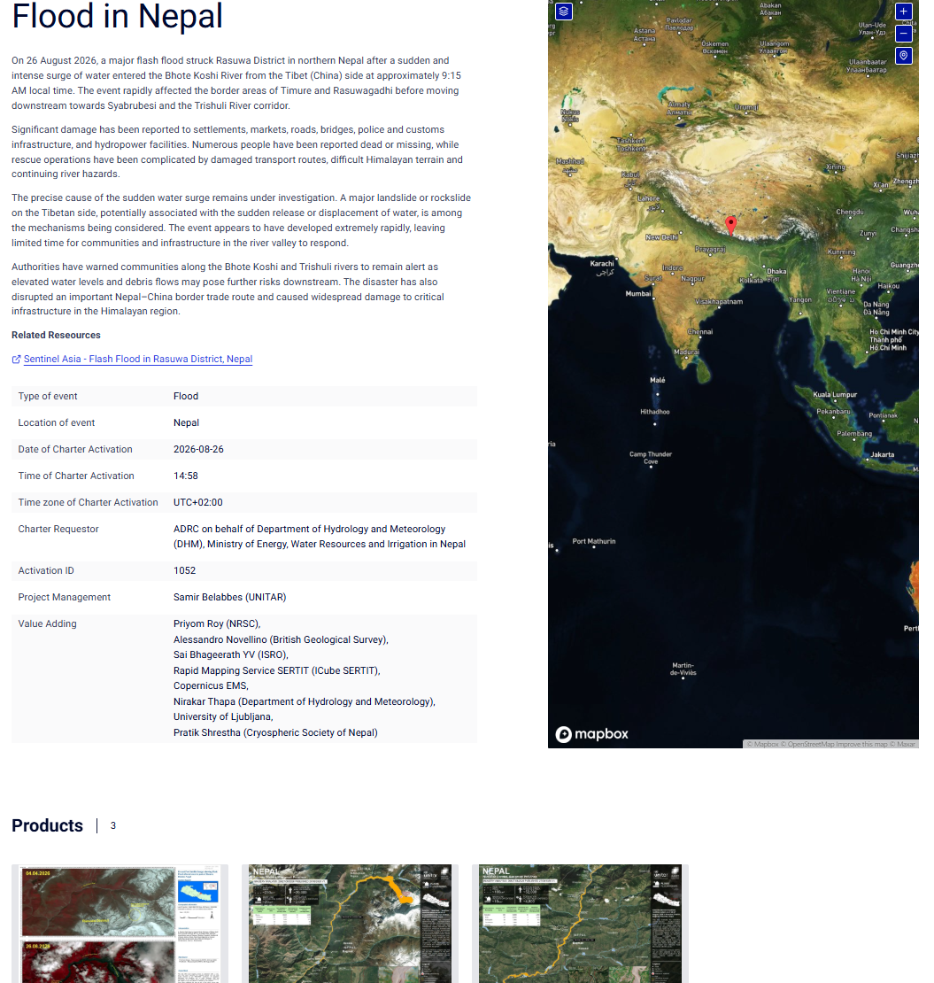
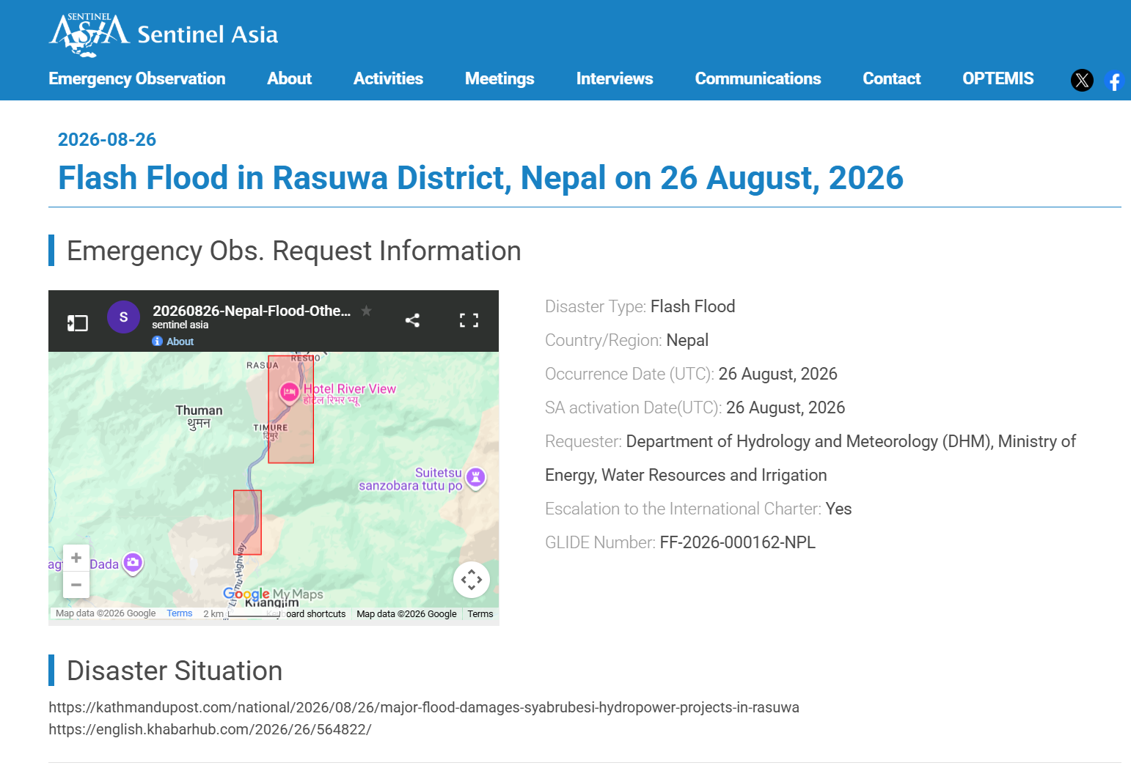
International Activation Pages (requested by DHM, activated through ADRC)
Sentinel Asia - Flash Flood in Rasuwa District, Nepal (SA-00658, requested by DHM)
https://sentinel-asia.org/EO/2026/article20260826NP.html
International Charter - Flood in Nepal, Activation #1052
https://disasterscharter.org/activations/flood-in-nepal-activation-1052-
Sources: Sentinel Asia — https://sentinel-asia.org/EO/2026/article20260826NP.html
33 / 46
ADRC 12/09/2026

Slide 34
Observation Bodies & Products (1/2)
All bodies contributing observations or value-added products; source tier shown per row
Body | Contribution | Status | Tier
Sentinel Asia | Emergency observation request 20260826-Nepal-Flood, requested by Nepal's Department of Hydrology and Meteorology and activated by ADRC on the day of the event. JAXA scheduled an ALOS-2 emergency observation. The Sentinel Asia record states escalation to the International Charter: Yes, and carries GLIDE FF-2026-000162-NPL. | Activated (SA-00658) | Official
International Charter | Activation #1052. The Charter page records the requestor as "ADRC on behalf of the Department of Hydrology and Meteorology (DHM), Ministry of Energy, Water Resources and Irrigation in Nepal". Project management: Samir Belabbes (UNITAR). Value adding: NRSC, British Geological Survey, ISRO, SERTIT (iCube), Copernicus EMS, DHM, University of Ljubljana and the Cryospheric Society of Nepal. Three products had been published as of 28 August. | Activated #1052 (26 Aug, 14:58 UTC+02:00) | Official
UNOSAT | Of 228 km2 analysed in Rasuwa, 22 km2 was affected and 1,920 of 19,940 residents were exposed. The map marks a potential ice-avalanche location on the Lende Khola inside the Tibet Autonomous Region, and includes before/after insets at Timure (WorldView-3, 19 Apr 2024 and Sentinel-2, 27 Aug 2026). | Maps published 27 Aug | Official
Rissho University / University of Tokyo | A Landsat-9 based analysis and a 3D damaged-area map derived from optical satellite data were contributed by Sentinel Asia member researchers. | Shared via Sentinel Asia | Official
TASA (Taiwan Space Agency) | Archive and observation data for 22 April 2026 and 28 August 2026, and a value-added product derived from a Sentinel-2 prior image and a FORMOSAT-5 post image (12 and 28 August 2026). | Uploaded 29 Aug | Official
JAXA (via RESTEC) | ALOS-2 archive/observation imagery and RGB composite data uploaded, covering observations of 19 December 2025, 30 January 2026 and 28 August 2026. | Uploaded 31 Aug | Official
Sources: Sentinel Asia · International Charter
34 / 46
ADRC 12/09/2026

Slide 35
Observation Bodies & Products (2/2)
All bodies contributing observations or value-added products; source tier shown per row
Body | Contribution | Status | Tier
GIC-AIT | A value-added product produced using Sentinel-1 data acquired on 28 and 31 August 2026 and Sentinel-2 imagery acquired on 27 August 2026. | Uploaded 31 Aug | Official
IWM (Institute of Water Modelling) | A value-added product produced using available Planet satellite imagery (28 Aug); IWM uploaded a second, extended-extent VAP on 30 Aug generated from PlanetScope imagery up to 28 Aug. | Uploaded 28 Aug; extended 30 Aug | Official
ADRC | ADRC revised the wide-area area of interest on 27 August after the requester narrowed the source location. The Department of Hydrology and Meteorology gave the ice-avalanche coordinates as 28.295727N, 85.507802E, noting that the original AOI had been set before the origin was known. | AOI revised 27 Aug | Official
Sources: Sentinel Asia · International Charter
35 / 46
ADRC 12/09/2026

Slide 36
Observations & Points to Watch
[Official] The hazard is not over. An estimated 0.11 sq km lake has formed upstream behind the blockage of the Lhende Khola, and NDRRMA warns of a continuing flood risk. The same sequence - blockage, impoundment, sudden breach - produced the 26 August flood, and downstream communities and responders are being told to stay on high alert.
[Official] The 28 August UNOSAT analysis extends downstream into Nuwakot District. The largest concentration of affected buildings is not in Rasuwa, where the surge began, but in Bidur Municipality in Nuwakot - about 2,600 buildings against about 1,030 in Gosaikunda, Rasuwa. Reporting that stops at the district where the event started understates the footprint.
[Official] There was no rainfall capable of explaining this flood. Rainfall and discharge records show no heavy or sufficiently localised rain, which is what led IRDR to look upstream for a slope failure. Rainfall-threshold flood warning would not have caught this event.
[Official] The temporary dam was invisible from downstream. Inflow from the Mala River and other tributaries kept the downstream channel flowing normally for the 18-19 hours the blockage held, so nothing in the downstream record signalled what was building upstream.
[Official] The damage was multi-sector and cascading. A single source-area disturbance propagated through a narrow, highly exposed mountain corridor and hit settlements, border trade, transport, energy, tourism, communications and the emergency response capacity itself at the same time.
[Official] The requester gave a precise source location. On 27 August the Department of Hydrology and Meteorology reported the ice-avalanche coordinates as 28.295727N, 85.507802E, drawn from Planet imagery, and noted that the original area of interest had been set before the origin was known. ADRC revised the wide-area AOI the same day.
36 / 46
ADRC 12/09/2026

Slide 37
Mechanism - and How the Terminology Changed
This event was described as a suspected glacial lake outburst flood (GLOF) in the first days. The IRDR rapid analysis of 28 August identifies an ice, rock and soil mass failure that dammed the river and then breached - not the outburst of a glacial lake. Both wordings are recorded here with their dates. The earlier wording was the best reading available at the time, not an error to be hidden.
Stage | What happened | When
Pre-event | Long-term environmental change in the northern Langtang region: water retreat, changing snow and ice conditions, increasing ice overburden. | -
Ice / rock avalanche | A massive volume of ice, rock and soil detaches at about 5,000 m around Deding and descends to about 3,000 m, fracturing and mixing during the descent. | 25 Aug, 13:00-14:00
Temporary dam | The collapsed ice-rock-debris mass blocks the channel and forms a natural impoundment dam. | 25 Aug, afternoon
Impoundment | Water accumulates for 18-19 hours from river flow and melting ice, raising lateral pressure on the dam. Inflow from the Mala River keeps the downstream channel flowing and masks the blockage. | 25-26 Aug
Sudden breach | Rising pressure, together with ice melting within the debris and loosening and saturation of the soil, breaches the dam. Strong ground vibration is recorded as an M4.4 event and an explosion-like sound is heard. | 26 Aug, about 08:35
Downstream propagation | Rasuwagadhi about 09:00, Timure about 09:15, Betrawati about 09:20. The steep, narrow corridor concentrated the flow; further downstream the valley widened, the flow slowed and less additional damage was reported. | 26 Aug, 09:00-
IRDR states that the precise source mechanism, breach dynamics, peak discharge and any seismic contribution require further investigation. Earlier wording: DHM, NDRRMA, ADRC, Sentinel Asia, JAXA and WFP used 'GLOF' in the first days; UNOSAT described the deposits as mudflow / rockflow; DG ECHO used 'ice-rock avalanche and flash flood'. The GLIDE number FF-2026-000162-NPL (Flash Flood) is a registration category and is unaffected.
Sources: IRDR Rapid Analysis Report, 28 Aug 2026 — https://reliefweb.int/report/nepal/irdr-rapid-analysis-report-scientific-anatomy-26-august-2026-bhotekoshi-flash-flood
37 / 46
ADRC 12/09/2026

Slide 38
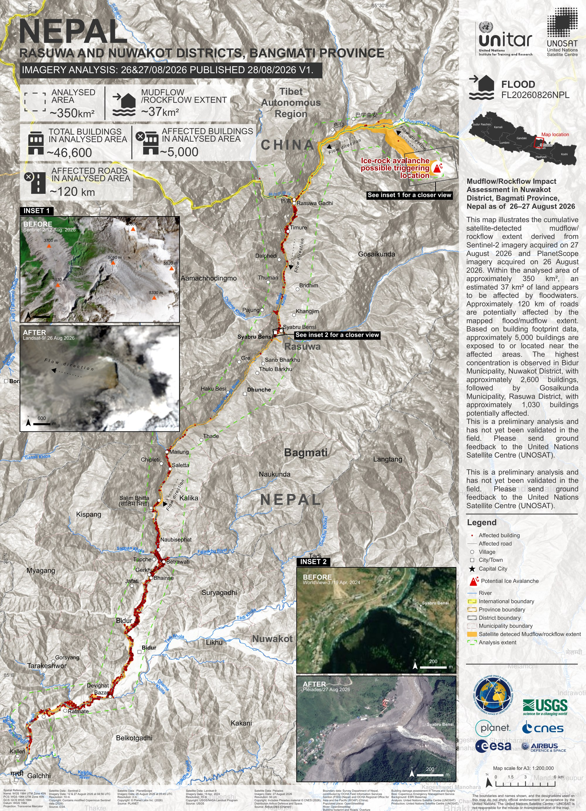
UNOSAT - Satellite-detected Mudflow / Rockflow Extent (Rasuwa and Nuwakot)
Product 4259, imagery analysis 26 and 27 August 2026, published 28 August 2026 (v1). Sentinel-2 imagery of 27 August and PlanetScope imagery of 26 August. Within an analysed area of about 350 km2, an estimated 37 km2 appears to be affected by floodwaters. Approximately 5,000 of the 46,600 buildings in the analysed area are exposed to or located near the affected areas, and about 120 km of roads are potentially affected. The highest concentration is in Bidur Municipality, Nuwakot District (about 2,600 buildings), followed by Gosaikunda Municipality, Rasuwa District (about 1,030 buildings). The map also marks the possible triggering location of the ice-rock avalanche on the Tibetan side of the border.
UNOSAT product 4259 - Rasuwa and Nuwakot Districts, Bagmati Province
https://unosat.org/products/4259
UNOSAT states this is a preliminary analysis that has not yet been validated in the field. UNOSAT describes the deposits as mudflow / rockflow; this is a description of what the imagery shows and does not contradict the GLOF attribution used by DHM, NDRRMA, ADRC, Sentinel Asia, JAXA and WFP.
Sources: UNOSAT — https://unosat.org/products/4259
38 / 46
ADRC 12/09/2026

Slide 39
Useful Links & Sources (1/8)
Source policy:
Source | Tier | URL
ReliefWeb - Nepal: Flash Floods, Aug 2026 (GLIDE FF-2026-000162-NPL) | Official | https://reliefweb.int/disaster/ff-2026-000162-npl
Sentinel Asia - emergency observation request for this event | Official | https://sentinel-asia.org/EO/2026/article20260826NP.html
International Charter - Flood in Nepal, Activation #1052 | Official | https://disasterscharter.org/activations/flood-in-nepal-activation-1052-
USGS - M 5.2 landslide (glacial collapse), 55 km NW of Kodari, Nepal | Official | https://earthquake.usgs.gov/earthquakes/eventpage/us7000tbwb
UNOSAT / International Charter - satellite-detected extent, Rasuwa District | Official | https://reliefweb.int/map/nepal/nepal-satellite-detected-mudflow-rockflow-extent-26-27-august-2026-rasuwa-district-bagmati-province-imagery-analysis-2627082026-published-27082026-v1
IFRC - CHF 25 million Emergency Appeal | Official | https://reliefweb.int/report/nepal/ifrc-launches-chf-25-million-emergency-appeal-response-devastating-nepal-flash-floods
UNICEF - US$17.2 million appeal | Official | https://reliefweb.int/report/nepal/flash-floods-nepal-leave-more-17000-children-need-urgent-humanitarian-assistance-enar
WFP Nepal External Situation Report, 27 August 2026 | Official | https://reliefweb.int/report/nepal/wfp-nepal-external-situation-report-27-august-2026
BIPAD Portal (Ministry of Home Affairs) - national incident database | Official | https://bipadportal.gov.np/
UNOSAT product 4259 - Rasuwa and Nuwakot, mudflow/rockflow extent (28 Aug 2026) | Official | https://unosat.org/products/4259
39 / 46
ADRC 12/09/2026

Slide 40
Useful Links & Sources (2/8)
Source | Tier | URL
IRDR Rapid Analysis Report - Scientific Anatomy of the 26 August 2026 Bhotekoshi Flash Flood (28 Aug 2026) | Official | https://reliefweb.int/report/nepal/irdr-rapid-analysis-report-scientific-anatomy-26-august-2026-bhotekoshi-flash-flood
UN - Nepal: Rasuwa Flood Flash Update #3 (28 Aug 2026) | Official | https://reliefweb.int/report/nepal/nepal-rasuwa-flood-flash-update-3
WFP Nepal - Situation Report on Flood Emergency, 29 August 2026 | Official | https://reliefweb.int/report/nepal/wfp-nepal-external-situation-report-29-august-2026
 | TBC | https://reliefweb.int/report/nepal/wfp-nepal-external-situation-report-30-august-2026
 | TBC | https://reliefweb.int/report/nepal/nepal-rasuwa-flood-flash-update-4-31-august-2026
 | TBC | https://reliefweb.int/report/nepal/dispatch-korea-disaster-relief-team-kdrt-response-flood-damage-nepal
 | TBC | https://reliefweb.int/report/nepal/nepal-flood-emergency-situation-report-reporting-period-30-31-august-2026
 | TBC | https://reliefweb.int/report/nepal/water-mission-responds-devastating-flash-floods-nepal
 | TBC | https://www.ndrrma.gov.np/
 | TBC | https://ndrrma.gov.np/mediafiles/rasuwa/SitRep_11_NEP_01092026.pdf
 | TBC | https://reliefweb.int/map/nepal/mudflowrockflow-impact-assessment-nuwakot-district-bagmati-province-nepal-26-27-august-2026-imagery-analysis-2627082026-published-28082026-v1
 | TBC | https://reliefweb.int/map/nepal/satellite-detected-newly-formed-barrier-lakes-following-ice-rock-avalanche-rasuwa-district-nepal-28-august-2026-imagery-analysis-2627082026-published-27082026-v1
40 / 46
ADRC 12/09/2026

Slide 41
Useful Links & Sources (3/8)
Source | Tier | URL
 | TBC | https://reliefweb.int/map/nepal/nepal-china-eu-response-ice-rock-avalanche-and-flash-flood-event-dg-echo-daily-map-02092026
 | TBC | https://reliefweb.int/report/nepal/rapid-disaster-impact-report-satellite-remote-sensing-reveals-severe-mudslide-impacts-along-china-nepal-border
 | TBC | https://reliefweb.int/report/nepal/nepal-floods-hit-vulnerable-communities-undp-estimates-22-million-tonnes-debris
 | TBC | https://reliefweb.int/report/nepal/nepal-flash-floods-medical-teams-deploy-emergency-zone
 | TBC | https://reliefweb.int/report/nepal/nepal-rasuwa-flood-flash-update-5-1-september-2026
 | TBC | https://reliefweb.int/report/nepal/unicef-nepal-humanitarian-situation-report-no1-rasuwa-flood-31-august-2026
 | TBC | https://reliefweb.int/report/nepal/nepal-flood-2026-dref-operation-mdrnp022
 | TBC | https://reliefweb.int/report/nepal/dispatch-japan-disaster-relief-jdr-expert-team-response-flash-flood-nepal
 | TBC | https://reliefweb.int/map/nepal/nepal-flash-floods-26th-august-2026-flood-extent-affected-districts-dhading-nuwakot-and-rasuwa-03092026
 | TBC | https://reliefweb.int/map/nepal/nepal-flash-floods-26th-august-2026-reference-map-nuwakot-district-03092026
 | TBC | https://reliefweb.int/map/nepal/nepal-flash-floods-26th-august-2026-reference-map-rasuwa-district-03092026
 | TBC | https://reliefweb.int/report/nepal/iom-nepal-flood-response-situation-report-3-3-september-2026
41 / 46
ADRC 12/09/2026

Slide 42
Useful Links & Sources (4/8)
Source | Tier | URL
 | TBC | https://reliefweb.int/report/nepal/wfp-nepal-situation-report-rasuwa-flood-response-04-september-2026
 | TBC | https://reliefweb.int/report/nepal/nepal-rasuwa-flood-flash-appeal-4-september-2026
 | TBC | https://reliefweb.int/report/nepal/nepal-flash-floods-displacement-snapshot-27-31-august-2026
 | TBC | https://reliefweb.int/map/nepal/nepal-rasuwa-floods-26th-august-2026-reference-map-series-affected-area-sheet-01-04092026
 | TBC | https://reliefweb.int/map/nepal/nepal-rasuwa-floods-26th-august-2026-reference-map-bidur-municipality-04092026
 | TBC | https://reliefweb.int/report/nepal/nepal-rasuwa-flood-situation-report-no-6
 | TBC | https://reliefweb.int/report/nepal/nepal-rasuwa-flood-situation-report-no-6-5-september-2026
 | TBC | https://risingnepaldaily.com/news/86182
 | TBC | https://risingnepaldaily.com/news/86159
 | TBC | https://reliefweb.int/report/nepal/nepal-flood-emergency-situation-report-reporting-period-4-6-september-2026
 | TBC | https://reliefweb.int/report/nepal/nepal-flash-floods-un-women-gender-alert-2
 | TBC | https://reliefweb.int/map/nepal/nepal-rasuwa-floods-26th-august-2026-reference-map-series-affected-area-06092026
 | TBC | https://reliefweb.int/map/nepal/nepal-flash-floods-26th-august-2026-affected-municipalities-settlements-06092026
42 / 46
ADRC 12/09/2026

Slide 43
Useful Links & Sources (5/8)
Source | Tier | URL
 | TBC | https://reliefweb.int/map/nepal/nepal-flash-floods-26th-august-2026-affected-population-06092026
 | TBC | https://reliefweb.int/report/nepal/marking-international-day-charity-stories-giving-through-qatar-charity-go-beyond-humanitarian-assistance
IOM - Nepal: Preliminary Findings, Baseline Site Profile Assessment (31 Aug-6 Sep 2026) | Official | https://reliefweb.int/report/nepal/nepal-preliminary-findings-baseline-site-profile-assessment-31-august-06-september-2026
IFRC - Nepal floods: IFRC delivers safe water and health care to affected communities (8 Sep 2026) | Official | https://reliefweb.int/report/nepal/nepal-floods-ifrc-delivers-safe-water-and-health-care-affected-communities
Logistics Cluster/WFP - Nepal LTC Logistics: Concept of Operations (6 Sep 2026) | Official | https://reliefweb.int/map/nepal/nepal-ltc-logistics-concept-operations-september-6-2026
NDRRMA - Rasuwa Flood: Search, Rescue and Relief Update (8 Sep 2026, 18:00) | Official | https://ndrrma.gov.np/mediafiles/rasuwa/Situation_update_English_2026.9.08_6_PM.pdf
NDRRMA Situation Report #18 (Nepali, 8 Sep 2026, 19:00) | Official | https://ndrrma.gov.np/mediafiles/rasuwa/SitRep_18_NEP_08092026.pdf
Project HOPE - Nepal Landslides & Flash Floods Situation Report #4 (8 Sep 2026, posted 9 Sep) | Media | https://reliefweb.int/report/nepal/nepal-landslides-flash-floods-situation-report-4-september-8-2026
MapAction - Rasuwa Floods DTM Baseline Site Profile Assessment, Rasuwa/Nuwakot/Dhading Districts (31 Aug-5 Sep 2026, maps) | Official | https://reliefweb.int/map/nepal/nepal-rasuwa-floods-26th-august-2026-dtm-baseline-site-profile-assessment-31-august-05-september-2026-rasuwa-district
Direct Relief - Nepal Flash Floods: Five Days After the Floods, Secondary Health Risks Rise | Media | https://reliefweb.int/report/nepal/nepal-flash-floods-five-days-after-floods-secondary-health-risks-rise
43 / 46
ADRC 12/09/2026

Slide 44
Useful Links & Sources (6/8)
Source | Tier | URL
NDRRMA Situation Report #19 (English, 9 Sep 2026, 19:00) | Official | https://ndrrma.gov.np/mediafiles/rasuwa/SitRep_ENG_09_09092026.pdf
NDRRMA Situation Report #19 (Nepali, 9 Sep 2026) | Official | https://ndrrma.gov.np/mediafiles/rasuwa/SitRep_19_NEP_09092026.pdf
WFP Nepal Situation Report on the Rasuwa Flood Response (10 Sep 2026) | Official | https://reliefweb.int/report/nepal/wfp-nepal-external-situation-report-10-september-2026
Nepal: Rasuwa Floods - DTM Baseline Site Profile Assessment (31 Aug-5 Sep 2026): Nuwakot District (MapAction) | Official | https://reliefweb.int/map/nepal/nepal-rasuwa-floods-26th-august-2026-dtm-baseline-site-profile-assessment-31-august-05-september-2026-nuwakot-district
Nepal: Rasuwa Floods - DTM Baseline Site Profile Assessment (31 Aug-5 Sep 2026): Dhading District (MapAction) | Official | https://reliefweb.int/map/nepal/nepal-rasuwa-floods-26th-august-2026-dtm-baseline-site-profile-assessment-31-august-05-september-2026-dhading-district
Nepal: Rasuwa Flood Situation Report No. 7 (UN Resident Coordinator's Office, 8 Sep 2026, covering 4-7 Sep) | Official | https://reliefweb.int/report/nepal/nepal-rasuwa-flood-situation-report-no-7-8-september-2026
Government Decides to Provide Emergency Relief Supplies in Response to Flood Damage in Nepal (Government of the Republic of Korea, 9 Sep 2026) | Official | https://reliefweb.int/report/nepal/government-decides-provide-emergency-relief-supplies-response-flood-damage-nepal
Canada deploys victim identification experts to support response to severe flooding along the Nepal-China border (Government of Canada, 10 Sep 2026) | Official | https://reliefweb.int/report/nepal/canada-deploys-victim-identification-experts-support-response-severe-flooding-along-nepal-china-border
Nepal: Operational update on humanitarian response after devastating floods (ICRC, 10 Sep 2026) | Media | https://reliefweb.int/report/nepal/nepal-operational-update-humanitarian-response-after-devastating-floods
44 / 46
ADRC 12/09/2026

Slide 45
Useful Links & Sources (7/8)
Source | Tier | URL
Nepal: Over 500 children separated from parents and hundreds still missing after floods (Save the Children, 9 Sep 2026) | Media | https://reliefweb.int/report/nepal/nepal-over-500-children-separated-parents-and-hundreds-still-missing-after-floods
Nepal: Flash Floods - Affected Municipalities (09/09/2026) (MapAction) | Official | https://reliefweb.int/map/nepal/nepal-flash-floods-26th-august-2026-affected-municipalities-09092026
NDRRMA - Rasuwa-Bhotekoshi Flood Search, Rescue and Relief Response Situation Report #09 (English series; = Nepali SitRep #19), 9 Sep 2026 19:00 | Official | https://ndrrma.gov.np/mediafiles/rasuwa/SitRep_ENG_09_09092026.pdf
MapAction/UNCT Nepal - Rasuwa Floods: Affected Settlements (09/09/2026) | Official | https://reliefweb.int/map/nepal/nepal-rasuwa-floods-26th-august-2026-affected-settlements-09092026
MapAction/UNCT Nepal - Rasuwa Floods: Affected Wards in Nuwakot District (08/09/2026) | Official | https://reliefweb.int/map/nepal/nepal-rasuwa-floods-26th-august-2026-affected-wards-nuwakot-district-08092026
MapAction/UNCT Nepal - Rasuwa Floods: Affected Wards in Rasuwa District (08/09/2026) | Official | https://reliefweb.int/map/nepal/nepal-rasuwa-floods-26th-august-2026-affected-wards-rasuwa-district-08092026
Direct Relief - Medicines Arrive in Nepal as Health Providers Work to Reach the Last Mile (8 Sep 2026) | Media | https://reliefweb.int/report/nepal/medicines-arrive-nepal-health-providers-work-reach-last-mile
IFRC - Nepal, Asia-Pacific: Flash Flood Emergency Appeal (MDRNP022) (28 Aug 2026) | Official | https://reliefweb.int/report/nepal/nepal-asia-pacific-flash-flood-emergency-appeal-mdrnp022
ETC/Logistics Cluster/WFP - Nepal Flash Floods: LTC Situation Report (Telecoms Area) #2 (5-11 Sep 2026) | Official | https://reliefweb.int/report/nepal/nepal-flash-floods-ltc-situation-report-telecoms-area-2-reporting-period-05-11-september-2026
45 / 46
ADRC 12/09/2026

Slide 46
Useful Links & Sources (8/8)
Source | Tier | URL
NDRRMA - Rasuwa-Bhotekoshi Flood Situation Report #22 (12 Sep 2026, 19:00 NPT) | Official | https://ndrrma.gov.np/mediafiles/rasuwa/SitRep_22_NEP_12092026.pdf
FAO - Nepal floods damage 1,800 hectares of crops and kill thousands of livestock (10 Sep 2026) | Official | https://reliefweb.int/report/nepal/nepal-floods-damage-1800-hectares-crops-and-kill-thousands-livestock
FEWS NET - Nepal Food Security Outlook Update (10 Sep 2026) | Official | https://reliefweb.int/report/nepal/nepal-food-security-outlook-update-stressed-ipc-phase-2-likely-rasuwa-district-following-historic-flooding-august-2026-january-2027
UNICEF - Flight lands in Kathmandu carrying vital humanitarian supplies (4 Sep 2026) | Official | https://reliefweb.int/report/nepal/flight-lands-kathmandu-carrying-vital-humanitarian-supplies-children-and-families-affected-nepal-floods-0
UNICEF Nepal Humanitarian Situation Report No.3 (8 Sep 2026) | Official | https://reliefweb.int/report/nepal/unicef-nepal-humanitarian-situation-report-no-3-8-september-2026
WFP Nepal Situation Report on the Rasuwa Flood Response (10 Sep 2026) | Official | https://reliefweb.int/report/nepal/wfp-nepal-situation-report-rasuwa-flood-response-10-september-2026
World Vision International Nepal - Rasuwa-Nuwakot Flash Flood Emergency Response, Situation Update 5 (10 Sep 2026) | Official | https://reliefweb.int/report/nepal/world-vision-international-nepal-rasuwa-nuwakot-flash-flood-emergency-response-situation-update-5-10-september-2026
46 / 46
ADRC 12/09/2026

