Slide 1
Visual Speech Recognition Model
Phantom Project
Ágnes Márkó
Dávid Kocsis
Notes:
As you can see our project was a visual speech recognition model.
We named it Phantom project.

Slide 2
Introduction
What is visual speech recognition, also known as lip-reading?
What was our goal with this project?
What was our motivation?
Notes:
Lip-reading: a technique to understand words or speech by visual interpretation of face, mouth, and lip movement without the involvement of audio
Goal: develop an automated lip-reading system using machine learning and deep learning
Motivation: 1.5 billion people live with hearing loss, expected to increase to 2.5 billion by 2050
We wanted to create a lip-reading system, because it can effectively help the lives of the people with hearing loss and they represent a significant portion of the population.

Slide 3
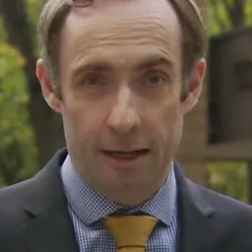
Dataset
Oxford-BBC LRW dataset
500 words, 1000 utterances each
Training, validation, and test sets
Subset used for this project: 6 words (ABOUT, ABUSE, ACCESS, ASKING, BILLION, CANCER)
Example metadata:
Disk reference: 6237663467807830543
Channel: BBC One HD
Program start: 2016-01-09 06:00:00 +0000
Clip start: 1742.44 seconds
Duration: 0.24 seconds
Notes:
large publicly available dataset with short video clips, approximately 29 frames
this dataset includes 500 different words, and for each word there is a training, validation and test set, all together for each word there is at least a thousand video clip.
metadata is also provided with each video, that’s how we can calculate the start and end frames for each word duration.
because we had limited computational resources we only trained a part of the LRW dataset.
we selected 6 words

Slide 4
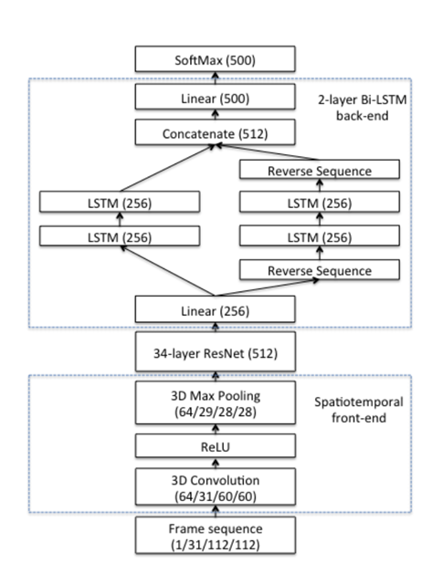
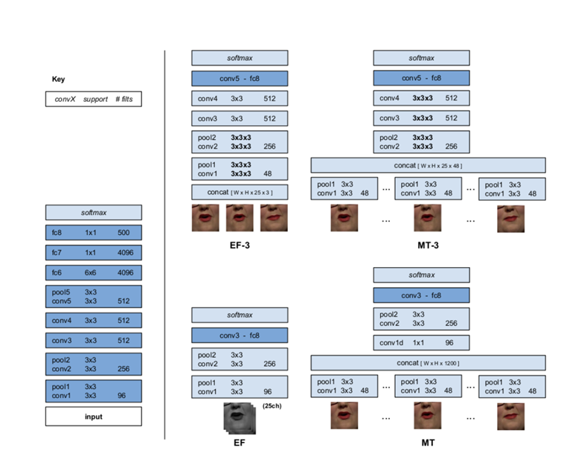
Previous solutions
Lip Reading in the Wild
2D and 3D CNN architectures
Top accuracy: 61.1%
Chung and Zisserman
2016
End-to-end AudioVisual Speech Recognition
ResNet and LSTM architectures
Word accuracy: 83.0%
Stafylakis and Tzimiropoulos
2017
Notes:
there are a lot of solutions with different architectures, I want to mention just a few.
The authors of the paper proposed 4 different CNN architectures.

Slide 5
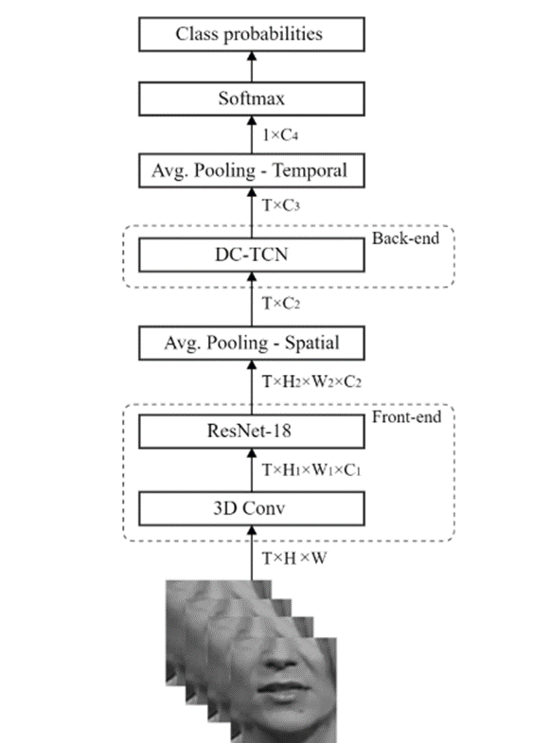
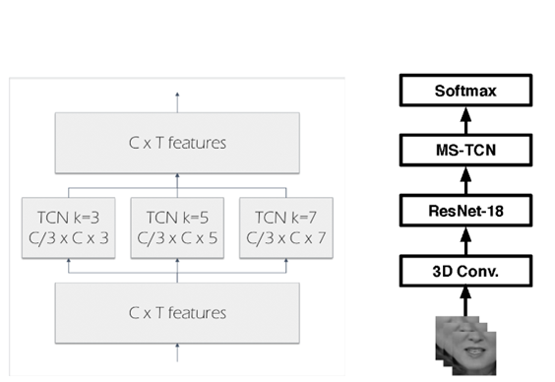
Lipreading using Temporal Convolutional Networks
Spatiotemporal CNN + ResNet + MS-TCN
Word accuracy: 85.3% (LRW), 41.4% (LRW-1000)
Martinez et al.
2020
Lip-reading with Densely Connected Convolutional Networks
Densely Connected TCN with SE attention
Accuracy: 88.36% (LRW), 43.65% (LRW-1000)
Ma et al.
2020

Slide 6
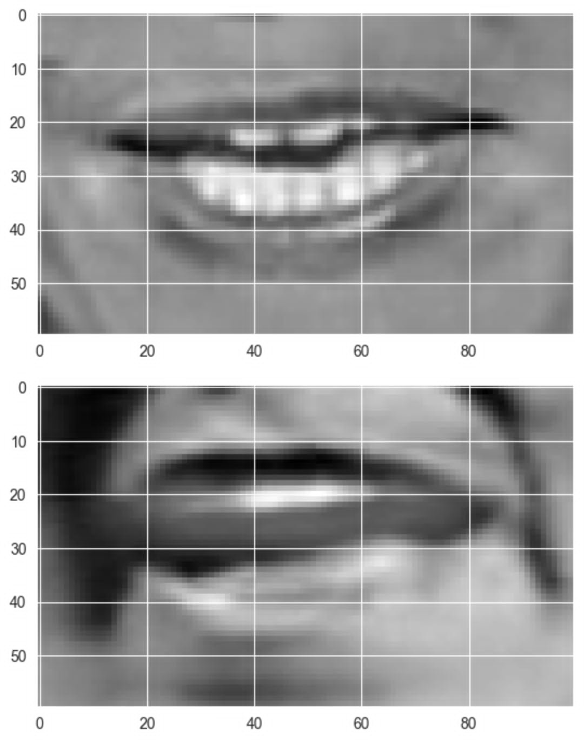
Proposed method
Model 1: 3D CNN with residual connections and WaveNet activation
Model 2: 3D CNN with ResNet blocks and BiLSTM units
Model 3: Spatiotemporal CNN-TCN with SE attention

Slide 7
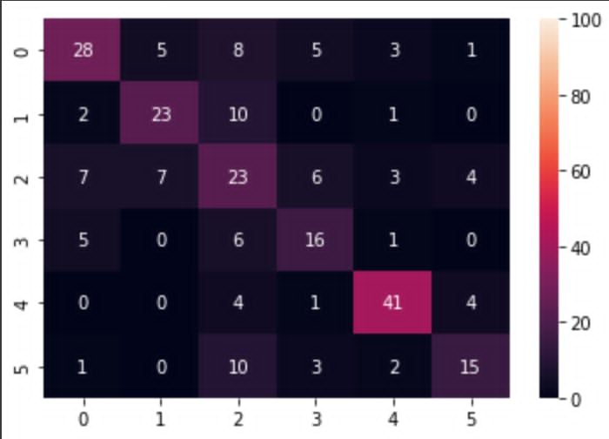
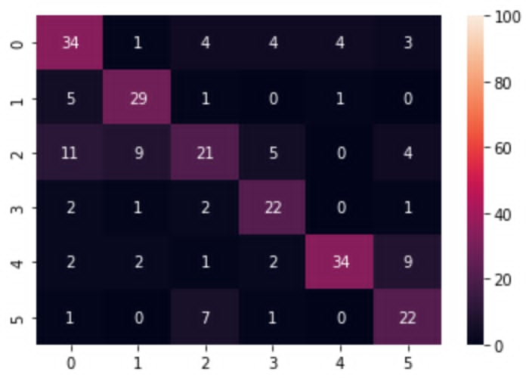
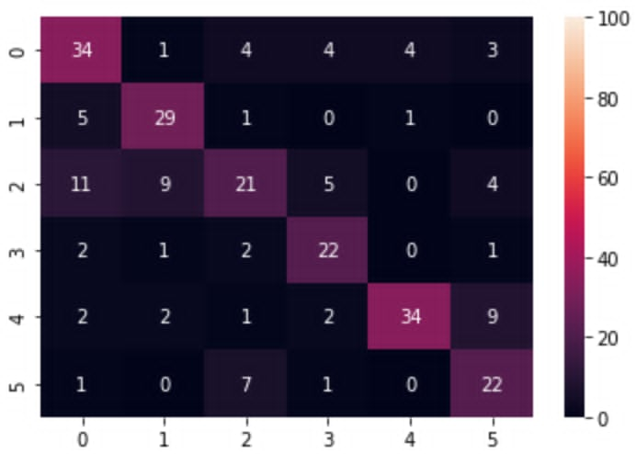
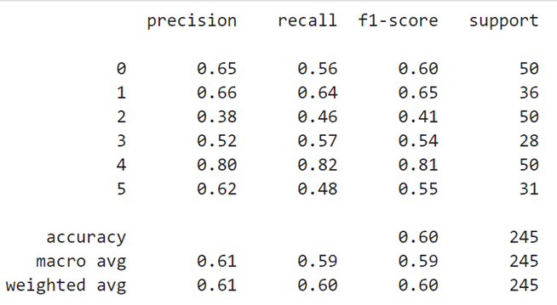
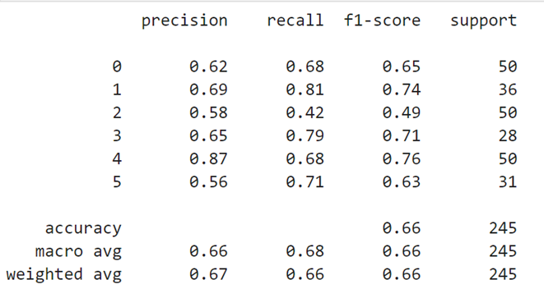
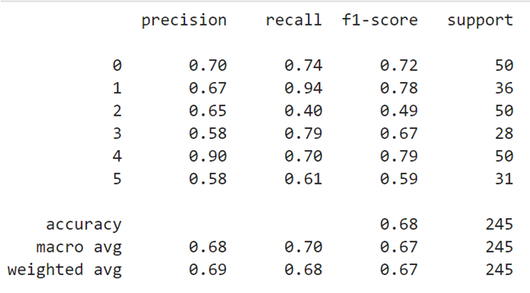
Results
ABOUT
ABUSE
ACCESS
ASKING
BILLION
CANCER
First model: Dilated Convnet
Second model: BiLSTM
Third model: Temporal Convnet

Slide 8
Thank you for your attention!

