Slide 1
Visual Speech Recognition Model
Phantom Project
Ágnes Márkó
05/15/2024
Dávid Kocsis

Slide 2
Introduction
What is visual speech recognition, also known as lip-reading?
What was our goal with this project?
What was our motivation?
Notes:
Lip-reading: a technique to understand words or speech by visual interpretation of face, mouth, and lip movement without the involvement of audio
Goal: develop an automated lip-reading system using machine learning and deep learning
Motivation: 1.5 billion people live with hearing loss, expected to increase to 2.5 billion by 2050

Slide 3
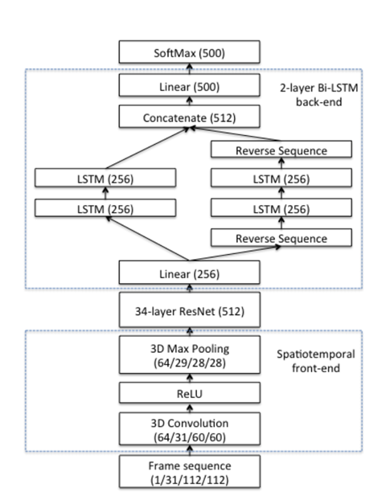
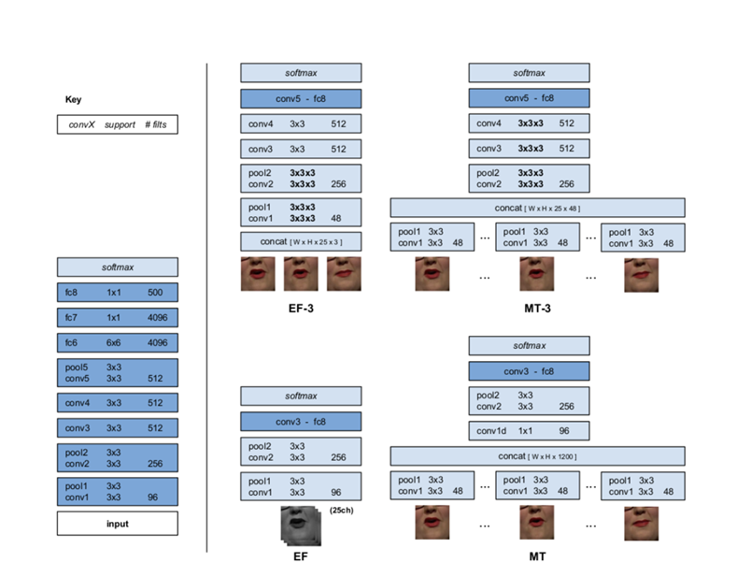
Previous solutions
Lip Reading in the Wild
2D and 3D CNN architectures
Top accuracy: 61.1%
Chung and Zisserman
2016
End-to-end AudioVisual Speech Recognition
ResNet and LSTM architectures
Word accuracy: 83.0%
Stafylakis and Tzimiropoulos
2017

Slide 4
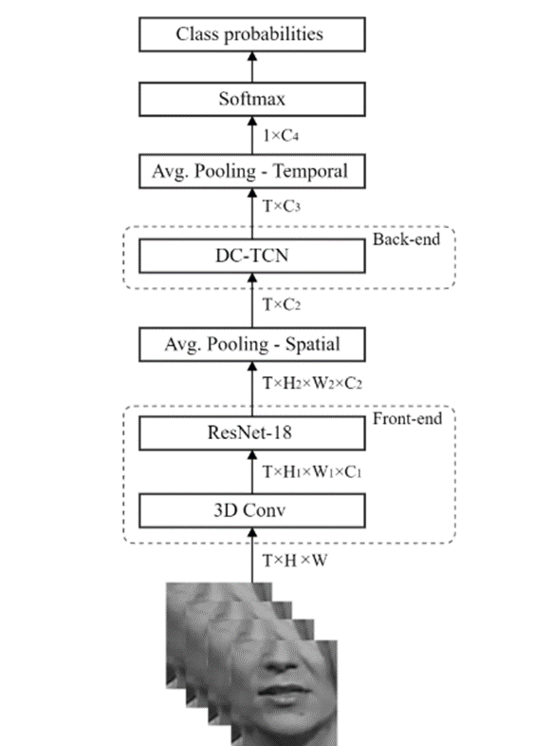
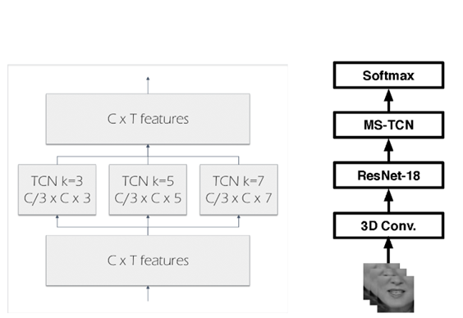
Lipreading using Temporal Convolutional Networks
Spatiotemporal CNN + ResNet + MS-TCN
Word accuracy: 85.3% (LRW), 41.4% (LRW-1000)
Martinez et al.
2020
Lip-reading with Densely Connected Convolutional Networks
Densely Connected TCN with SE attention
Accuracy: 88.36% (LRW), 43.65% (LRW-1000)
Ma et al.
2020

Slide 5

Dataset
Oxford-BBC LRW dataset
500 words, 1000 utterances each
Training, validation, and test sets
Subset used for this project: 6 words, varying articulation
Example metadata:
Disk reference: 6237663467807830543
Channel: BBC One HD
Program start: 2016-01-09 06:00:00 +0000
Clip start: 1742.44 seconds
Duration: 0.24 seconds

Slide 6
Proposed method
Model 1: 3D CNN with residual connections and WaveNet activation
Model 2: 3D CNN with ResNet blocks and BiLSTM units
Model 3: Spatiotemporal CNN-TCN with SE attention

Slide 7
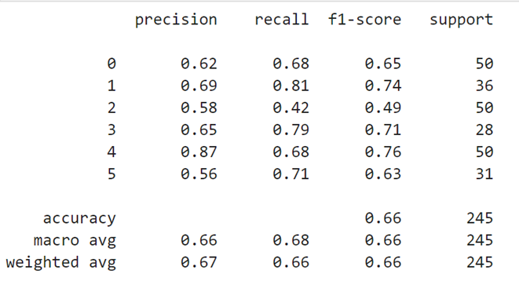
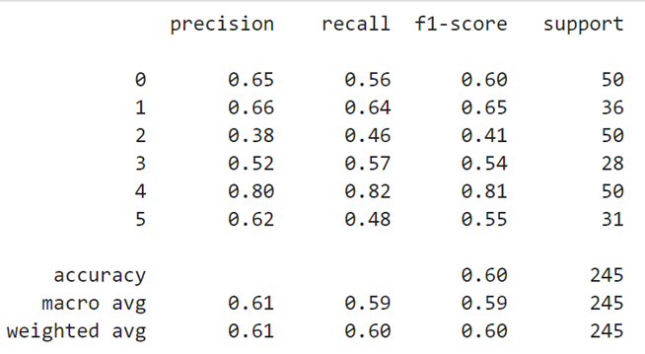
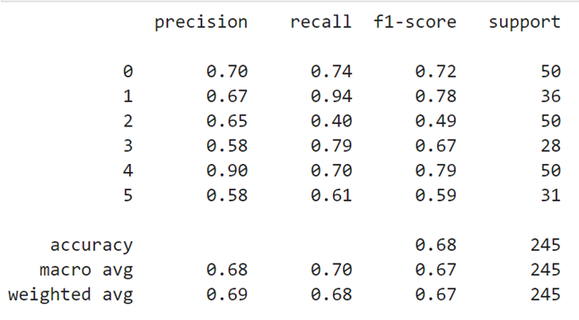
Results
Second model: BiLSTM
First model: Dilated Convnet
Third model: Temporal Convnet

Slide 8
Thank you for your attention!

