Slide 1
ENGI 301 Plant Care and Data Display Device Proposal
9/25/2023
Brendan Hlibok

Slide 2
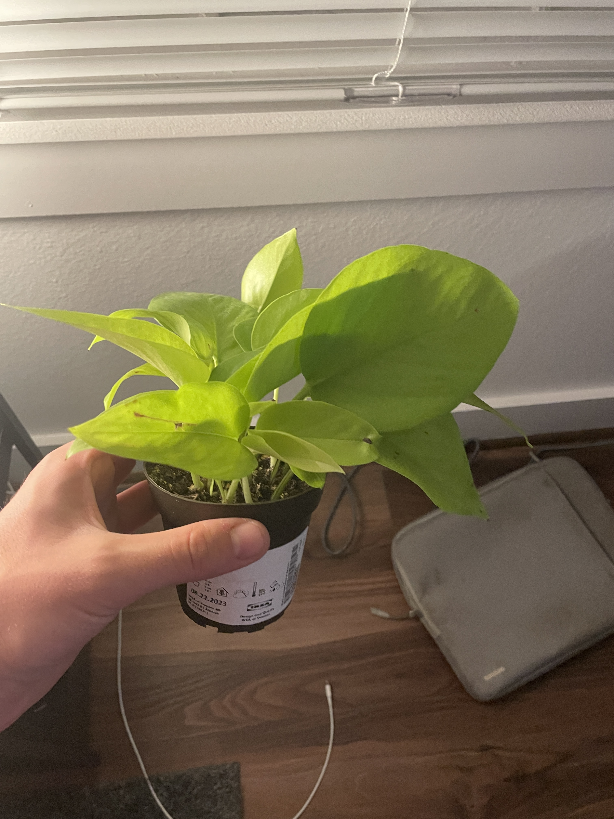
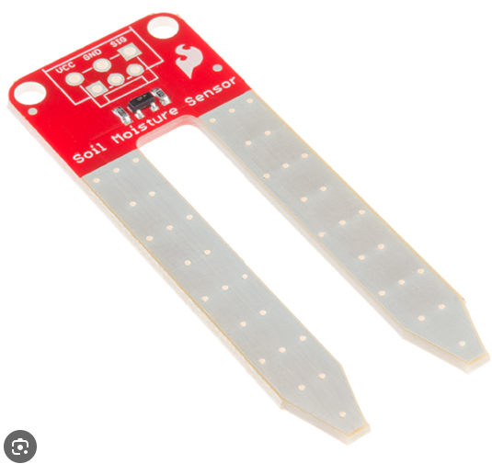
Background Information
Low soil & Heat warning system
Will test how moist the soil is and let you know when to water
Similar projects
Soil Moisture Sensor With LCD Display
https://www.hackster.io/PatelDarshil/soil-moisture-sensor-with-lcd-display-71d6df
Plant Babysitter
https://www.beagleboard.org/projects/plant-babysitter
New added features
LCD displays exact amount to water & days since last watered
Temperature sensor will check if conditions are good
I recently got my first house plant and I want to take very good care of it

Slide 3
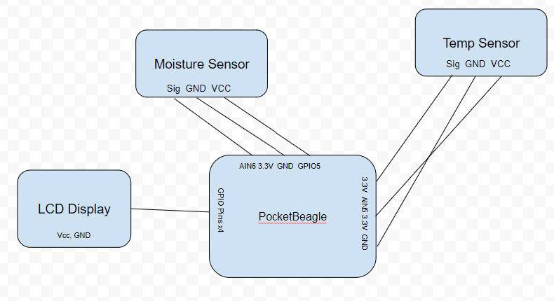
System Block Diagram

Slide 4
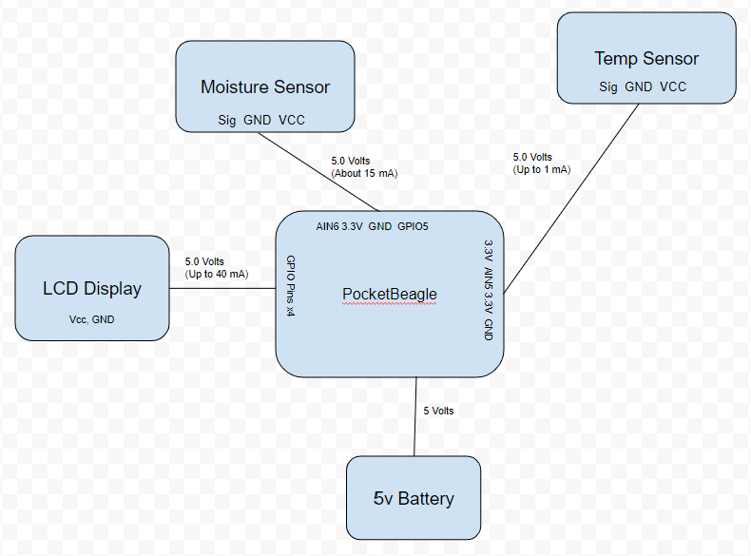
Power Block Diagram

Slide 5
Components / Budget
Component | Need to Buy | Cost
Moisture Sensor | https://www.amazon.com/Capacitive-Moisture-Corrosion-Resistant-Detection/dp/B07SYBSHGX | 2.00
Temp/Humidity Sensor | https://www.amazon.com/Precision-Temperature-Humidity-Measurement-Communication/dp/B092495GZJ | 1.70
Character Display (16x2) | https://www.adafruit.com/product/181 | 9.95
See Next Slide for Instructions

