Slide 1
ENGI 301 Plant Care and Data Display Device Proposal
Updated 10/12/2023
Brendan Hlibok

Slide 2
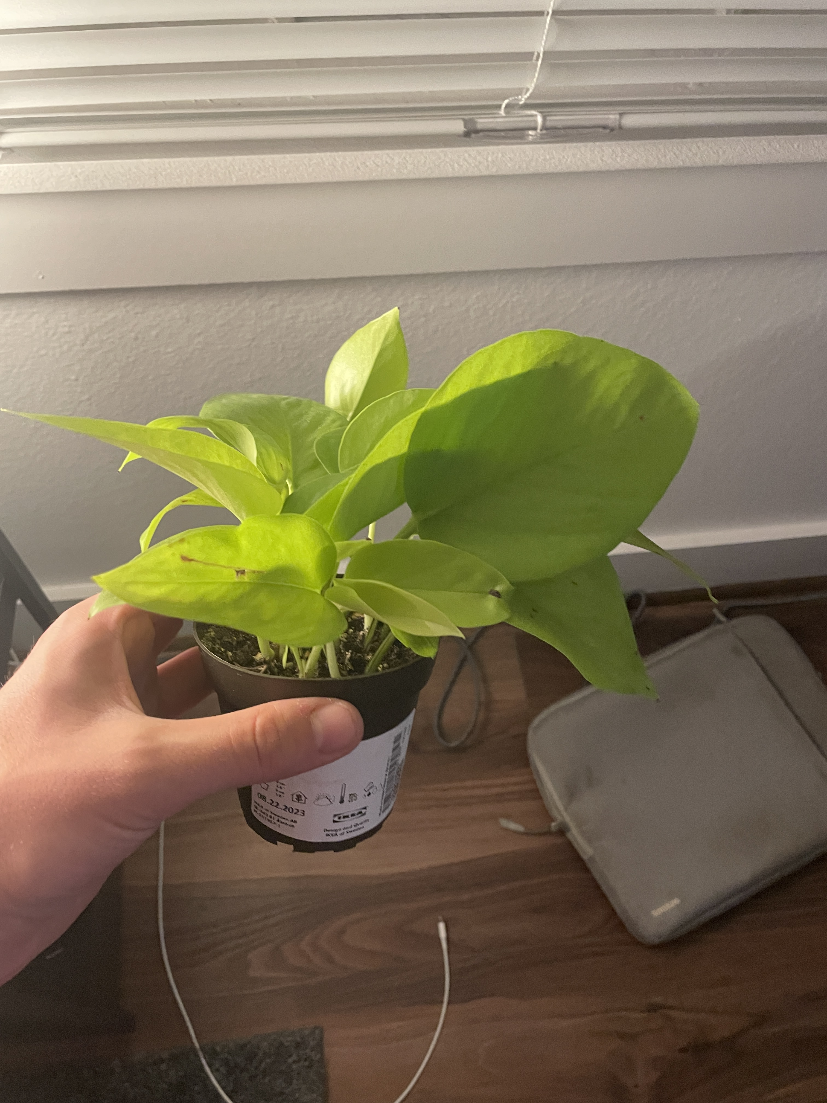
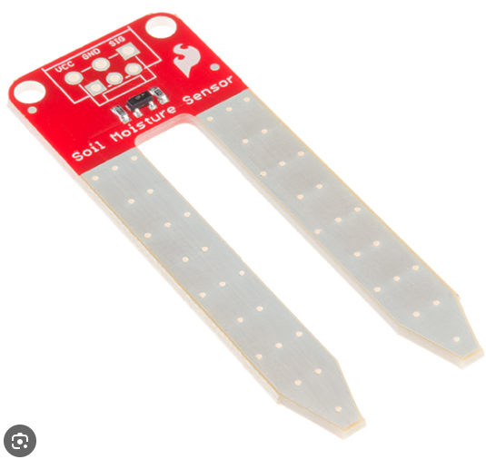
Background Information
Low soil & Heat warning system
Will test how moist the soil is and let you know when to water
Similar projects
Soil Moisture Sensor With LCD Display
https://www.hackster.io/PatelDarshil/soil-moisture-sensor-with-lcd-display-71d6df
Plant Babysitter
https://www.beagleboard.org/projects/plant-babysitter
New added features
LCD displays exact amount to water & days since last watered
Temperature sensor will check if conditions are good
I recently got my first house plant and I want to take very good care of it
Why?
I recently got my first house plant and I want to take very good care of it

Slide 3
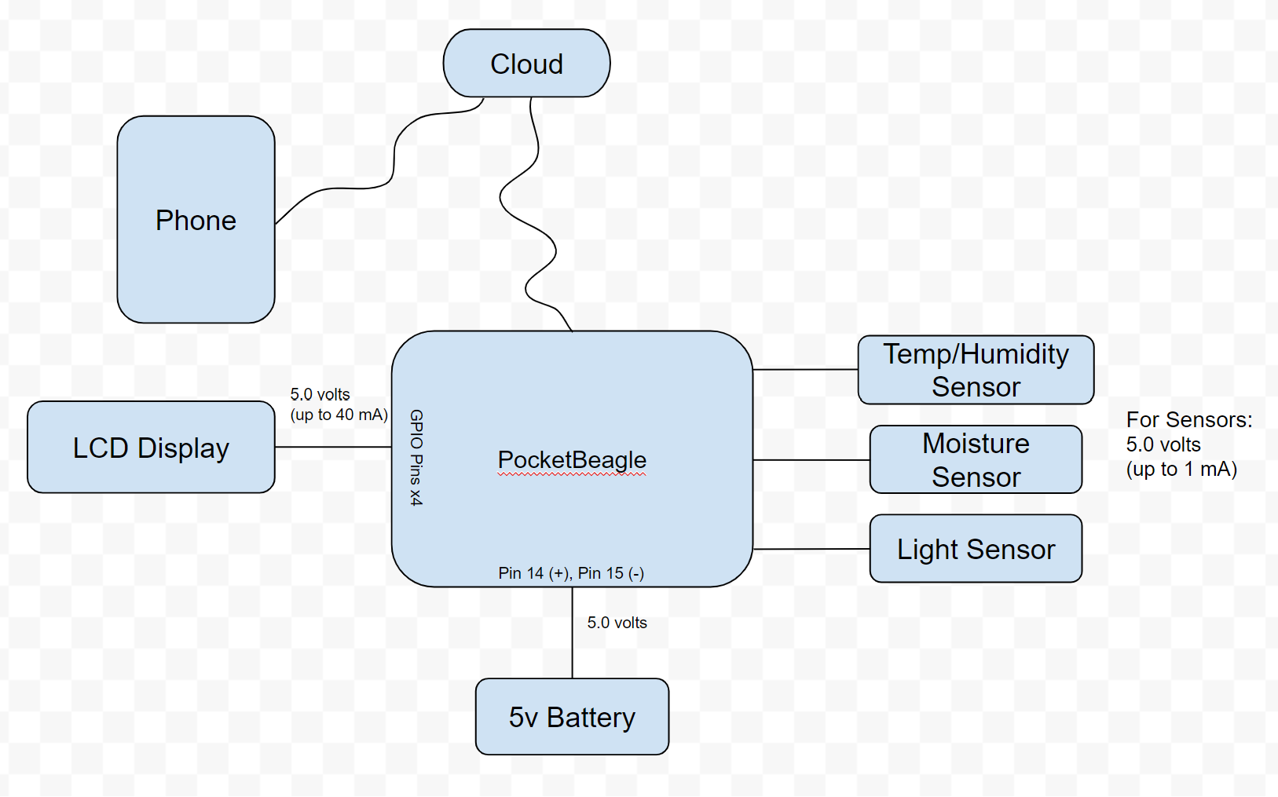
System Block Diagram

Slide 4
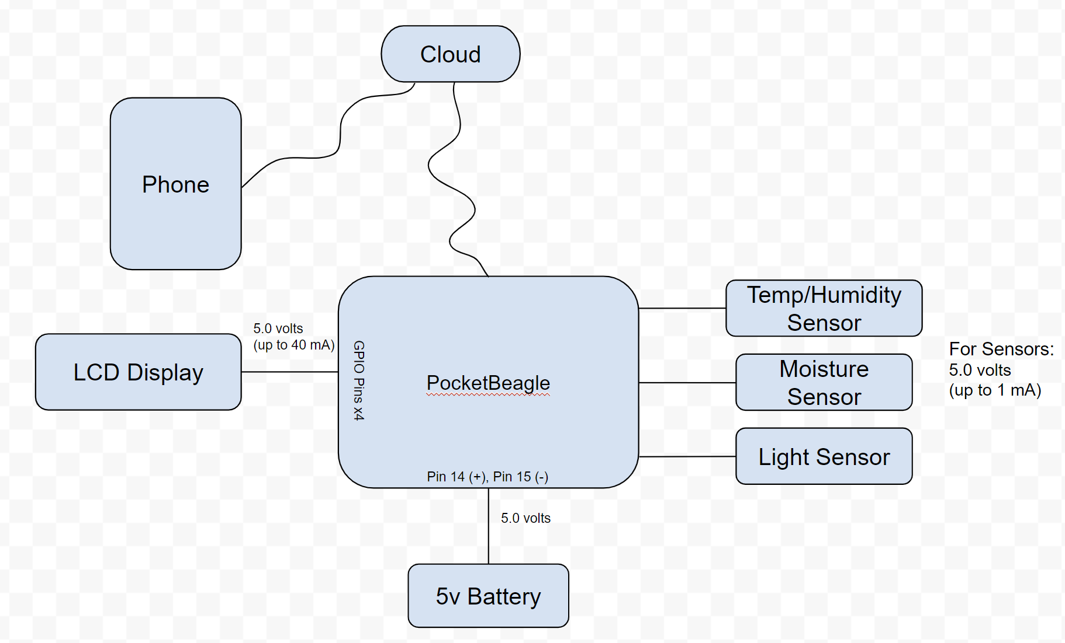
Power Block Diagram

Slide 5
Components / Budget
Component | Need to Buy | Cost
Moisture Sensor | https://www.amazon.com/Capacitive-Moisture-Corrosion-Resistant-Detection/dp/B07SYBSHGX | 2.00
Temp/Humidity Sensor | https://www.amazon.com/Precision-Temperature-Humidity-Measurement-Communication/dp/B092495GZJ | 1.70
Character Display (16x2) | https://www.adafruit.com/product/181 | 9.95
Light Sensor | https://www.adafruit.com/product/4681 | 4.50
USB Wifi | https://www.amazon.com/wifi-adapter-usb-pc-network/dp/B008IFXQFU | 9.99
See Next Slide for Instructions

Slide 6
Software Diagram (Inputs/Outputs)
INPUTS:
4 Local buttons to ask for Moisture, Temp, Humidity, and Light Data locally
4 Phone buttons to ask for data from anywhere
OUTPUTS:
Moisture, Temp, Humidity, and Light Data
Warning to water plant
Days since plant watered

Slide 7
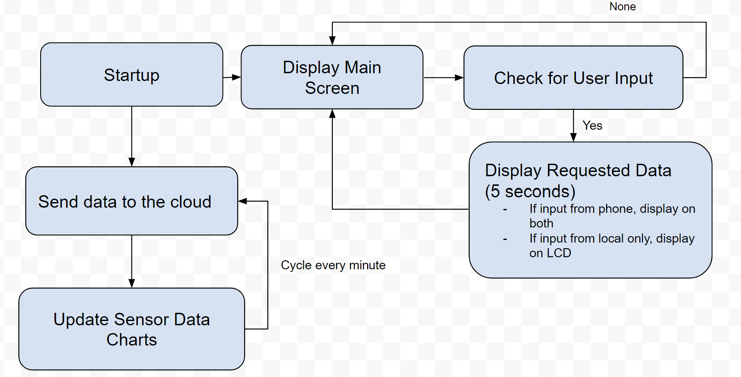
Software Diagram (Main Class)
MAIN
Setup:
Startup Python
Connect to internet
Initialize input pins for sensors, buttons, and display
Code Flow Chart:

Slide 8
Software Diagram (Component Classes)
Moisture, Temperature/Humidity, and Light Sensor Classes (3x)
-Get DATA Function
-Function to get the sensor reading when requested
Button Classes (4x for each data output)
- When pressed function
-Communicate to display to display certain information
Display Class
-When data requested from button pressed function
-Ask for information from the sensor classes
-Display the information on display
Communication Class (Cloud)
-Request information from the sensor classes function
-Cyclically gathers information from the sensors
-Get information from sensors classes function when requested by phone
-3 functions: When (X) sensor button pressed, send data to phone
Phone Class
-Ask for (X) sensor information from the cloud function (3 functions)
-Display information (3 functions)

