Slide 1



How to Measure the Liquidity
of Cryptocurrency Markets?
Research Seminar:
Data Analysis in Finance
Group 17
A replication of Brauneis, Mestel, Riordan & Theissen (2021) on independently collected Tardis.dev exchange data, with our own robustness extension
Chistiakova Maria · Rudko Sofia · Meyzler Liya · Samoilova Maria
Moscow, 2026
Notes:
Maria Chistiakova (about 0:15)
Good afternoon, everyone. We are Group 17: Maria Chistiakova, Sofia Rudko, Liya Meyzler and Maria Samoilova. Our topic is a simple question with a difficult answer: how can we measure the liquidity of cryptocurrency markets? We replicated a paper by Brauneis, Mestel, Riordan and Theissen on our own data, and then we tested its results a bit harder.

Slide 2

The question we ask
PROBLEM
Crypto exchanges publish no shared order-book history. Can cheap measures from prices and volume tell us what trading really costs?
“Does the cheap proxy see the real cost of trading?”
Paper Brauneis et al. race 8 low-frequency proxies against 4 order-book benchmarks (BTC, ETH; 2017–2019).
Our replication Does their ranking hold on independently recorded exchange data from 2019?
Our extension Is the agreement more than shared volatility? Does a calibrated proxy measure cost levels on later dates?
A high correlation is not the same as the right cost level.
Brauneis, A., Mestel, R., Riordan, R., Theissen, E. (2021). How to measure the liquidity of cryptocurrency markets? Journal of Banking & Finance 124, 106041 (SSRN version, March 2020).
Notes:
Maria Chistiakova (about 0:40)
Liquidity means how cheap it is to trade quickly. For crypto, there is no shared history of quotes and order books: every exchange has its own book, and old order-book data are expensive and hard to work with. So people often use cheap proxies that need only prices and volume. But do these cheap measures really see the cost of trading? The paper answers this with a kind of horse race. We ask two more things: does their ranking hold on independent data, and is the agreement real, or is it just volatility?

Slide 3
What the paper finds
THE PAPER · AUTHORS' RESULTS
Brauneis et al. (2020): Bitcoin, hourly, 16 Dec 2017 – 16 Jun 2019. All numbers on this slide are the authors'.
0.59–0.84
≈ 0
0.35–0.72
66.67%
AR's correlation with the four benchmarks: the highest of all eight proxies
Amihud ratio: virtually uncorrelated with every benchmark
TX and $Vol correlate positively with costs: more trading, higher costs
of hours in which AR orders the three venues exactly like the quoted spread
The authors' recommendation
Timing and comparing venues → AR
CS is second for QS, ES and PI. A principal-component mix of all proxies does not beat AR.
Cost levels → Kyle and Amihud
Smallest level errors (Table 5); AR overstates the level. Kyle tracks the roundtrip cost (0.69) but not the spreads.
Source: Brauneis et al. (SSRN 2020), Figure 1, Tables 5–6 and Section 4; published 2021 in the Journal of Banking & Finance.
Notes:
Maria Chistiakova (about 0:45)
Everything on this slide is the authors' result, not ours: Bitcoin, hourly data, December 2017 to June 2019. The winner is the Abdi–Ranaldo estimator, AR, with correlations from 0.59 to 0.84, the highest of all eight cheap proxies. The Amihud ratio, which is very popular for stocks, is almost zero. A surprising result: the number of trades and dollar volume go up together with costs. And AR orders the three exchanges correctly in two thirds of the hours. So the authors recommend AR for timing and for comparing exchanges, but Kyle or Amihud if you need the level of costs. [Please remember this last point, we will come back to it.]

Slide 4
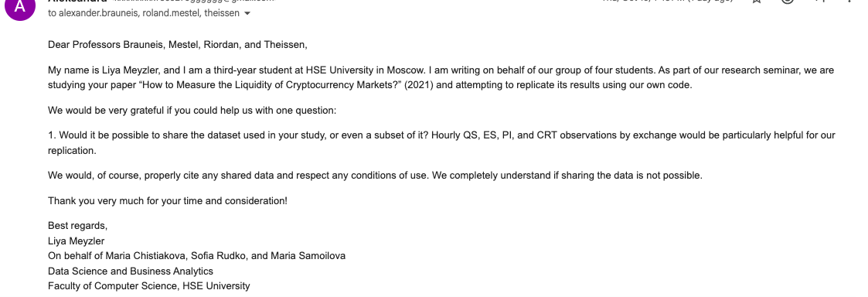
Our data: collected independently from Tardis.dev
DATA
We asked the authors for their dataset and have had no reply, so we built our own sample from recorded exchange feeds.
1 We asked the authors
2 So we collected the data ourselves
7 days
6 markets
1st UTC day of each month, June–December 2019
Bitfinex, Bitstamp, Coinbase × BTC/USD, ETH/USD
126 files
807 / 1,008
trades, best quotes, 25-level books · 2.9 GiB
market-hours pass the paper's 48-of-60 rule
Email to all four authors, sent on behalf of the group. No reply so far.
Not the authors' dataset: independent recordings of the exchanges' live WebSocket feeds, not their REST-API snapshots. Only 1 June 2019 lies inside the paper's period, so this is an out-of-sample check.
Tardis.dev historical CSV datasets: trades, quotes and book_snapshot_25. Raw and minute-level files stay local (Tardis.dev terms of service).
Notes:
Maria Chistiakova (about 0:45)
First, we needed data. We wrote to all four authors and asked for their dataset, or even a small part of it. Here is our email. Unfortunately, we have not received a reply. So we collected real historical exchange data ourselves, from Tardis.dev, which records the live feeds of the exchanges. We took the same three exchanges and the same two pairs, on the first day of each month from June to December 2019: 126 files, about 2.9 gigabytes. This gives 1,008 market-hours, and 807 of them pass the paper's rule: at least 48 minutes with trades in the hour.

Slide 5
Same markets, different data and design
DATA
Our results are an independent check of the paper's findings, not a copy of its tables.
 | Brauneis et al. (paper) | Our study
Period | 16 Dec 2017 – 16 Jun 2019 | 7 days, Jun–Dec 2019
Data source | authors' REST-API polling | Tardis.dev feed recordings
Order book | ≤ 50 levels, irregular snapshots | 25 levels, 10-second grid
Frequency | hourly, daily, 15-day | hourly
Hourly intervals | ≈ 9,500 | 807 valid of 1,008
Evaluation | correlations, quantiles, PCA, regimes, errors, rankings | correlations, regimes, errors, rankings + our extension
Valid hours per market
 | BTC | ETH
Bitfinex | 164 | 122
Bitstamp | 167 | 28
Coinbase | 163 | 163
Bitstamp ETH is thin: read with care. 1 Aug 2019 has recording gaps on Bitfinex and in Coinbase trades.
1
Data and sample
Maria Chistiakova
2
Eight proxies
Sofia Rudko
3
Benchmarks and comparison
Liya Meyzler
4
Robustness and extension
Maria Samoilova
Paper: about 9,500 hourly intervals after the same 80% (48-of-60 minutes) coverage rule. Notebook Sections 2.7 and 3.6.
Notes:
Maria Chistiakova (about 0:30)
The markets are the same as in the paper, but the data source, the period and the order-book depth are different, and only the first of June is inside the authors' period. So this is an out-of-sample check, not a copy of their tables. One market is thin: Bitstamp Ether has only 28 valid hours, so we are careful with it. We split the work into four parts, and now Sofia will explain the eight cheap measures.

Slide 6
Eight proxies, four ideas
PROXIES · PART 2
All eight need only minute open, high, low, close, number of trades and USD volume.
ACTIVITY
PRICE MOVE PER DOLLAR
BID–ASK BOUNCE
HIGH–LOW RANGE
TX, $Vol
Amihud, Kyle
Roll p, Roll r
CS, AR
How much people trade: trades and USD volume per minute.
How far the price moves for each dollar traded.
Trades flip between bid and ask, so price changes partly undo each other.
A minute's high, low and close contain about half a spread (Corwin–Schultz, Abdi–Ranaldo).
high = more liquid
high = less liquid
high = less liquid
high = less liquid
Not interchangeable: AR, CS and Roll r are in bp like the quoted spread; Amihud is per USD, Kyle in (1/USD)^{1/3}.
Definitions as in Brauneis et al., Section 2.2.2. Computed per UTC hour from one-minute bars (notebook Section 4).
Notes:
Sofia Rudko (about 0:45)
Thank you, Maria. My part is the eight cheap measures, the ones you can compute without an order book. They need only minute prices, the number of trades and volume. I split them into four groups. Trades and dollar volume show how busy the market is. Amihud and Kyle ask how far the price moves for each dollar traded. Roll looks at the bounce between the bid and the ask. And Corwin–Schultz and Abdi–Ranaldo read the spread from the high, the low and the close of each minute. Be careful: for the two activity measures a high value means a liquid market, for the other six it means an expensive one. So they are not eight versions of the same thing.

Slide 7

How we computed them, and how we know the code is right
PROXIES · PART 2
One value per market-hour, from minutes with trades only.
Steps
Checks
1
60,480 one-minute bars: 42 market-days × 1,440 minutes
Hand example, 4 minutes: TX 2.25, $Vol 1,250, Roll p 2.83, as on paper
2
One value per UTC hour, using only minutes with trades
Flat price, true spread 5 bp: AR 5.00, CS 5.00, Roll 5.02
3
Keep the hour if ≥ 48 of 60 minutes have trades: 807 of 1,008
Totals: TX and volume add back up to the hourly totals exactly
Every proxy is checked before any result is read.
4
Pairs only from neighbouring minutes with trades, never across a gap or an hour
Recomputation: proxies match the saved file (max. relative difference 7.7·10⁻¹²)
AR, CS and Roll r in bp, like QS; Amihud and Kyle depend on USD units. Notebook Sections 4.1–4.6.
Notes:
Sofia Rudko (about 0:40)
We take the minute bars from Part 1 and compute one value per hour. Like the authors, we keep an hour only if at least 48 of its 60 minutes have trades, so 807 of 1,008 hours. When a formula needs two minutes in a row, we use only neighbouring minutes with trades, and we never jump over a gap. To check the code, we computed a small example by hand, and we built a fake market with a flat price and a spread of five basis points: AR and CS give back exactly five. [Trades and volume also add up to the hourly totals, and the final notebook recomputes every proxy and matches the saved file.]

Slide 8
AR gets the timing right, but overstates small spreads
PROXIES · PART 2
Within one minute, the high–low range is mostly price movement, not the spread.
BITFINEX BTC · 164 HOURS · MEDIANS
0.52 bp
→
1.73 bp
true quoted spread
AR estimate: more than 3×
59%
of Bitfinex BTC hours have Roll = 0 (42–59% on Bitfinex and Coinbase)
29–60%
of AR and CS minute pairs are negative and set to 0, as in the paper: an upward push
Spread × 9 → AR only × 1.5. Same bias without any data problems.
Medians over valid hours (notebook Sections 4.8–4.9). Simulation: random-walk price, trades at bid or ask, inputs taken from our own medians.
Notes:
Sofia Rudko (about 0:45)
Now an important detail: AR gets the timing right, but not the level. On Bitfinex Bitcoin the real spread is about half a basis point, but AR says 1.7, more than three times as much. And Roll is zero in 59 percent of the hours there. Why? Within one minute, the high–low range is mostly price movement, not the spread. In our simulation with a known spread, the true spread grows nine times, from 0.5 to 4.5 basis points, but AR only grows from 2.7 to 4.1. So this bias comes from the method, not from bad data.

Slide 9
Is the paper's “surprising sign” just volatility?
PROXIES · PART 2
Spearman correlation with QS before and after removing hourly volatility, five larger markets.
SIMULATION
AR −0.03
spread moves on its own
AR 0.66
spread and trading follow volatility
AR −0.01
same, volatility removed
TX's link with QS disappears or turns negative; AR keeps 0.41–0.61. AR sees the spread itself.
Partial Spearman correlation on ranked hourly volatility. Bitstamp ETH (28 hours) not shown. Part 4 repeats this for all four benchmarks with bootstrap intervals.
Notes:
Sofia Rudko (about 0:50)
The surprise in the paper is that more trading goes with wider spreads. We think the reason is volatility: in a busy hour, spreads get wider and people trade more, at the same time. So we removed hourly volatility and looked again. On the left are trades: on Bitfinex Bitcoin the correlation falls from 0.51 to about zero, and on Bitstamp Bitcoin, where it was already negative, it falls to minus 0.64. On the right is AR: it keeps between 0.41 and 0.61. So AR really sees the spread, and the surprising sign is mostly volatility. Now Liya will show how we measured the real cost of trading.

Slide 10

Four benchmarks: what a trade really costs
BENCHMARKS · PART 3
The “true” liquidity, built from best quotes, trades and 25-level order books on a 10-second grid.
QS
ES
Our five construction decisions
Quoted spread
Effective spread
(ask − bid) / midpoint at every valid grid point
2 × |trade price − midpoint| / midpoint, first trade after a snapshot
Trades matched to quotes on the same clock (capture time)
Quote at most 60 s old (30 s as a check)
ES as printed (absolute); signed ES as a check
PI keeps the sign, as the text defines it
CRT on 25 levels: enough in 99.85% of snapshots
PI
CRT25
Price impact
Roundtrip cost
signed change of the midpoint after the trade
buy and sell 32k USD of BTC (18k of ETH) through at most 25 book levels
Paper: irregular REST-API snapshots, up to 50 levels. Where the SSRN text and tables disagree (ES, PI, Table 5 units), our choices are documented in notebook Section 2.6.
Notes:
Liya Meyzler (about 1:00)
Thank you, Sofia. To judge the cheap measures, we need the real cost of trading. Like the paper, we use four benchmarks. The quoted spread is the gap between the best ask and the best bid. The effective spread compares the price of a real trade with the midpoint. Price impact shows how much the midpoint moves after a trade. And the roundtrip cost is what you pay if you buy and immediately sell a large order, 32 thousand dollars of Bitcoin, through the order book. We had to make some decisions. We matched trades and quotes on the same clock. The paper's formulas and tables do not fully agree, so we kept the effective spread as printed, with a signed version as a check, and we kept the sign in price impact, as the text says. [Our books have 25 levels instead of 50, but 25 levels are enough in 99.85 percent of snapshots.]

Slide 11
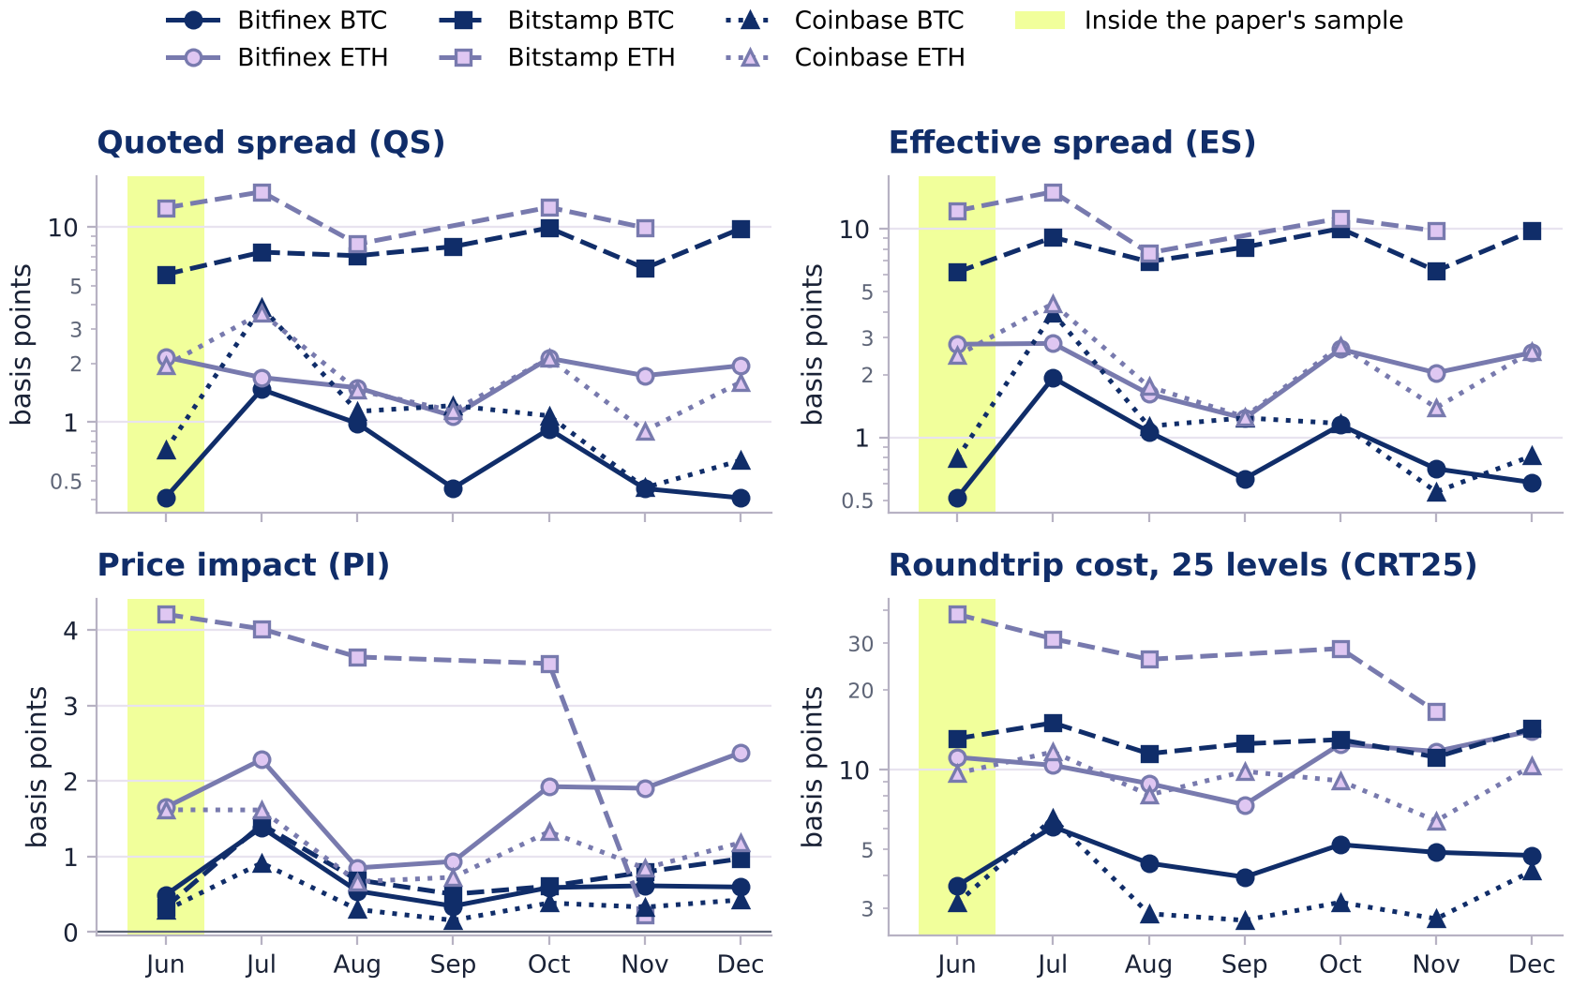
Benchmark levels on the seven dates
BENCHMARKS · PART 3
The venues line up as in the paper; QS and CRT25 levels are close to it, ES and PI levels are higher.
Close to Table 3
QS Bitfinex BTC: 0.725 bp (paper 0.723). CRT25 BTC on Bitfinex / Bitstamp / Coinbase: 4.72 / 12.96 / 3.64 bp vs 3.72 / 14.30 / 3.41.
Higher than Table 3
ES and PI are 2.4–8.5× the paper's means; our ES exceeds QS in 5 of 6 markets. Likely cause (our hypothesis): on a 10-second grid the quote is several seconds old at the trade.
Coinbase BTC
Our QS is about 4× the paper's: 1.31 vs 0.32 bp.
Daily means over valid hours; QS, ES and CRT25 on a log scale. Lime band: 1 June 2019, the only date inside the paper's sample. Paper: Table 3 (BTC), Table 7 (ETH).
Notes:
Liya Meyzler (about 0:45)
Here are the benchmarks on our seven days. Bitstamp is clearly the most expensive exchange. The quoted spread and the roundtrip cost are close to the paper's levels: for Bitfinex Bitcoin we get 0.725 basis points, and the paper has 0.723. But our effective spread and price impact are 2.4 to 8.5 times higher than in the paper. We think the main reason is our regular 10-second grid: when a trade happens, the quote is already a few seconds old. But this is our hypothesis, we could not prove it.

Slide 12
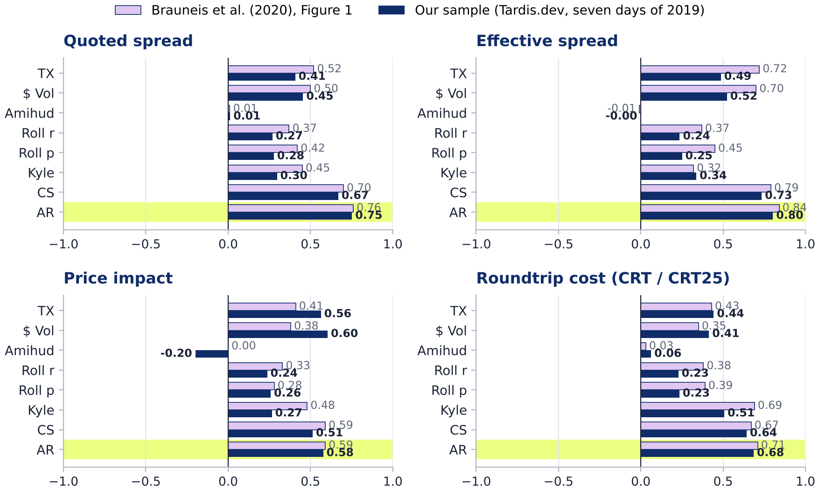
The main result replicates: AR tracks costs best
RESULTS · PART 3
Hourly correlations with the four benchmarks, Bitcoin, averaged over the three venues.
Paper (Brauneis et al.)
Our sample
AR vs … | Ours | Paper
Quoted spread | 0.75 | 0.76
Effective spread | 0.80 | 0.84
Roundtrip cost | 0.68 | 0.71
Price impact | 0.58 | 0.59
AR is first for QS, ES and CRT25; for PI, $Vol (0.60) is marginally above AR (0.58).
Amihud ≈ 0 again; TX and $Vol positive again (0.41–0.60).
Pearson within each venue, averaged over Bitfinex, Bitstamp and Coinbase, as in the paper's Figure 1. Ours: 494 valid BTC hours; CRT25 on 25 levels.
Notes:
Liya Meyzler (about 0:45)
This is the main replication: the paper's Figure 1 next to ours. Lilac bars are the authors, navy bars are us. AR is again the best proxy for the quoted spread, the effective spread and the roundtrip cost: 0.75, 0.80 and 0.68, against 0.76, 0.84 and 0.71 in the paper. For price impact, dollar volume is just a little above AR. Amihud is again close to zero, and trades and volume are again positive. So the main ranking of the paper holds on our data.

Slide 13
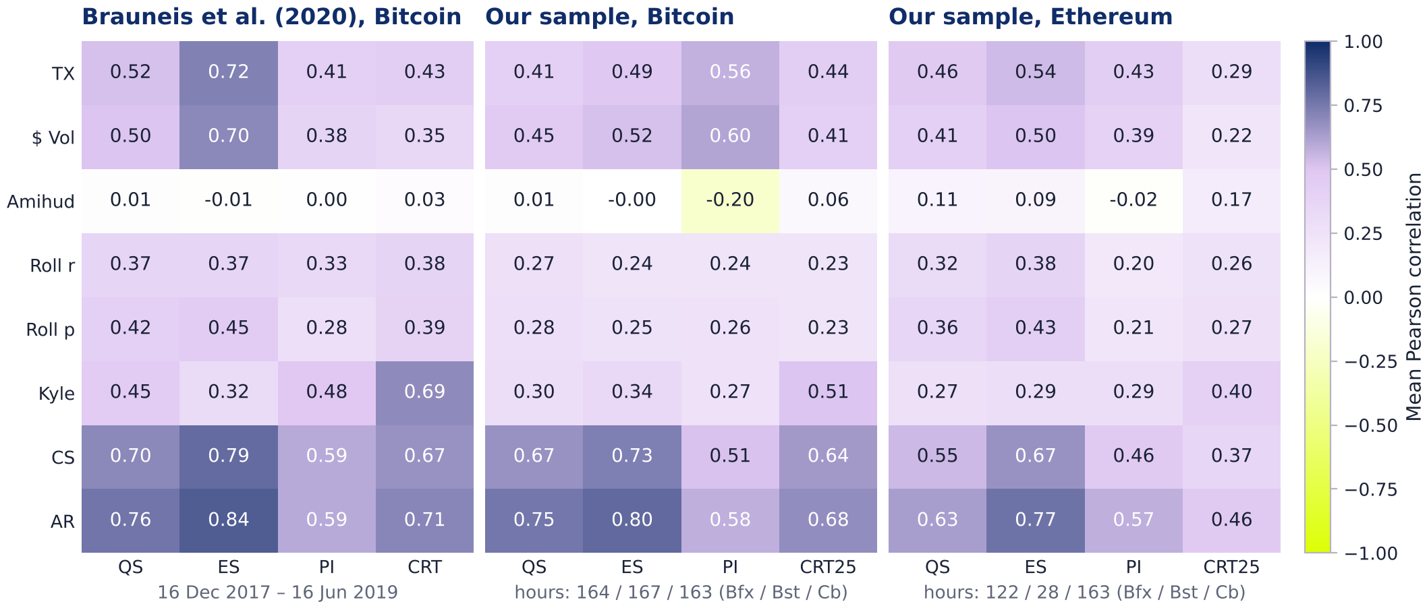
Same ordering of proxies, slightly weaker coefficients
RESULTS · PART 3
Mean correlation of each proxy with each benchmark: the paper (Bitcoin) and our sample (Bitcoin, Ethereum).
0.90
correlation of our 32 BTC coefficients with the paper's
0.98
rank agreement of the 8 proxies for QS (ES 0.90, CRT 0.90, PI 0.65)
−0.065
mean difference; ours lower in 24 of 32
4 of 4
Rankings agree more than sizes: 7 days of 2019 against 18 months of 2017–2019.
ETH: AR is top for all four benchmarks
Hourly data, valid hours only; colour scale from −1 (lime) through 0 (white) to +1 (navy). The paper's values are the labels printed in its Figure 1.
Notes:
Liya Meyzler (about 0:35)
If we look at the full matrix, the picture is very similar. Our 32 Bitcoin coefficients correlate with the paper's at 0.90. Our values are a bit lower, by 0.065 on average, but the order of the proxies is almost the same: the rank agreement is 0.98 for the quoted spread. So the differences are mostly in size, not in order. And for Ethereum, AR is the best for all four benchmarks.

Slide 14
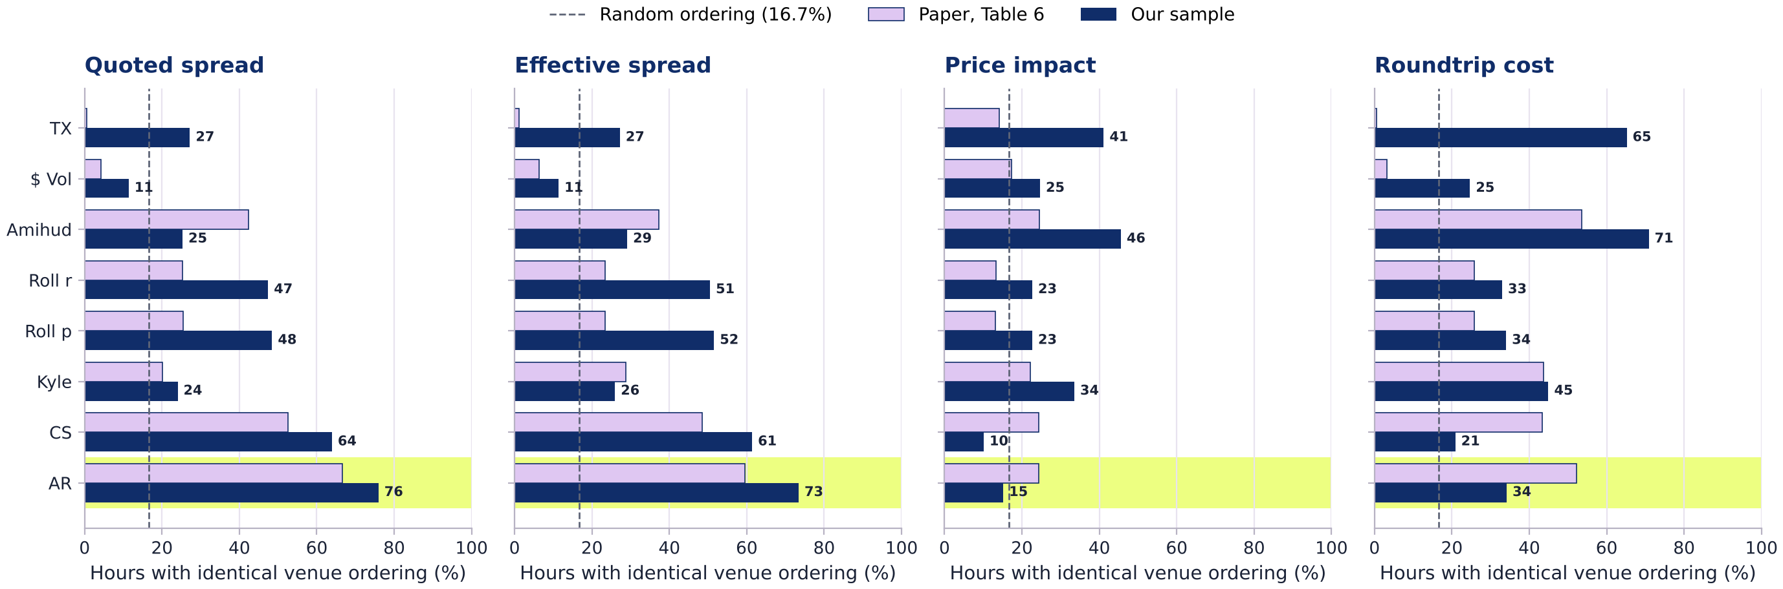
AR also ranks the venues best
RESULTS · PART 3
How often a proxy orders Bitfinex, Bitstamp and Coinbase exactly like the benchmark (Bitcoin, hourly).
QS: AR 75.9% (paper 66.67%)
ES: AR 73.4% (paper 59.57%)
CRT: Amihud first (70.9%)
PI: AR 15.2% < random 16.7%
158 hours with all three venues valid; TX and $Vol reversed; ties excluded (Roll: 97 untied hours). ETH QS: AR 61.5% of 26 hours. Paper: Table 6.
Notes:
Liya Meyzler (about 0:50)
The last test from the paper is about exchanges. For every hour, we check if a proxy puts Bitfinex, Bitstamp and Coinbase in the same order as the benchmark. Random guessing gives 16.7 percent. For the quoted spread, AR is right in 76 percent of the hours; the paper has 67. For the effective spread, 73 percent. But for price impact AR fails: it is right in only 15 percent of the hours, even below random. So the main findings of the paper replicate. Now Maria will show what happens when we test them harder.

Slide 15
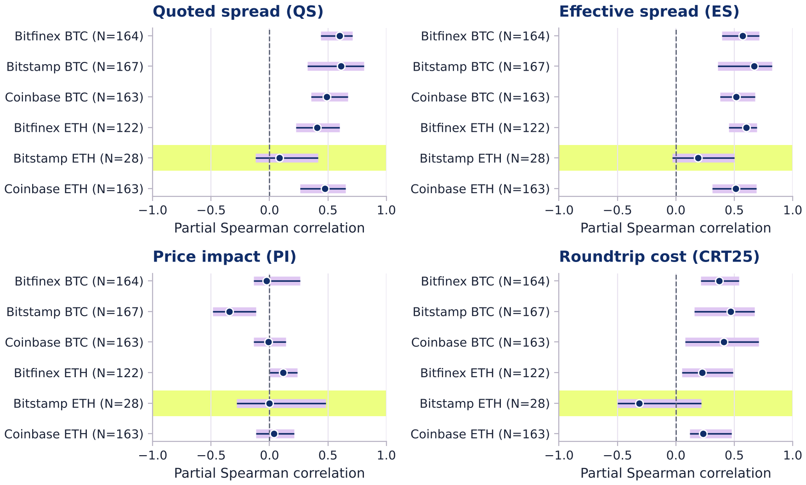
Beyond volatility: AR still tracks the spreads
EXTENSION · PART 4
Partial Spearman correlation of AR with each benchmark after removing hourly volatility, with 95% bootstrap intervals.
QS 0.41–0.61 · ES 0.51–0.67
Survive the control; every interval is above zero (lower bounds 0.23–0.45)
CRT25 0.22–0.47
Weaker; lower bounds 0.05–0.21
PI −0.35 to 0.12
Gone; Bitstamp BTC even negative, interval [−0.49, −0.12]
TX and $Vol
Negative partial correlation with CRT25 in all five markets
Ranges over the five larger markets. 999 date-block resamples of the seven dates, same draws for all markets; individual intervals, no multiple-comparison adjustment. Lime band: Bitstamp ETH.
Notes:
Maria Samoilova (about 0:50)
Thank you, Liya. My part is our extension. First, volatility. Sofia showed it for the quoted spread; here it is for all four benchmarks, with uncertainty. We remove ranked hourly volatility and correlate what is left. Because we have only seven days, we use a bootstrap that resamples whole days, 999 times. For the quoted and the effective spread, AR stays clearly positive, from 0.41 to 0.67, and all intervals in the five larger markets are above zero. For the roundtrip cost the link is weaker. But for price impact it disappears: beyond volatility, AR does not see price impact.

Slide 16
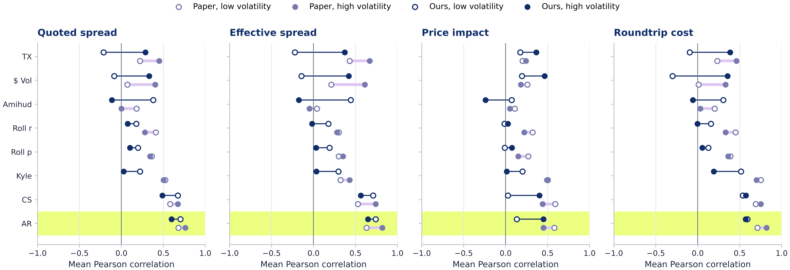
Calm vs volatile hours: the paper's pattern reverses
EXTENSION · PART 4
Bitcoin correlations in the lowest and highest volatility tercile. Open marker: calm hours; filled marker: volatile hours.
AR–QS: 0.70 → 0.60 (paper 0.68 → 0.76)
AR still best for QS and ES in both terciles
TX with QS: −0.21 calm, +0.29 volatile
Terciles of hourly volatility per market; Pearson per venue, averaged over the three venues. Paper values from its Figure 6. Return and volume splits: notebook Section 7.3.
Notes:
Maria Samoilova (about 0:40)
Second, market conditions. Like the paper, we split the hours into the calmest third and the most volatile third. The paper finds higher correlations in volatile hours. For AR we find the opposite: with the quoted spread, 0.70 in calm hours and 0.60 in volatile hours. Still, AR is the best proxy for both spreads in both groups. [And trades are negatively related to the spread in calm hours, and positively only in volatile hours, which again points to volatility.]

Slide 17
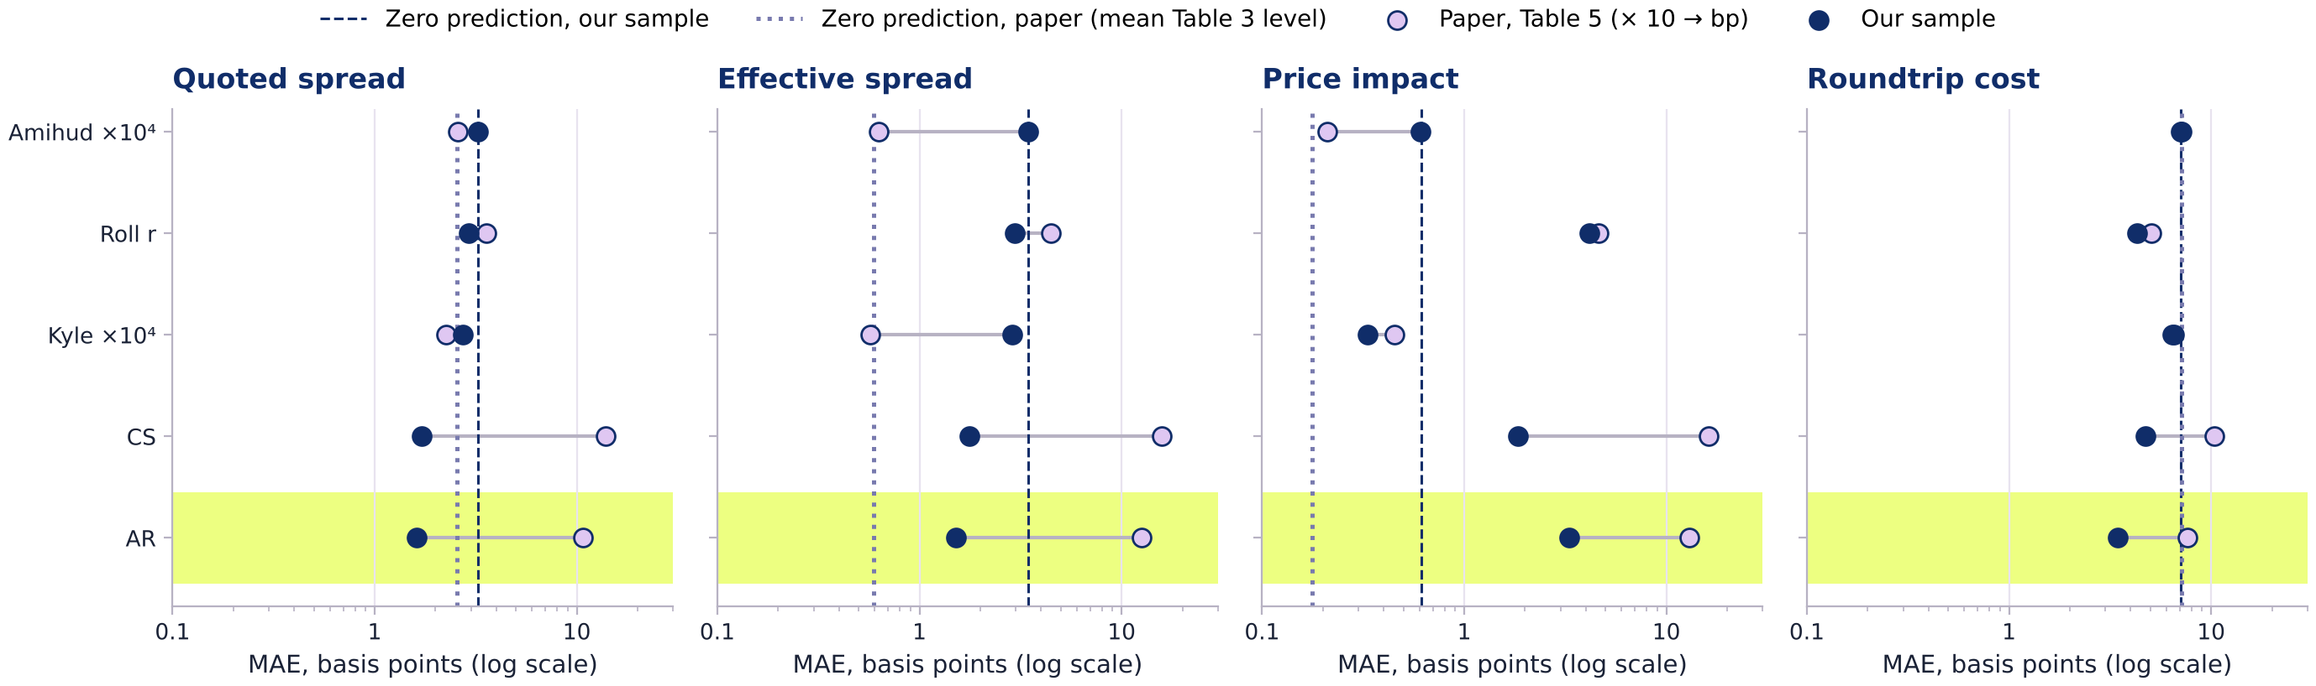
Level accuracy needs a baseline
EXTENSION · PART 4
Mean absolute error against each benchmark (Bitcoin, bp, log scale), with the error of always predicting zero.
Paper: Kyle and Amihud are the most accurate in levels.
Ours: Amihud's error = predicting zero (QS 3.25 vs 3.25 bp; paper 2.58 vs ≈ 2.54). AR has the smallest QS and ES errors: 1.61 and 1.52 bp.
Mean of three venues, hourly. Paper: Table 5 printed ×1,000, multiplied by 10 (our reading of its units). Dotted line: the paper's mean level = error of predicting zero (QS, CRT; lower bound for ES, PI).
Notes:
Maria Samoilova (about 0:40)
Third, levels. The paper says Kyle and Amihud are the most accurate in levels. We added a very simple baseline: always predict zero. Amihud's error is the same as the error of predicting zero, in our data, and almost exactly in the paper's own numbers, because the scaled Amihud ratio is tiny. So a small error does not make a good measure. In our sample, AR has the smallest error for both spreads.

Slide 18
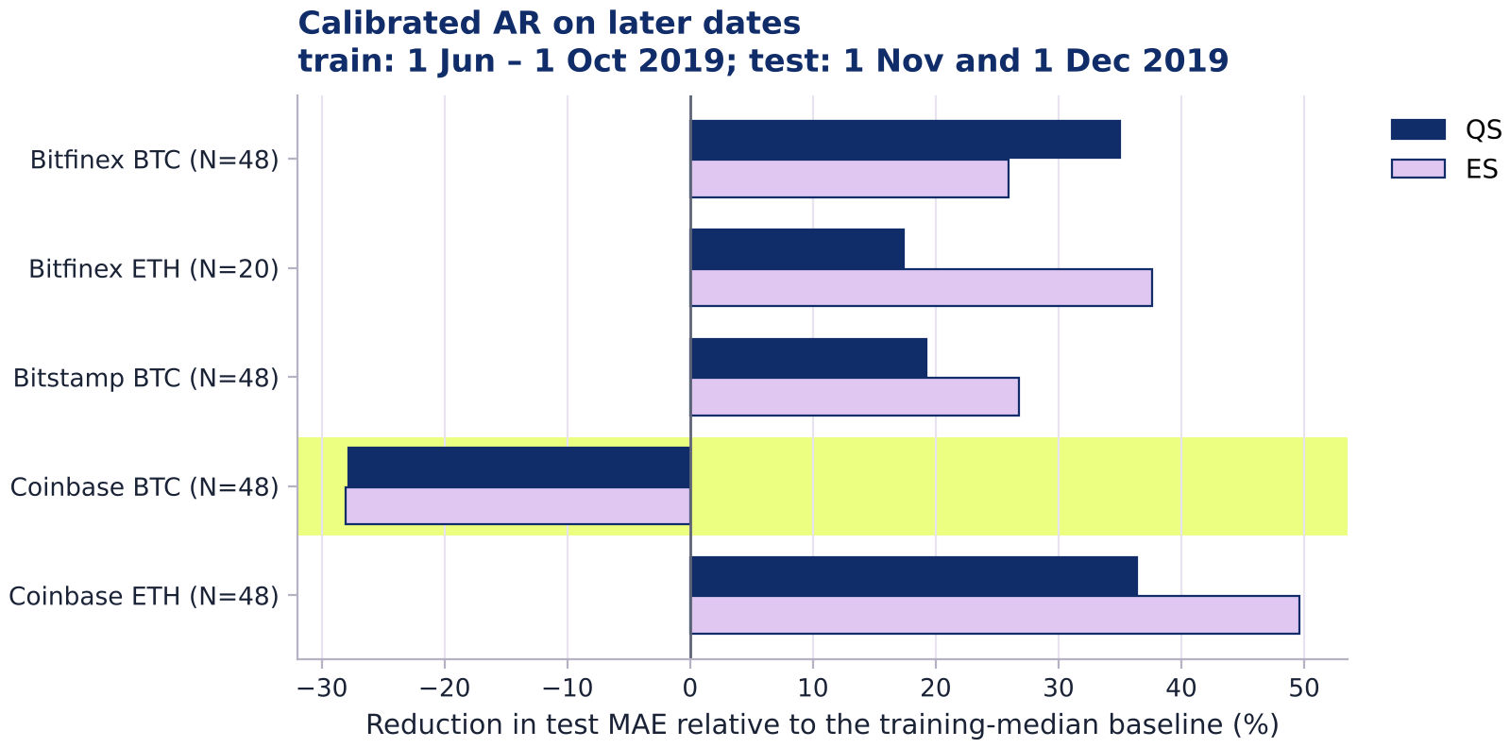
Does a calibrated AR measure costs on later dates?
EXTENSION · PART 4
Train on 1 Jun – 1 Oct 2019, test on 1 Nov and 1 Dec 2019, compare with the training median.
1
Fit benchmark = a + b × proxy on training dates only
2
Apply it to the same hours on the test dates
3
Compare with zero and training-median baselines
QS +17–36% · ES +26–50%
lower test error in 4 of 5 markets
Coinbase BTC −28%
Test-day spreads fell below the training level; predicting zero beats every calibrated proxy.
Calibration fixes AR's level bias only while the cost level is stable. Raw AR: 1.2–3.1× the baseline's QS error.
Affine calibration of the standardized proxy, fitted on training dates only; QS and ES clipped at 0. Measures the same hour, not a forecast. Bitstamp ETH omitted (1 test hour).
Notes:
Maria Samoilova (about 0:50)
Fourth, can a proxy measure cost levels on new dates? We fit a simple linear calibration only on June to October, and test it on November and December against the training median. In four of five markets, calibrated AR reduces the error: by 17 to 36 percent for the quoted spread and by 26 to 50 percent for the effective spread. But on Coinbase Bitcoin it fails. Spreads on the test days were lower than before, and even predicting zero beats every calibrated proxy. So calibration helps only when the cost level is stable.

Slide 19
Which findings of the paper replicate?
SYNTHESIS
Bitcoin, hourly. Lilac column: the paper's numbers; navy column: our sample.
Finding of the paper | Paper | Our sample | Verdict
AR best for QS, ES, CRT | 0.76 / 0.84 / 0.71 | 0.75 / 0.80 / 0.68 | Replicated
AR best for PI | 0.59 | 0.58 ($Vol 0.60) | Partly
CS second | for QS, ES, PI | for QS, ES, CRT25 | Largely
Amihud uncorrelated | −0.01 to 0.03 | −0.20 to 0.06 | Replicated
TX, $Vol positive with costs | 0.35 to 0.72 | 0.41 to 0.60 | Replicated*
Kyle tracks the roundtrip cost | 0.69 | 0.51 | Weaker
AR best in calm and volatile hours | yes | yes for QS and ES | Largely
Correlations higher in volatile hours | yes | no: lower for AR | Not replicated
Kyle and Amihud best in levels | yes | Amihud = zero baseline | Not replicated
AR ranks venues best (QS) | 66.67% | 75.9% | Replicated
Benchmark levels (Table 3) | — | QS, CRT close; ES, PI 2.4–8.5× | Partly
* After removing volatility, the activity–cost link mostly disappears (slide 15). Full table: notebook Section 6.7.
Notes:
Maria Samoilova (about 0:35)
Here is the full scorecard. The core of the paper replicates: AR is the best for timing and for ranking exchanges, and Amihud tells us almost nothing. Some results are weaker, like Kyle for the roundtrip cost. And two claims do not replicate in our sample: correlations are not higher in volatile hours, and Amihud is not accurate in levels, it is just close to zero.

Slide 20
Our contribution: what we add beyond the paper
NOVELTY · OUR CONTRIBUTION
All six points are implemented and run in our final notebook (Sections 3–7).
1
Independent data
2
Volatility control
3
Uncertainty for 7 days
The six markets rebuilt from raw Tardis.dev trades, quotes and 25-level books, mostly after the paper's period, with unit and integration tests.
Partial Spearman correlations: AR's link to spreads survives, its link to price impact does not; the activity–cost sign is largely volatility.
Date-block bootstrap with 999 resamples of whole days: 95% intervals for all 192 partial correlations.
4
A baseline for levels
5
Out-of-sample calibration
6
Transparent definitions
Errors compared with predicting zero: Amihud's “accuracy” equals the zero forecast, in our data and in the paper's.
Train June–October, test November–December against zero and median baselines: helps in 4 of 5 markets, fails when the level shifts.
ES absolute and signed, signed PI, Table 5 units documented; checks of quote age (30 vs 60 s), book depth and proxy bias by simulation.
Planned but not done: the Binance 2024 → 2025 extension from our project plan (see Limitations).
Notes:
Maria Samoilova (about 0:45)
So, what is new in our work? First, an independent check on different data, mostly after the paper's period, built from raw trades, quotes and order books. Second, correlations controlled for volatility. Third, bootstrap intervals for a short sample. Fourth, a zero baseline for level accuracy. Fifth, an out-of-sample calibration test with simple baselines. And sixth, we documented every definition choice and tested the sensitivity to quote age and book depth. All of this is implemented in our final notebook.

Slide 21
Limitations: what our design cannot show
CRITIQUE
Seven selected days: our findings are indicative rather than conclusive.
Sample
7 first-of-month days (807 hours vs ≈ 9,500 in the paper); Bitstamp ETH only 28 hours; recording gaps on 1 Aug 2019.
Different data
WebSocket recordings on a 10-second grid instead of REST snapshots: explains part of the higher ES and PI levels.
Book depth
25 instead of 50 levels: CRT25 approximates CRT, although 25 levels fill the order in 99.85% of snapshots.
Scope
Hourly only: no daily or 15-day frequency, quantile dependence or PCA composite; the planned Binance 2024 → 2025 extension was not done.
Definitions
ES, PI and Table 5 units follow our documented reading of the SSRN text; the authors have not confirmed it.
Reproducibility
FAST_MODE loads ES, PI and CRT25 from the full run; only the full mode (several hours) recomputes them from raw data.
Notebook Section 8.4.
Notes:
Maria Samoilova (about 0:25)
Our study has clear limits. Seven days are not eighteen months. Our data come from a different source, with 25 levels and a 10-second grid. We worked only with hourly data, and we did not do quantile dependence, the PCA composite or the Binance extension from our plan. And some definitions are our interpretation, because the authors have not replied. So our results are indicative, not final.

Slide 22
Conclusions
CONCLUSIONS
What we can say after replicating and extending the paper.
01
The central result travels
On independent 2019 data, AR again tracks spreads and roundtrip costs best and ranks the venues best.
02
Volatility is a common driver
The positive activity–cost link mostly disappears once volatility is removed; AR keeps 0.41–0.61 with QS.
03
Price impact is the hardest
No proxy tracks it after the volatility control, and AR ranks the venues by it no better than chance.
04
Levels need a baseline
Amihud's small error is the zero forecast; AR is biased upwards at minute frequency.
05
For practice
Use AR to compare venues and time liquidity; for cost levels, calibrate on recent data and check against a simple baseline.
Notes:
Maria Samoilova (about 0:30)
To conclude: the paper's main result travels well. AR is the best cheap measure for timing spreads and comparing exchanges. But part of its success is volatility, it does not capture price impact, and for cost levels you need calibration and a simple baseline. Thank you for your attention. We are happy to answer your questions.

Slide 23
References, data and tools
REFERENCES
Main paper
Brauneis, A., Mestel, R., Riordan, R., Theissen, E. (2021). How to measure the liquidity of cryptocurrency markets? Journal of Banking & Finance 124, 106041. We worked with the SSRN version of March 2020.
Proxy methods
Roll (1984); Amihud (2002); Corwin & Schultz (2012); Kyle & Obizhaeva (2016); Abdi & Ranaldo (2017), as cited in the paper.
Data
Tardis.dev historical CSV datasets: trades, quotes and book_snapshot_25 for Bitfinex, Bitstamp and Coinbase, seven days of 2019.
Code
Group17_Cryptocurrency_Liquidity_Measurement_notebook.ipynb (Python 3, pandas, NumPy, matplotlib). FAST_MODE about one minute; full mode several hours.
Use of language models: an LLM (Claude, Anthropic) helped us implement and review code and draft explanations and slides. All numbers come from the notebook's computed outputs.
Notes:
Not presented. Shown only if asked about sources, data or tools.

Slide 24

Thank you
Questions are welcome
…and may your spreads always be tight
Chistiakova Maria · Rudko Sofia · Meyzler Liya · Samoilova Maria
Research Seminar: Data Analysis in Finance · Group 17 · Moscow, 2026
Notes:
Maria Samoilova closes; the whole group answers questions. Backup slide 25 has short answers on the proxies (Sofia).

Slide 25
Proxy details for questions
BACKUP · PART 2
Short answers on the eight proxies (Sofia).
Why average TX over minutes with trades?
That is the paper's definition (Section 2.2.2): a minute without trades is a gap, not a zero.
Does setting negative pairs to 0 bias AR and CS?
Yes, upwards, as in the paper. 29–60% of pairs are negative; “average first, clip after” gives CS = 0 in five of six markets.
Why is Roll so often zero?
Spreads below 1 bp against minute moves of about 7 bp: the covariance is often positive, so Roll = 0. The simulation shows the same.
Why does AR keep the square root?
As in the SSRN formula: AR is then a spread in bp, comparable with QS.
What are Kyle's units?
Kyle divides by total hourly USD volume, so its level depends on units; we scale it ×10⁴ only for level comparisons.
What about odd Bitfinex prices?
33.4% of BTC and 21.5% of ETH minutes have sub-cent prices; kept as recorded and flagged.
Notebook Sections 4.6–4.9.
Notes:
Backup for Sofia's Q&A. Not presented in the 15 minutes.

