Slide 1

Tetris 2048
COMP 204 - Programming Studio
Mustafa Mert Burma 041701033
Rabia Kodal 041701018
Şafak Barış041701007
Prof. Dr. Muhittin Gökmen
Mustafa Ersen
Aysenaz Ezgi Ergin

Slide 2
Tetris 2048
In this Project we will try to develop a game in java using the basic drawing class
The game we will develop is two well-known games;Tetris and 2048
∙First we will develop the basic Tetris game.
∙ Then we will combine it with 2048.
An example image for the game is shown on next page

Slide 3
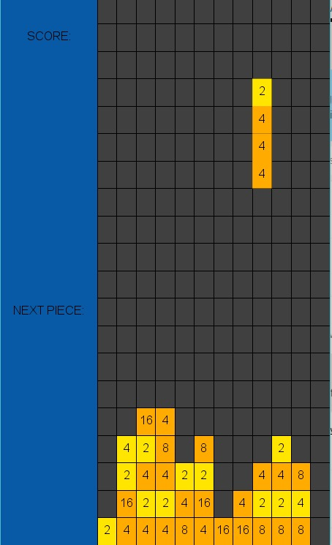
Tetris 2048

Slide 4
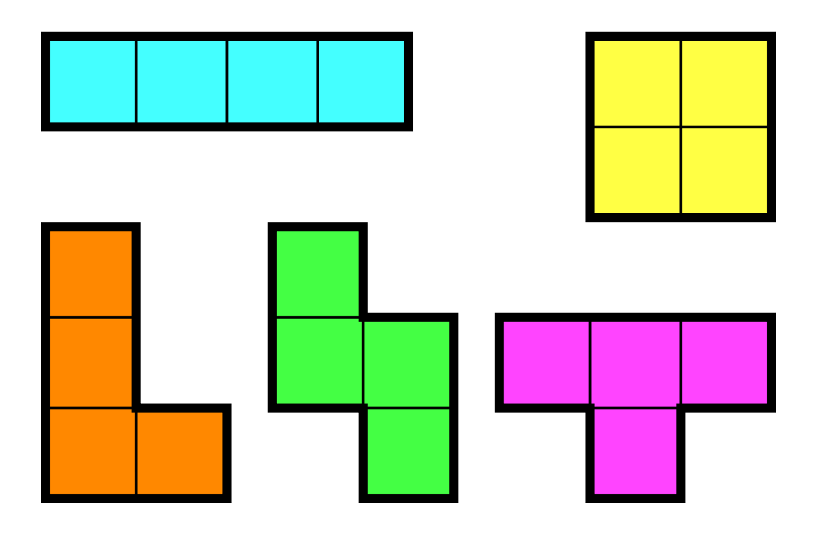
About Tetris
Tetris is a tile-matching puzzle style game designed and developed by Alexey Pajitnov,
Dmitry Pavlovsky and Vadim Gerasimov in 1984
Goal of Tetris is clearing as many horizontal lines of blocks as possible.
The player can move, rotate and drop different shapes each composed of four
blocks in the 2D playing field.

Slide 5
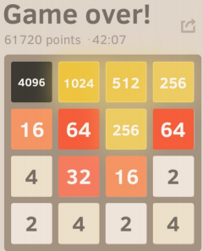
About 2048
2048 is a small puzzle game (created by Gabriele Cirulli) in which the player moves tiles on a 4x4 board.
While moving the tiles, if two tiles with the same value touch, they merge into a single tile with their value doubled.
If the 4x4 board becomes full of tiles and no more move is possible, the player loses the game.

Slide 6
TETRİS 2048
Score is determined both from merged numbers as in 2048
and cleared horizontal rows as in Tetris.
Merging numbers has a higher priority than clearing rows
The sum of all the numbers in each cleared horizontal row
is also added to the score.

Slide 7
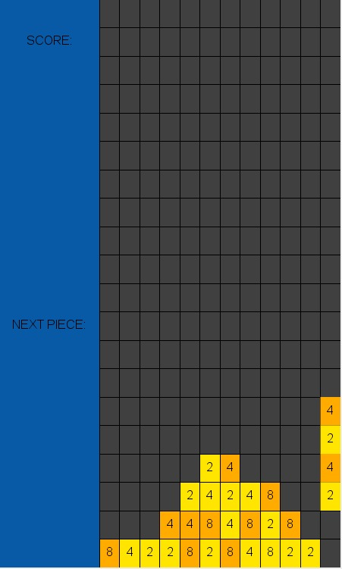
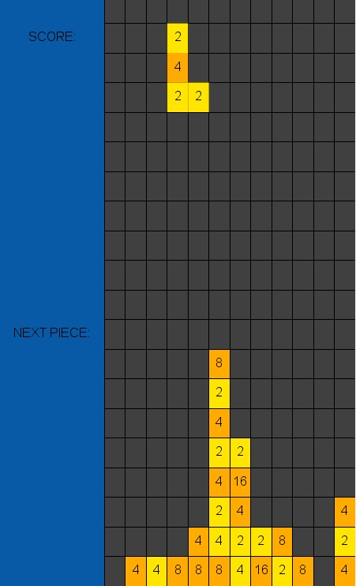
Demonstration of Merging Numbers and Clearing Horizontal Rows

