Slide 1


Repeatability Tests
Kodanda Challa

Slide 2
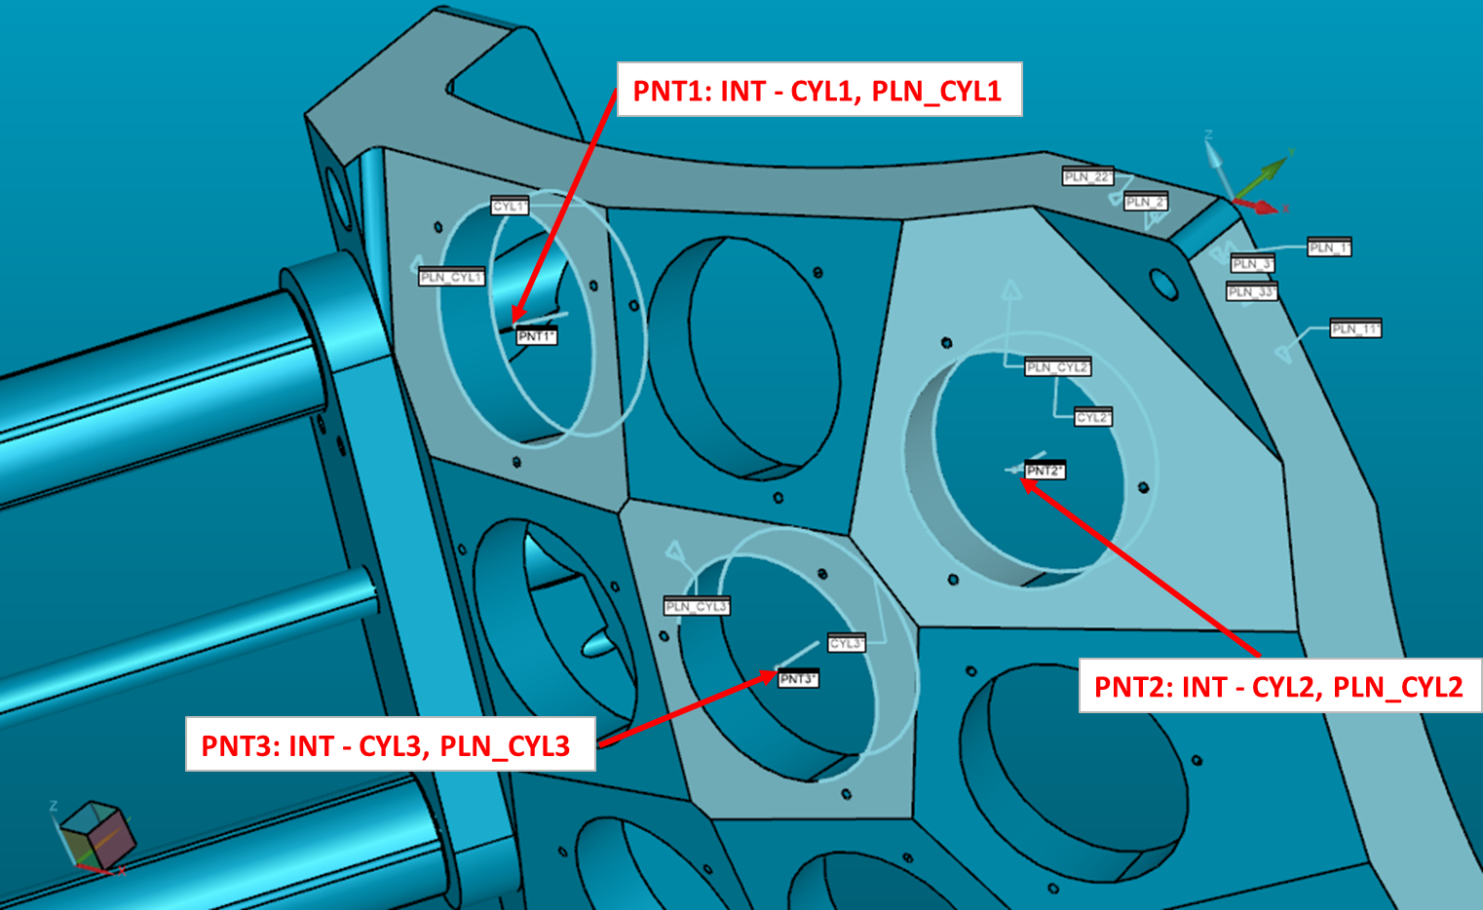
Calibration of Three points
PNT = Point
INT: Intersection
CYL: Cylinder
PLN_CYL: Plane of CYL
Calibrating Point 1 ÷ 3 again - again after different actions
Repeatabilty tests (Actions)
Piston
Rail
Piston Rail

Slide 3
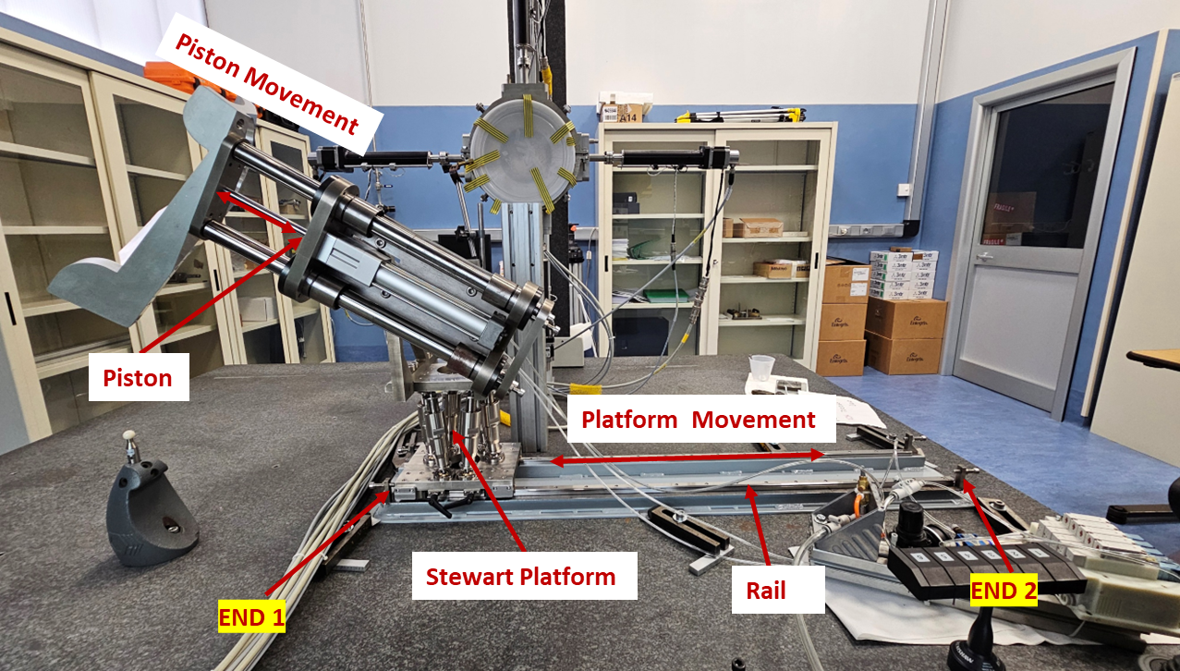

Slide 4
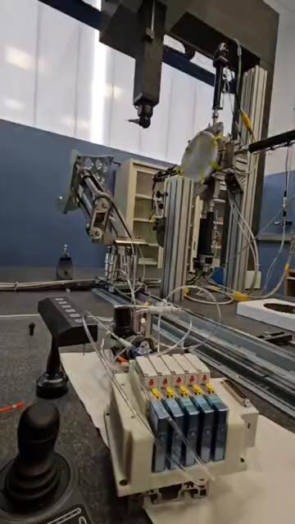
Piston_Rail Repeatability Tests
Initial Measurement:
With the piston at Top Dead Centre (TDC), and Platform at End 1, record the coordinates of Point 1 Point 2 and Point 3 using the Coordinate Measuring Machine (CMM).
Movement Cycle:
Move the piston from TDC to Bottom Dead Centre (BDC) and then back to TDC.
Move the rail from End 1 to End 2 and then back to End 1.
Repeat Measurement:
Record the coordinates of Point 1 Point 2 and Point 3 again using the CMM.
Repetitions:
Repeat steps 2 and 3 ten times for a total of ten measurements.

Slide 5
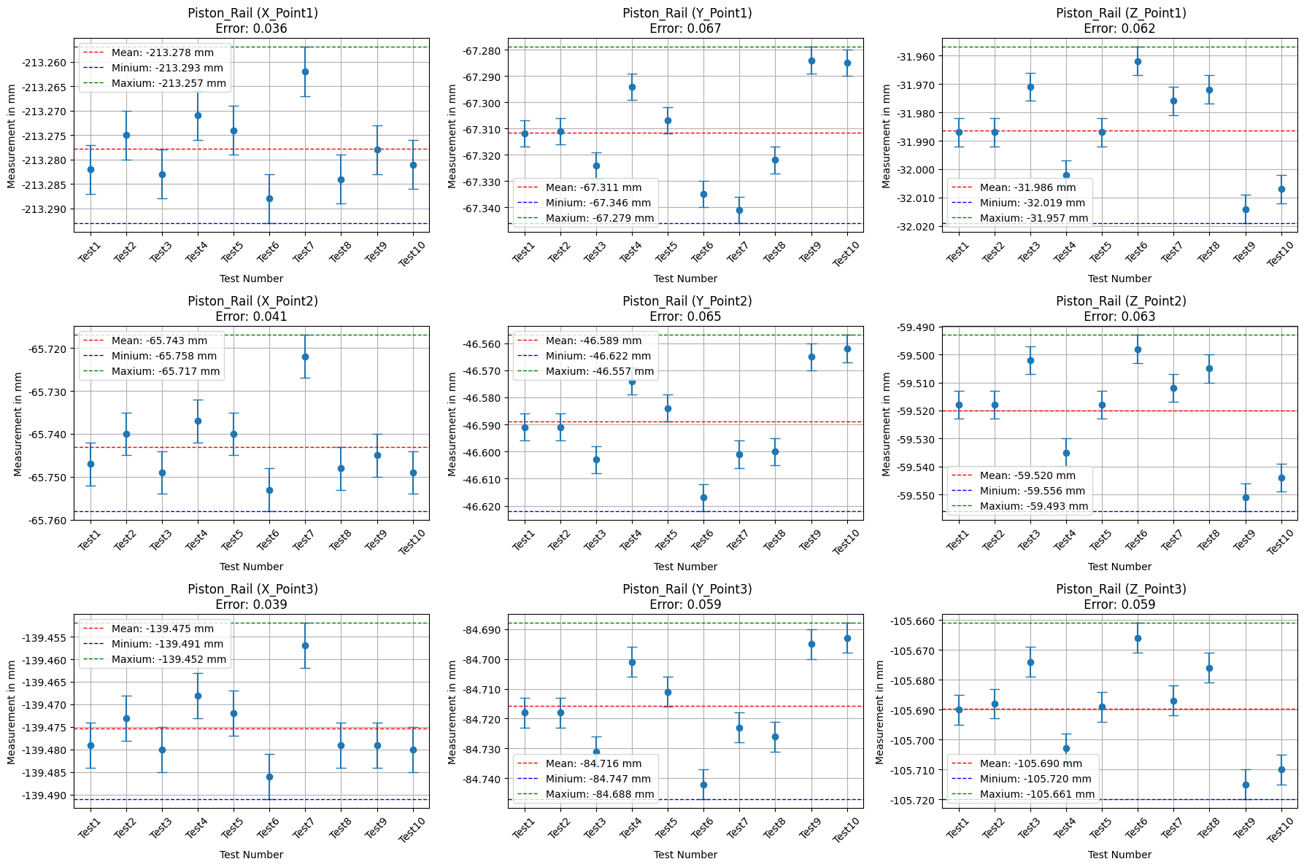
Piston_ Rail Repeatability test (outcome)

Slide 6
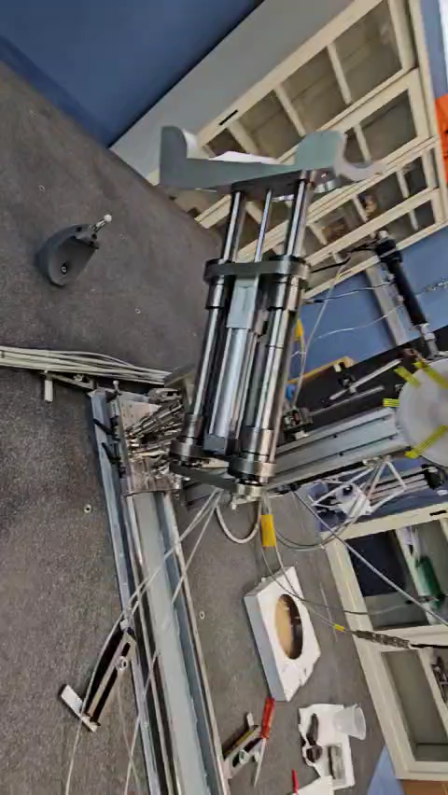
Piston Repeatability Tests
Initial Measurement (TDC):
With the piston at Top Dead Centre (TDC), record the coordinates of Point 1 Point 2 and Point 3 using the Coordinate Measuring Machine (CMM).
Piston Movement Cycle:
Move the piston from TDC to Bottom Dead Centre (BDC) and then back to TDC.
Repeat Measurement (TDC):
With the piston now back at TDC, record the coordinates of Point 1 Point 2 and Point 3 again using the CMM.
Repetitions:
Repeat steps 2 and 3 ten times for a total of ten measurements at TDC after the piston movement cycle.

Slide 7
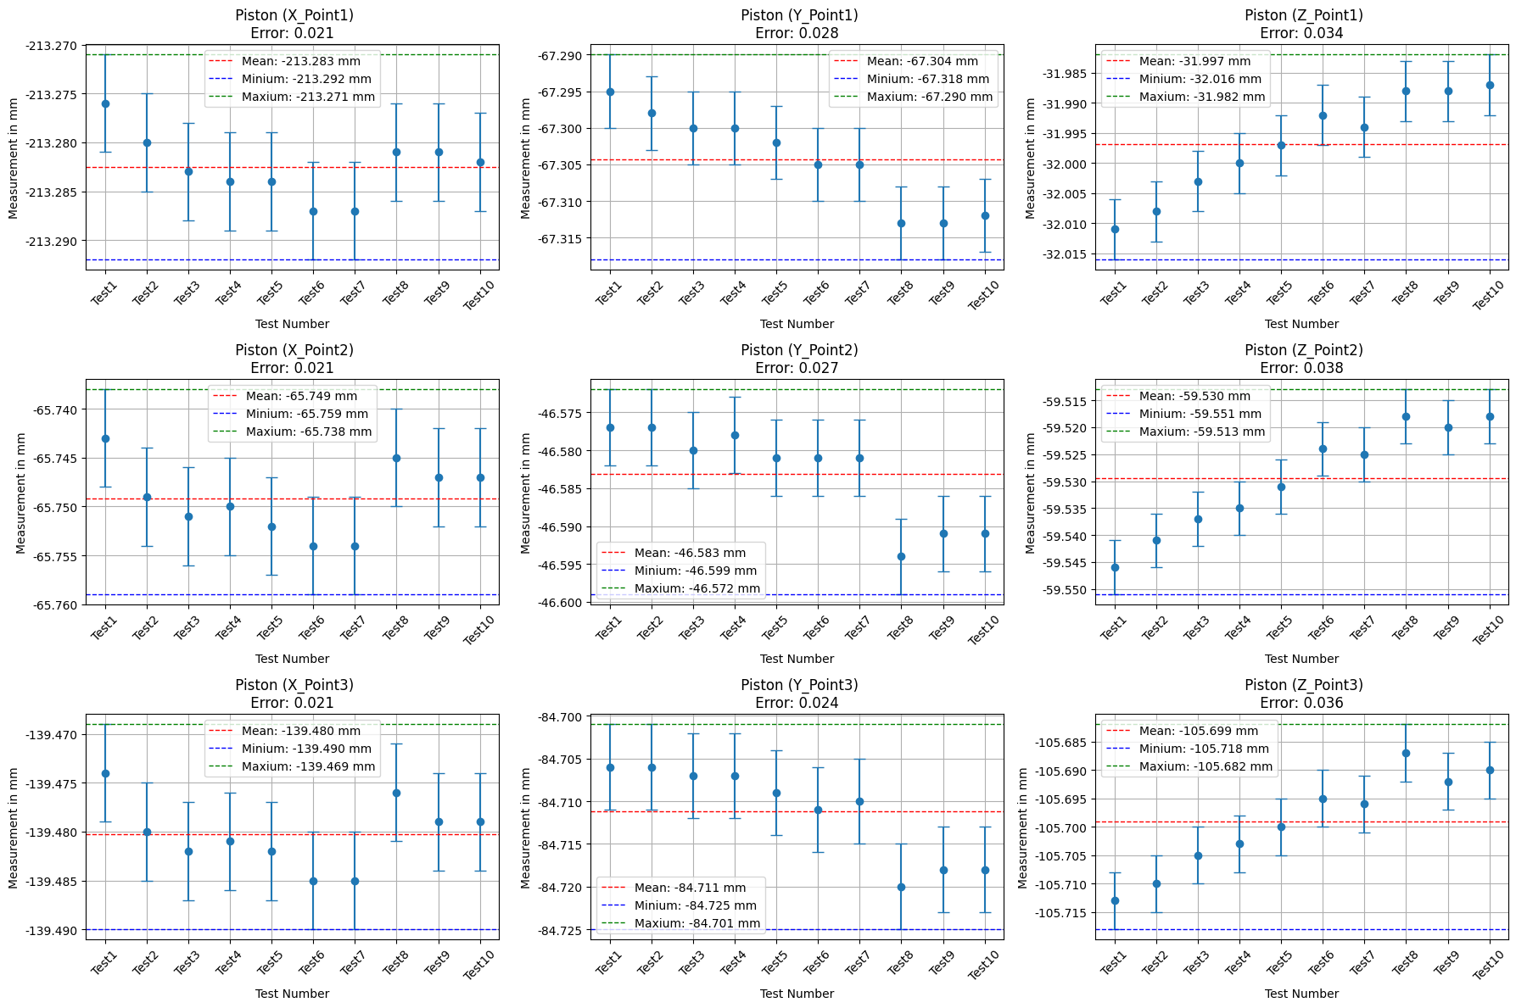
Piston Repeatability test (outcome)

Slide 8
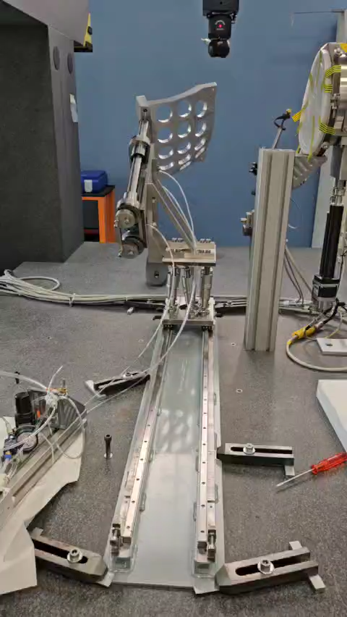
Rail Repeatability Tests (Piston upside)
Initial Measurement (End 1):
With the rail at End 1 record the coordinates of Point 1 Point 2 and Point 3 using the Coordinate Measuring Machine (CMM).
Rail Movement Cycle:
Move the rail from End 1 to End 2 and then back to End 1.
Repeat Measurement (End 1):
With the rail now back at End 1, record the coordinates of Point 1 Point 2 and Point 3 again using the CMM.
Repetitions:
Repeat steps 2 and 3 ten times for a total of ten measurements at End 1 after the rail movement cycle.

Slide 9
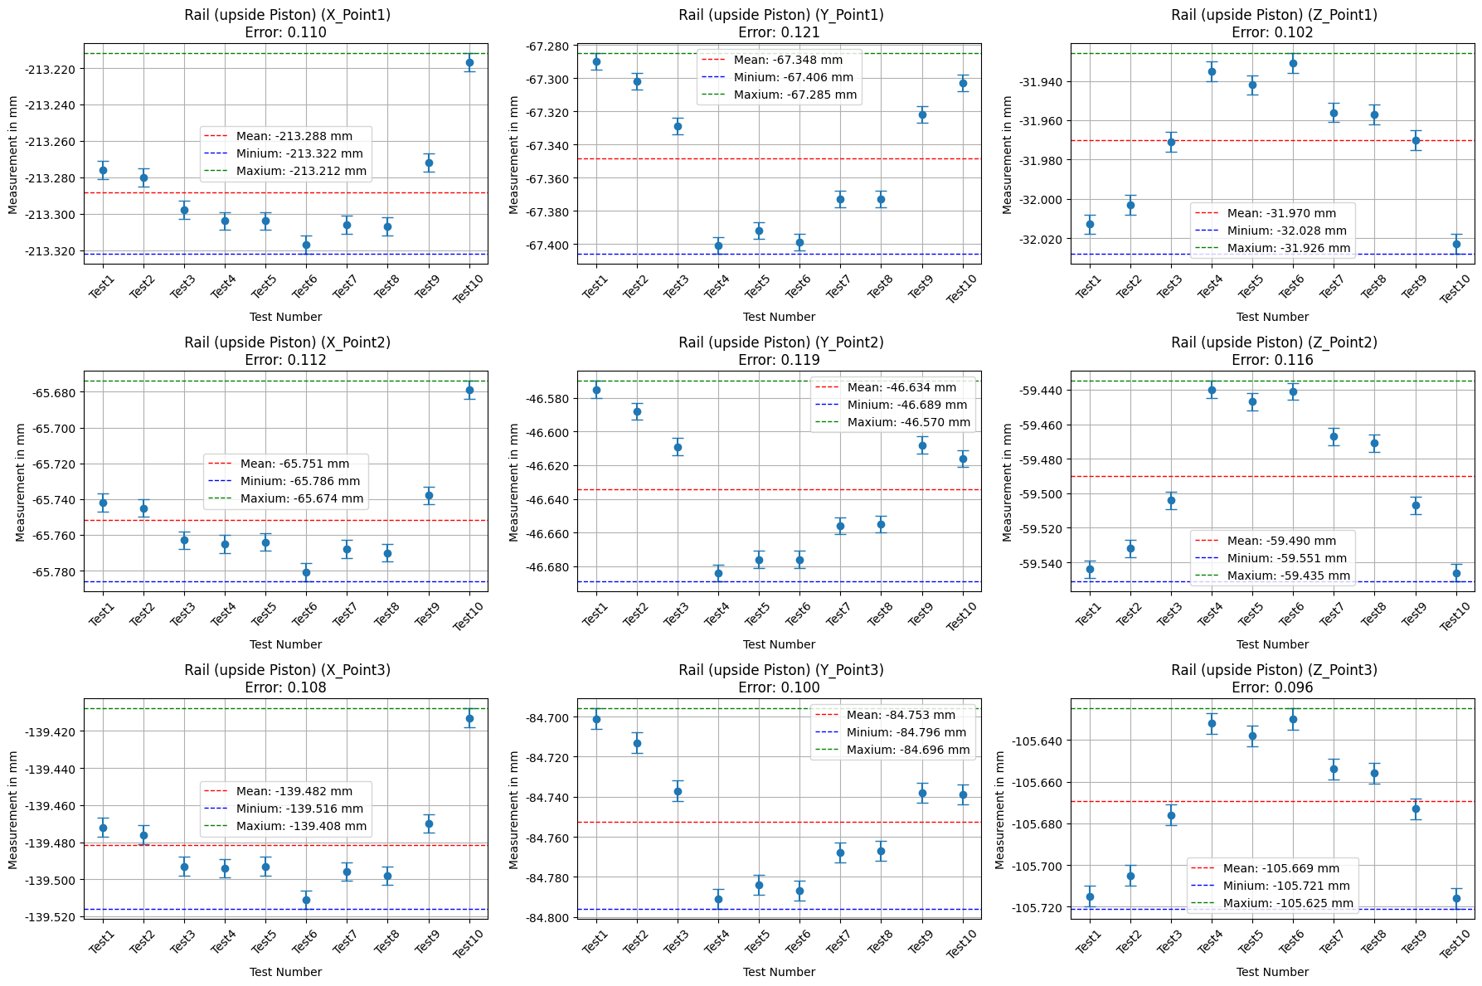
Rail Repeatability test (outcome – Upside Piston)

Slide 10
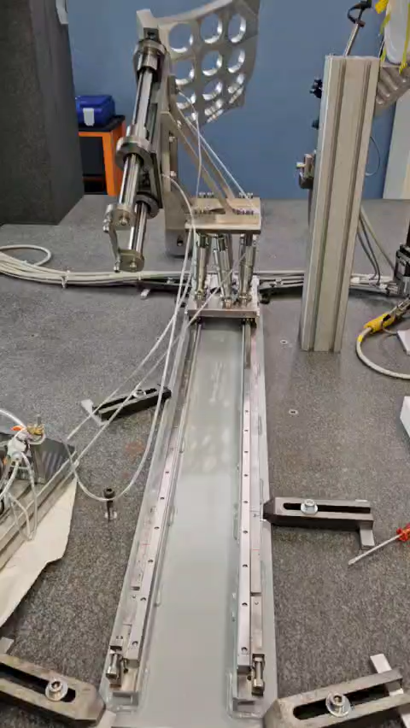
Rail Repeatability Tests (Piston Downside)
Initial Measurement (End 1):
With the rail at End 1 record the coordinates of Point 1 Point 2 and Point 3 using the Coordinate Measuring Machine (CMM).
Rail Movement Cycle:
Move the rail from End 1 to End 2 and then back to End 1.
Repeat Measurement (End 1):
With the rail now back at End 1, record the coordinates of Point 1 Point 2 and Point 3 again using the CMM.
Repetitions:
Repeat steps 2 and 3 ten times for a total of ten measurements at End 1 after the rail movement cycle.

Slide 11
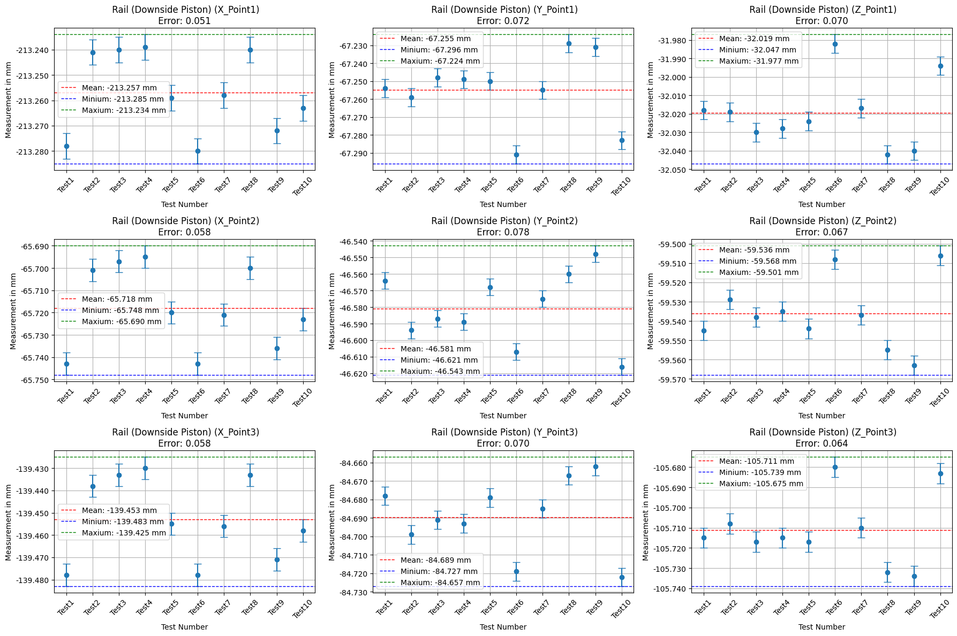
Rail Repeatability test (outcome-Downside Piston)

Slide 12
Conclusion
Maximum Error is 0.121 mm

Slide 13
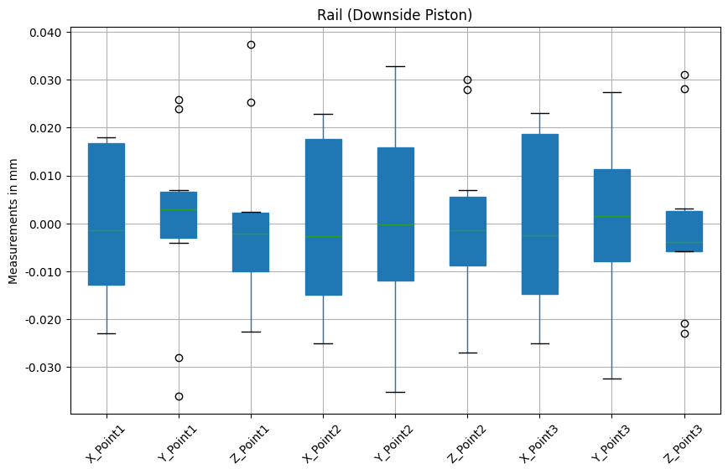
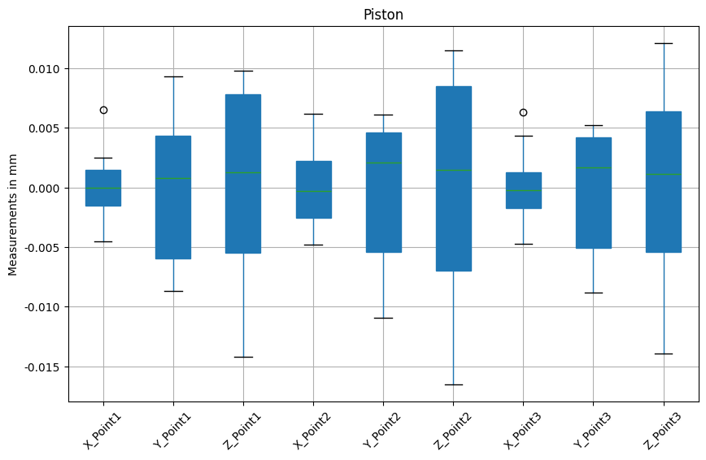
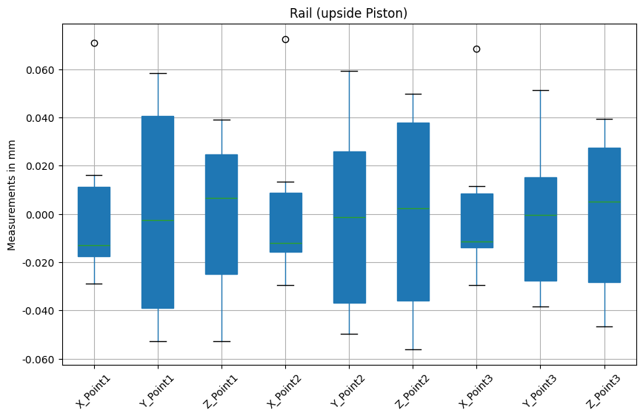
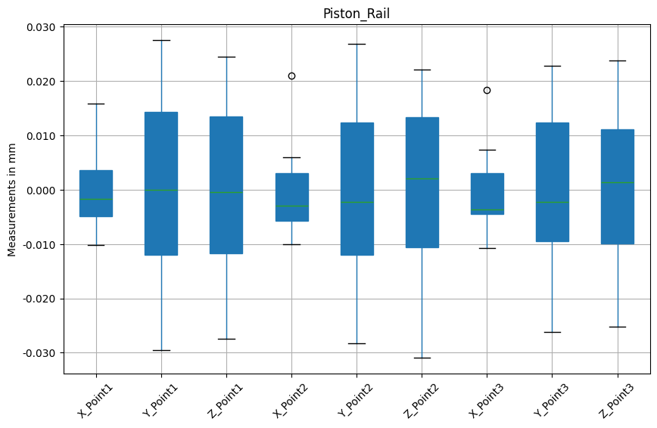
Conclusion
Maximum deviation range is < ±0.06 mm from the Mean Value
=Test Value – Mean Value

Slide 14
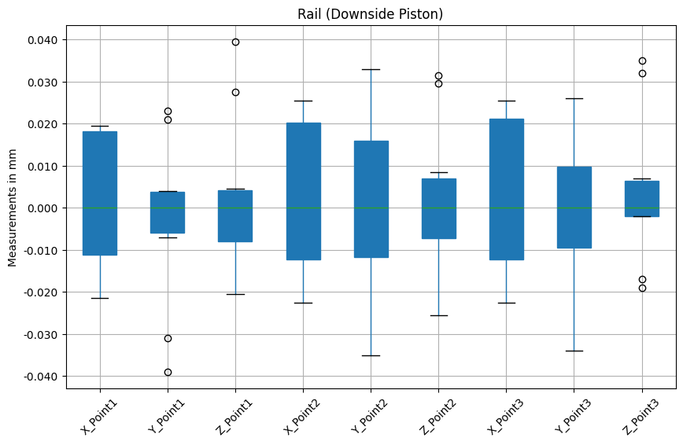
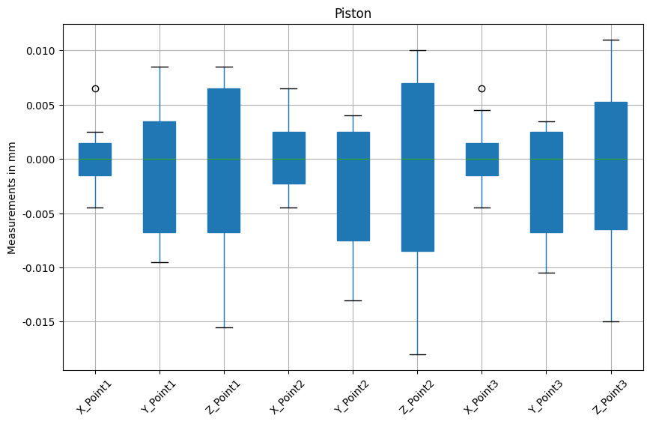
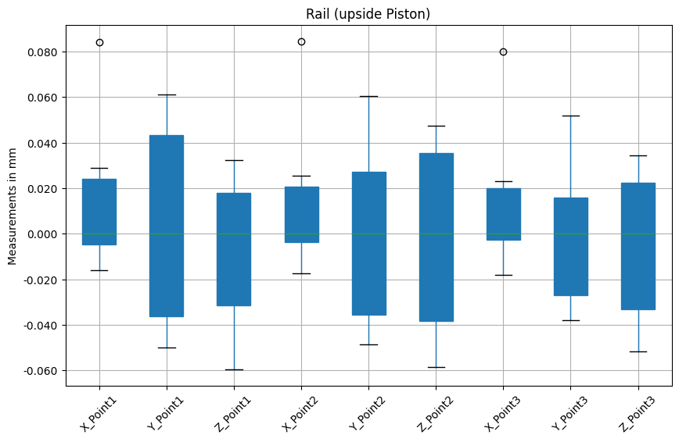
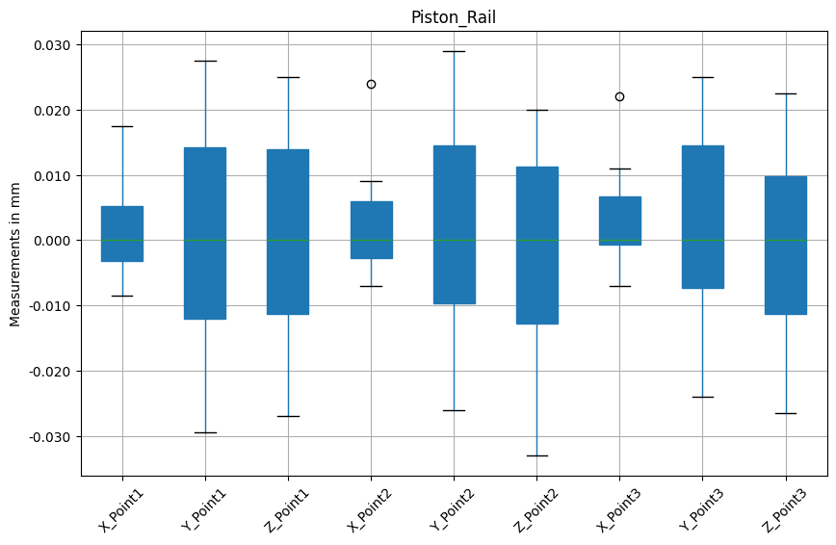
Conclusion
Maximum deviation range is < ±0.06 mm from the Median Value
=Test Value – Median Value

Slide 15
Thank You

