Slide 1
Brain Tumor MRI Classification (Images)
Kodanda Challa · 25727
4-Class (Multiclass classification problem) · Format 2
Train and compare classification models
SKimage + OpenCV → Feature Extraction
Raw Pixels → Learns Features Automatically
01
04
K-Nearest Neighbors
Custom CNN + Grad-CAM
Conv layers auto-extract spatial features
Grad-CAM heatmap shows model attention
02
Support Vector Machine
05
ResNet-50 Transfer + LIME
03
Pretrained ImageNet weights transferred
LIME explains patch-level predictions
Random Forest
Kaggle Dataset (7200 Images): kaggle.com/datasets/masoudnickparvar/brain-tumor-mri-dataset

Slide 2
BRAIN TUMOR MRI
CLASSIFICATION
A Comprehensive Machine Learning Study
Classical ML
CNN + Grad-CAM
Transfer Learning (ResNet50) + LIME
Notes:
SLIDE 1 · Title (~1 min) Open with: 'Brain tumors are life-threatening and early, accurate diagnosis is critical. Today I'll walk you through three machine learning approaches I built and compared for classifying brain tumors from MRI scans — moving from classical methods all the way to deep transfer learning.' Briefly mention the three parts and that you'll compare their accuracy and explainability at the end.

Slide 3
Agenda
00
03
Problem & Data
Transfer Learning + LIME
MRI classification challenge + dataset overview
ResNet50 + LIME for model-agnostic explanations
01
04
Classical ML
Comparison and Conclusions
HOG/GLCM features · KNN · SVM · Random Forest
Accuracy, speed, interpretability across all parts
02
CNN + Grad-CAM
Deep learning + visual explainability
Notes:
SLIDE 2 · Agenda (~1 min) Briefly show the roadmap. Say: 'We have 15 minutes, so here's the plan — problem and data first, then three progressive approaches, followed by a head-to-head comparison and key conclusions.' Don't read every item — just gesture to the structure.

Slide 4
Problem Statement — 4-Class MRI Classification
THE CHALLENGE
4-CLASS CLASSIFICATION TASK
Brain tumors require accurate classification for effective treatment planning. Manual MRI diagnosis is time-consuming and error-prone.
This project builds and compares multiple ML pipelines for automated multiclass tumor classification.
Glioma
Tumor from brain's glial cells
Meningioma
Tumor in protective brain membranes
No Tumor
MRI with no detectable brain tumor
Pituitary
Tumor in pituitary gland at brain's base
KEY OBJECTIVES
Compare Classical vs Deep Learning
Develop Explainable AI models
Evaluate multi-architecture accuracy
Identify tumor-relevant image regions
Notes:
SLIDE 3 · Problem (~1.5 min) Explain the clinical context: radiologists must classify brain tumors into one of four categories — each requiring a very different treatment pathway. Manual reading is slow and variable. Emphasise this is a 4-class image classification problem — not binary. That makes it harder. Quickly read off the four classes.

Slide 5
Part 1 · Dataset & Preprocessing Pipeline
DATASET: Dataset_MRI
✓ Well-balanced class distribution across all 4 categories
✓ Variable image sizes → all resized to 128 × 128 for consistency
✓ Mixed colour modes (grayscale & RGB) → converted to RGB then grayscale for feature extraction
PREPROCESSING PIPELINE
1
2
3
4
5
6
Load Images
RGB → Grayscale
Resize 128×128
Normalize [0,1]
HOG + GLCM
Features
StandardScaler
+ PCA
PCA DIMENSIONALITY REDUCTION (95% variance retained)
8,106
1,622
95%
5×
Original Dimensions
Reduced Dimensions
Variance Retained
Reduction Ratio
Notes:
SLIDE 4 · Dataset & Preprocessing (~1 min) Mention the dataset is well-balanced — important because imbalanced classes would bias the classifier. Walk through the pipeline quickly: load → convert → resize → normalize → extract features → reduce with PCA. Highlight the PCA result: we compressed 8,106 dimensions down to 1,622 while retaining 95% of the variance — a 5× reduction that speeds up training significantly.

Slide 6
Part 1 · Classical ML — Model Comparison & Results
THREE CLASSIFIERS — DEFAULT vs TUNED (5-Fold GridSearchCV)
KNN
SVM ★ BEST
Random Forest
Distance-based proximity
Boundary / hyperplanes
Ensemble / decision trees
Best CV Score
Best CV Score
Best CV Score
93.93%
94.61%
88.16%
k=3, metric=euclidean, weights=distance
C=10, gamma=scale, kernel=rbf
n=150, max_depth=None, min_split=10
Final Test Accuracy — SVM (tuned):
90.56%
GridSearchCV tested 30 KNN × 60 SVM × 216 RF parameter combinations across 5 folds
KEY FINDINGS
• SVM outperforms KNN and Random Forest in both speed and accuracy
• Learning curves show all models generalise better with more training data
• Feature engineering quality is the main bottleneck — motivates deep learning
Notes:
SLIDE 6 · Classical ML Results (~1.5 min) Explain GridSearchCV: instead of guessing hyperparameters, we systematically tested 30, 60, and 216 combinations respectively. SVM wins convincingly at 90.56%. Why? It finds the optimal decision boundary in high-dimensional feature space — exactly what our PCA-reduced HOG+GLCM vector looks like. Key transition: despite good accuracy, classical ML requires manual feature selection. What if we could let the model learn its own features? That's where CNNs come in.

Slide 7
Part 2 · Convolutional Neural Networks Architecture
WHY CNN?
CNN LAYER ARCHITECTURE
No manual features
Input Layer
Learns directly from raw pixels
224 × 224 × 3 (RGB)
(Conv2D + BatchNorm) × 2
Spatial awareness
Detect edges, shapes, patterns
Preserves image structure
MaxPooling2D
X 3
Reduce spatial size, retain features
Hierarchical
Dropout
Edges → textures → patterns → objects
regularise
GlobalAveragePooling2D
Proven
Compress feature maps → 1 value each
State-of-art in medical imaging
Dense Layer + Dropout
Combine features for classification, regularise
Output Layer
4 class probabilities
Notes:
SLIDE 7 · CNN Architecture (~1.5 min) Contrast with Part 1: no feature engineering needed. The network learns what to look for. Walk through the layers briefly — the key idea is hierarchical feature learning: early layers detect edges, middle layers detect shapes, late layers detect complex patterns like tumor morphology. Mention the config: 224×224 images, Adam optimiser, 15 epochs with early stopping to avoid overfitting.

Slide 8
Part 2 · CNN Results + Grad-CAM Explainability
CNN Test Accuracy
81.87%
GRAD-CAM EXPLAINABILITY
• Creates a heatmap over prediction-important regions
• Uses gradients of last convolutional layer
TRAINING CONFIGURATION
• No model modification or retraining needed
• Image: 224×224×3 Batch: 32 Epochs: 15
• LR: 0.001 Optimizer: Adam
• Class-specific: different class → different heatmap
• Loss: Categorical Cross-Entropy
• 🔴 Red = important · 🔵 Blue = unimportant
• Callbacks: EarlyStopping · ReduceLR · Checkpoint
• Red regions often align with actual tumor location
IMPROVEMENT PATHS → MOTIVATES PART 3
Crop MRI brain region
Stronger augmentation
More conv layers
→ Use Transfer Learning
Notes:
SLIDE 8 · CNN Results + Grad-CAM (~1.5 min) Accuracy dipped to 81.87% vs classical ML's 90.56% — explain why: CNN needs more data and takes longer to train. Our dataset is relatively small. But the big win is Grad-CAM: we can now visualise what the network is 'looking at'. Show that red hotspots align with actual tumor regions — this is critical for clinician trust. Transition: 'So CNN gave us interpretability but lower accuracy. Can we get both? Yes — by using a pre-trained network in Part 3.'

Slide 9
Part 3 · Transfer Learning — ResNet50
WHY TRANSFER LEARNING?
RESNET50 ARCHITECTURE
General features
50
175
Early layers learn edges/textures applicable to any image — pre-trained on 1.2M ImageNet images
Weight Layers
Total Operations
Less data needed
ImageNet knowledge compensates for limited medical images (1K–10K vs 100K+)
53
16
Faster training
Convolutions
Skip Connections
Only train the custom head — base stays frozen
FINE-TUNING CONFIGURATION
• Image: 224×224×3 (ResNet required)
ResNet50 Test Accuracy
• Batch: 32 Epochs: 20 LR: 0.001
89.81%
• Optimizer: Adam Loss: Cat. Cross-Entropy
↑ over CNN · less training data needed
• Callbacks: EarlyStopping · ReduceLR
Notes:
SLIDE 9 · ResNet50 (~1.5 min) Key intuition: ResNet50 was trained on 1.2 million general images. The features it learned — edges, textures, shapes — transfer remarkably well to medical MRI. We freeze the base (keep ImageNet weights), add a custom classification head, and train only the head. This is fast and requires far less data. Mention skip connections (residual connections) — the innovation that lets ResNet train very deep networks without vanishing gradients. Result: 89.81% — much better than CNN, close to classical ML but with far less feature engineering.

Slide 10
Part 3 · LIME — Model-Agnostic Explainability
HOW LIME WORKS
LIME vs GRAD-CAM
1 SELECT
Choose a prediction to explain
Aspect
Grad-CAM
LIME
Model Support
CNN only
Any model
2 PERTURB
Create variations by masking image regions
Speed
Very fast
Slow (many perturbations)
Output type
Pixel heatmap
Superpixel importance
3 PREDICT
Run perturbed inputs through the model
Granularity
Pixel-level
Superpixel-level
4 LEARN
Fit a simple interpretable model locally
Clinical use
Heatmap overlay
Region explanation
Why this matters for healthcare:
5 VISUALISE
Show which superpixels drove the decision
LIME is model-agnostic — it can explain ANY classifier, not just CNNs. Critical for regulatory approval and clinician trust in AI-assisted diagnosis.
Notes:
SLIDE 10 · LIME (~1 min) LIME's key innovation: it is model-agnostic. While Grad-CAM is tied to CNNs, LIME works on any model — our SVM, our ResNet50, any future model. The approach: locally approximate the black-box model with a simple linear model. By perturbing the input (masking image regions), we see which superpixels the model cares about. For doctors: LIME can say 'the model focused on this specific region when predicting Glioma' — and that explanation is in human-understandable superpixel terms, not raw gradient values.

Slide 11
Comparative Analysis — All Three Approaches
METHOD CHARACTERISTICS
Criterion
Cl. ML
CNN
Transfer
Data Needed
Medium
Large
Small-Med
Training Time
Fast
Slow
Fast
Feature Eng.
Manual
None
None
Interpretability
High
Medium
High
Explainability
Limited
Grad-CAM
LIME
90.56%
81.87%
89.81%
Classical ML
CNN
ResNet50
Notes:
SLIDE 11 · Comparative Analysis (~1.5 min) This is the key slide — bring it all together. The chart tells the story: Classical ML (SVM) wins on raw accuracy at 90.56%, Transfer Learning (ResNet50) is close at 89.81%, and CNN sits at 81.87%. But accuracy isn't the only dimension — read the table: • Classical ML needs manual feature engineering but is fast and interpretable • CNN learns features automatically but needs large data and is a black box (partially opened with Grad-CAM) • Transfer Learning gets the best of both worlds: accuracy, speed, and LIME explainability For a real medical deployment, the answer is almost always Transfer Learning + LIME.

Slide 12
Thank You
Questions & Discussion
90.56%
81.87%
89.81%
SVM (Classical ML)
CNN
ResNet50 (Transfer)
Notes:
SLIDE 13 · Thank You (~0.5 min) Leave the three accuracy numbers on screen during Q&A — they anchor the discussion. Anticipated questions: • Why did classical ML beat CNN? → Small dataset; CNN needs more data to shine • Why not use all three together? → Ensemble is possible future work • How would you deploy this clinically? → Needs clinical validation, regulatory approval, radiologist-in-the-loop design • What about 3D MRI? → Mentioned in future work; much more data-hungry but more informative

Slide 13
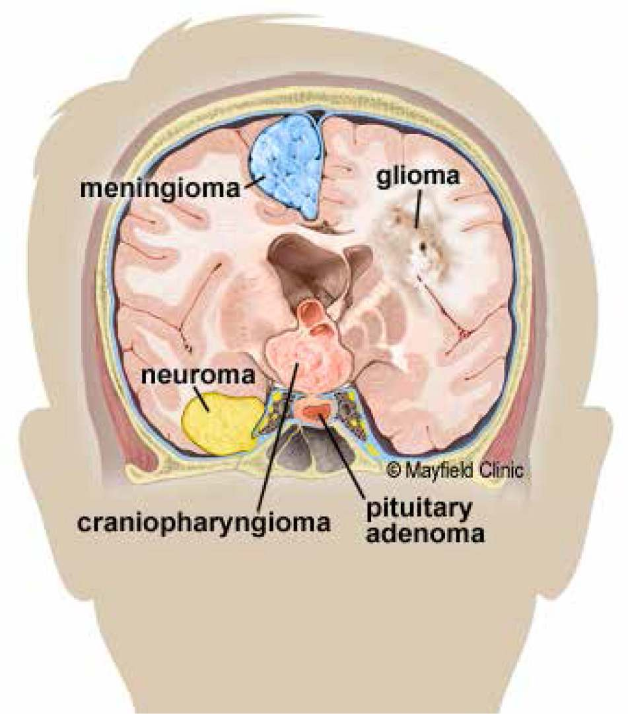
Problem Statement — 4-Class MRI Classification
Notes:
SLIDE 3 · Problem (~1.5 min) Explain the clinical context: radiologists must classify brain tumors into one of four categories — each requiring a very different treatment pathway. Manual reading is slow and variable. Emphasise this is a 4-class image classification problem — not binary. That makes it harder. Quickly read off the four classes.

Slide 14
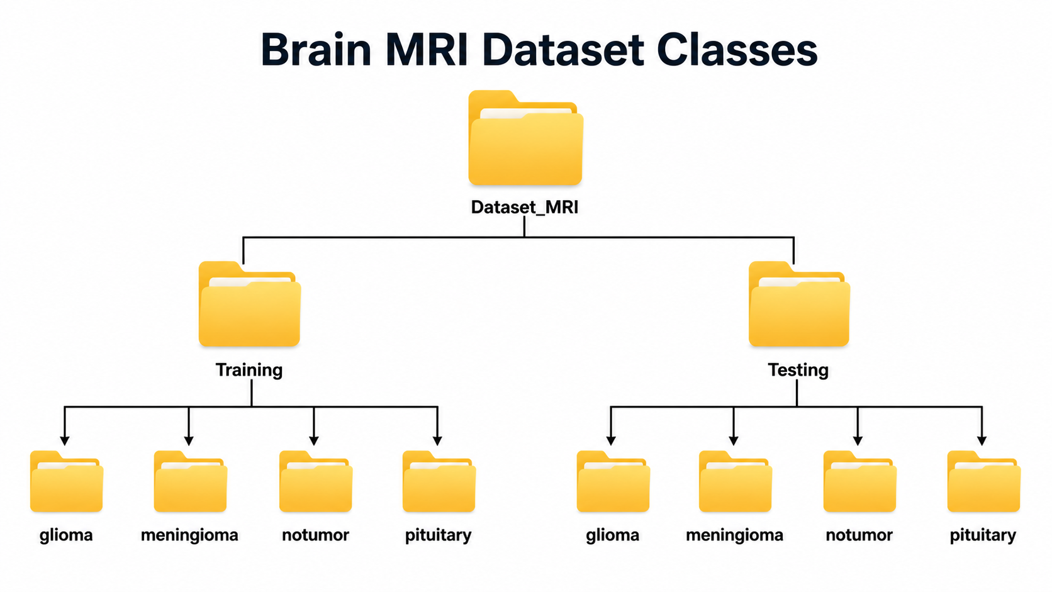
Dataset
DATASET: Dataset_MRI
✓ Well-balanced class distribution across all 4 categories
✓ Variable image sizes → all resized to 128 × 128 for consistency
✓ Mixed colour modes (grayscale & RGB) → converted to RGB then grayscale for feature extraction
Notes:
SLIDE 4 · Dataset & Preprocessing (~1 min) Mention the dataset is well-balanced — important because imbalanced classes would bias the classifier. Walk through the pipeline quickly: load → convert → resize → normalize → extract features → reduce with PCA. Highlight the PCA result: we compressed 8,106 dimensions down to 1,622 while retaining 95% of the variance — a 5× reduction that speeds up training significantly.

Slide 15
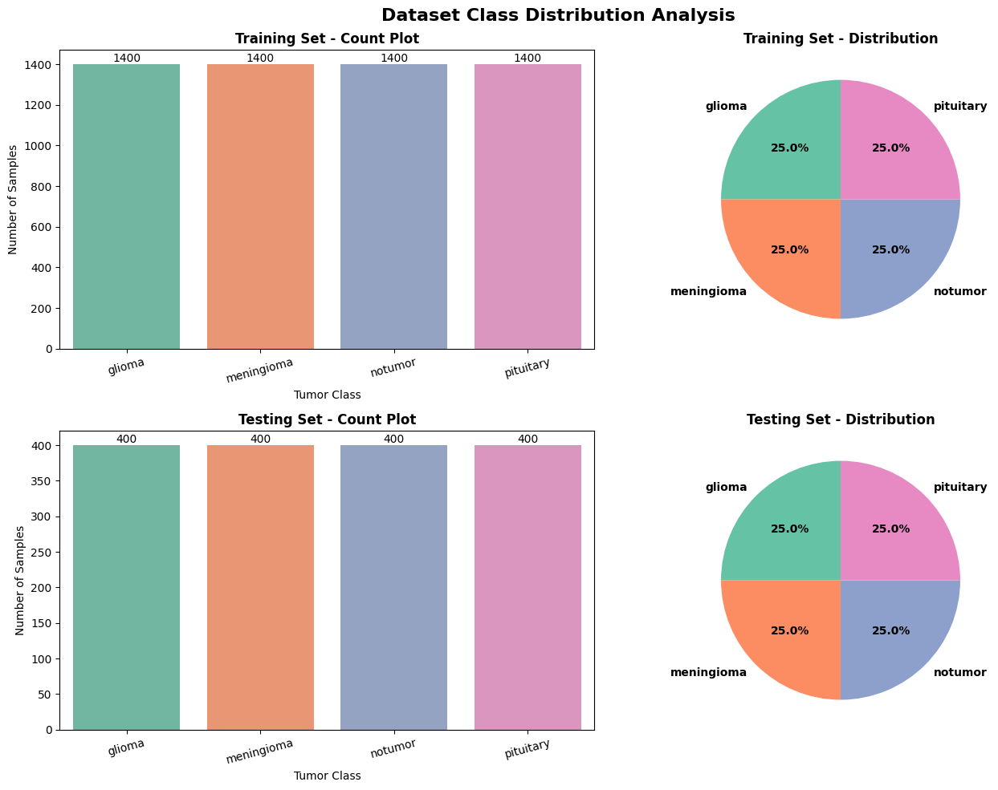
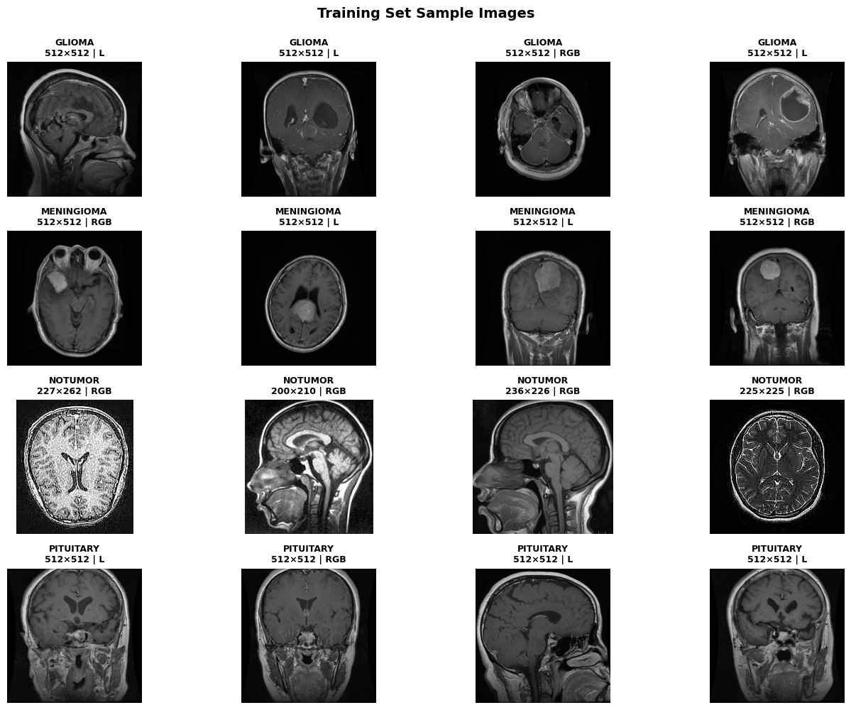
Dataset
DATASET: Dataset_MRI
✓ Well-balanced class distribution across all 4 categories
✓ Variable image sizes → all resized to 128 × 128 for consistency
✓ Mixed colour modes (grayscale & RGB) → converted to RGB then grayscale for feature extraction
Notes:
SLIDE 4 · Dataset & Preprocessing (~1 min) Mention the dataset is well-balanced — important because imbalanced classes would bias the classifier. Walk through the pipeline quickly: load → convert → resize → normalize → extract features → reduce with PCA. Highlight the PCA result: we compressed 8,106 dimensions down to 1,622 while retaining 95% of the variance — a 5× reduction that speeds up training significantly.

Slide 16
Part 1 · Feature Extraction — HOG & GLCM
PREPROCESSING PIPELINE
1
2
3
4
5
6
Load Images
RGB → Grayscale
Resize 128×128
Normalize [0,1]
HOG + GLCM
Features
StandardScaler
+ PCA
HOG — Histogram of Oriented Gradients
GLCM — Gray Level Co-occurrence Matrix
• Captures edge and shape information
• Measures spatial relationships of pixel intensities
• Divides image into 8×8 pixel cells
• Captures fine-grained texture patterns
• Computes gradient histograms per cell
• Features: contrast, dissimilarity, homogeneity
• 9 orientation bins per histogram
• Additional: energy, angular second moment (ASM)
• Excellent for detecting structural patterns in MRI
• Complements HOG with texture-level information
SHAPE & EDGE DETECTOR
TEXTURE DETECTOR
Notes:
SLIDE 5 · Feature Extraction (~1 min) Explain the intuition: before deep learning, we had to manually engineer features that tell the model what to look at. HOG answers: 'What shape is this?' — it detects edges and gradients, useful for finding tumor boundaries. GLCM answers: 'What texture is this?' — tumor tissue has different intensity patterns from healthy tissue. Together, HOG + GLCM give us both shape and texture — a strong combined feature vector.

Slide 17
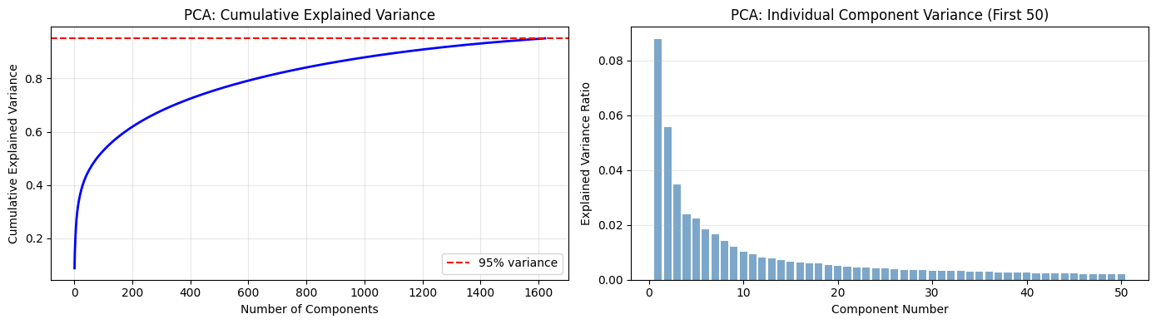
Part 1 · Dataset & Preprocessing Pipeline
PREPROCESSING PIPELINE
1
2
3
4
5
6
Load Images
RGB → Grayscale
Resize 128×128
Normalize [0,1]
HOG + GLCM
Features
StandardScaler
+ PCA
PCA DIMENSIONALITY REDUCTION (95% variance retained)
8,106
1,622
95%
5×
Original Dimensions
Reduced Dimensions
Variance Retained
Reduction Ratio
Notes:
SLIDE 4 · Dataset & Preprocessing (~1 min) Mention the dataset is well-balanced — important because imbalanced classes would bias the classifier. Walk through the pipeline quickly: load → convert → resize → normalize → extract features → reduce with PCA. Highlight the PCA result: we compressed 8,106 dimensions down to 1,622 while retaining 95% of the variance — a 5× reduction that speeds up training significantly.

Slide 18
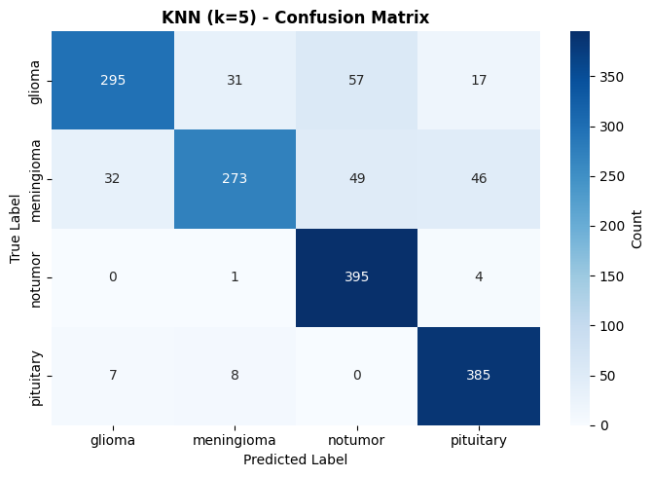
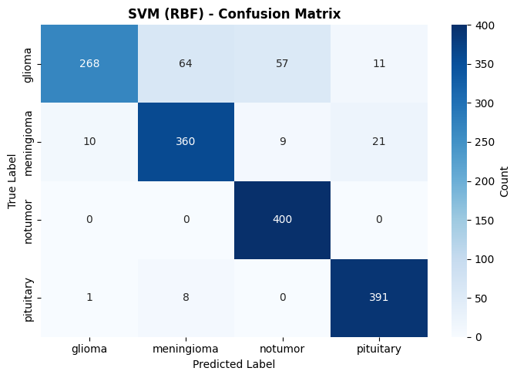
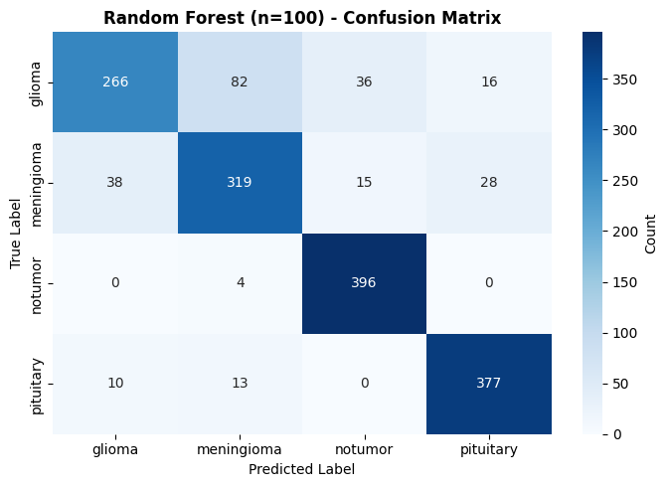
Part 1 · ML Model with Default Parameters
Test Accuracy: 84.25%
Test Accuracy: 88.69%
Test Accuracy: 84.88%
Notes:
SLIDE 5 · Feature Extraction (~1 min) Explain the intuition: before deep learning, we had to manually engineer features that tell the model what to look at. HOG answers: 'What shape is this?' — it detects edges and gradients, useful for finding tumor boundaries. GLCM answers: 'What texture is this?' — tumor tissue has different intensity patterns from healthy tissue. Together, HOG + GLCM give us both shape and texture — a strong combined feature vector.

Slide 19
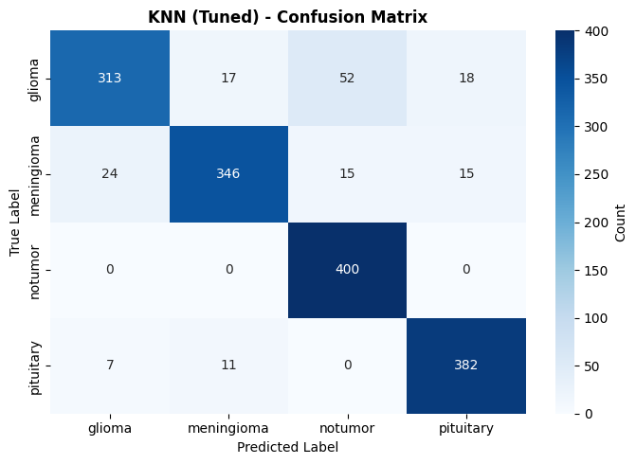
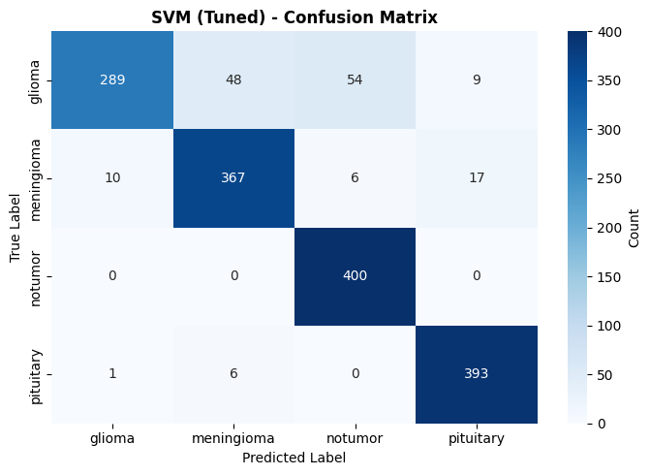
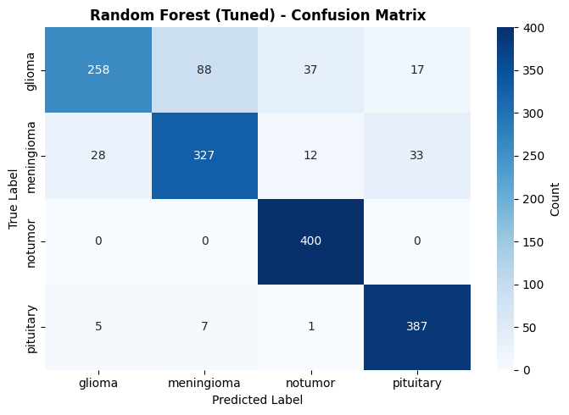
Part 1 · ML Model with Hyper Parameters Tuning
Test Accuracy: 90.06%
Test Accuracy: 90.56%
Test Accuracy: 85.75%
Notes:
SLIDE 5 · Feature Extraction (~1 min) Explain the intuition: before deep learning, we had to manually engineer features that tell the model what to look at. HOG answers: 'What shape is this?' — it detects edges and gradients, useful for finding tumor boundaries. GLCM answers: 'What texture is this?' — tumor tissue has different intensity patterns from healthy tissue. Together, HOG + GLCM give us both shape and texture — a strong combined feature vector.

Slide 20
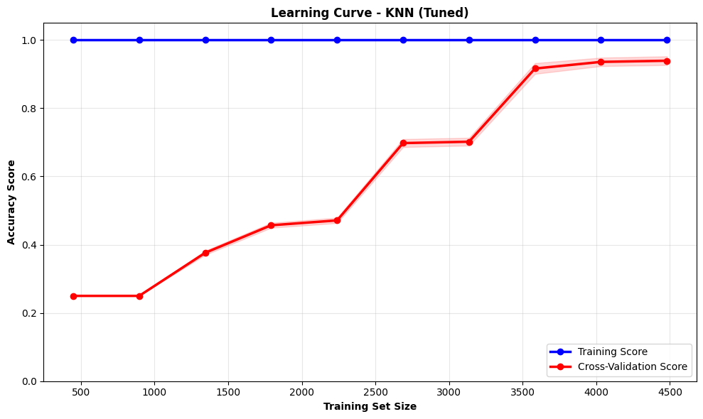
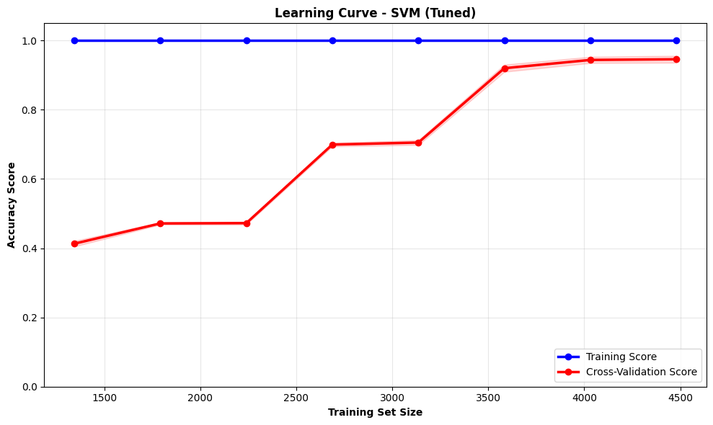
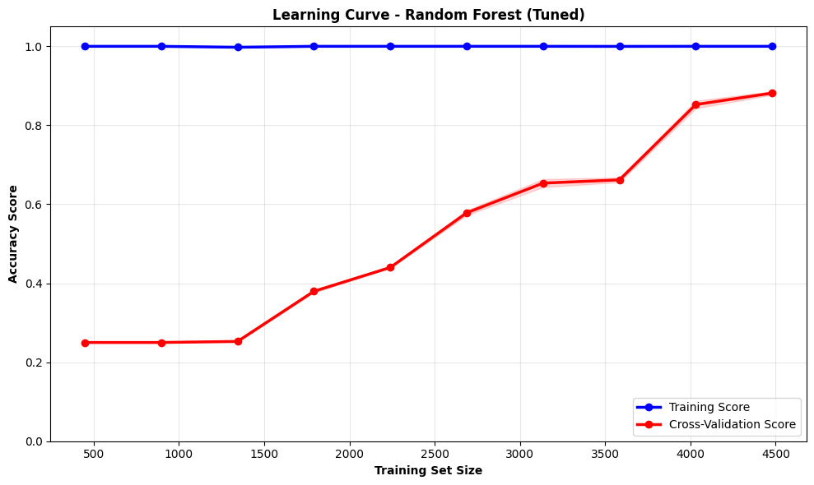
Part 1 · ML Model Learning Curves
Notes:
SLIDE 5 · Feature Extraction (~1 min) Explain the intuition: before deep learning, we had to manually engineer features that tell the model what to look at. HOG answers: 'What shape is this?' — it detects edges and gradients, useful for finding tumor boundaries. GLCM answers: 'What texture is this?' — tumor tissue has different intensity patterns from healthy tissue. Together, HOG + GLCM give us both shape and texture — a strong combined feature vector.

Slide 21
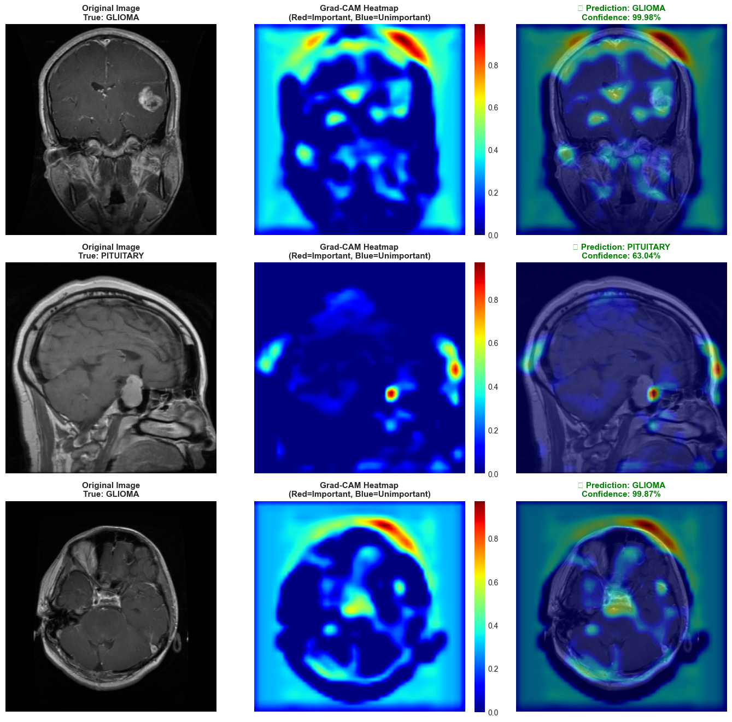
GRAD CAM
GRAD-CAM EXPLAINABILITY
• Creates a heatmap over prediction-important regions
• Uses gradients of last convolutional layer
• No model modification or retraining needed
• Class-specific: different class → different heatmap
• 🔴 Red = important · 🔵 Blue = unimportant
• Red regions often align with actual tumor location
Notes:
SLIDE 5 · Feature Extraction (~1 min) Explain the intuition: before deep learning, we had to manually engineer features that tell the model what to look at. HOG answers: 'What shape is this?' — it detects edges and gradients, useful for finding tumor boundaries. GLCM answers: 'What texture is this?' — tumor tissue has different intensity patterns from healthy tissue. Together, HOG + GLCM give us both shape and texture — a strong combined feature vector.

Slide 22
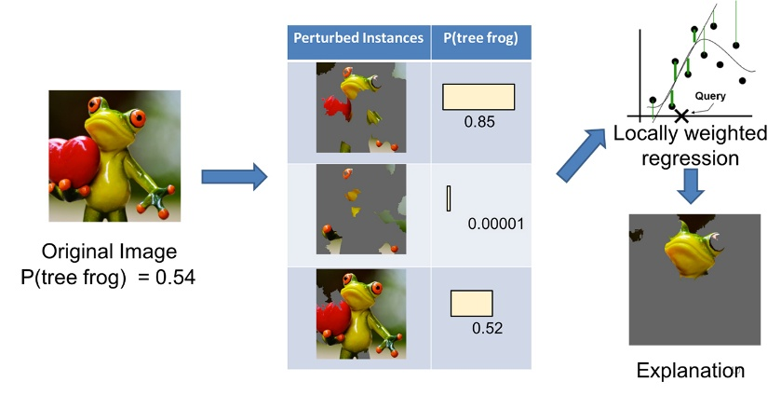
LIME
HOW LIME WORKS
1 SELECT
Choose a prediction to explain
2 PERTURB
Create variations by masking image regions
3 PREDICT
Run perturbed inputs through the model
4 LEARN
Fit a simple interpretable model locally
5 VISUALISE
Show which superpixels drove the decision
Notes:
SLIDE 5 · Feature Extraction (~1 min) Explain the intuition: before deep learning, we had to manually engineer features that tell the model what to look at. HOG answers: 'What shape is this?' — it detects edges and gradients, useful for finding tumor boundaries. GLCM answers: 'What texture is this?' — tumor tissue has different intensity patterns from healthy tissue. Together, HOG + GLCM give us both shape and texture — a strong combined feature vector.

Slide 23
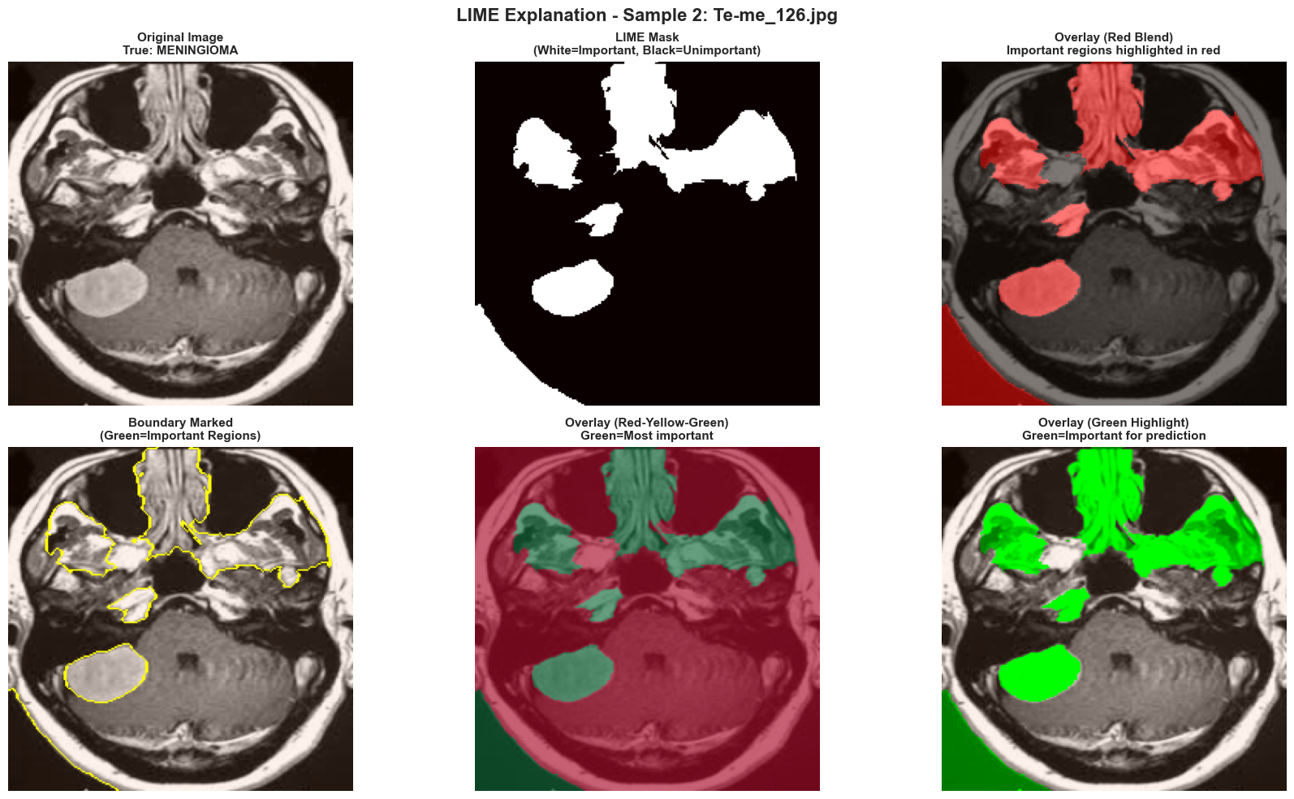
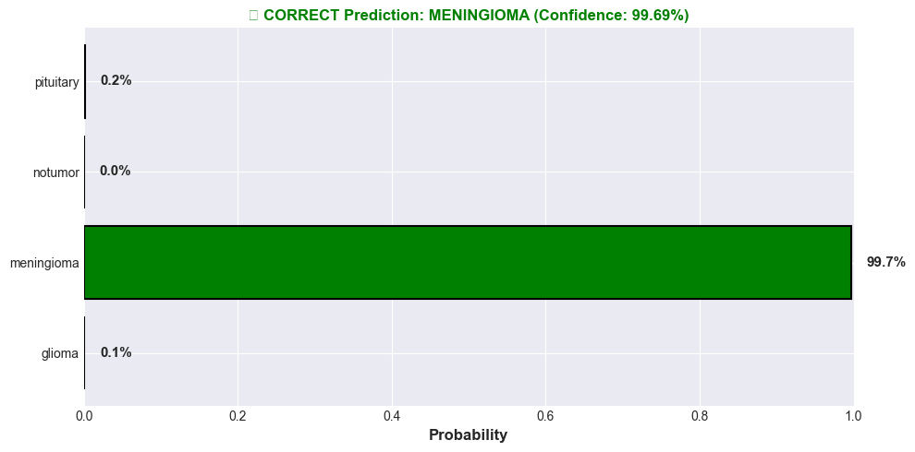
LIME
HOW LIME WORKS
1 SELECT
Choose a prediction to explain
2 PERTURB
Create variations by masking image regions
3 PREDICT
Run perturbed inputs through the model
4 LEARN
Fit a simple interpretable model locally
5 VISUALISE
Show which superpixels drove the decision
Notes:
SLIDE 5 · Feature Extraction (~1 min) Explain the intuition: before deep learning, we had to manually engineer features that tell the model what to look at. HOG answers: 'What shape is this?' — it detects edges and gradients, useful for finding tumor boundaries. GLCM answers: 'What texture is this?' — tumor tissue has different intensity patterns from healthy tissue. Together, HOG + GLCM give us both shape and texture — a strong combined feature vector.

Slide 24
Conclusions & Future Directions
PART 1 · Classical ML
PART 2 · CNN + Grad-CAM
PART 3 · ResNet50 + LIME
90.56%
81.87%
89.81%
• HOG + GLCM = strong feature set
• Automatic feature discovery
• Best overall approach
• SVM excels in high-dimensional space
• Grad-CAM reveals decision regions
• ImageNet knowledge transfers to MRI
• Highly interpretable, fast baseline
• Needs more data to compete
• LIME provides model-agnostic explanations
• Bottleneck: manual feature engineering
• Strong foundation for transfer learning
• Ready for clinical deployment pathway
Notes:
SLIDE 12 · Conclusions (~1 min) Summarise the three-part journey: 1. Classical ML showed us that handcrafted features + SVM are a strong, interpretable baseline 2. CNN automated feature learning and gave us visual explainability via Grad-CAM 3. Transfer Learning (ResNet50) delivered accuracy + efficiency + LIME explainability — the best all-rounder For future work: 3D MRI volumes have more spatial information, Vision Transformers are the new frontier, and real-world deployment requires clinical validation. Close with: 'The core lesson is that explainability and accuracy don't have to be a trade-off — Transfer Learning + LIME gives us both.'

