Slide 1
RTBDP · Free University of Bozen-Bolzano
Real-Time Crypto Market
Anomaly Detection & Dashboard
Spotting cheating in live crypto trading — shown on a dashboard in seconds
GitLab Repository: https://gitlab.inf.unibz.it/kodanda.challa/rtbdp-crypto-anomaly
GitHub Repository: https://github.com/kodandachalla/RTBDP_Project
Kodanda Challa Real-Time Big Data Processing · 2025–2026
Notes:
[0:00–0:30] Hello, I'm Kodanda Challa. My project watches live crypto trades and spots cheating within seconds. It's built from Kafka, Flink, PostgreSQL and Grafana — and the whole thing starts with one Docker command. I'll explain the problem, show how it works with simple diagrams, then run a demo.

Slide 2
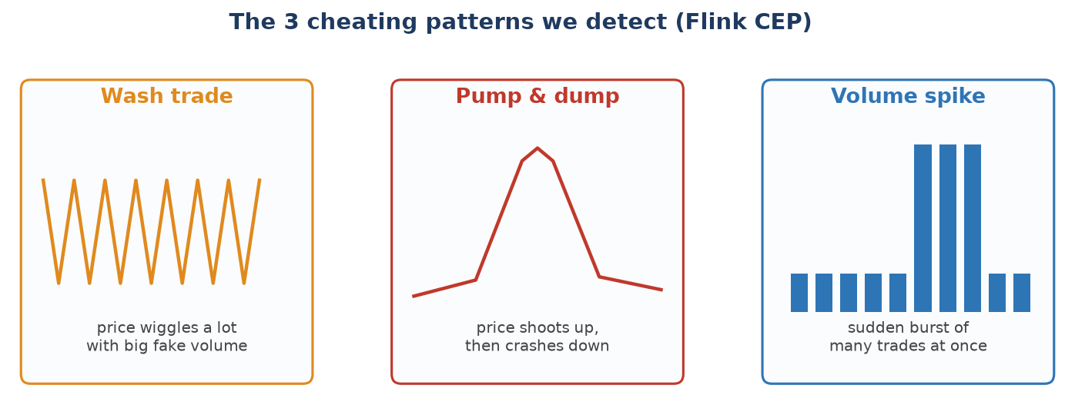
THE PROBLEM
Crypto markets are a target for cheating
Crypto trades 24/7 and produces thousands of trades a second.
Because it is lightly regulated, people cheat:
• Wash trading — a person quietly buys and sells to themselves to make a coin look busier than it really is.
• Pump and dump — a group pushes a price up fast, then sells at the top, leaving buyers with losses.
• Volume spikes — a sudden flood of trades, which can come before a price crash.
Wash trade: price wiggles + fake volume.
Pump & dump: up fast, then crash.
Volume spike: sudden flood of trades.
Each match is saved as a MEDIUM or HIGH alert and appears on the dashboard in seconds.
Finding these tricks a day later is useless. To help an exchange or regulator the warning must appear within seconds. That is exactly what this project does.
Notes:
Crypto markets run 24/7 with very little regulation — making them a target for manipulation. We need real-time detection.

Slide 3
THE DATA
Live trades from Binance — free, no key
6
One always-open connection gives us every trade for all six coins.
coins watched live
symbol · price · volume · exact time (to the millisecond)
Symbol | Name
BTCUSDT | Bitcoin
ETHUSDT | Ethereum
BNBUSDT | BNB (Binance Coin)
SOLUSDT | Solana
DOGEUSDT | Dogecoin
XRPUSDT | XRP (Ripple)
Fast never stops — 50 to 200 trades per second, per coin
Enough hundreds of trades a second in total — real stream load
A bit messy trades can arrive slightly out of order — we handle that
Tiny each message is small and simple to read
Notes:
[3:00–4:00] All data comes from one place: Binance's free public trade feed — no API key. One always-open WebSocket gives every trade for all six coins. Each message is tiny: coin, price, amount, and the exact time. Three things matter: it's fast and never stops, there's plenty of it, and it can arrive slightly out of order — which the system is built to handle.

Slide 4
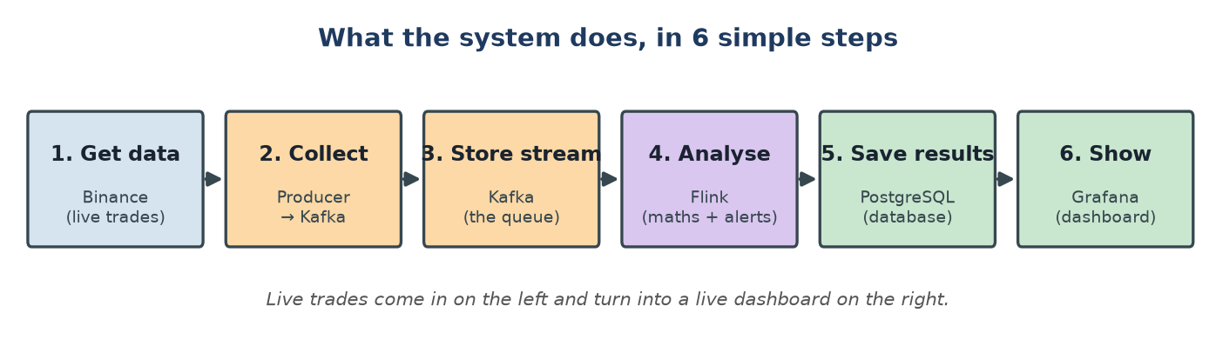
THE BIG PICTURE
What it does, in six simple steps
Live trades come in on the left and become a live dashboard on the right. Each step is a small, well-known tool.
Notes:
[2:00–3:00] Here's the whole idea in six steps. Get the data from Binance, collect it into Kafka, store the stream, analyse it with Flink, save results to a database, and show them in Grafana. Live trades enter on the left; a live dashboard comes out on the right. Each box is a standard tool.

Slide 5
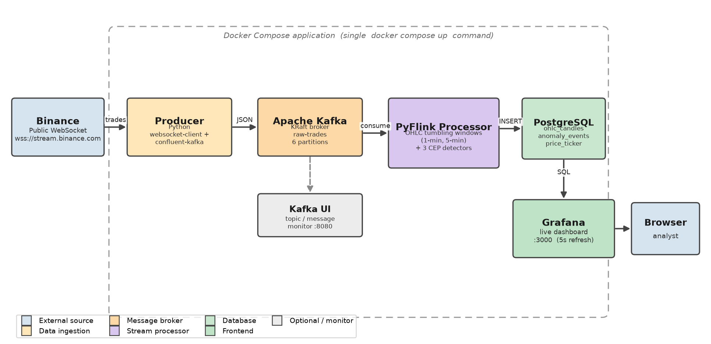
HOW IT FITS TOGETHER
The architecture
Standard course shape: collect → Kafka → Flink → database → dashboard. Every box is one Docker container; they find each other by name.
Notes:
[4:00–5:15] This is the architecture, and it follows the standard course shape: collect into Kafka, process with Flink and save to a database, then the dashboard reads the database. Every box is a Docker container on one private network — they find each other by name, for example Flink reaches the database just by using the name 'postgres'. Kafka runs in modern KRaft mode, so there's no ZooKeeper.

Slide 6
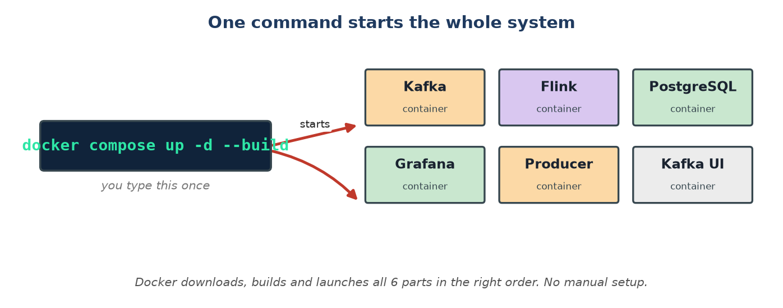
THE BEST PART
One command starts everything
You only install Docker. Then docker compose up -d --build downloads, builds and starts all six parts in the right order — no manual setup.
kafka + postgres → kafka-ui + grafana + producer → flink-processor
Notes:
[5:15–6:15] This is the part I'm most happy with. The only thing you install is Docker. Then a single command — docker compose up -d --build — downloads, builds and launches all six parts in the correct order. Health checks make sure Flink and the producer wait until Kafka and the database are ready. To stop, you run docker compose down. That makes it very easy for anyone to try.

Slide 7
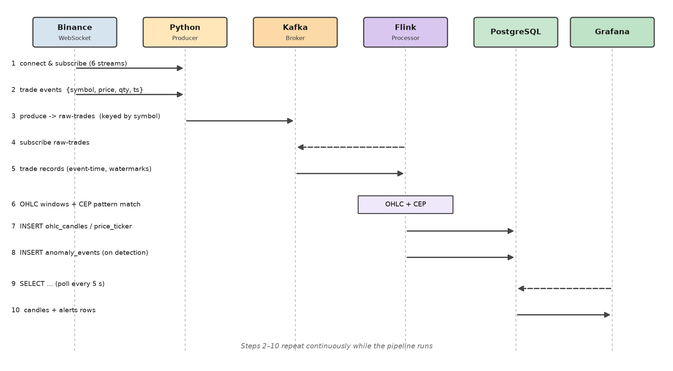
STEP BY STEP
How one trade travels through the system
1–2
Get the trade
Binance sends a trade. The Python collector reads it and cleans it up.
3
Put in Kafka
The collector puts the trade into Kafka on the lane for that coin.
4–5
Flink reads it
Flink takes the trade using event timestamp and assigns a watermark.
6
Candles + checks
Flink updates the price candles and feeds the trade to all three CEP detectors — each updating that coin's state.
7–8
Save results
Flink saves the candle and any alert into PostgreSQL. The price ticker is upserted.
Get trade → put in Kafka → Flink reads it → make candles + check patterns → save to database → dashboard shows it. This repeats forever.
Every 30 seconds Flink checkpoints state to disk so a crash resumes cleanly.
Dashboard updates
9–10
Grafana asks the database for fresh data every 5 seconds and redraws all panels.
Notes:
[6:15–7:15] Following one trade: Binance sends it, the collector puts it into Kafka on that coin's lane, Flink reads it using the trade's own timestamp, updates the candles and checks the three patterns, then saves a candle and any alert to the database. Grafana asks the database for fresh data every 5 seconds and redraws. This loop runs continuously.

Slide 8
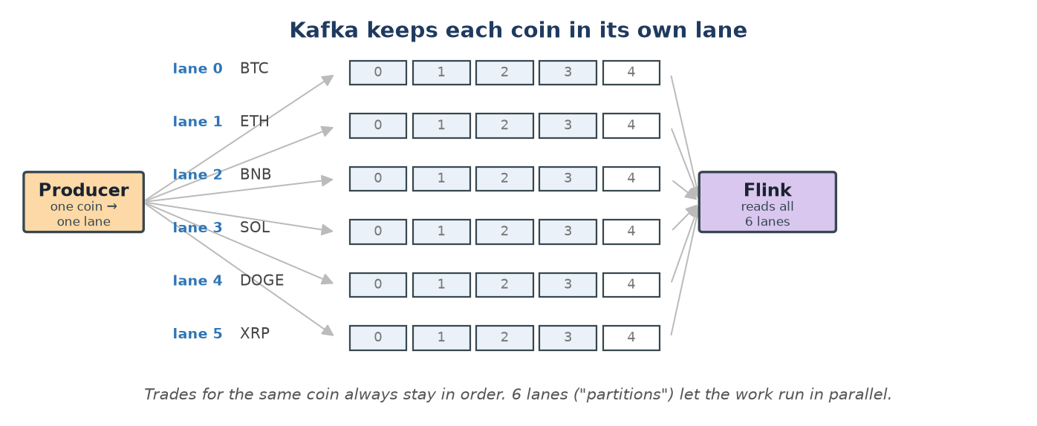
Kafka
Each coin gets its own lane
Kafka splits the stream into 6 lanes (one per coin). Trades for the same coin stay in order, the work runs in parallel, and we can scale up later with no code change.
Notes:
[7:15–8:15] First key idea. Inside Kafka the stream is split into six lanes, called partitions — one per coin. This keeps each coin's trades in the right order and lets the work run in parallel. It also means we can speed the system up later just by adding workers, up to one per lane, without changing any code.

Slide 9
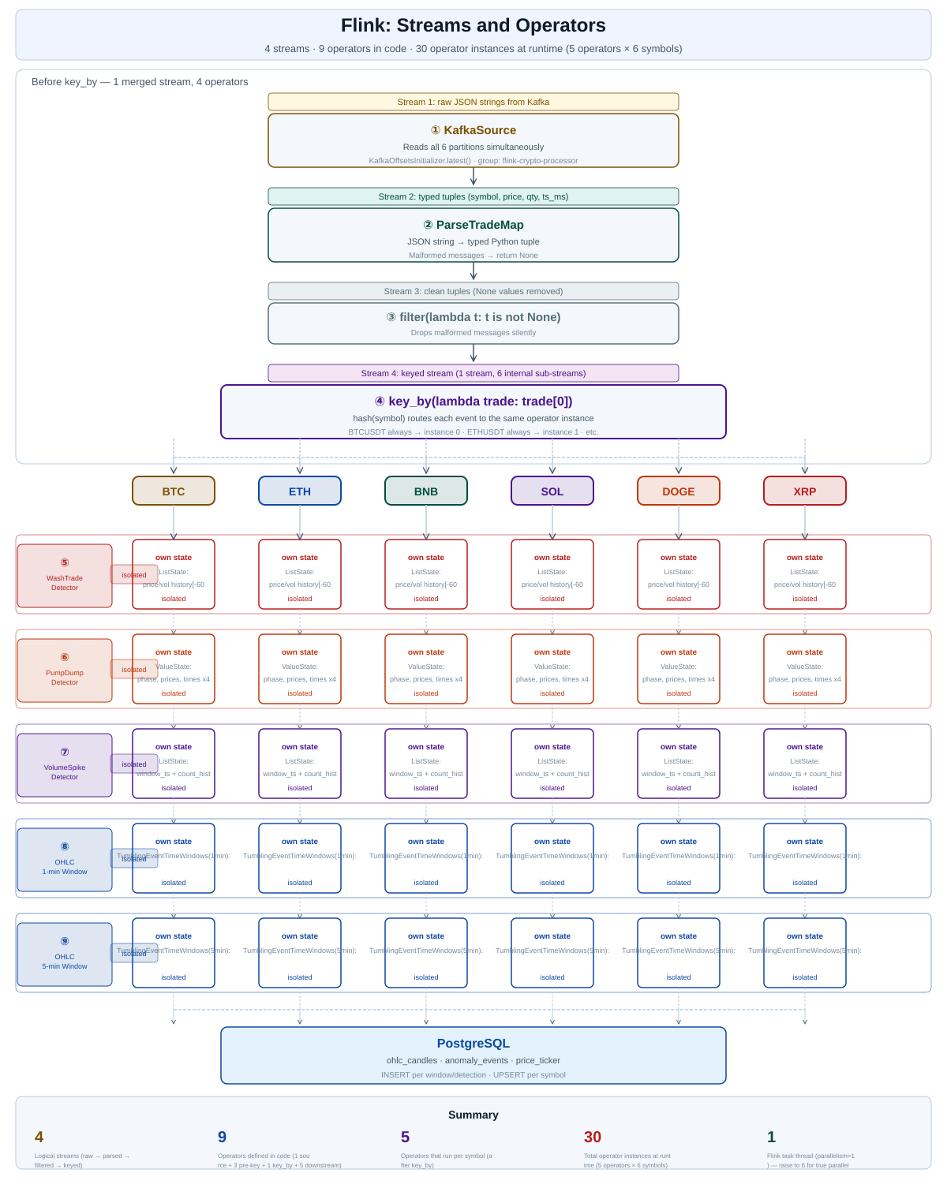
How the pipeline splits into streams and operators
INSIDE FLINK
4 streams · 9 operators in code · 30 isolated operator instances at runtime (5 operators × 6 symbols)
After key_by(symbol), each coin gets its own isolated state in every Flink operator. BTCUSDT's price history never mixes with DOGEUSDT's price history — guaranteed by Flink.
Why this matters for correctness:
Without isolation, BTC's $64,000 price and DOGE's $0.086 price would be in the same list. The swing calculation would show 74,000% — every trade would fire a WASH_TRADE alert. With key_by, each coin only sees its own history.
Notes:
Walk through the diagram. Key message: key_by creates 30 isolated state spaces. BTCUSDT state NEVER mixes with DOGEUSDT.

Slide 10
THE CORE
The three cheating patterns we detect
〰 Wash trade
📈 Pump & dump
🌊 Volume spike
What it is:
What it is:
What it is:
A person quietly buys and sells to themselves to make a coin look busier than it really is.
A group pushes a price up fast, then sells everything at the top, leaving buyers with losses.
A sudden flood of trades — can signal the beginning of a flash crash or manipulation.
Detection:
Detection:
Detection:
Price swings ±0.3% AND volume is 1.5× the rolling average across last 60 trades.
Price rises 0.4%, then drops 0.3% from the peak within 4 minutes.
Trade count in 10 seconds exceeds 2× the 10-minute rolling average. 30s cooldown.
Flink state:
Flink state:
Flink state:
ListState — rolling price and volume history, capped at 60 entries per coin.
ValueState — 3-phase state machine: WATCHING → PUMP_CONFIRMED → ALERT.
ListState — sliding 10s window + 60-bucket rolling history per coin.
Each match is saved as MEDIUM or HIGH severity and appears in the dashboard alerts table within seconds.
Notes:
Explain each pattern. For the exam: mention ListState vs ValueState, why bounded at 60 entries, key isolation.

Slide 11
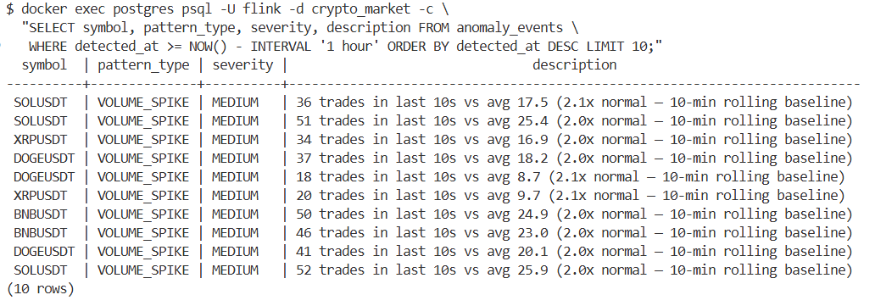
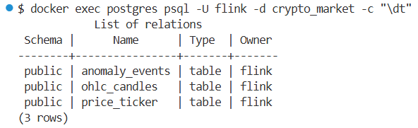
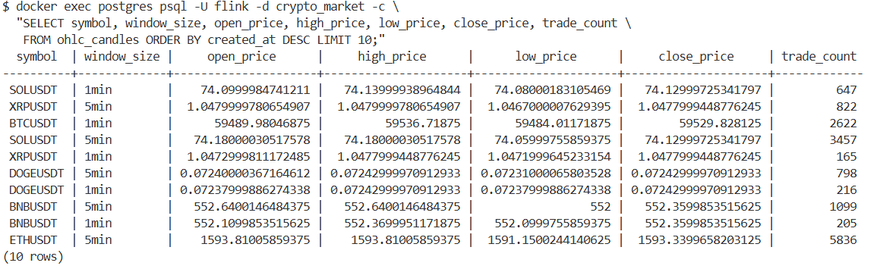
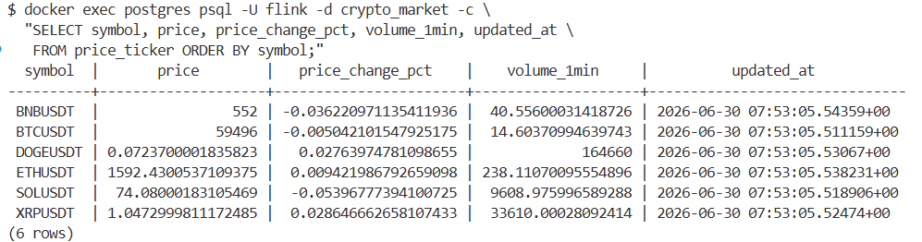
3 Tables on PostgreSQL
INSIDE POSTGRESQL
Notes:
Walk through the diagram. Key message: key_by creates 30 isolated state spaces. BTCUSDT state NEVER mixes with DOGEUSDT.

Slide 12
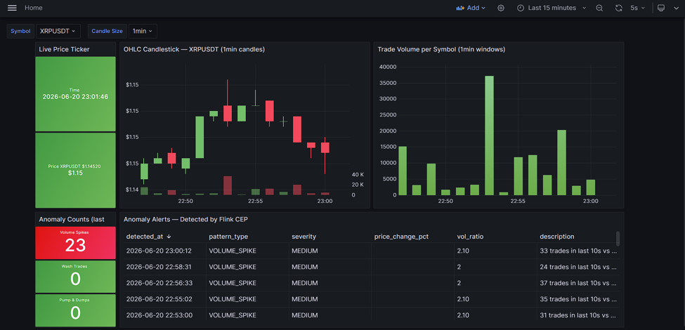
WHAT THE USER SEES
The live dashboard
Five live panels
Price ticker
price
Candles
1-min or 5-min
Volume bars
per coin
Alert count
last hour
Alerts table
what + how serious
Pick a coin and candle
size from the menus.
Notes:
[10:45–11:45] Everything the user needs is on one Grafana dashboard, refreshing every 5 seconds. Five panels: live price per coin with green/red; the candle chart; volume per coin; how many alerts in the last hour; and a live table of detected cheating with time, coin, pattern and severity. Two menus at the top pick the coin and the candle size. Let me show it live now.

Slide 13
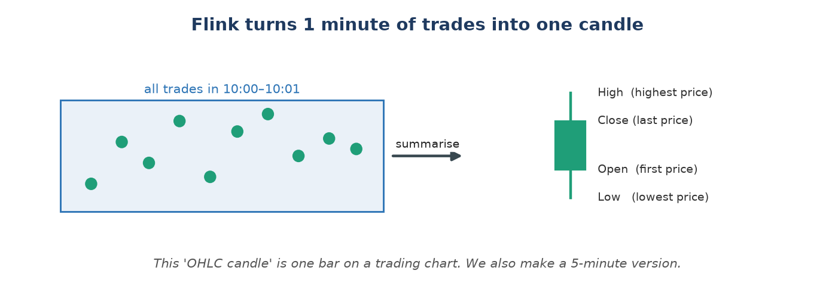
THE CORE
Turning trades into price candles
Flink groups one minute of trades into a single candle: first, highest, lowest and last price. It uses each trade's real time, so late trades still land in the right candle.
Notes:
[8:15–9:15] Second idea. Traders read 'candles' — a candle summarises a short time as four numbers: open (first price), high, low, and close (last price). Flink groups every minute (and every 5 minutes) of trades into one candle. Crucially it uses each trade's real timestamp, not the arrival time, so a trade that arrives a little late still lands in the correct candle. That keeps results correct and repeatable.

Slide 14
IDEA 2
Turning trades into price candles
Traders read price candles. A candle is a simple summary of a short period: the first price (open), the highest, the lowest, and the last price (close). Flink groups all trades in each window into a single candle using TumblingEventTimeWindows.
1-min window
5-min window
open · high · low · close · volume · count
open · high · low · close · volume · count
→ Grafana candlestick chart
→ Broader trend analysis
The Grafana dashboard has a $candle_size dropdown — switch between 1-minute and 5-minute candles without any code change.
Green candle
Red candle
Getting it right
We use the trade's exchange timestamp, not arrival time. A 3-second watermark absorbs late messages. A 10-second idleness setting stops a quiet coin from freezing all windows.
Close price > open price — buyers were in control that minute
Close price < open price — sellers were in control that minute
Notes:
Explain: tumbling windows, event-time, watermarks, idleness. These are the core course concepts all visible in one slide.

Slide 15
LIVE DEMO
Let's watch it run
1
docker compose up -d --build
Six parts start together. Kafka and PostgreSQL pass health checks first.
2
http://localhost:3000 → admin / admin
Dashboard auto-loads from provisioning files. Select DOGEUSDT from the dropdown.
3
Switch $symbol dropdown → DOGEUSDT
DOGE fires anomaly alerts fastest. Watch the red alert count climb.
4
Switch $candle_size → 1min or 5min
All panels update instantly — candlestick, volume bars, alerts table.
5
http://localhost:8080 → Kafka UI
Shows raw-trades topic, 6 partitions, live messages flowing in real time.
Notes:
Run the demo live. DOGE and XRP give the fastest anomaly alerts. Switch candle sizes to show the $candle_size variable working.

Slide 16
LESSONS LEARNED
What worked, what was hard, what's next
Worked well
Was hard
Next
• Simple, well-known design (Kafka→Flink→DB→dashboard)
• One command starts everything — easy to try
• One lane per coin keeps data tidy and easy to scale
• Parts start together, but Kafka needs a moment — had to wait
• A quiet coin froze the others until one setting fixed it
• Tuning the rules to show alerts fast in a short demo
• Use Flink SQL to write less code
• Run on a bigger cluster for more coins
• Let it learn each coin's 'normal' automatically
Notes:
[14:15–15:00] Lessons. Worked well: a simple well-known design, one-command startup, and one lane per coin that keeps data tidy and easy to scale. Hard: parts start together but Kafka needs a moment, so the programs had to wait; a quiet coin once froze the others until one setting fixed it; and tuning the rules to fire fast in a short demo. Next: use Flink SQL for less code, run on a bigger cluster, and let the system learn each coin's normal behaviour automatically. Thank you.

Slide 17
Thank you
Live crypto trades → cheating alerts on a dashboard, in seconds — started with one command.
Kodanda Challa · Real-Time Big Data Processing 2025–2026
Questions welcome.
Notes:
[15:00] That's the project: live crypto trades turned into cheating alerts on a dashboard in seconds, all started with one command. Code is in the repo. Happy to take questions. Be ready for: why Flink? why Kafka lanes? what happens if it crashes? how would you scale it? why these limits?

Slide 18
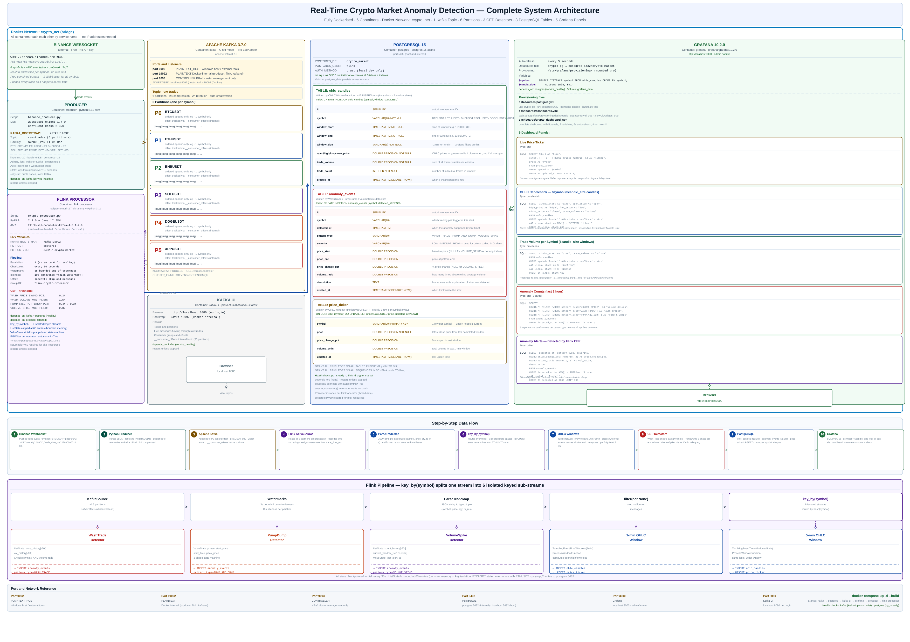
HOW IT FITS TOGETHER
The architecture
Standard course shape: collect → Kafka → Flink → database → dashboard. Every box is one Docker container.
Notes:
Walk through the white diagram. Point to: Docker boundary, all 6 containers, port numbers, data flow arrows.

