Slide 1


STEWART PLATFORM
by
KODANDA CHALLA

Slide 2
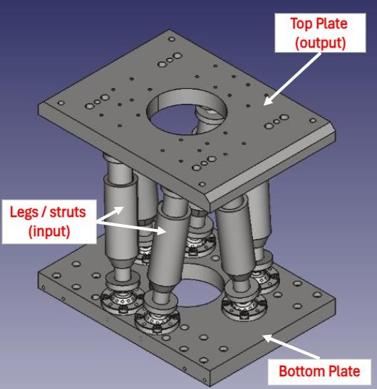
Forward Kinematics
Forward kinematics involves determining the position and orientation of the top platform given the lengths of the six struts. This means calculating where the top platform is and how it is oriented in 3D space based on the known strut lengths.
Steps:
  Input: Known lengths of the six struts.
  Process: Use geometric and trigonometric relationships to compute the position (x, y, z) and orientation (roll, pitch, yaw) of the top platform.
  Output: The position and orientation of the top platform.
  Forward kinematics for a Stewart platform is generally complex due to the non-linear relationships between the strut lengths and the platform’s pose.

Slide 3
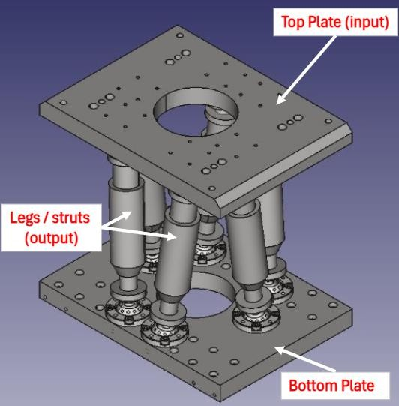
Inverse kinematics
Inverse kinematics involves determining the required lengths of the six struts to achieve a desired position and orientation of the top platform. This means calculating how each strut should extend or retract to move the top platform to a specific pose.
Steps:
  Input: Desired position (x, y, z) and orientation (roll, pitch, yaw) of the top platform.
  Process: Use the geometric and trigonometric relationships to compute the lengths of the struts.
  Output: The lengths of the six struts.
  Inverse kinematics is typically easier to solve than forward kinematics for a
Stewart platform because it involves direct geometric relationships.

Slide 4
Summary:
Forward Kinematics:
Strut lengths -> Position and Orientation of Top Plate
Inverse Kinematics:
Position and Orientation of Top Plate -> Strut lengths
https://github.com/kodandachalla/Hexapod_Inverse_Kinematics
https://github.com/kodandachalla/Hexapod_Forward_Kinematics
4

Slide 5
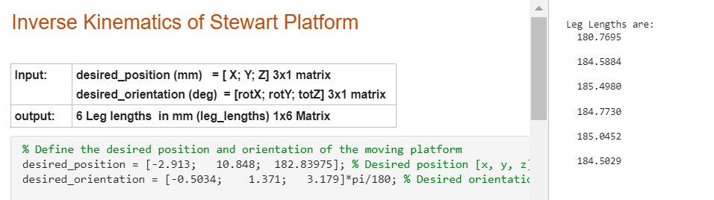
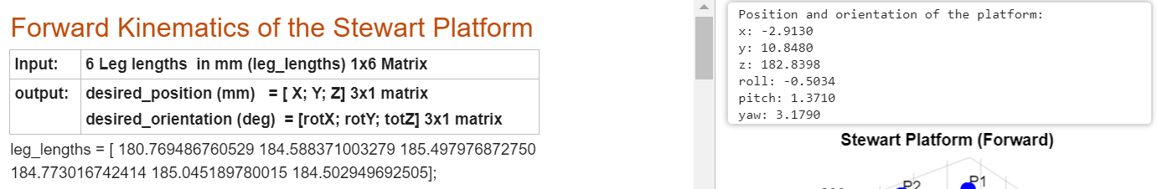
Comparison Forward vs Inverse results

Slide 6
Calibration of Platforms using CMM*
Calibration of individual plates are necessary to locate real universal joint points for
Fixed Platform
Moving Platform
Leg center points are Recorded
Note: calibration points numbering is different from assembly points numbering
*CMM (Coordinate Measuring machine)

Slide 7
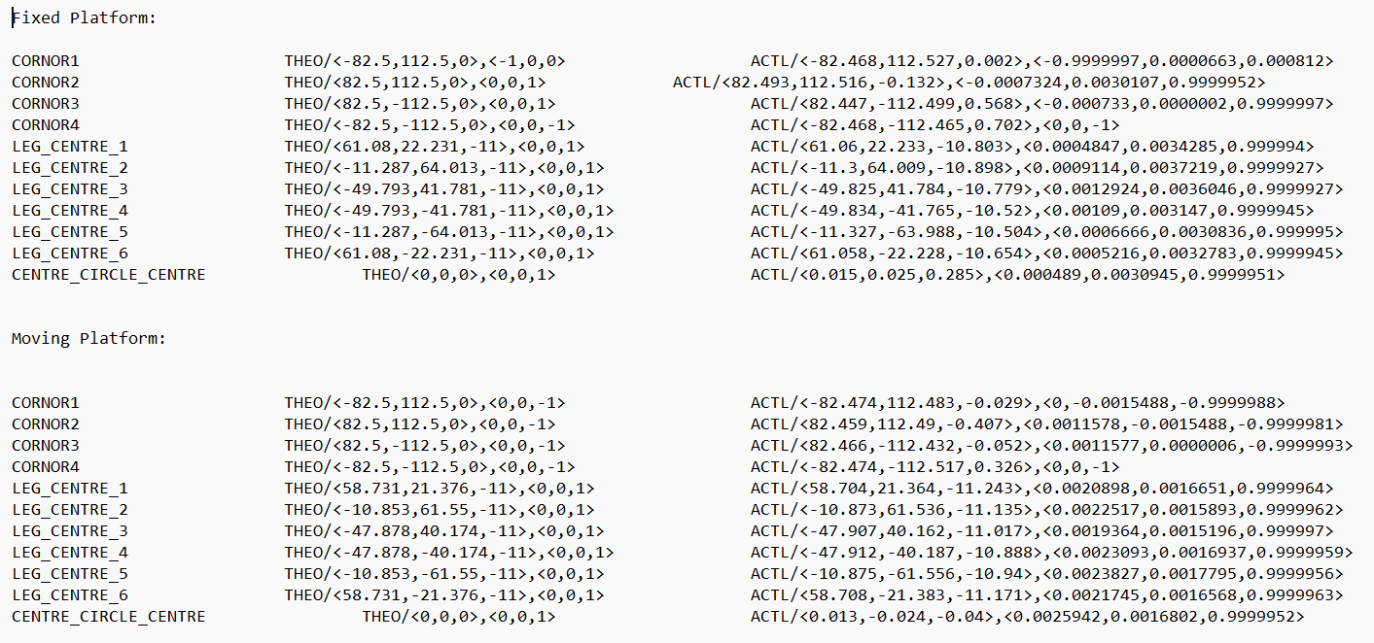
Calibration of Platforms

Slide 8
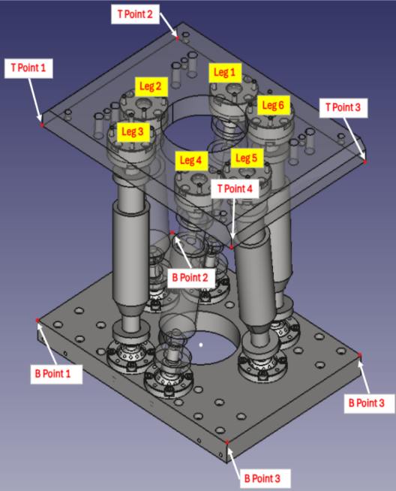
Moving Measured Points
Platform Calibration points are different from assembly Points

Slide 9
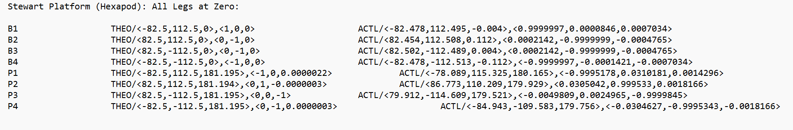
Calibrated assembled Hexapod and captured following data
Kept all legs gauges at Zero position (Case 1)*, and captured B points and T points (fig) using CMM
CMM Coding: https://github.com/kodandachalla/Hexapod_Calibration

Slide 10
CMM Coding
Take points along the four sides and Top surface of the Fixed platform using CMM.
Using the intersection of the four side planes and the top plane, locate the four corner points (B points fig) of the top plane of the bottom platform.
Remember origin at center of rectangle because Simulink MATLAB modeled according to it.
Repeat for top platform
CMM Coding: https://github.com/kodandachalla/Hexapod_Calibration

Slide 11
Simulink Projection
  Construct Top Plane of the Fixed platform using B points (fig) from assembly calibration
  Calculate rotational matrix at center of Fixed platform and project Calibrated Fixed leg points on the plane using 3 non-colinear points Formulae
  Construct Bottom Plane of the Moving platform using T points (fig) from assembly calibration
  Calculate rotational matrix at center of Moving platform and project Calibrated Moving leg points on the Plane using 3 non-colinear points Formulae

Slide 12
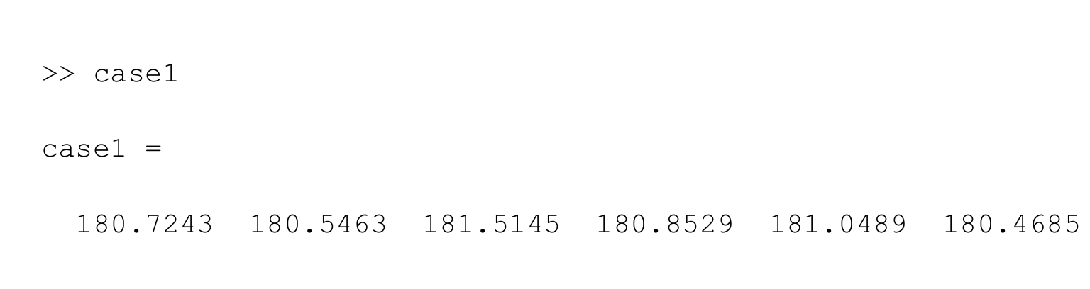
Legs length calculation
In the global coordinate measure the distance between fixed platform points and moving platform points gives leg lengths

Slide 13
Checking
Case 1: Kept all gauges at Zero position
Calculate leg lengths using inverse kinematics (MATLAB -Simulink) and store it as Case1
Case 2: Adjust leg lengths manually Leg 5 and 6 increased by 4mm rest all at Zero position
Repeat all steps of case 1 and Calculate leg lengths using inverse kinematics (MATLAB -Simulink) and store it as Case2
Verify change:
Case 1 Lenths + increments = Case 2 or 3 Lenths
Case 3: Kept all gauges at +4mm and leg1 at zero position
Repeat all steps of case 1 and Calculate leg lengths using inverse kinematics (MATLAB -Simulink) and store it as Case3
13

Slide 14
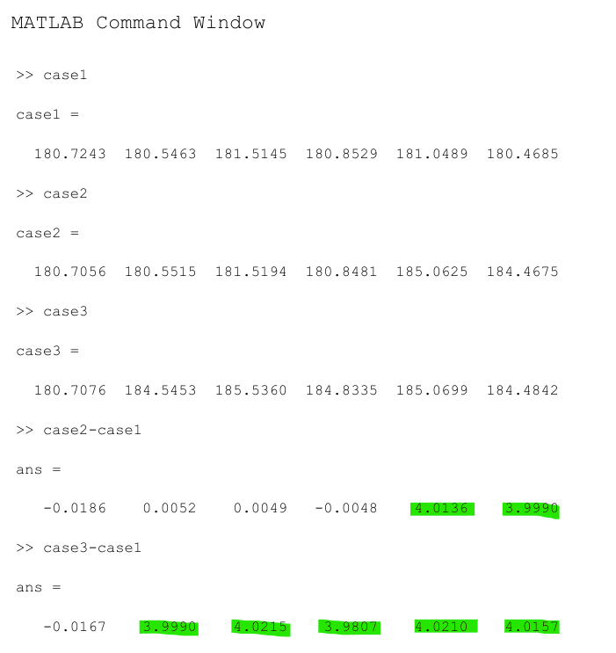
Conclusion
Case 1: All gauges at Zero position
Case 2: Gauge 5 & 6 +4mm, rest all Zero
Case 3: Gauge 1 Zero, rest all +4mm
Model predicts the change in leg lengths perfectly
https://github.com/kodandachalla/Hexapod_Calibration

Slide 15
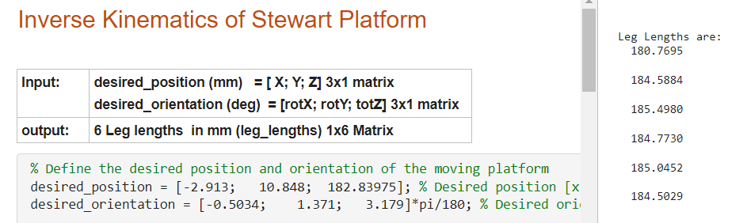
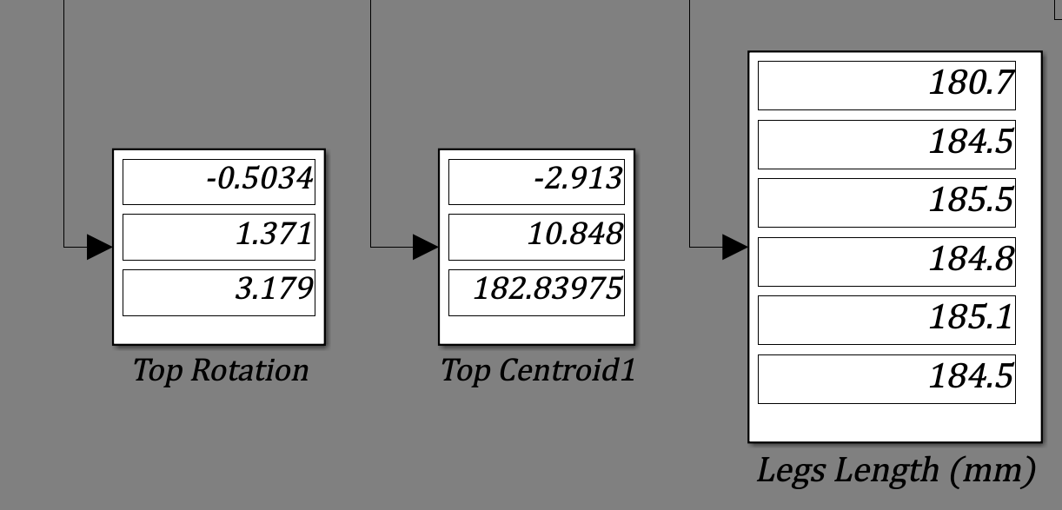
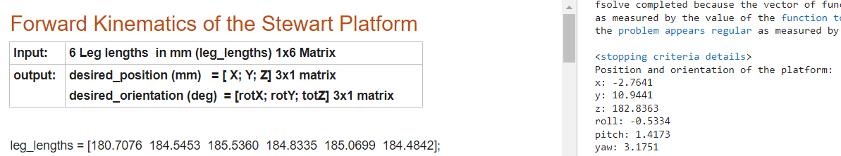
Comparisons
Simulink Model

Slide 16
THANK YOU
KODANDA CHALLA

